Slide 1

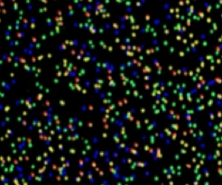
High Throughput Sequencing
(NEXT GENERATION SEQUENCING) Technologies and Applications
Petrus Tang, Ph.D. (鄧致剛)
Graduate Institute of Basic Medical Sciences
and
Bioinformatics Center, Chang Gung University.
petang@mail.cgu.edu.tw
http://petang.cgu.edu.tw

Slide 2
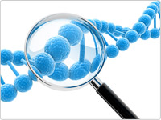

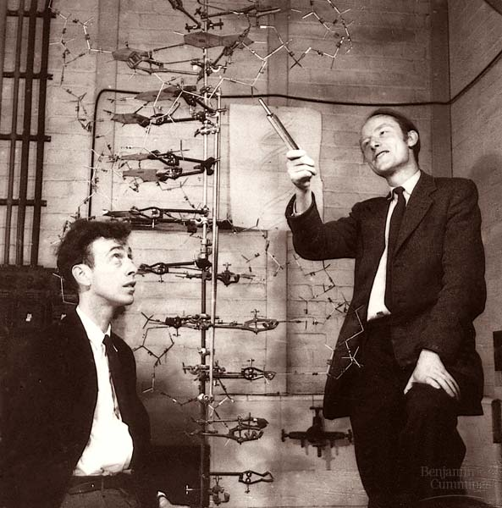

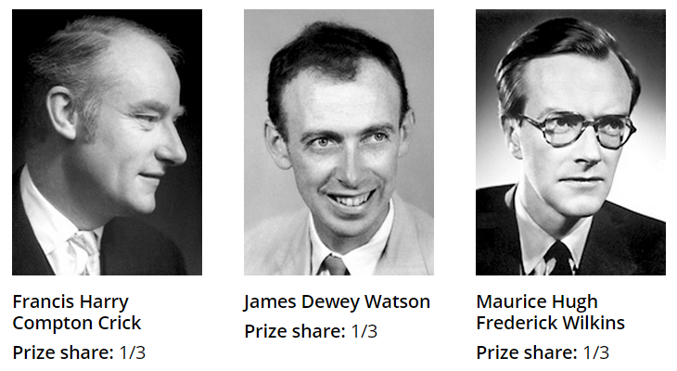
James Watson and Francis Crick with their DNA model at the Cavendish Laboratories in 1953

Slide 3
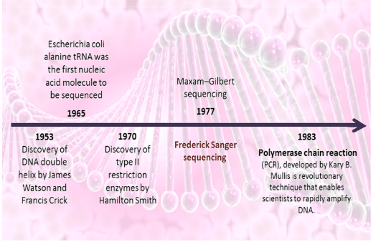
Do You Read Me?

Slide 4
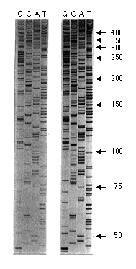
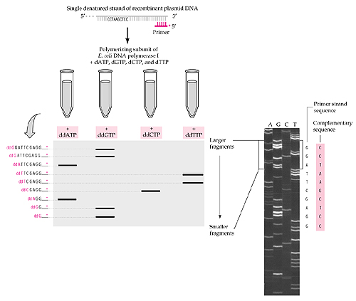
Sanger Dideoxy Sequencing
Sanger, F. et al. Nature 24, 687–695 (1977).
Sanger, F., Nicklen, S. & Coulson, A.R. Proc. Natl. Acad. Sci. USA 74, 5463–5467 (1977).

Slide 5
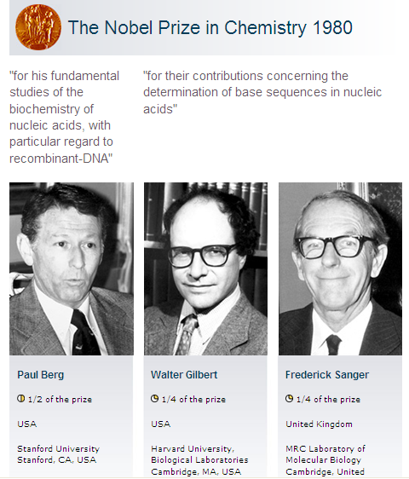
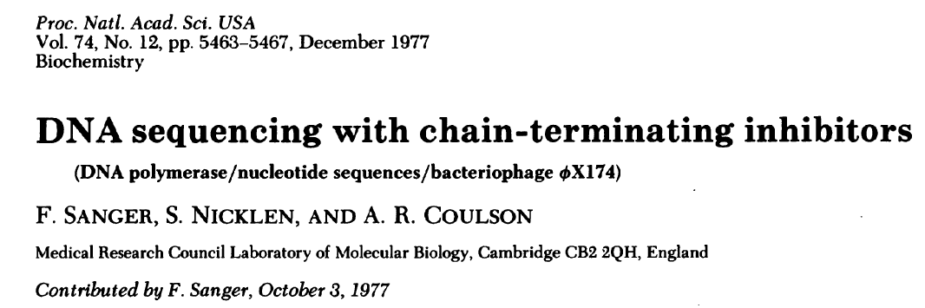
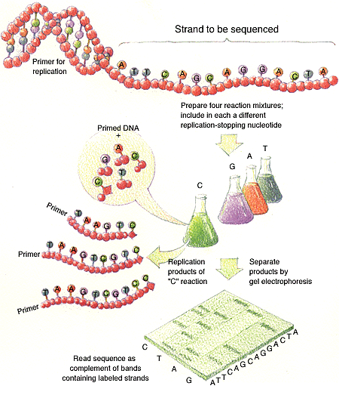
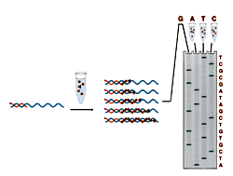
Recombinant DNA
Chemical sequencing
Chain-termination sequencing

Slide 6
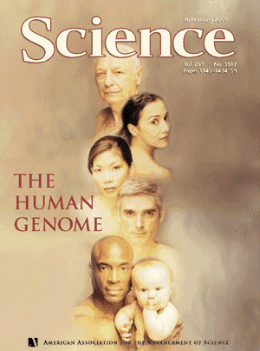

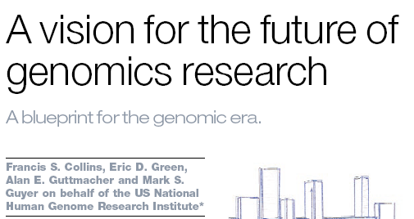

>10 years to finish
USD 3 billion
February 2001: Completion of the Draft Human Genome
Science, 16 February 2001
Vol. 291, Pages 1145-1434
Nature, 15 February 2001
Vol. 409, Pages 813-960
April 2003: High-Resolution Human Genome
Nature, 23 April 2003
Vol. 422, Pages 1-13

Slide 7

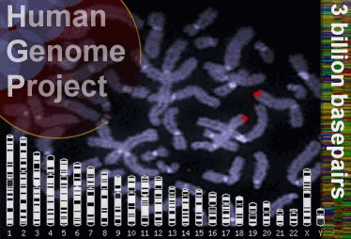
3,000,000,000 bp

Slide 8
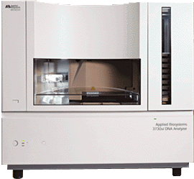
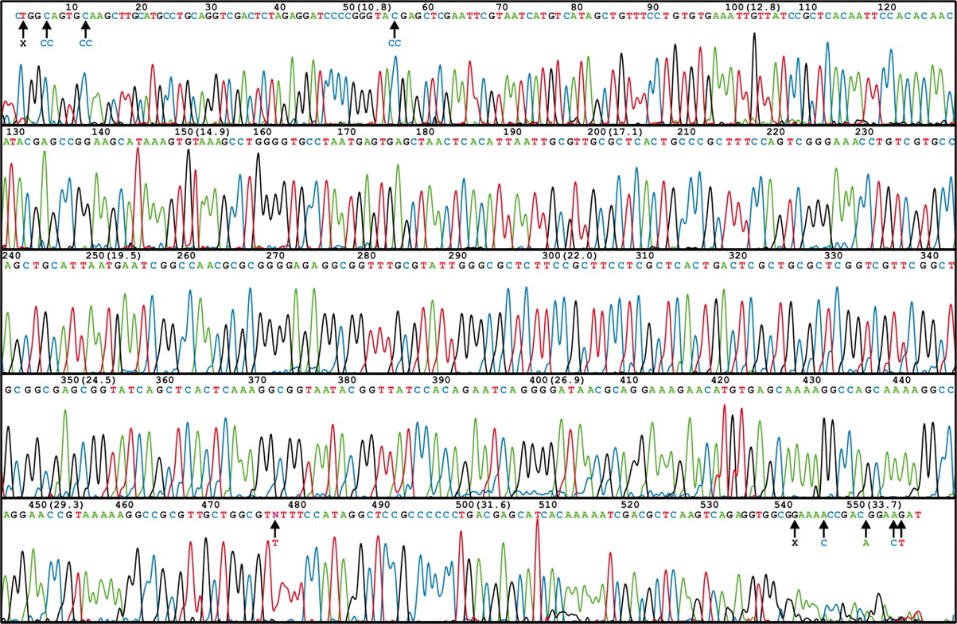
ABI 3730 XL DNA Sequencer
96/384 DNA sequencing in 2 hrs, approximately 600-1000 readable bps per run.
1-4 MB bps/day
A human genome of 3GB need 750 days to finish

Slide 9
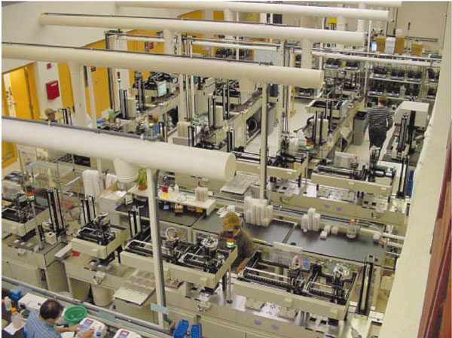
Whitehead Institute

Slide 10


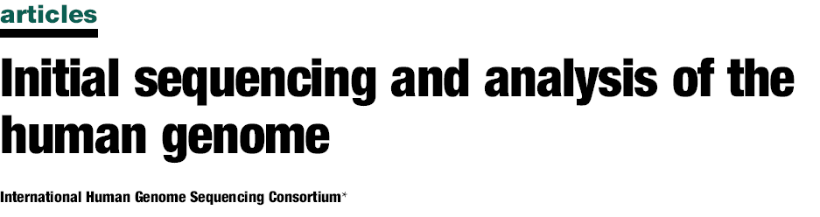
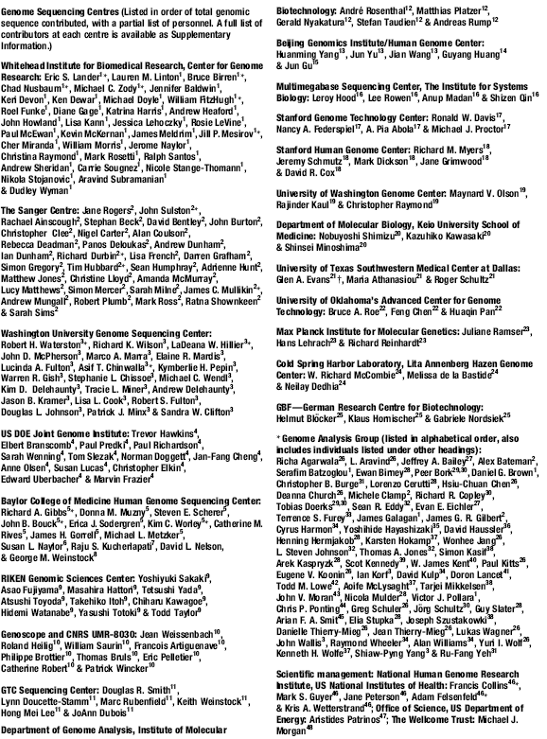
273 authors
254 authors

Slide 11
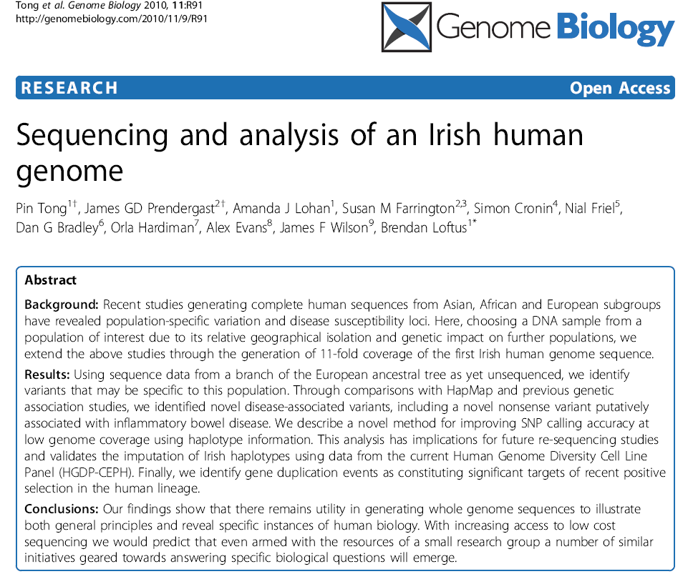

Slide 12
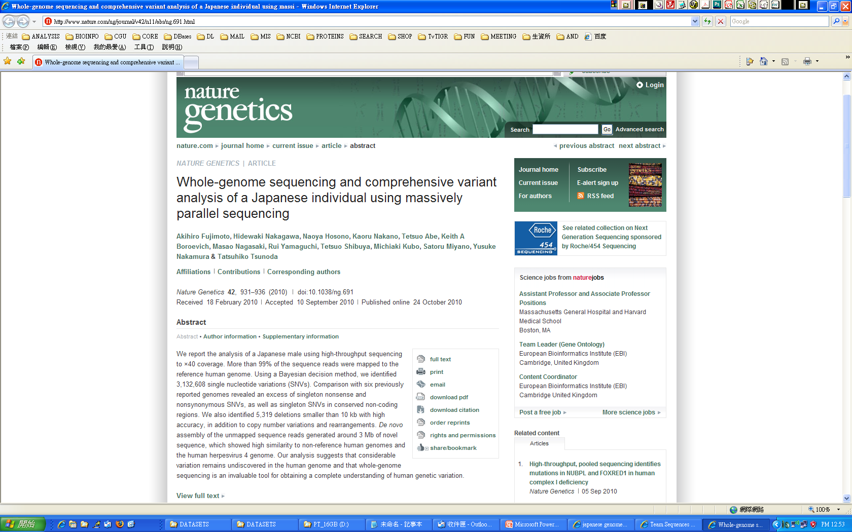

Slide 13
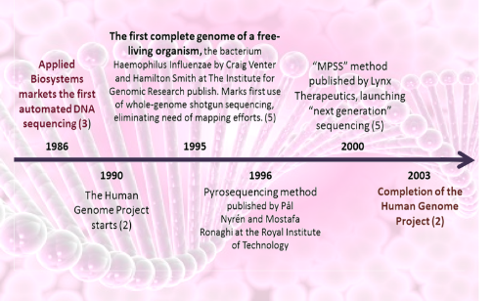
Next Generation Sequencing Technology
Massively Parallel Signature Sequencing (MPSS)

Slide 14

NEXT GENERATION SEQUENCING

Slide 15
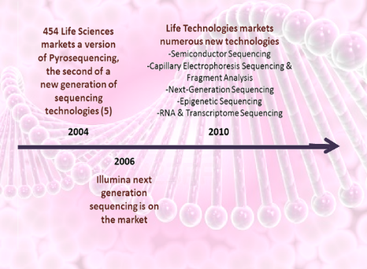
Next Generation Sequencing Technology
Massively Parallel Signature Sequencing (MPSS)
(Genome Sequencer, GS)
(Sequencing by Oligonucleotide Ligation
and Detection, SOLiD)
(Genome Analyzer, GA)

Slide 16
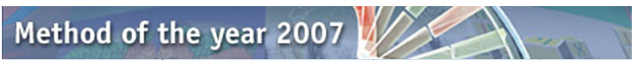




Next Generation Sequencing Technology
Massively Parallel Signature Sequencing (MPSS)
NATURE METHODS | VOL.5 NO.1 | JANUARY 2008
Nature Methods' Method of the Year 2007 goes to next-generation sequencing. This series of articles showcase how these novel sequencing methods came into their own in 2007 and the incredible impact they promise to have in a variety of research applications. The Methods to Watch feature provide a glimpse and a wish list for future Methods of the Year.
454 GS FLX
http://www.454.com/
SOLEXA
http://www.illumina.com/pages.ilmn?ID=250
SOLID
http://marketing.appliedbiosystems.com/

Slide 17
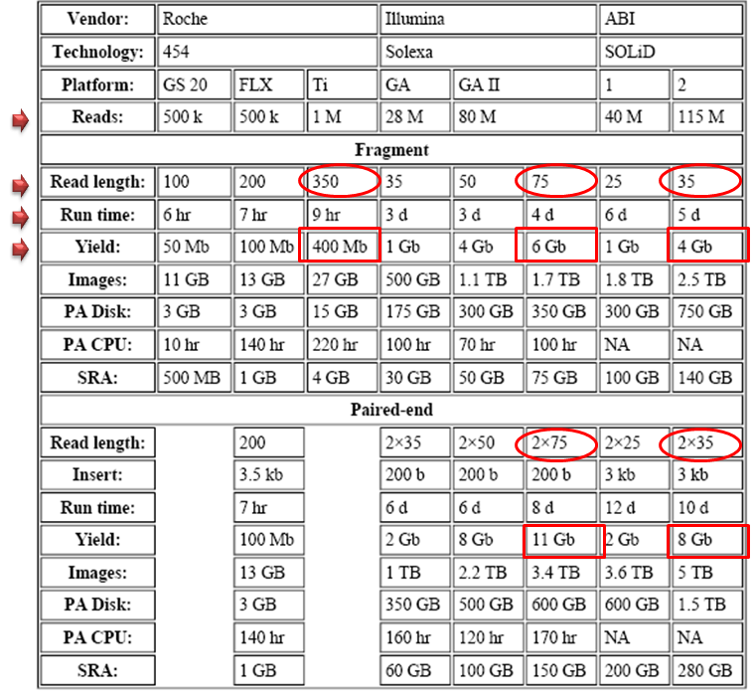
Throughput of NGS machines (2007-2009)
Throughput = total number of reads x read length
High throughput
Short read/run
Illumina
SOLiD
Low throughput-
Long read/run
Roche
(~4Gb/4 days)

Slide 18


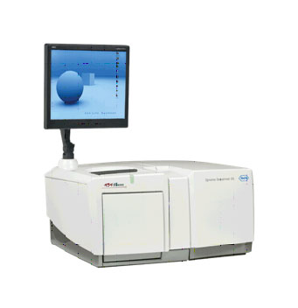
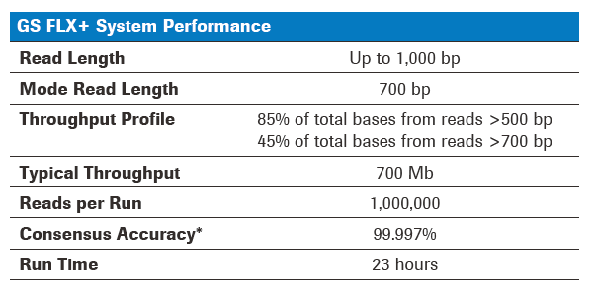
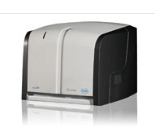
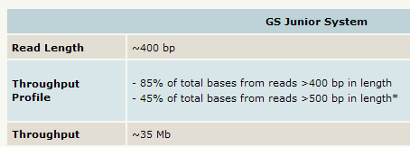
Throughput of NGS machines: Roche (2012)

Slide 19
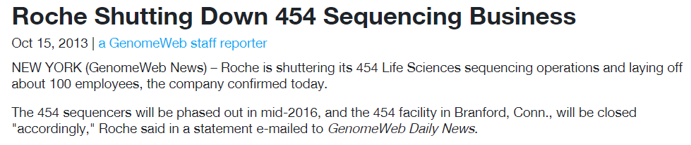
Throughput of NGS machines: Roche

Slide 20

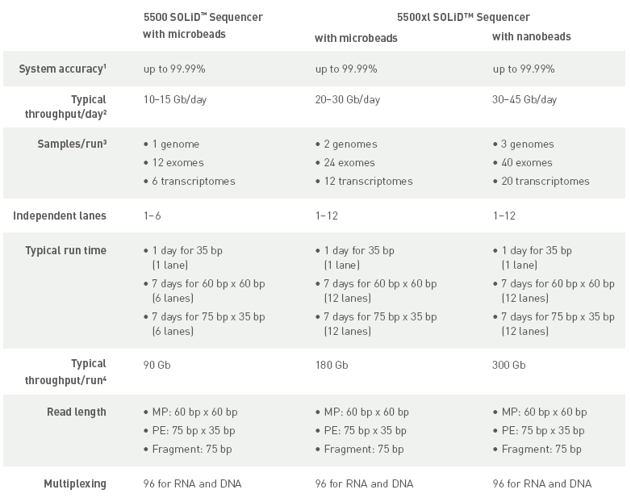
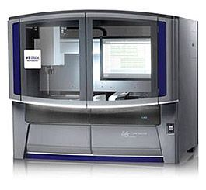
Throughput of NGS machines: SOLiD 4 (2013)
In 2014 ABI SOLiD was replaced by the Ion Torrent sequencing platforms
(Proton and Personal Genome Machine)

Slide 21
Next Generation Sequencing Technology
Massively Parallel Signature Sequencing (MPSS)
NATURE METHODS | VOL.5 NO.1 | JANUARY 2008
Nature Methods' Method of the Year 2007 goes to next-generation sequencing. This series of articles showcase how these novel sequencing methods came into their own in 2007 and the incredible impact they promise to have in a variety of research applications. The Methods to Watch feature provide a glimpse and a wish list for future Methods of the Year.
X
454 GS FLX
http://www.454.com/
SOLEXA
http://www.illumina.com/pages.ilmn?ID=250
X
SOLID
http://marketing.appliedbiosystems.com/

Slide 22
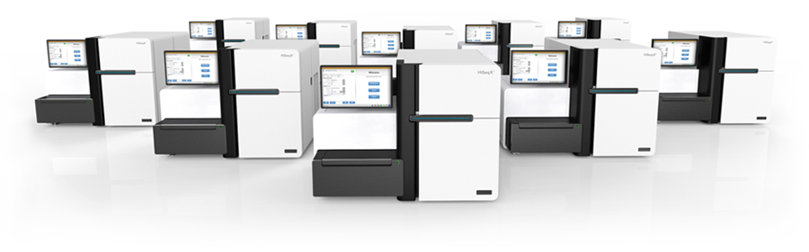
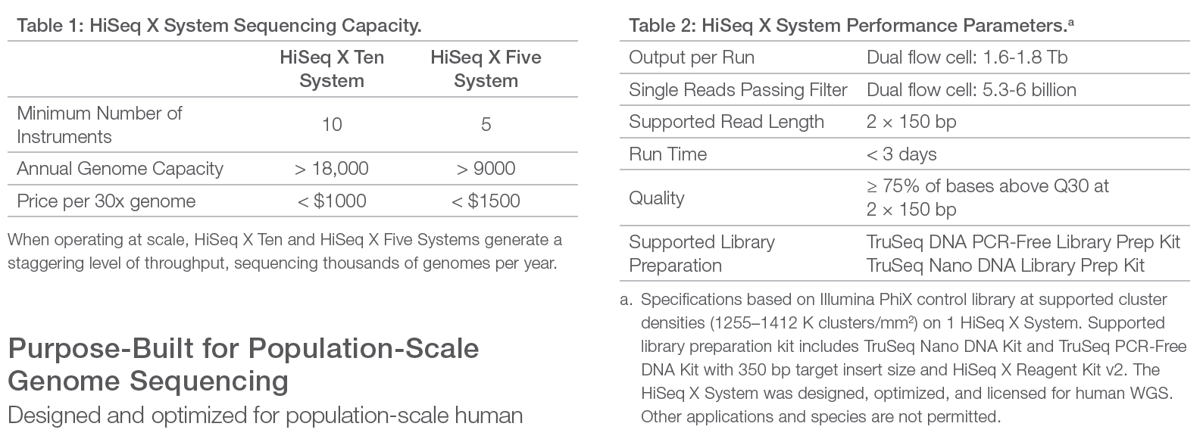
2014 NGS Machines: Hiseq X

Slide 23
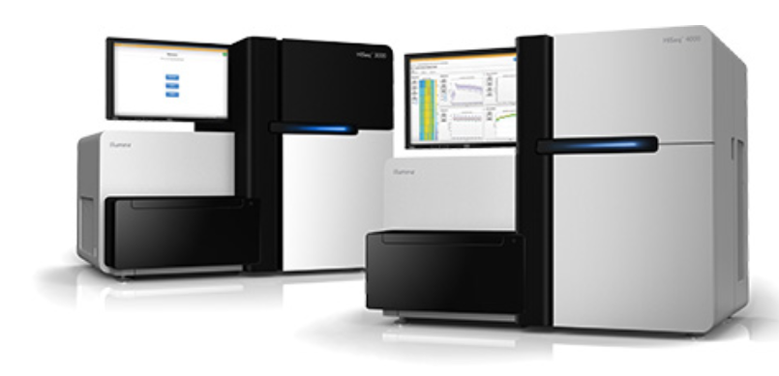
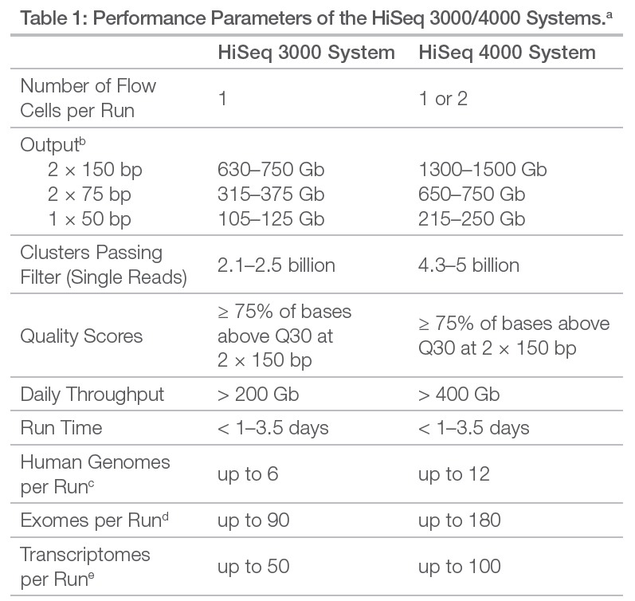
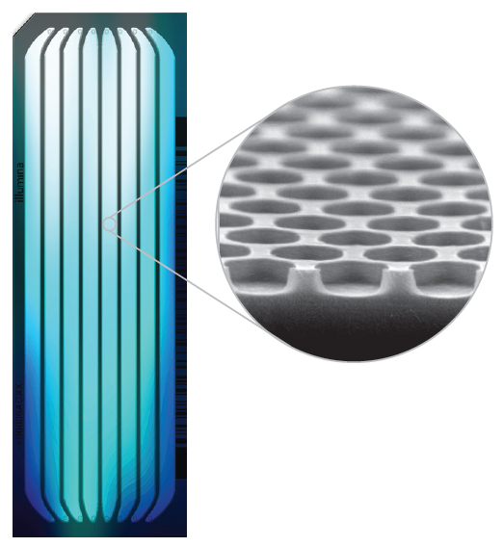
2015 NGS Machines: Hiseq 3000/4000

Slide 24
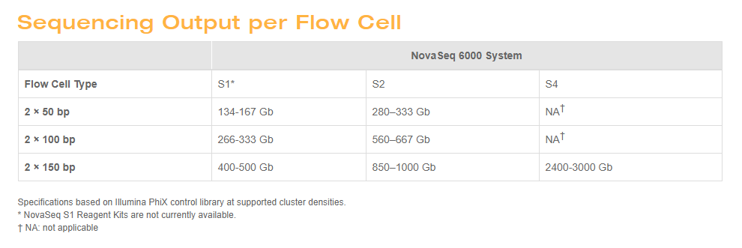
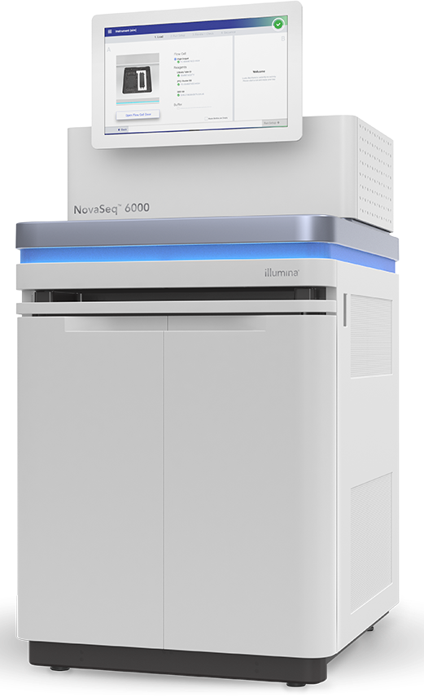
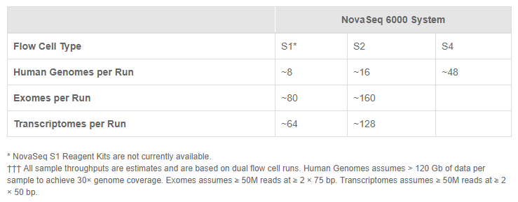
2016 NGS Machine: NovaSeq6000

Slide 25
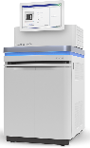
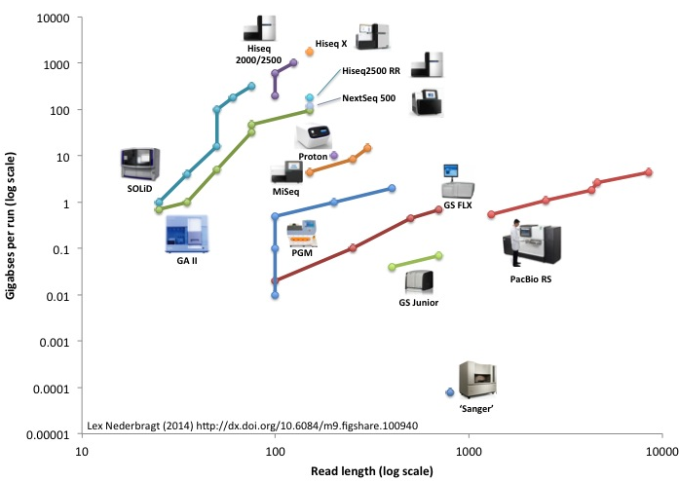
Throughput of NGS machines ~2016
NovaSeq6000
High throughput
short read
Illumina
X
X
X
Low throughput,
Very long read
PacBio
X

Slide 26
NEXT GENERATION SEQUENCING
Basis Principles
Temple fragmentation (library) Amplification Sequencing Detection

Slide 27

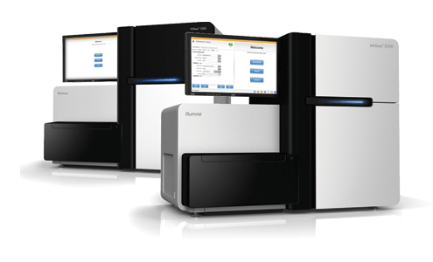
Illumina Sequencing by Synthesis (SBS)

Slide 28
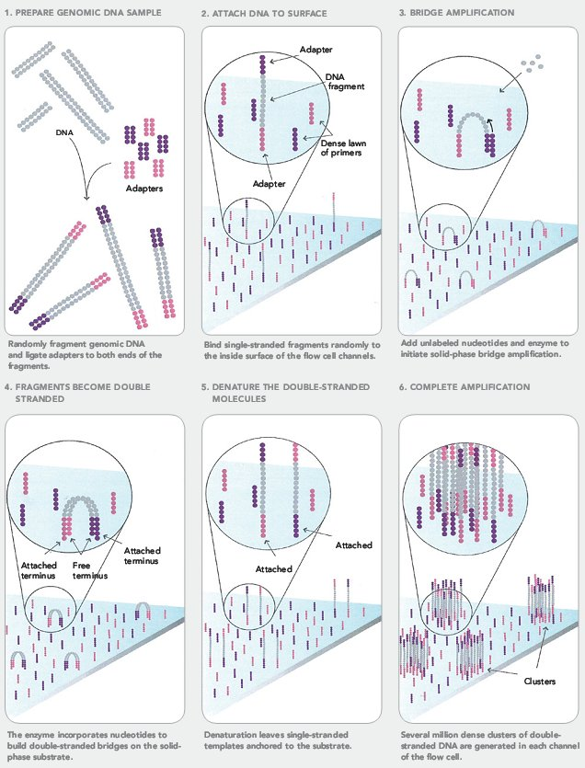
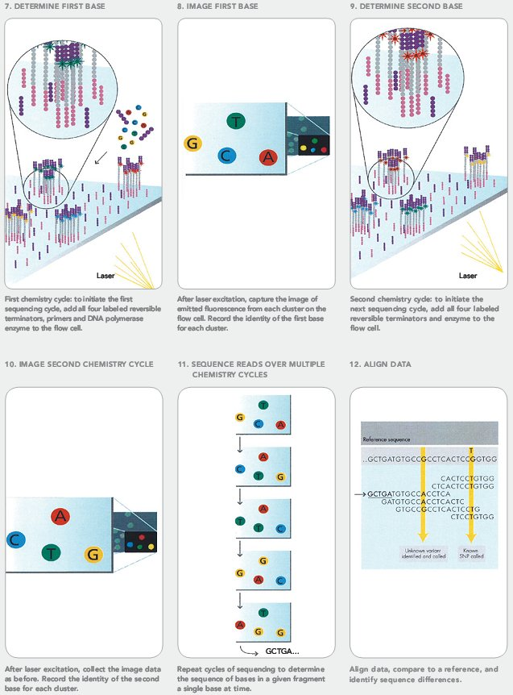
Solexa Genome Analyzer

Slide 29

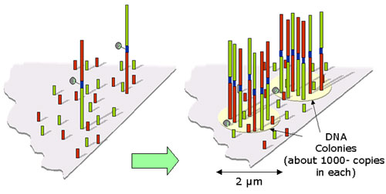
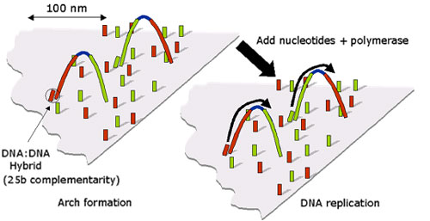
Cluster Generation
Clusters Array
Template Bridging

Slide 30
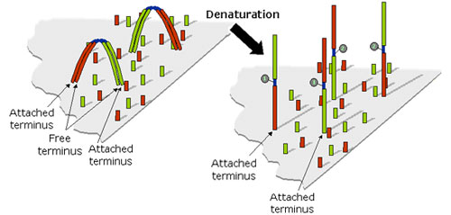
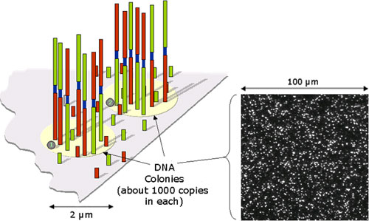
Denaturation
Ready For Sequencing

Slide 31
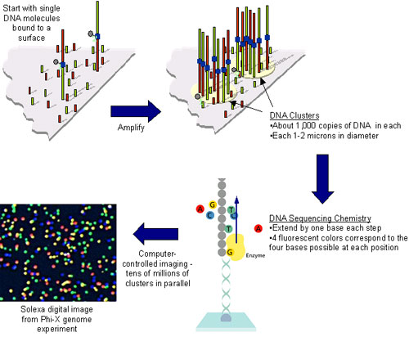
Sequencing-By-Synthesis

Slide 32



Incorporation
Fluorescent Detection
Sequence Generated At Every Site On The Array

Slide 33


From Debbie Nickerson, Department of Genome Sciences, University of Washington, http://tinyurl.com/6zbzh4

Slide 34

From Debbie Nickerson, Department of Genome Sciences, University of Washington, http://tinyurl.com/6zbzh4

Slide 35


Illumina sequencing-by-synthesis
Sample preparation.
Fragments of DNA are ligated to end adapters, denatured and bound at one end to a solid surface already coated with a dense layer of the adapters. Each single stranded fragment is immobilized at one end, while its free end ‘bends over’ and hybridizes to a complementary adapter on the surface, which initiates the synthesis of the complementary strand in the presence of amplification reagents. Multiple cycles of this solid-phase amplification followed by denaturation create clusters of ~1,000 copies of single-stranded DNA molecules distributed randomly on the surface.
Sequencing with reversible terminators.
Synthesis reagents, added to the flow cell, consist of primers, DNA polymerase and four differently labeled, reversible terminator nucleotides. After incorporation of a nucleotide, which is identified by its color, the 3′ terminator on the base and the fluorophore are removed, and the cycle is repeated for a read length of 30–35 nucleotides.

Slide 36





Combinatorial Probe-Anchor Ligation (cPAL) sequencing
Complete Genomics was founded in 2006 and in March 2013 was acquired by
BGI-Shenzhen for USD 117.6 million.

Slide 37




BGISEQ-50
BGISEQ-500

Slide 38







Evolution of Sequencing Technology
Sanger dideoxy-sequencing
Single molecule sequencing and nanopore technology?
ABI 3730XL
Massive parallel sequencing
Oxford Nanopore Technologies,, Electron Optica, Electronic BioSciences, GenapSys, Genia, GnuBIO, IBM, LaserGen, Lightspeed Genomics, NABsys, NobleGen Biosciences, QuantuMDx, Reveo, Stratos Genomics, Two Pore Guys, ZS Genetics………………….
Roche 454 FLX, Life Technologies SOLiD,
Illumina Hiseq, Life Tech Ion Torrent, BGIseq
Bead-based em-PCR and sequencing by ligation
Dover Systems' Polonator
Massive parallel sequencing and
single molecule sequencing
Pacific Biosciences (single-molecule real-time DNA sequencing (SMRT) technology)
Helicos (true single-molecule-sequencing (tSMS) technology)
VisiGen Biotechnologies (real-time, single-molecule sequencing
fluorescence resonance energy transfer (FRET) technology)

Slide 39
NEXT-NEXT-NEXT-
NEW GENERATION SEQUENCING
Basis Principles
Temple fragmentation (library) Amplification Sequencing Detection

Slide 40



Single Molecule Real-Time Sequencing
Real-time monitoring of PCR activity
Read-out by fluorescence resonance energy transfer between polymerase and nucleotides or
Waveguides allow direct observation of polymerase and fluorescently labeled nucleotides
VisGen Biotechnologies
Pacific Biosciences
Helicos Biosciences
Helicos BioSciences said in a regulatory filing that it has sold certain patent applications covering molecular diagnostic applications of its technology to Sequenom for $1.3 million. The patent applications cover methods for detecting fetal nucleic acids and diagnosing fetal abnormalities. Helicos also warned that if it is "unable to successfully raise additional capital, we may have to cease operations and/or seek bankruptcy protection."

Slide 41


Single Molecule Real-Time (SMRT) Sequencing

Slide 42




Sequel & RSII systems
Sequel
RSII

Slide 43



Slide 44


Oxford Nanopore Sequencing
Nucleic acids driven through a nanopore.
Differences in conductance of pore provide readout.
This diagram shows a protein nanopore set in an electrically resistant membrane bilayer. An ionic current is passed through the nanopore by setting a voltage across this membrane.
If an analyte passes through the pore or near its aperture, this event creates a characteristic disruption in current. By measuring that current it is possible to identify the molecule in question. For example, this system can be used to distinguish the four standard DNA bases and G, A, T and C, and also modified bases. It can be used to identify target proteins, small molecules, or to gain rich molecular information for example to distinguish the enantiomers of ibuprofen or molecular binding dynamics.

Slide 45





Slide 46





Slide 47


R9.4 flow cell
Throughput: 5-10 Gb
2014 E. coli genome
Avg. read length: 5.4 kb
Longest read: 10 kb
2015
Mean read length: 2 kb
Median read length : 1 kb
Longest read: 98 kb

Slide 48


Slide 49


Slide 50


Slide 51


Slide 52


SmidgION: nanopore sensing for use with mobile devices

Slide 53


Slide 54
Cost of NGS machines
High throughput, short read/run
COST USD800,000
Low throughput-
long read/run
COST USD1,000,000

Slide 55
Cost of NGS machines
High throughput, short read/run
COST USD800,000
Medium throughput, short read/run
COST USD200,000-400,000
Low throughput-
long read/run
COST USD1,000,000

Slide 56




Personal Sequencer
Miseq/MiniSeq
Personal Sequencing System
Ion Torrent/Ion Proton
Personal Genome Machine

Slide 57





Slide 58






Slide 59


Slide 60




Ion Torrent Sequencing
314 chip
316 chip

Slide 62



(2012)

Slide 63

Miniseq (2016)

Slide 64






Slide 65



Slide 66


GeneReader
Early-access customers in 2013,
Commercial launch in early 2014.
20 flowcells configuration
20-400M reads per flow cell
12 minutes per base sequencing-by-synthesis (50-bases ~10 hours)

Slide 67




Droplet-based Sequencing

Slide 68



Droplet-based Sequencing
Microfluidics, the science that deals with the behavior, precise control and manipulation of fluids that are geometrically constrained to a small, typically sub-millimeter scale, emerged in the beginning of the 1980s and is used widely in technologies such as inkjet print heads, DNA chips, lab-on-a-chip technology, micro-propulsion and micro-thermal technologies. GnuBIO has adapted technology developed in Dr. David Weitz laboratory at Harvard. This technology is combined with proprietary molecular biology assays to create a unique next-generation DNA sequencing technology.
The science behind this GnuBIO sequencing technology utilizes droplet microfluidics to perform the biochemical reactions for sequencing inside of tiny picoliter -sized aqueous drops. Each droplet acts as a discrete reaction vessel, like a miniature test tube, where the sequencing assay is performed.

Slide 69


Storage & Computing Power
Next gen sequencers generated Giga bp to Tera bp of data

Slide 70

http://allseq.com/knowledgebank

Slide 71

NEXT GENERATION SEQUENCING Applications & Analysis

Slide 72


Applications on Biomedical Sciences

Slide 73


High-throughput Sequencing (HTseq) Platforms

Slide 74


Applications on Biomedical Sciences

Slide 75



