Slide 1
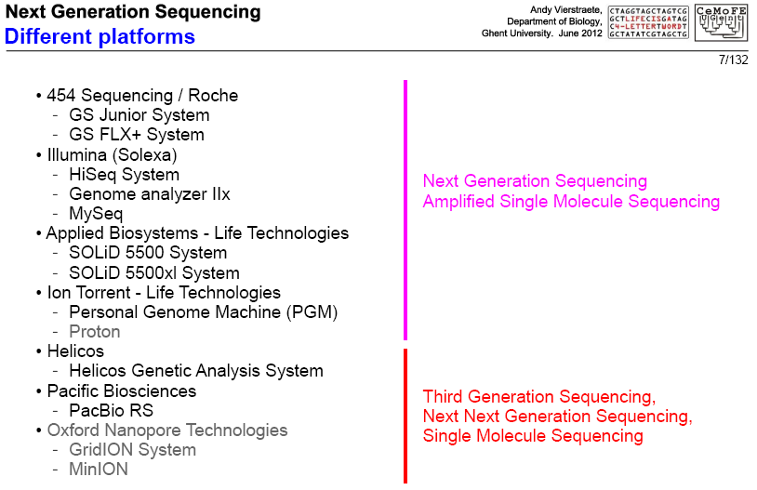

Slide 2
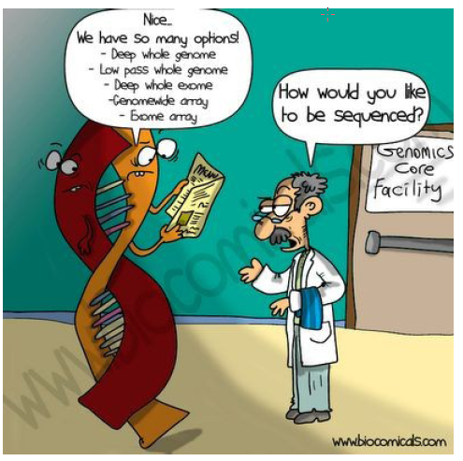
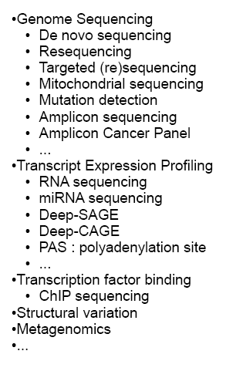

Slide 3
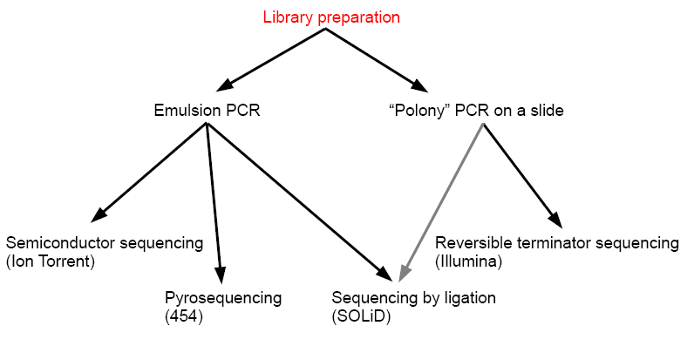

Slide 4
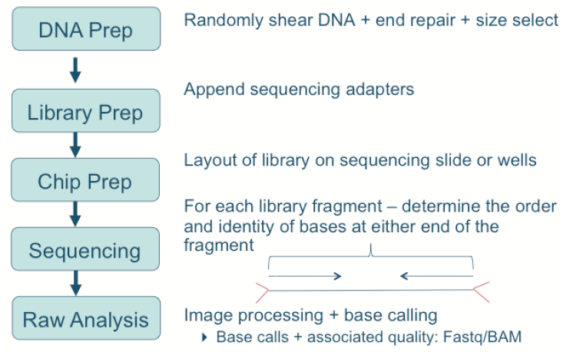

Slide 5
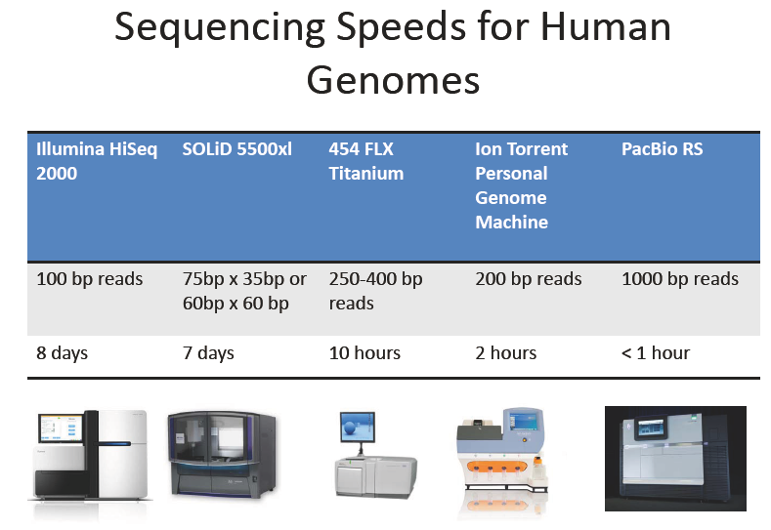

Slide 7
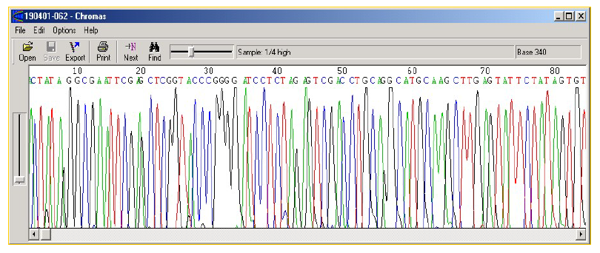
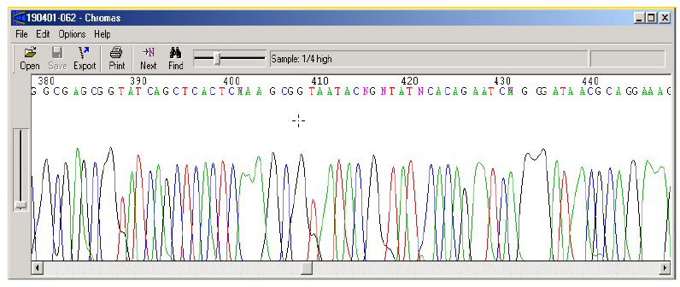
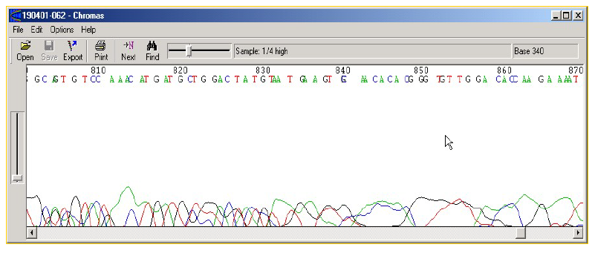
Trace File
High quality region - NO ambiguities (Ns)
Medium quality region - SOME ambiguities (Ns)
Poor quality region - LOW confidence

Slide 8
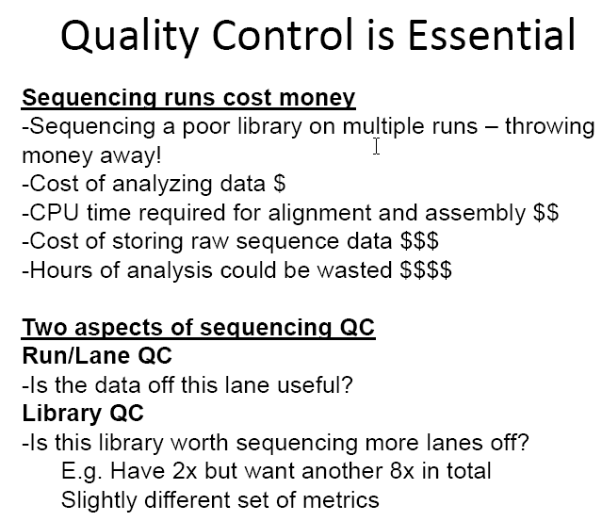

Slide 9
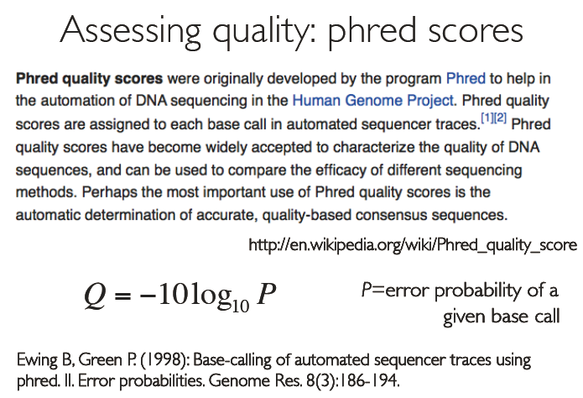

Slide 10

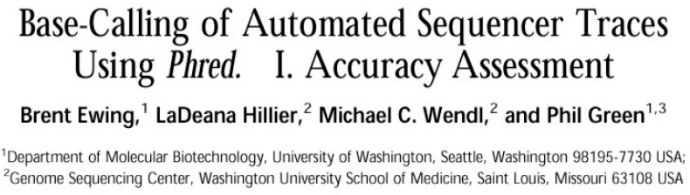

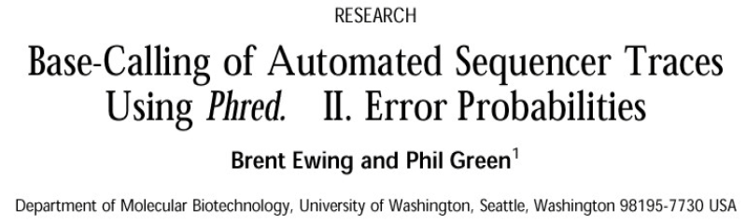

Slide 11
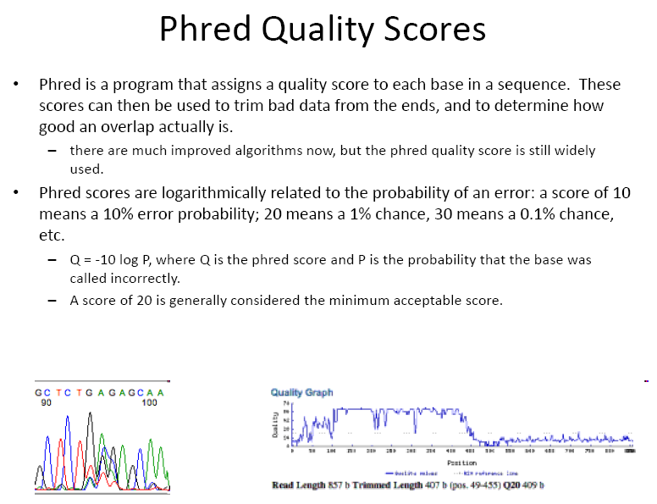

Slide 12
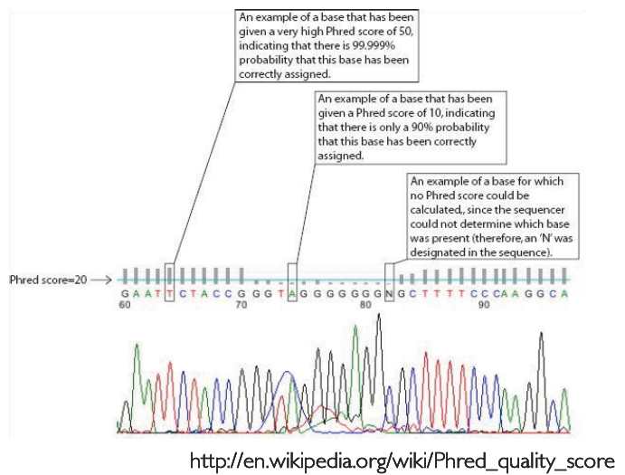

Slide 13
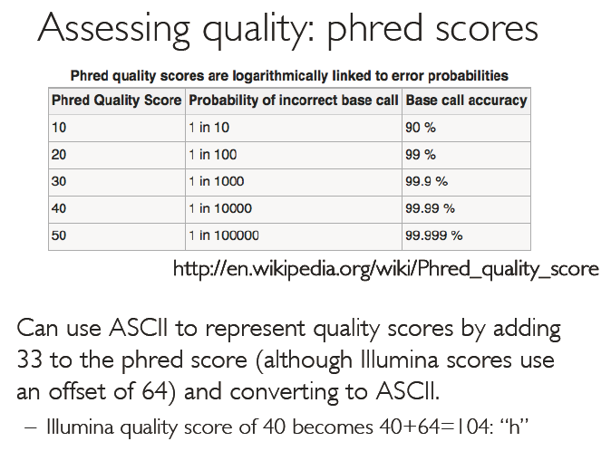

Slide 14
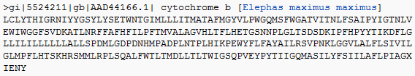
Sequence Formats
All Sequence formats are ASCII text containing sequence ID, Quality Scores, Annotation details, comments, and other descriptions about sequence
Formats are designed to hold sequence data and other information about sequence

Slide 15
Read output formats
454
Solexa/Illumina
SOLiD

Slide 16
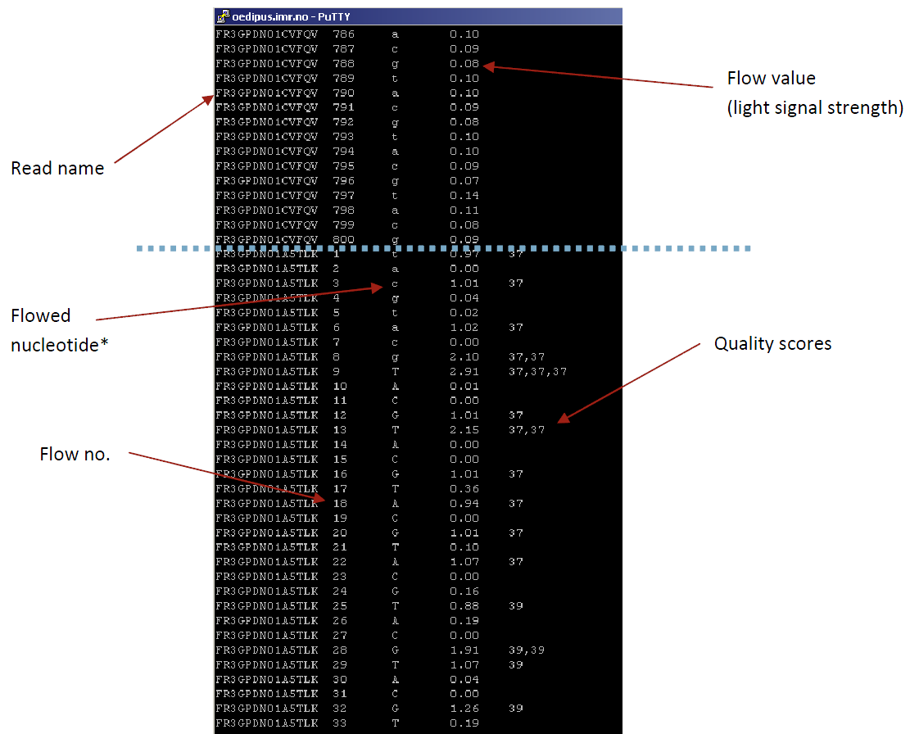
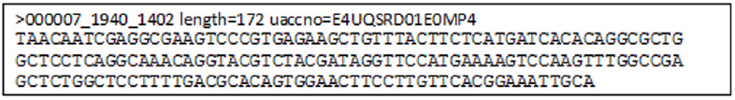
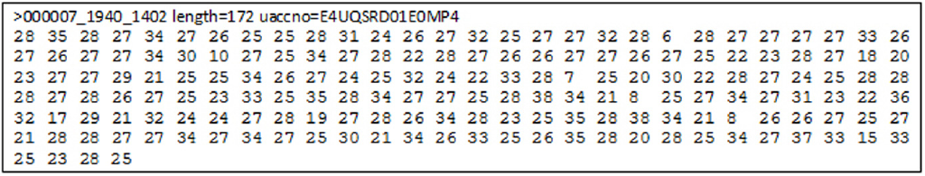
454 output formats
Standard flowgram format
.sff
.fna
.qual
Notes:
Sequencers use their own output formats, and even multiple different formats per technology.
Output formats from Roche 454 sequencers:
.sff is 454’s binary(=compressed) format, including the raw data. Not the very raw images, but flow values (flowgram), base calls, base-call qualities, read trimming and quality.
There are many simple tools that “unzip” .sff into some readable textual format (see the black example).
.fna is a FASTA (or FASTA-like) format including the base-called reads.
.qual includes qualities corresponding to bases in .fna.

Slide 17
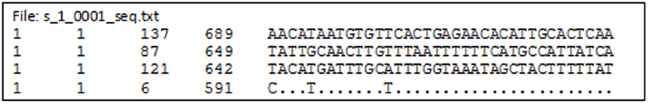
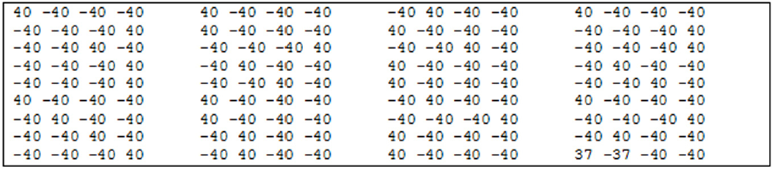
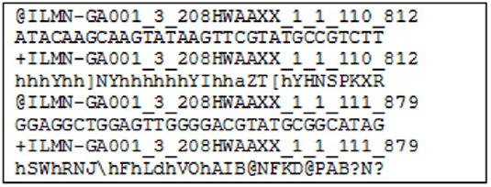
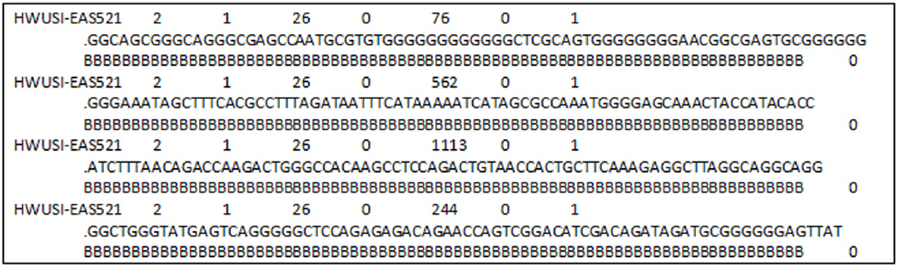


Illumina output formats
.seq.txt
.prb.txt
Illumina FASTQ (ASCII – 64 is Illumina score)
Qseq
(ASCII – 64 is Phred score)
Illumina single line format
SCARF
Phred quality scores
Solexa Compact ASCII Read Format
Notes:
Illumina is over-creative with their own formats.
.seq.txt: base-called sequences
.prb.txt: qualities for each nucleotide/each cycle (is some kind of semi-raw data?)
Illumina FASTQ is not real FASTQ, but looks similarly (to cause confusion). The quality score is an own Illumina score, computed by subtracting 64 from the ASCII code of the character. For example the ‘h’ in the example is ord(‘h’) – 64 = 104 – 64 = 40.
See http://www.asciitable.com/ for ASCII codes (Dec is the ‘ord’ in decimal numbers).
The Illumina score can be transformed to Phred score. Given a character ch, the following expression should give the Phred quality q (please double-check:) q = 10 * log(1 + 10 ^ (ord(ch) - 64) / 10.0)) / log(10)
Qseq: Not looking like FASTQ, but the scores are proper Phred scores. Their encoding is however still ASCII – 64.
Illumina “single line format” and SCARF: base-called sequences and quality scores in a bit more handy format.

Slide 18
Illumina FastQ
ASCII value for h= 103
Quality of Base A at the position 1 = 103- 64
103- 64 = 39
Where 39 is the phred score

Slide 19
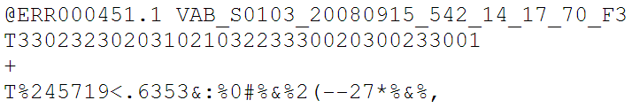
SOLiD output format(s)
CSFASTA
color-space sequence reads in a fasta format
These reads can be retained and analyzed in color-space by software
The Format Conversion Tool offers options for cleaning of the CSFASTA files
Notes:
SOLiD outputs CSFASTA. It’s a semi-raw format similar to FASTQ. Read starts with the first base, but colour calls follow.
NB! All the mentioned formats of the sequencers may be out of date with the current versions of the machines & software. Please refer to fresh documentation.

Slide 20
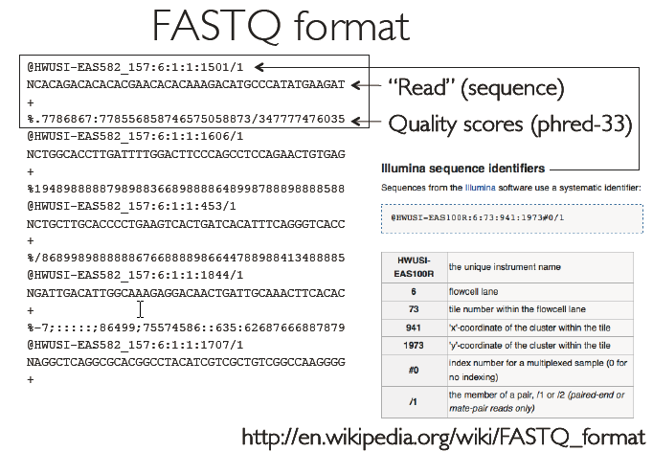

Slide 21
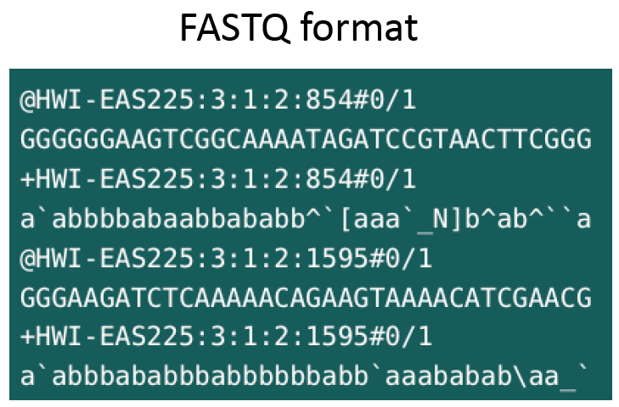

Slide 22
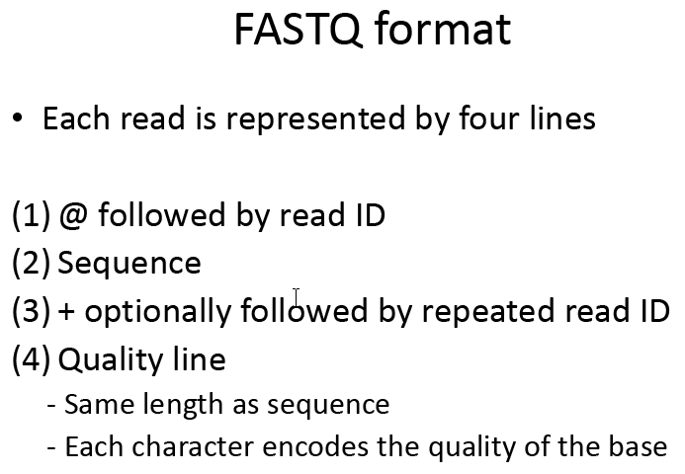

Slide 23
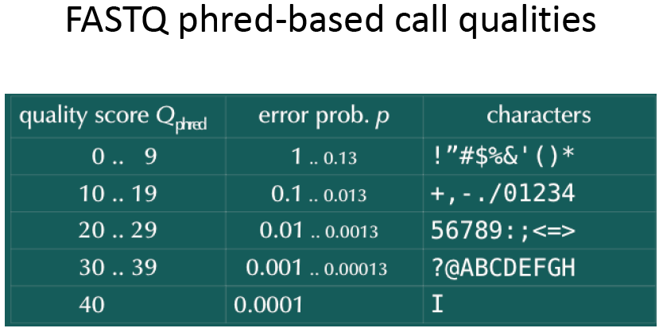

Slide 24
QC analysis

Slide 25
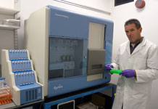
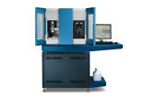
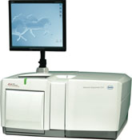
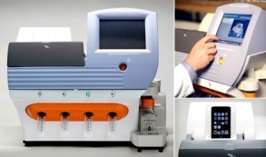
All platforms have errors
Illumina
SoLID/ABI-Life
Roche 454
Ion Torrent
Removal of low quality bases/ Low complexity regions
Removal of adaptor sequences
Homopolymer-associated base call errors (3 or more identical DNA bases) causes higher number of (artificial) frameshifts

Slide 26
Illumina artefacts
under represented GC rich regions
    PCR
    Sequencing
GGC/GCC motif is associated with low quality and mismatches
Low quality reads < 20% phred score

Slide 27
Need for QC & Preprocessing
QC analysis of sequence data is extremely important for meaningful downstream analysis
To analyze problems in quality scores/ statistics of sequencing data
To check whether further analysis with sequence is possible
To remove redundancy (filtering)
To remove low quality reads from analysis
To remove adapter contamination
Highly efficient and fast processing tools are required to handle large volume of datasets

Slide 28
Need for QC & Preprocessing
The quality of data is very important for various downstream analyses, such as sequence assembly, single nucleotide polymorphisms identification
Most of the programs available for downstream analyses do not provide the utility for quality check and filtering of NGS data before processing

Slide 29
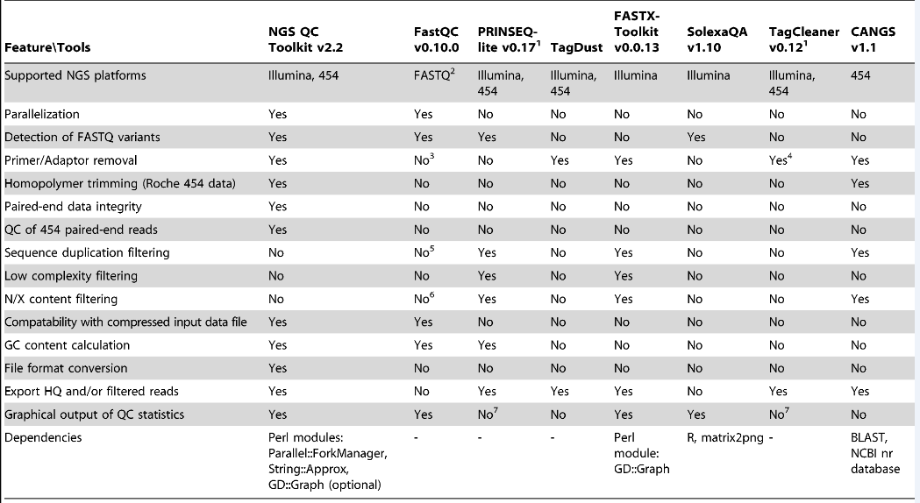

Slide 30
NGS QC Toolkit & FastQC
NGS QC Toolkit is for quality check and filtering of high-quality read
This toolkit is a standalone and open source application freely available at http://www.nipgr.res.in/ngsqctoolkit.html
Application have been implemented in Perl programming language
QC of sequencing data generated using Roche 454 and Illumina platforms
Additional tools to aid QC : (sequence format converter and trimming tools) and analysis (statistics tools)
FastQC can be used only for preliminary analysis

Slide 31
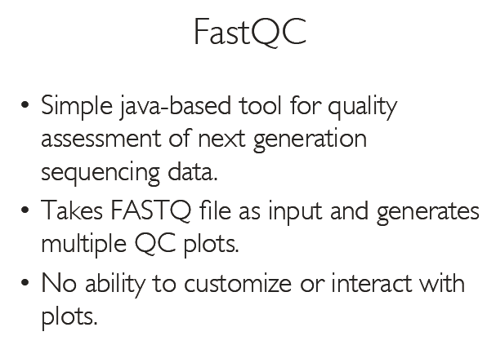

Slide 32
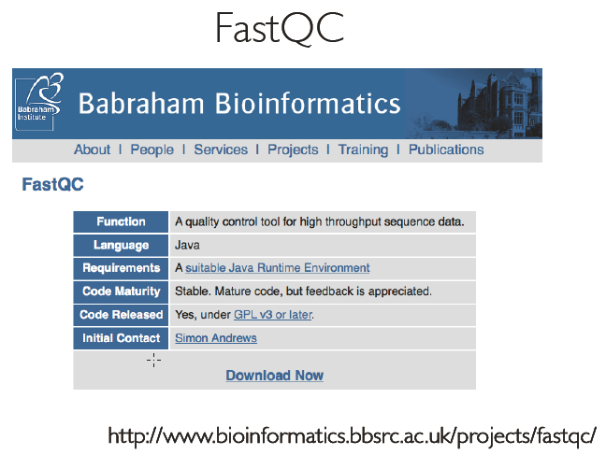

Slide 33
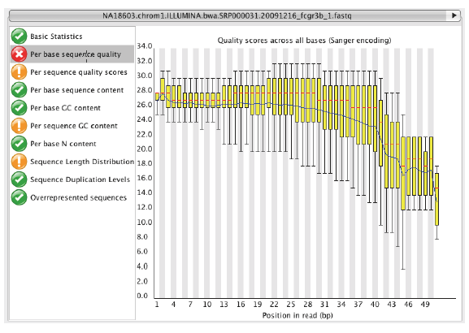

Slide 34
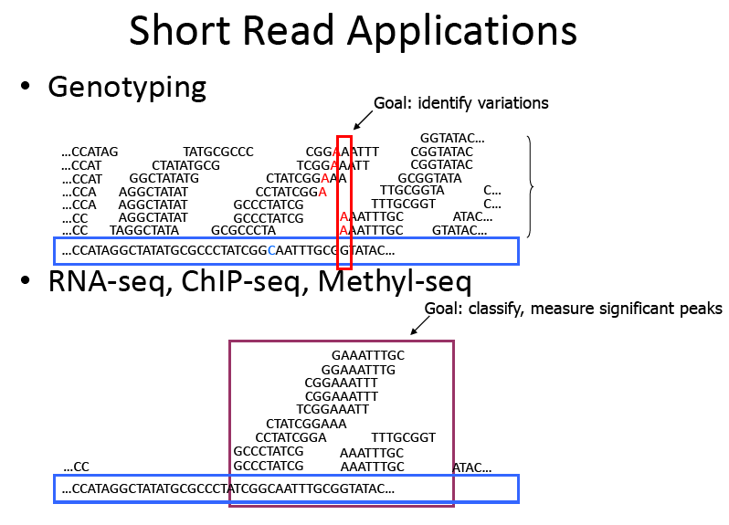

Slide 35
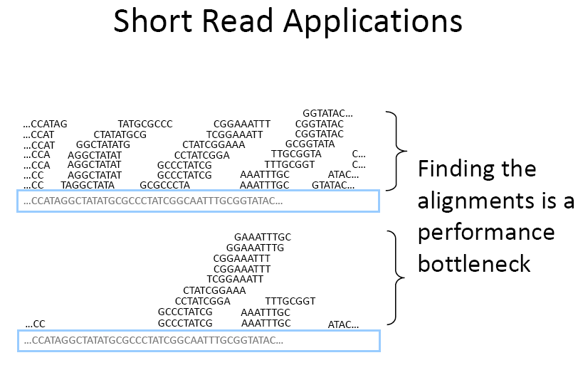

Slide 36
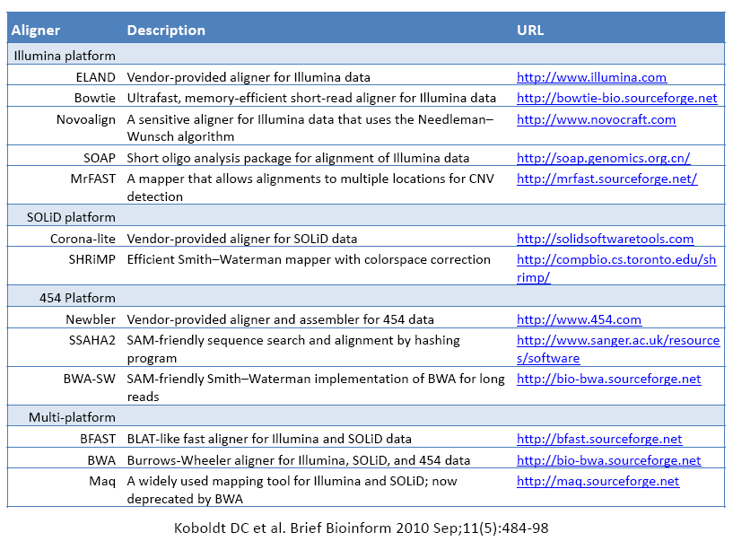

Slide 37
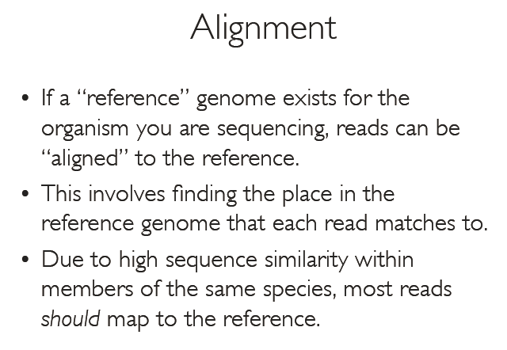

Slide 38
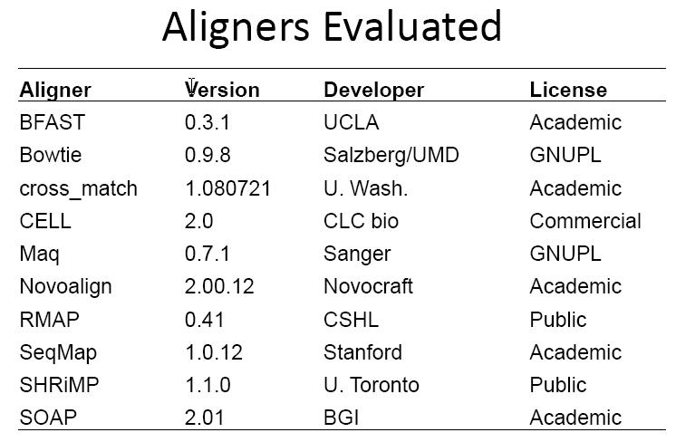

Slide 39
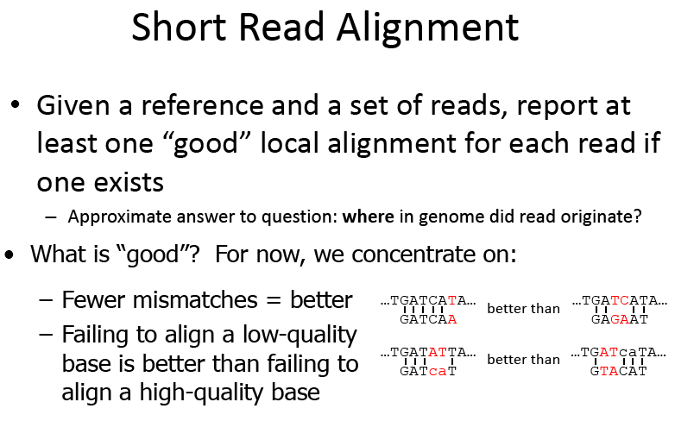

Slide 40
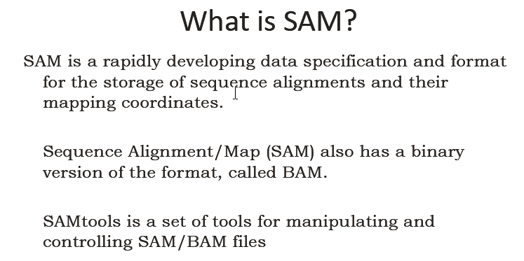

Slide 41
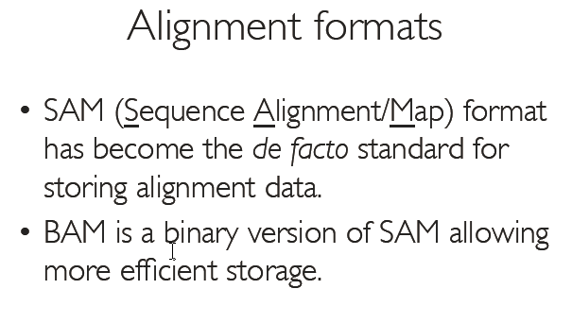
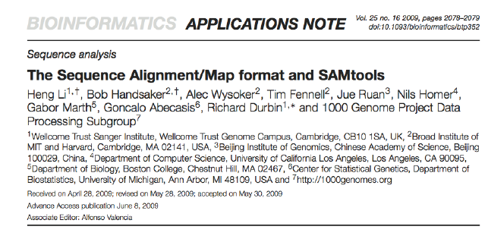

Slide 42
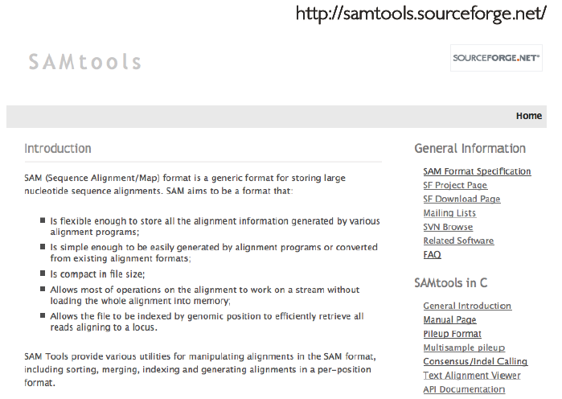

Slide 43
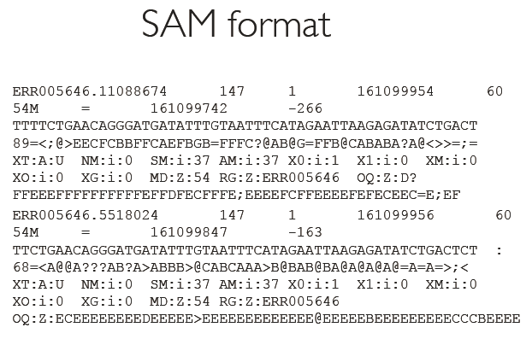

Slide 44
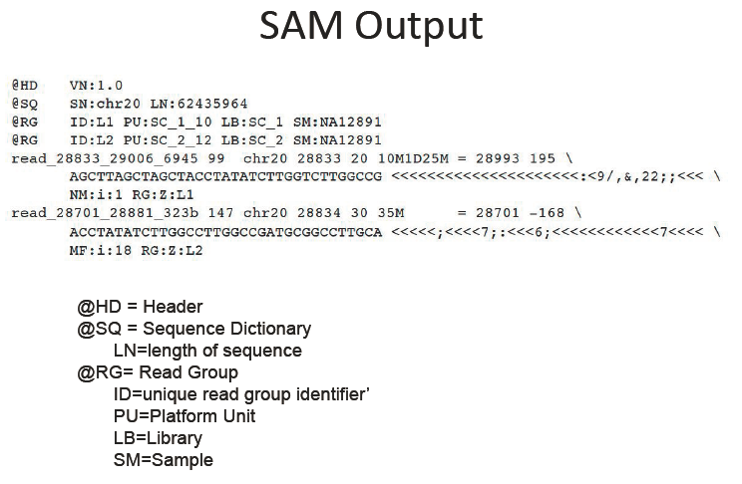

Slide 45
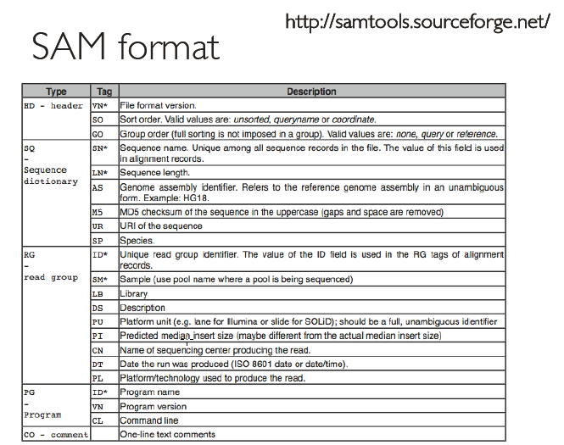

Slide 46


Slide 47


Slide 48


Slide 53




Slide 54


Slide 55




Slide 56



Slide 57


