Slide 1
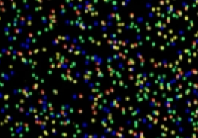
Databases and Tools for
High Throughput Sequencing Analysis
P. Tang (鄧致剛); PJ Huang (黄栢榕)
Bioinformatics Center, Chang Gung University.

Slide 2

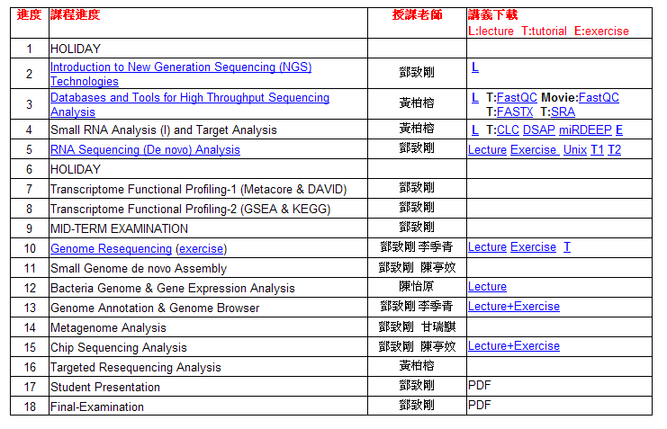

Slide 3
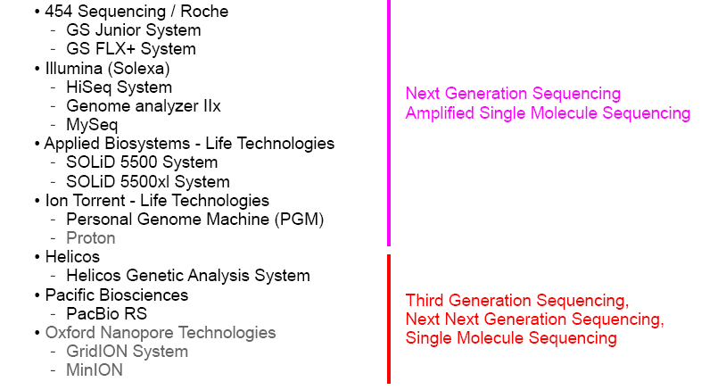
HTseq Platforms

Slide 4
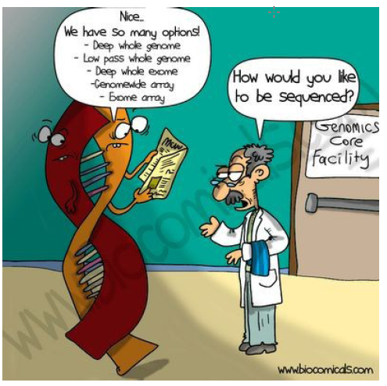
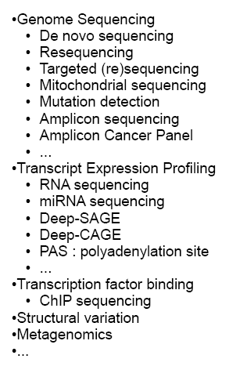

Slide 5
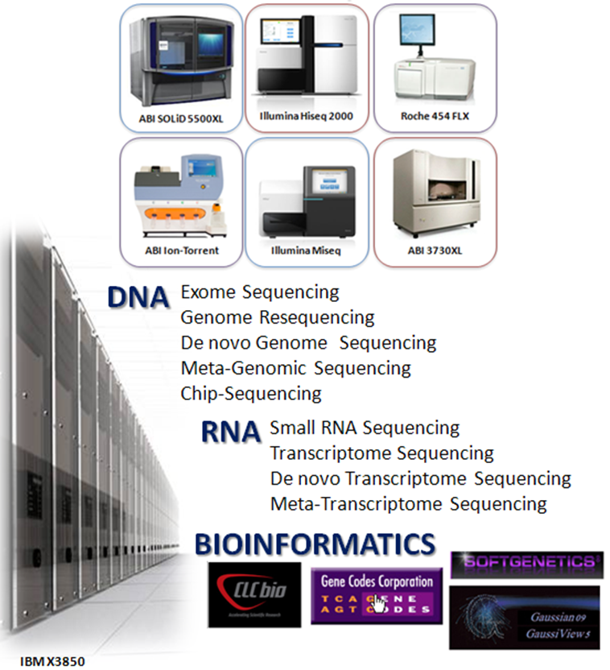
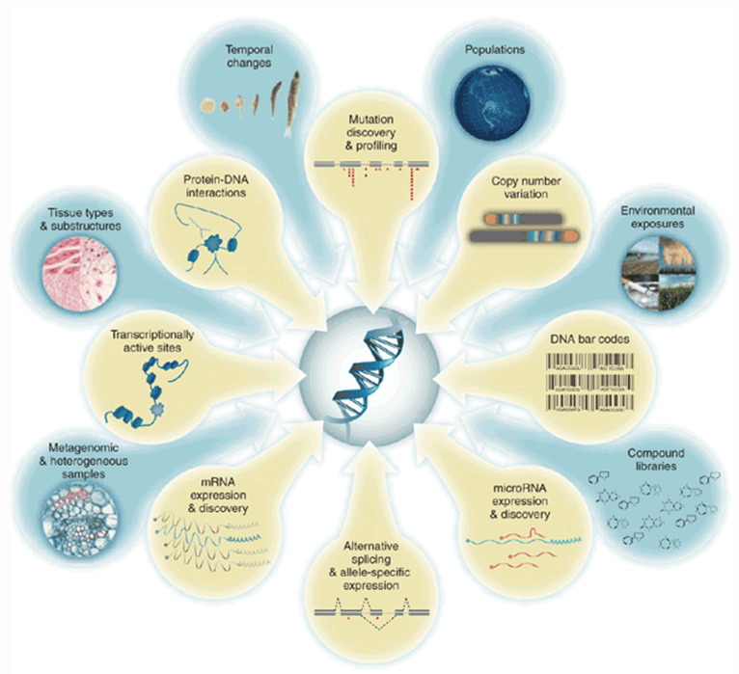
Applications on Biomedical Sciences

Slide 6
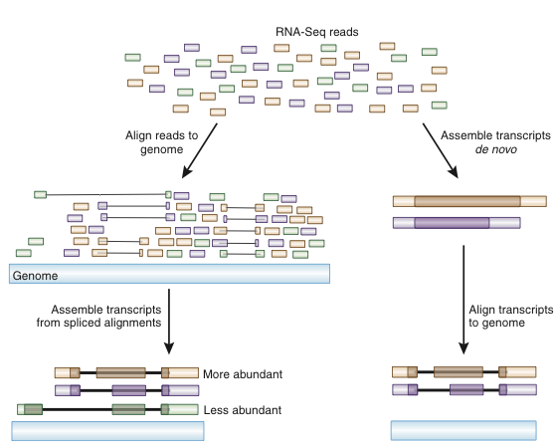
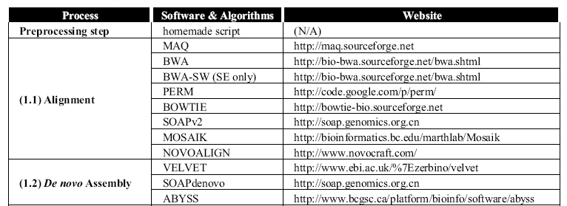
Analysis Strategies: Reference Sequence Alignment (Mapping) vs De novo Assembly
or transcriptome

Slide 7
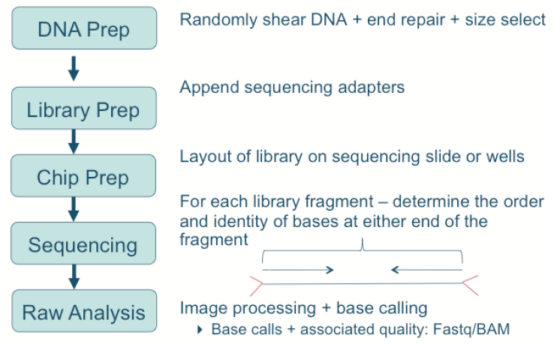
HTseq Experiment

Slide 8
Great… I got my data now what…
Data and information management is slowly moving out of infancy in genomics science…. at the toddler stage…
The Good news
  Some data formats are being accepted widely
The Bad news
  Still many competing standards in some areas
  Interoperability of data standards is almost non-existent
  Governance is questionable

Slide 9
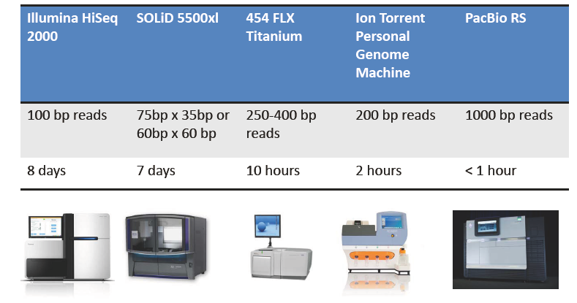
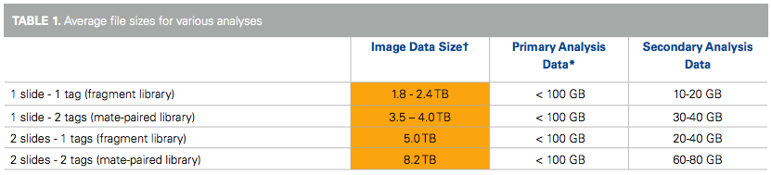
Storage & Computing Power
Next gen sequencers generated Giga bp to Tera bp of data

Slide 10
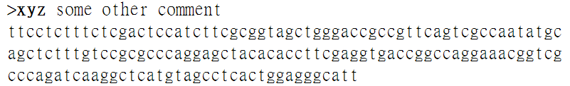
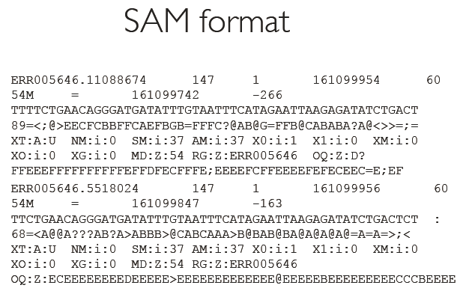
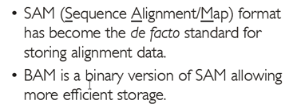
Data Format Types
Raw Sequence Data e.g. fasta
Aligned data e.g. BAM
Processed data e.g. BED

Slide 11
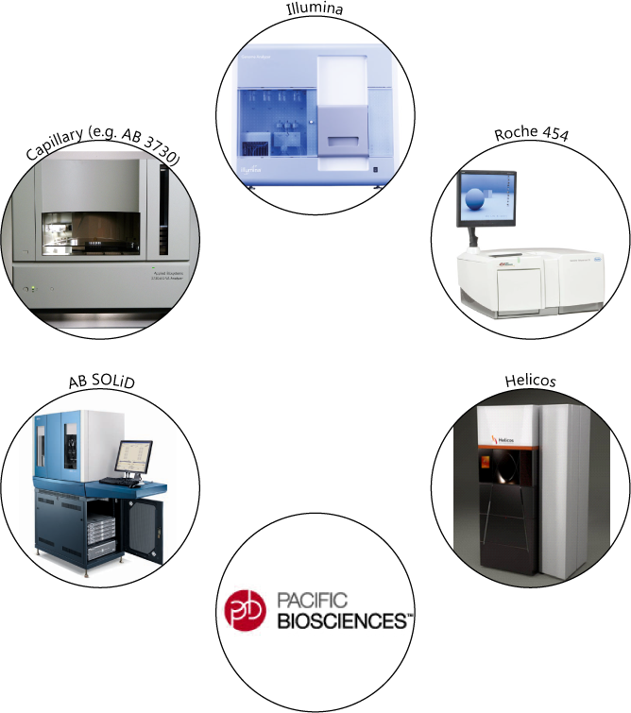
Interpreting raw data

Slide 12
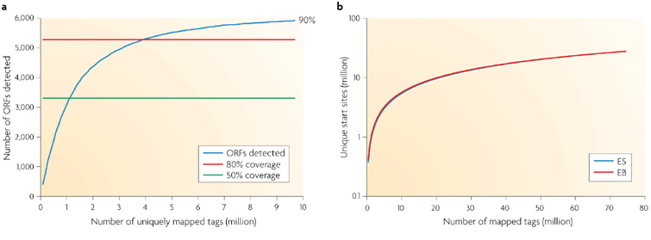
How deep should we go?
coverage
80% of yeast genes (genome size: ~120MB) were detected at 4 million uniquely mapped RNA-Seq reads, and coverage reaches a plateau afterwards despite the increasing sequencing depth. Expressed genes are defined as having at least four independent reads from a 50-bp window at the 3' end.
The number of unique start sites detected starts to reach a plateau when the depth of sequencing reaches 80 million in two mouse transcriptomes. ES, embryonic stem cells; EB, embryonic body.
Nature Reviews Genetics 10, 57-63

Slide 13
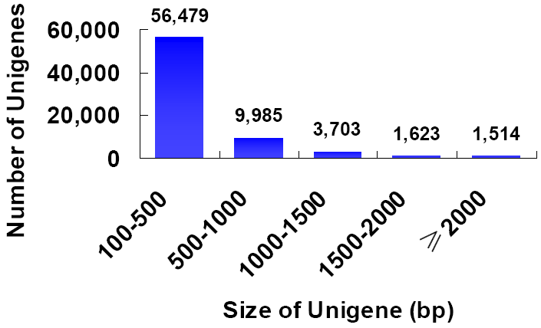
Genome Size
De novo assembled rice transcriptome
1.3 Gb RNA‐Seq data (genome size: ~400MB)
85% of assembled unigenes were covered by gene models

Slide 14
HTseq Raw Data Format
fasta (Sanger)
csfasta (SOLiD)
fastq (Solexa)
sff (454)
…. And about 30 other file formats
http://emboss.sourceforge.net/docs/themes/SequenceFormats.html

Slide 15
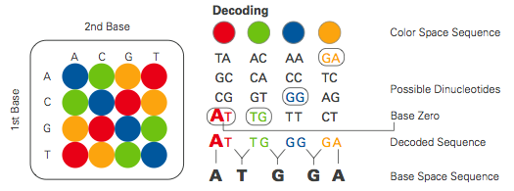
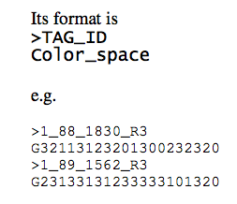
SOLiD Color Space

Slide 16
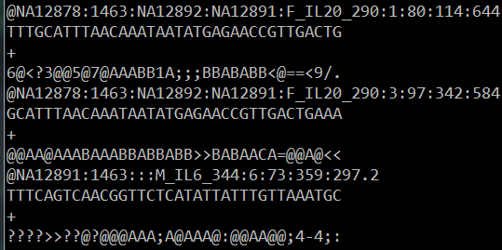
(cs)Fasta/(cs)Fastq
FASTA
  Header line “>”
  Sequence
FASTQ
  Add QVs encoded as single byte ASCII codes
Most aligners accept FASTA/Q as input
Issue: data is volumous (2 bytes per base for FASTQ)
Do PHRED scaled values provide the most information?

Slide 17
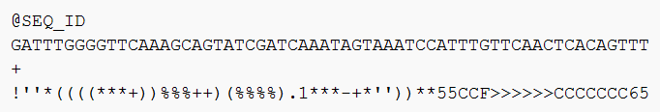
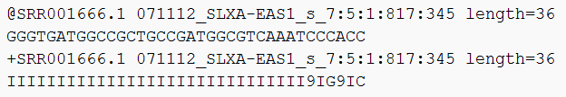
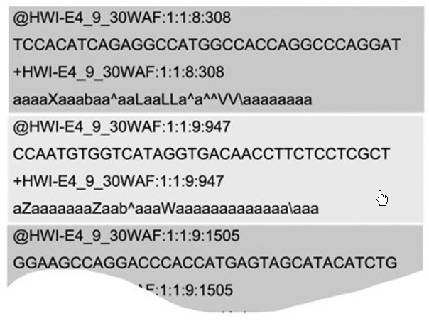
Fastq: Illumina & Snager

Slide 18
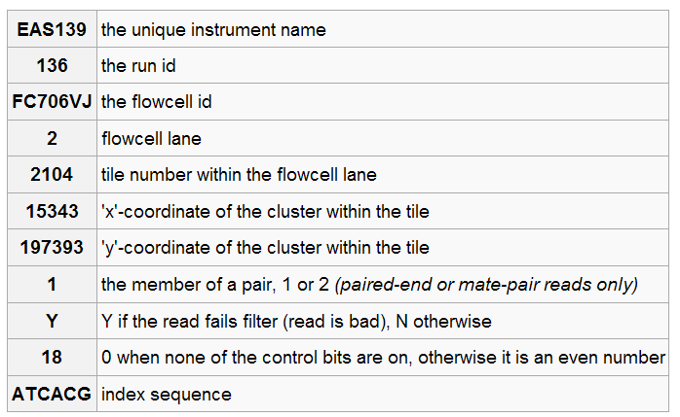
Fastq: Illumina & NCBI

Slide 19
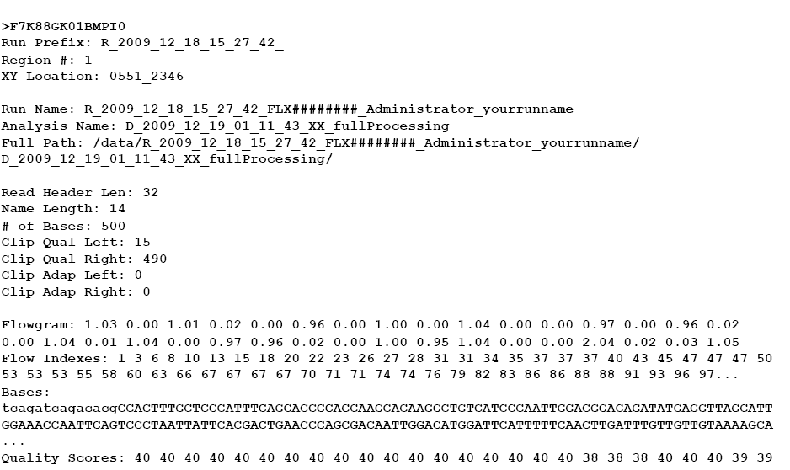
sff (text format): 454

Slide 20
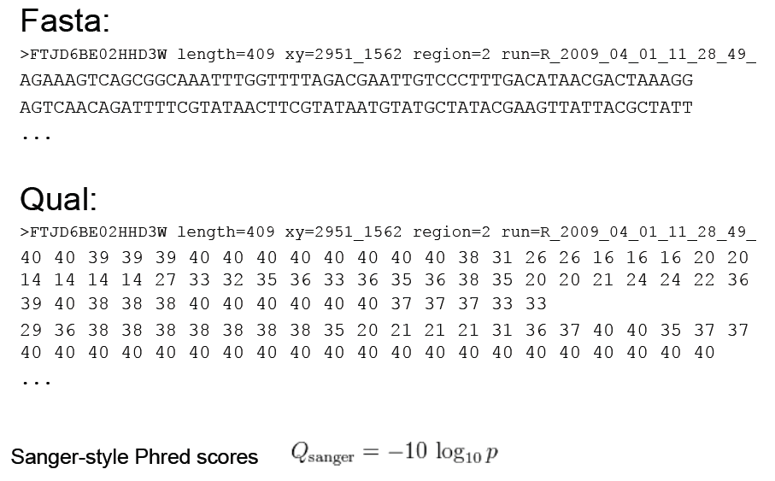
454 fasta with quality file

Slide 21
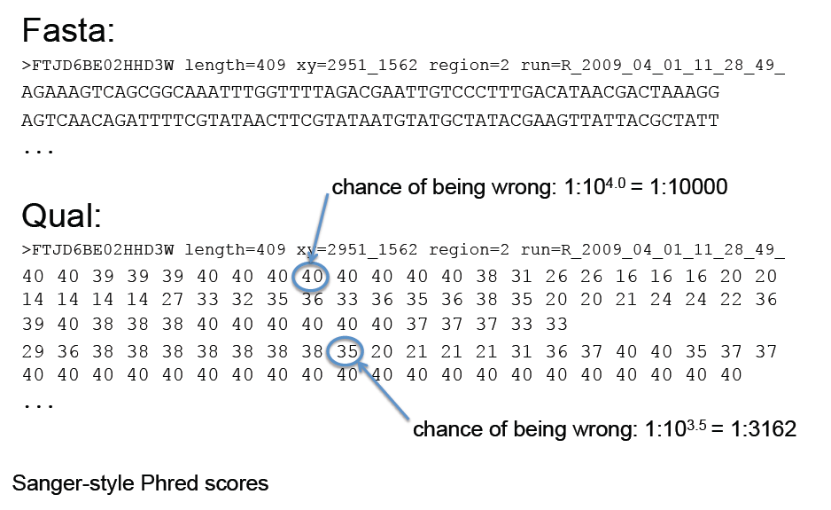
454 base quality?

Slide 22
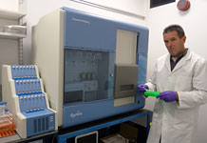
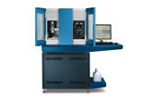
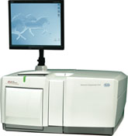
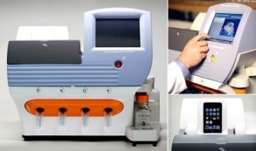
All Platforms have Errors
Illumina
SoLID/ABI-Life
Roche 454
Ion Torrent
Removal of low quality bases/ Low complexity regions
Removal of adaptor sequences
Homopolymer-associated base call errors (3 or more identical DNA bases) causes higher number of (artificial) frameshifts

Slide 23
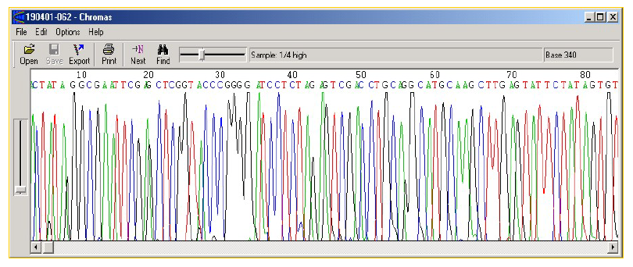
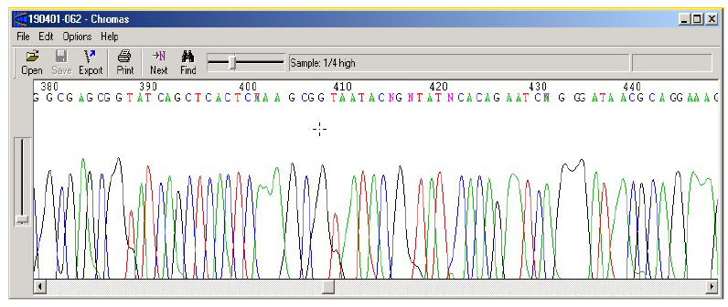
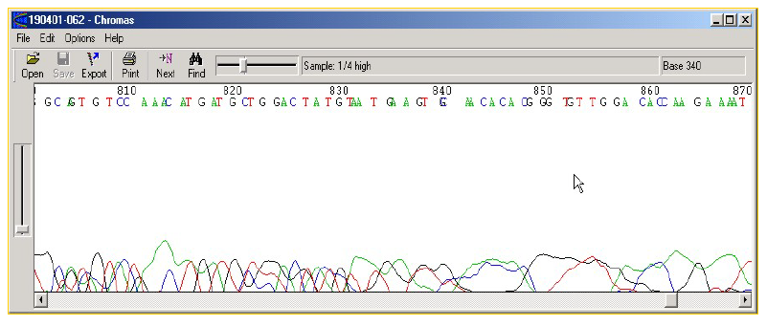
Trace File
High quality region - NO ambiguities (Ns)
Medium quality region - SOME ambiguities (Ns)
Poor quality region - LOW confidence

Slide 24
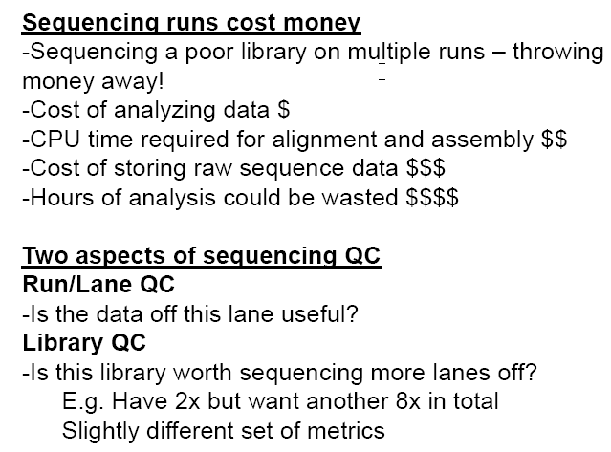
Quality Control Is Essential

Slide 25
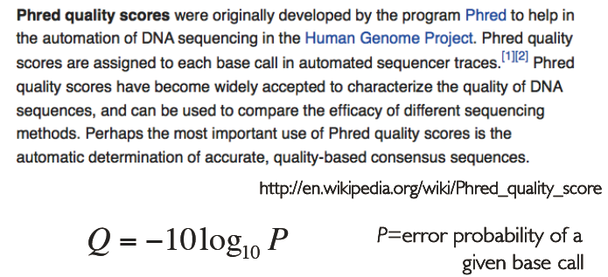
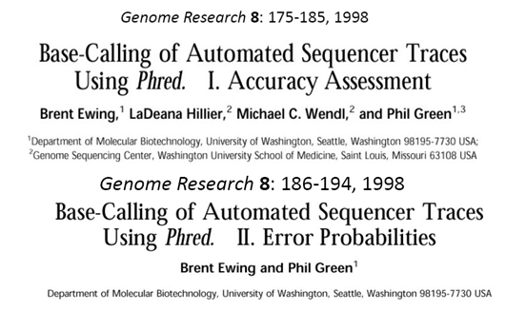
Accessing Quality: phred scores

Slide 26
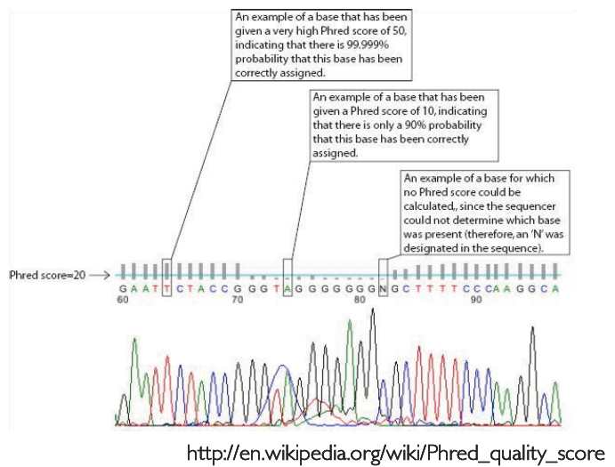
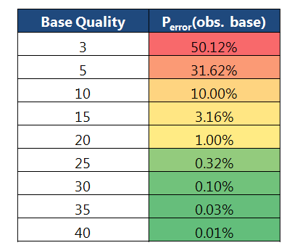
Accessing Quality: phred scores

Slide 27
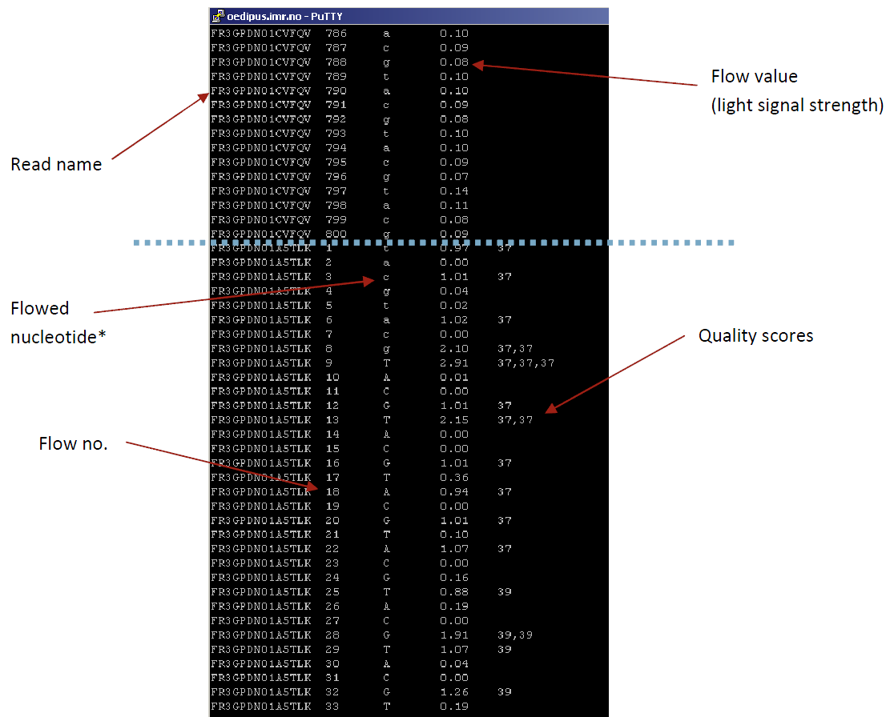
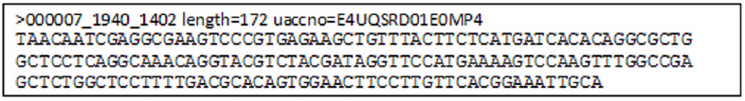
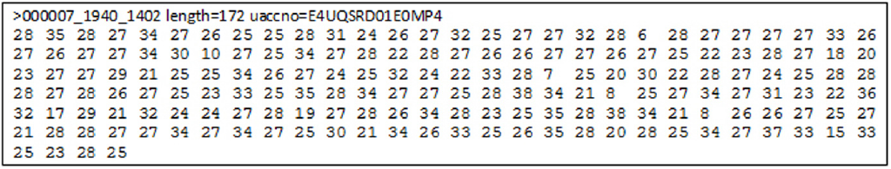
454 output formats
Standard flowgram format
.sff
.fna
.qual
Notes:
Sequencers use their own output formats, and even multiple different formats per technology.
Output formats from Roche 454 sequencers:
.sff is 454’s binary(=compressed) format, including the raw data. Not the very raw images, but flow values (flowgram), base calls, base-call qualities, read trimming and quality.
There are many simple tools that “unzip” .sff into some readable textual format (see the black example).
.fna is a FASTA (or FASTA-like) format including the base-called reads.
.qual includes qualities corresponding to bases in .fna.

Slide 28
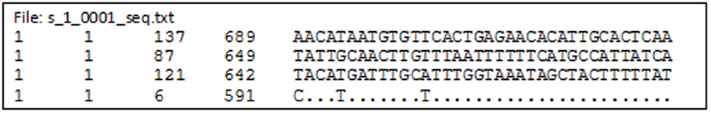
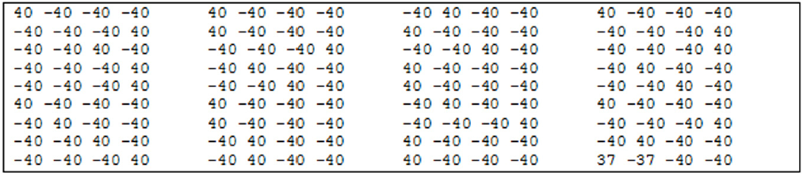
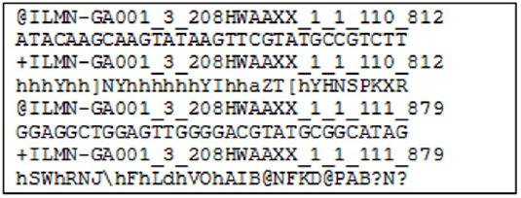
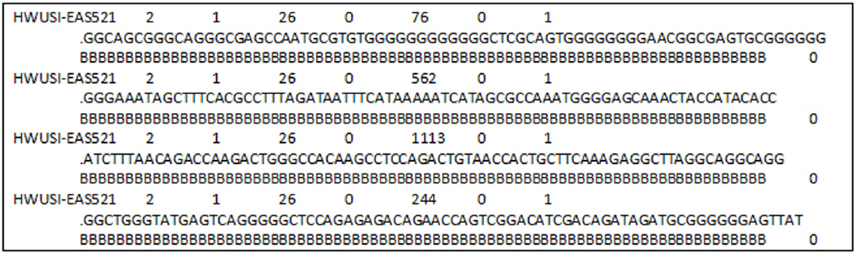


Illumina output formats
.seq.txt
.prb.txt
Illumina FASTQ (ASCII – 64 is Illumina score)
Qseq
(ASCII – 64 is Phred score)
Illumina single line format
SCARF
Phred quality scores
Solexa Compact ASCII Read Format
Notes:
Illumina is over-creative with their own formats.
.seq.txt: base-called sequences
.prb.txt: qualities for each nucleotide/each cycle (is some kind of semi-raw data?)
Illumina FASTQ is not real FASTQ, but looks similarly (to cause confusion). The quality score is an own Illumina score, computed by subtracting 64 from the ASCII code of the character. For example the ‘h’ in the example is ord(‘h’) – 64 = 104 – 64 = 40.
See http://www.asciitable.com/ for ASCII codes (Dec is the ‘ord’ in decimal numbers).
The Illumina score can be transformed to Phred score. Given a character ch, the following expression should give the Phred quality q (please double-check:) q = 10 * log(1 + 10 ^ (ord(ch) - 64) / 10.0)) / log(10)
Qseq: Not looking like FASTQ, but the scores are proper Phred scores. Their encoding is however still ASCII – 64.
Illumina “single line format” and SCARF: base-called sequences and quality scores in a bit more handy format.

Slide 29
Illumina FastQ
ASCII value for h= 103
Quality of Base A at the position 1 = 103- 64
103- 64 = 39
Where 39 is the phred score

Slide 30
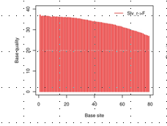
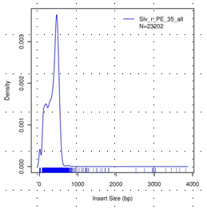
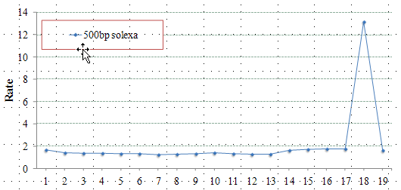

Quality Control
Read quality distribution
Library insert size
Mapping Rate
Duplication assessment

Slide 31

Quality Control Tools

Slide 32
NGS QC Toolkit & FastQC
NGS QC Toolkit is for quality check and filtering of high-quality read
This toolkit is a standalone and open source application freely available at http://www.nipgr.res.in/ngsqctoolkit.html
Application have been implemented in Perl programming language
QC of sequencing data generated using Roche 454 and Illumina platforms
Additional tools to aid QC : (sequence format converter and trimming tools) and analysis (statistics tools)
FastQC can be used only for preliminary analysis

Slide 33


Slide 34


Slide 35

http://www.ncbi.nlm.nih.gov/geo/

Slide 36


http://www.ncbi.nlm.nih.gov/gds/
expression profiling by array
expression profiling by genome tiling array
expression profiling by high throughput sequencing
expression profiling by mpss
expression profiling by rt pcr
expression profiling by sage
expression profiling by snp array
genome binding/occupancy profiling by array
genome binding/occupancy profiling by genome tiling array
genome binding/occupancy profiling by high throughput sequencing
genome binding/occupancy profiling by snp array
genome variation profiling by array
genome variation profiling by genome tiling array
genome variation profiling by high throughput sequencing
genome variation profiling by snp array
methylation profiling by array
methylation profiling by genome tiling array
methylation profiling by high throughput sequencing
methylation profiling by snp array
non coding rna profiling by array
non coding rna profiling by genome tiling array
non coding rna profiling by high throughput sequencing
other
protein profiling by mass spec
protein profiling by protein array
snp genotyping by snp array
third party reanalysis

Slide 37




Slide 38

"Illumina Genome Analyzer" AND smallRNA

Slide 39




Slide 40


Slide 41




Slide 42



Slide 43

http://seqanswers.com/

