Slide 1
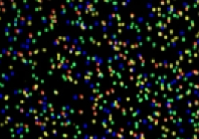
Small RNA
High Throughput Sequencing Analysis I
P. Tang (鄧致剛); PJ Huang (黄栢榕)
Bioinformatics Center, Chang Gung University.

Slide 2
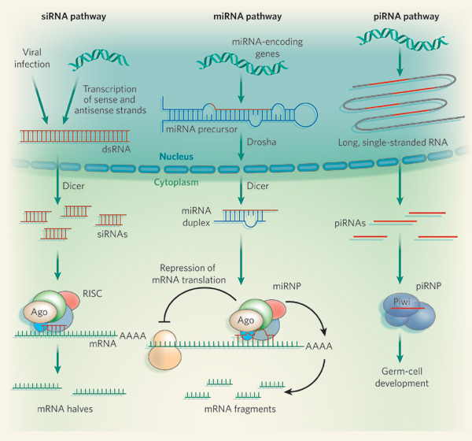
Non-coding Regulatory RNAs
siRNA
Formed through cleavage of synthetic long double-stranded RNA molecules
microRNA (miRNA)
Processed from long, single-stranded RNA sequences that fold into hairpin structures
Piwi-RNA (piRNA)
Generated from long single-stranded precursors.
Nature 451, 414-416

Slide 3
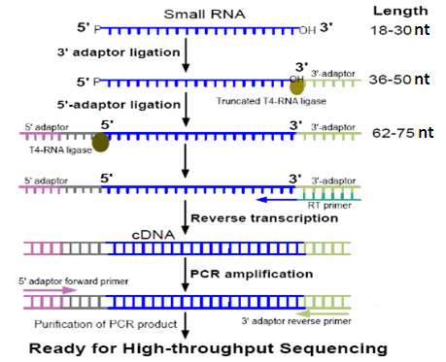
Sample Preparation for small RNA Sequencing

Slide 4
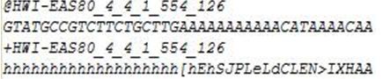
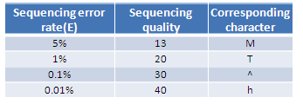
Data Processing
Sequence name
Sequence
Sequence name
Quality
The data is processed by the following steps:
1) Getting rid of low quality reads
2) Getting rid of reads with 5' primer contaminants
3) Getting rid of reads without 3' primer
4) Getting rid of reads without the insert tag
5) Getting rid of reads with poly A/G/C/T/N
6) Getting rid of reads shorter than 16-18nt ?
7) Summarize the length distribution of the clean reads

Slide 5
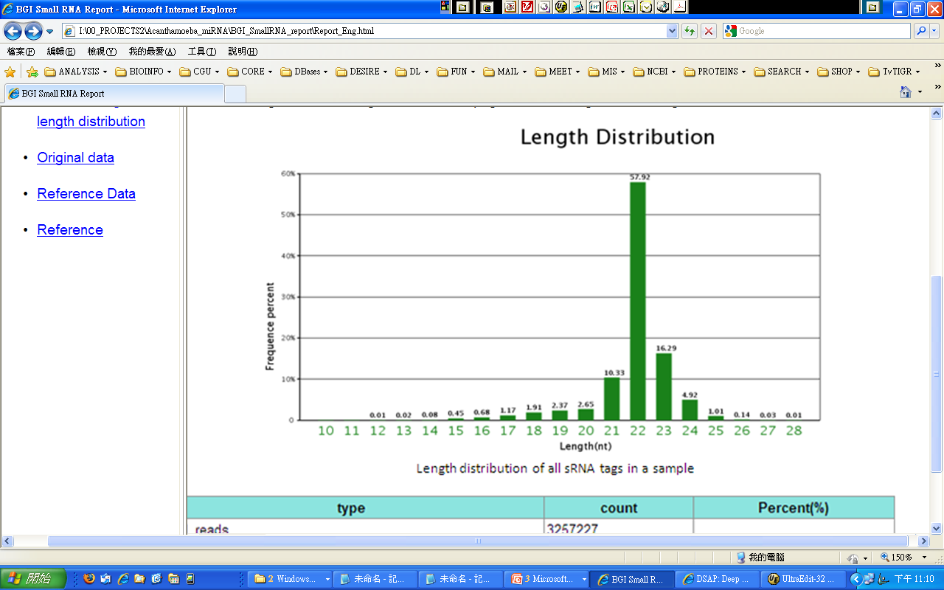
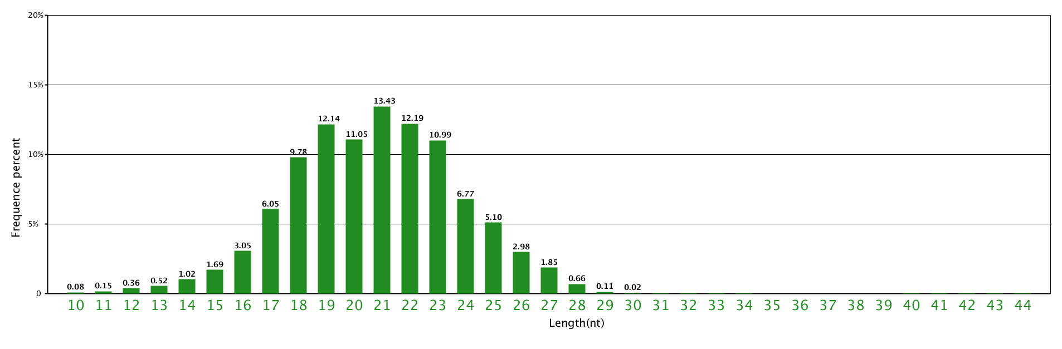
Which one is the correct distribution?

Slide 6
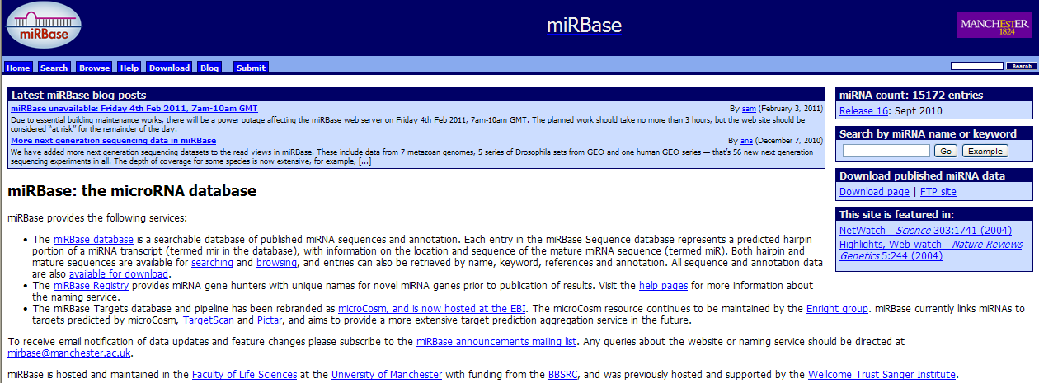
Understand the Reference Database
http://www.mirbase.org/

Slide 7
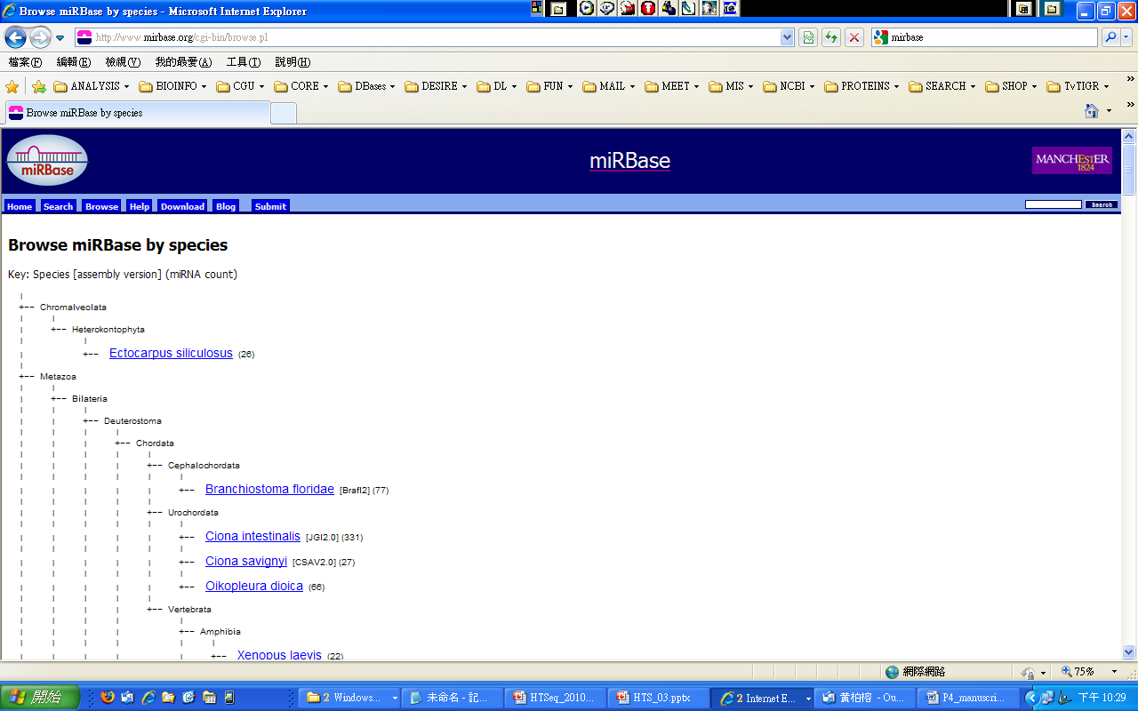
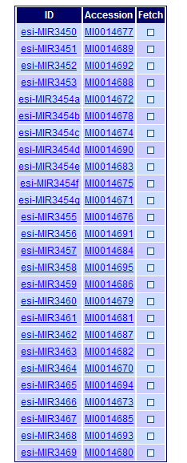
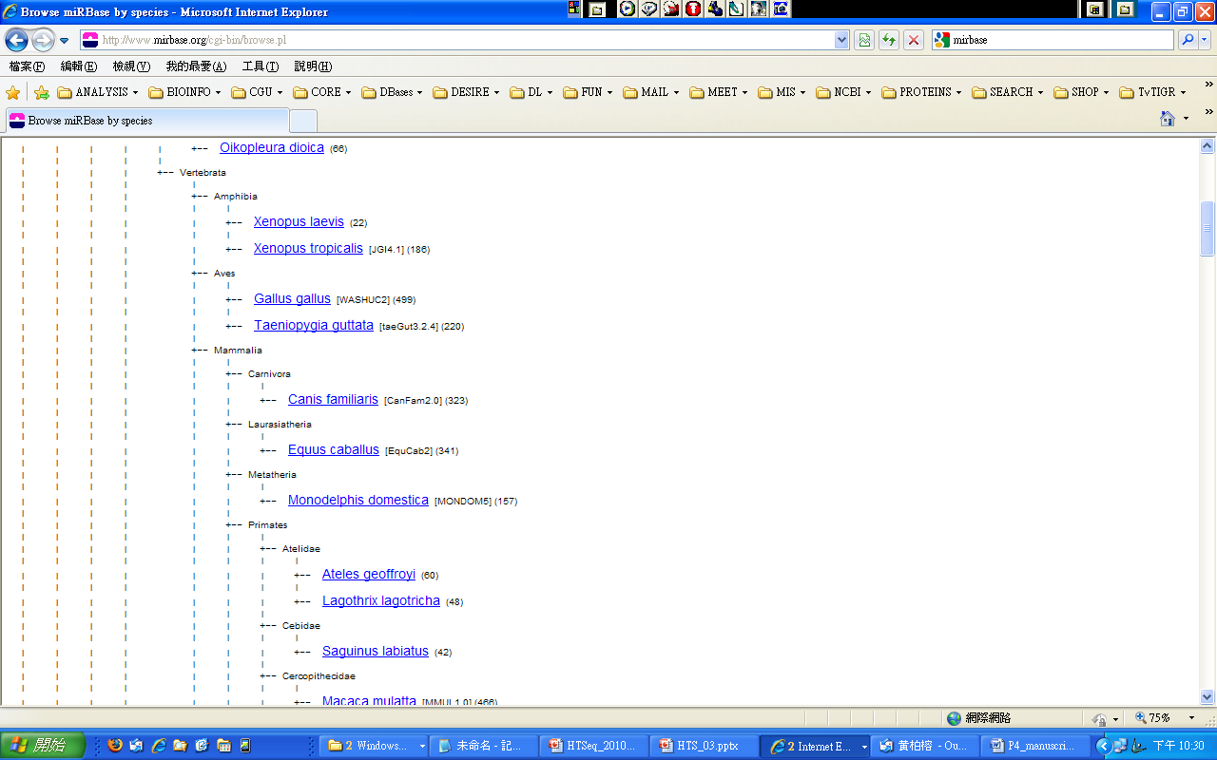

Slide 8
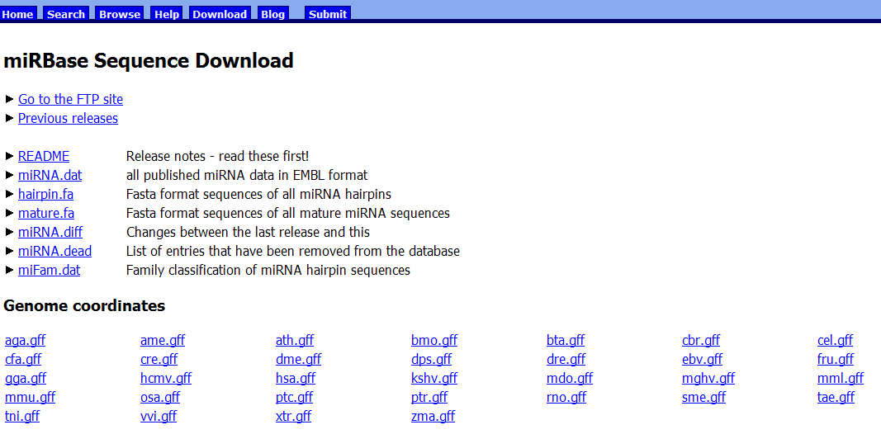

Slide 9
mature.fa
>hsa-miR-3944 MIMAT0018360 Homo sapiens miR-3944
UUCGGGCUGGCCUGCUGCUCCGG
>hsa-miR-3945 MIMAT0018361 Homo sapiens miR-3945
AGGGCAUAGGAGAGGGUUGAUAU
>far-miR159 MIMAT0018362 Festuca arundinacea miR159
UUUGGAUUGAAGGGAGCUCUG
>far-miR160 MIMAT0018363 Festuca arundinacea miR160
UGCCUGGCUCCCUGUAUGCCA
hairpin.fa
>cel-let-7 MI0000001 Caenorhabditis elegans let-7 stem-loop UACACUGUGGAUCCGGUGAGGUAGUAGGUUGUAUAGUUUGGAAUAUUACCACCGGUGAAC
UAUGCAAUUUUCUACCUUACCGGAGACAGAACUCUUCGA
>cel-lin-4 MI0000002 Caenorhabditis elegans lin-4 stem-loop AUGCUUCCGGCCUGUUCCCUGAGACCUCAAGUGUGAGUGUACUAUUGAUGCUUCACACCU
GGGCUCUCCGGGUACCAGGACGGUUUGAGCAGAU

Slide 10
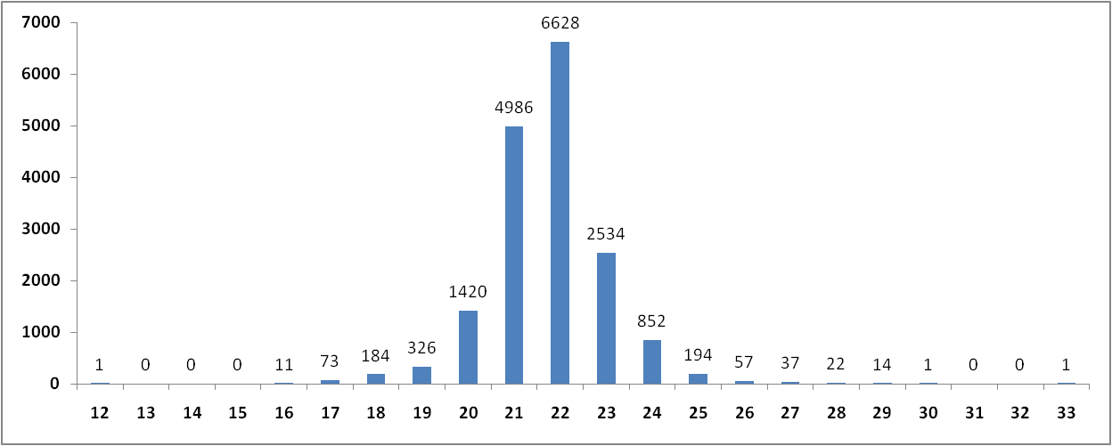
Number of mature miRNA
Length of mature miRNA

Slide 11
Number of mature miRNA
Length of mature miRNA

Slide 12
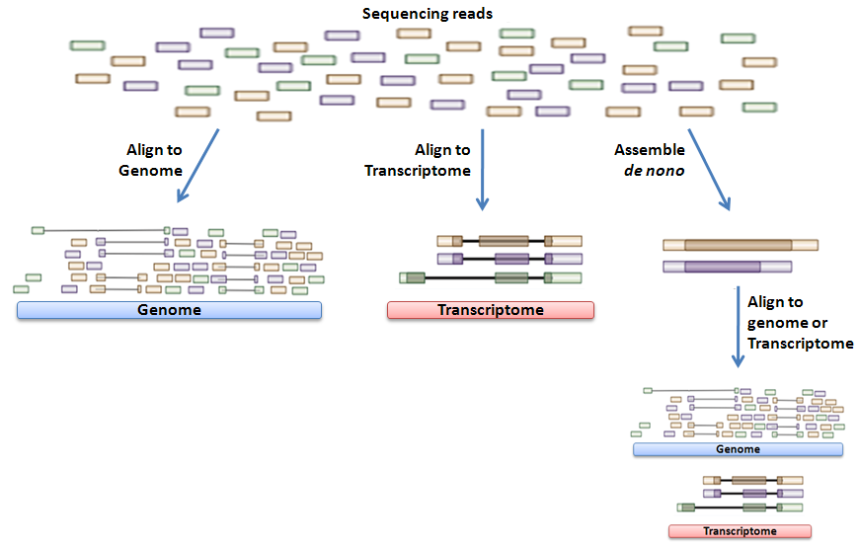
Sequencing Reads Assessment

Slide 13
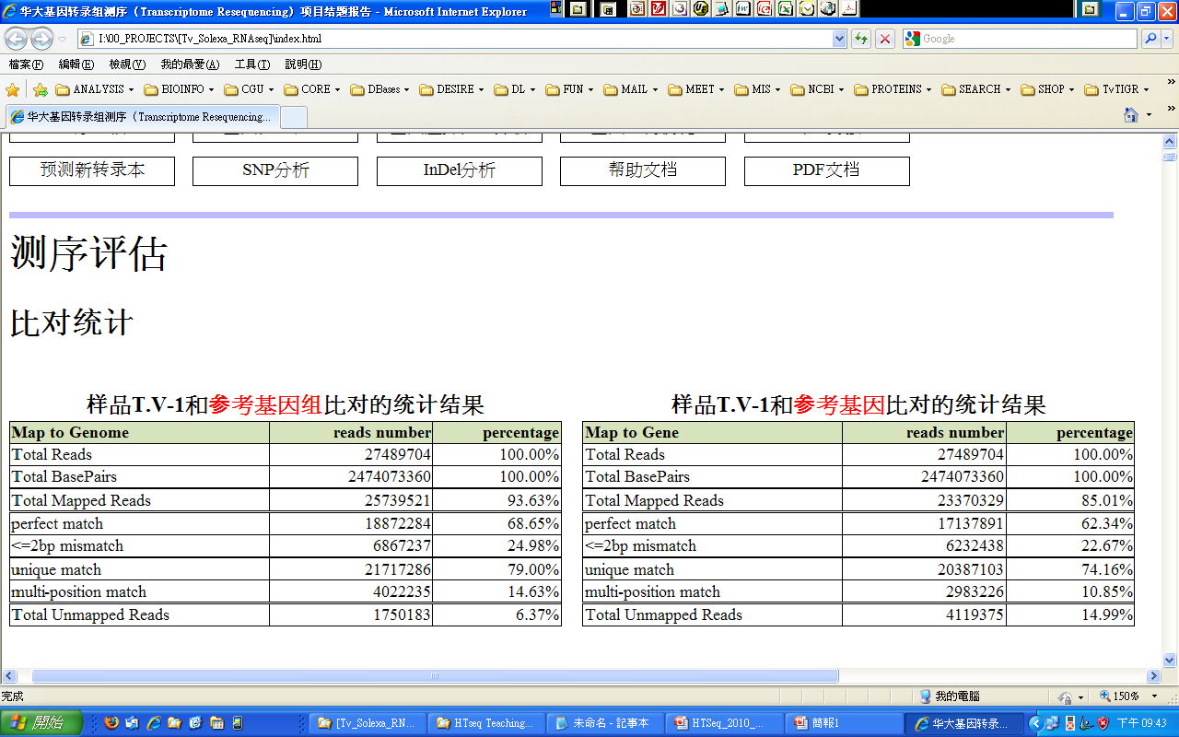
Mapping Result

Slide 14
Drawbacks for each strategy
Alignment to genome
Computationally expensive
It is never a good idea to simply align HTS data to the genome
Need a spliced aligner or a surrogate (such as including exon-exon junction sequences in ‘genome’)
Alignment to transcriptome
Reads deriving from non-genic structures may be ‘forcibly’ (and erroneously) aligned to genes
Incorrect gene expression values
False positive SNVs
Many other potential problems
Assembly
Low expression = difficult/impossible to assemble
Misassemblies/fragmented contigs due to repeats
Requires vast amounts of memory

Slide 15
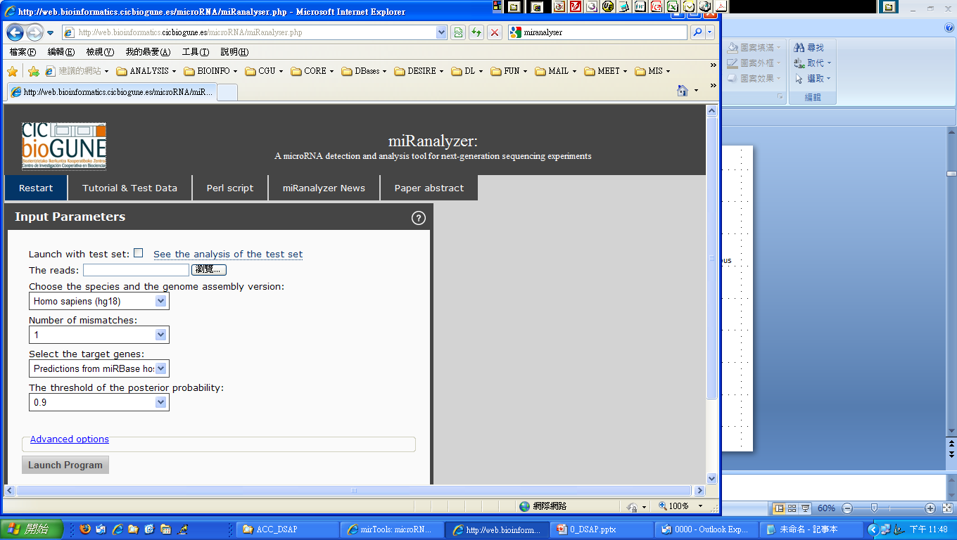


Analysis Tools for small-RNA Deep Sequencing
LINUX/UNIX BASED TOOLS
Discovering microRNAs from deep sequencing data using miRDeep
Nature Biotechnology (2008) 26 (4), pp. 407-415
MIRExpress: Analyzing high-throughput sequencing data for profiling microRNA expression
BMC Bioinformatics (2009) 10, art. no. 1471, pp. 328 .
SeqBuster, a bioinformatic tool for the processing and analysis of small RNAs datasets, reveals ubiquitous miRNA modifications in human embryonic cells.
Nucleic acids research (2010) 38 (5), pp. e34
MIReNA: Finding microRNAs with high accuracy and no learning at genome scale and from deep sequencing data
Bioinformatics (2010) 26 (18), art. no. btq329, pp. 2226-2234
WEB-BASED TOOLS
miRanalyzer: A microRNA detection and analysis tool for next-generation sequencing experiments
Nucleic Acids Research (2009) 37 (SUPPL. 2), pp. W68-W76 *
(http://web.bioinformatics.cicbiogune.es/microRNA/miRanalyser.php)
DSAP: deep-sequencing small RNA analysis pipeline
Nucleic Acids Research. (2010) 38(Web Server issue): W385–W391
(http://dsap.cgu.edu.tw/)
mirTools: microRNA profiling and discovery based on high-throughput sequencing
Nucleic Acids Research. (2010) 38(Web Server issue): W392–W397
(http://centre.bioinformatics.zj.cn/mirtools/)

Slide 16
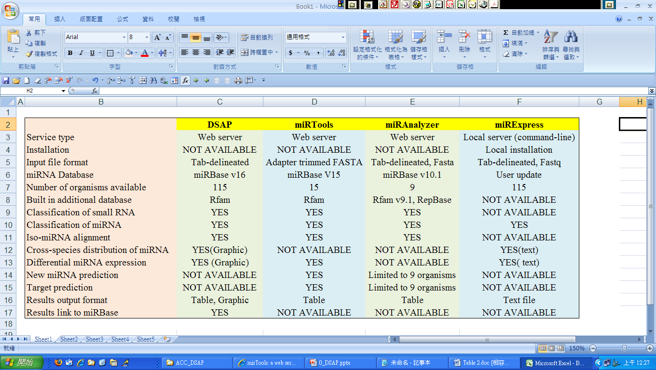
Comparison of Tools

Slide 17
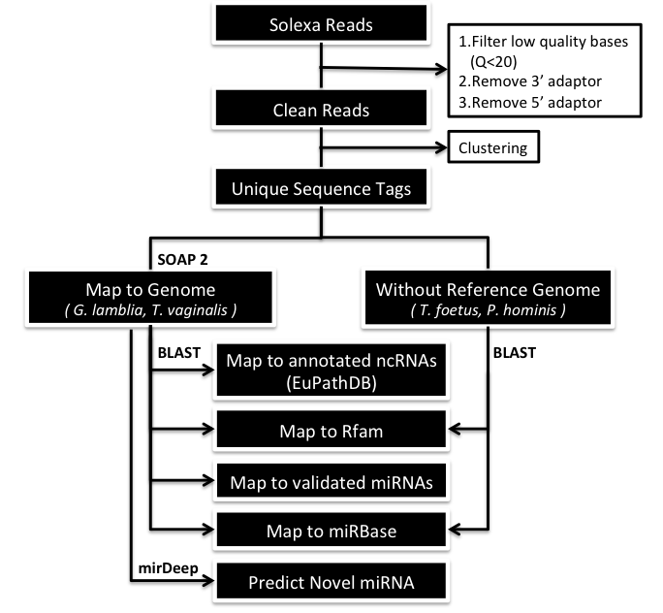

Slide 18
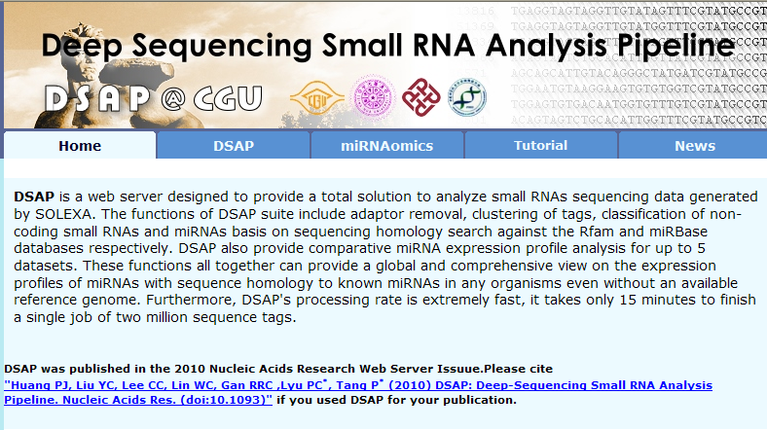
http://dsap.cgu.edu.tw

Slide 19
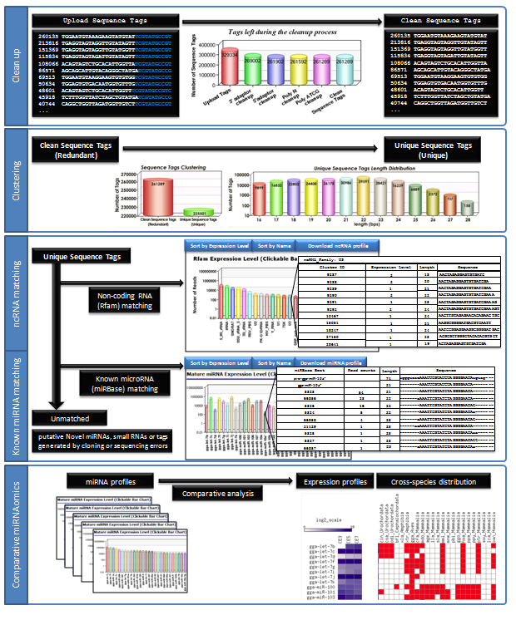
Workflow
Clean up
↓
Clustering
↓
ncRNA matching
(Rfam V10 )
↓
Known miRNA Matching
(miRBase V16)
↓
Comparative miRNAomics

Slide 20
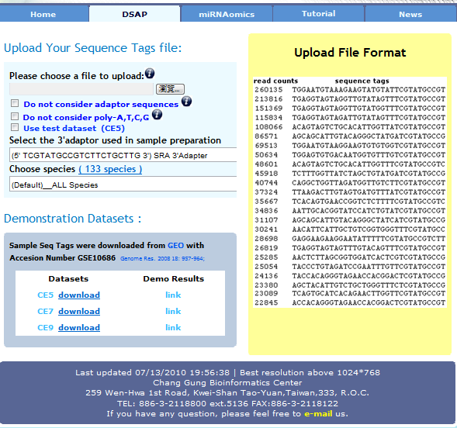
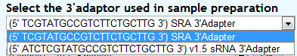
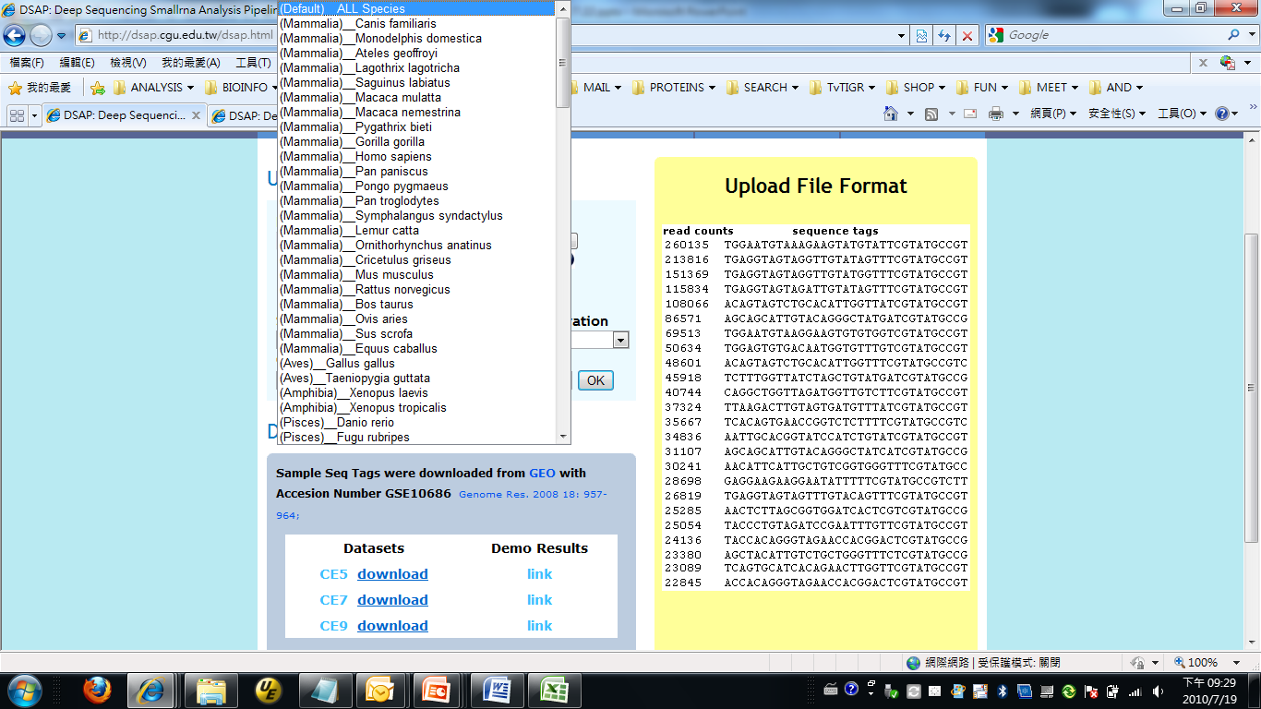
DSAP Data Input Page

Slide 21
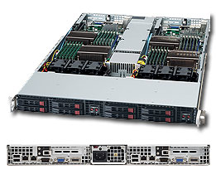
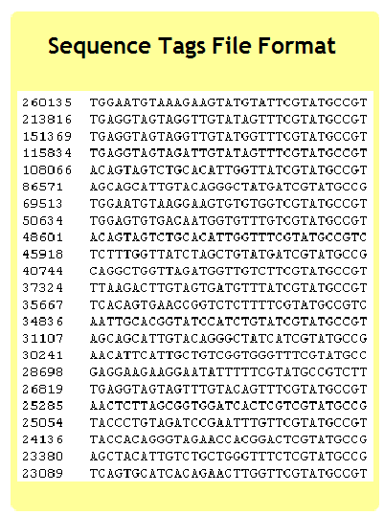
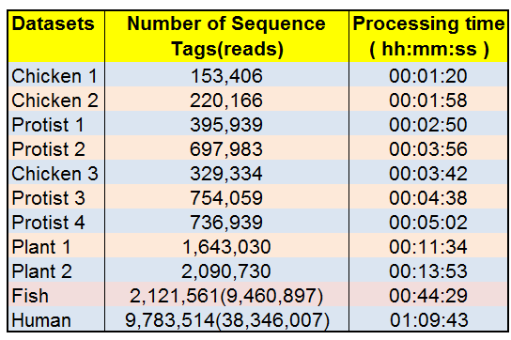
Implementation
DSAP runs on a Linux CentOS 64-bit server housing
two quad-core Intel® Xeon® 5300 Series Processors and
16 GB RAM.

Slide 22
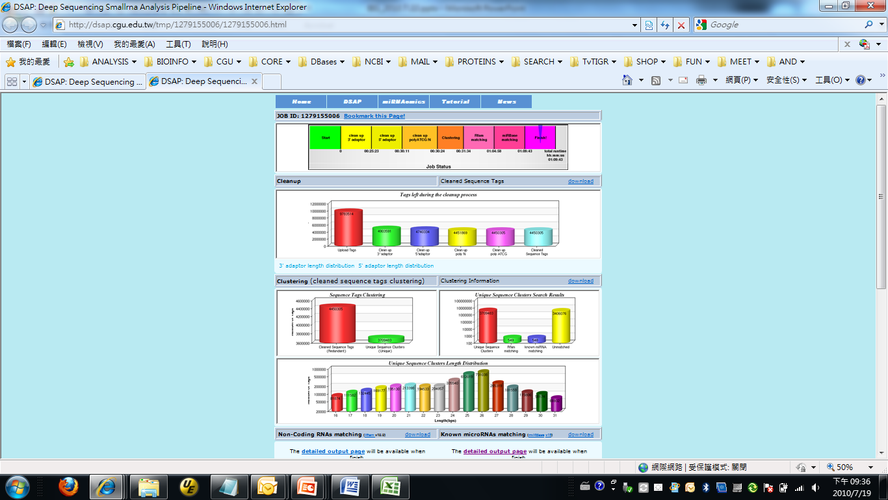
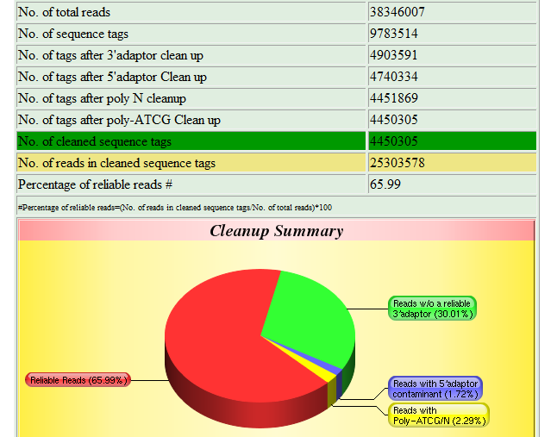
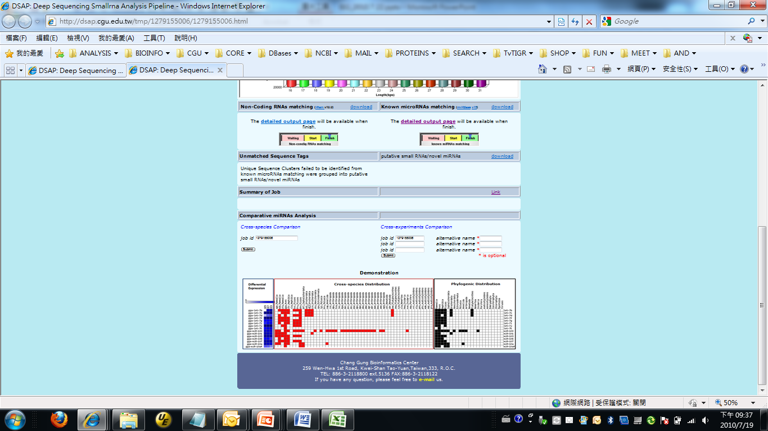
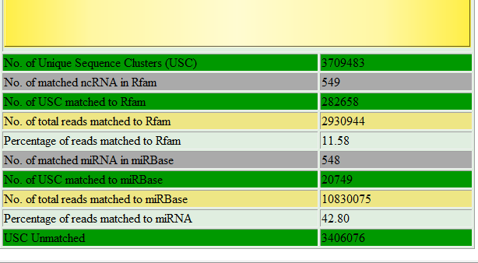
DSAP Data Output

Slide 23
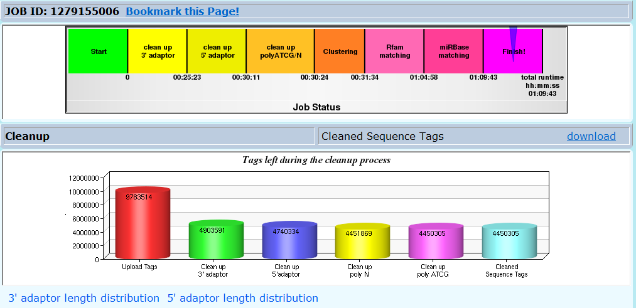
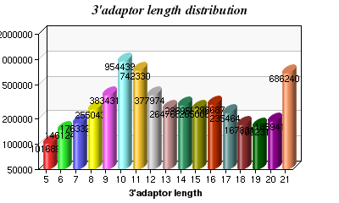
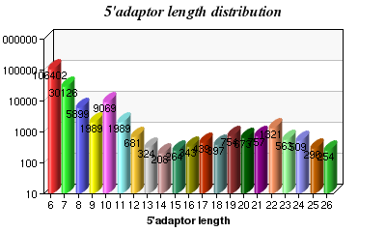
Number of reads: 38,346,007 Number of Tags: 9,783,514
JOB ID:1234567890

Slide 24
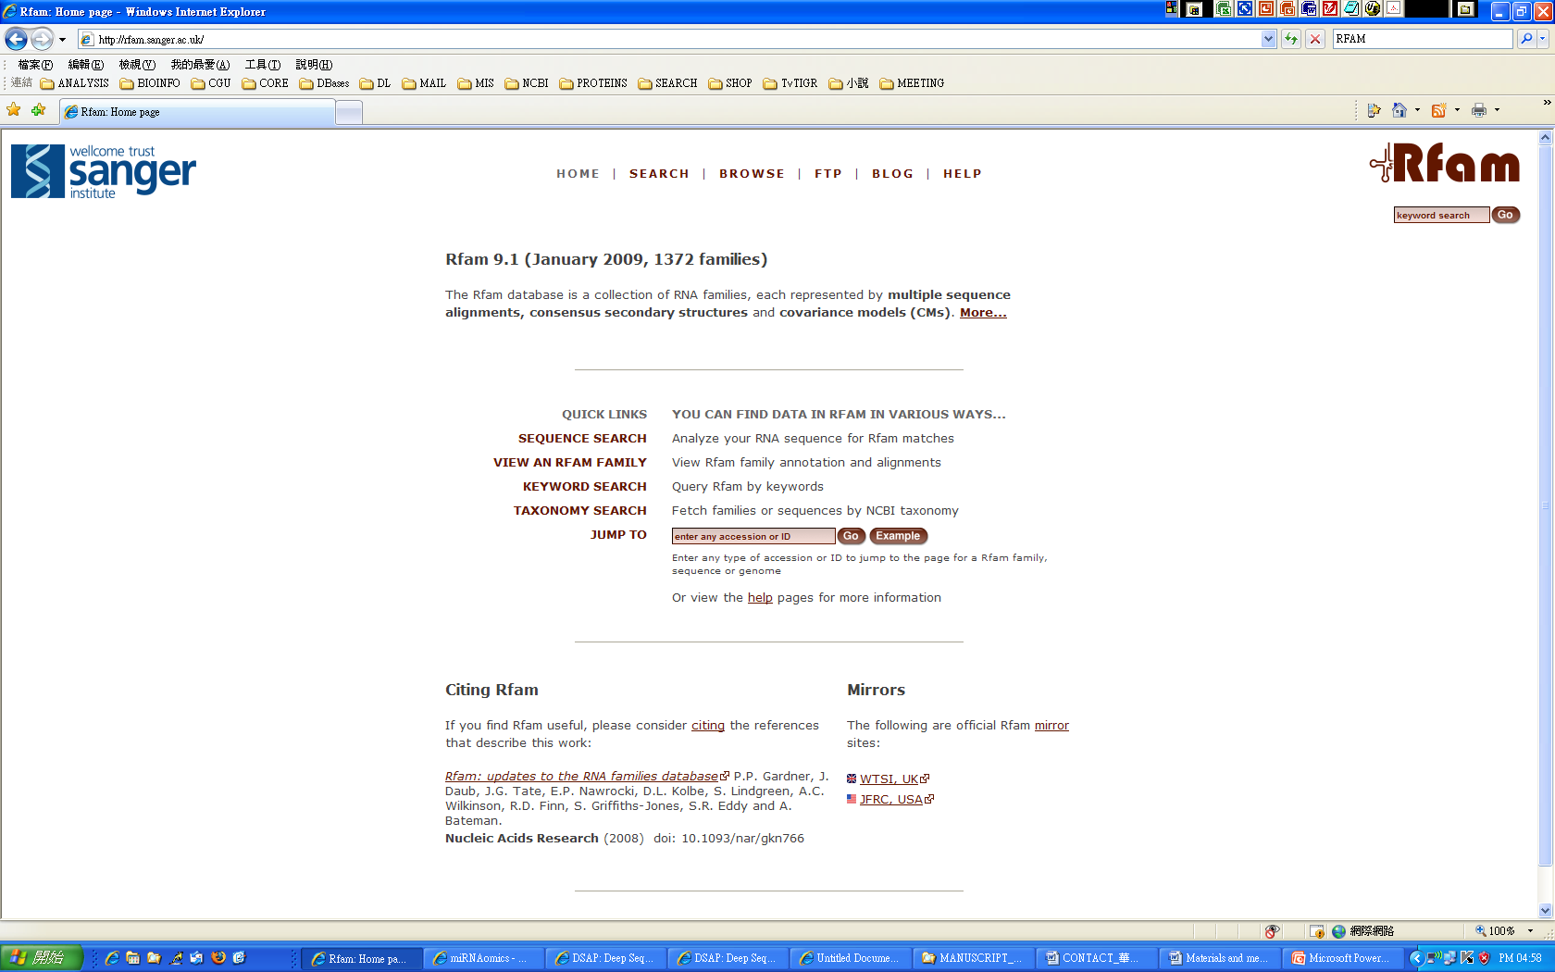
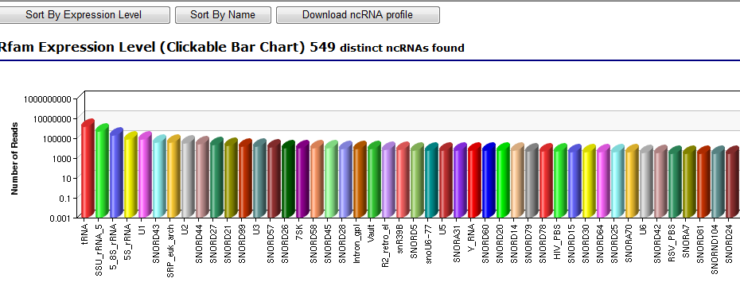
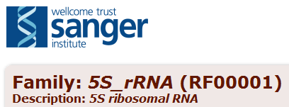
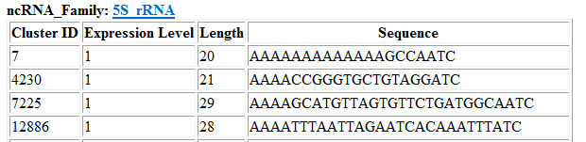
Non-Coding RNAs Searching

Slide 25

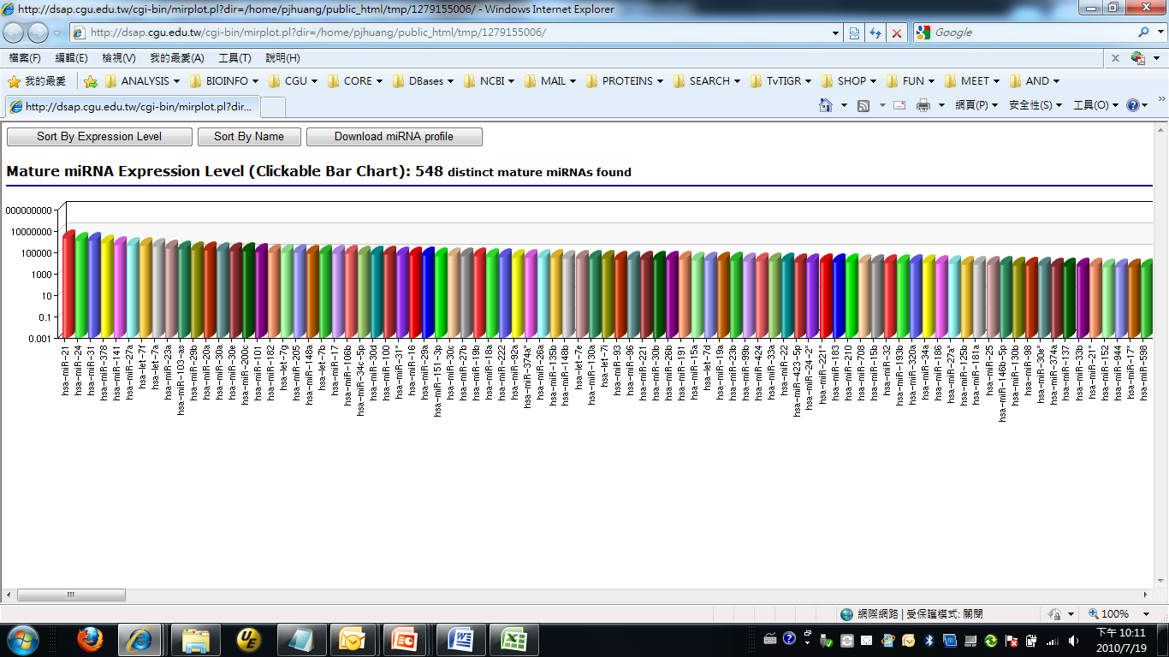
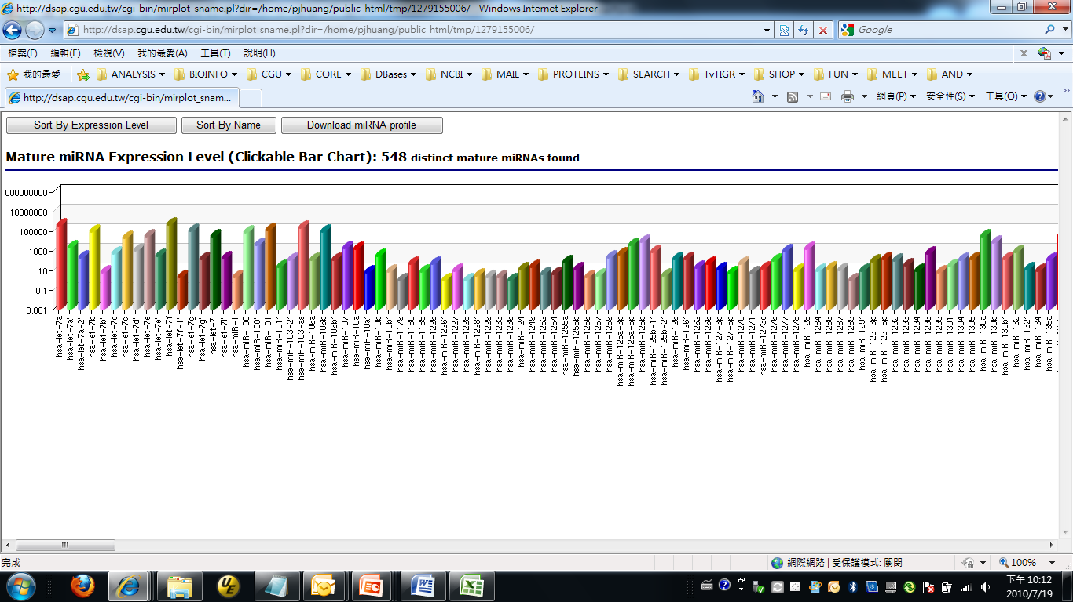
miRNAs Searching

Slide 26
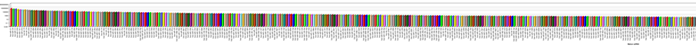
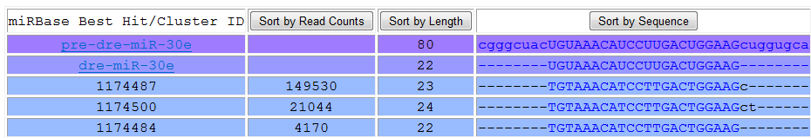
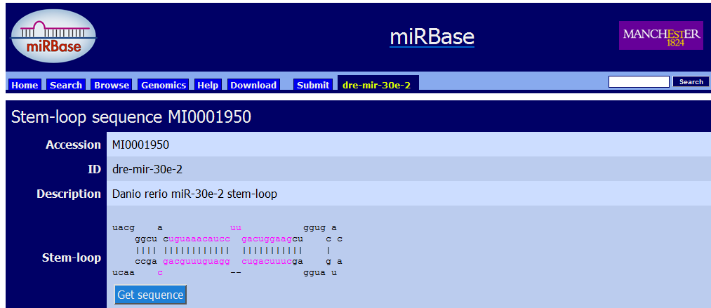
Iso-miR

Slide 27
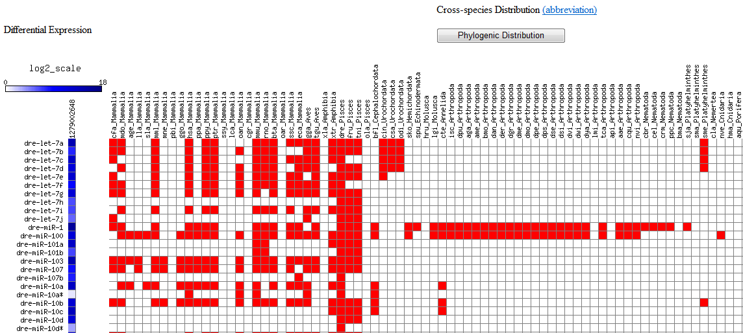
Cross-species Distribution of Identified miRNAs

Slide 28
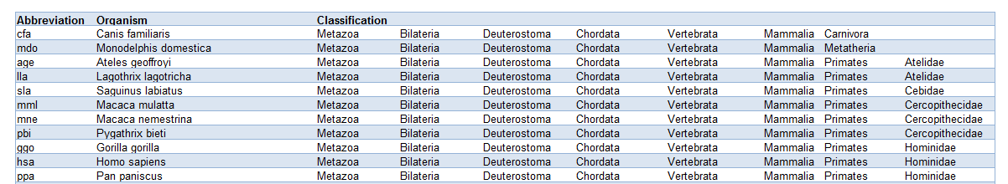
Cross-species Distribution of Identified miRNAs

Slide 29
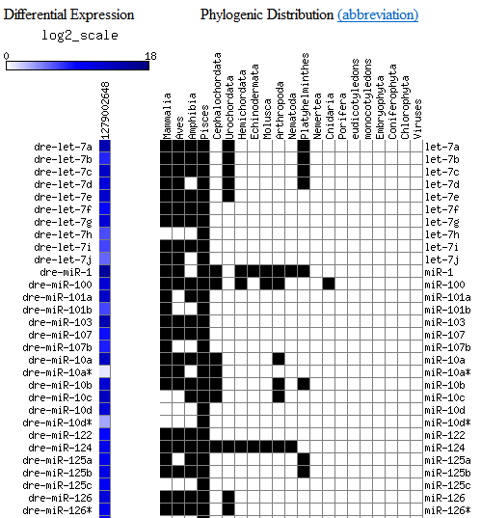
Phylogenic Distribution of Identified miRNAs

Slide 30
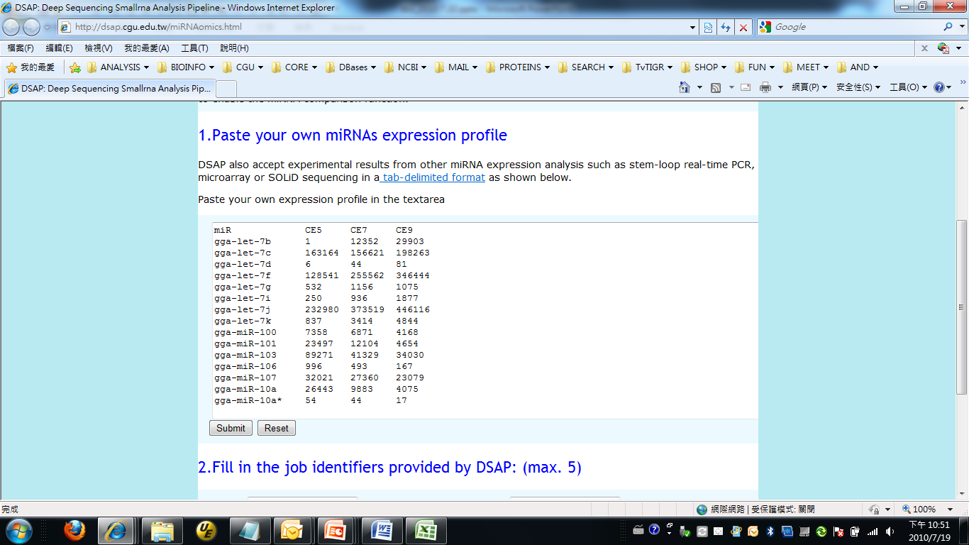
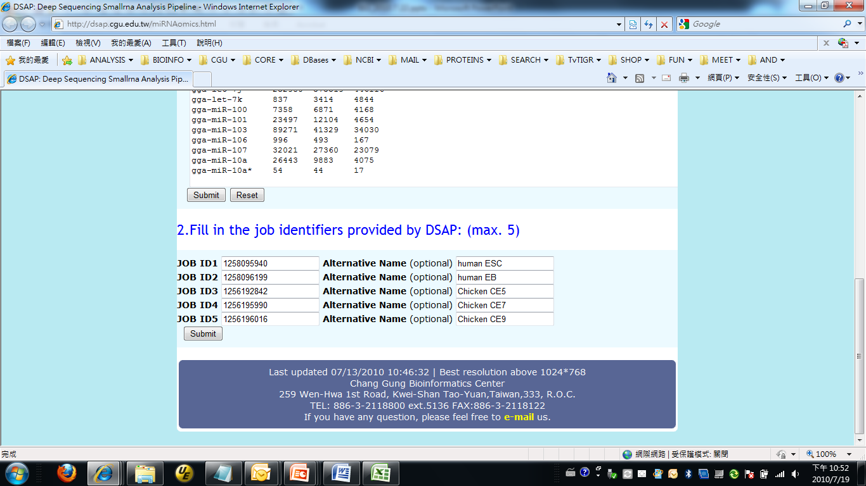
Comparative miRNAomics
non-normalized
normalized

Slide 31
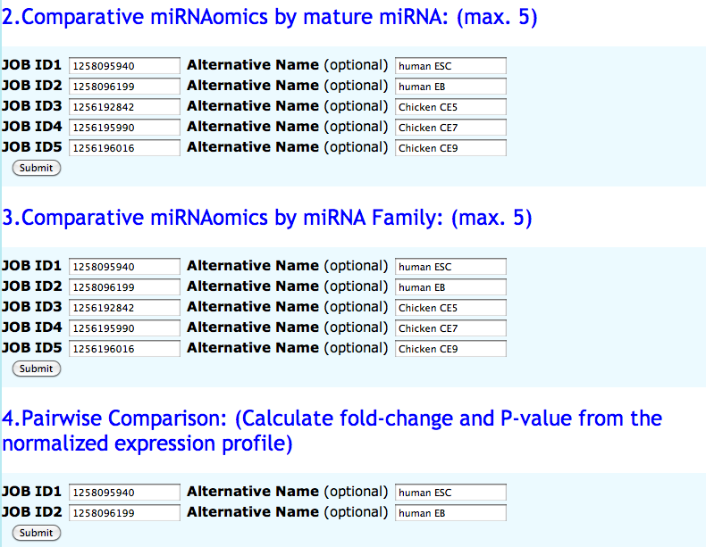

Slide 32
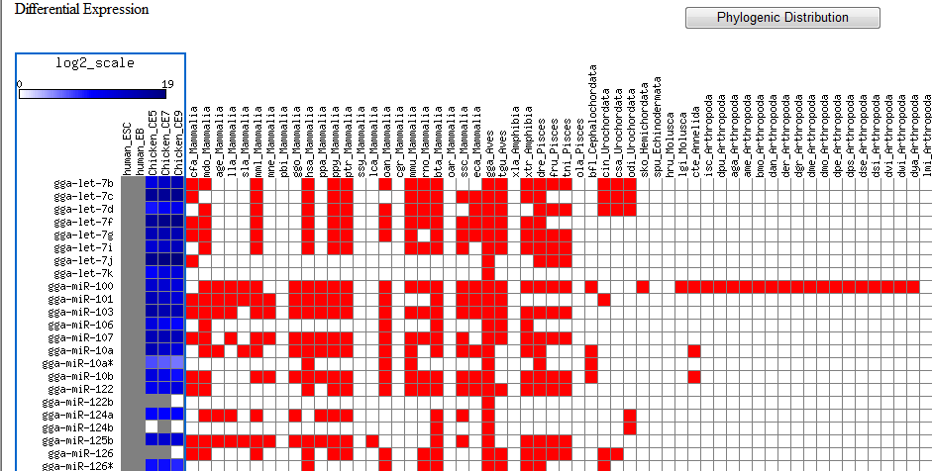
Comparative miRNAomics by mature miRNA

Slide 33
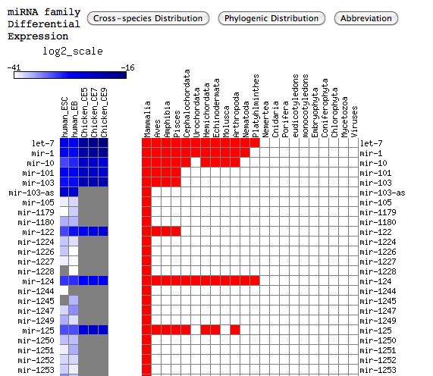

Comparative miRNAomics by miRNA family
normalized

Slide 34



Pairwise Comparsion
P<0.01
0.01<P<0.05

