Slide 1
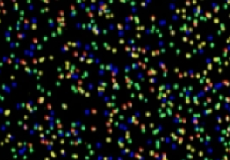
RNA Sequencing I:
De novo RNAseq
P. Tang (鄧致剛); RRC. Gan (甘瑞麒)
Bioinformatics Center, Chang Gung University.

Slide 2
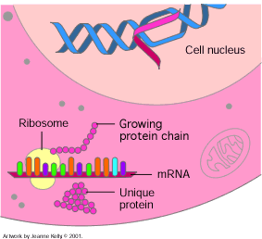
Why Measure Gene Expression?
Unique set of genes
are expressed
at different growth conditions
and
at different stages.

Slide 3
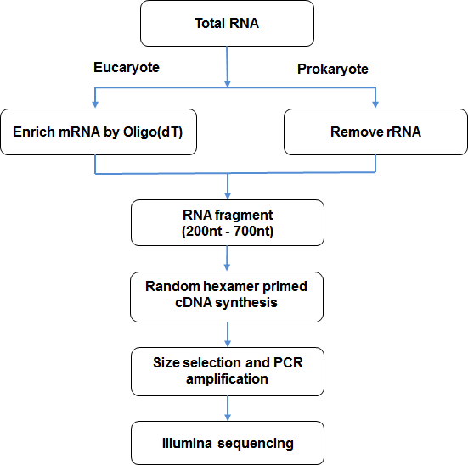
Experimental Workflow
cDNA/RNA fragment
De novo Transcriptome Analysis
Transcriptome Analysis with Regerence

Slide 4
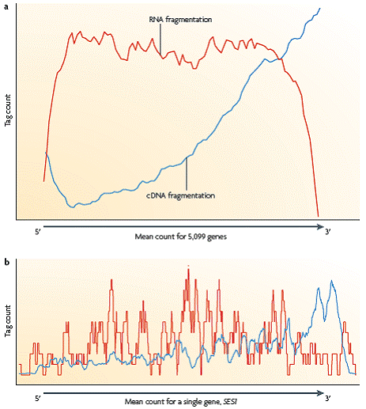
Library Preparation vs Sequencing randomness
Fragmentation of mRNA/cDNA was performed through the physical or chemical methods during the experiment of transcriptome analysis. If the randomness of fragmentation is poor, reads would more frequently generated from specific regions of the original transcripts and the following analysis will be affected.

Slide 5
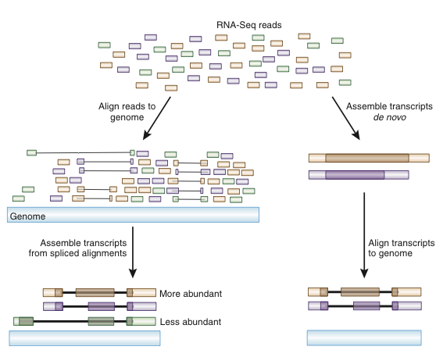
De novo Transcriptome Sequencing
Assembly is the only option when working with a creature with no genome sequence,
alignment of contigs may be to ESTs, cDNAs etc
RNAseq reads
Filer clean reads
Remove reads which containing adaptors
Remove reads in which unknown bases are more than 5%
Remove low quality reads (more than half of the bases' qualities are less than 5)
De novo assembly
Contigs
Functional Annotation
- BLASTx NCBI nr
- BLASTx Uuiprot
- Protein domain/motif search
- Gene Ontology
- KEGG
- Specific databases

Slide 6
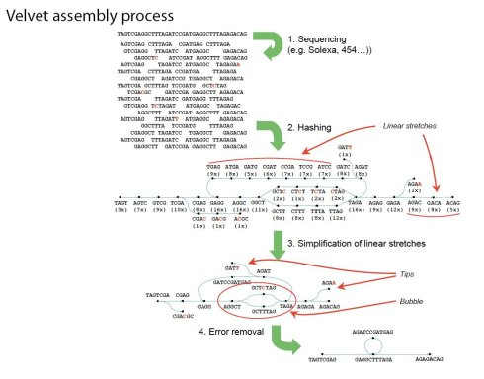
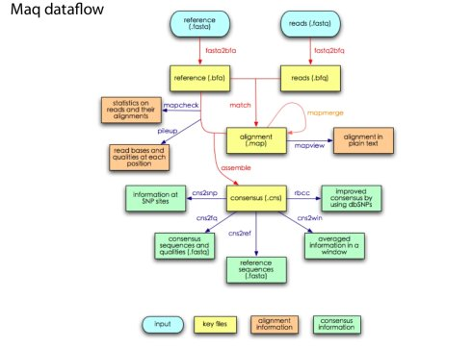
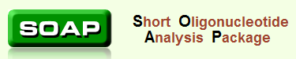
De novo Assembler
Velvet
Maq
SOAP de novo
http://www.ebi.ac.uk/~zerbino/velvet/
http://maq.sourceforge.net/
http://soap.genomics.org.cn/

Slide 7
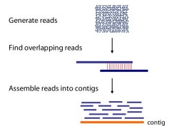
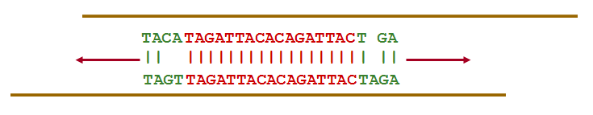
Parameters for Assemble
Important Parameters:
Percentage of Overlap
- 100%, 80%, 50%, 20%?
2. Percentage of allowed mismatches
- 10% or 20%?

Slide 8
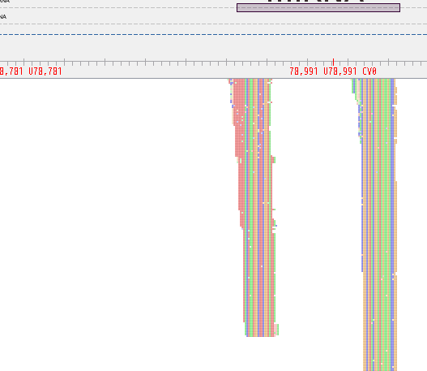
Assembled/Aligned Reads
Contig/Gene
Total reads in a contig/gene (mapped reads)
Forward reads
Reverse reads
Non-specific reads
Non-perfect reads
Unique reads (Total reads – non specific reads)

Slide 9

Gene Expression Annotation
Gene coverage
Gene coverage is the percentage of a gene been covered by reads.
This value equals to ratio of the number of bases in a gene covered by unique mapping reads to number of total bases in that gene
Gene expression levels
The calculation of Unigene expression uses RPKM method (Reads Per kb per Million reads)
The RPKM method is able to eliminate the influence of different gene length and sequencing discrepancy on the calculation of gene expression. Therefore, the calculated gene expression can be directly used for comparing the difference of gene expression among samples
C = number of reads that uniquely aligned to gene A,
N = total number of reads that uniquely aligned to all genes,
L = number of bases on gene A.

Slide 10
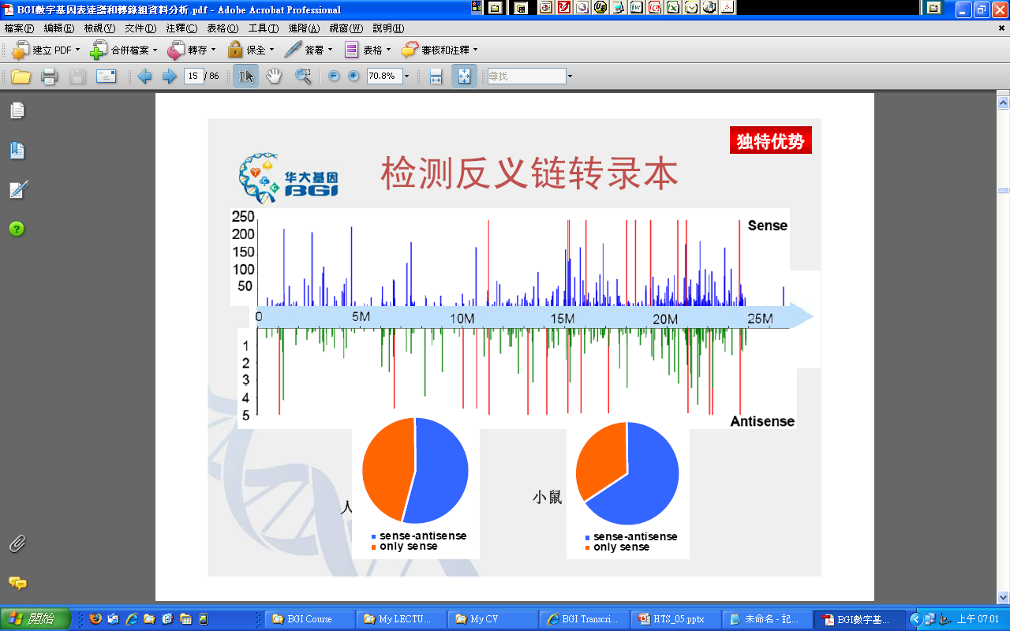
Sense vs Anti-sense Transcripts
Human
Mouse

Slide 11
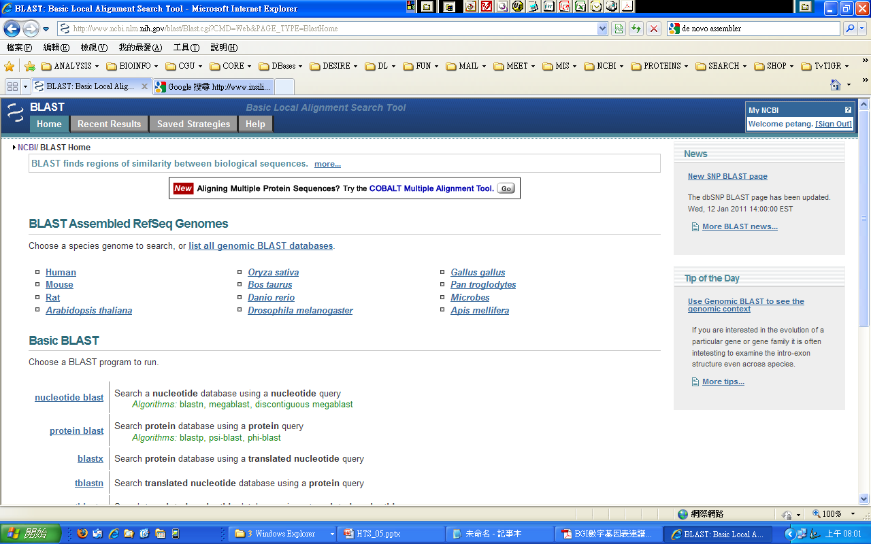
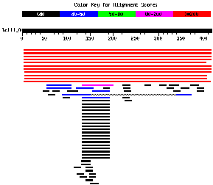
BLAST
E-vale
Score
% Identity
% Length

Slide 12

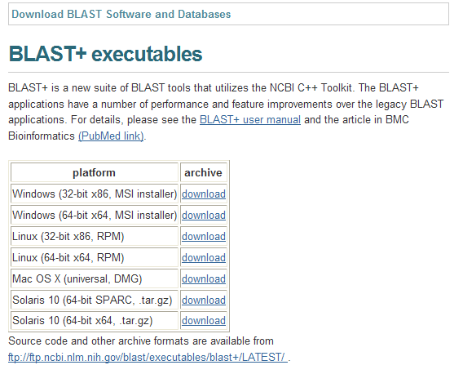
Stand-alone BLAST
http://blast.ncbi.nlm.nih.gov/Blast.cgi?CMD=Web&PAGE_TYPE=BlastDocs&DOC_TYPE=Download

Slide 13
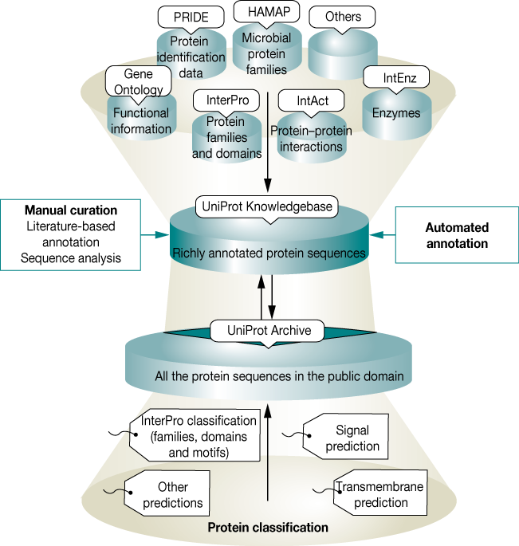
UniProt
UniRef 50
UniRef 90
UniRef 100
UniProtKB

Slide 14
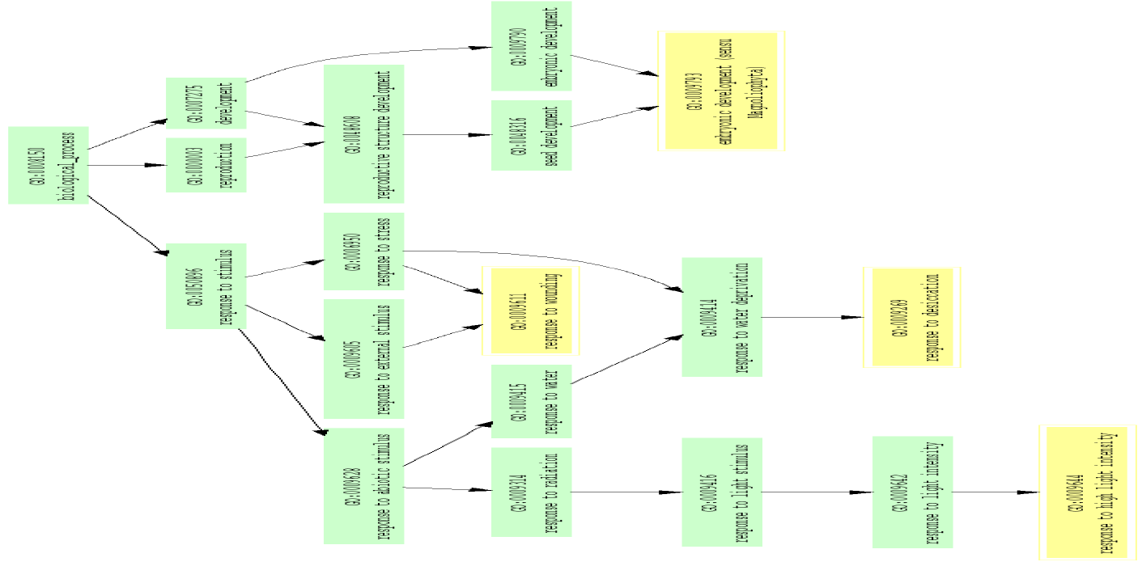
Gene Ontology

Slide 15
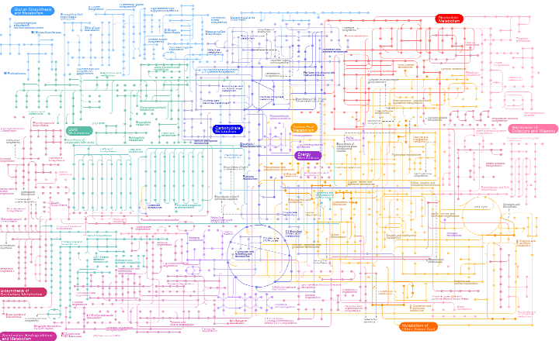
KEGG

Slide 16
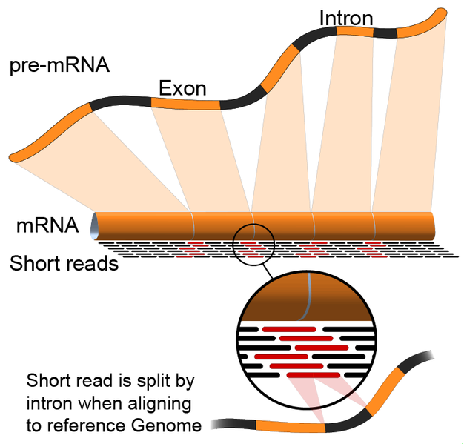
Transcriptome Sequencing with Reference
To be continue

