Slide 1
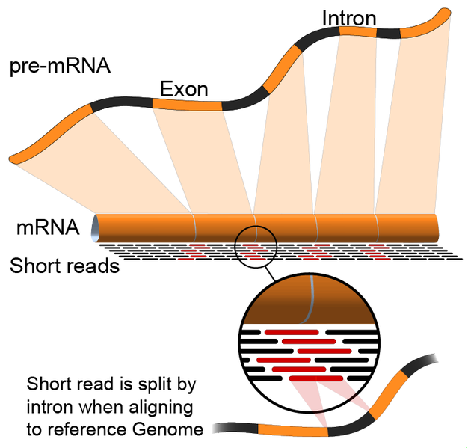
Transcriptome Sequencing with Reference
To be continue

Slide 2
Transcriptome Sequencing with Reference

Slide 3
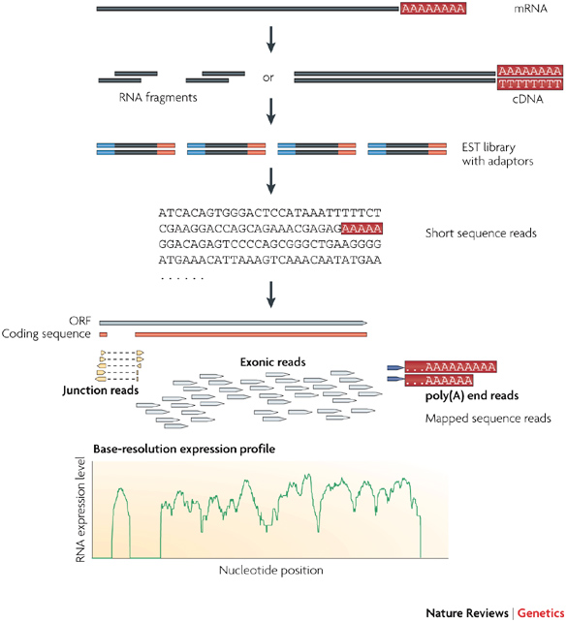
Overview of RNA-Seq

Slide 4
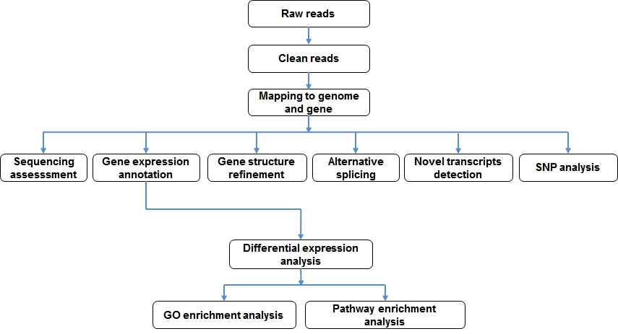
Bioinformatics Analysis Pipeline for
Transcritpome Sequencing with Reference

Slide 5
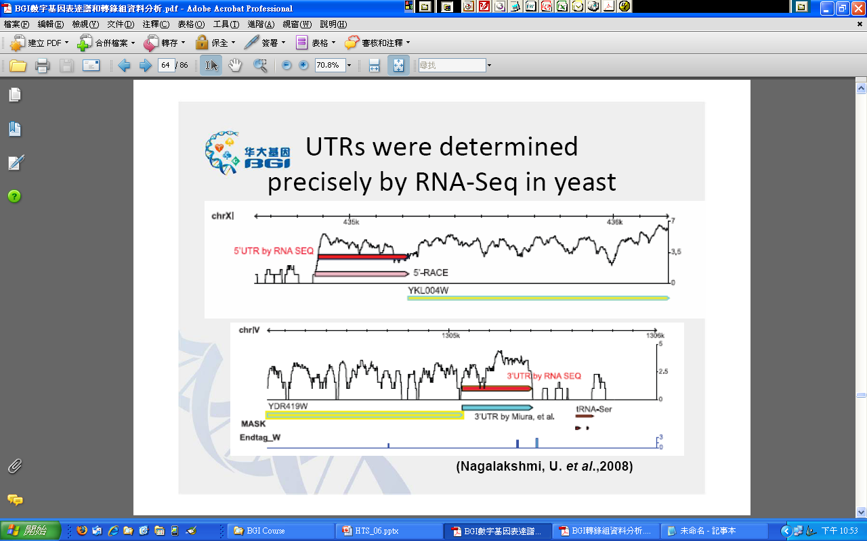
Gene structure refinement
UTRs by RNA‐Seq in yeast
(Nagalakshmi, U. et al.,2008)

Slide 6
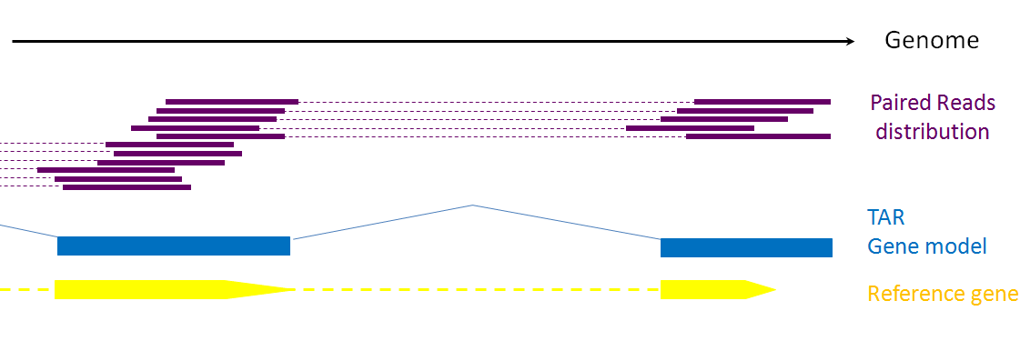
Gene structure refinement
The gene structure was optimized according to the distribution of the reads, information of paired-end and the annotation of reference gene. We can get the distribution of reads in the genome by aligning the continuous and overlap reads form a Transcription Active Region (TAR). According to paired-end data, we can connect the different TARs to form a potential gene model. We can compare the gene model with the existing gene annotated to extend the gene 5'and 3' end

Slide 7
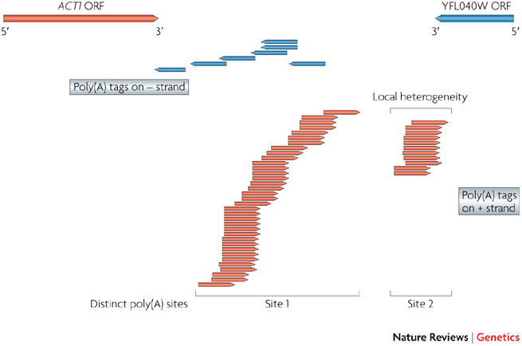
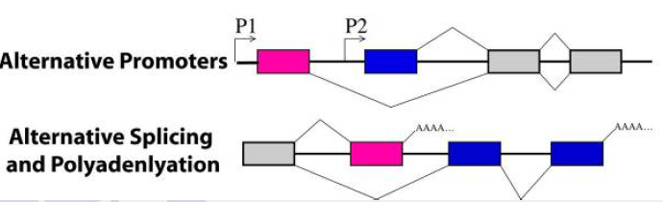
Poly(A) tags from RNA-Seq
A region containing two overlapping transcripts (ACT1, from the actin gene, and YFL040W, an uncharacterized ORF) from the Saccharomyces cerevisiae genome is shown. Arrows point to transcription direction. The poly(A) tags from RNA-Seq experiments are shown below these transcripts, with arrows indicating transcription direction. The precise location of each locus identified by poly(A) tags reveals the heterogeneity in poly(A) sites, for example, ACT1 has two big clusters, both with a few bases of local heterogeneity. The transcription direction revealed by poly(A) tags also helps to resolve 3'-end overlapping transcribed regions
Nature Reviews Genetics 10, 57-63

Slide 8
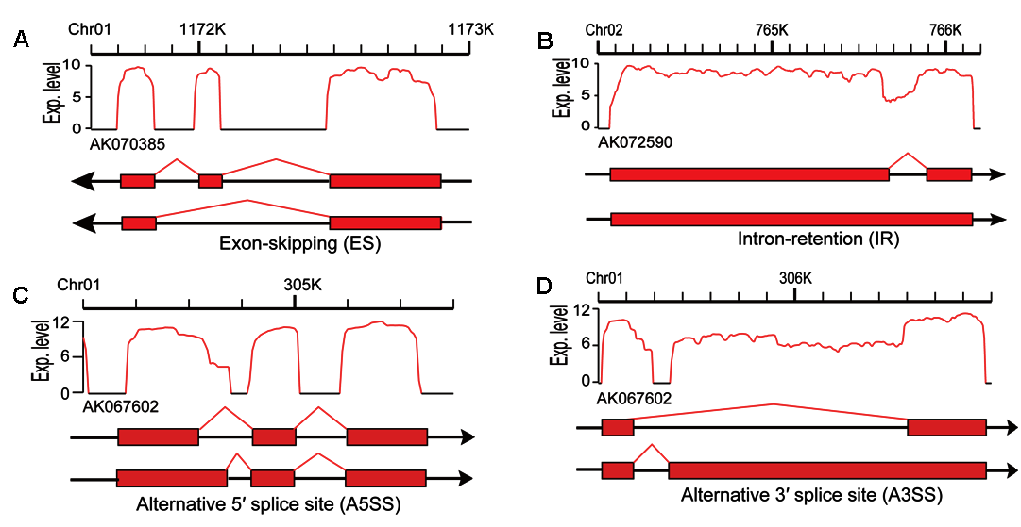
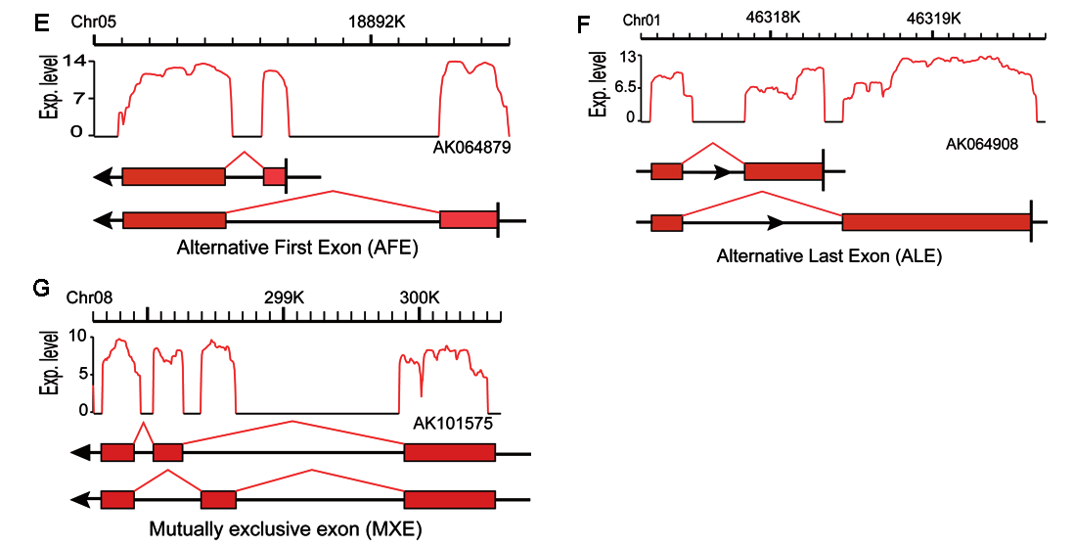
Alternative Splicing (AS)

Slide 9
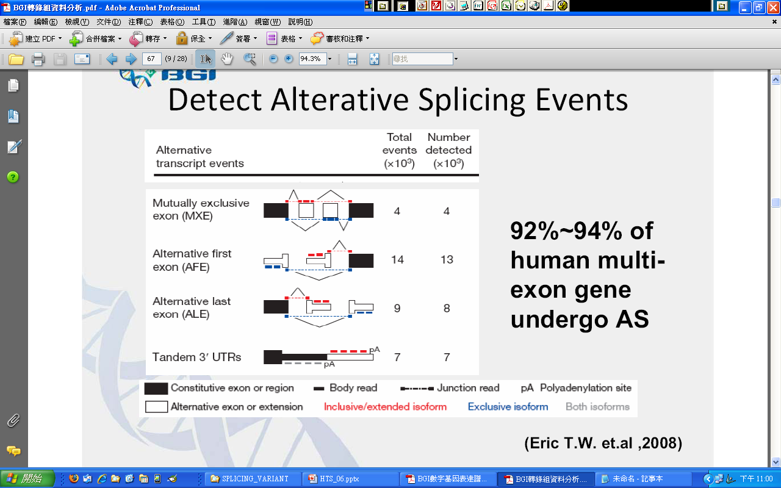
92%~94% of human multi-exon gene undergo Alternative Splicing (AS)

Slide 10
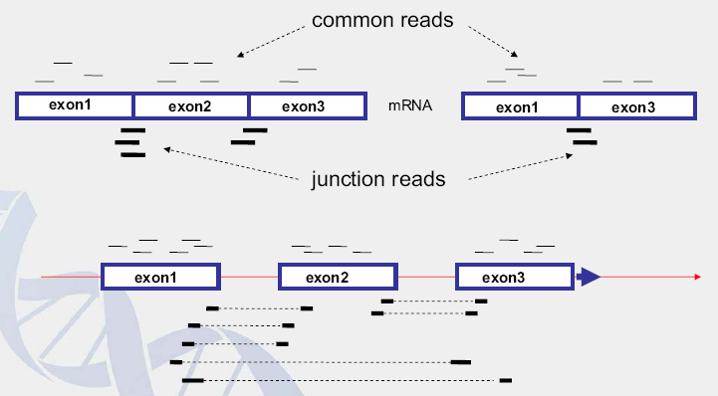
Exon junction reads

Slide 11
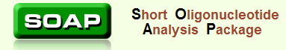
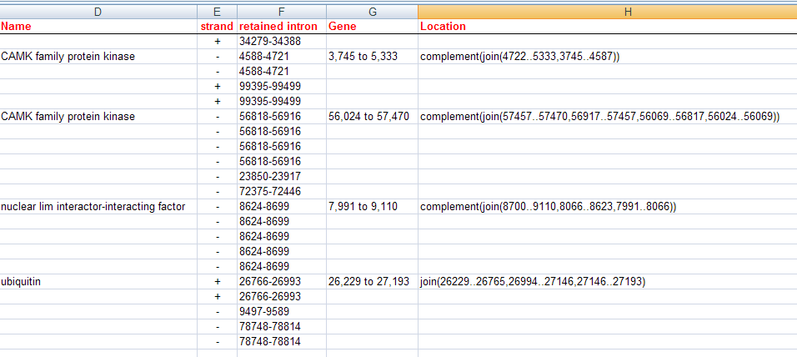
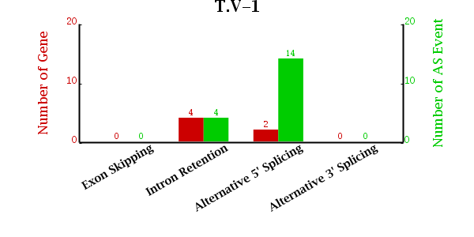
Output of SOAPals

Slide 12
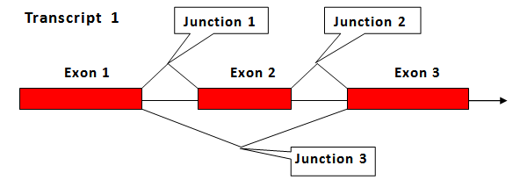
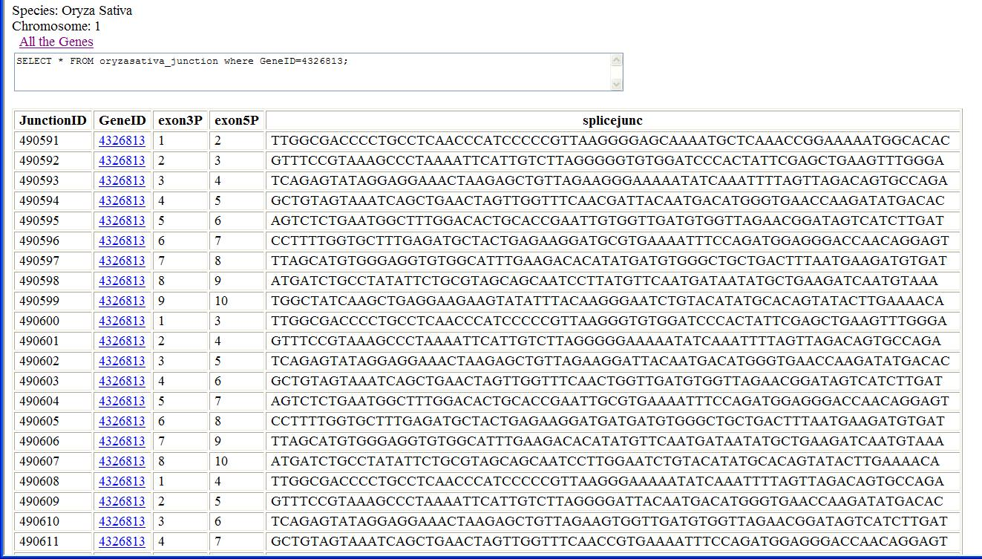
Splice Junction Database

Slide 13
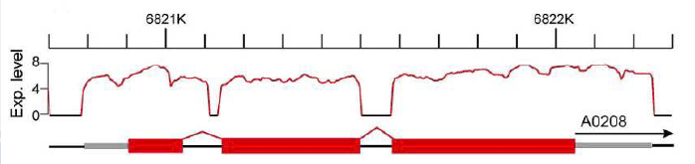
Novel Transcripts
Novel transcripts can be found by high throughput sequencing since present databases may be incomplete. Gene models found in intergenic regions (200 bp away from upstream or downstream genes) were thought to be candidate of novel transcripts

Slide 14
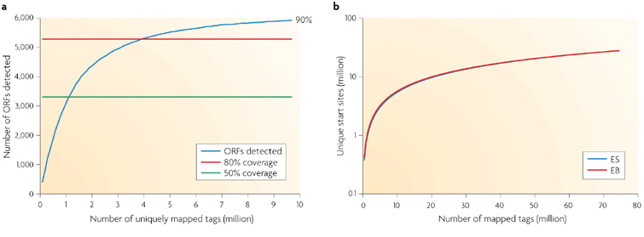
How deep should we go?
80% of yeast genes (genome size: ~12MB) were detected at 4 million uniquely mapped RNA-Seq reads, and coverage reaches a plateau afterwards despite the increasing sequencing depth. Expressed genes are defined as having at least four independent reads from a 50-bp window at the 3' end.
The number of unique start sites detected starts to reach a plateau when the depth of sequencing reaches 80 million in two mouse transcriptomes. ES, embryonic stem cells; EB, embryonic body.
Nature Reviews Genetics 10, 57-63

Slide 15
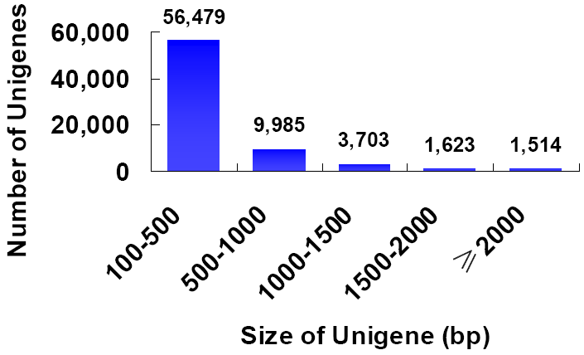
How deep should we go?
De novo assembled rice transcriptome
1.3 Gb RNA‐Seq data (genome size: ~400MB)
85% of assembled unigenes were covered by genemodels

Slide 16
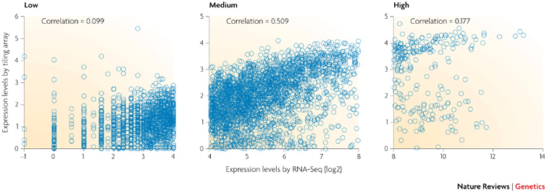
RNA-Seq and microarray compared
Expression levels are shown, as measured by RNA-Seq and tiling arrays, for Saccharomyces cerevisiae cells grown in nutrient-rich media. The two methods agree fairly well for genes with medium levels of expression (middle), but correlation is very low for genes with either low or high expression levels.
Nature Reviews Genetics 10, 57-63

Slide 17
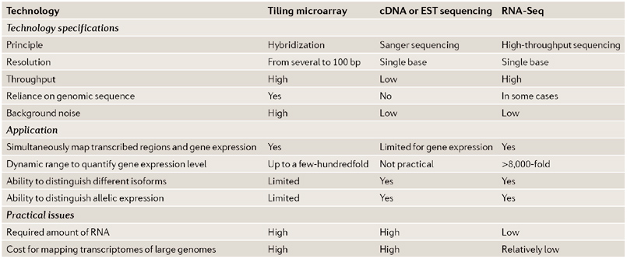
Nature Reviews Genetics 10, 57-63

Slide 18
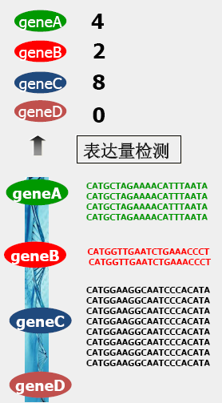
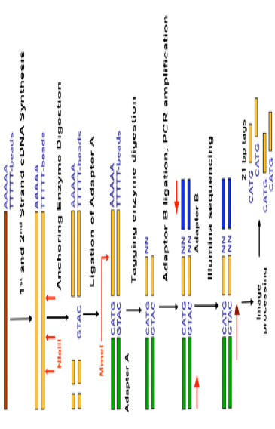
Digital Gene Expression Profiling
DGE

Slide 19
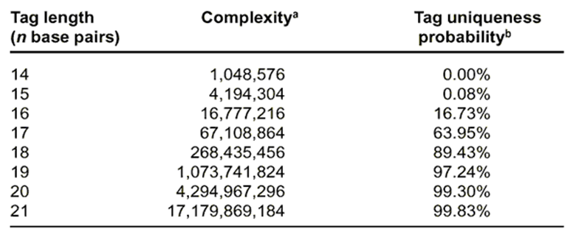
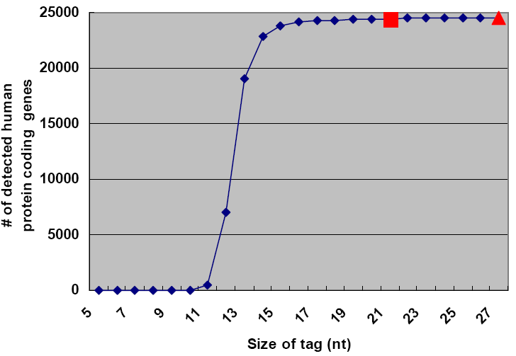
Tag length vs Complexity

Slide 20
Exercise AGAIN……………….

