Slide 1
RNA seq analysis with reference genome

Slide 2
Dataset
Reference genome
  mouse chromosome 16 subset, 13Mbp
  (complete chr16, 98Mbp)
Reads
  Brain
  Liver
Mortazavi, A., Williams, B. A., McCue, K., Schaeffer, L., and Wold, B. (2008).
Mapping and quantifying mammalian transcriptomes by rna-seq.
Nat Methods, 5(7):621-628.

Slide 3
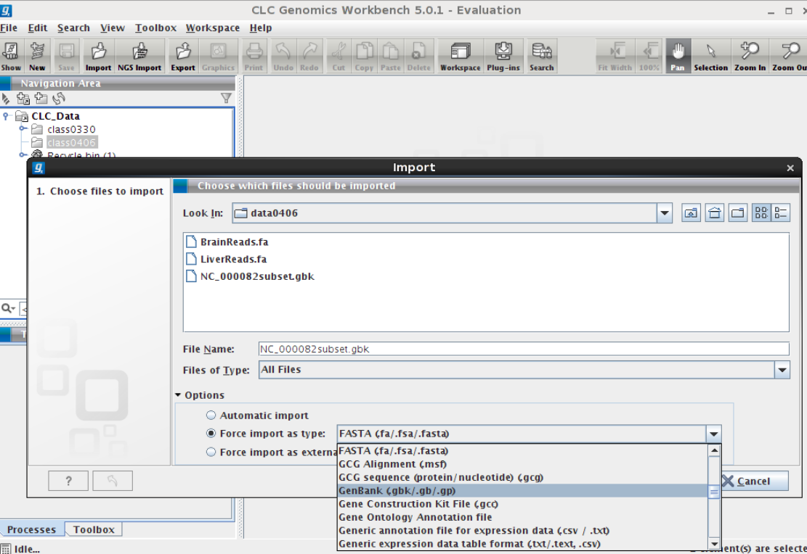
Import Genome information
NC000082subset.gbk

Slide 4
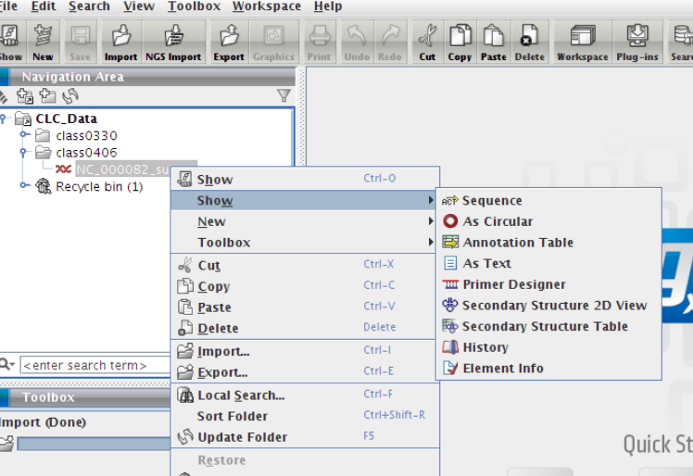

Slide 5
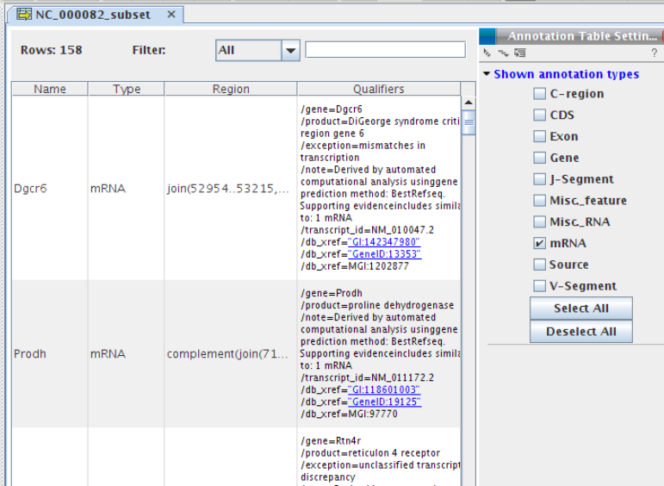

Slide 6
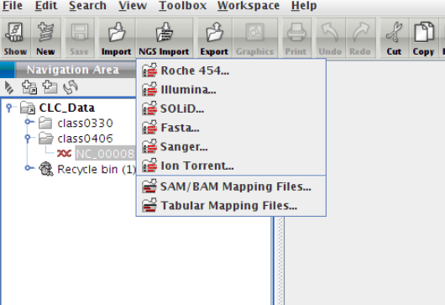

Slide 7
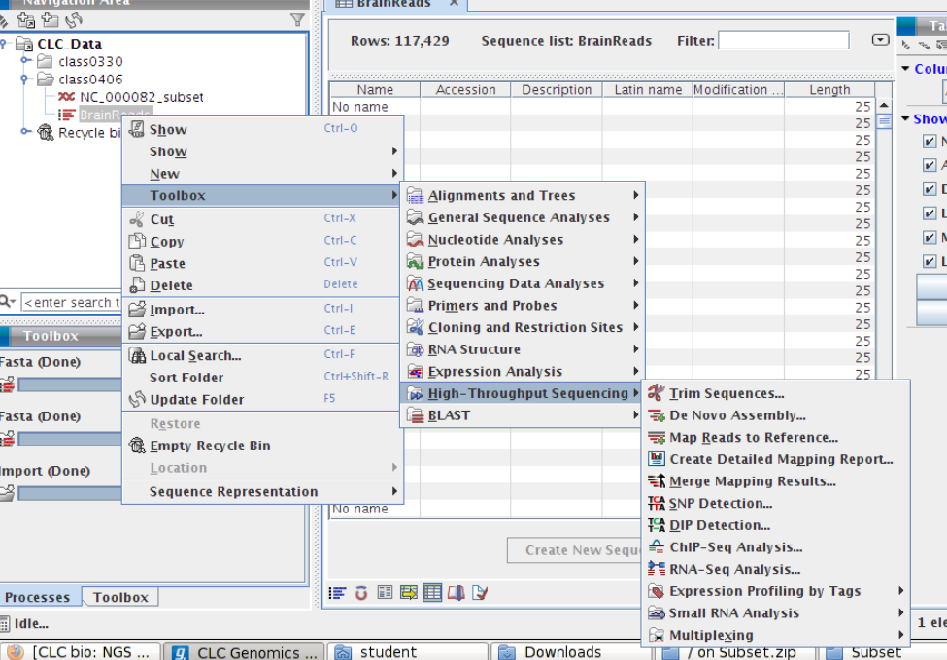
Start RNA seq analysis

Slide 8
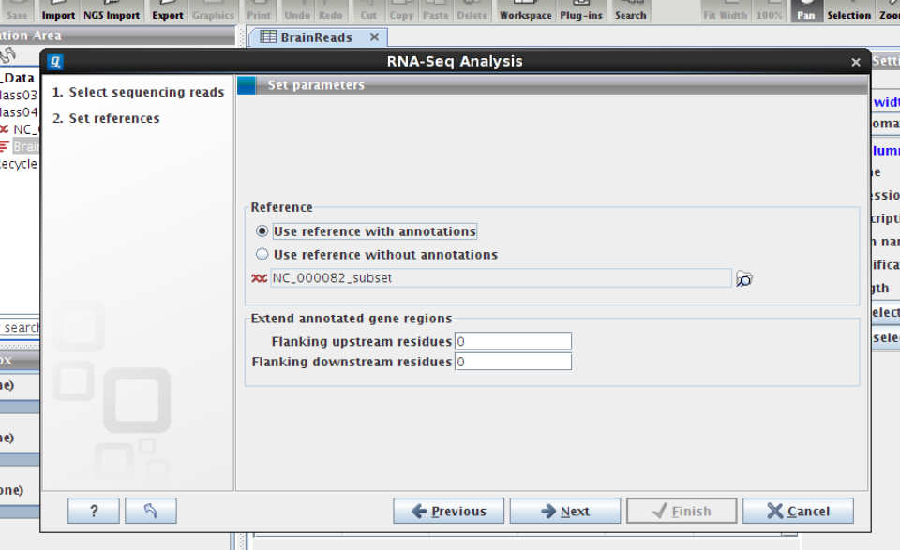
Select Reference with annotation

Slide 9
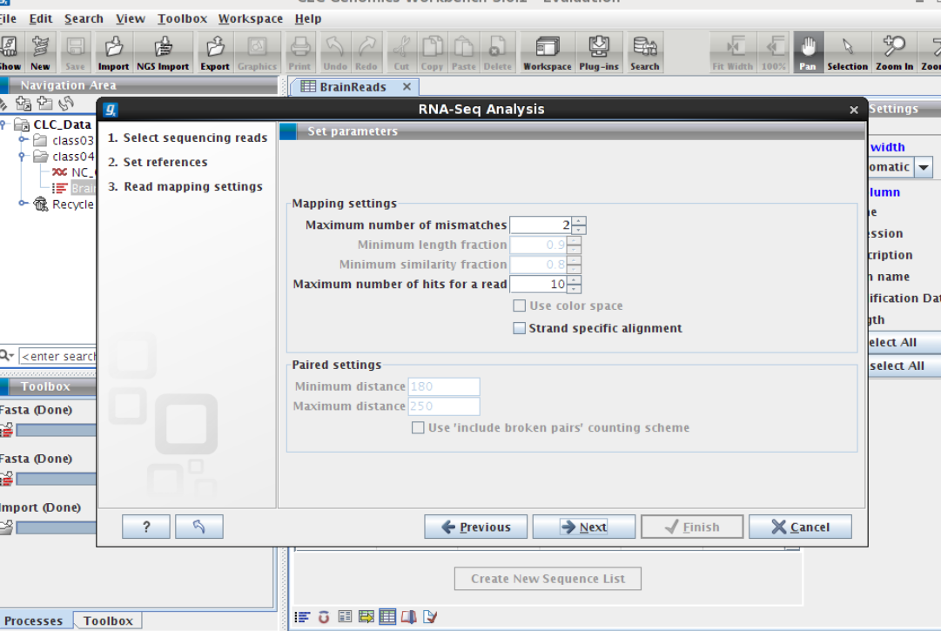
Setting mapping argument

Slide 10
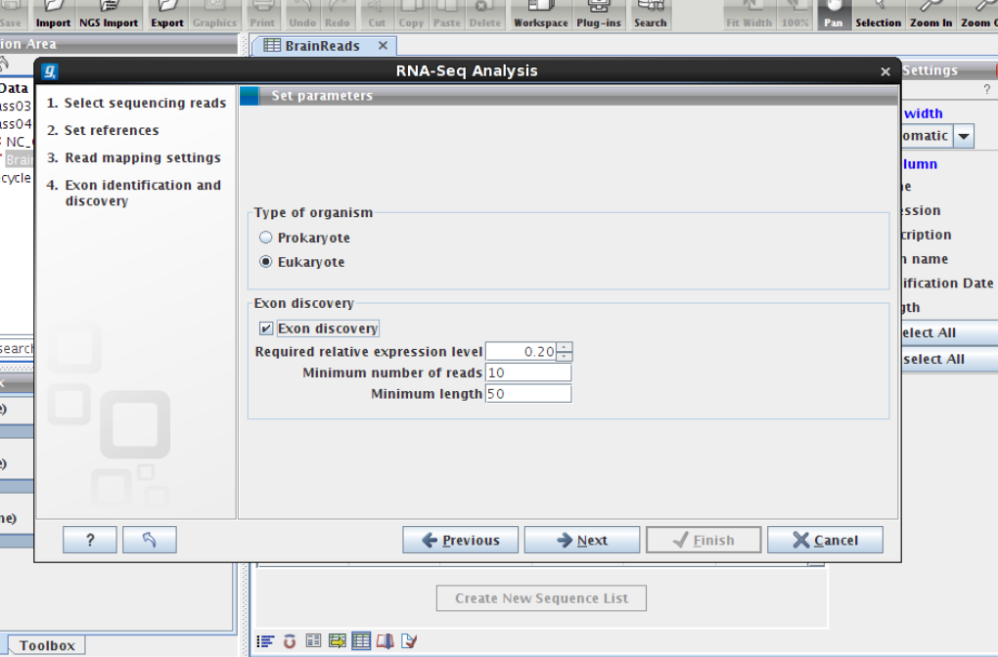
setting Exon argument

Slide 11
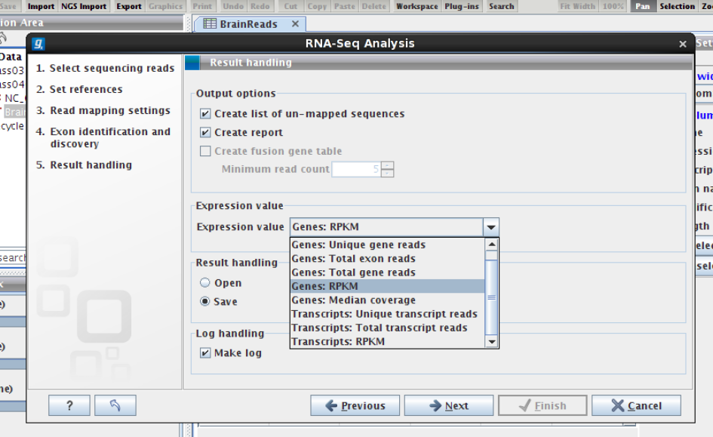

Slide 12

RPKM
Read per kilobase of exon model per million mapped reads
# total mapped reads
Mapped contig/exon length
Mortazavi, A. et.al. (2008). Mapping and quantifying mammalian transcriptomes by rna-seq. Nat Methods,
5(7):621--628.

Slide 13
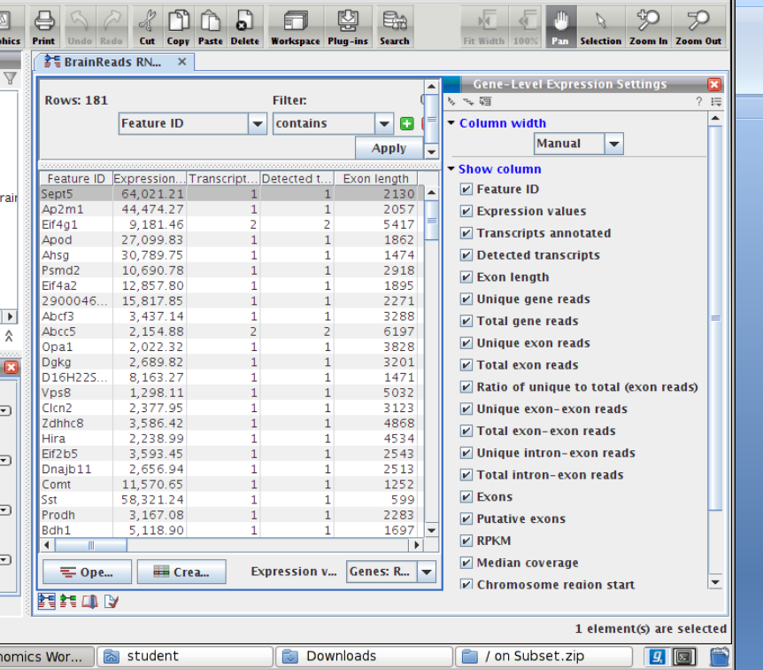

Slide 14
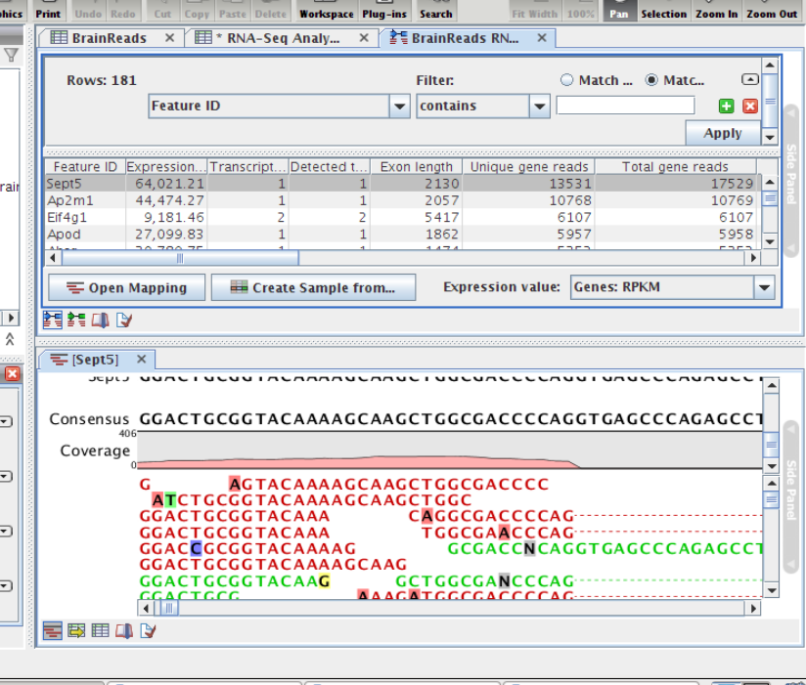

Slide 15
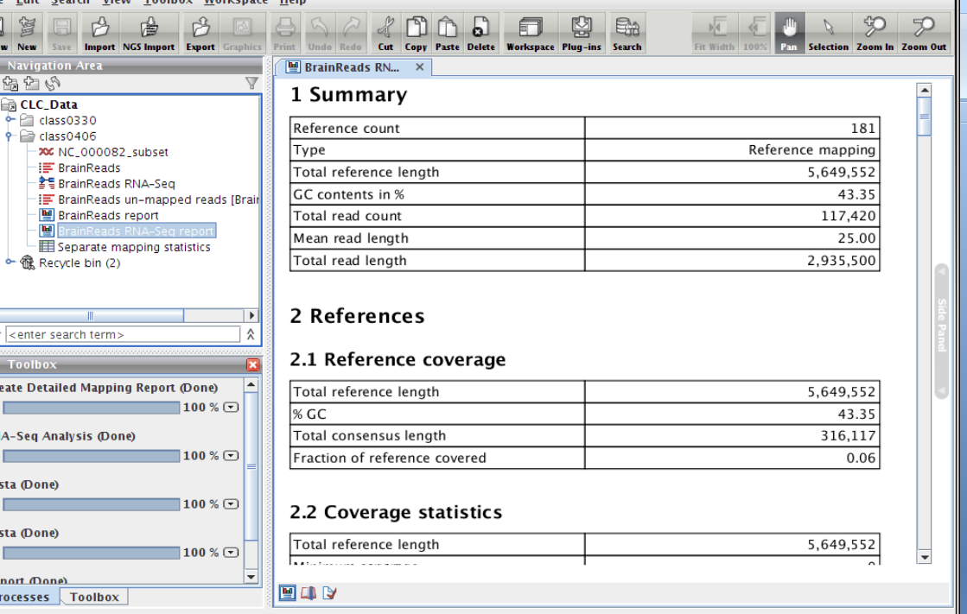

Slide 16
Exercise:
Import Liver Reads
do above steps

Slide 17
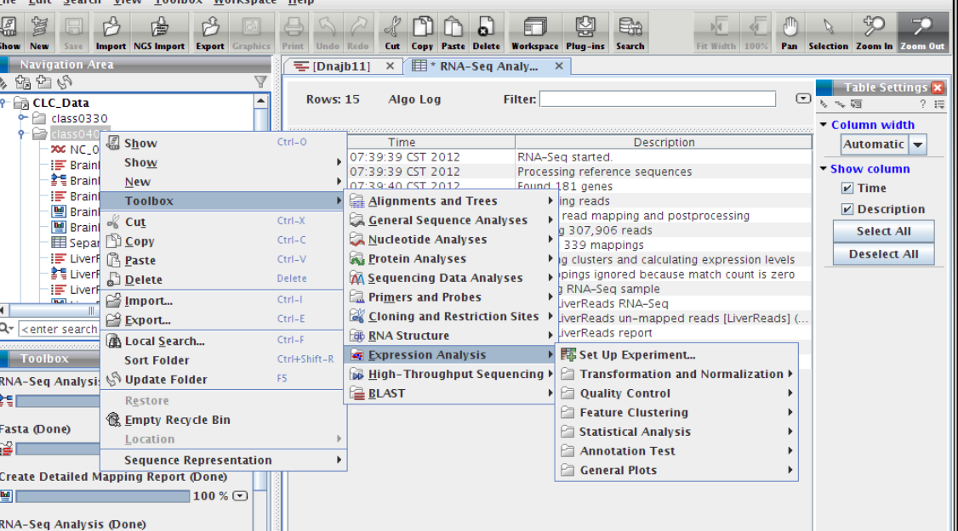
Expression analysis

Slide 18
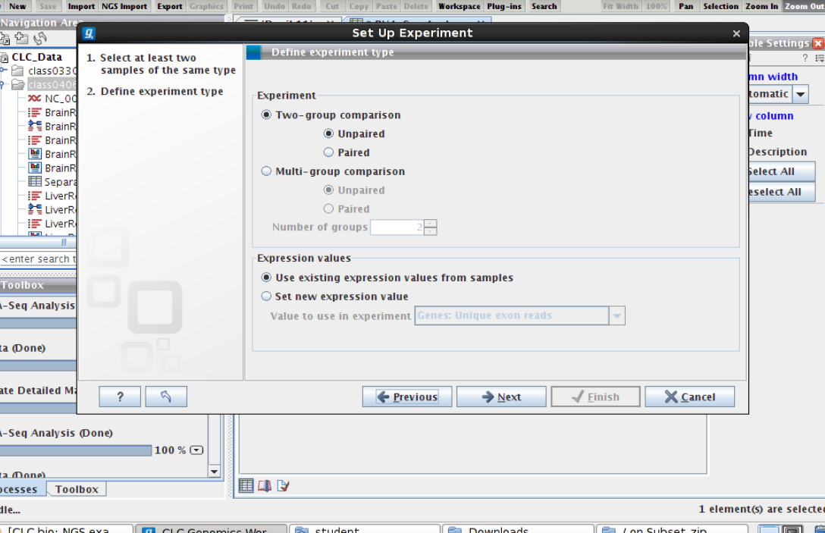

Slide 19
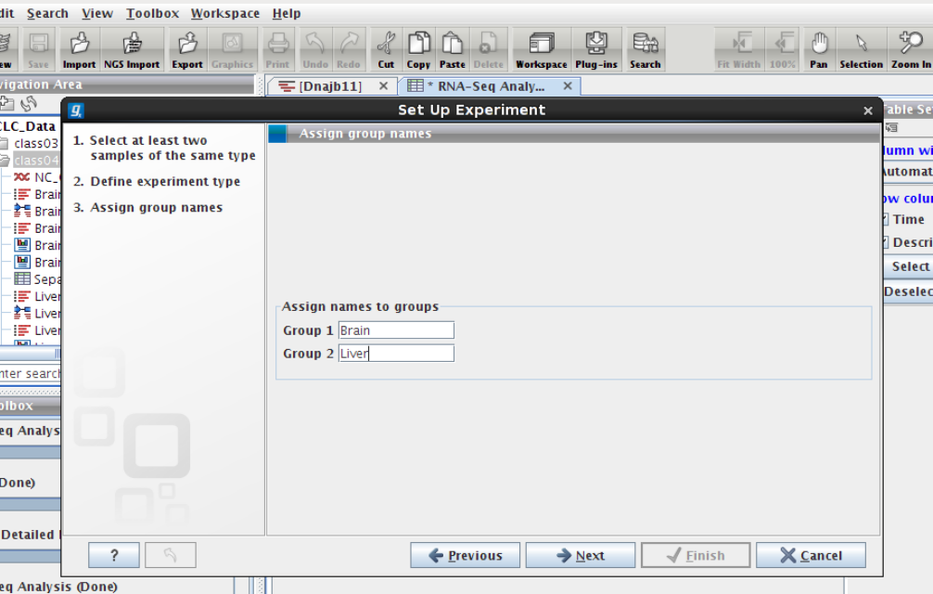

Slide 20
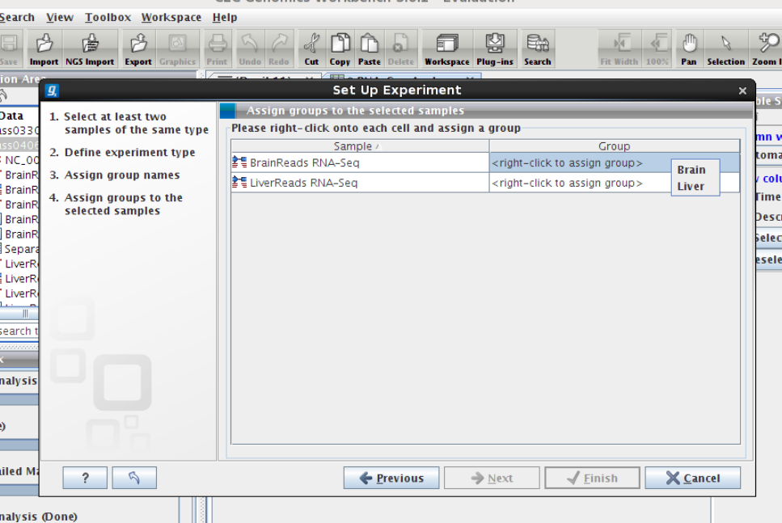

Slide 21
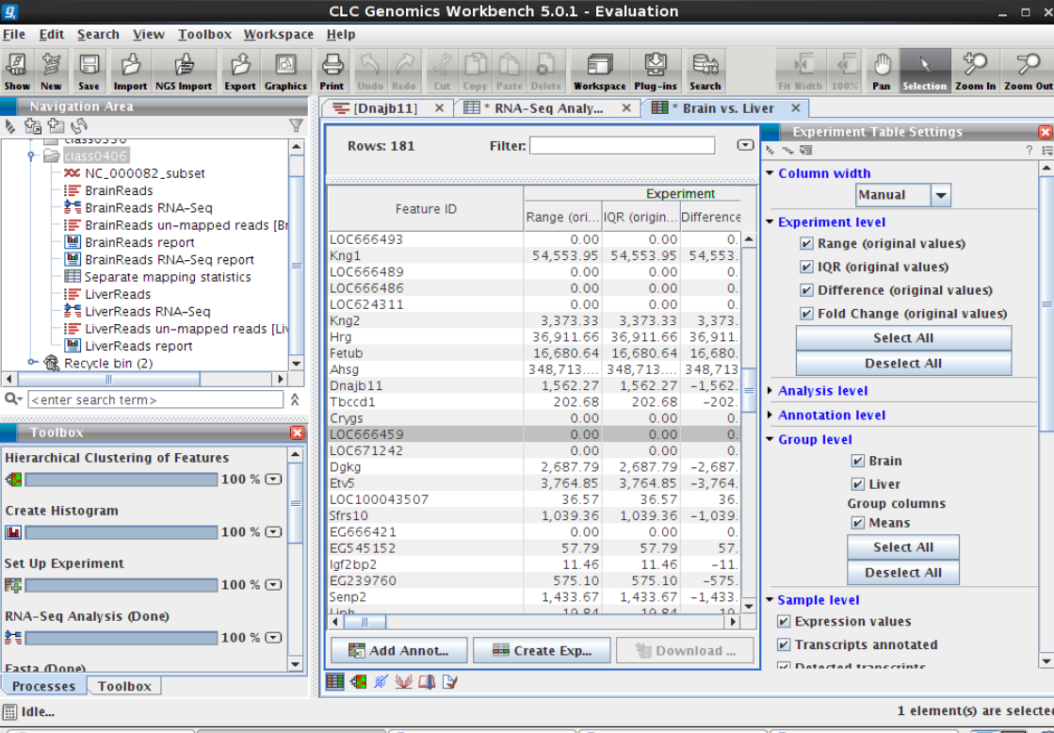
Experiment Table for Comparision

Slide 22
Comparative analysis for
denovo transcriptome analysis?

