Slide 1
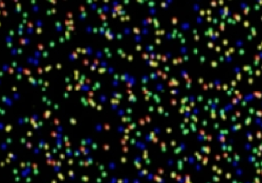
Genome Sequencing
Genome Resequencing
De novo Genome Assembly
Bacteria Genome Analysis
Genome Annotation and Genome Browser
P. Tang (鄧致剛); RRC. Gan (甘瑞麒); PJ Huang (黄栢榕)
Bioinformatics Center, Chang Gung University.

Slide 2
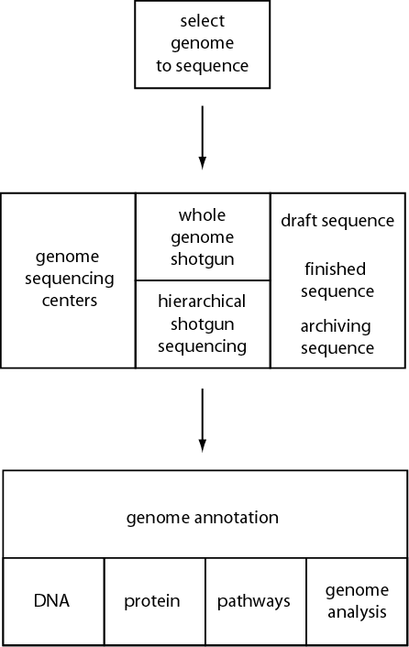
Overview of Genome Analysis

Slide 3
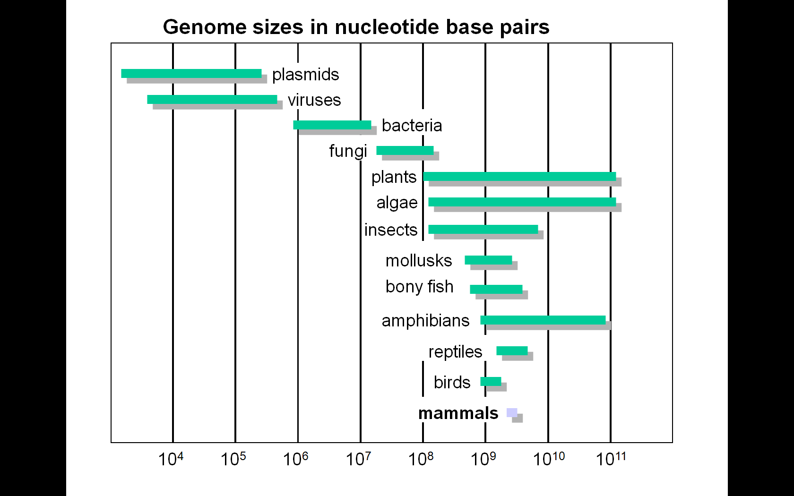
Criteria for selecting genomes for sequencing
Criteria include:
genome size (some plants are >>>human genome)
cost
relevance to human disease (or other disease)
relevance to basic biological questions
relevance to agriculture

Slide 4
Criteria for selecting genomes for sequencing
Sequence one individual genome, or several?
Try one…
--Each genome center may study one
chromosome from an organism
--It is necessary to measure polymorphisms
(e.g. SNPs) in large populations
For viruses, thousands of isolates may be sequenced.
For the human genome, cost is the impediment.

Slide 5
Ancient DNA projects
Special challenges:
Ancient DNA is degraded by nucleases
The majority of DNA in samples derives from unrelated organisms such as bacteria that invaded after death
The majority of DNA in samples is contaminated by human DNA
Determination of authenticity requires special controls, and analysis of multiple independent extracts
Metagenomics projects
Two broad areas:
Environmental (ecological)
  e.g. hot spring, ocean, sludge, soil
Organismal
  e.g. human gut, feces, lung

Slide 6
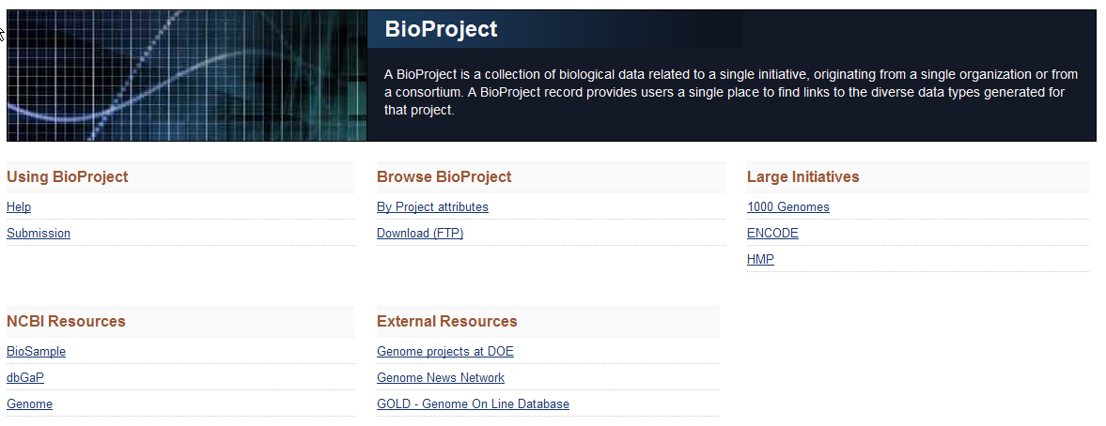
http://www.ncbi.nlm.nih.gov/sites/entrez?db=bioproject

Slide 7
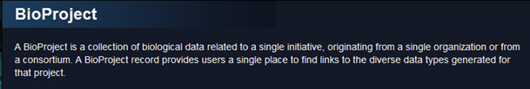
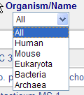
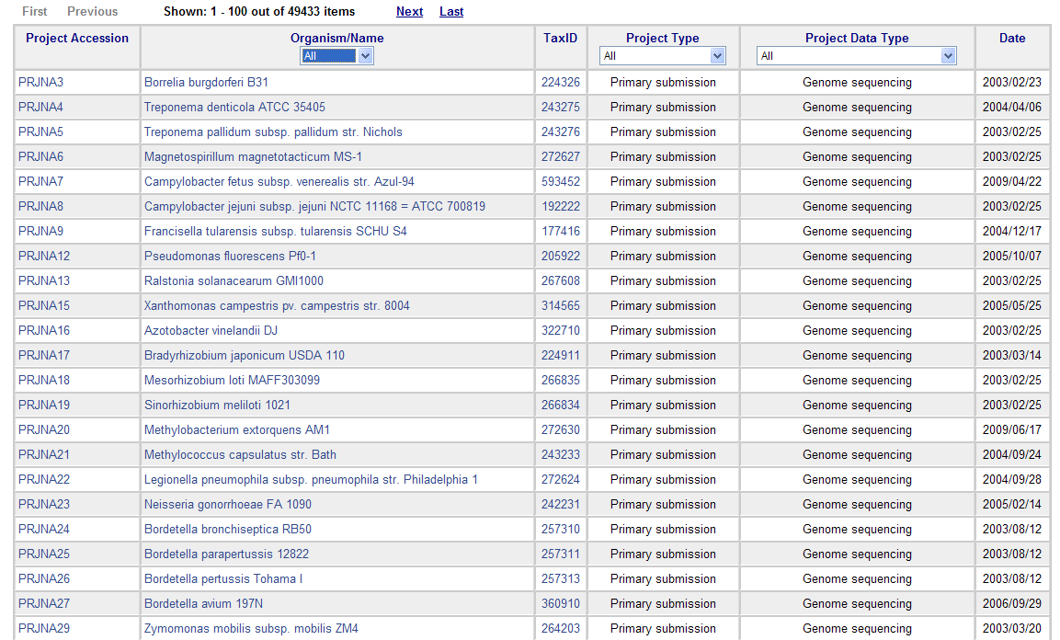
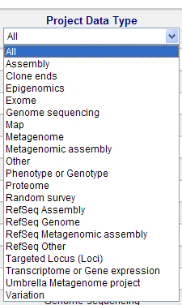

Slide 8
Whole Genome Sequencing (WGS)
Multiple copies of DNA
Fragments of 200 - 200,000 bases
No information is retained on which part of the DNA the fragments came from.

Slide 9
WGS sequencing: fragments
We start with millions of pairs of reads, 100 - 1000 bases each
Multiple copies of DNA provide multiple coverage by reads
The problem of genome assembly is to recover the original sequence of bases of the genome (as much as possible…).

Slide 10
Assembling a jigsaw puzzle 1
The task of the assembly becomes the task of assembling a giant jigsaw puzzle
We look for reads whose sequences suggest that they came from the same place in the genome:
AGTGATTAGATGATAGTAGA
|||||||||
GATGATAGTAGAGGATAGATTTA

Slide 11
Assembling a jigsaw puzzle 2
Then we put “overlapping” reads together
AGTGATTAGATGATAGTAGA
AGATGATAGTAGAGATAGATAGACC
ATAGATAGACCACTCATCATAC
AGTGATTAGATGATAGTAGAGATAGATAGACCACTCATCATAC
reads
This yields a “contig”

Slide 12
Assembling a jigsaw puzzle 3
We use read pairing information to order and orient contigs to produce scaffolds – the final product of assembly
Pairs of reads belonging to the same fragment of DNA
contig
contig

Slide 13
Difficulties in NGS assembly
  Sequencing errors: two reads that came from the same place in the genome often have mismatching sequences
  AGTGATTAGATCATAGTAGAG
  || |||||||||
  ATGATAGTAGAGGATAGAT
  Repetitive DNA (~ 5-20% of human DNA is repetitive):
  TTAGGGTTAGGGTTAGGGTTAGGGTTAGGG

Slide 14
Repeat regions may cause omissions
A
R
B
R
C
A
R
C
Long insert library :10kb
Mate-paired librared
Long read : 3-4 Kb from 3rd Generation sequencer.

Slide 15
Erroneous duplications
Two recent published assemblies of the cow genome: UMD2 and BosTau4
Segmental duplications were a central theme in BosTau4 genome paper
UMD2 assembly had many fewer duplications
We examined the duplications, > 99.5% identity, >5000bp, one copy in the UMD2 assembly and two copies in the BosTau4
UMD2
BosTau4
Each base in the genome is covered by 6 reads, on average. A way to judge which assembly is correct is to compute the average read coverage for these regions.

Slide 16
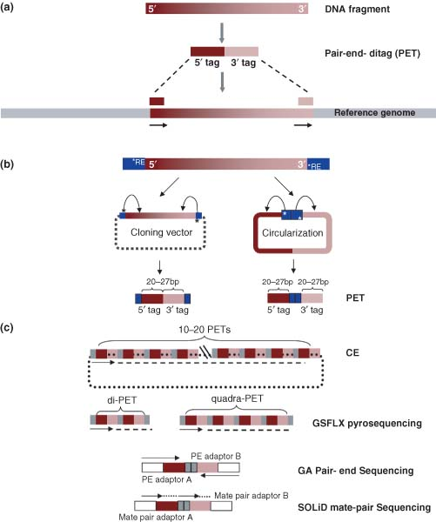
Next Gen vs. Sanger Sequencing

Slide 17
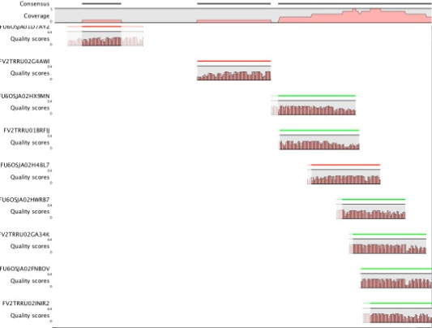
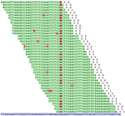
De novo Sequencing vs Re-sequencing
Assembly
Mapping
Assembly Tools
ABySS
ALLPATHS
Edena
Euler-SR
SHARCGS
SHRAP
SSAKE
Velvet
Alignment Tools
Cross_match
ELAND
Exonerate
MAQ
Mosaik
SHRiMP
SOAP
Zoom
CLC Genomics

Slide 18
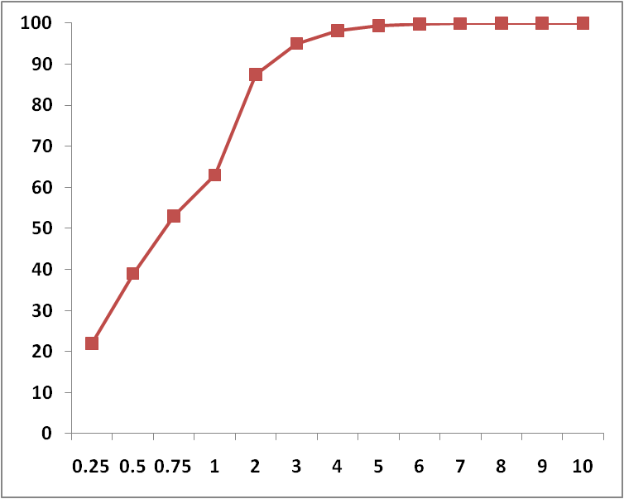
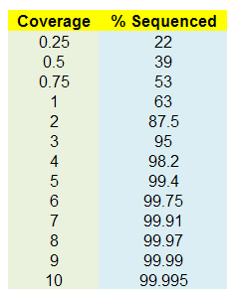
When has a genome been fully sequenced?
% Sequenced
Coverage

Slide 19
Read coverage
Sanger sequencing ~1000bp
NGS sequencing
Solexa: ~100bp
SOLiD: ~70bp
For 99.75% - 99.99% Accuracy
NEED 60X - 100X COVERAGE
% Sequenced
Coverage

Slide 20
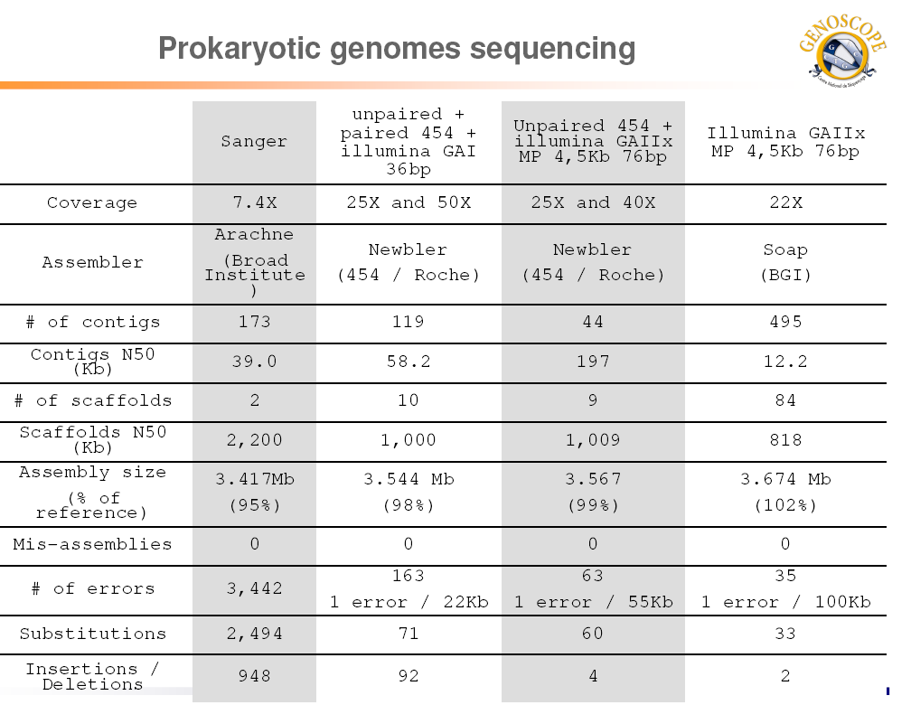

Slide 21


