Slide 1
Denovo genome assembly and analysis

Slide 2
outline
De novo genome assembly
Gene finding from assembled contigs
Gene annotation

Slide 3
Denovo genome assembly
Reads
Genome contig

Slide 4
Gene finding
To find out coding region on genome sequence
Genome
?
Genes on
Genome

Slide 5
Gene Annotation
Genome
Genes on
Genome
For each gene….
  Conserved?
  Domain?
  Function?

Slide 6
get reads file
download a random generated reads file
  http://163.25.92.61/course/randomreads30k.fasta
open CLC to assemble contigs from reads

Slide 7
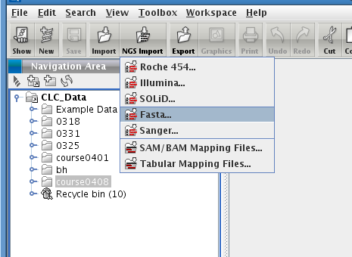
NGS import the reads file

Slide 8
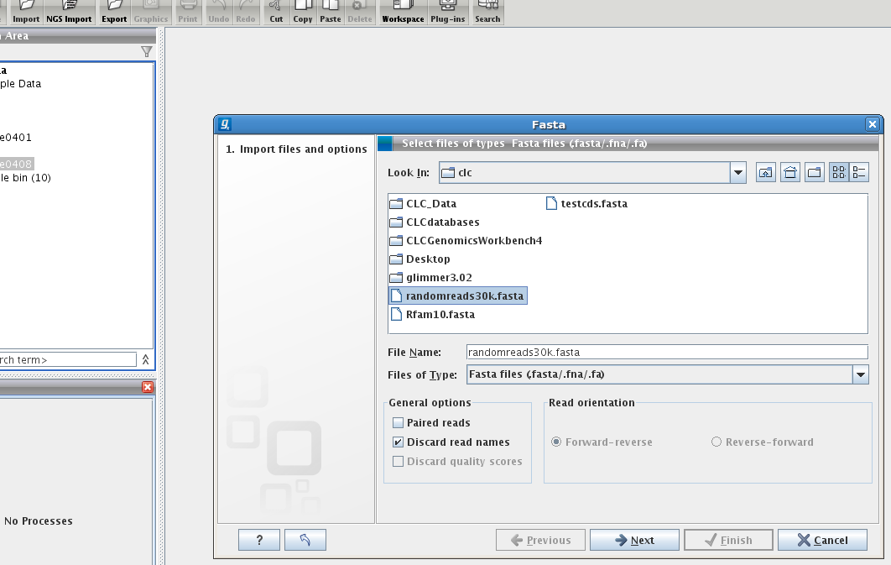

Slide 9
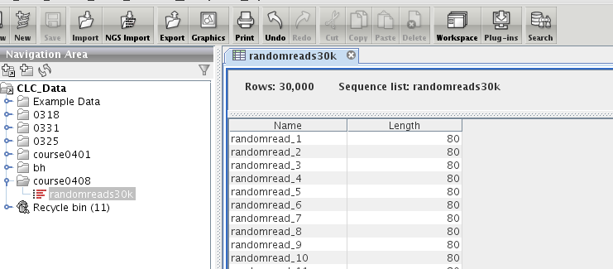

Slide 10
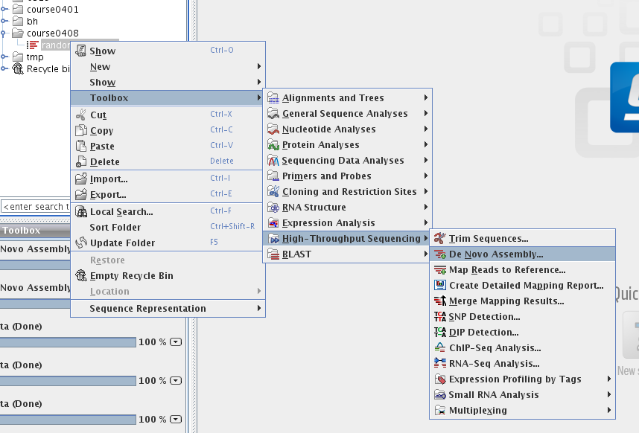
Denovo assembly

Slide 11
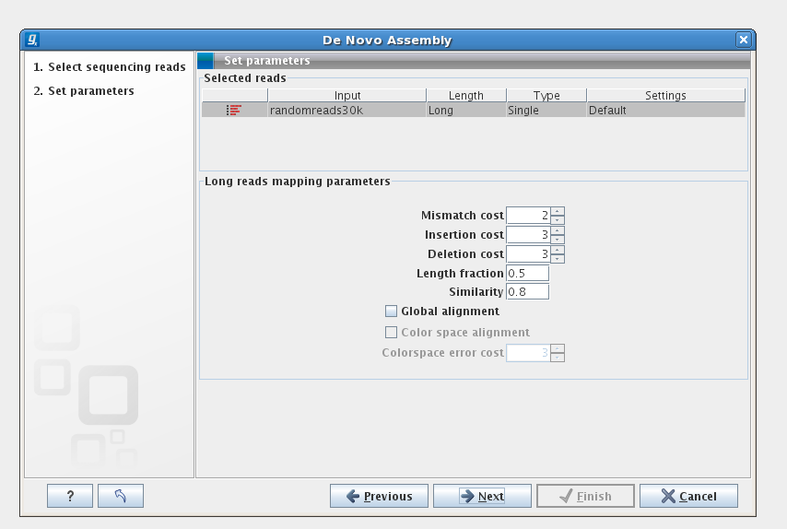

Slide 12
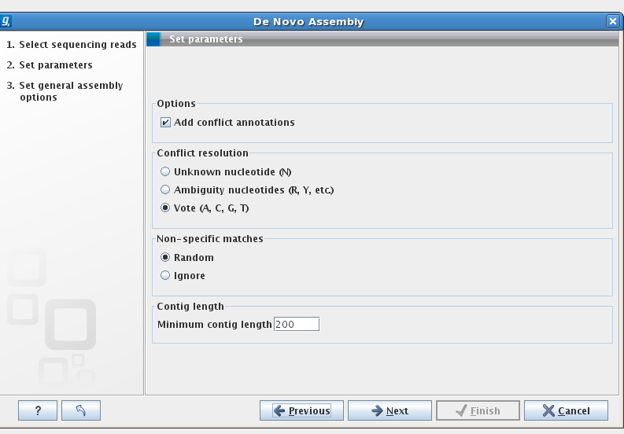
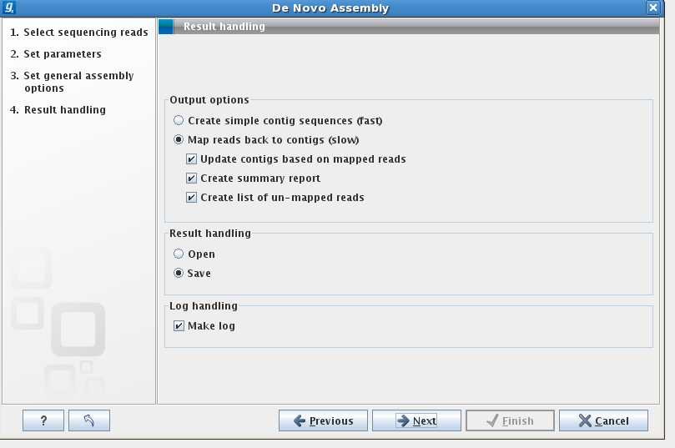

Slide 13
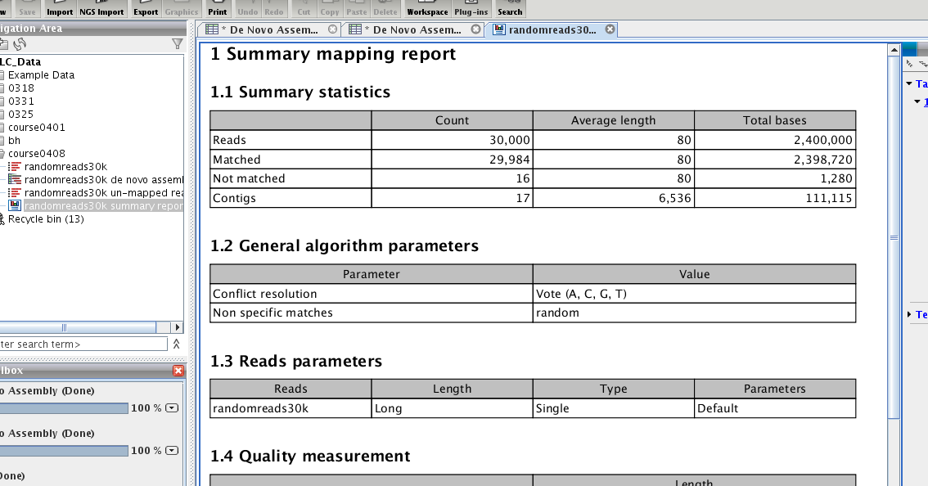
report

Slide 14
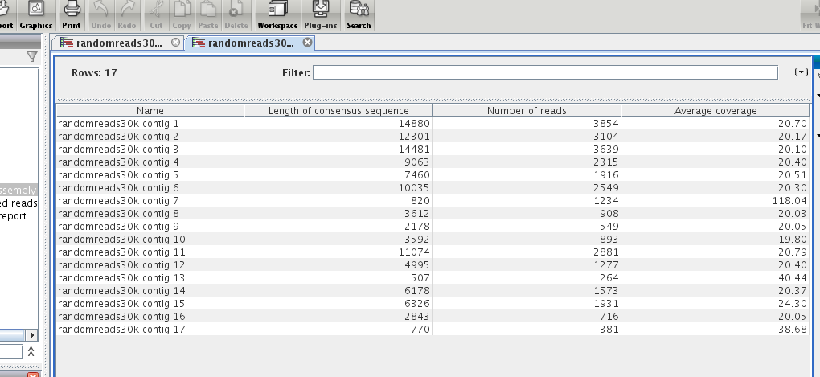
assembled contigs

Slide 15
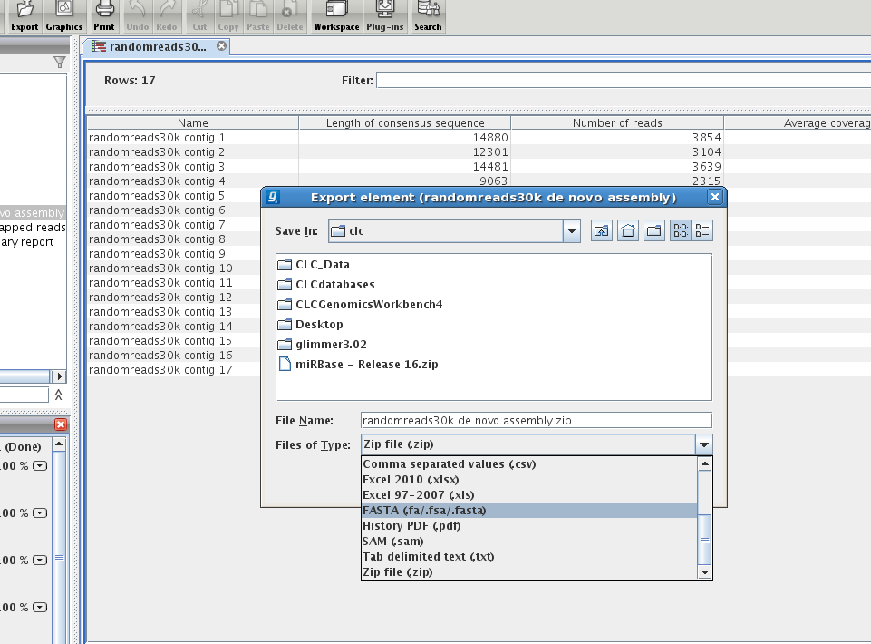
export fasta file

Slide 17
Glimmer
Glimmer is a system for finding genes in microbial DNA, especially the genomes of bacteria, archaea, and viruses.
  (Gene Locator and Interpolated Markov ModelER)
http://www.cbcb.umd.edu/software/glimmer/
Center for Bioinformatics & Computational Biology, University of Maryland
Paper about Glimmer 1.0
  S. Salzberg, A. Delcher, S. Kasif, and O. White. Microbial gene identification using interpolated Markov models, Nucleic Acids Research 26:2 (1998), 544-548.
Glimmer2.0
  A.L. Delcher, D. Harmon, S. Kasif, O. White, and S.L. Salzberg. Improved microbial gene identification with GLIMMER, Nucleic Acids Research 27:23 (1999), 4636-4641.
Glimmer 3.0
  A.L. Delcher, K.A. Bratke, E.C. Powers, and S.L. Salzberg. Identifying bacterial genes and endosymbiont DNA with Glimmer. Bioinformatics 23:6 (2007), 673-679.

Slide 18
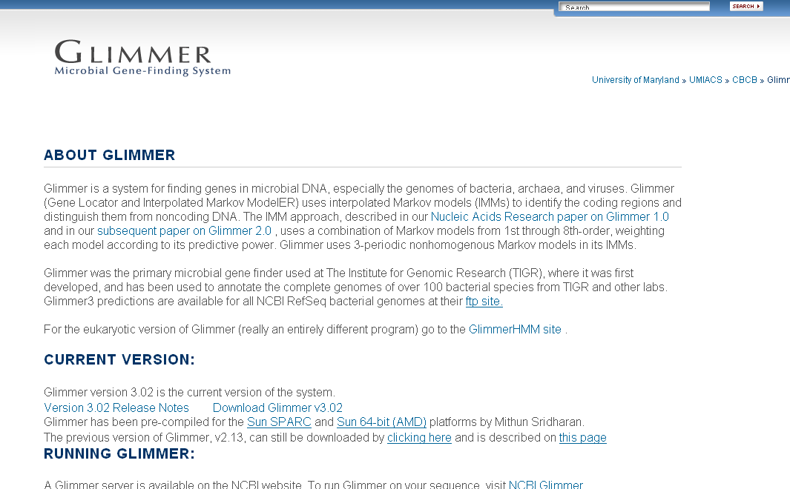
http://www.cbcb.umd.edu/software/glimmer/
Dondload
Glimmer 3.02 Here!

Slide 19
Or download glimmer from here
wget http://163.25.92.61/course/glimmer302.tar.gz

Slide 20
Glimmer install
extract
  tar zxvf glimmer302.tar.gz
  tree -d glimmer3.02/
go into directory of glimmer’s source code
  cd glimmer3.02/src/
  pwd
compile the binary code
  make
executable binary will be located in
  ( glimmer3.02/bin/ )

Slide 21
Concept of glimmer
Trainning model from…
  Known genes
  Genes from evolutionary relative organism
  Open reading frames
model
Genome
Genes on genome

Slide 22
4 steps to run the glimmer
long-orfs
  This program identifies long, non-overlapping open reading frames (orfs) in a DNA sequence file.
extract
  This program reads a genome sequence and a list of coordinates for it and outputs a multifasta file of the regions specified by the coordinates
build-icm
  This program constructs an interpolated context model (ICM) from an input set of sequences.
glimmer3

Slide 23
g3-from-scartch.csh
glimmer3.02/scripts/
g3-from-scratch.csh genome.fasta mygenome
The script would then run the commands:
  long-orfs -n -t 1.15 genome.fasta mygenome.longorfs
  extract -t genome.fasta mygenome.longorfs > mygenome.train
  build-icm -r mygenome.icm < mygenome.train
  glimmer3 -o50 -g110 -t30 genom.seq mygenome.icm mygenome

Slide 24
Output of glimmer
(xxx.predict)
>gi|15638995|ref|NC_000919.1| Treponema pallidum subsp. pallidum str. Nichols, complete genome
orf00001 4 1398 +1 6.22
orf00003 1641 2756 +3 2.89
orf00004 2776 3834 +1 5.47
orf00005 3863 4264 +2 2.77
orf00006 4391 6832 +2 7.08
orf00007 6832 7074 +1 0.25
orf00008 7317 7967 +3 6.92
orf00009 7997 8260 +2 2.91
orf00010 9515 8340 -3 2.80
orf00011 9838 9984 +1 0.10
orf00013 10237 10362 +1 6.02
orf00014 10396 12378 +1 3.77
orf00015 12545 13210 +2 8.04
ID
Start & stop position
frame
score

Slide 25
Modification of the script g3-from-scartch.csh
vi ../scripts/g3-from-scartch.csh
set awkpath = /fs/szgenefinding/Glimmer3/scripts
set glimmerpath = /fs/szgenefinding/Glimmer3/bin
set awkpath = ~/glimmer3.02/scripts
set glimmerpath = ~/glimmer3.02/bin

Slide 26
vi 編輯器: vi filename
i
a
o
命令模式
:
輸入模式
檔案模式
w 儲存
q 離開vi
wq 儲存後離開
q! 不儲存就離開
ESC
ESC

Slide 27
Convert coordinate file into fasta format (single fasta file)
extract
  Usage:
    extract genome_file coord_file > fasta_file

Slide 28
for multiple fasta file coordinate convert
use home-made script to re-format
coordinate file
  http://163.25.92.61/course/multipredict.pl
multi-extract
  Usage:
    multi-extract genome_file coord_file > fasta_file

Slide 30
NetBlast
The BLAST client, or blastcl3, bypasses the web browser and interacts directly with the NCBI BLAST server that powers the NCBI web BLAST service
ftp://ftp.ncbi.nlm.nih.gov/blast/executables/release/LATEST/
But you can download here…
cd ~ (go back to your home directory)
wget http://163.25.92.61/course/netblast-2.2.25-ia32-linux.tar.gz
extract
  tar zxvf netblast-2.2.20-ia32-linux.tar.gz

Slide 31
blastcl3
netblast-2.2.25/bin/
./blastcl3 -p program -i input_sequence -d dbname -o output_file
  -p (blastn, blastx, blastp, tbastn tblastx)
  -i (query file, predice genes here)
  -d (database name)
  nr, NCBI non-redundant database
  -o (output file)

Slide 32
Blast programs
-p program | -i Query sequence | -d database sequence
blastn | nucleotide | nucleotide
blastp | amino acid | amino acid
blastx | translated nucleotide | amino acid
tblastn | amino acid | translated nucleotide
tblastx | translated nucleotide | translated nucleotide

Slide 33
./blastcl3
-p blastn
-i mygene.fasta
-d nt
-o mygeneblast.html
-m 2
-K 1
-T T

