Slide 1
Genome Resequencing analysis
2012/Apr/27

Slide 2
outline
import data
Mapping reads to reference genome
SNP detect
DIP (InDel) detect
  deletion/insertion polymorphisms
  A.k.a Insert deletion

Slide 3
3 files for 454 genome resequencing
  Ecoli.FLX.fna
  (Reads sequence in fasta format)
  Ecoli.FLX.qual
  (Reads quelity in fasta format)
  NC_010473.gbk
  (E. coli str. K-12 substr. DH10B, complete genome sequence in Genbank format)

Slide 4
3 files for 454 genome resequencing
Read sequence (Ecoli.FLX.fna)
>EECRH8001A0WUU
GGGGGGGGGGGGGGGGGGGGGGGGGGGGGGAGTAATGCCGTCGCCCGCCTGTCCGGTGAC
GATTTCCAGCGCGCCATCGCCACAGGCAATCAGCAGTGGCGCAACAGAAATCACGCTCCC
CGGCTGTGCTTTGCTGGCATGAGGATGAACACGCGACGACCAGACGGTGAATTTCTGATT
GCCAACATAGCTGAAGGCACCCGGCCACGGATCGGCAACGGCACGTACCATGTTGTGCAG
>EECRH8001DOWTE
GGCGTCTTTTATAAAGATGAGCCCATCAAAGAACTGGAGTCGGCGCTGGTGGCGCAAGGC
TTTCAGATTATCTGGCCACAAAACAGCGTTGATTTGCTGAAATTTATCGAGCATAACCCT
CGAATTTGCGGCGTGATTTTTGACTGGGATGAGTACAGTCTCGATTTATGTAGCGATATC
AATCAGCTTAATGAATATCTCCCGCTTTATGCCTTCATCAACACCCACTCGA
>EECRH8001EBQ91
CCGTACGATCCGAATACCCAACGACGGGTTGTGCGCGAACGTTTGCAGGCGCTGGAAATC
ATTAATGAGCGCTTTGCCCGCCATTTTCGTATGGGGCTGTTCAACCTGCTGCGTCGTAGC
CCGGATATAACCGTCGGGGCCATCCGCATTCAGCCGTACCATGAATTTGCCCGCAACCTG
CCGGTGCCGACCAACCTGAACCTTATCCA
Read Quality (Ecoli.FLX.qual )
>EECRH8001A0WUU
14 7 3 1 1 1 1 1 1 1 1 1 1 1 1 1 1 1 1 1 1 1 1 1 1 1 1 1 1 1 28 9 26 35 28 28 27 34 28 28 28 26 24 37 33 15 28 34 28 28 27 27 31 22 32 24 27 27 28 27
24 27 36 32 13 35 28 28 28 27 25 23 26 34 28 27 25 25 28 32 24 25 28 27 29 21 26 29 20 28 27 27 27 27 28 26 26 31 23 27 27 28 34 27 28 26 28 36 32 14 25 25 28 27 27 27 28 37 33 20 5 34 27 26 20 28 26 28 23 37 33 14 26 27 27 34 28 26 27 28 27 19 34 27 28 26 27 31 22 27 27 26 28 28 26 26 25 27 24 33 25 25 28 22 24 35 28 26 23 33 26 36 31 12 28 27 27 25 33 26 27 27 18 32 24 28 25 28 26 27 28 27 28 32 24 33 26 25 28 34 30 9 35 28 27 18 28 28 32 25 28 28 23 34 28 27 34 27 22 34 28 27 27 24 24 28 23 34 27 27 26 27 32 24 27 28 28 27 24 27
>EECRH8001DOWTE
31 12 28 28 28 28 37 33 20 5 26 27 34 30 10 27 28 28 28 28 27 36 32 13 28 28 28 37 32 14 28 34 27 28 27 34 27 28 28 27 27 33 25 27 28 27 27 33 26 27 33 26 27 27 28 34 28 34 28 27 37 33 16 27 27 28 28 35 28 27 28 28 28 34 26 33 25 28 28 37 33 20 6 28 27 27 27 27 34 27 27 28 36 31 12 27 28 27 27 37 33 14 36 32 13 27 27 28 28 27 27 27 28 27 35 28 36 32 13 27 27 28 33 25 36 32 13 25 28 32 24 27 28 27 27 27 38 34 24 14 4 28 27 27 28

Slide 5
  Reference genome ( NC_010473.gbk )
LOCUS NC_010473 4686137 bp DNA circular BCT 23-JAN-2012
DEFINITION Escherichia coli str. K-12 substr. DH10B chromosome, complete genome.
ACCESSION NC_010473 VERSION NC_010473.1 GI:170079663 DBLINK Project: 58979
KEYWORDS .
SOURCE Escherichia coli str. K-12 substr. DH10B
ORGANISM Escherichia coli str. K-12 substr. DH10B Bacteria; Proteobacteria; Gammaproteobacteria; Enterobacteriales; Enterobacteriaceae; Escherichia.
FEATURES Location/Qualifiers
source 1..4686137
/organism="Escherichia coli str. K-12 substr. DH10B"
/mol_type="genomic DNA"
/strain="K-12"
/sub_strain="DH10B"
/db_xref="taxon:316385"
gene 190..255
/gene="thrL" /locus_tag="ECDH10B_0001"
/db_xref="GeneID:6058969"
CDS 190..255
/gene="thrL"
/locus_tag="ECDH10B_0001"
/note="involved in threonine biosynthesis; controls the expression of the thrLABC operon" /codon_start=1
/transl_table=11
/product="thr operon leader peptide"
/protein_id="YP_001728984.1"
/db_xref="GI:170079664"
/db_xref="ASAP:AEC-0000073"
/db_xref="GeneID:6058969"
gene 337..2799
/gene="thrA"
/locus_tag="ECDH10B_0002"
/db_xref="GeneID:6058347“
……
……
http://www.ncbi.nlm.nih.gov/nuccore/170079663

Slide 6
How many reads in a fasta file?
Extract lines with “>” character
And count it
How many reads in quality file?
grep “>” Ecoli.FLX.fna
grep -c “>” Ecoli.FLX.fna

Slide 7
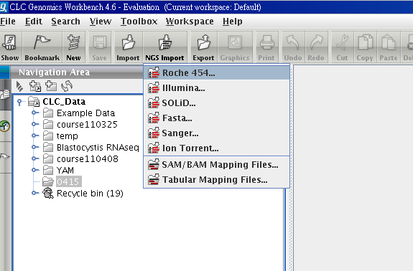
Import 454 reads

Slide 8
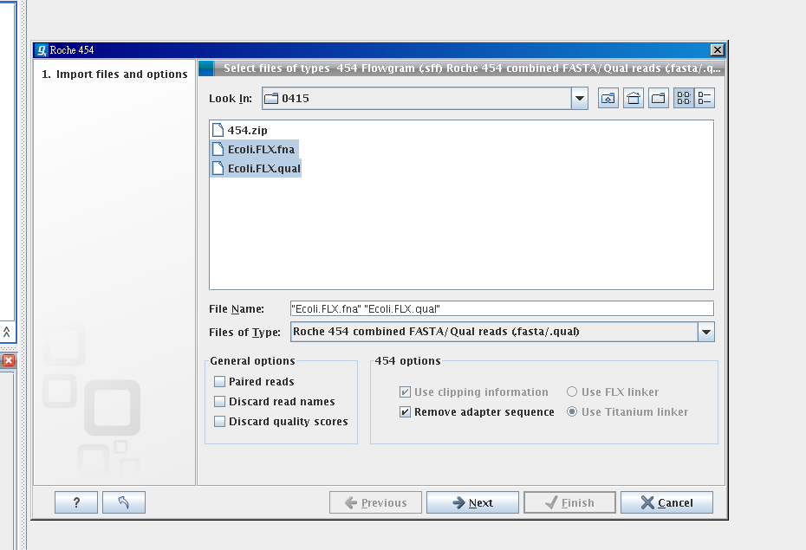
Select 2 files via Ctrl key

Slide 9
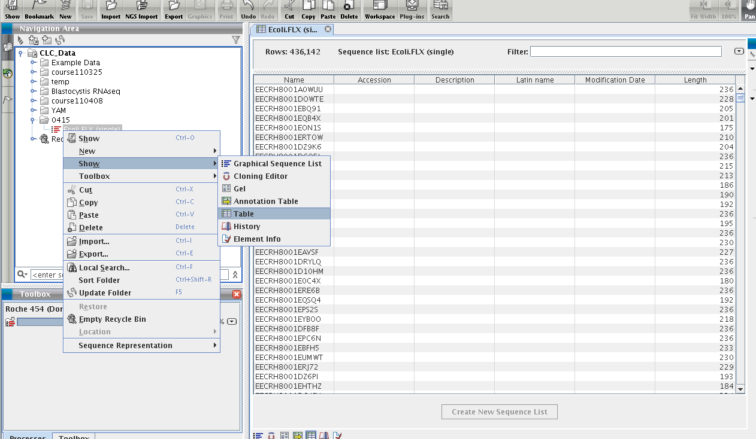

Slide 10
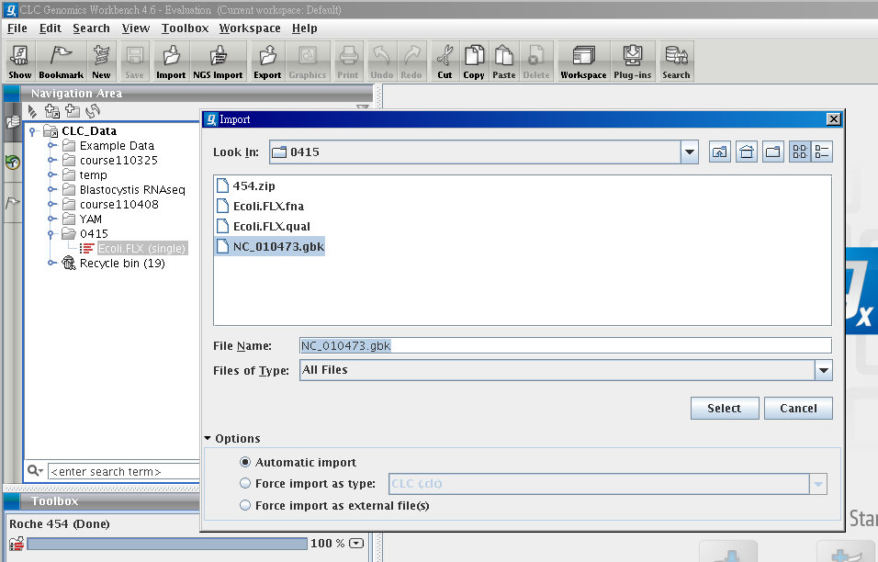
Import Reference genome

Slide 11
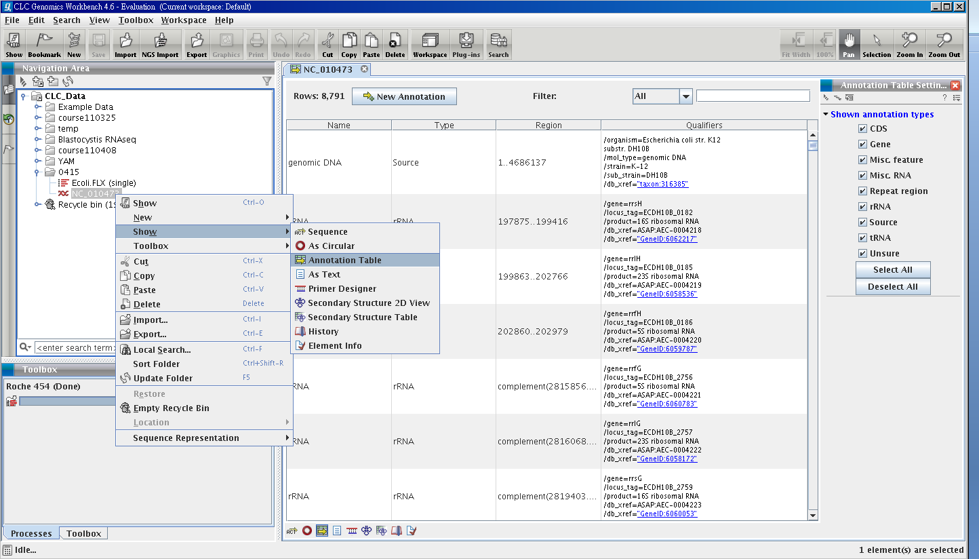

Slide 12
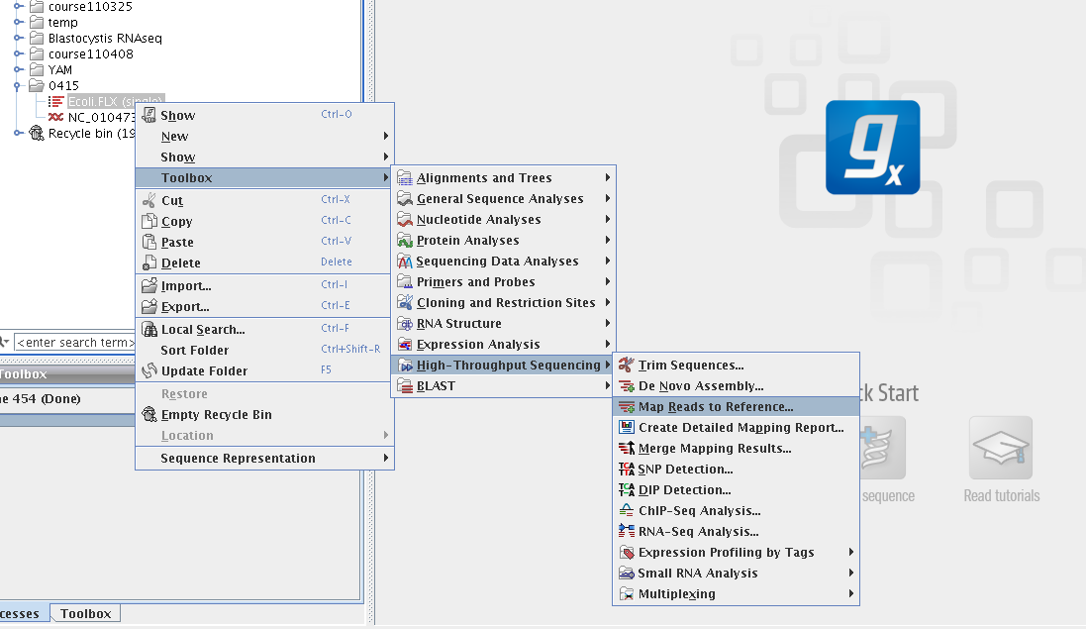
Mapping reads to Reference

Slide 13
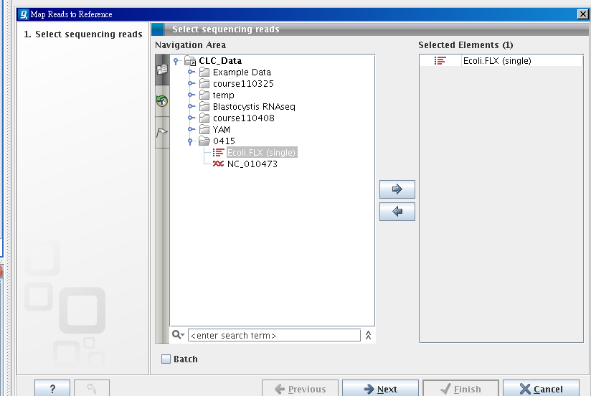
Select reads

Slide 14
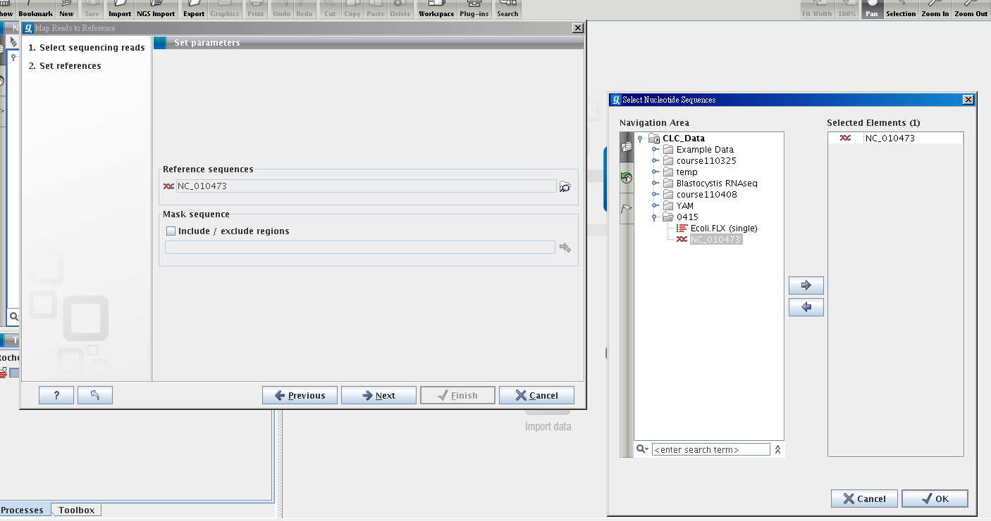
Select NC_010473 as reference

Slide 15
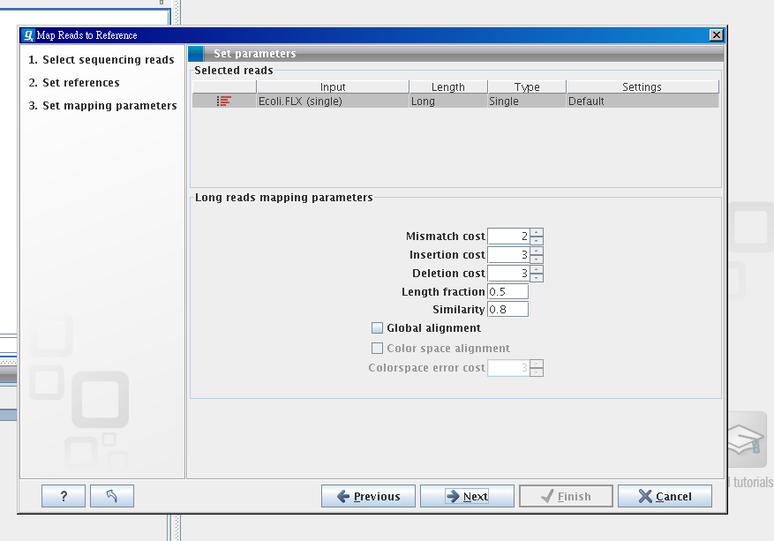

Slide 16
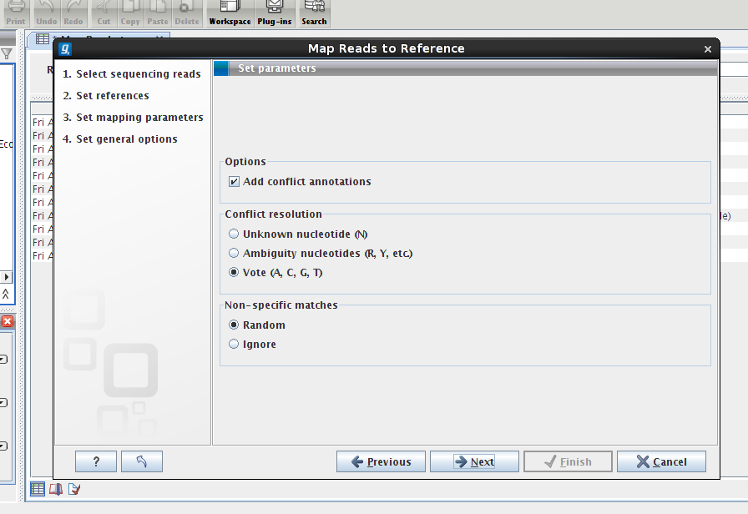

Slide 17
IUPAC nucleotide code
IUPAC nucleotide code | Base
A | Adenine
C | Cytosine
G | Guanine
T (or U) | Thymine (or Uracil)
R | A or G
Y | C or T
S | G or C
W | A or T
K | G or T
M | A or C
B | C or G or T
D | A or G or T
H | A or C or T
V | A or C or G
N | any base
. or - | gap

Slide 18
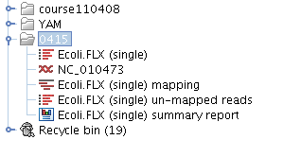
Mapping result

Slide 19
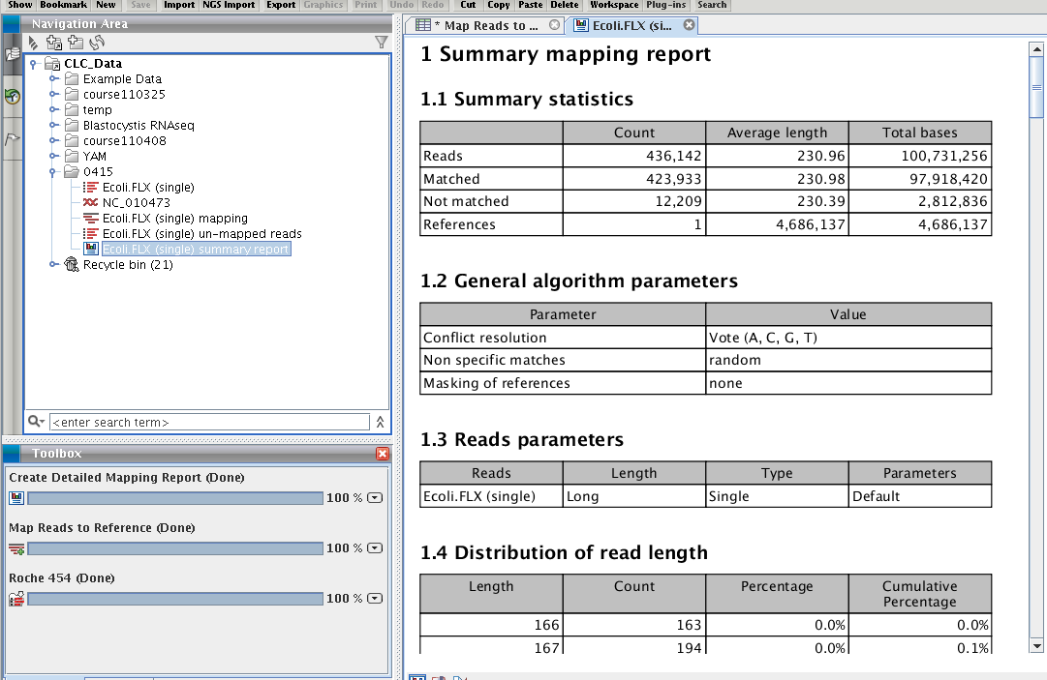
Mapping report

Slide 20
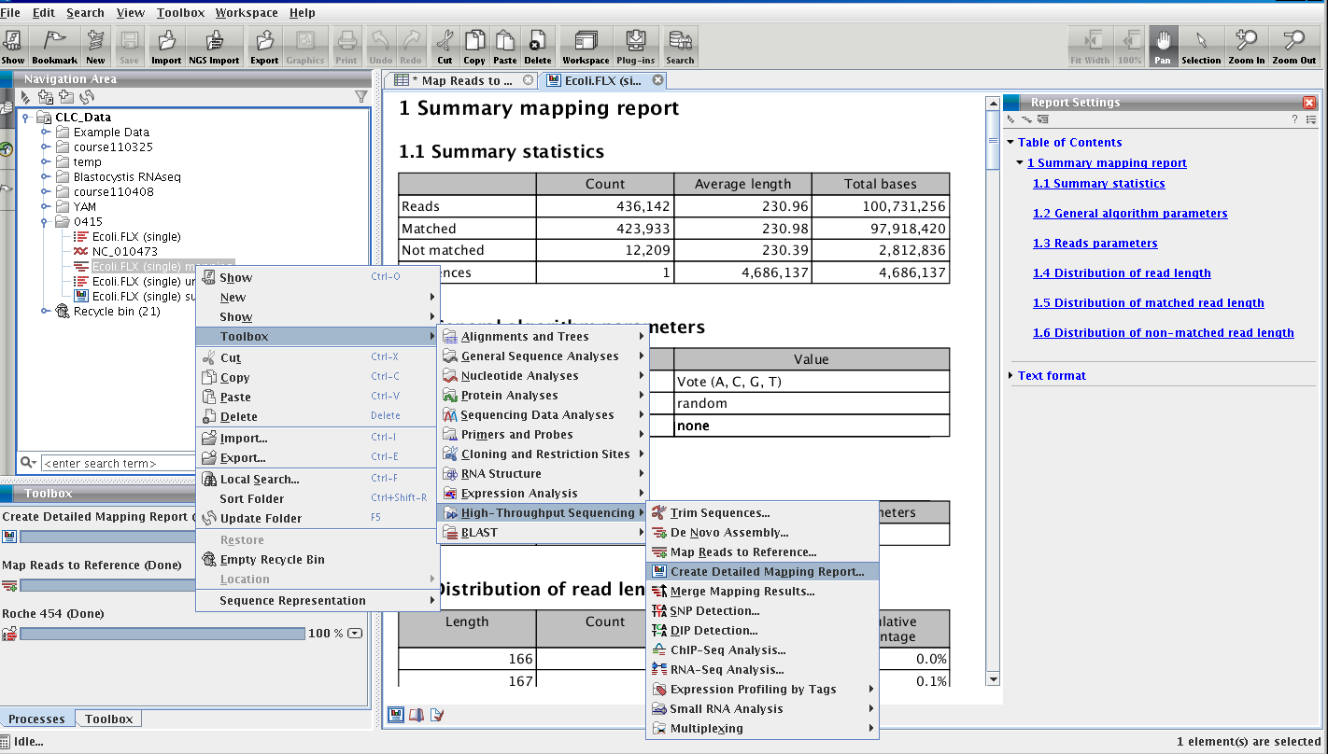
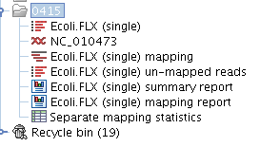
Create detail report

Slide 21
Reference and consensus sequence
insertion
deletion
SNP (or SNV)
Ref
ACGTACGTACGTACGTACGTAC-GTACGTACGTACGTACGTACGTACGTACGTACG
Con
ACGTACGTACGTACGTACGTACAGTACGTACGTACGTAC-TCCGTTCGTACGTACG
Reads
ACGTACGTACGT
CGTACGTACGTACAGTACGTACGTACGTA
CGTACGTAC-TCCGTTCGTACGTACG
ACGTAC-TCCGTTCGTACGTACG

Slide 22
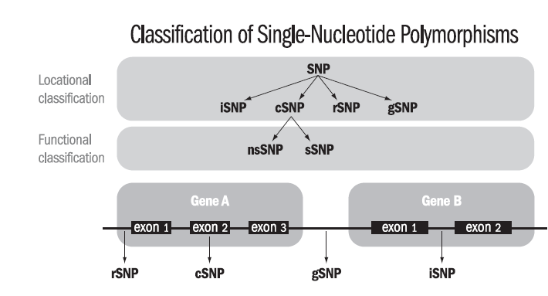
SNP
gSNPs
  intergenic regions.
rSNPs
  regulatory regions,
iSNPs
  intronic regions
cSNPs
  coding regions (exons)
sSNP
  synonymous SNP
nsSNP
  Non-synonymous SNP
http://www.clcbio.com/sciencearticles/BE-SNP.pdf

Slide 23
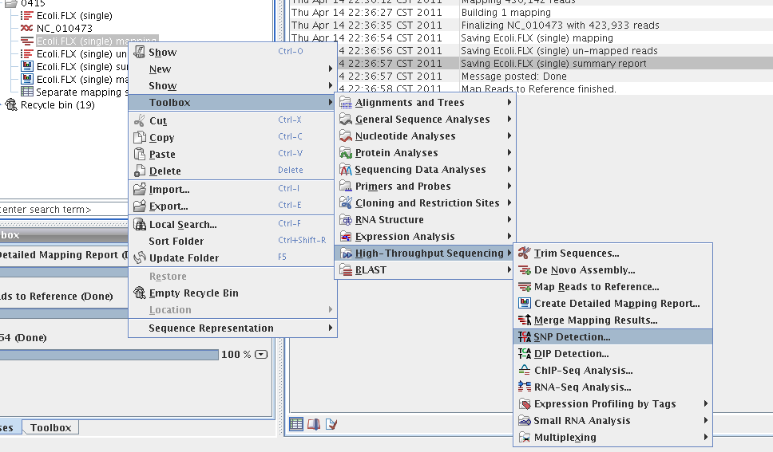
SNP detection

Slide 24
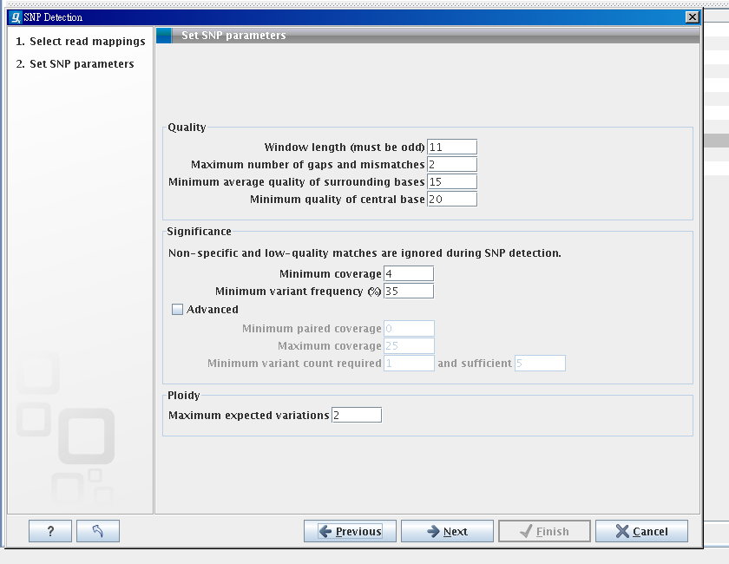

Slide 25
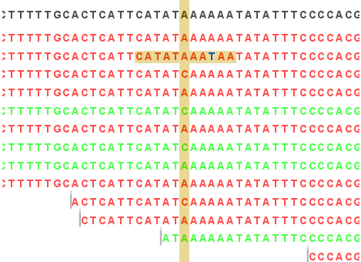
filter of quality

Slide 27
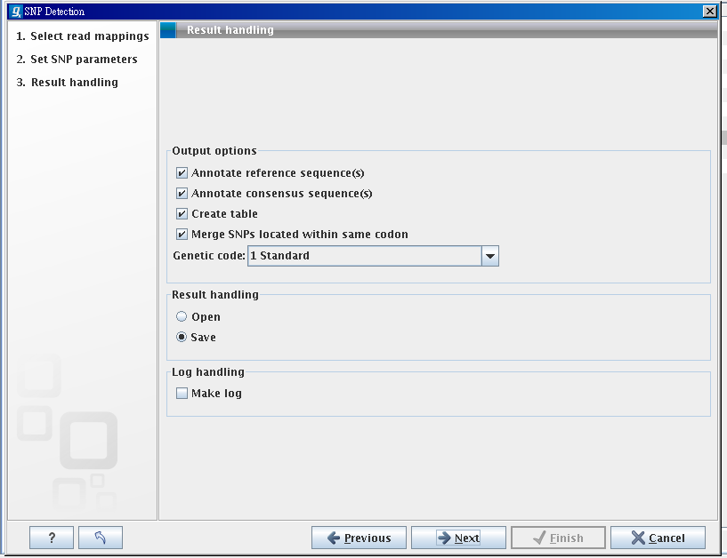

Slide 28
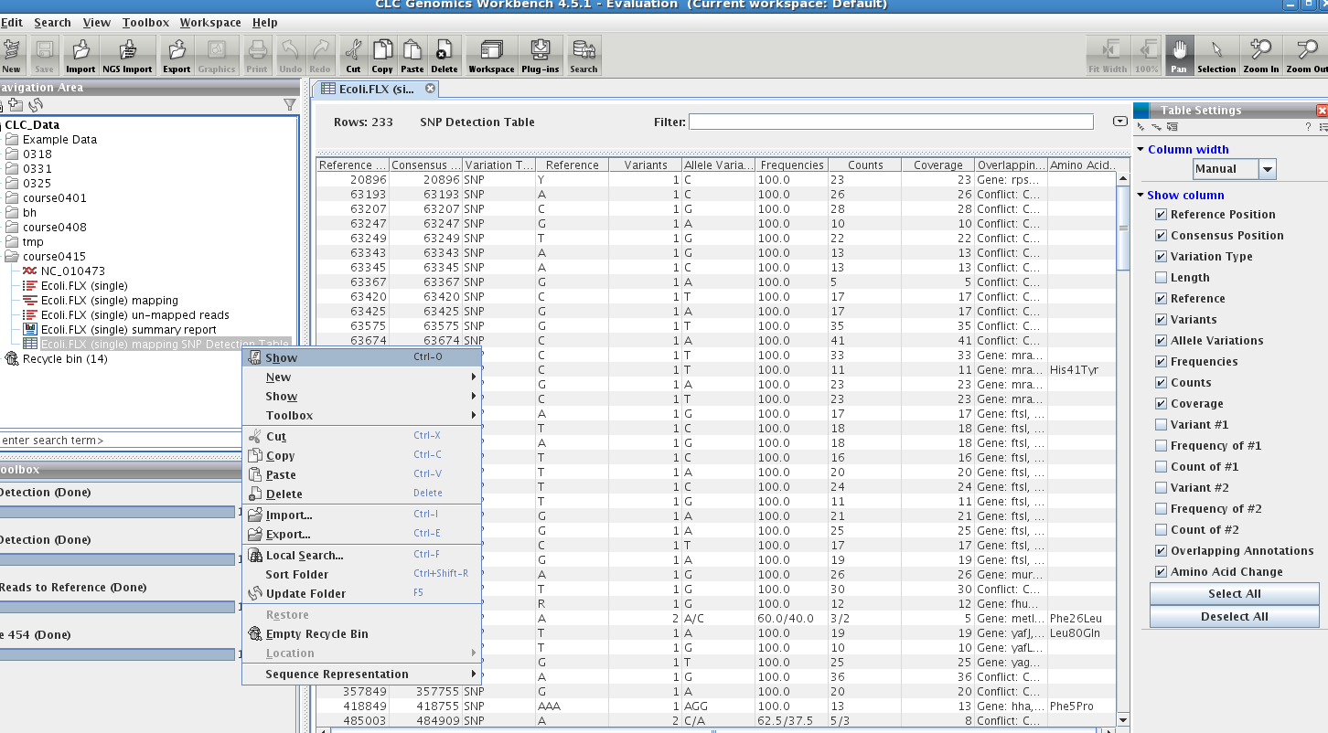
show SNP table

Slide 29
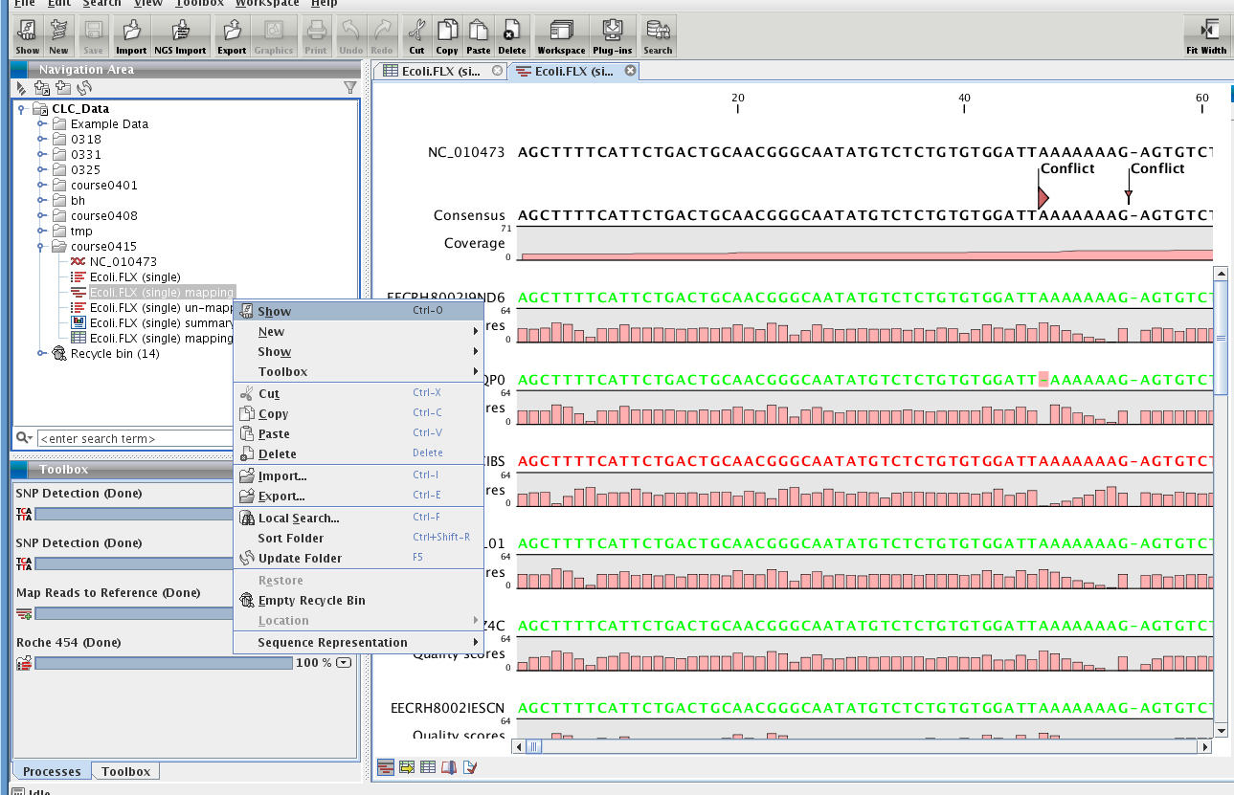
show genome/reads mapping

Slide 30
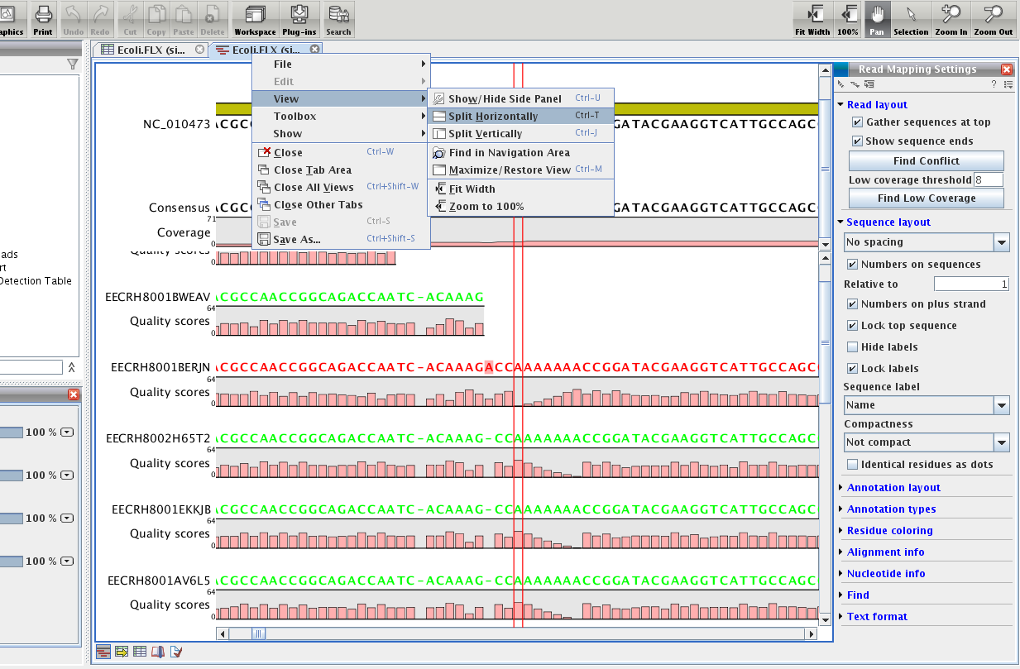

Slide 31
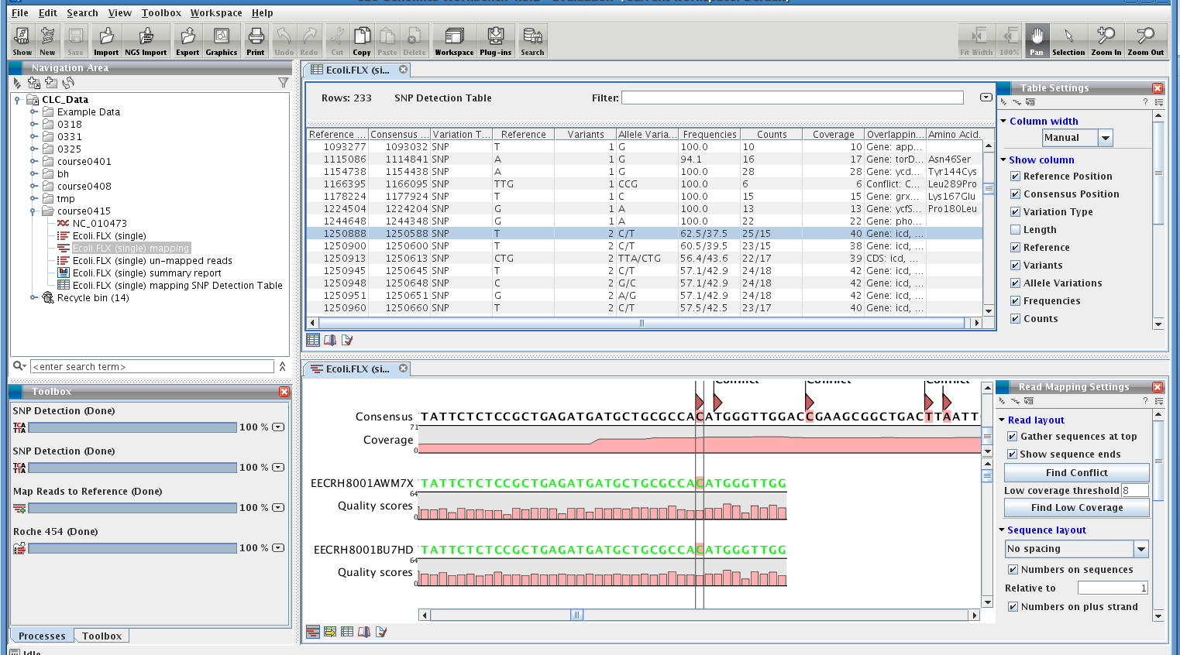

Slide 32
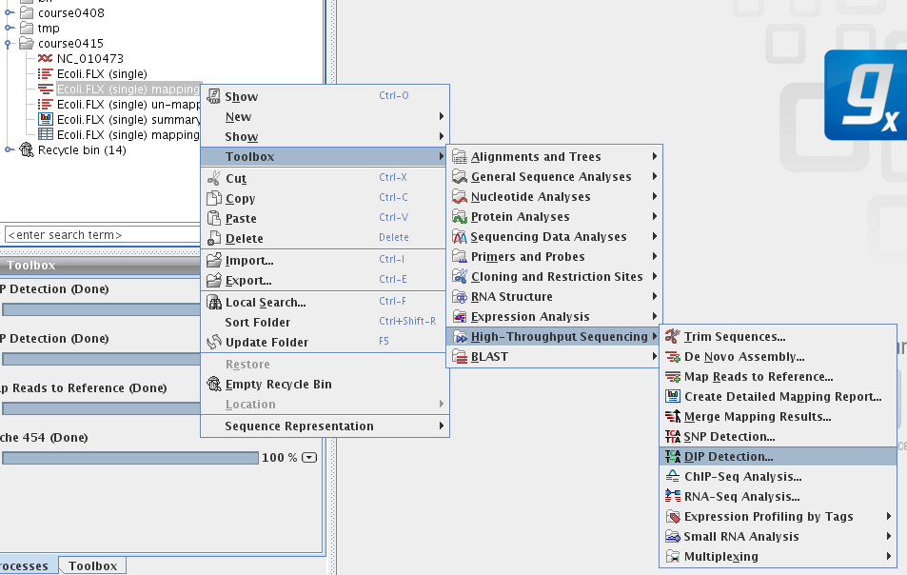
DIP detection

Slide 33
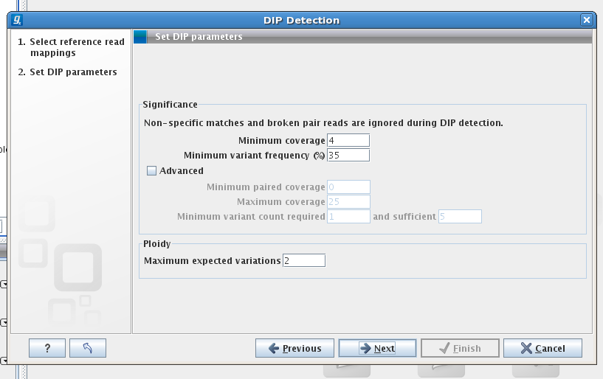

Slide 34
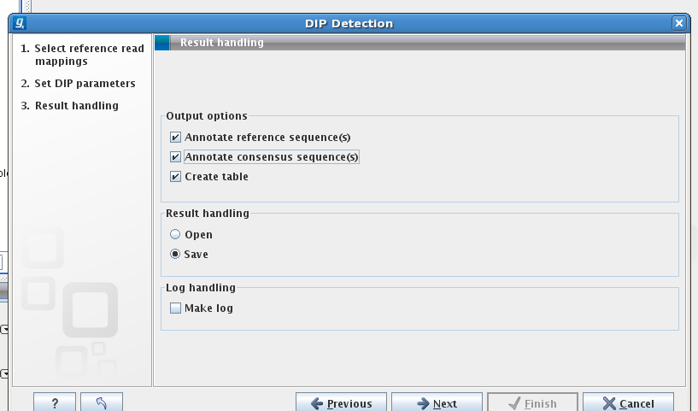

Slide 35
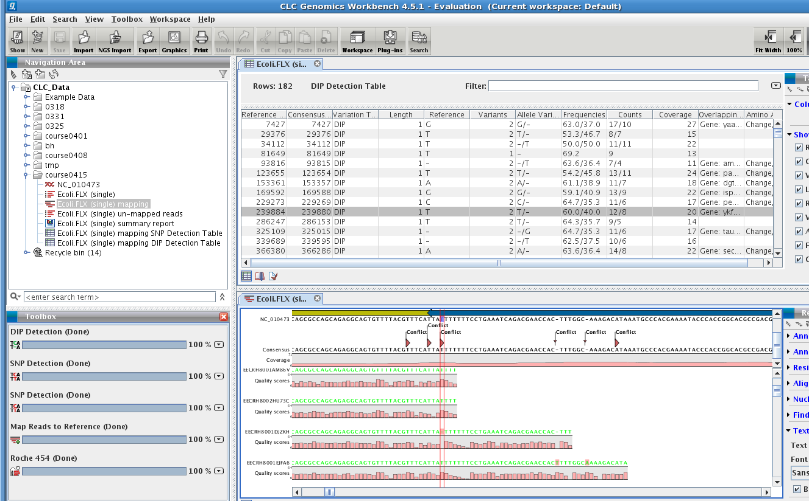

Slide 36
exercise
solexa_ecoli_1.fq
solexa_ecoli_2.fq

