Slide 1
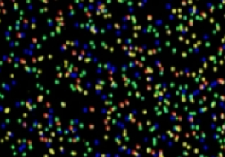
Genome Re-Sequencing
Genome Mapping
Single Nucleotide Polymorphism (SNP )
Deletion-Insertion Polymorphisms (DIP)
P. Tang (鄧致剛); RRC. Gan (甘瑞麒)
Bioinformatics Center, Chang Gung University.

Slide 2
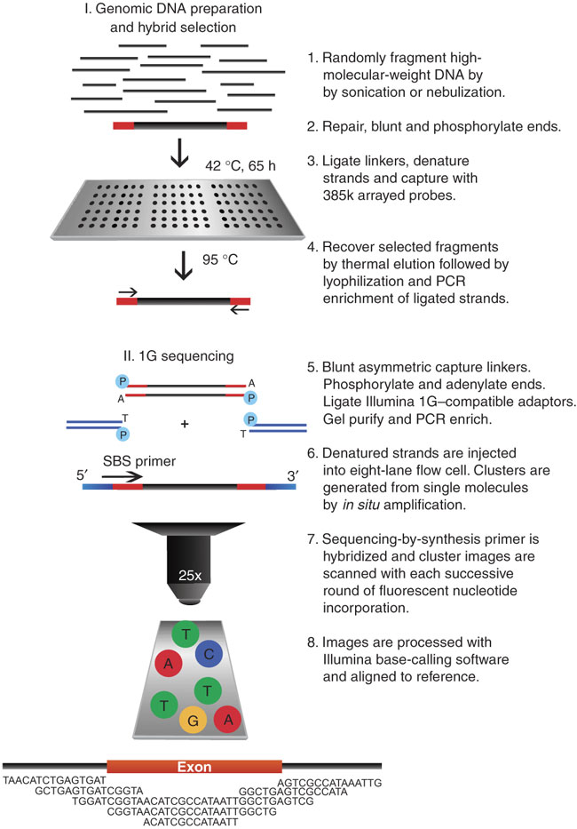
Human Exome Sequencing

Slide 3
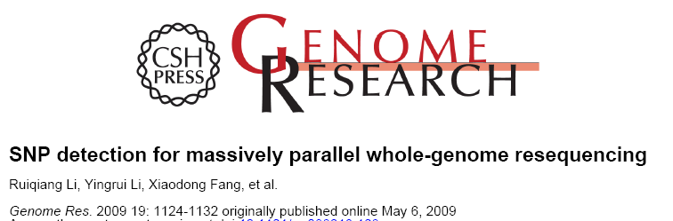
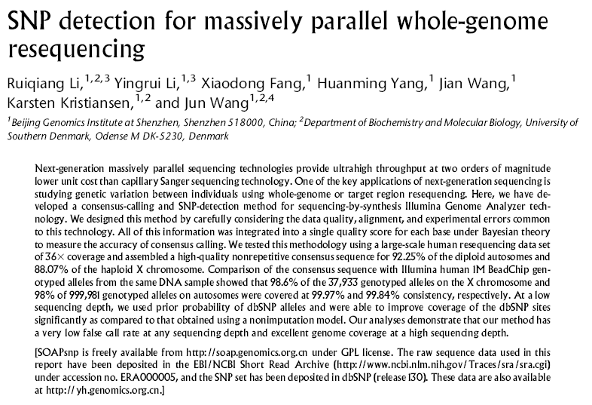

Slide 4
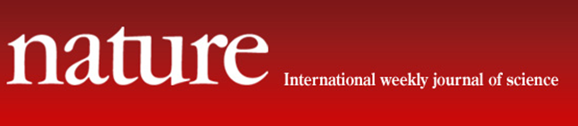
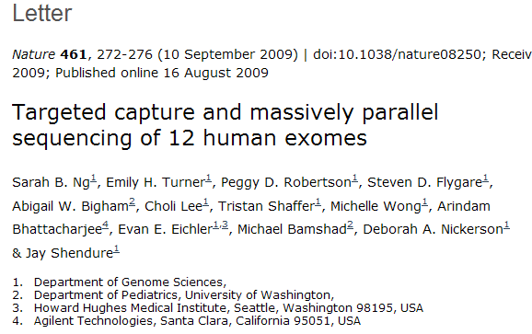

Slide 5
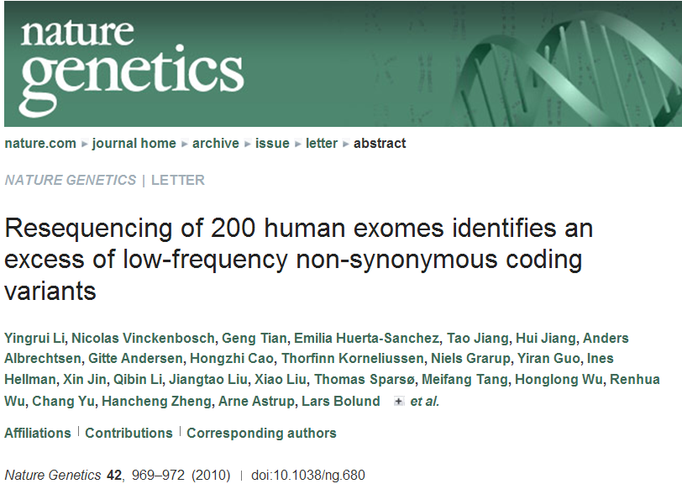

Slide 6
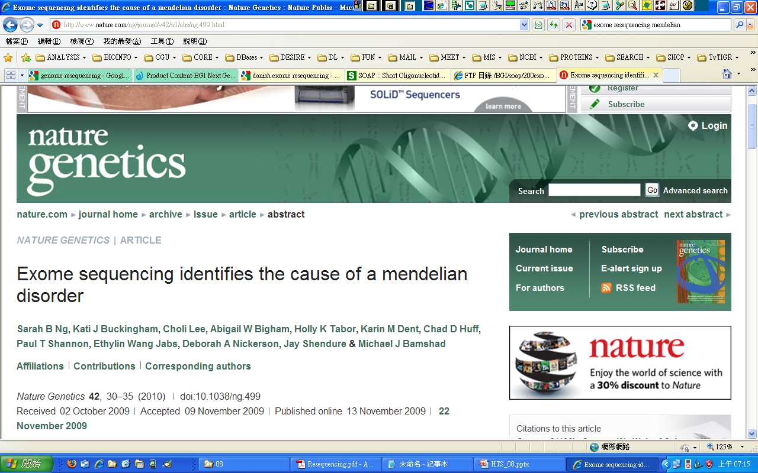
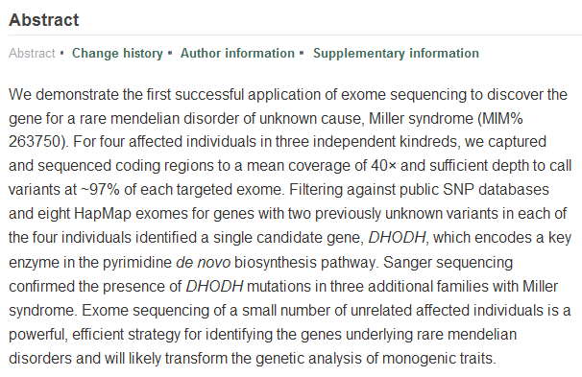

Slide 7
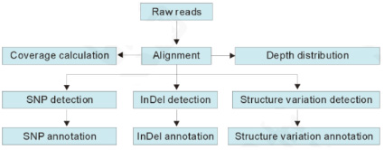
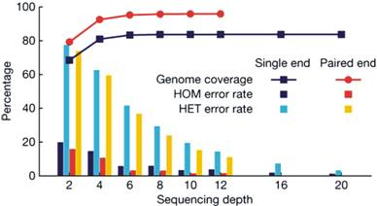
Bioinformatics of Genome Re-sequencing
Human whole genome re-sequencing
Human exome sequencing
Bacteria genome re-sequencing

Slide 8

Resequencing: Reference assembly
followed by SNP and DIP detection
Analyzing a E. coli re-sequencing data set from 454 which contain more than 400,000 reads.

