Slide 1
Genome Resequencing analysis

Slide 2
outline
Download & import data
Mapping reads to reference genome
SNP detect
DIP (InDel) detect

Slide 3
Rsequence sample data
Download data from http://163.25.92.61/course/454.zip
Extract the file
wget http://163.25.92.61/course/454.zip
unzip 454.zip

Slide 4
3 files are extracted from 454.zip
  Ecoli.FLX.fna (Reads sequence in fasta format)
  Ecoli.FLX.qual (Reads quelity in fasta format)
  NC_010473.gbk (E. coli str. K-12 substr. DH10B, complete genome sequence in Genbank format)
Read sequence
>EECRH8001A0WUU
GGGGGGGGGGGGGGGGGGGGGGGGGGGGGGAGTAATGCCGTCGCCCGCCTGTCCGGTGAC
GATTTCCAGCGCGCCATCGCCACAGGCAATCAGCAGTGGCGCAACAGAAATCACGCTCCC
CGGCTGTGCTTTGCTGGCATGAGGATGAACACGCGACGACCAGACGGTGAATTTCTGATT
GCCAACATAGCTGAAGGCACCCGGCCACGGATCGGCAACGGCACGTACCATGTTGTGCAG
>EECRH8001DOWTE
GGCGTCTTTTATAAAGATGAGCCCATCAAAGAACTGGAGTCGGCGCTGGTGGCGCAAGGC
TTTCAGATTATCTGGCCACAAAACAGCGTTGATTTGCTGAAATTTATCGAGCATAACCCT
CGAATTTGCGGCGTGATTTTTGACTGGGATGAGTACAGTCTCGATTTATGTAGCGATATC
AATCAGCTTAATGAATATCTCCCGCTTTATGCCTTCATCAACACCCACTCGA
>EECRH8001EBQ91
CCGTACGATCCGAATACCCAACGACGGGTTGTGCGCGAACGTTTGCAGGCGCTGGAAATC
ATTAATGAGCGCTTTGCCCGCCATTTTCGTATGGGGCTGTTCAACCTGCTGCGTCGTAGC
CCGGATATAACCGTCGGGGCCATCCGCATTCAGCCGTACCATGAATTTGCCCGCAACCTG
CCGGTGCCGACCAACCTGAACCTTATCCA
Read Quality
>EECRH8001A0WUU
14 7 3 1 1 1 1 1 1 1 1 1 1 1 1 1 1 1 1 1 1 1 1 1 1 1 1 1 1 1 28 9 26 35 28 28 27 34 28 28 28 26 24 37 33 15 28 34 28 28 27 27 31 22 32 24 27 27 28 27
24 27 36 32 13 35 28 28 28 27 25 23 26 34 28 27 25 25 28 32 24 25 28 27 29 21 26 29 20 28 27 27 27 27 28 26 26 31 23 27 27 28 34 27 28 26 28 36 32 14 25 25 28 27 27 27 28 37 33 20 5 34 27 26 20 28 26 28 23 37 33 14 26 27 27 34 28 26 27 28 27 19 34 27 28 26 27 31 22 27 27 26 28 28 26 26 25 27 24 33 25 25 28 22 24 35 28 26 23 33 26 36 31 12 28 27 27 25 33 26 27 27 18 32 24 28 25 28 26 27 28 27 28 32 24 33 26 25 28 34 30 9 35 28 27 18 28 28 32 25 28 28 23 34 28 27 34 27 22 34 28 27 27 24 24 28 23 34 27 27 26 27 32 24 27 28 28 27 24 27
>EECRH8001DOWTE
31 12 28 28 28 28 37 33 20 5 26 27 34 30 10 27 28 28 28 28 27 36 32 13 28 28 28 37 32 14 28 34 27 28 27 34 27 28 28 27 27 33 25 27 28 27 27 33 26 27 33 26 27 27 28 34 28 34 28 27 37 33 16 27 27 28 28 35 28 27 28 28 28 34 26 33 25 28 28 37 33 20 6 28 27 27 27 27 34 27 27 28 36 31 12 27 28 27 27 37 33 14 36 32 13 27 27 28 28 27 27 27 28 27 35 28 36 32 13 27 27 28 33 25 36 32 13 25 28 32 24 27 28 27 27 27 38 34 24 14 4 28 27 27 28

Slide 5
How many reads in a fasta file?
Extract lines with “>” character
And count it
grep “>” Ecoli.FLX.fna
grep -c “>” Ecoli.FLX.fna

Slide 6
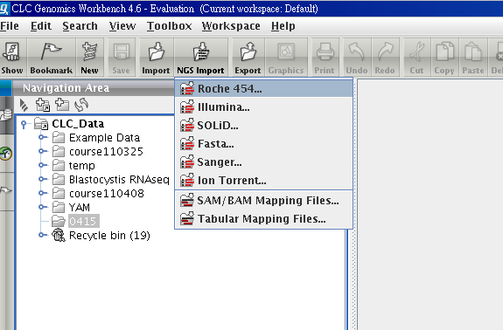
Import 454 reads

Slide 7
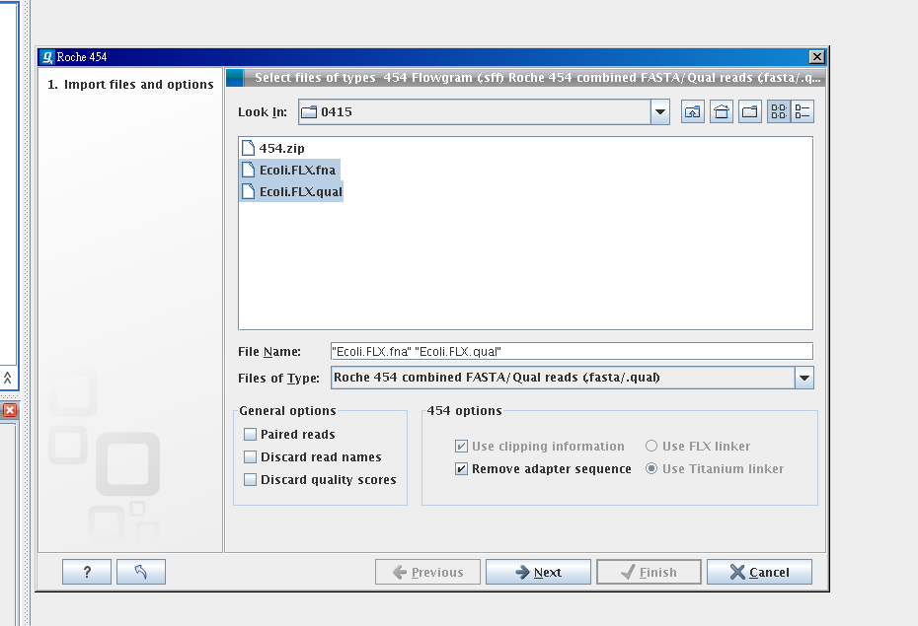
Select 2 files via Ctrl key

Slide 8
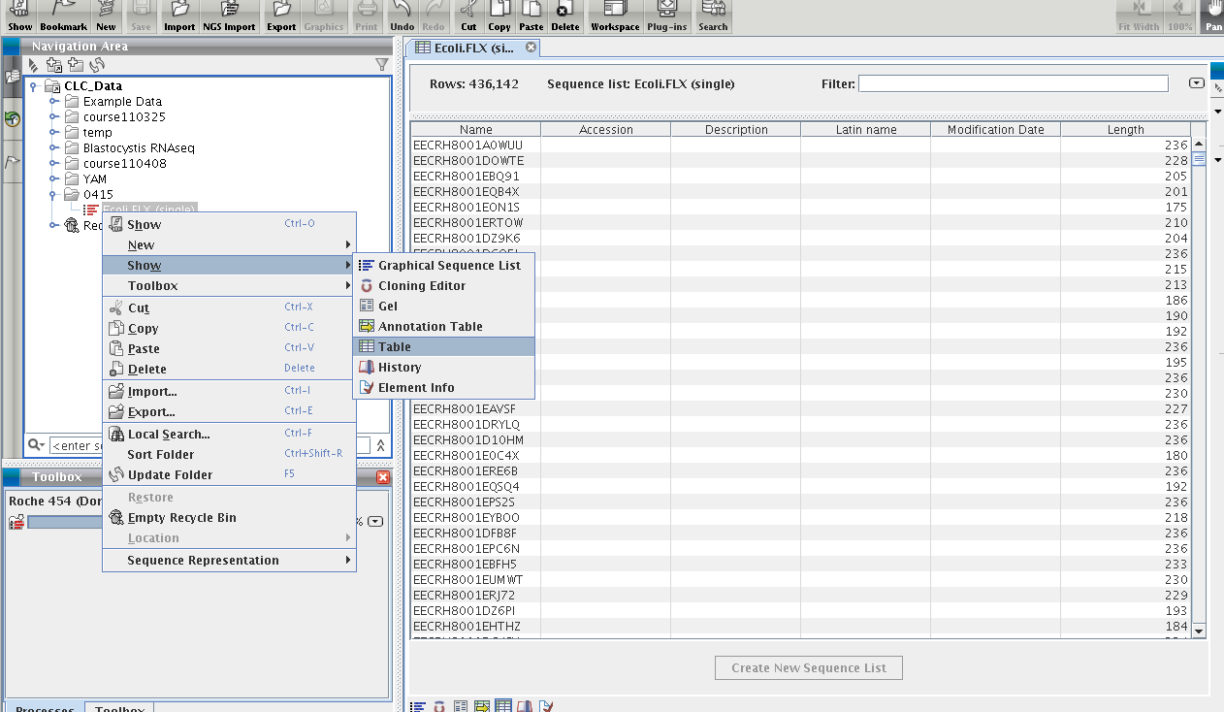

Slide 9
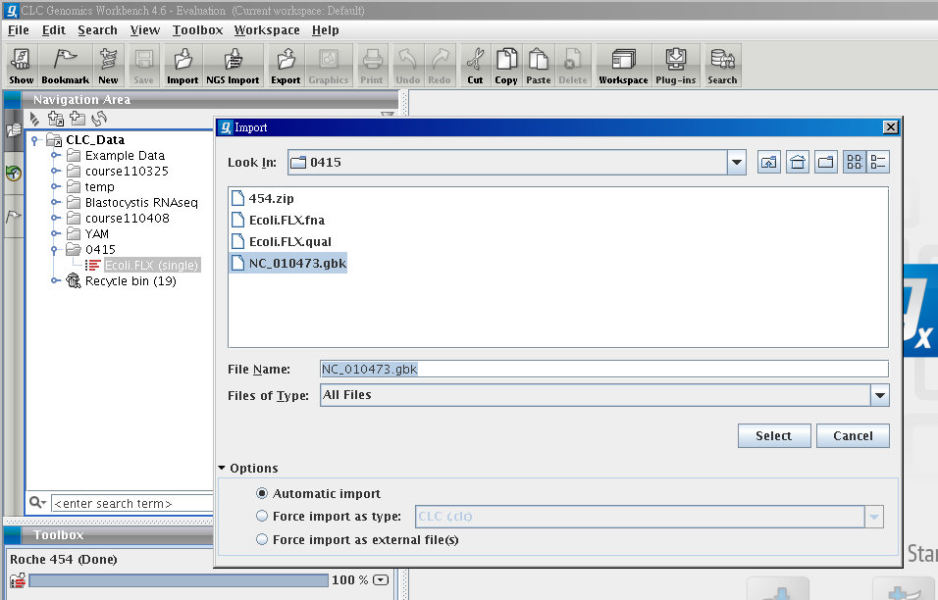
Import Reference genome

Slide 10
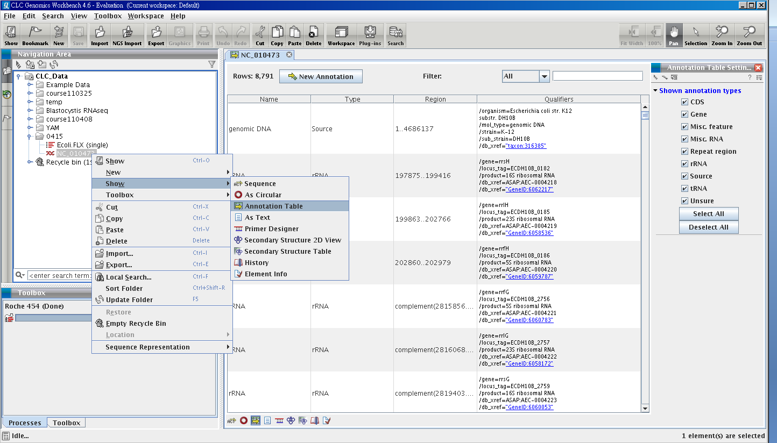

Slide 11
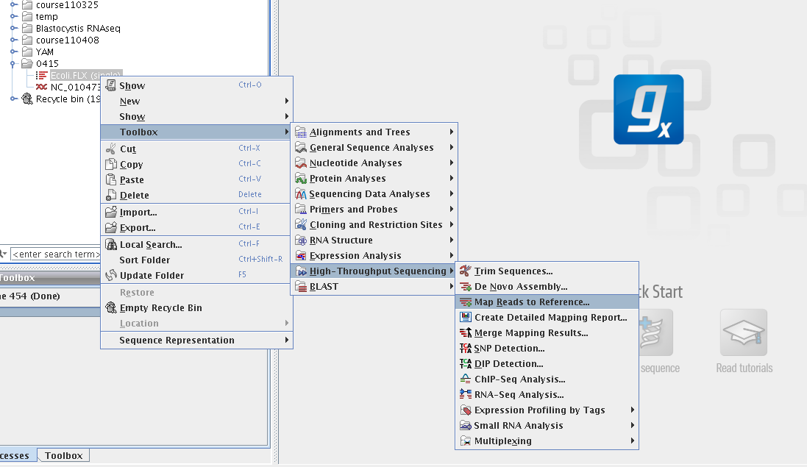
Mapping reads to Reference

Slide 12
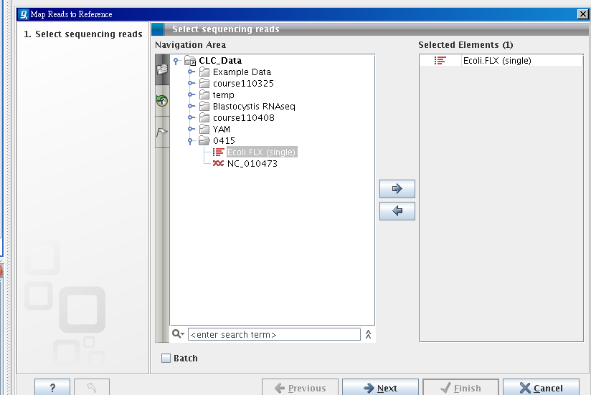
Select reads

Slide 13
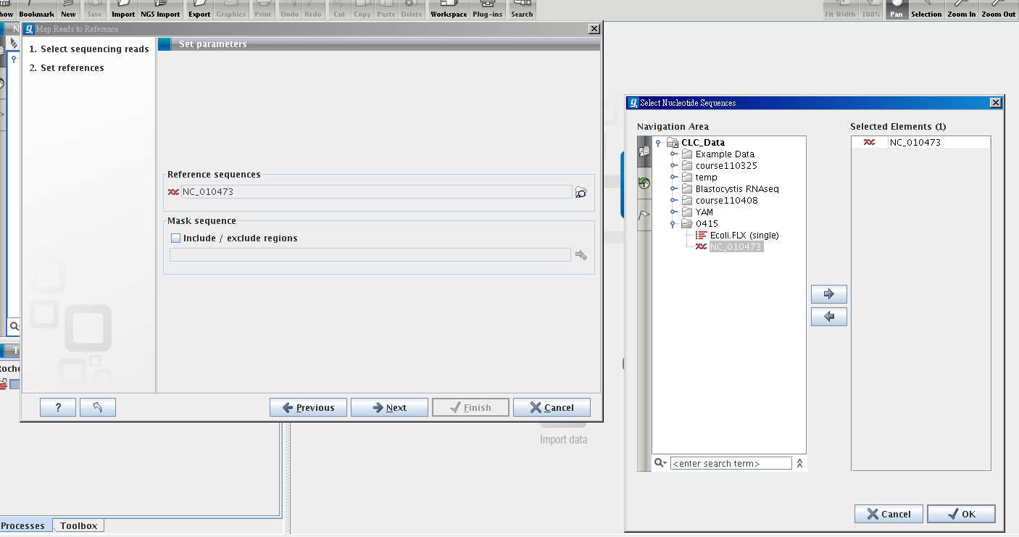
Select NC_010473 as reference

Slide 14
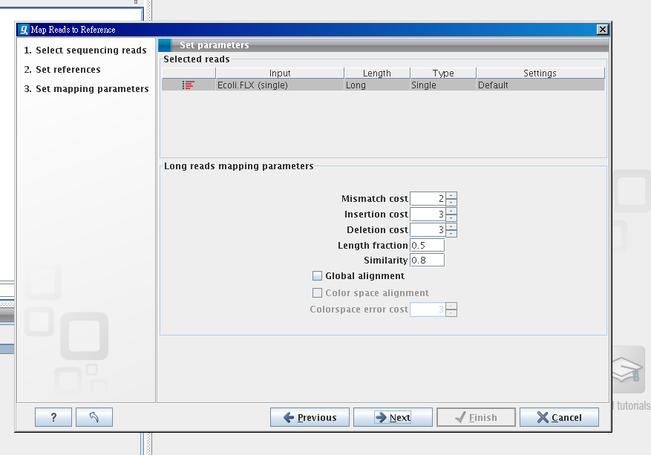

Slide 15
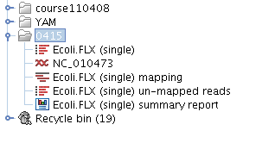
Mapping result

Slide 16
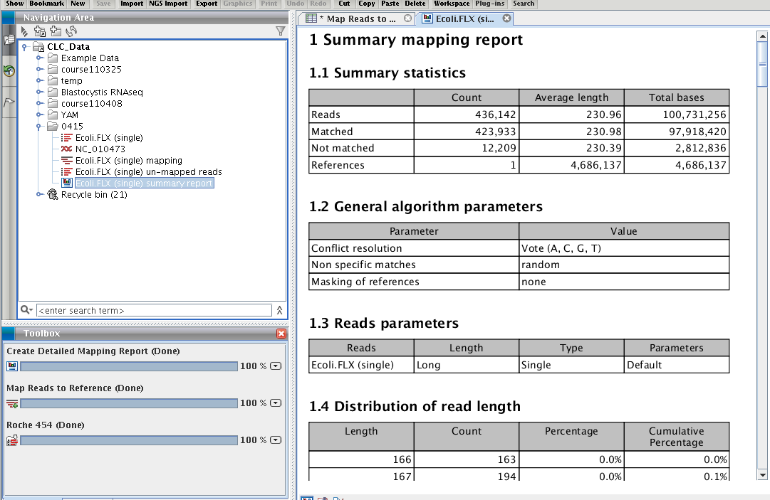
Mapping report

Slide 17
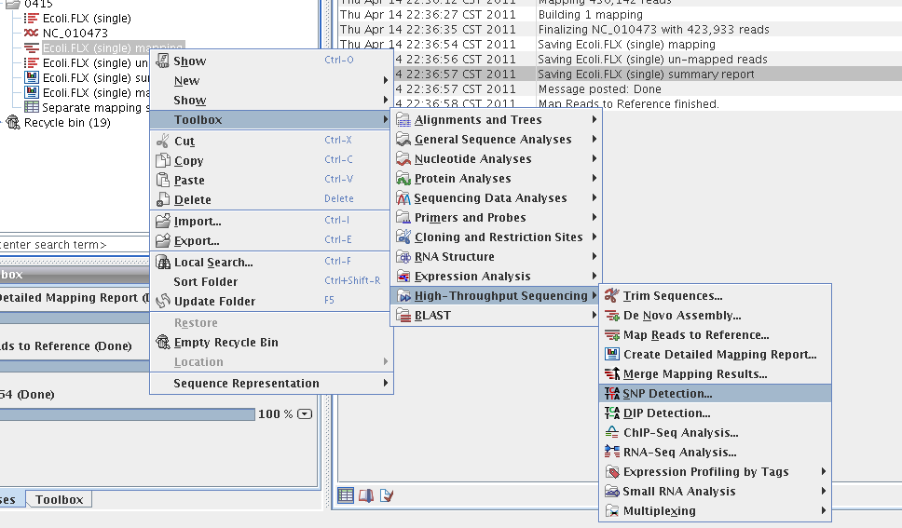
SNP detection

Slide 18
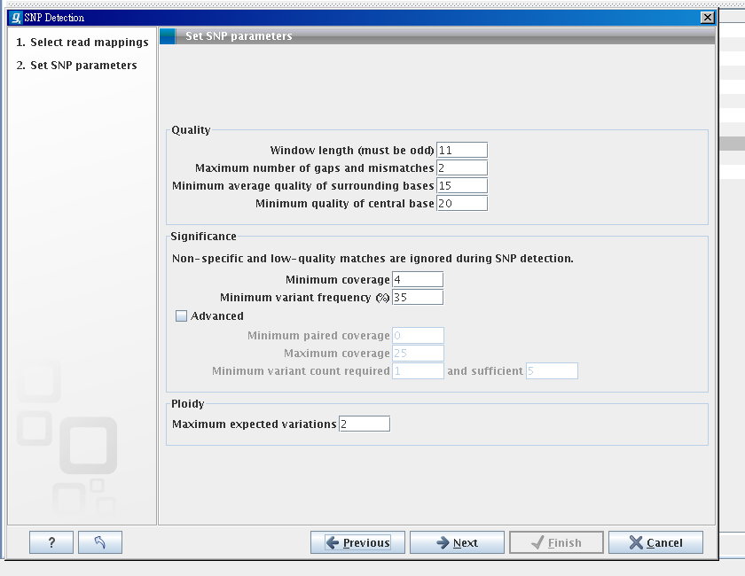

Slide 19
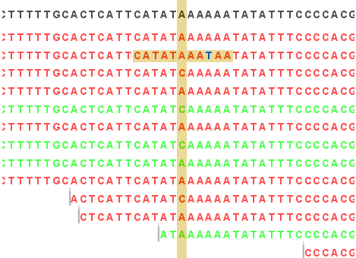
filter of quality

Slide 20
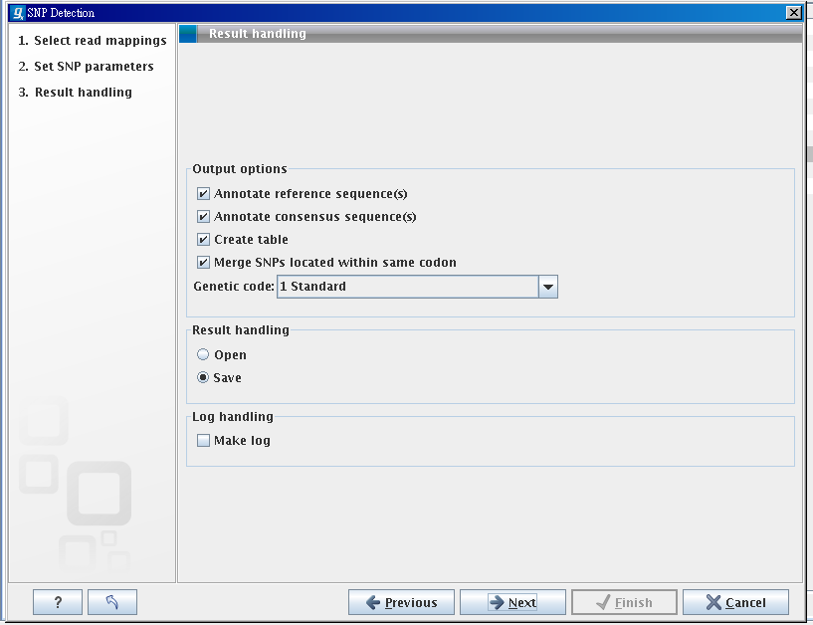
Annotate SNP on reference/consensus sequence

Slide 21
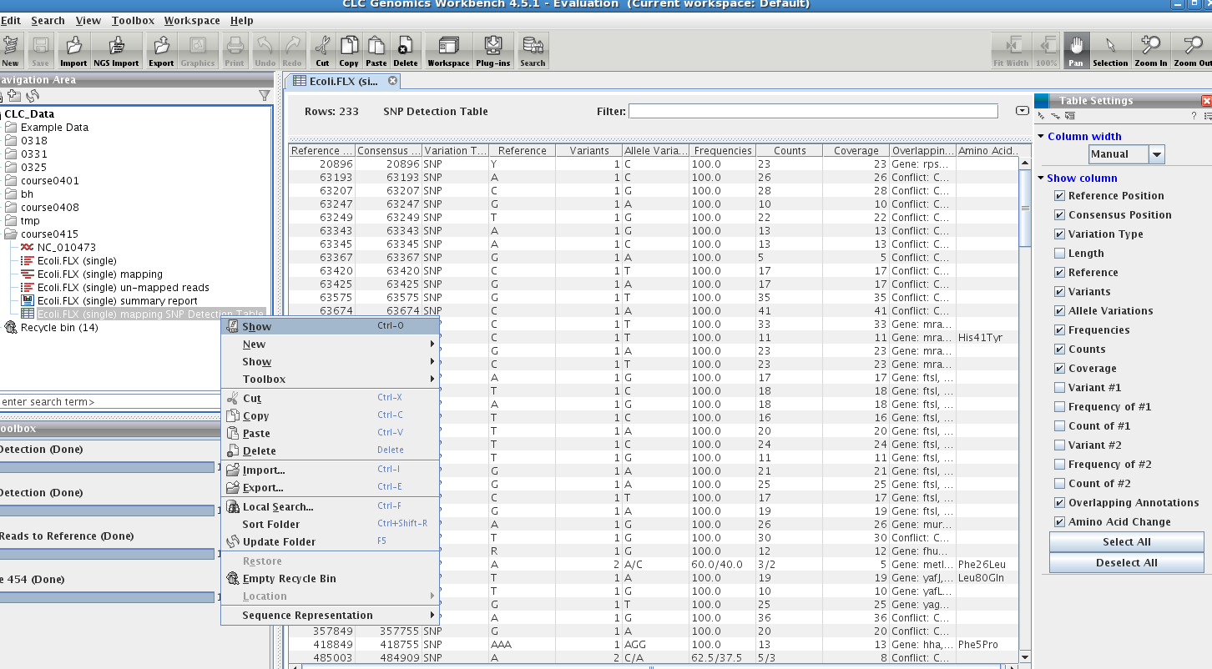
show SNP table

Slide 22
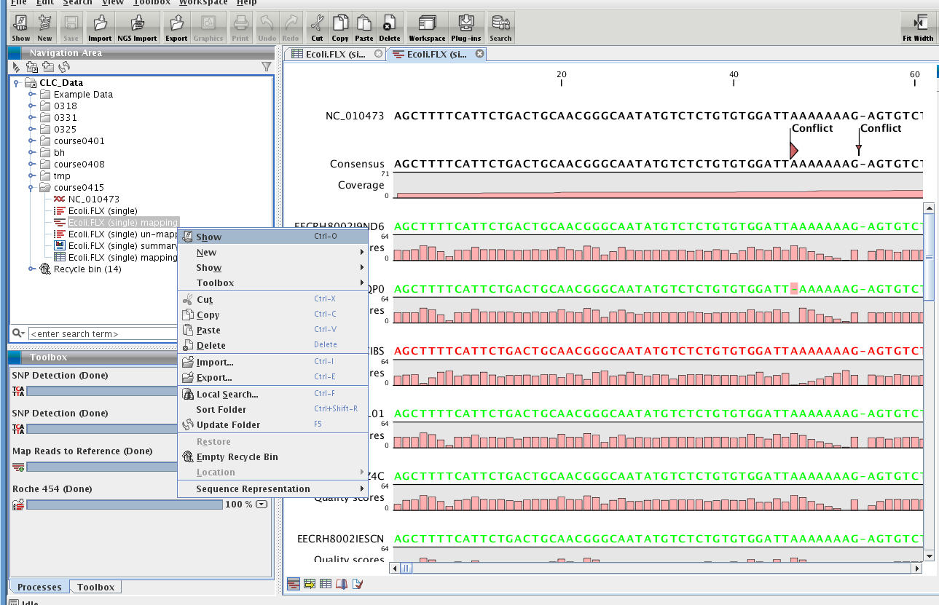
show genome/reads mapping

Slide 23
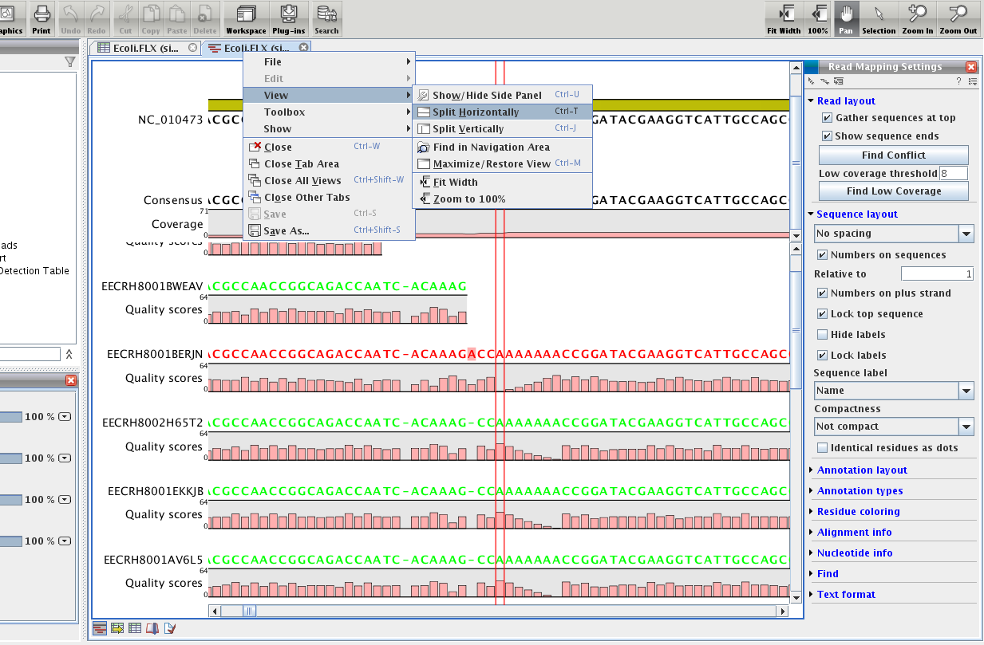

Slide 24
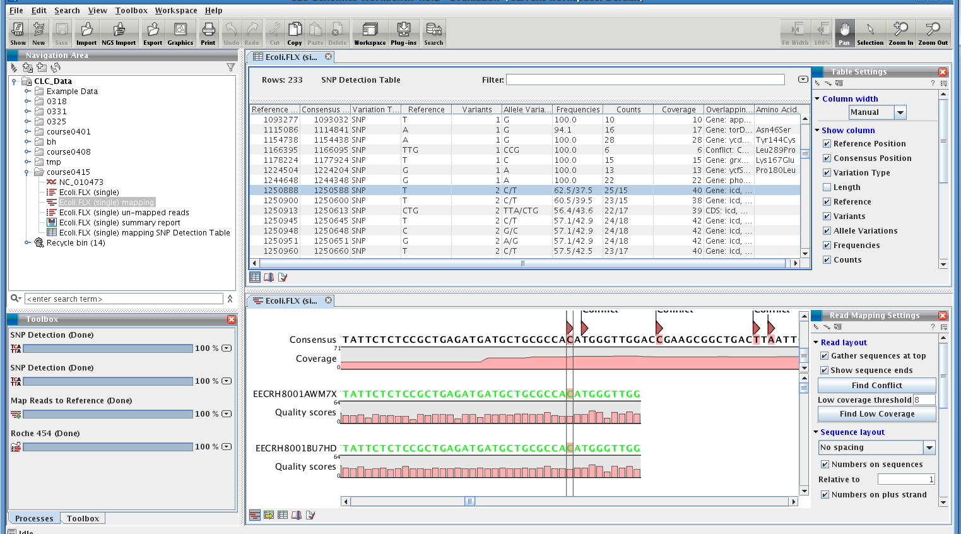

Slide 25
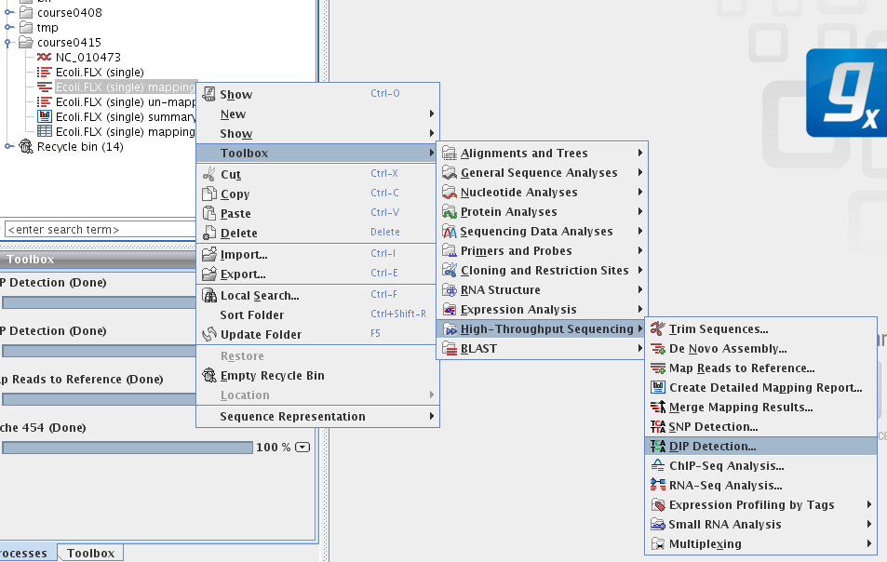
DIP detection

Slide 26
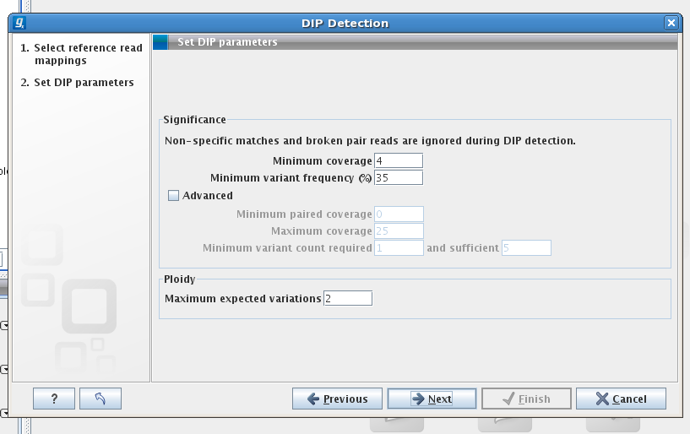

Slide 27
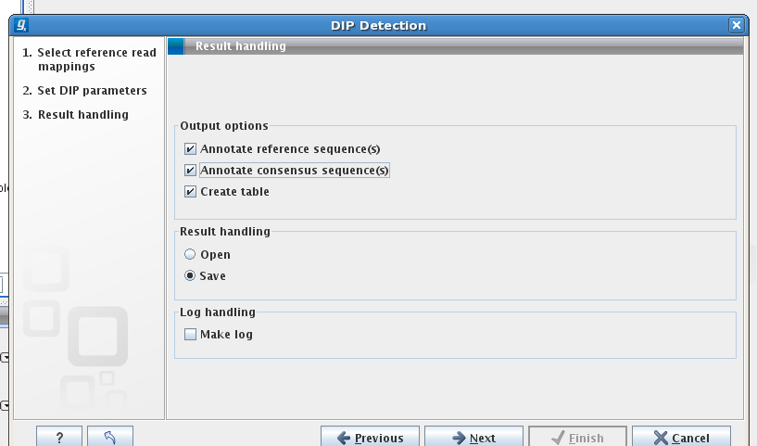

Slide 28


