Slide 1
ChIP seq
Tingwen Chen (陳亭妏)
Bioinformatics center
CGU
5.4.2012

Slide 2
Part I

Slide 3
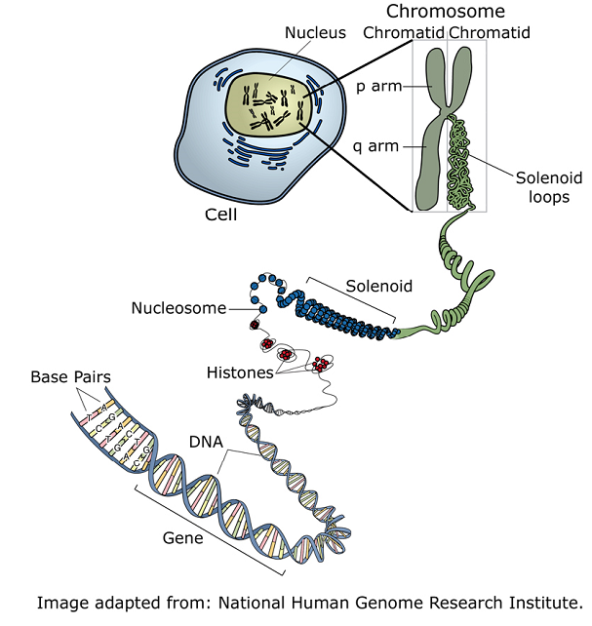
DNA and Proteins
Histone
Histone acetylases
Histone deacetylases
Chromosome remodelers
Transcription factor
Meyhlases
…

Slide 4
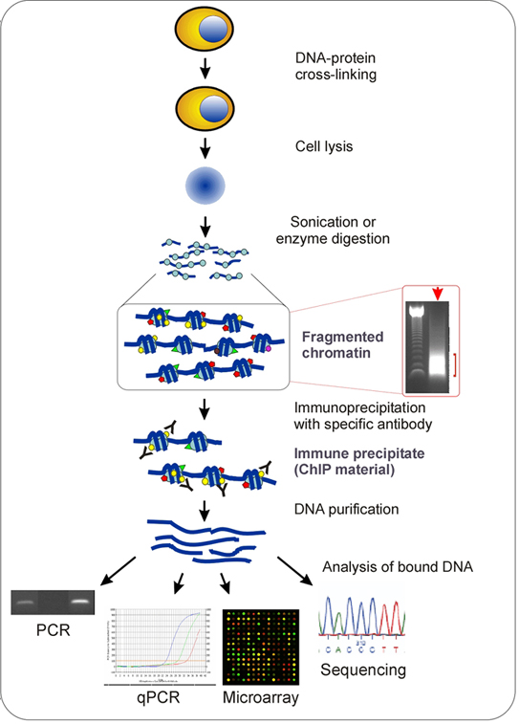
What is ChIP
Chromatin immunoprecipitation
Technique used to investigate the interaction between proteins and DNA in the cell
http://www.bioscience.org/2008/v13/af/2733/fulltext.asp?bframe=figures.htm&doi=yes

Slide 5
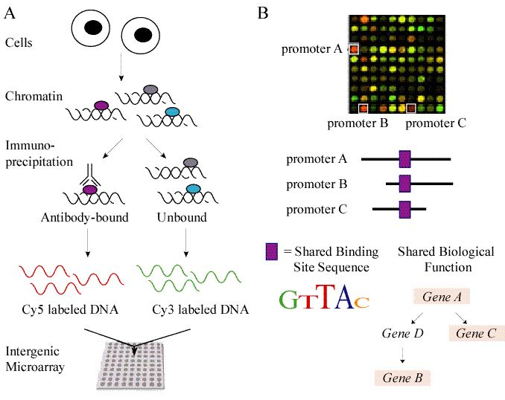
ChIP chip
(Wong and Chang, 2005)

Slide 6
What is ChIP-Sequencing?
ChIP-Sequencing is a new frontier technology to analyze protein interactions with DNA.
ChIP-Seq
  Combination of chromatin immunoprecipitation (ChIP) with ultra high-throughput massively parallel sequencing
  Allow mapping of protein–DNA interactions in-vivo on a genome scale

Slide 7
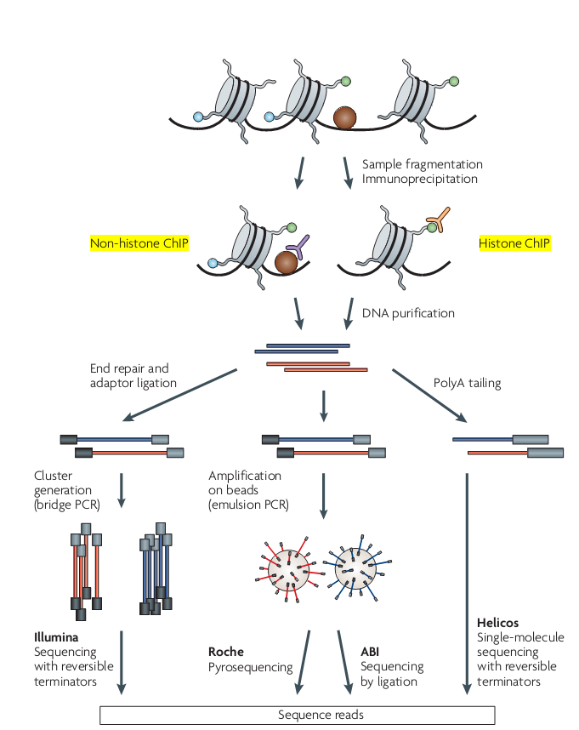
ChIP seq
(2009, Park)

Slide 8
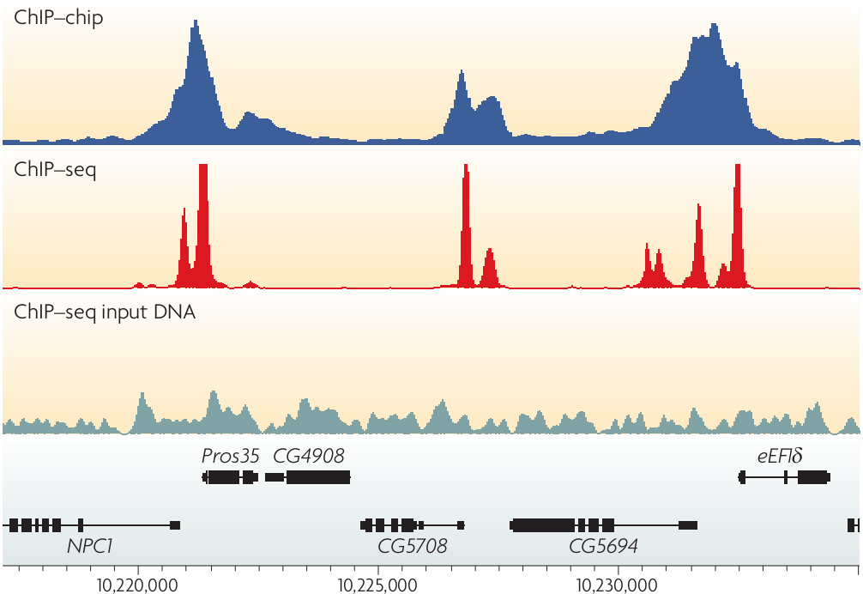
resolution
(Park, 2009)

Slide 9
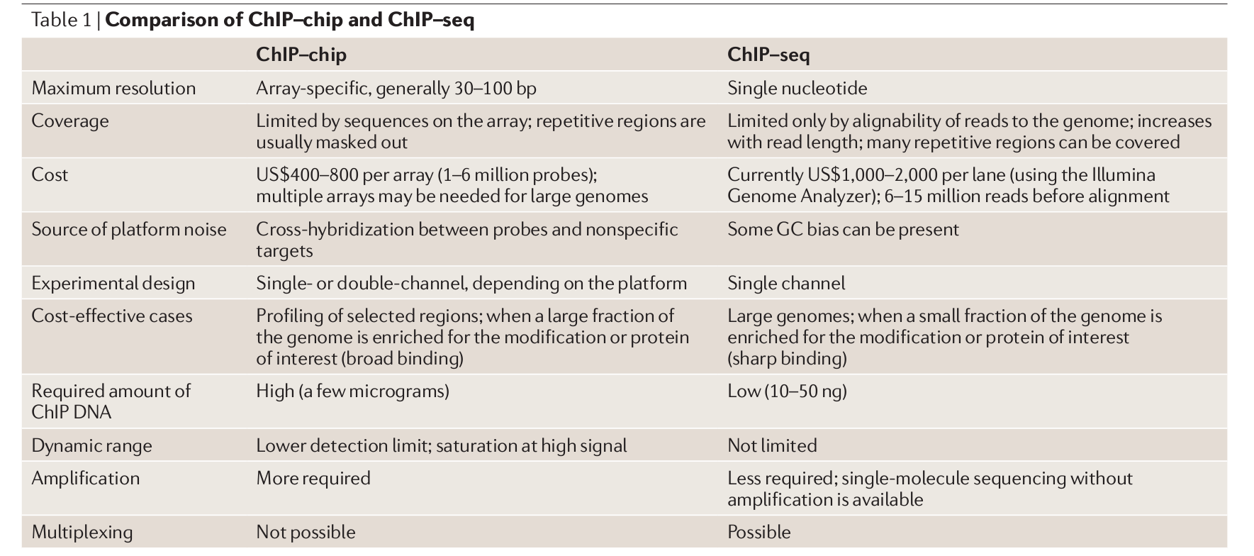
comparison
10-100 ng => > 2 μg
(Park, 2009)
For exam-ple, only 48% of the human genome is non-repetitive, but 80% is mappable with 30 bp reads and 89% is mappable with 70 bp reads.
Notes:
A typical ChIP experiment requires ~10⁷ cells and yields 10–100 ng of DNA.

Slide 10
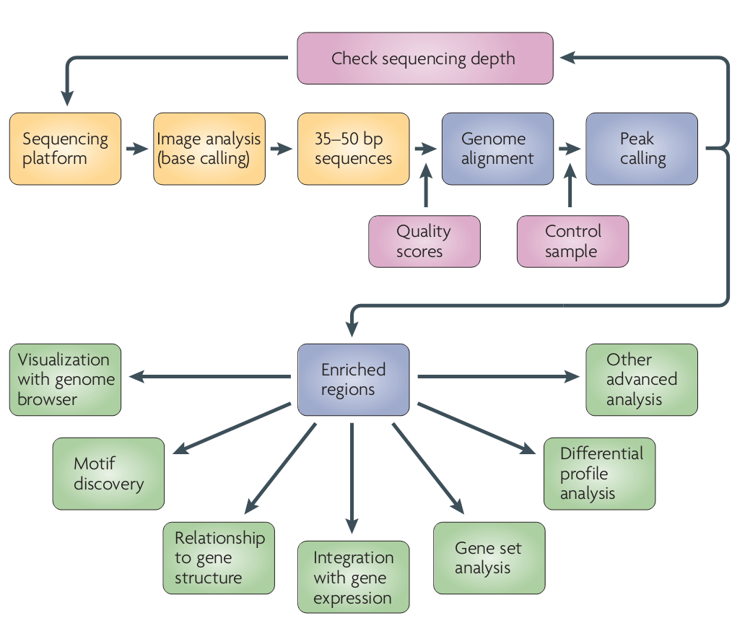
(Park, 2009)

Slide 11
Mapping Methods:
Indexing the Oligonucleotide Reads
ELAND (Cox, unpublished)
  “Efficient Large-Scale Alignment of Nucleotide Databases” (Solexa Ltd.)
SeqMap (Jiang, 2008)
  “Mapping massive amount of oligonucleotides to the genome”
RMAP (Smith, 2008)
  “Using quality scores and longer reads improves accuracy of Solexa read mapping”
MAQ (Li, 2008)
  “Mapping short DNA sequencing reads and calling variants using mapping quality scores”

Slide 12
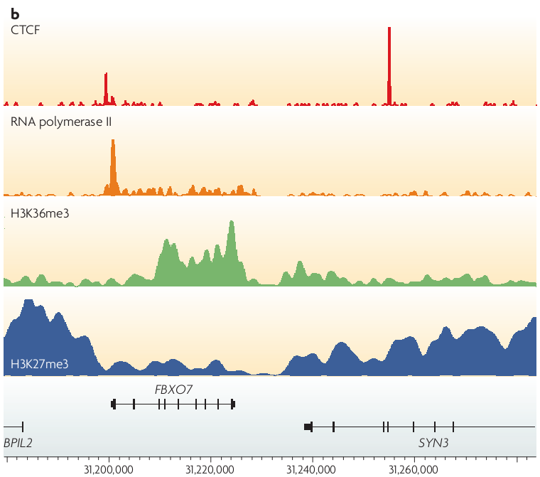
Peak calling
Sharp (e.g. TF binding)
Mixture (e.g. polymerase binding)
Broad (e.g. histone modification)
(Park, 2009)

Slide 13
Region level Peak calling
Usually a sliding-window approach is used
  Typically, window size depends on the event size
  Often overlapping/adjacent/nearby regions are merged
More rarely, an island approach is used
  Build regions out of overlapping (inferred) fragments or reads.
Most of the time, enriched region is trimmed to give a higher resolution event location (this would be the actual peak)
Sometimes, regions/peaks are split up in post-processing (multiple nearby events)

Slide 14
Base pair level peak calling
Typically two strategies:
Find the number of fragments (usually Not reads) overlapping that position
  need to go from reads to fragments
Find the number of reads (fragment ends) reported at that position (possibly, taking strandedness into account)
Very large selection of tools and techniques:
ERANGE, FindPeaks, MACS, QuEST, CisGenome , SISSRS, USeq, PeakSeq, SPP, ChIPSeqR , GLITR, ChIPDiff, T-PIC, BayesPeak, MOSAiCS, CCAT, CSAR

Slide 15
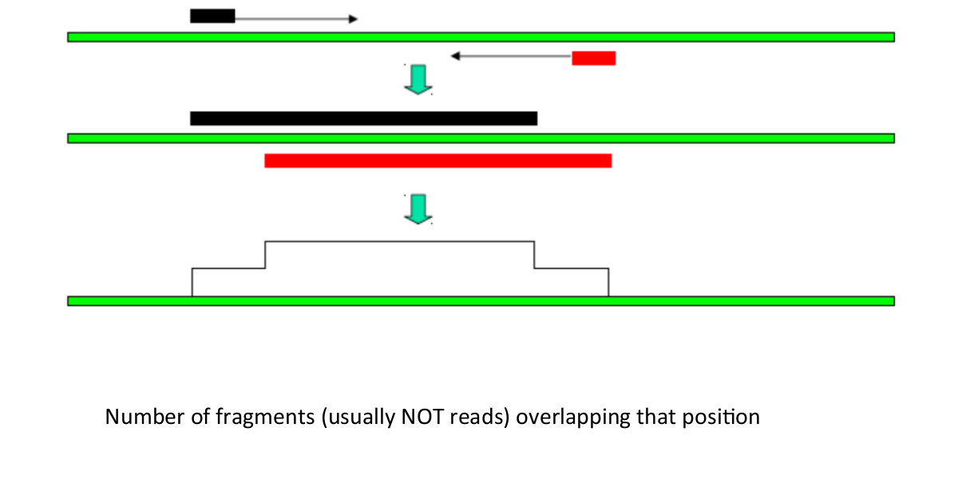
Fragments based
Slide modified from István Albert

Slide 16
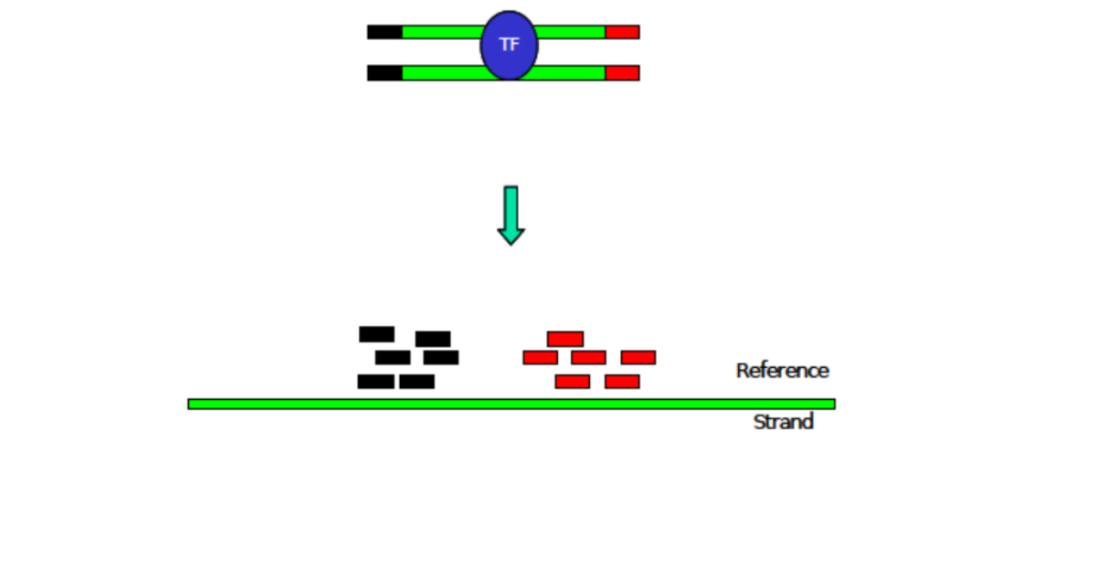
Reads based
Slide modified from István Albert

Slide 17
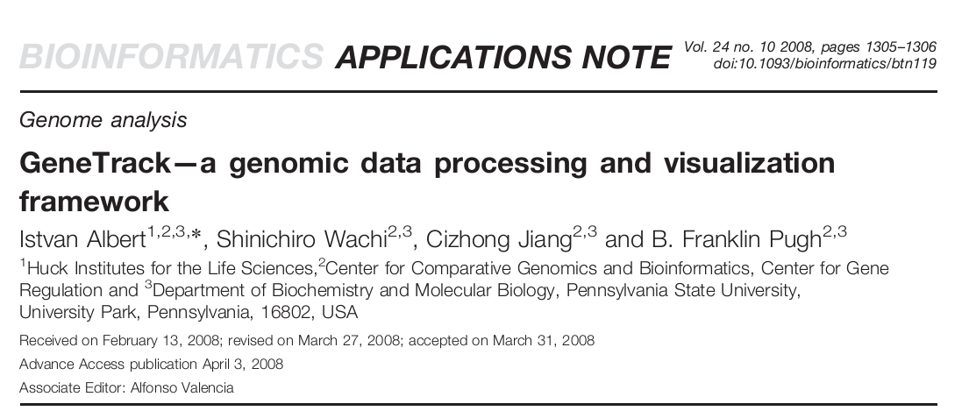
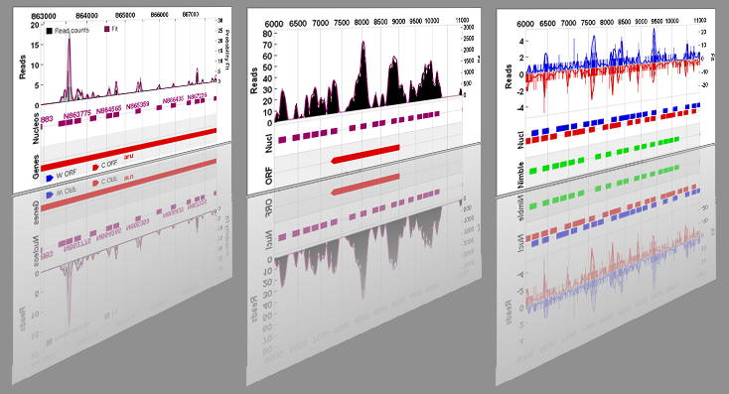
http://code.google.com/p/genetrack/

Slide 18
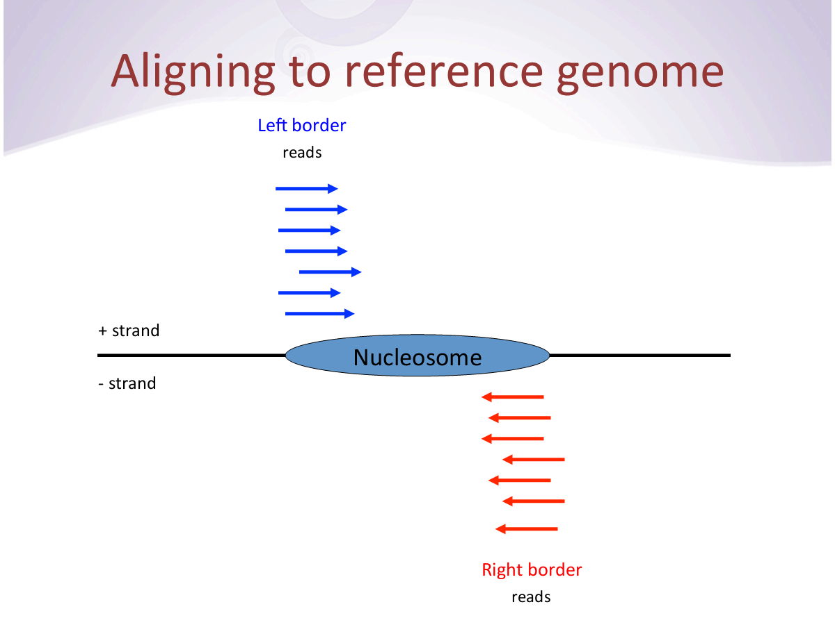
Slide modified from István Albert

Slide 19
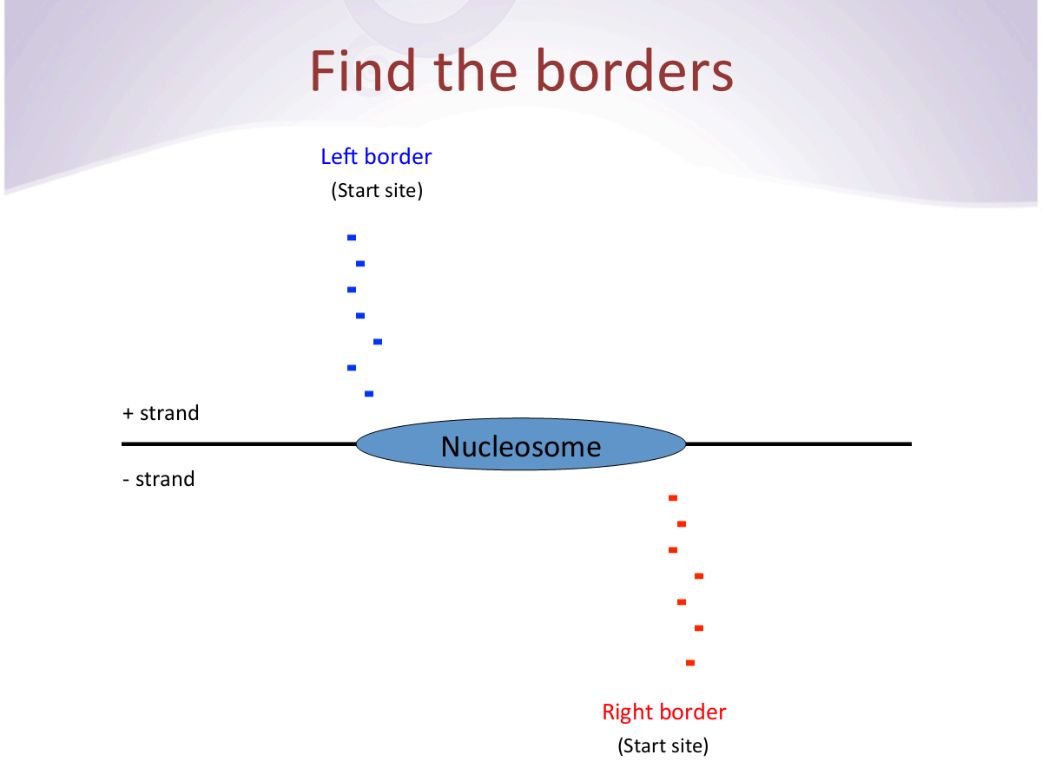
Slide modified from István Albert

Slide 20
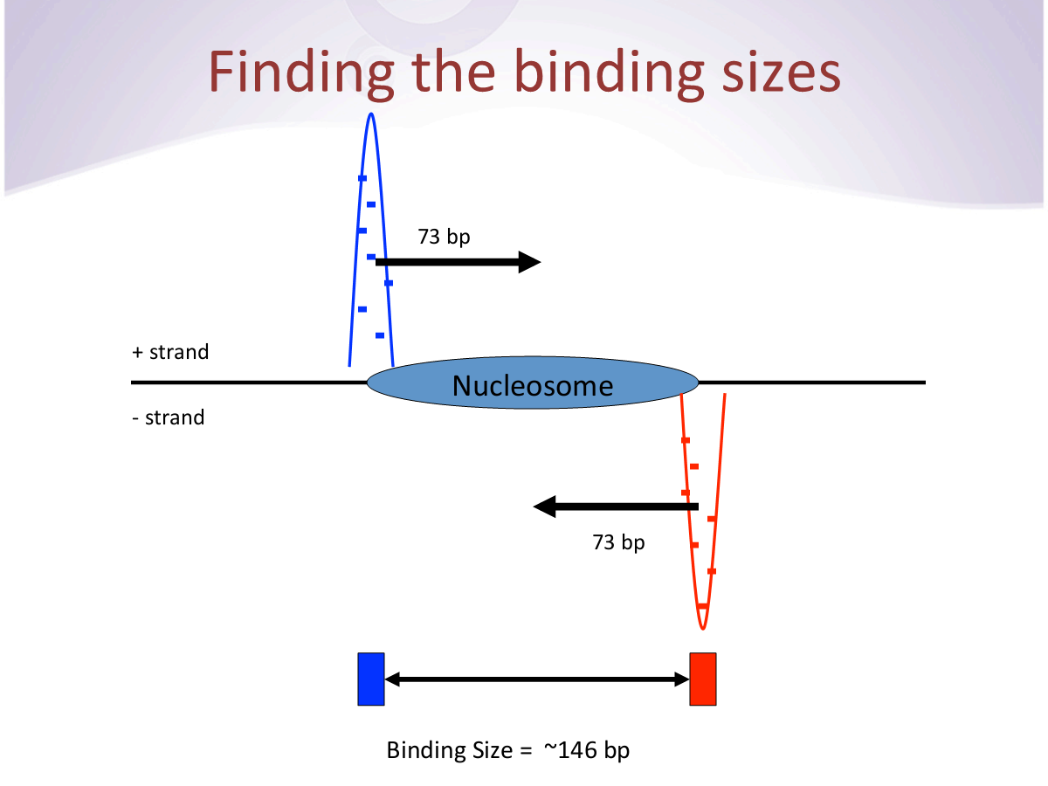
Slide modified from István Albert

Slide 21
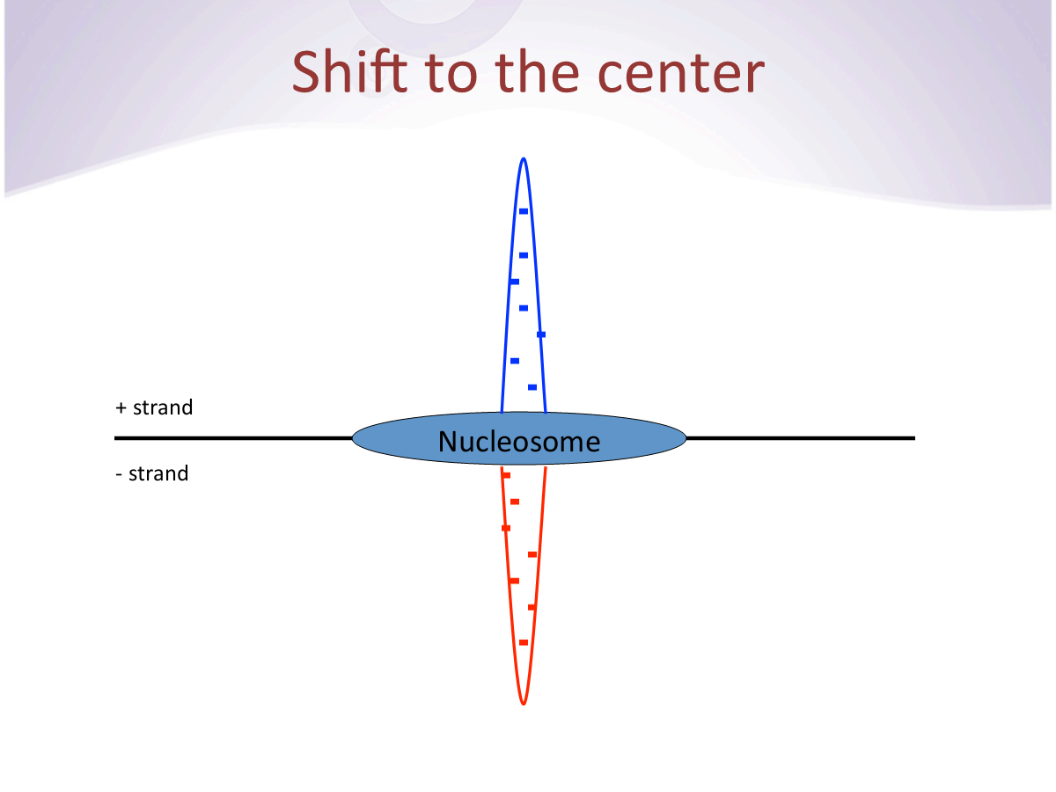
Slide modified from István Albert

Slide 22
Enrichment measures
Overlap approach: typically, the maximum overlap in the region is the measure
Read count approach: typically, the total number of reads in the region is the measure
■
Variation: calculate separate enrichment measures based on strand-specific reads.
Notes:
Slides modified from Oleg Mayba, Laurent Jacob, Sandrine Dudoit
Division of Biostatistics and Department of Statistics
University of California, Berkeley

Slide 23
Peak-Calling: Background
No-model approach (no BG estimation)
  Require enrichment > cutoff (user-specified)
  E.g., number of reads in 1kb bin > 10 (arbitrary number).
  Maybe use some other requirements (post-filtering)
  => No statistics can be done.

Slide 24
Peak-Calling: Background
Model null distribution of enrichment values based on sample itself
  Analytical
  Empirical (simulation-based)
Use significance measure (p-value, FDR) cutoff to retain regions

Slide 25
Peak-Calling: Background
First assumption people made: the distribution of read/fragment start sites is uniform across genome (apart from event sites)
  Poisson process with per-base rate = #(reads)/G
  Variation: exclude non-mappable portion of genome from G (mappability depends on your alignment strategy, unresolved bases in genome assembly)
  Variation: empirical null distribution based on simulations. This is more amenable to modifications
  For any p-value/FDR, it is straightforward to calculate enrichment significance cutoffs for both count-based and overlap-based measures
There is a problem: the distribution of read/fragment start sites is far from uniform as also seen in control samples (samples lacking enrichment due to event of interest)

Slide 26
Non-Uniformity of ChIP Sample
Background: Sequence features
Some of this non-uniformity can be attributed to library prep/sequencing and alignment steps
Mappability
  Depending on alignment strategy, there can be structural 0’s in data.
  Paired-ends information helps mitigate this somewhat
  Longer read lengths help to mitigate this too
GC bias
  Illumina-sequenced reads tend to be GC-rich
  There are some protocol modifications that try to minimize this bias

Slide 27
negative controls
Input DNA
Non-specific antibody
Different tissue
http://www.bioscience.org/2008/v13/af/2733/fulltext.asp?bframe=figures.htm&doi=yes

Slide 28
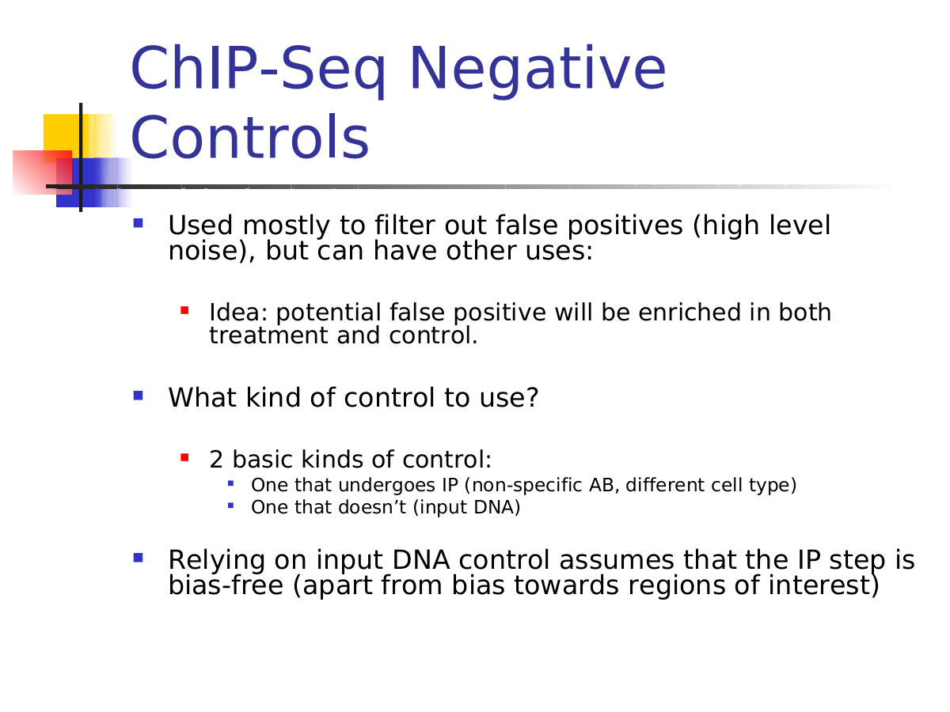

Slide 29
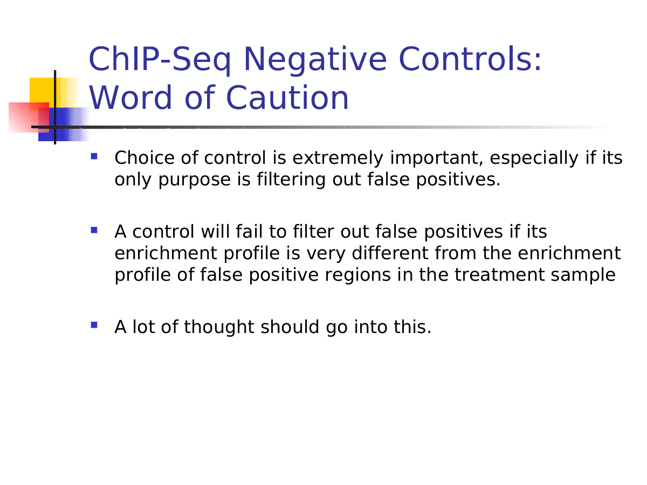

Slide 30
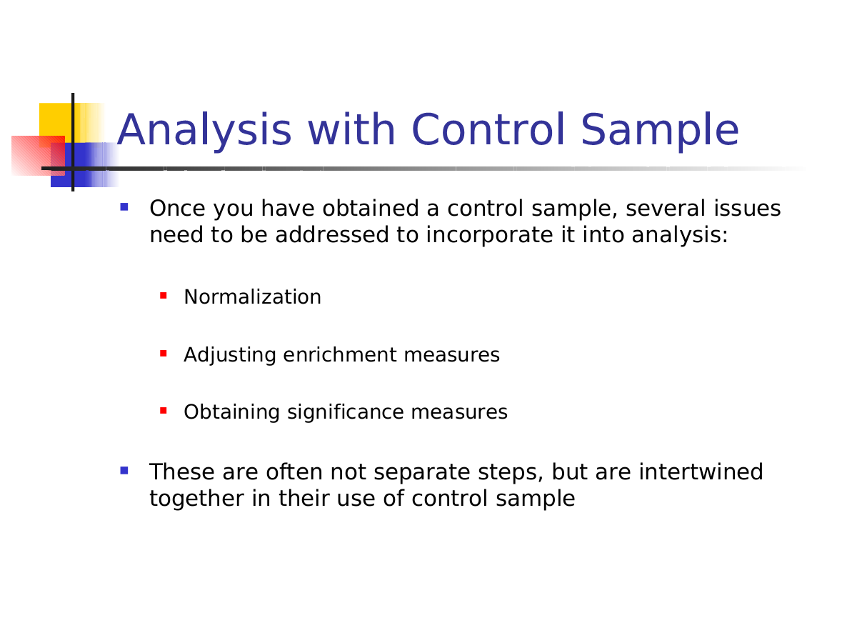

Slide 31
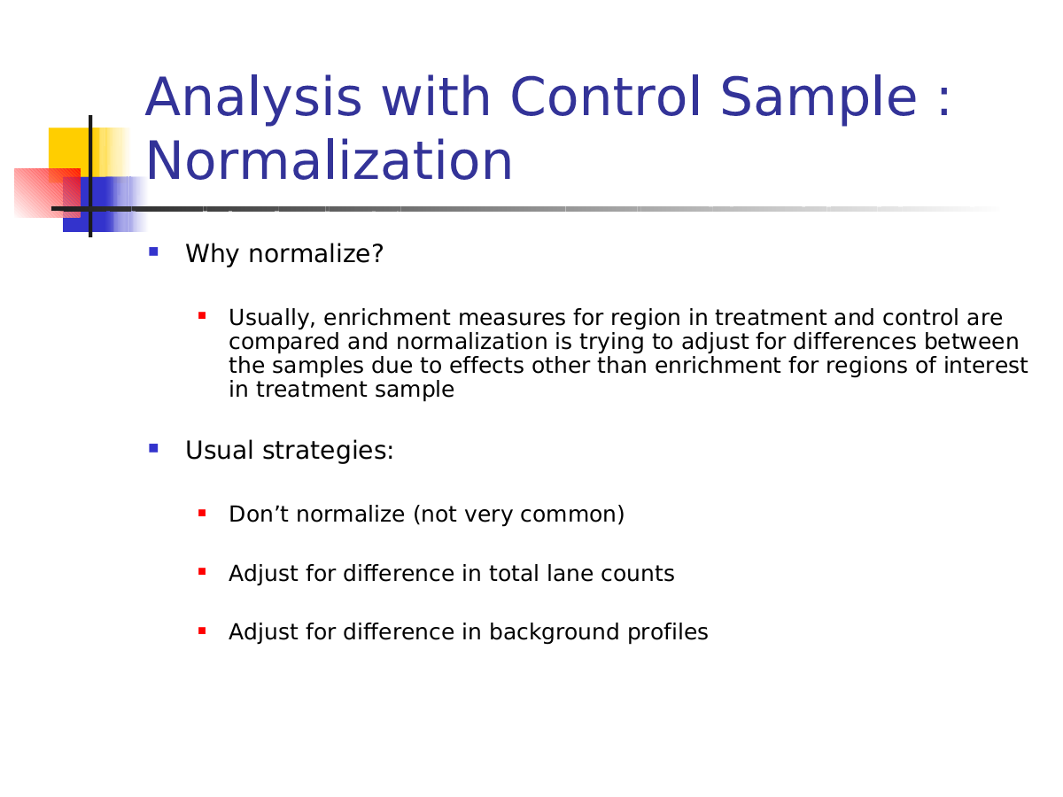

Slide 32
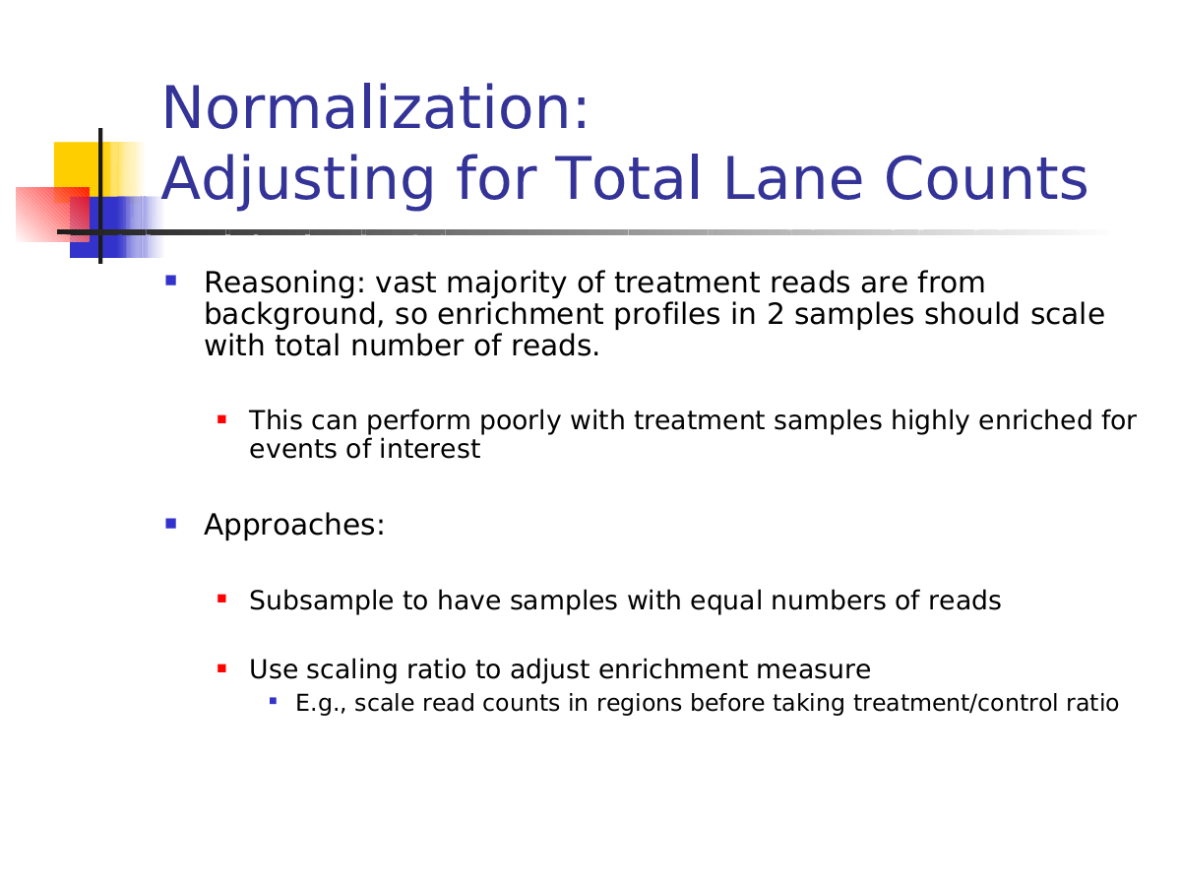

Slide 33
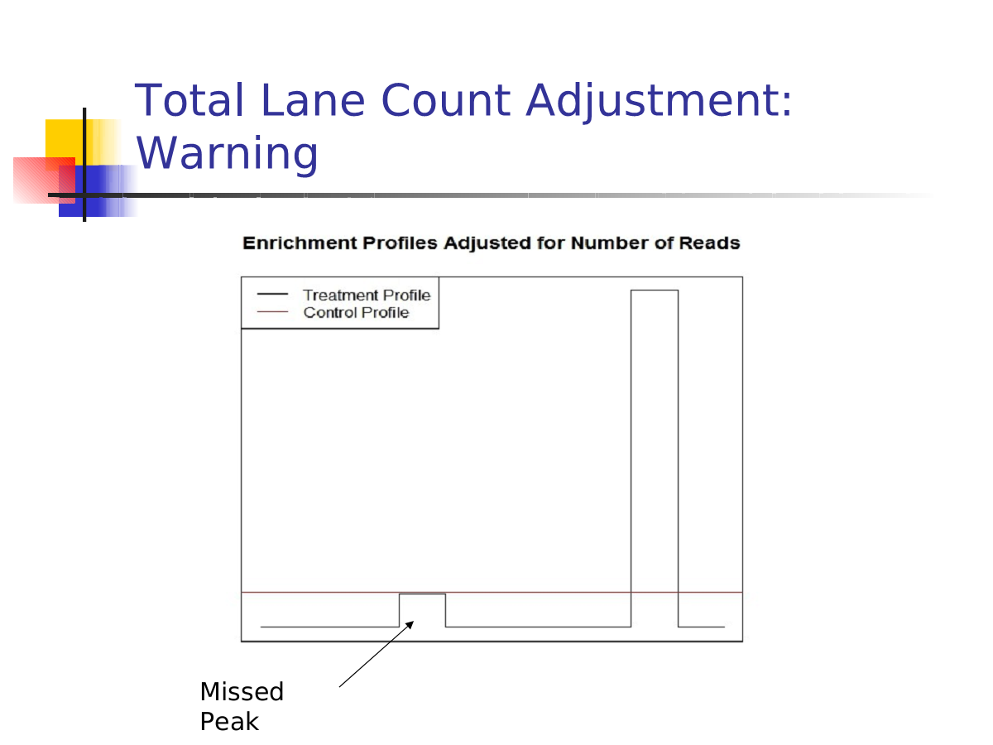

Slide 34
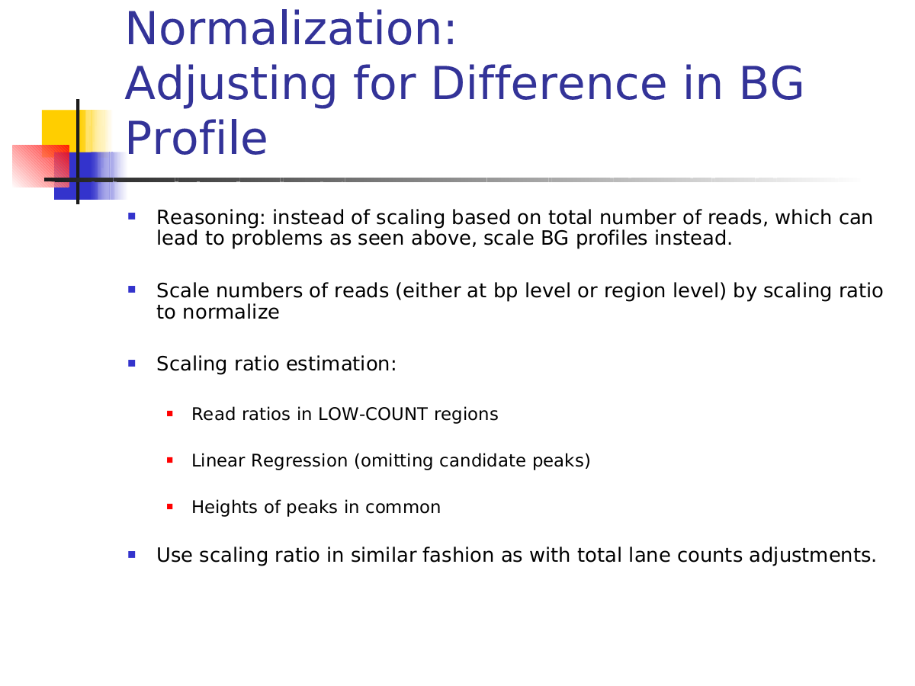

Slide 35
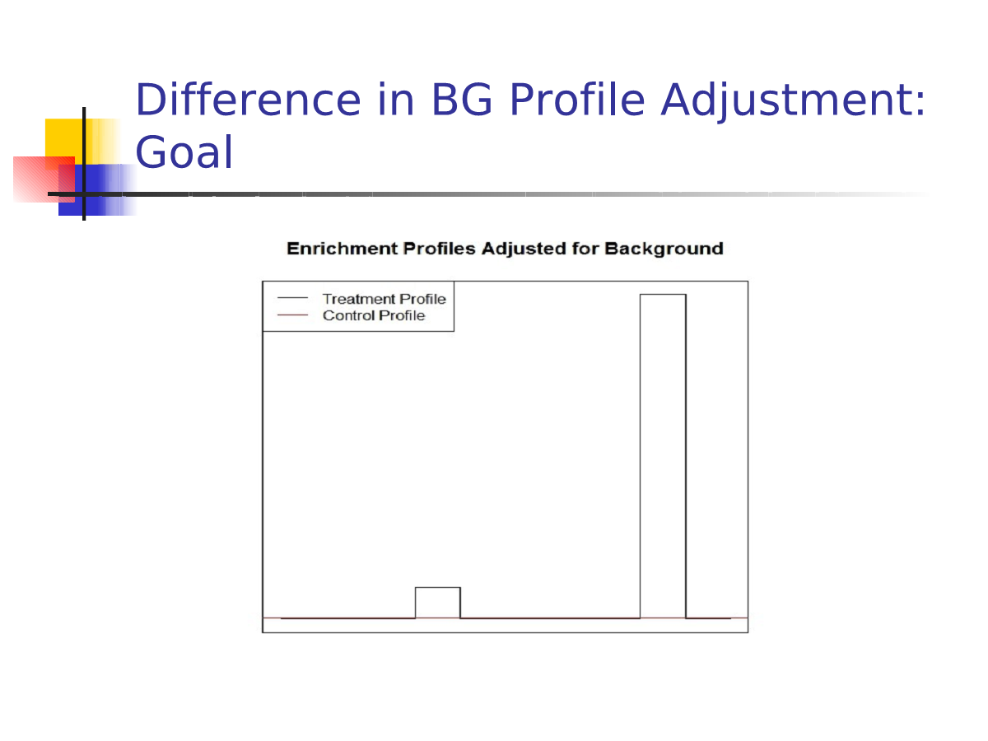

Slide 36
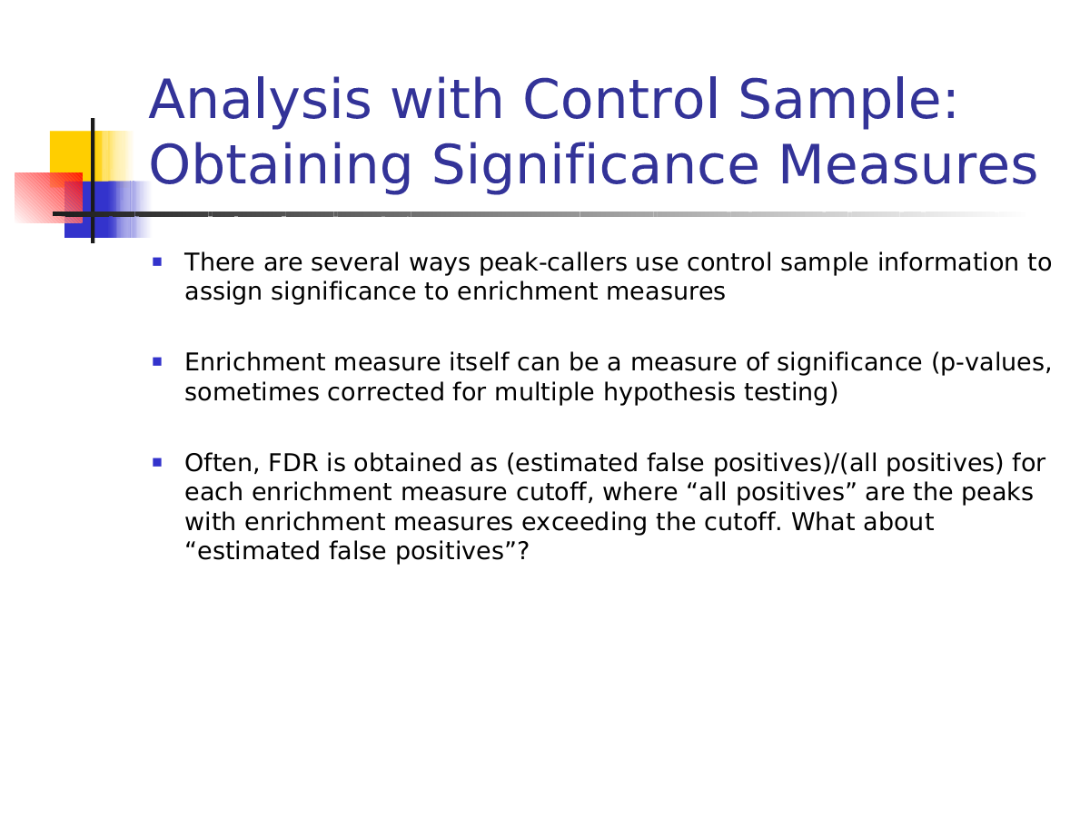

Slide 37
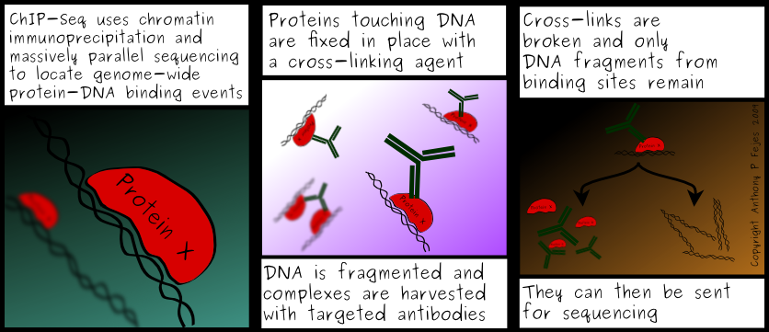

Slide 38
Examples

Slide 39
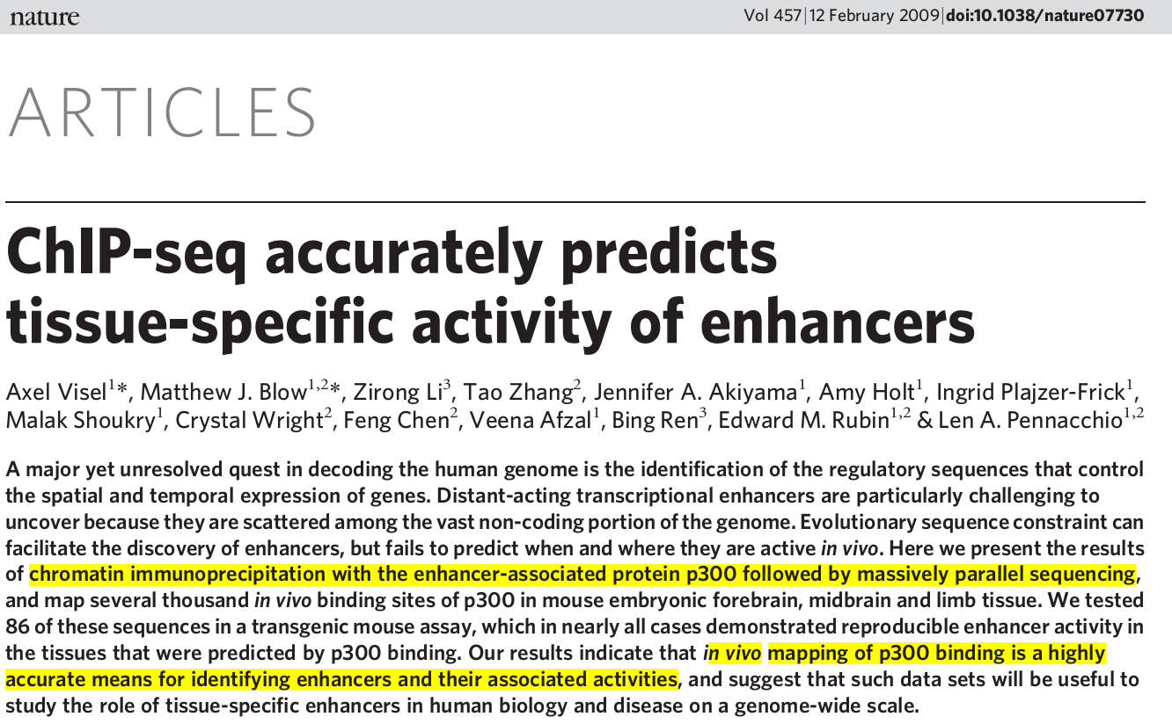

Slide 40
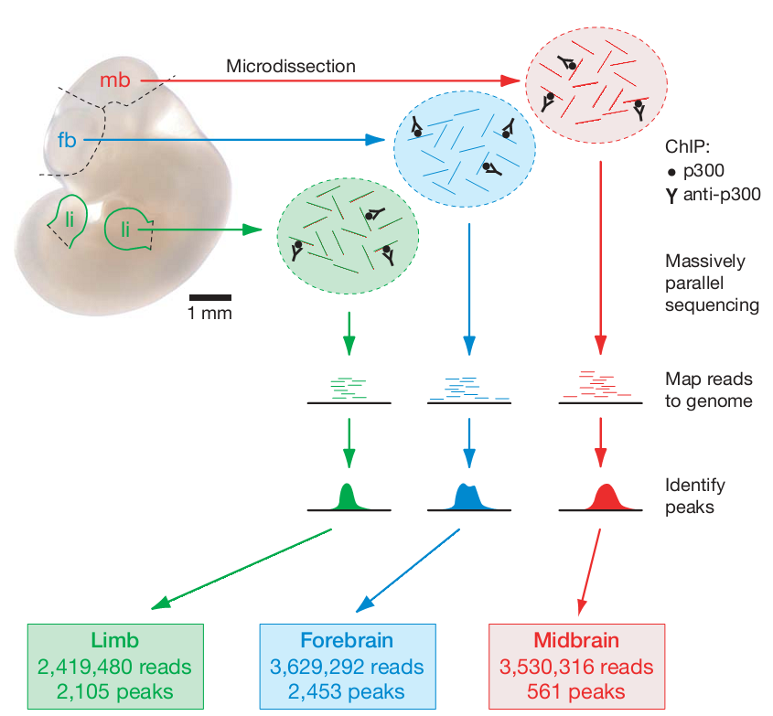
The acetyltransferase and transcriptional coactivator p300 is a near-ubiquitously expressed component of enhancer-associated protein assemblies and is critically required for embryonic development.
fb, forebrain; li, limb; mb, midbrain

Slide 41
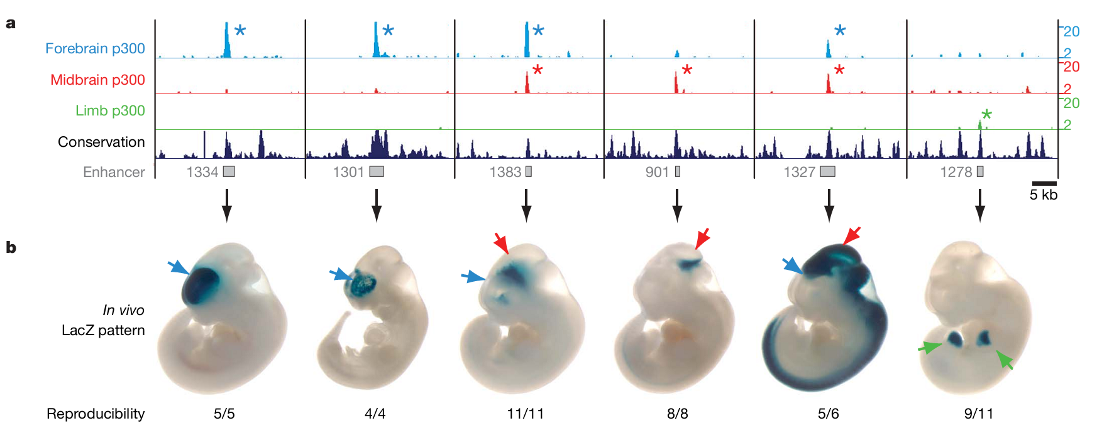
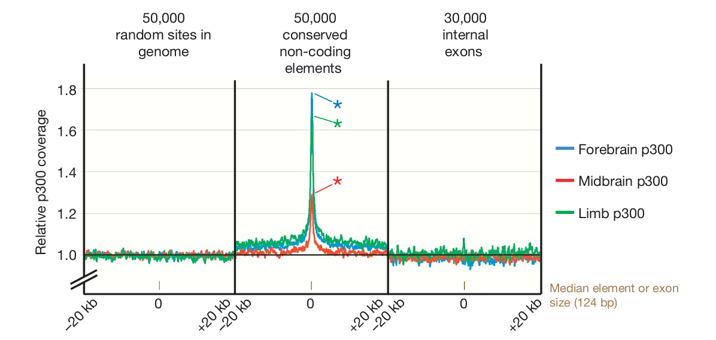

Slide 42
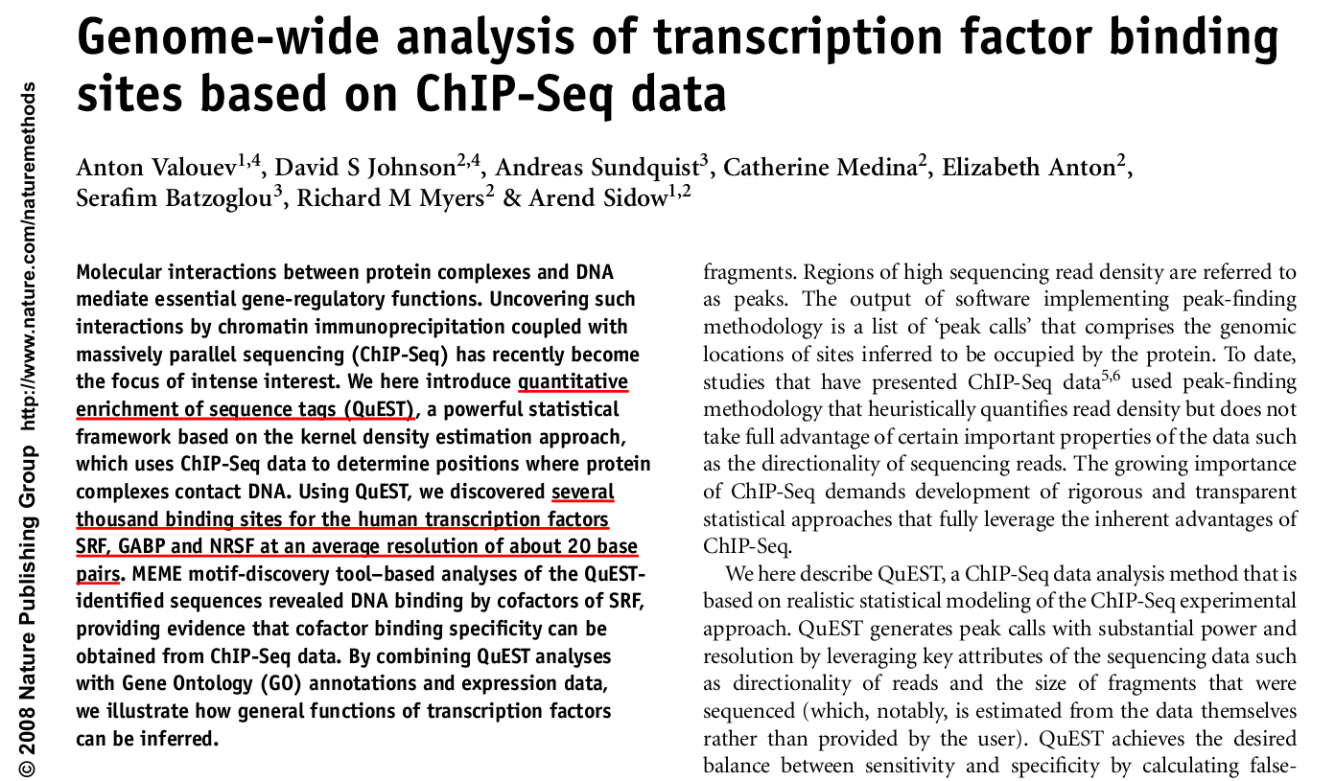

Slide 43
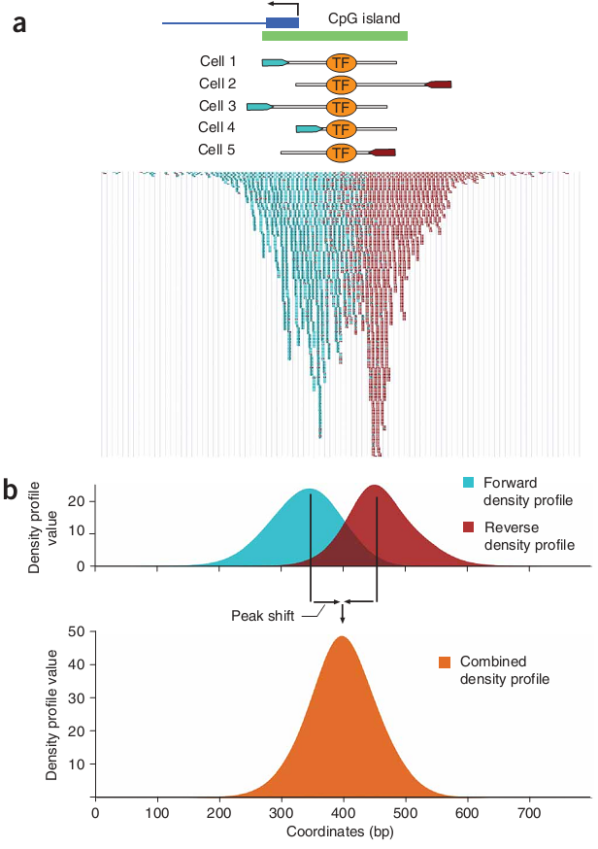

Slide 44
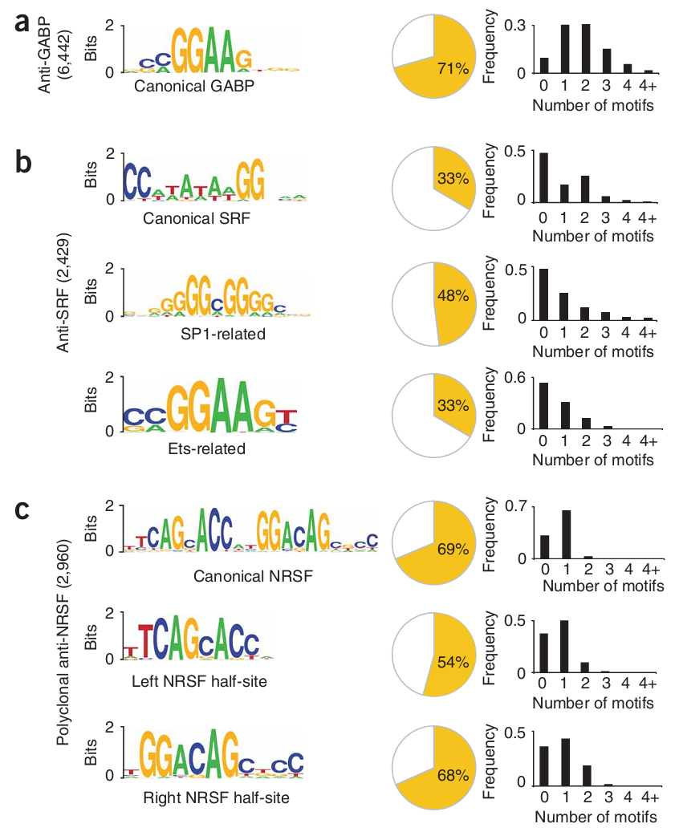
Growth-associated binding protein (GABP)
serum response factor (SRF)
neuron-restrictive silencer factor (NRSF)
Notes:
Growth-associated binding protein (GABP) and serum response factor (SRF) are thought to function primarily as transcriptional activa-tors 12–18, and neuron-restrictive silencer factor (NRSF) is a tran-scriptional repressor

Slide 45
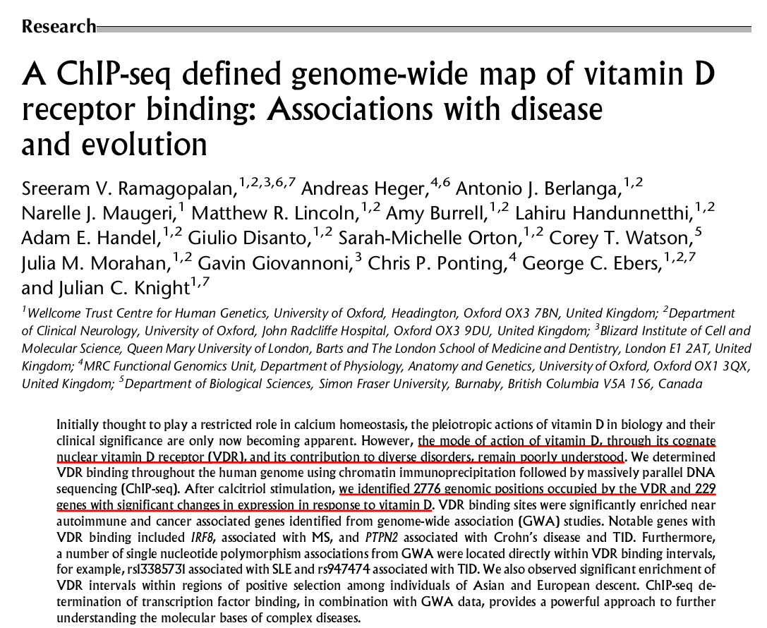

Slide 46
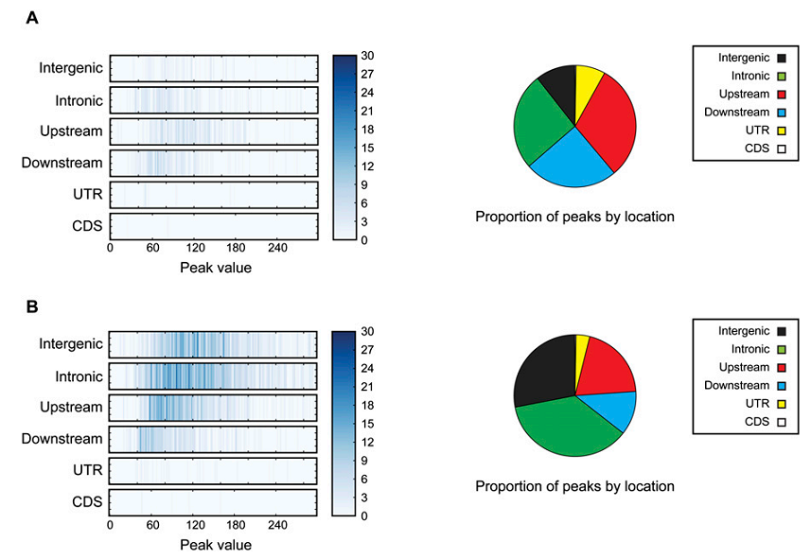
Unstimulated cells
Calcitrol-stimulated
cells

Slide 47
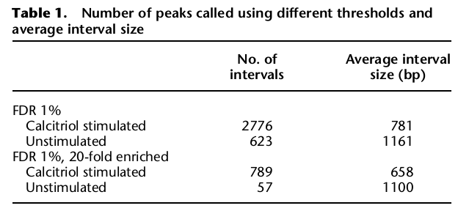
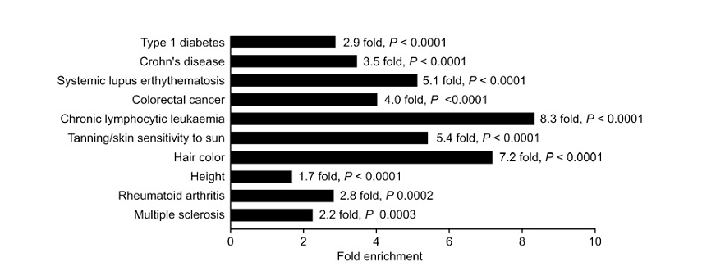
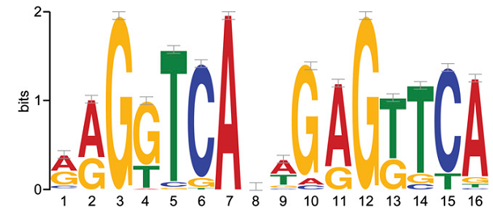

Slide 48
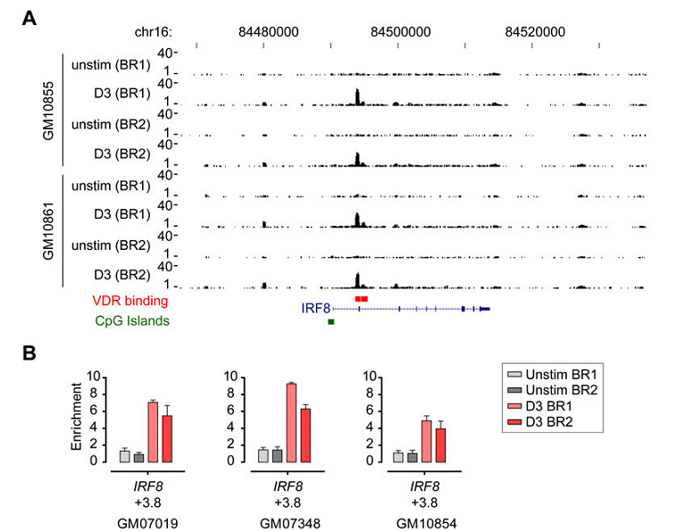
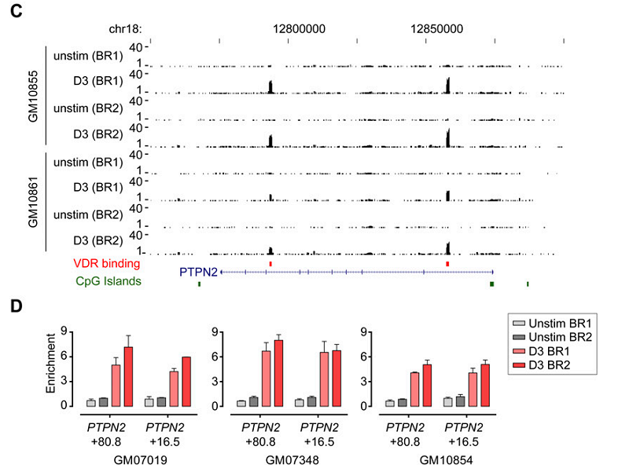

Slide 49
Part II

Slide 50
Chip-seq data analysis steps
import the data
map the reads to a reference
use the ChIP sequencing tool to detect significant peaks in the sample.

Slide 51
wget http://192.168.75.28/class/chipseq/ChIP-seq%20reads%20-%20subset.fa
wget http://192.168.75.28/class/chipseq/NC_000073.gbk
wget http://192.168.75.28/class/chipseq/Mouse_Reads_subset.fa
wget http://192.168.75.28/class/chipseq/NC_000021%20-%20subset.gbk

Slide 52
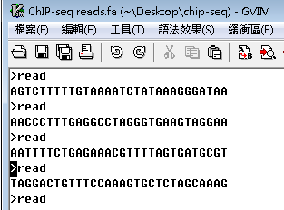
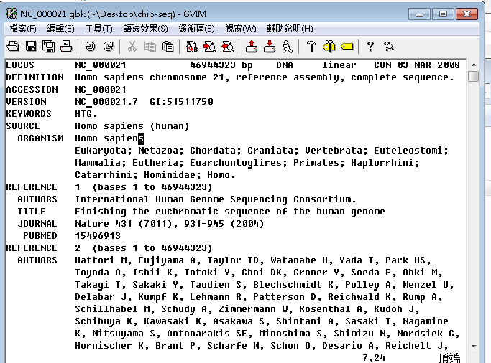
Input
Download reads & reference from:

Slide 53
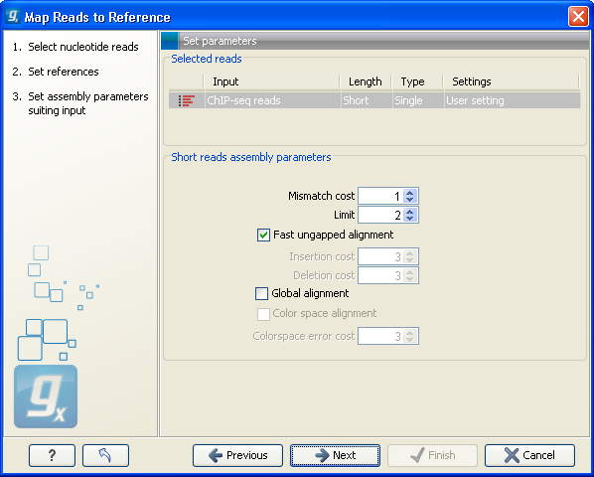
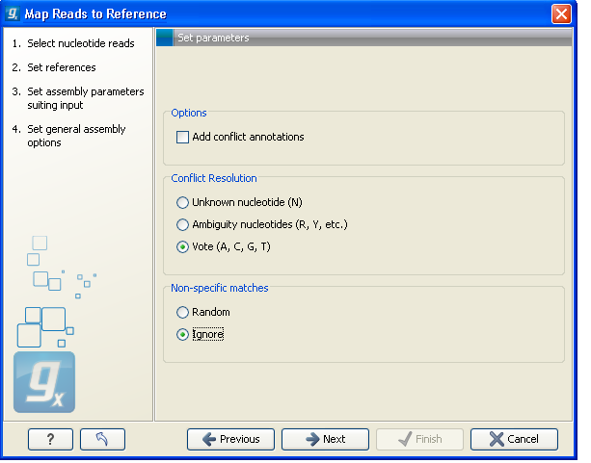
map the reads to a reference

Slide 54
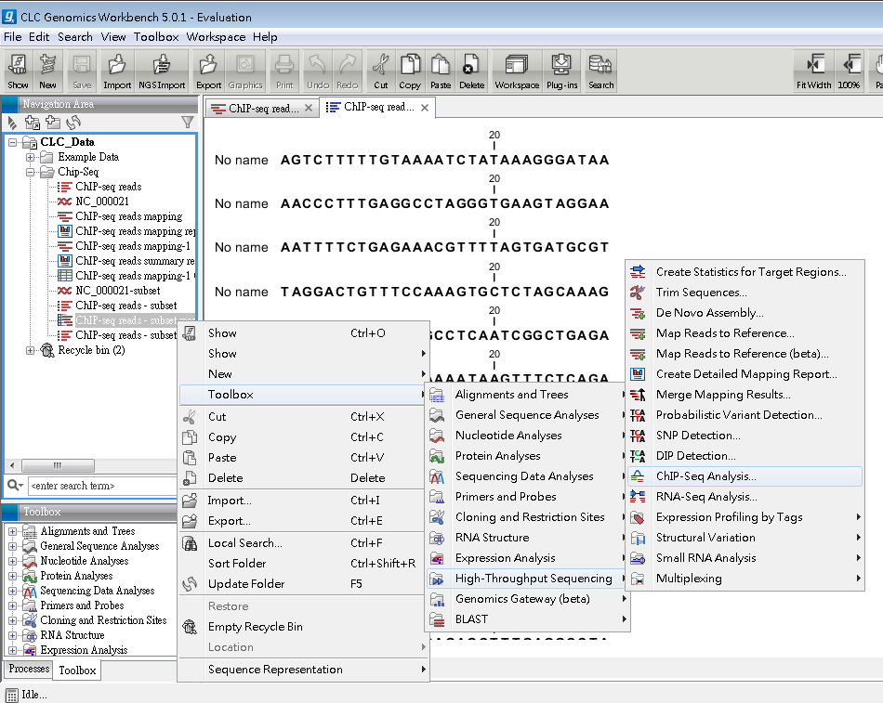
detect significant peaks
Notes:
Calculate the null distribution of background sequencing signal
Scan the mappings to identify candidate peaks with a higher read count than expected from the null distribution
Merge overlapping candidate peaks
Refine the set of candidate peaks based on the count and the spatial distribution of reads of forward and reverse orientation within the peaks

Slide 55
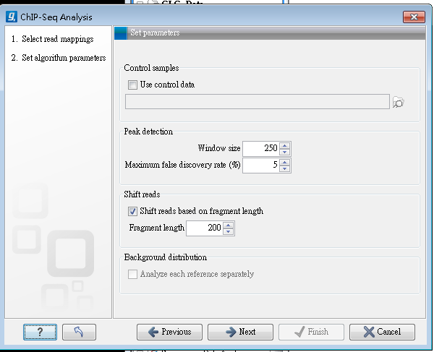
parameters

Slide 56
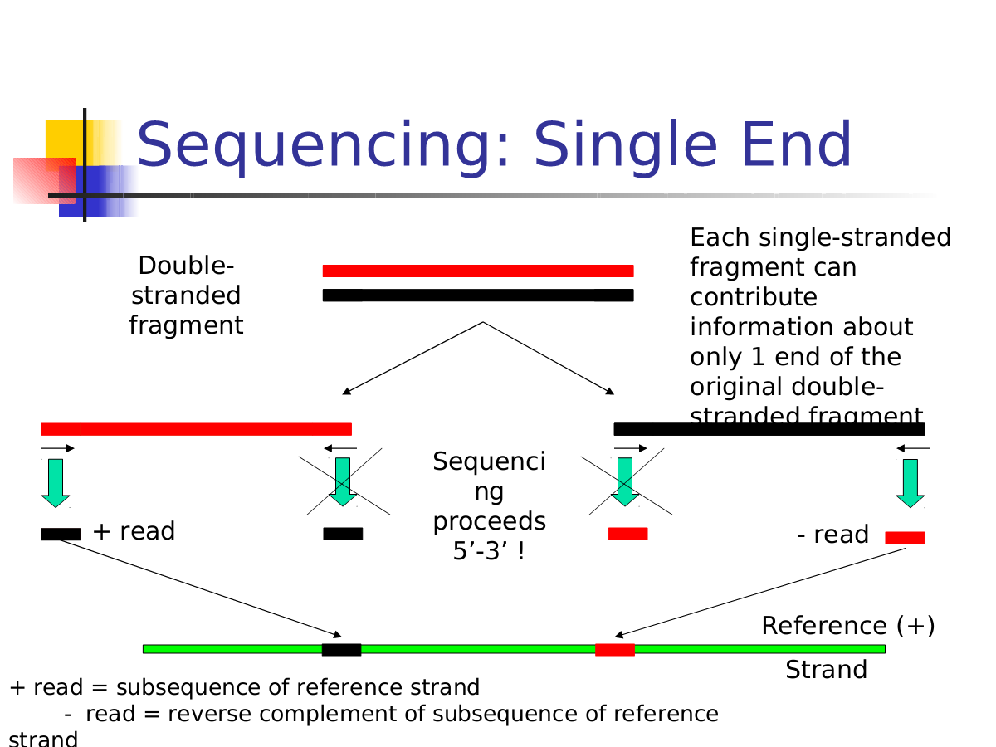

Slide 57
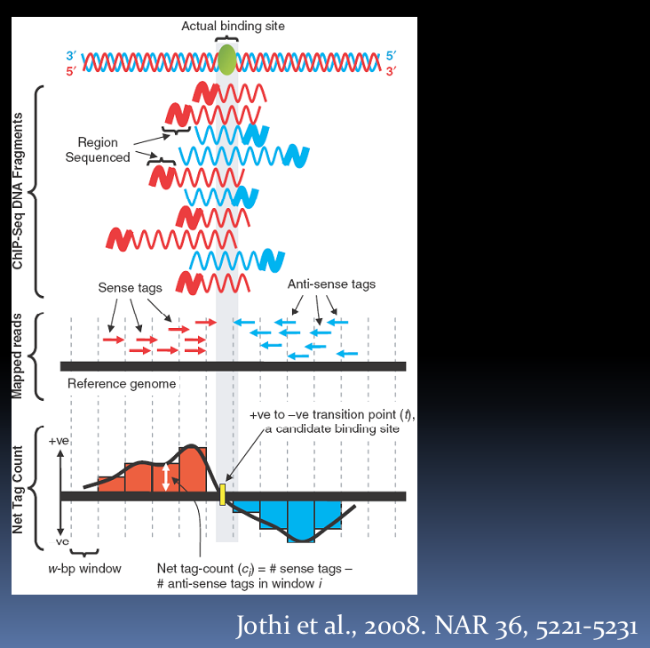
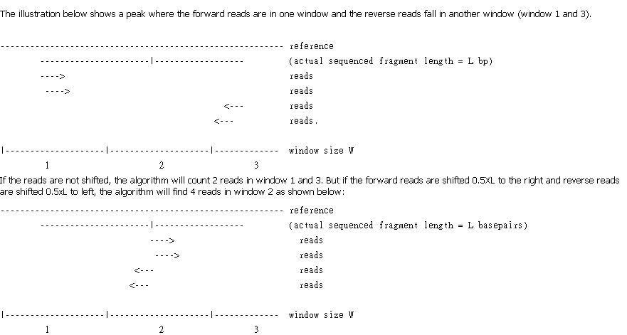
So shifting reads will increase the signal to noise ratio.

Slide 58
parameters

Slide 59
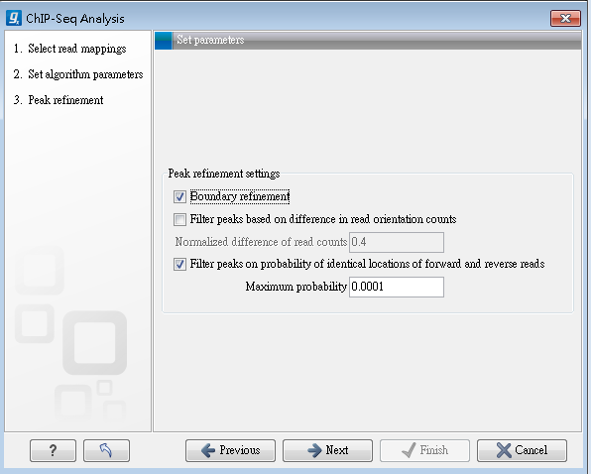

Notes:
The null hypothesis here is that the positions of forward and reverse reads within a peak are drawn from the same distribution i.e. that their locations are not significantly different

Slide 60


Slide 61
practices

Slide 62

Data resource
Notes:
download.clcbio.com/testdata/raw_data/chip-seq_pparg-subset.zip
First of all, only one of the 18 samples have been used. It is the sample of PPAR on day 6. This sample has been mapped against the mouse refseq genome, and two regions of chromosome 7 have been taken out for use in this tutorial. The reference sequence used is 10 Mbp, and there are 23,600 reads of 32 bp each.

Slide 63

The paper comments on the gene perilipin (Plin), so we will now take a look at the binding sites surrounding that gene.

Slide 64


