Slide 1

IGV tools

Slide 2
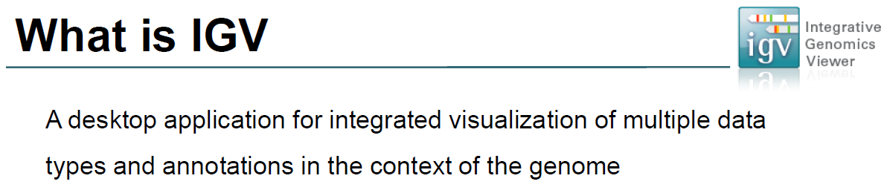
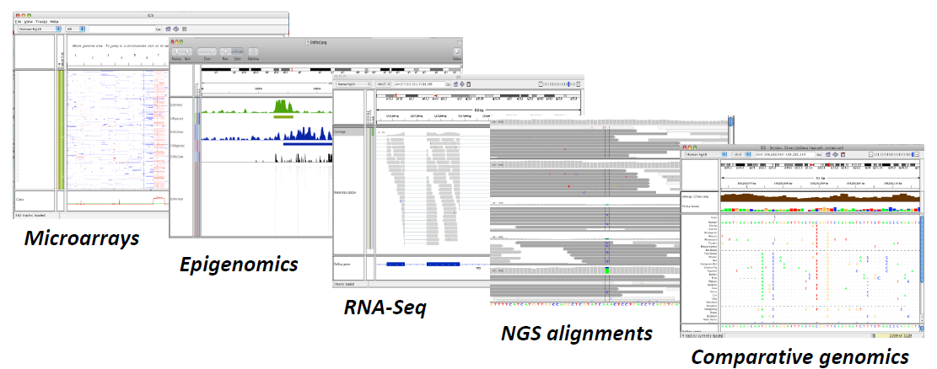

Slide 3
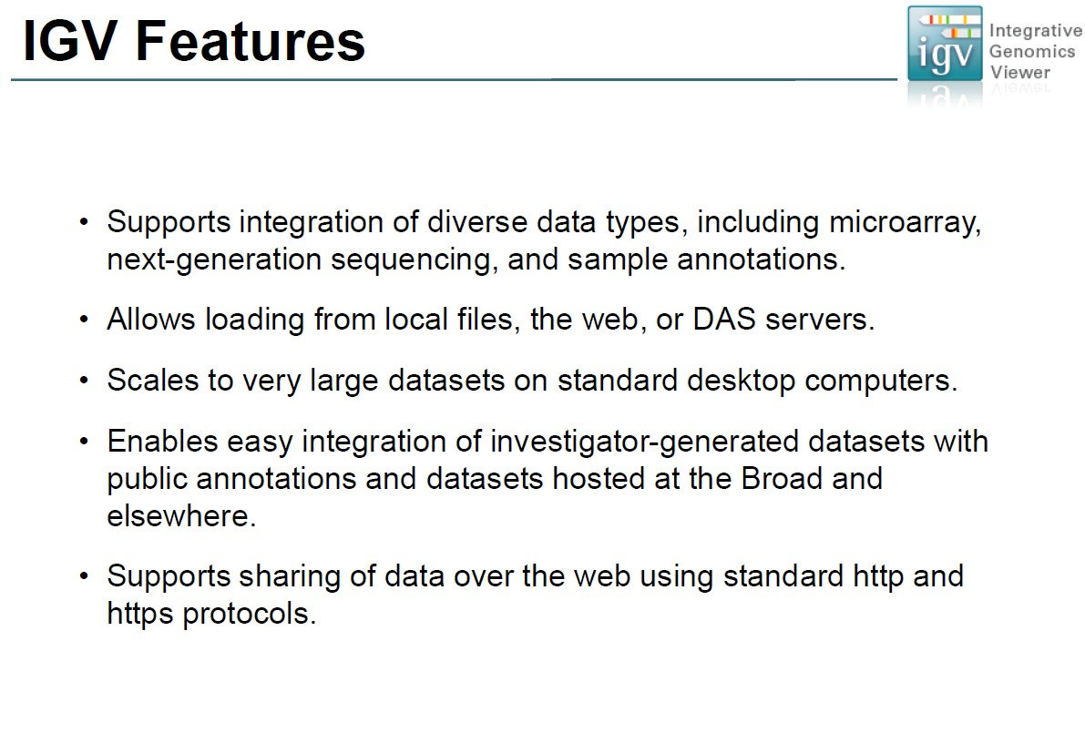

Slide 4
Pipeline
Download genome from Ensembl bacteria database
Map reads to genome by CLC
Export the mapping reads file (SAM)
Using the mapping reads file to find SNP by CLC
View sequence on IGV
Export SNP file by EXCEL

Slide 5
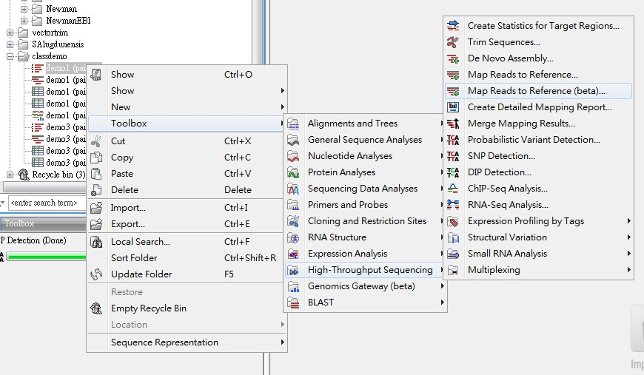
Download genome from Ensembl bacteria database
Map reads to genome by CLC
Export the mapping reads file (SAM)
Using the mapping reads file to find SNP by CLC
View sequence on IGV
Export SNP file by EXCEL

Slide 6
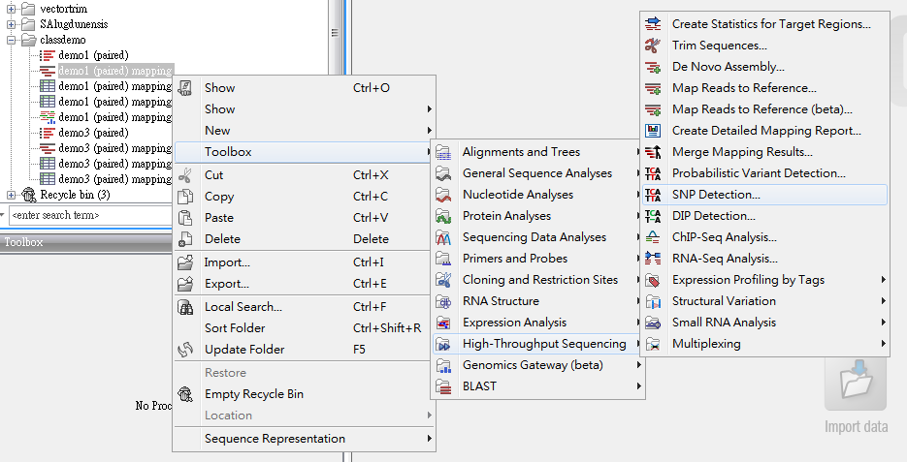
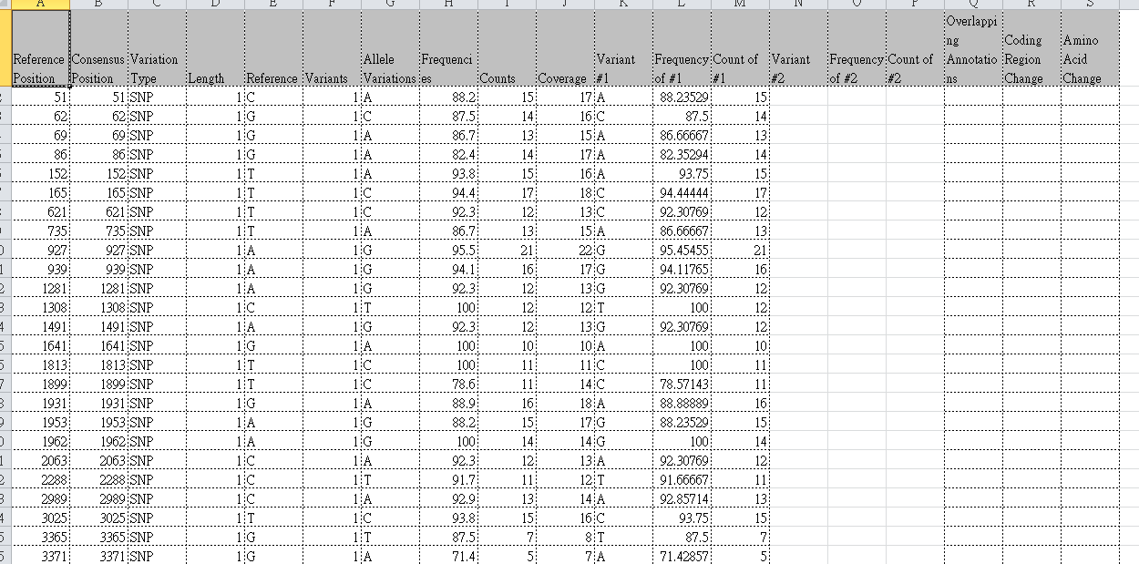
Download genome from Ensembl bacteria database
Map reads to genome by CLC
Export SNP file by EXCEL
Export the mapping reads file (SAM)
Using the mapping reads file to find SNP by CLC
Download Excel file : http://163.25.92.70/class
View sequence on IGV
Export SNP file by EXCEL

Slide 7
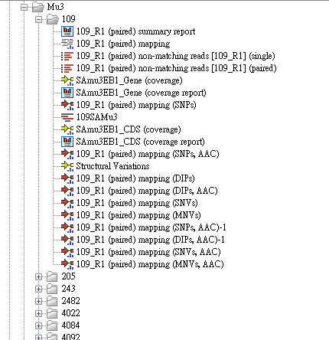
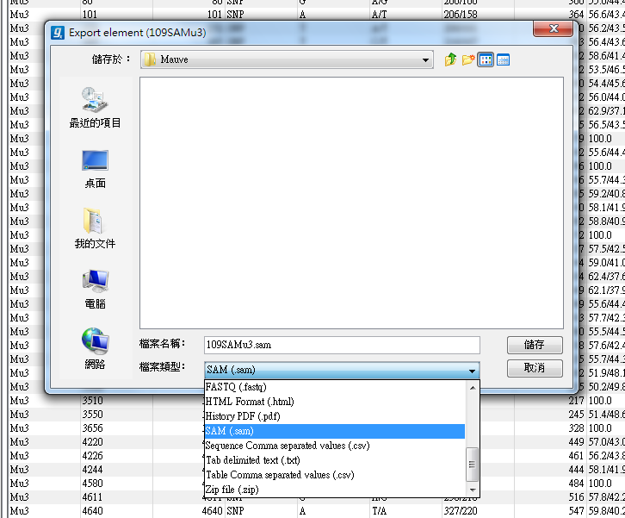
Using samtools
Download genome from Ensembl bacteria database
Map reads to genome by CLC
SAM convert to BAM file
Sort the BAM file
Output the sorted BAM file
Export the mapping reads file (SAM)
Using the mapping reads file to find SNP by CLC
Index the BAM file
Output the index BAM file
View sequence on IGV
Export SNP file by EXCEL

Slide 8
Download SAM file : http://163.25.92.70/class
SAM convert to BAM file
samtools view –bS (SAM) –T (Reference) –o (BAM)
ex : samtools view –bS demo1.sam –T SAmu50Ebl.fa
–o demo1.bam
Sort the BAM file
samtools sort (BAM) (BAM.sorted)
ex : samtools sort demo1.bam demo1.sorted
Index the BAM file
samtools index (BAM.sorted)
ex : samtools index demo1.sorted

Slide 9
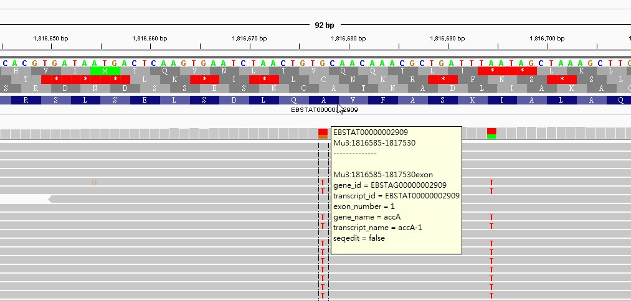
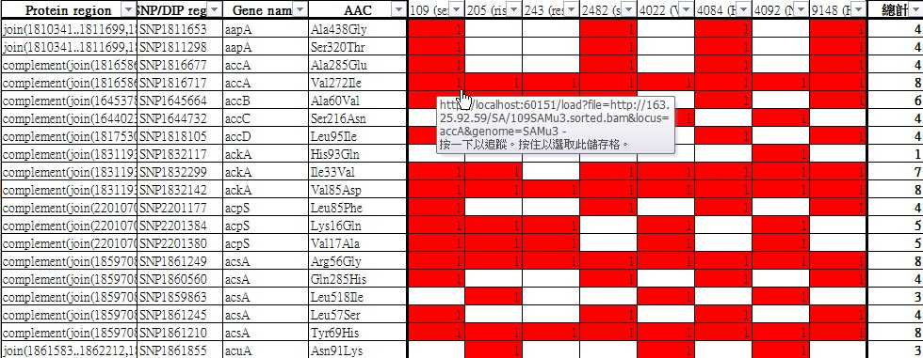
Download genome from Ensembl bacteria database
Map reads to genome by CLC
Export the mapping reads file (SAM)
Using the mapping reads file to find SNP by CLC
View sequence on IGV
Export SNP file by EXCEL

