Slide 1
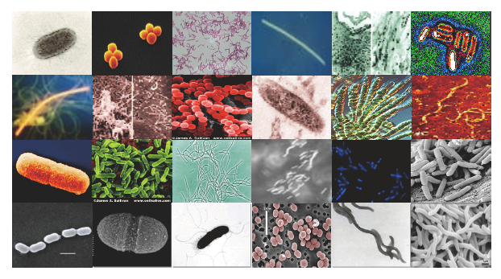

Metagenomics analysis
P. Tang (鄧致剛); YM Yeh (葉元鳴)
Bioinformatics Center, Chang Gung University.
Notes:
Metagenomics is the study of metagenomes
by recovering genetic materials directly from environmental or biological samples.

Slide 2
Defining Metagenomics
Microbiome: Attributed to Joshua Lederberg by Hooper and Gordon (2001): “the collective genome of our indigenous microbes (microflora), the idea being that a comprehensive genetic view of Homo sapiens as a life-form should include the genes in our microbiome”
Microbiota: the actual set of microorganisms found in a particular setting (semi-interchangably with Microbiome as some interpret Microbiome as Microbial Biome)
  http://microbe.net/2015/04/08/what-does-the-term-microbiome-mean-and-where-did-it-come-from-a-bit-of-a-surprise/
Metagenome: Handelsman et al. (1998) “…advances in molecular biology and eukaryotic genomics, which have laid the groundwork for cloning and functional analysis of the collective genomes of soil microflora, which we term the metagenome of the soil.”
  Meta = Beyond
Does not encompass marker-gene surveys (e.g., 16S)
Bioinformatics.ca

Slide 3


The Human Microbiome
Human gut microbiome: 2-3 million genes
Typically > 160 “species”
at any given sampling time
Host:
~25,000 genes
Qin et al., Nature (2010)
Bioinformatics.ca

Slide 4
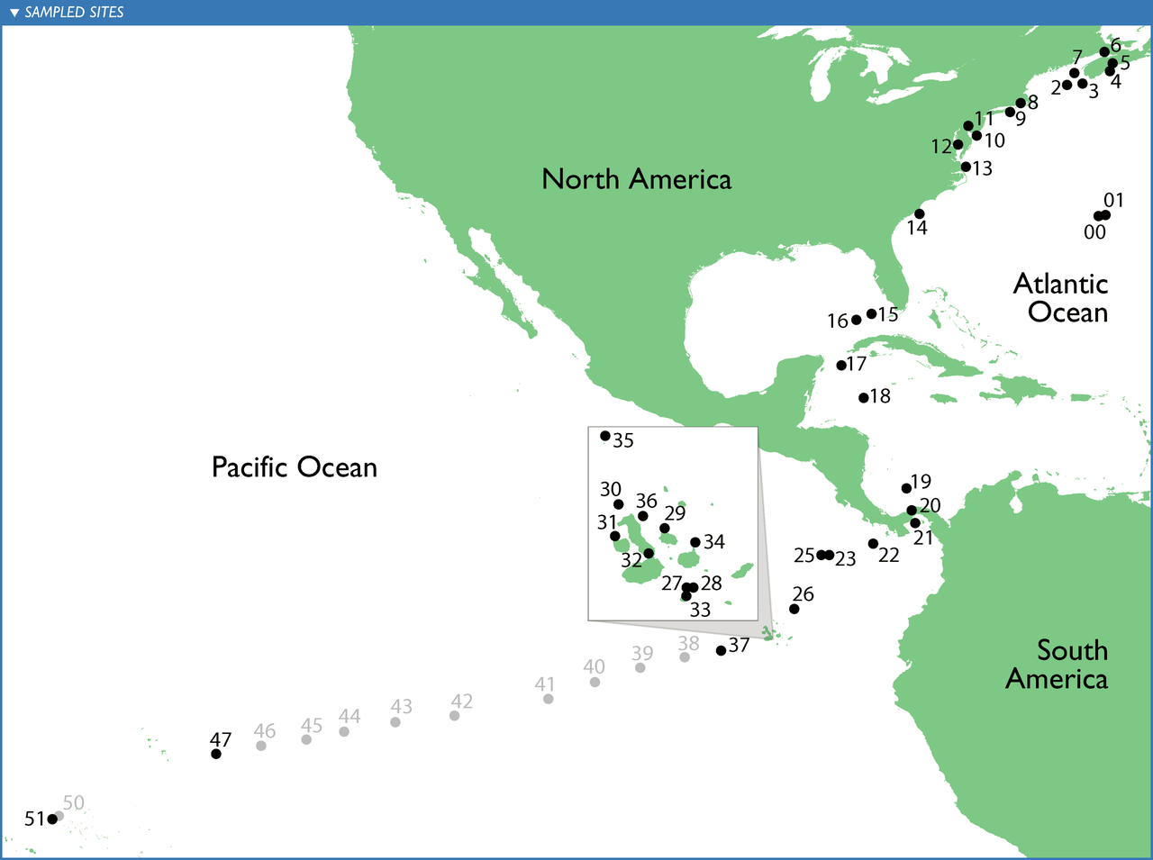
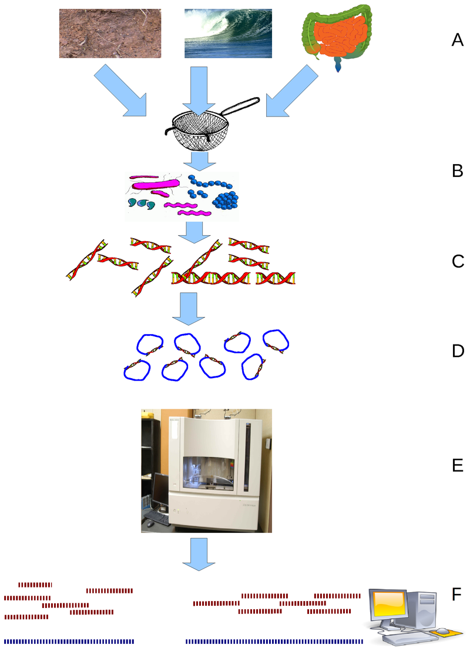

Metagenomics history
Global Ocean Sampling Expedition (GOS)
shotgun sequencing
Celera Genomics
The Institute for Genomic Research
The J. Craig Venter Institute
Craig Venter
The pilot project, conducted in the Sargasso Sea, found DNA from nearly 2000 different species, including 148 types of bacteria never before seen.
Notes:
Beginning in 2003, Craig Venter, leader of the privately funded parallel of the Human Genome Project, has led the Global Ocean Sampling Expedition (GOS), circumnavigating the globe and collecting metagenomic samples throughout the journey. All of these samples are sequenced using shotgun sequencing, in hopes that new genomes (and therefore new organisms) would be identified. The pilot project, conducted in the Sargasso Sea, found DNA from nearly 2000 different species, including 148 types of bacteria never before seen.^{[15]} Venter has circumnavigated the globe and thoroughly explored the West Coast of the United States, and completed a two-year expedition to explore the Baltic, Mediterranean and Black Seas. Analysis of the metagenomic data collected during this journey revealed two groups of organisms, one composed of taxa adapted to environmental conditions of 'feast or famine', and a second composed of relatively fewer but more abundantly and widely distributed taxa primarily composed of plankton.^{[16]}

Slide 5
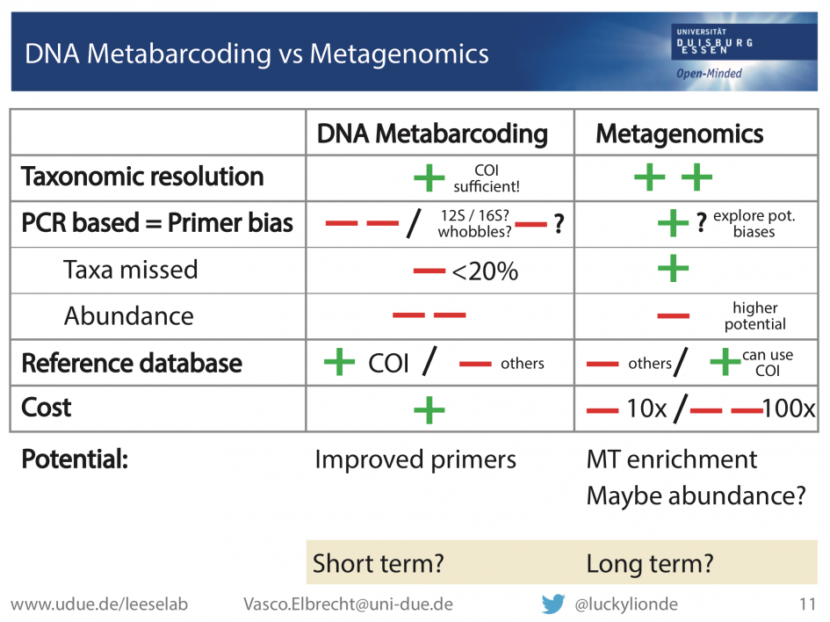
sequencing approaches
Metagenomics
Study of metagenomes, genetic materials directly from environmental samples.
Shotgun metagenomics
  Randomly shears DNA, sequence many different species in environment and attempts to reconstruct multiple genomes.
Metabarcoding
Subset of metagenomics.
Study of one or more marker gene.
Gene specific primers to ‘barcode’ that gene, i.e. 16S, ITS or CO1
Aim is often to identify different species and compare different community
Notes:
cytochrome c oxidase subunit I (COI) gene is frequently used as the marker of choice because no other genetic region

Slide 6
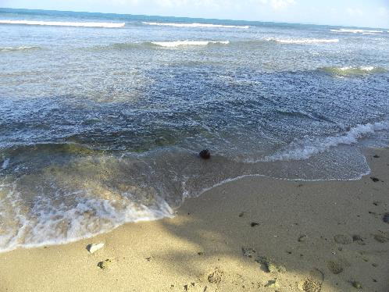
The big picture
Explore the relationship between microbes and their habitat
To accomplish this, we use a series of experimental and computational techniques to make inferences about the community:
Marker genes
Metagenomes
Metatranscriptomes
Metaproteomes
Metametabolomes
“Culturomes”
Bioinformatics.ca

Slide 7
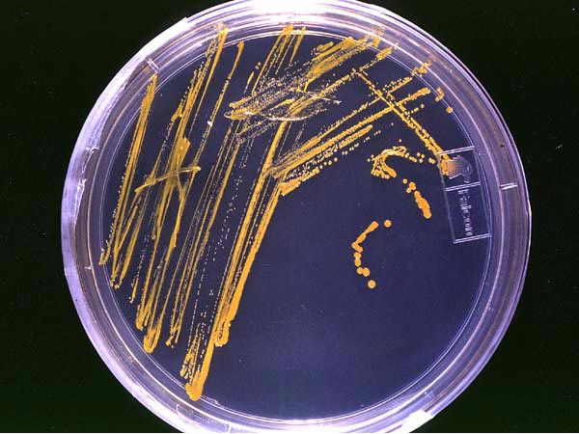
NGS and metagenomics
Accelerated by NGS, predominately 454 sequencing because of the longer read length, now more with Illumina based chemistry.
Organism no longer needs to be cultivated and cloned — Culture independent insight
Direct sequencing from environment as a “community”
You can pool multiple samples together
Not all microbes can be cultured

Slide 8
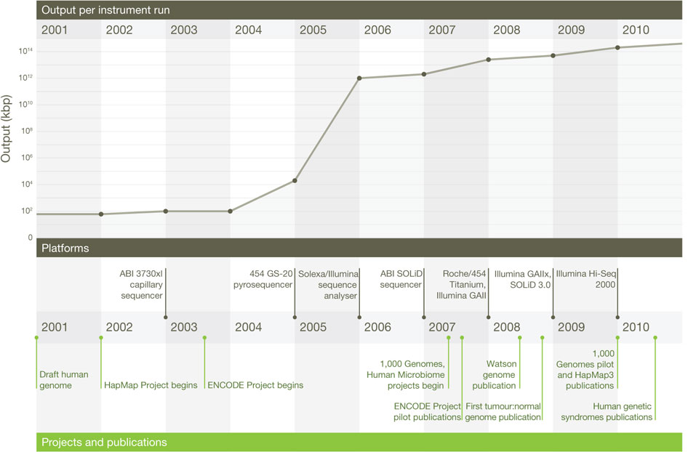
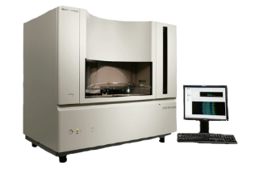
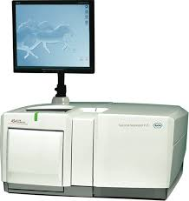
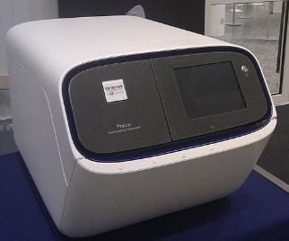
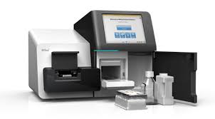
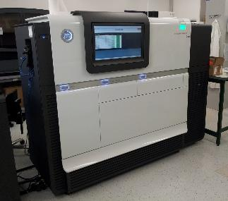
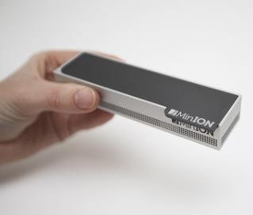





Sequencing Run Capacity
ER Mardis. Nature 470, 198-203 (2011) doi:10.1038/nature09796

Slide 9
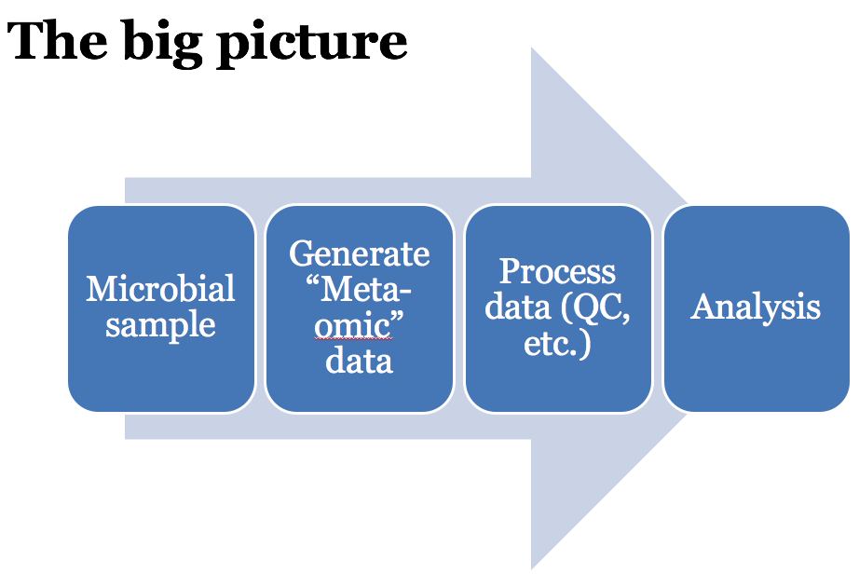
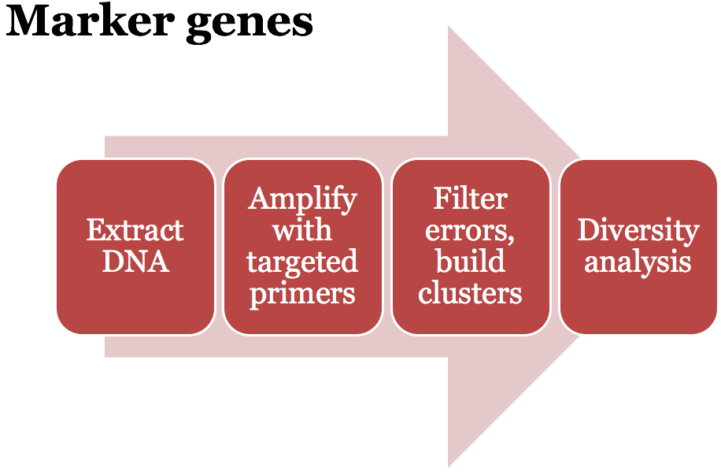
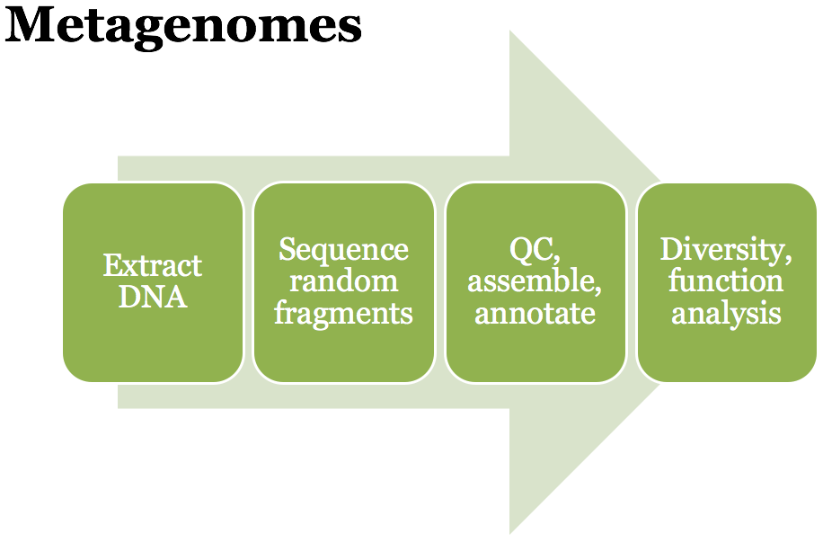
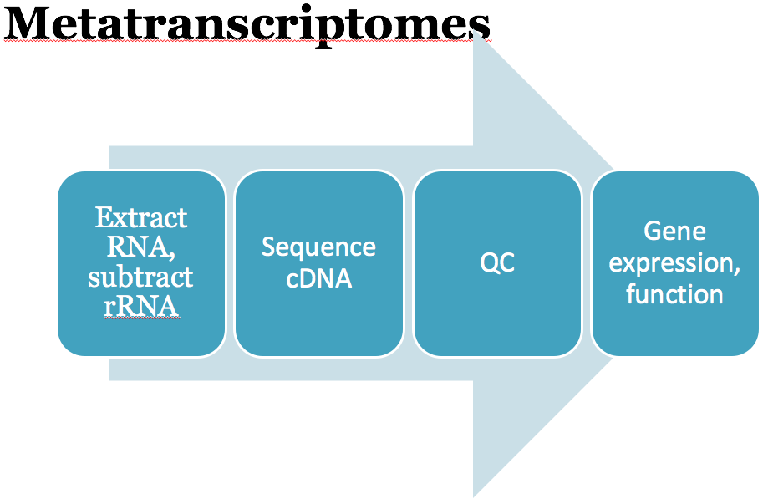
high-level workflows
Bioinformatics.ca

Slide 10
Analysis approach

Slide 11
Metagenomic reads vs 16S rRNA for microbial diversity identification
Metagenome
Amplification of 16S rRNA
DNA Isolation
Fragmentation
of DNA
Metagenomic Reads
16S rRNA from multiple species
Tools: Kraken, PhylopathiaS, Phymm, phymmBL,
Metabin
Microbial diversity
Microbial diversity

Slide 12
16S rRNA – a “gold standard” for microbial molecular identification
Universal
Highly conserved
Long enough (~1500 bp) to provide significant discrimination between many species
Structural information can guide alignment and phylogenetic reconstruction
Many species now represented in the database
16S rRNA gene sequencing
Limitations:
Insufficient and underestimated diversity
Earlier → By sequencing whole gene
Now → By sequencing short variable regions

Slide 13
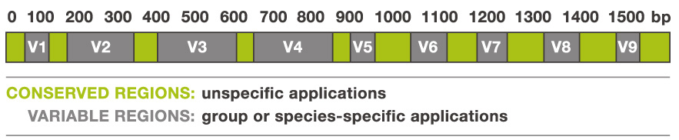
16S ribosomal protein
highly conserved between different species of bacteria and archaea
whereas the rest of genetic content varies greatly across species
16S RNA can be used for taxonomical classification

Slide 14
16S gene coverage (RDP release 11.1 )

Slide 15
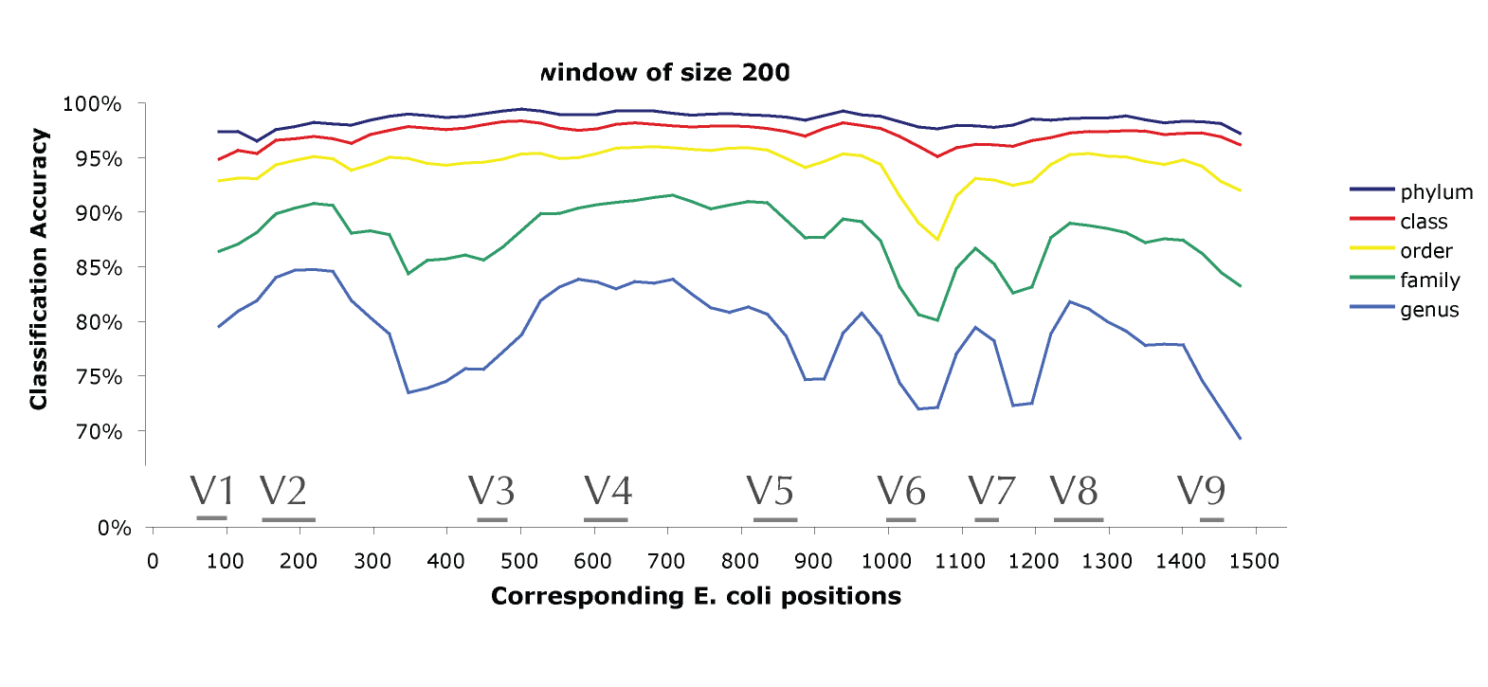
Classifier Accuracy on 200 bp Regions
From Wang et. al., AEM, 2007

Slide 16
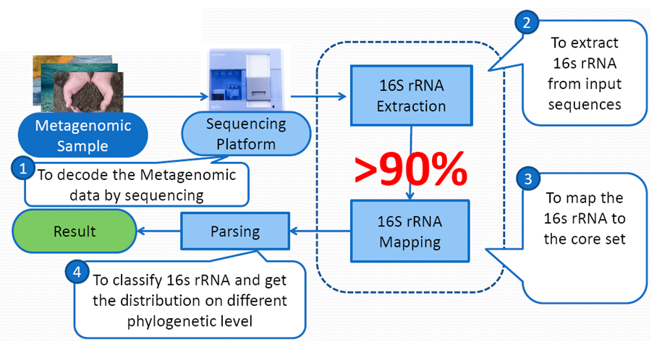
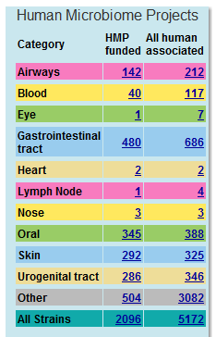

Classical Metagenomics Approach
PCR of
16S rRNA
16S rRNA sequence dependent
1st PCR (16S rRNA family specific primer sets)
2nd PCR (NGS library)
454 Sequencing platform
Database update

Slide 17
Analysis approach
Taxonomy independent analysis
  Reads are group into operational taxonomic units (OTU) based on a specified sequence variation.
Taxonomy dependent analysis
  Assignment at the level of domain, phylum, class, order, family, genus, and species
  Require a reference database

Slide 18
Taxonomy independent analysis
Group reads into OTU based on certain imposed similarity threshold
  In study of bacteria, 97% seems like a good starting point
  Species dependent, genes dependent, threshold may vary
  1 OTU = 1 organism
Extract a OTU representative sequence
  Most common sequence
  Sequence that has minimum difference to all other sequences in the same OTU

Slide 19
Taxonomy dependent analysis
Classify sequences
BLAST
  Simply BLAST what you have (phylotyping) MEGAN
Online RDP classifier (Ribosomal Database Project )
  RDP 10.26 (Release 11, Update 5 consists of 3,356,809 aligned and annotated 16S rRNA sequences
  Limited by number of reads you can submit
Online Greengenes classifier based on NAST alignment
  Require pre-aligned dataset
  Limited by number of reads you can submit

Slide 20
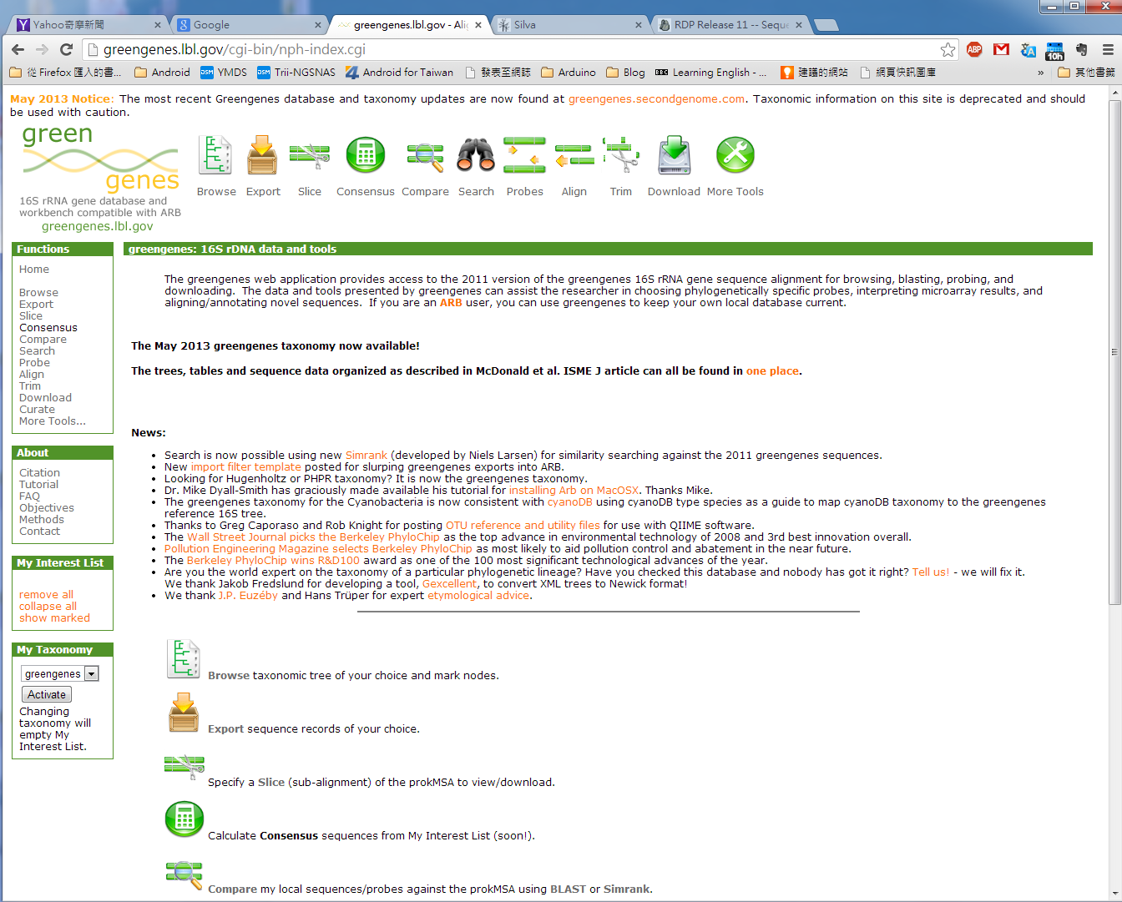
Greengenes
http://greengenes.lbl.gov/

Slide 21
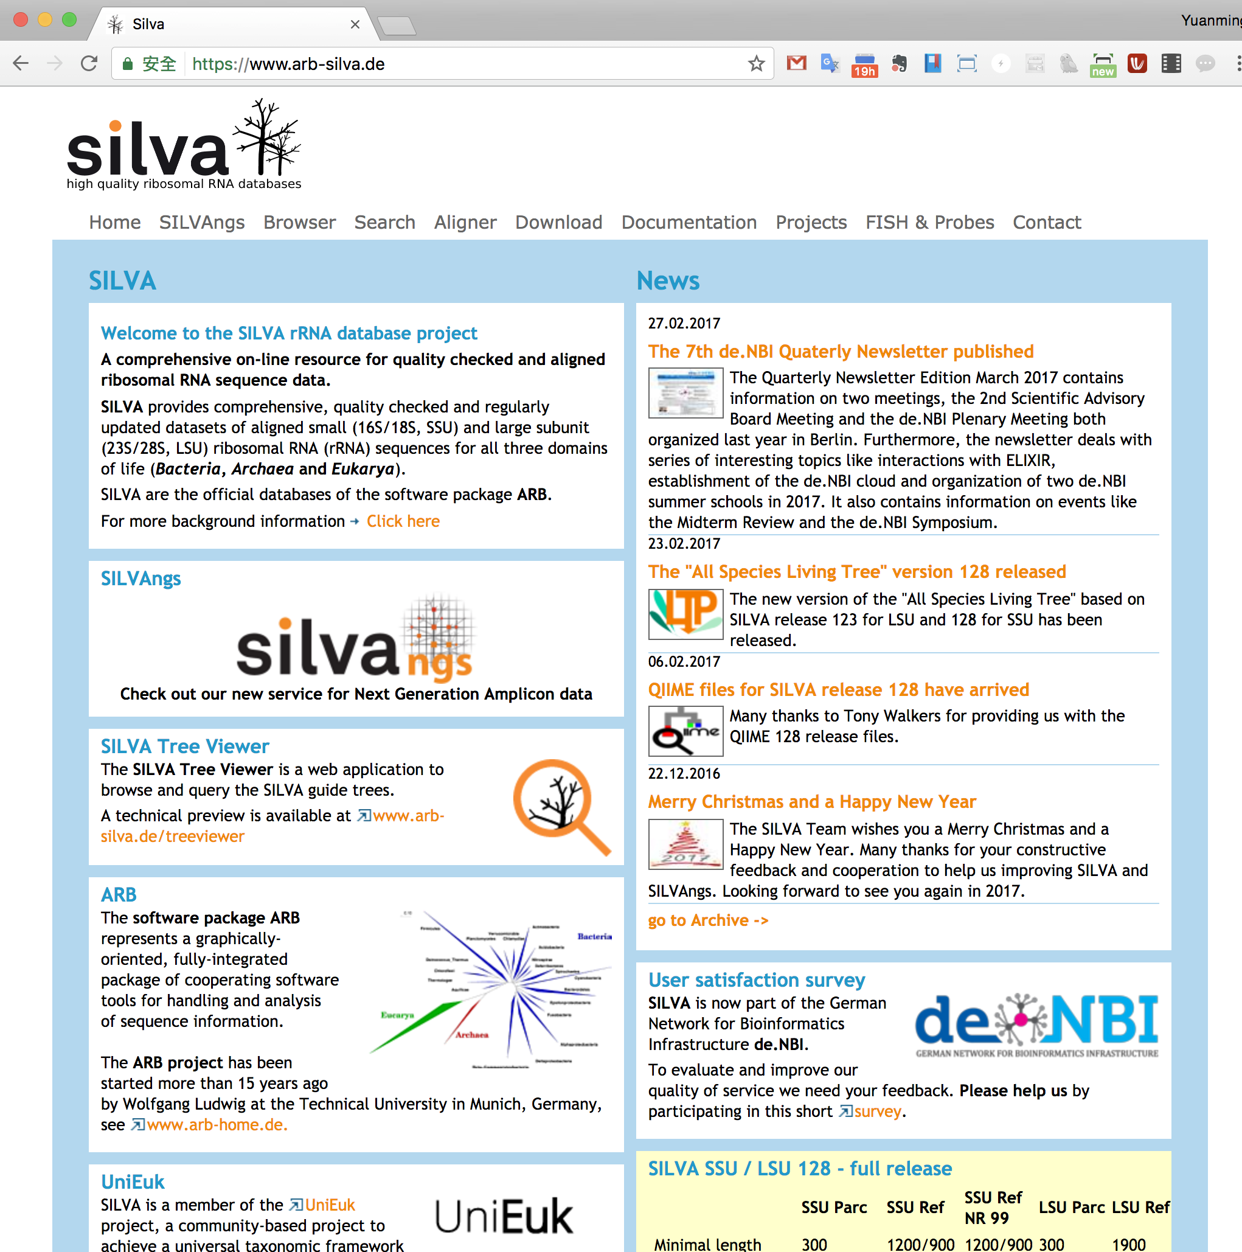
SILVA
http://www.arb-silva.de/

Slide 22
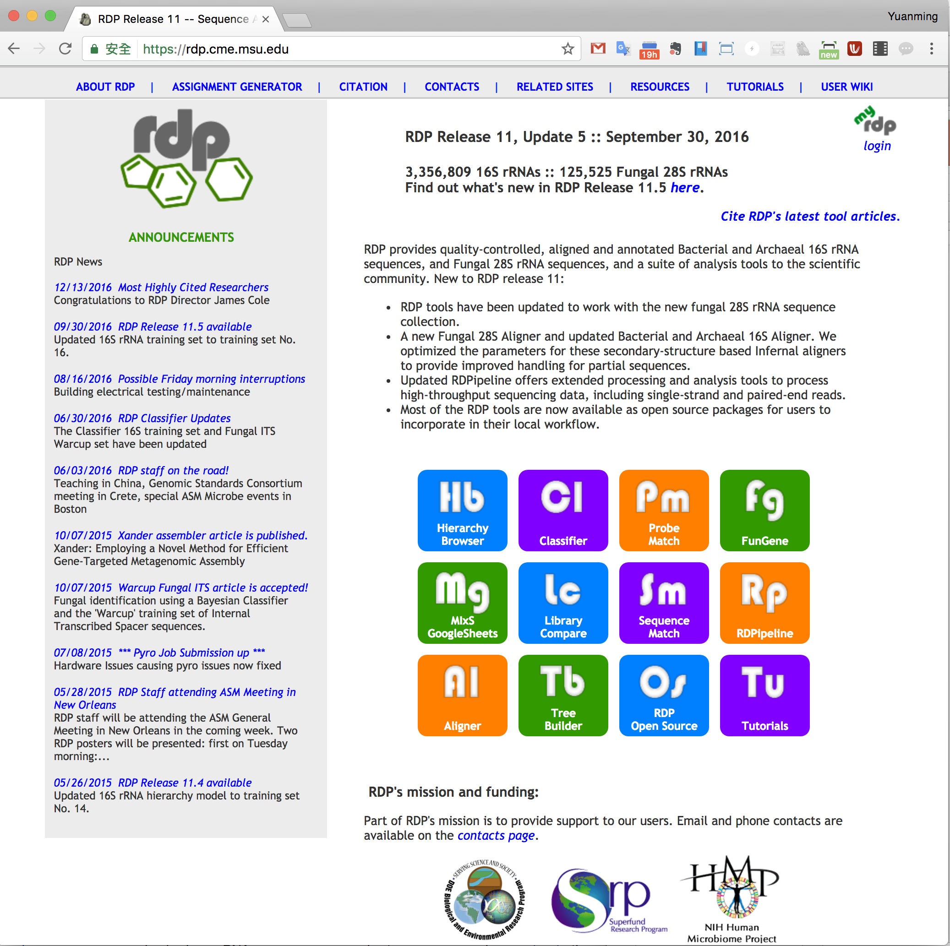
RDP
http://rdp.cme.msu.edu/

Slide 23
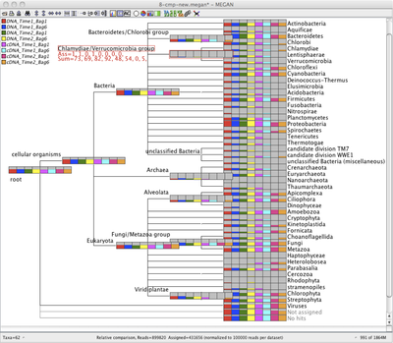
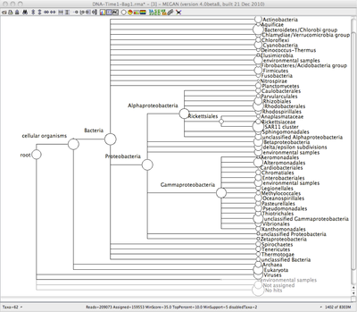
One common phylotyping workflow
Run the blast aligners with the reads against the NCBI bacterial database (can be very time consuming)
Use MEGAN – Metagenome Analyzer to process the results
http://ab.inf.uni-tuebingen.de/software/megan/

Slide 24
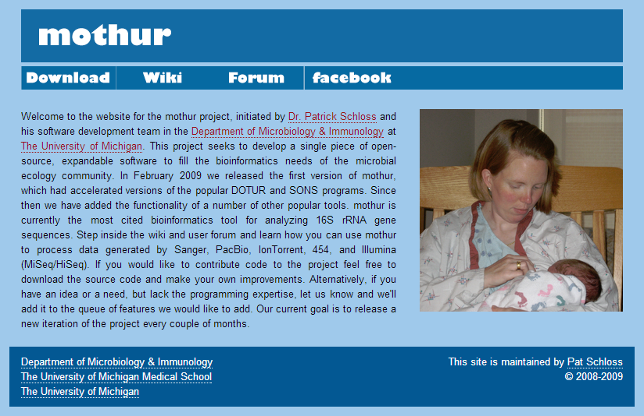
The mothur package
Primarily OTU based but it has phylotyping functionality built in
http://www.mothur.org/

Slide 25

The QIIME package
Takes users data easy to OTU picking, taxonomic assignment, and construction of phylogenetic trees from representative sequences of OTUs, and through downstream statistical analysis, visualization, and production of publication-quality graphics.
http://qiime.org/

Slide 26
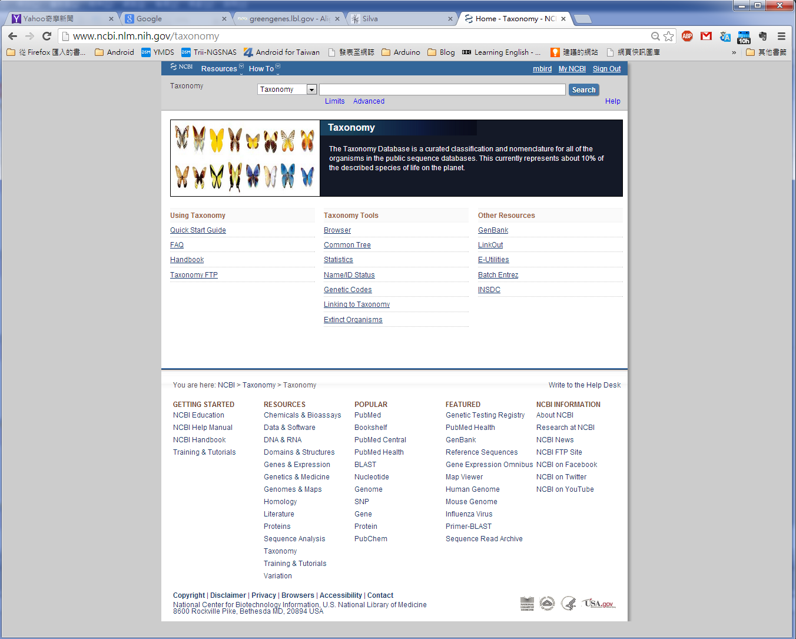
NCBI taxonomy

Slide 27
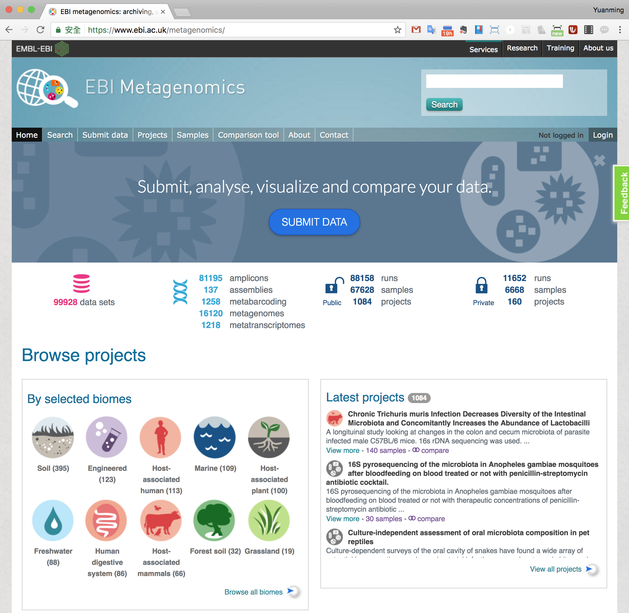
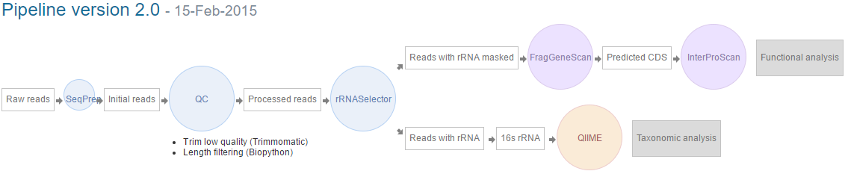
EBI Metagenomics

Slide 28
Major concerns in metagenomic analysis

Slide 29
Data Quality
Major concerns in metagenomic analysis
Sequencing errors
  Introduced in workup
  Error rates, error type (PacBio: 10% random, Illumina – 0.1% substitution)
Chimeras
  Amplification artifacts, cloning of restriction fragments
Metadata Acquisition and Availability
  Studying complex ecosystem – multifactorial
  Public datasets, often metadata embedded in publications or simply not available
Bioinformatics.ca

Slide 30
Comparability / Reproducibility
Major concerns in metagenomic analysis
16S: different V regions give different results
Different sequencing platforms / sampling conditions ALSO give different results
  Eisen paper about different recoveries under different conditions
Workflow complexity / plethora of tools
  Difficult to evaluate tools for microbiome analysis
  Ground truth hard to establish for microbiome samples
  Use of mock communities or simulated data
Bioinformatics.ca

Slide 31
Linkage and resolution
Major concerns in metagenomic analysis
Strain-level diversity in metagenomes will often be missed due to difficulties in differentiating minor variants from sequencing errors
Should you assemble metagenomic reads?
  Longer sequences have more information
  By assembling the reads, you could create chimeric contigs consisting of DNA fragments from different (non-clonal) organisms
Bioinformatics.ca

Slide 32
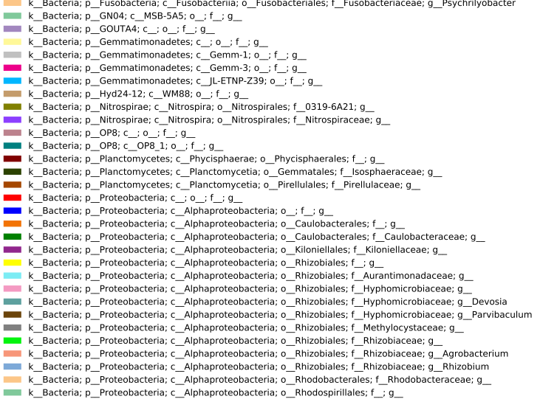
Taxonomy and OTUs
Major concerns in metagenomic analysis
???
Seed sequences
97%
De novo
RDP taxonomic predictions
+
taxonomy in general
OTUs – arbitrary, quasi-phylogenetic
Bioinformatics.ca
Notes:
Human urge to classify

Slide 33
Metagenomics
Exercise
http://120.126.1.1/CGBCHTS/Metagenomics_exercise.html

Slide 34
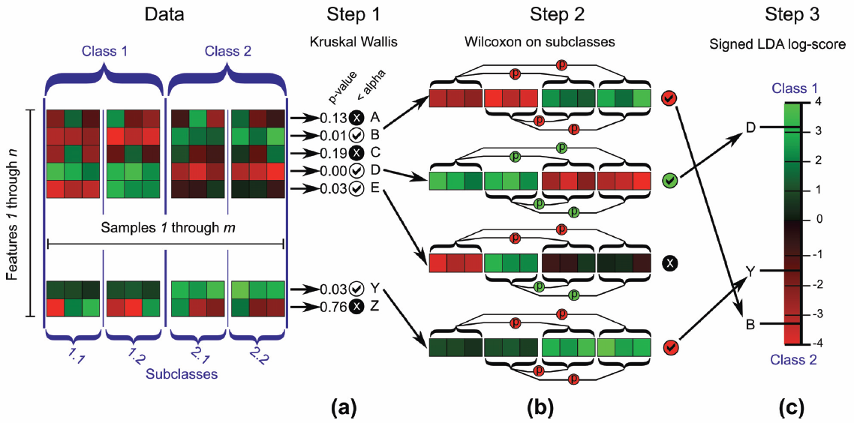
Segata et al. Genome Biology 2011

