Slide 1








Slide 2
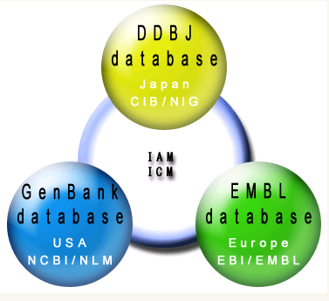
GenBank/EMBL/DDBJ
International
Nucleotide Sequence Database
DDBJ: DNA Data Bank of Japan
CIB: Center for Information Biology and
DNA Data Bank of Japan
NIG: National Institute of Genetics
Primarily
Databases
EMBL:
European Molecular Biology
Laboratory
EBI:
European Bioinformatics
Institute
NCBI:
National Center for Biotechnology Information
NLM:
National Library of Medicine

Slide 3
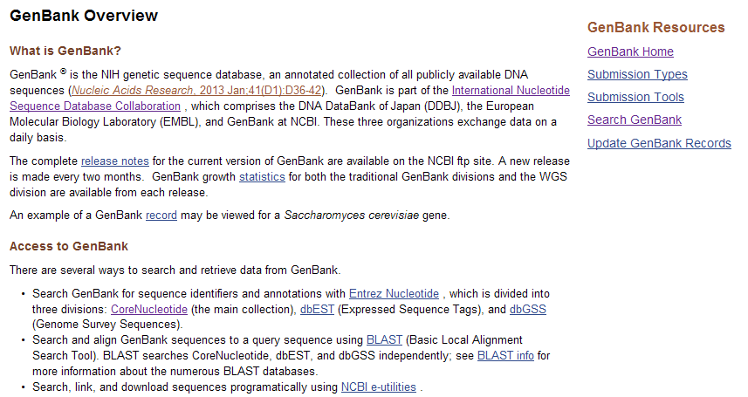
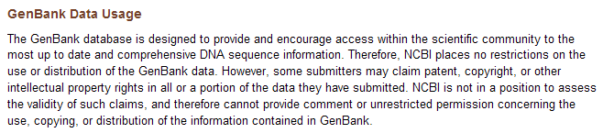
http://www.ncbi.nlm.nih.gov/genbank/

Slide 4
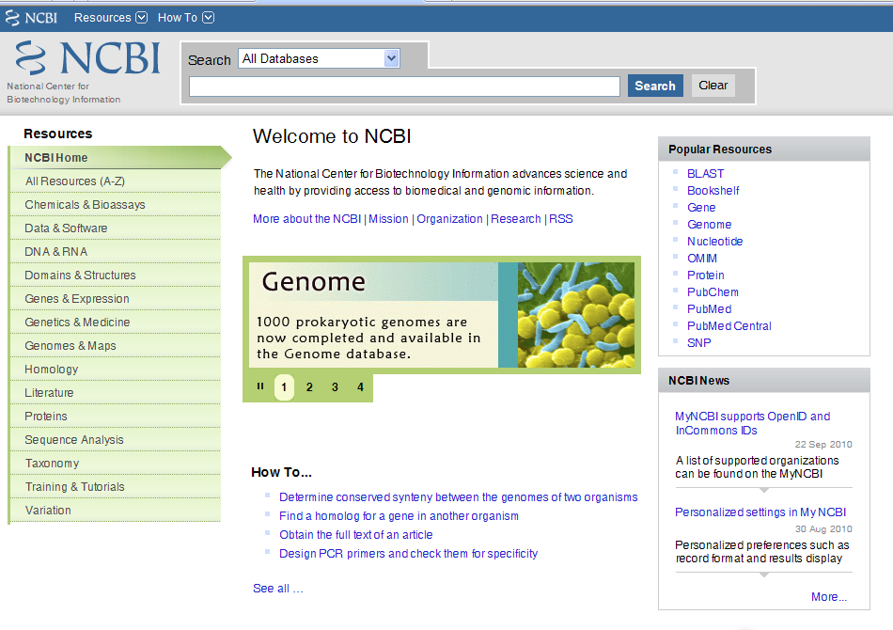
Secondarily Databases

Slide 5
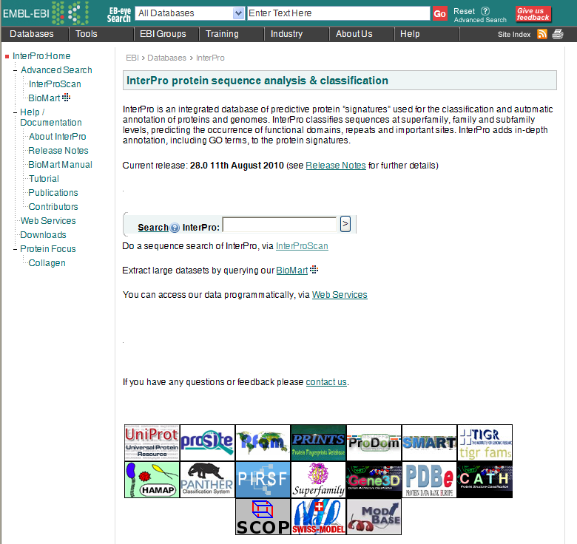
Secondarily Databases

Slide 6
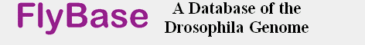




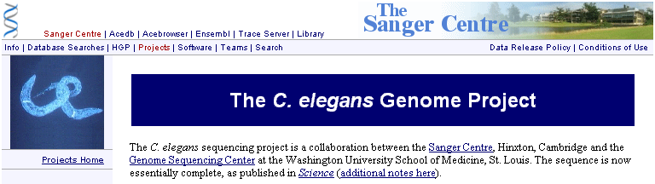

Slide 7
Database Retrieving and
Manipulation Network
Databases
Literature Database
Sequence Databases -
Primary Databases
Secondarily Databases
GCG
Vector NTI
CLC
Open Sources
Endnote
MS Office
Adobe
Query by
1.Text
2.Sequence
Retrival
System
Softwares
GenBANK
GCG
FASTA
Staden
Image
Formats
Information
Sequence
Converter
Sequnece,Structure,Image,Document

Slide 8

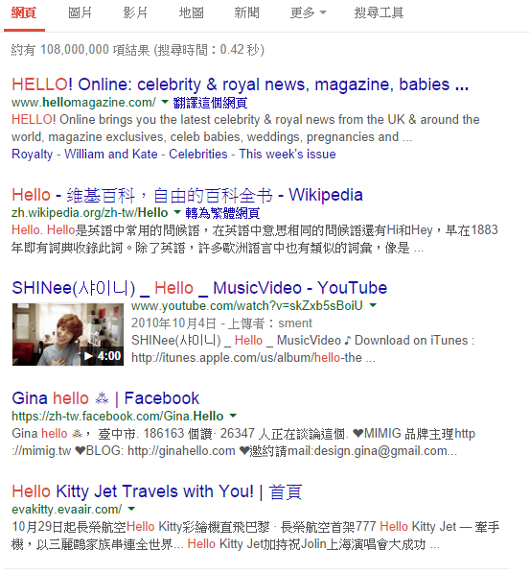
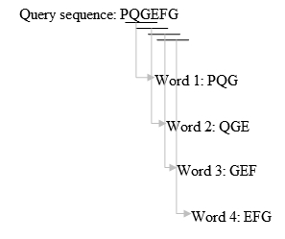
fuzzy search
（approximate string matching）

Slide 9
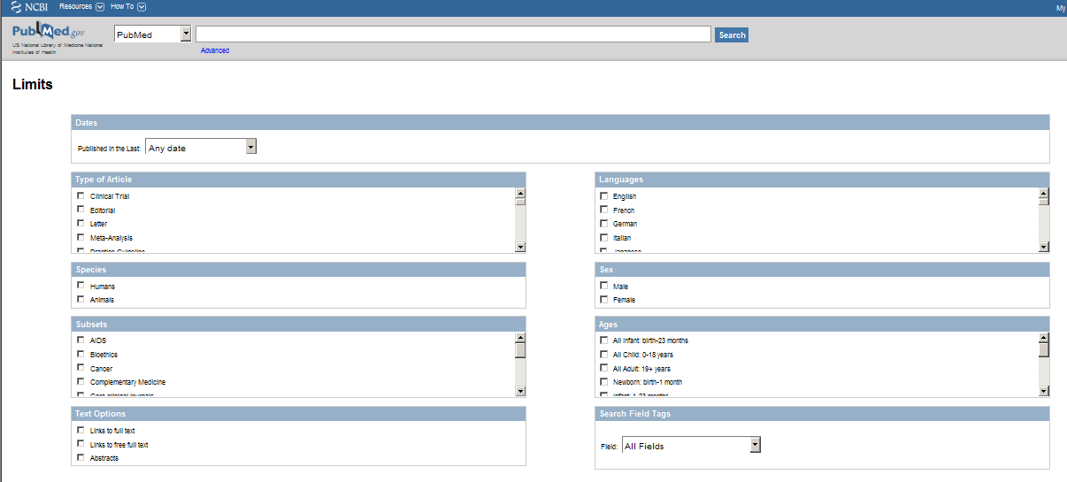
Literature Databases

Slide 10
Sequence Comparison
Nucleotide sequence alignments
mismatch
gap
match
137 AGACCAACCTGGCCAACATGGTGAAATCCCATCTCTAC.AAAAATACAAA 185
|||||| ||||||||||||||||||| |||||||||| ||||||||||
1 AGACCAGCCTGGCCAACATGGTGAAACTCCATCTCTACTGAAAATACAAA 50
Protein sequence alignments
Conserved substitution
10 20 30 40 50 60
ggamma.pep MGHFTEEDKATITSLWGKVNVEDAGGETLGRLLVVYPWTQRFFDSFGNLSSASAIMGNPK
|||||||||||||||||:|||::|||||:|||||:|||||||||||||||||||||||||
HGCZG MGHFTEEDKATITSLWGHVNVDEAGGETIGRLLVLYPWTQRFFDSFGNLSSASAIMGNPK
10 20 30 40 50 60
Residues with shared chemical properties can substitute for each other
Size, charge, hydrophobicity, polarity
scored less than a match, but better than a mismatch
Conservative changes scored as better than non-conservative

Slide 11
Pairwise Comparsion
Local Alignment
compares regions within two sequences and
can return several matches
BLAST
vs
Global Alignment
compare entire sequences
FASTA

Slide 12
Query by sequence
Program | QUERY | Database
blastp | amino acid sequence | protein sequence database.
blastn | nucleotide sequence | nucleotide sequence database.
blastx | nucleotide sequence translated in all reading frames | protein sequence database (use this option to find potential translation products of an unknown nucleotide sequence)
tblastn | amino acid sequence | nucleotide sequence database translated in all reading frames
tblastx | six-frame translations of a nucleotide sequence | six-frame translations of a nucleotide sequence database. (tblastx program cannot be used with the nr database on the BLAST Web page because it is computationally intensive)

Slide 13
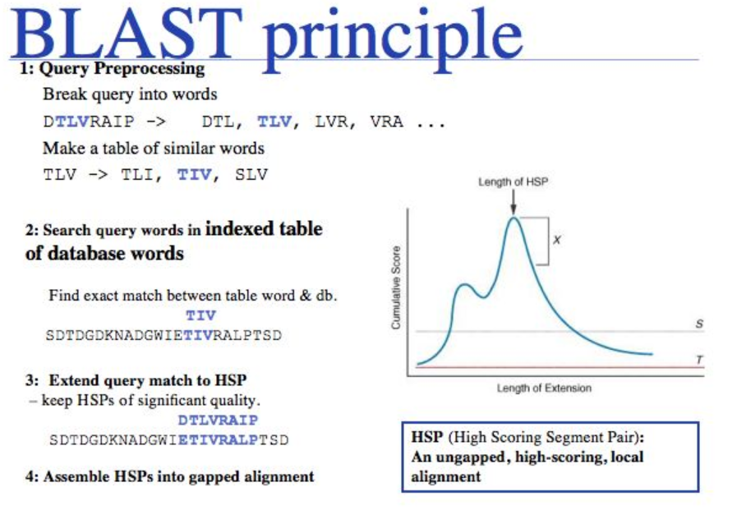

Slide 14

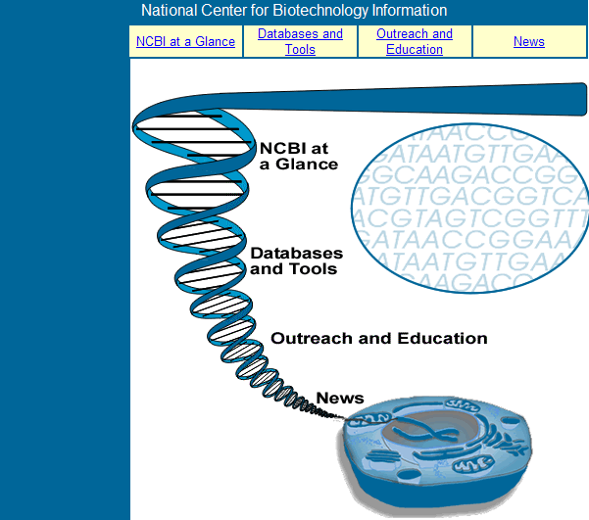
http://www.ncbi.nlm.nih.gov/About/glance/index.html

Slide 15
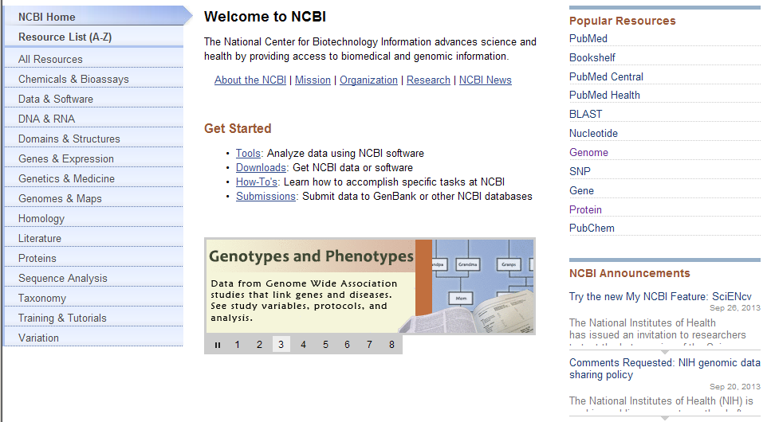

Slide 16
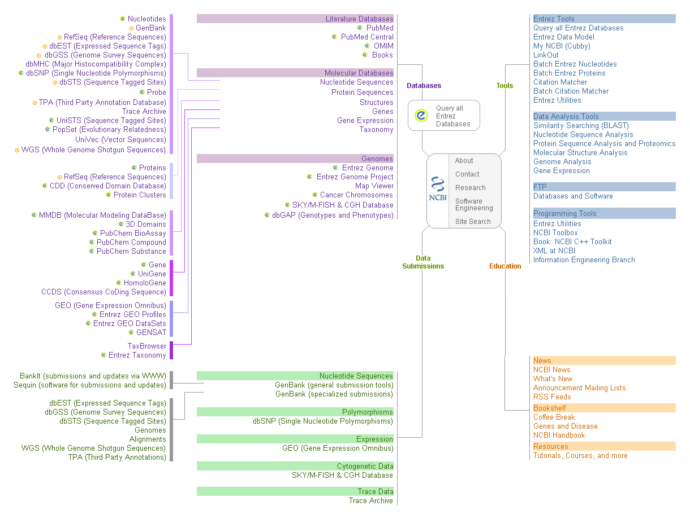
Notes:
shiuan
16

Slide 17
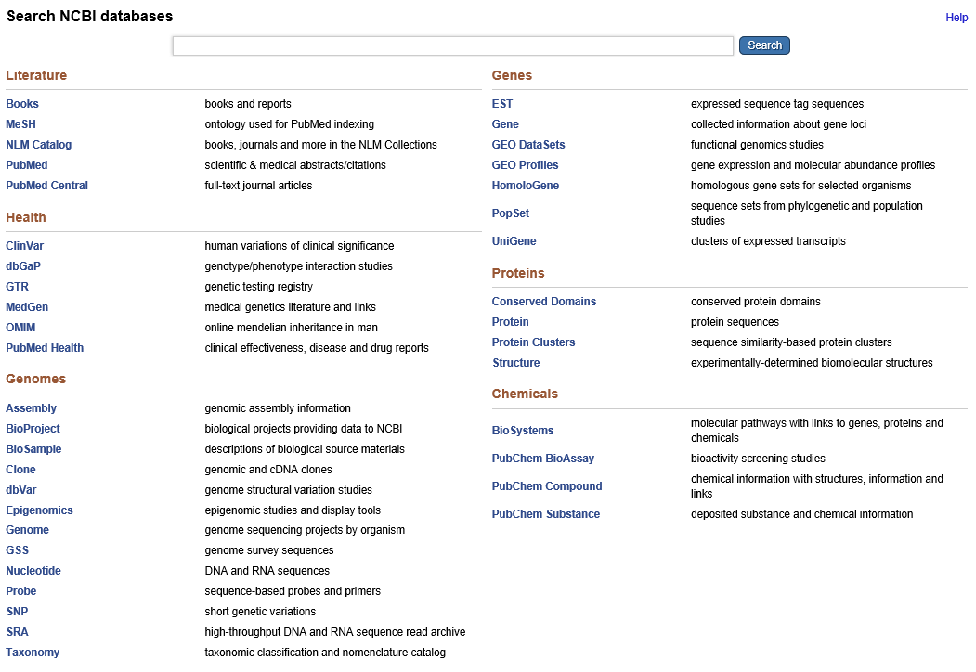
http://www.ncbi.nlm.nih.gov/sites/gquery

Slide 18
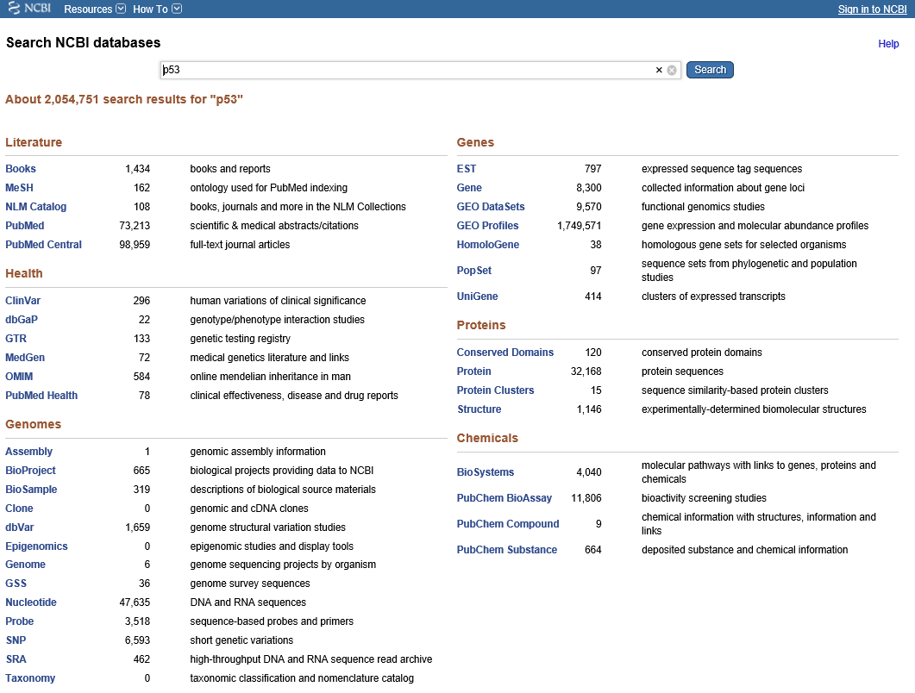

Slide 19
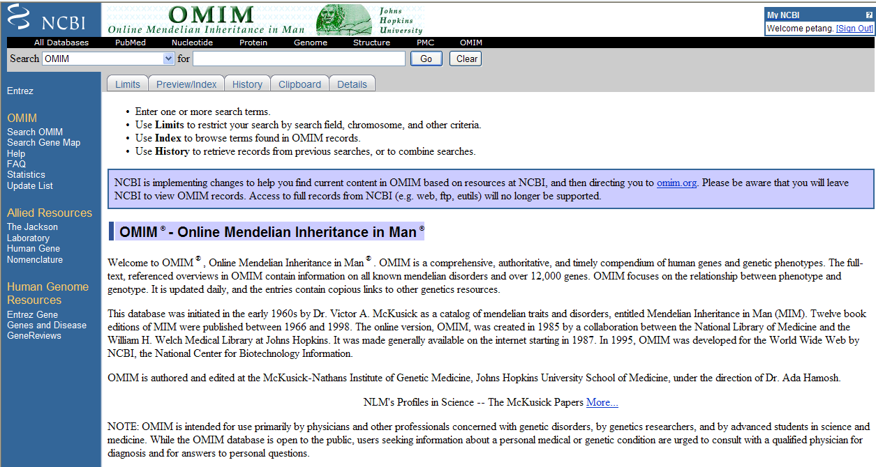
Literature Databases
http://www.ncbi.nlm.nih.gov/omim

Slide 20
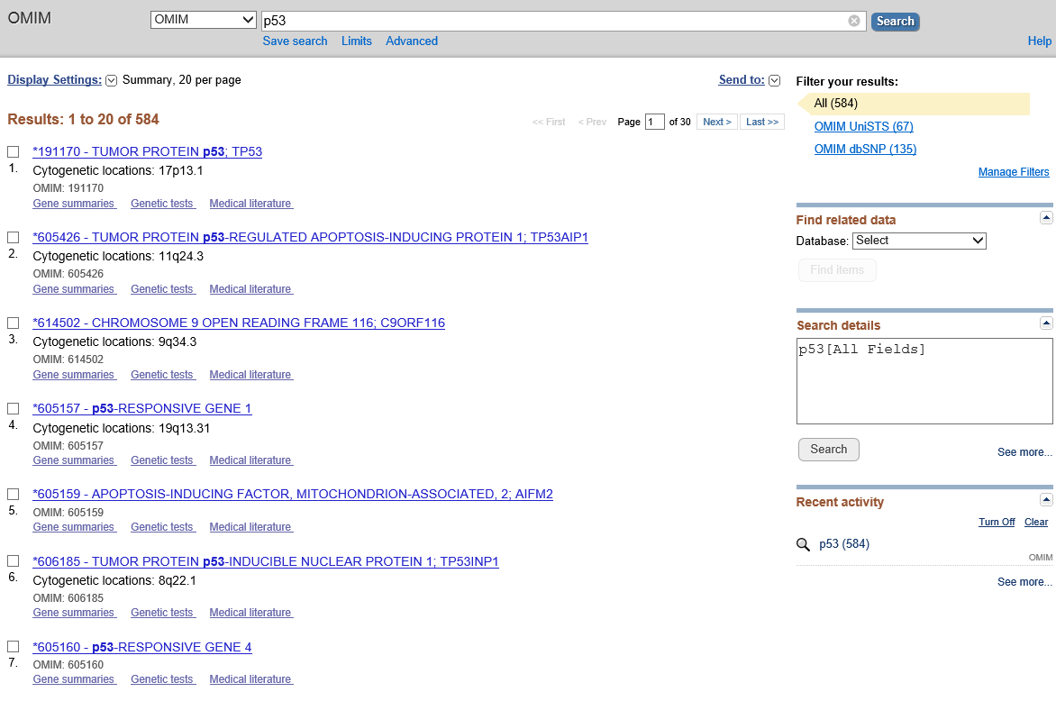

Slide 21
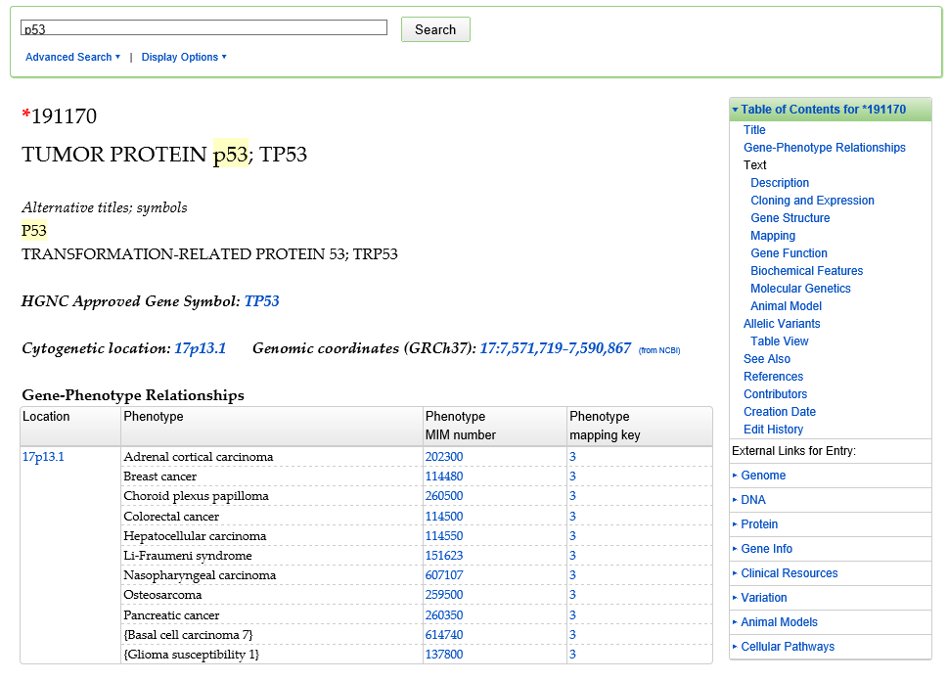

Slide 22
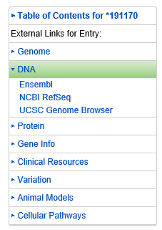
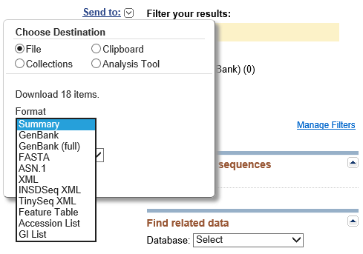
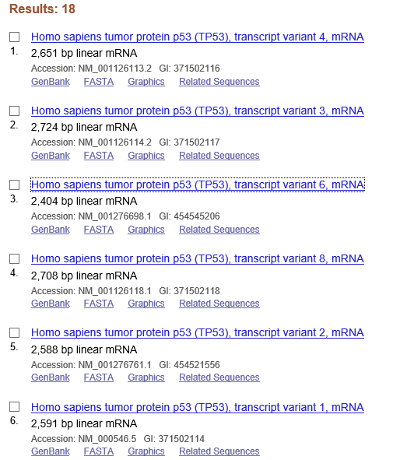
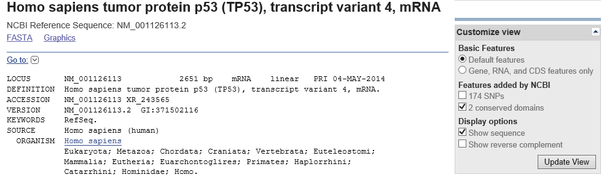

Slide 23
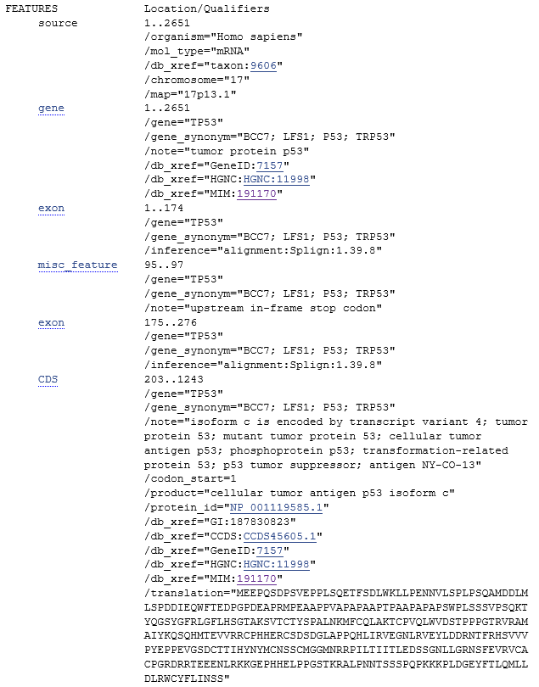
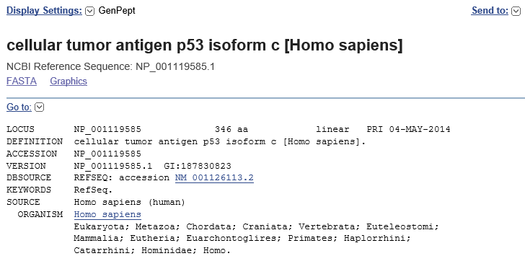

Slide 24
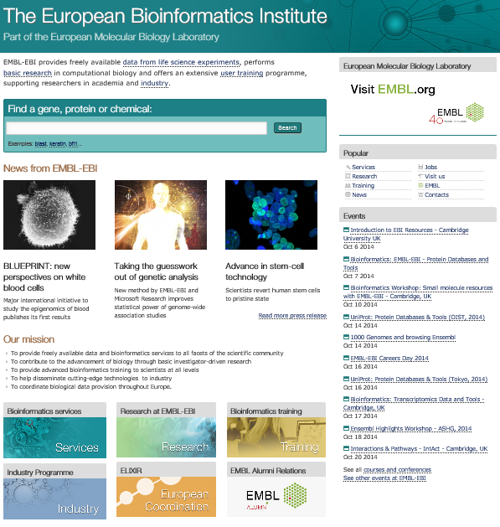
http://www.ebi.ac.uk/

Slide 25
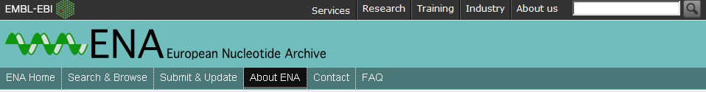
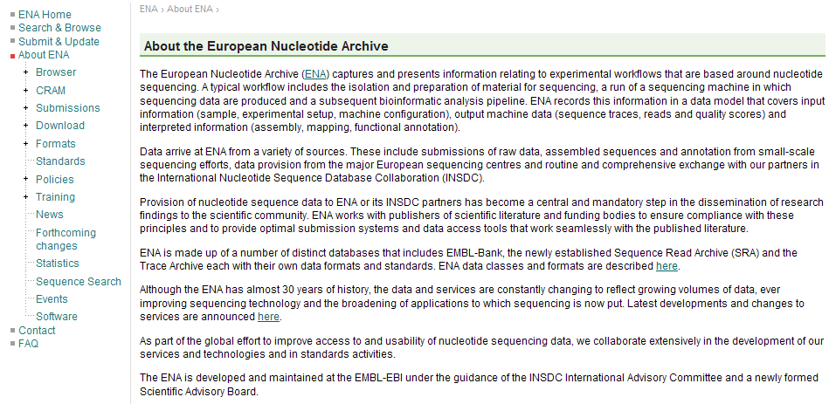

Slide 26

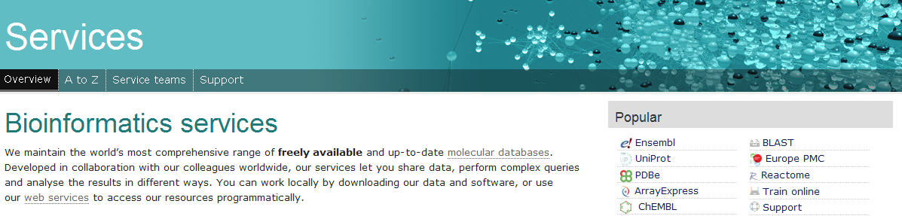
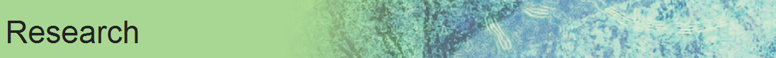


http://www.ebi.ac.uk/
EMBL-EBI provides freely available data from life science experiments, performs basic research in computational biology and offers an extensive user training programme, supporting researchers in academia and industry.

Slide 27
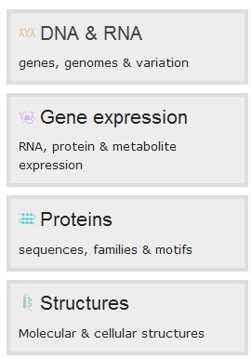
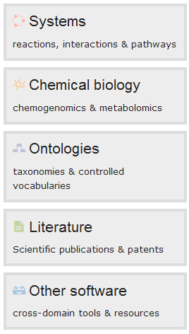

Slide 28
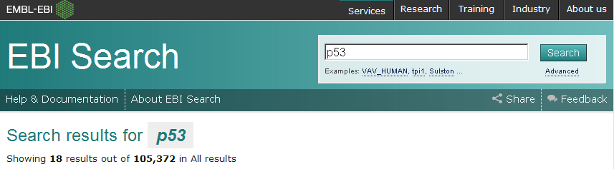
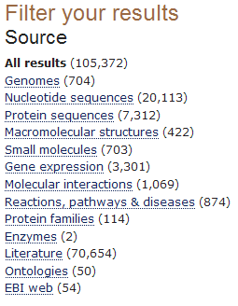
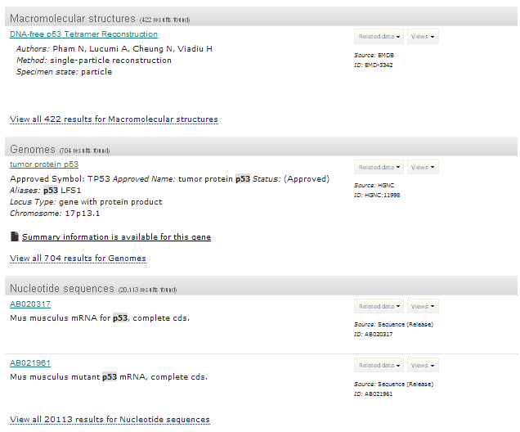

Slide 29
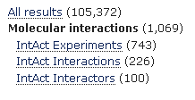
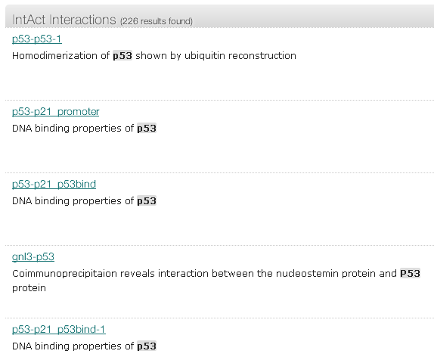

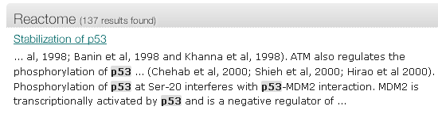

Slide 30
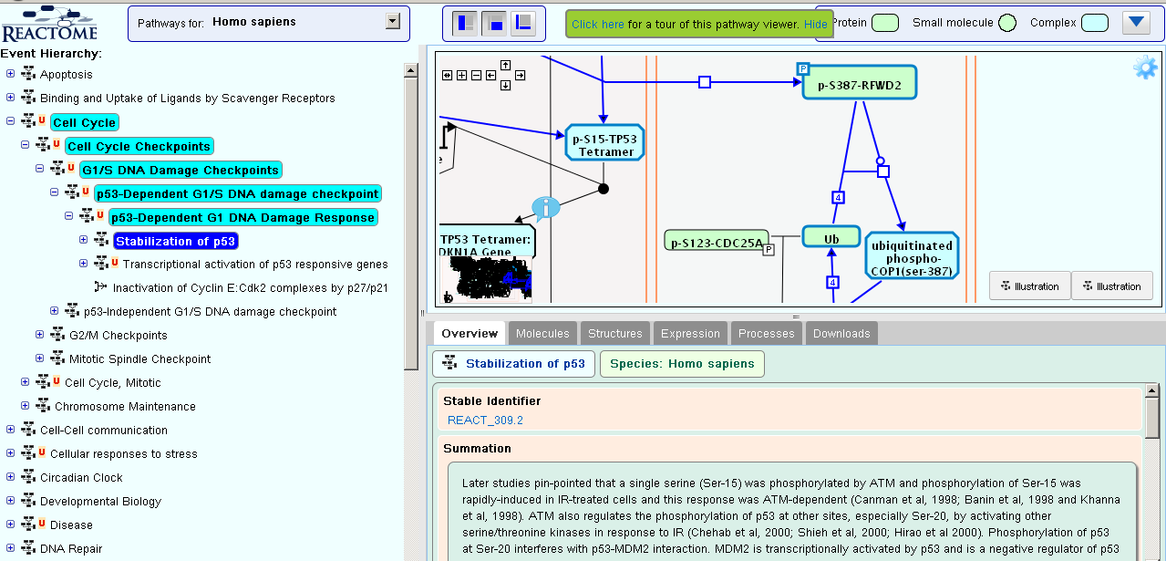
http://www.ebi.ac.uk/intact/pages/interactions/interactions.xhtml?query=EBI-1799550&filter=ac

Slide 31

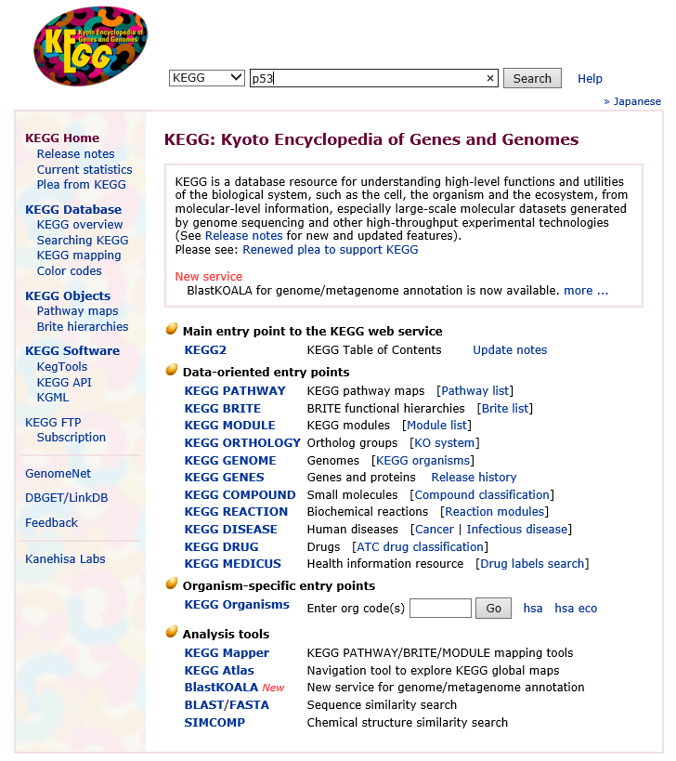
Metabolic & Signalling Pathways
Kyoto Encyclopedia of Genes &Genomes
http://www.genome.ad.jp/kegg/

Slide 32
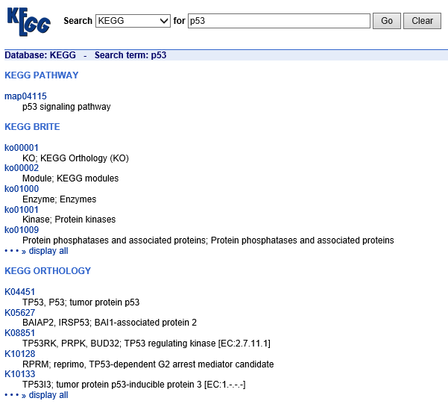
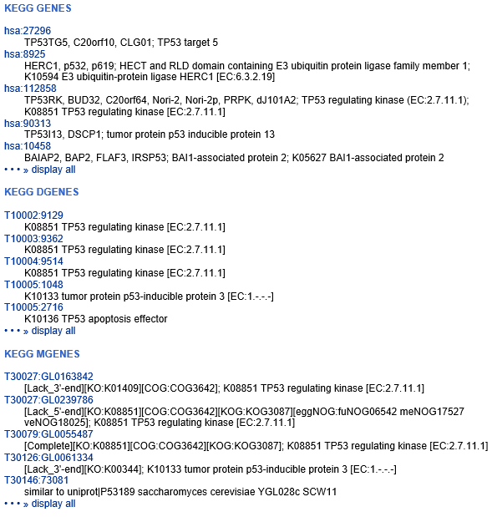

Slide 33
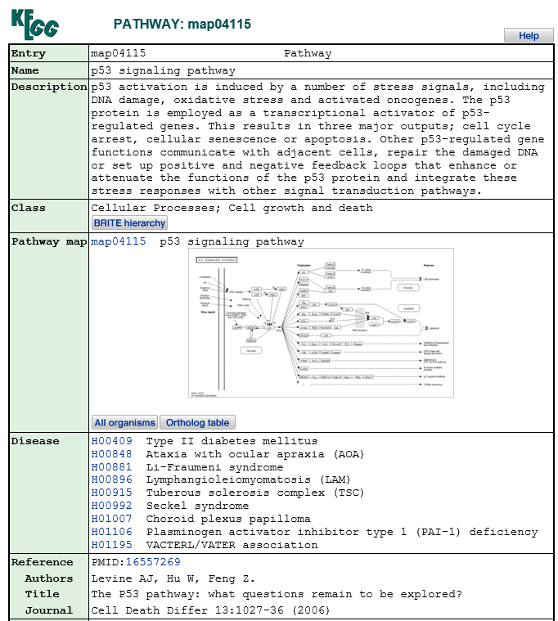
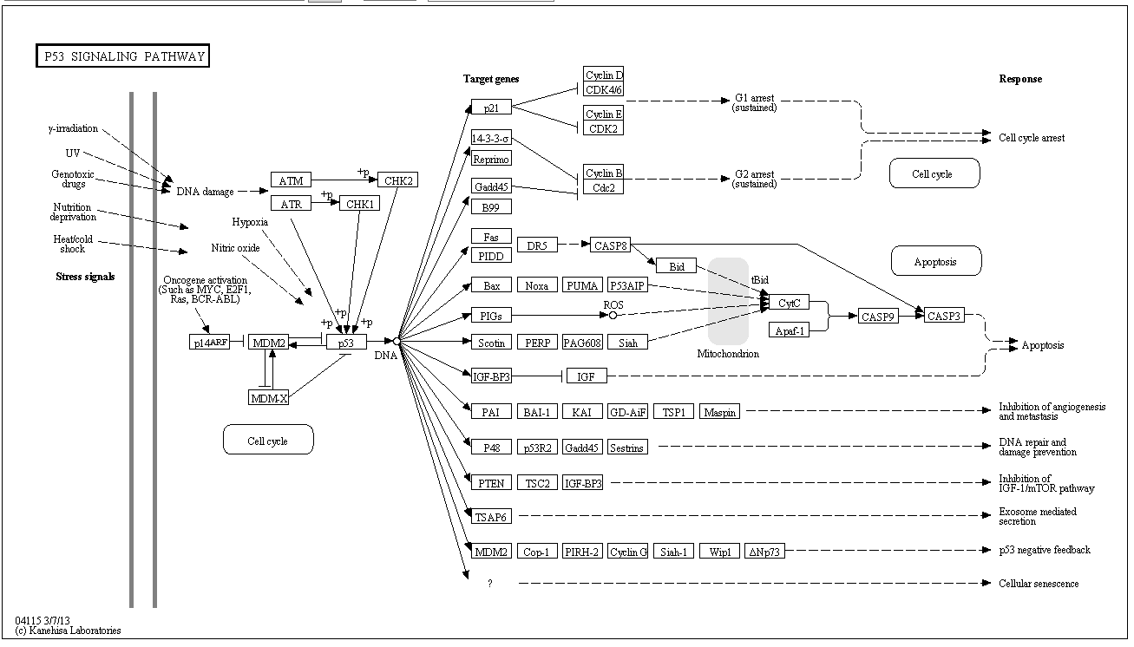
http://www.genome.jp/kegg-bin/show_pathway?map04115

Slide 34
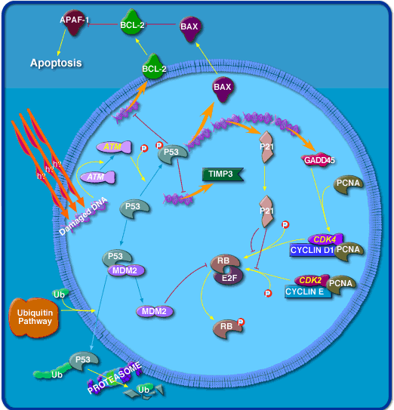

Metabolic & Signalling Pathways
Biocarta
( http://biocarta.com)

Slide 35
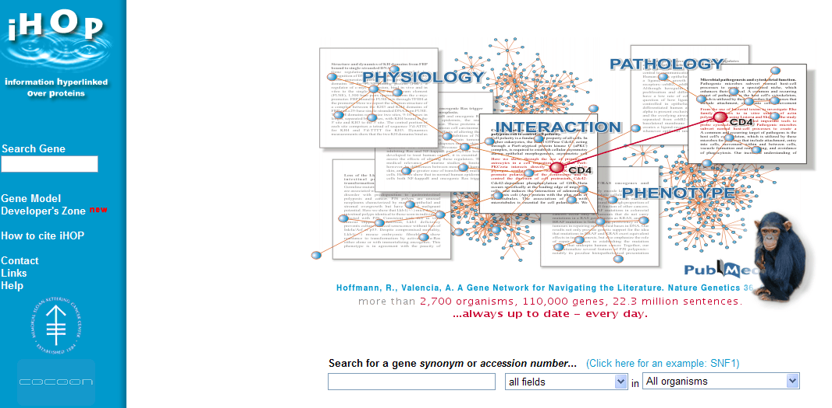
http://www.ihop-net.org/UniPub/iHOP/

Slide 36
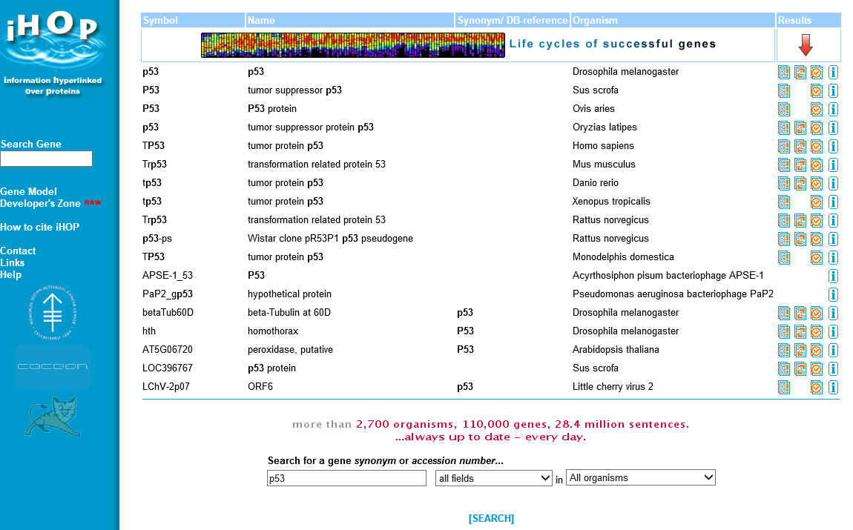

Slide 37
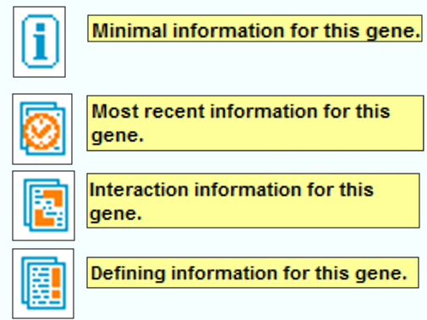
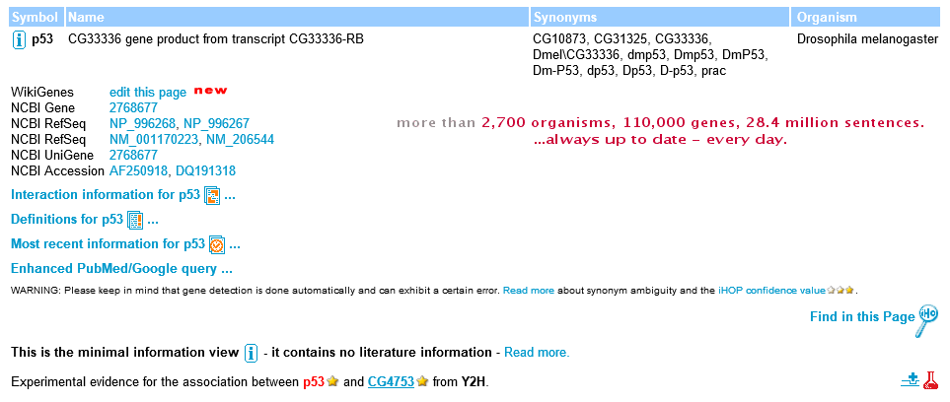
Minimal information for this gene
Most recent information for this gene
Interaction information for this gene
Defining information for this gene

Slide 38

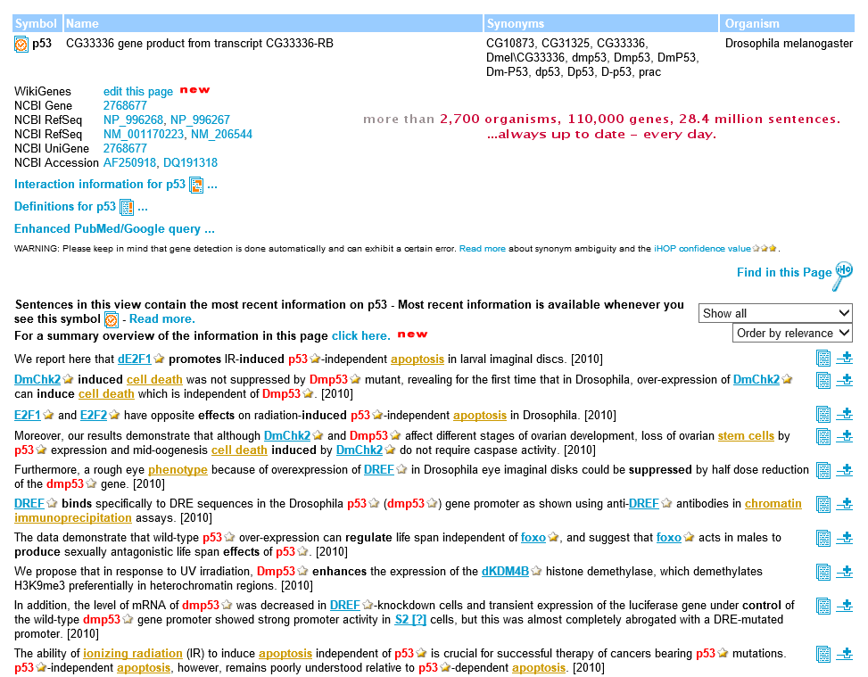

Slide 39



January each year

