Slide 1
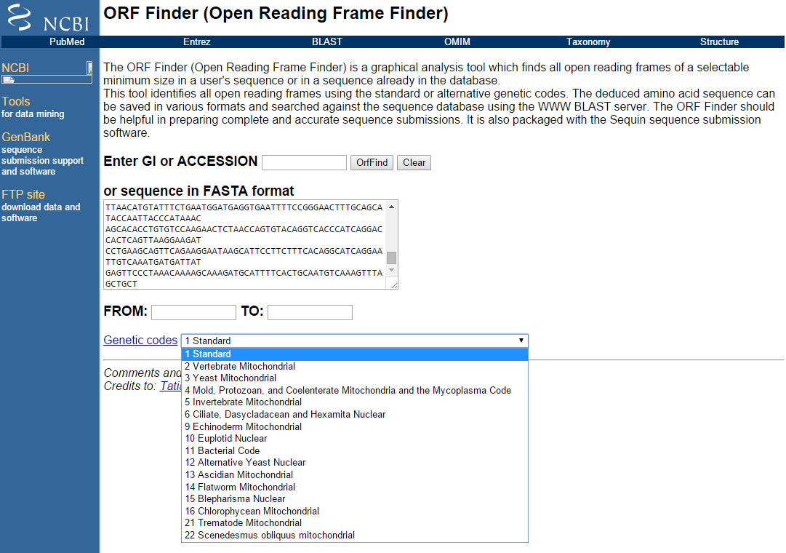
http://www.ncbi.nlm.nih.gov/gorf/gorf.html
Download sequence

Slide 2
To gain a better appreciation for the relative performance of the methods discussed in this chapter and how the results may vary between methods, use FGENES, GENSCAN, and HMMgene to answer each of the following questions.
1. How many exons are in the unknown sequence?
2. What are the start and stop points for each of these exons?
3. Which strand (forward or reverse) are the putative exons found on?
4. Are there any unique features present, like polyA tracts? Where are they located?
5. Can any protein translations be derived from the sequence? What is the length (in amino acids) of these translations?
Method Exons Start-Stop (Strand) polyA Translations
FGENESH+ 1 154-4344 (+) None 1 (1396 aa)
HMMgene 1 1-4344 (+)
GENSCAN 1 1-4344 (+) 1 (4561-4566) 1 (1447 aa)
6. For HMMgene only, can alternative translations be computed for this particular DNA sequence? If so, give the number of exons and the length of the coding region (CDS) for each possible alternative prediction. Note on which strand the alternative translations are found.
Forward Strand Exons CDS for each prediction
Suboptimal 1 1 154-4344
Suboptimal 2 1 2-4344
Suboptimal 3 1 457-4344
Suboptimal 4 1 253-4344•Reverse Strand Exons CDS for each prediction
Suboptimal 1 2 1177-3347
Suboptimal 2 2 627-3347
Suboptimal 3 2 1194-2571
Suboptimal 4 2 130-2571

Slide 3
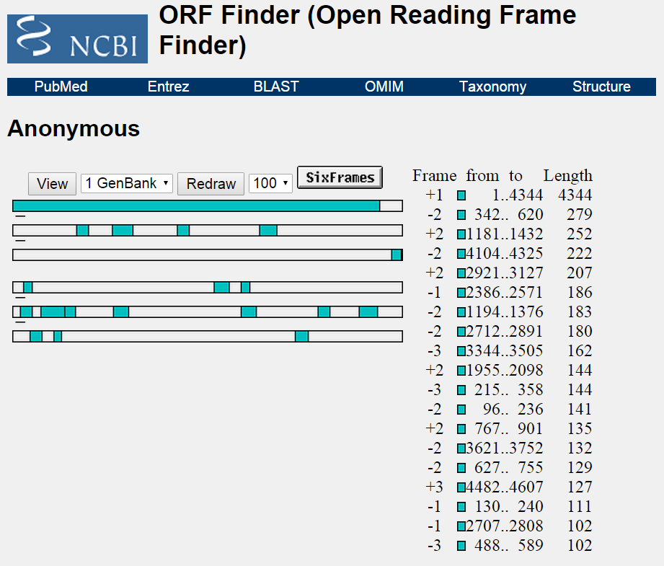

Slide 4
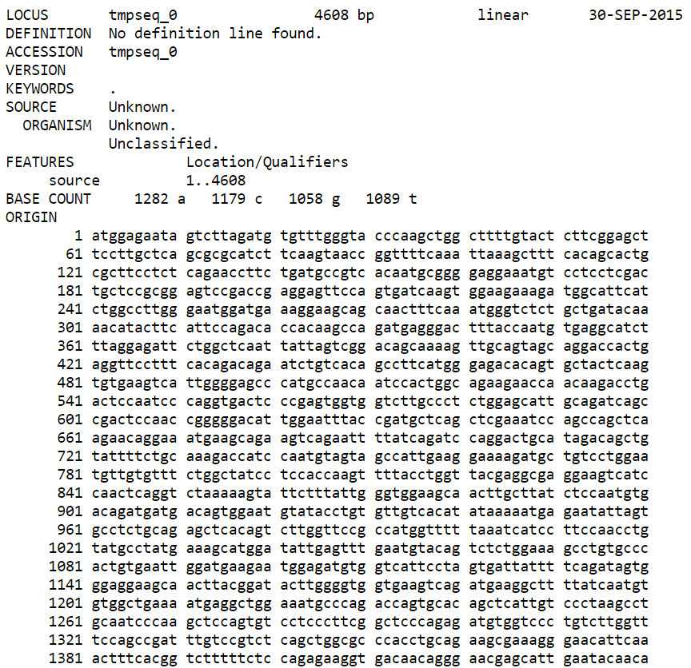

Slide 5
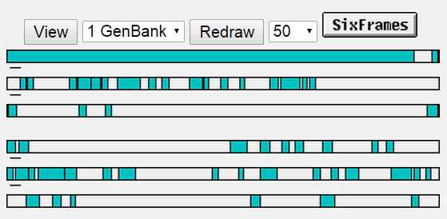
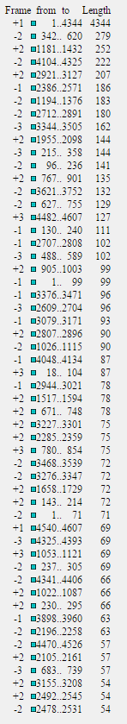
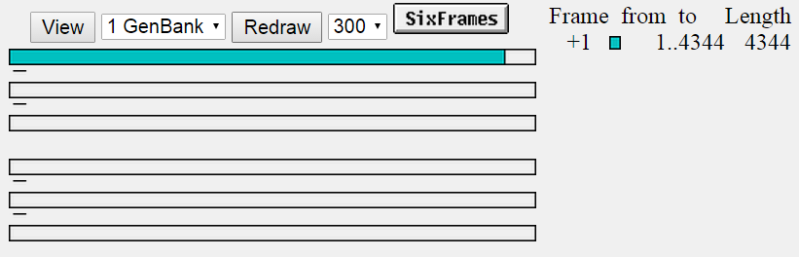

Slide 7
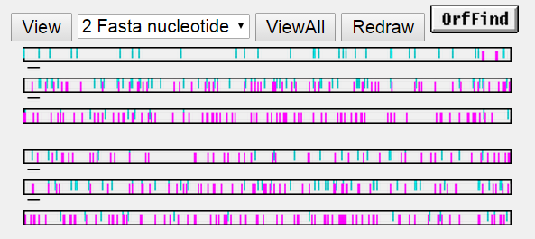
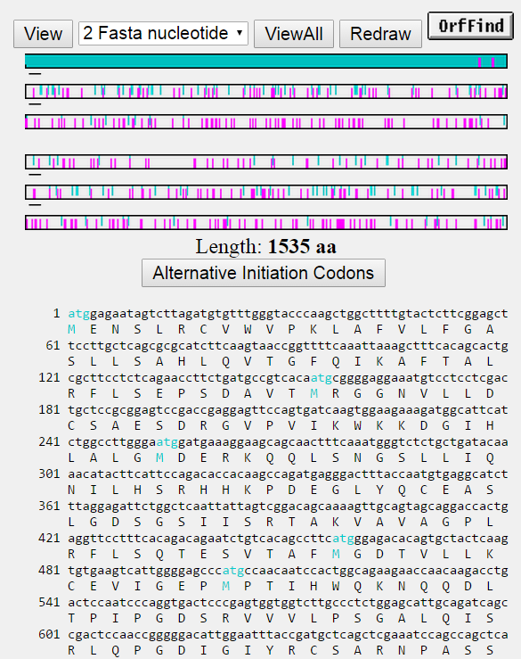
click

Slide 8
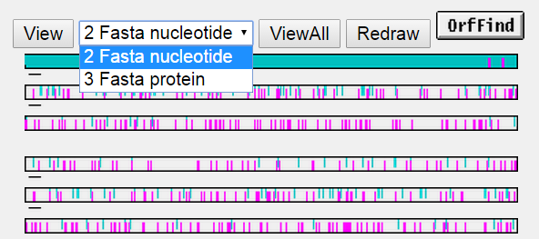
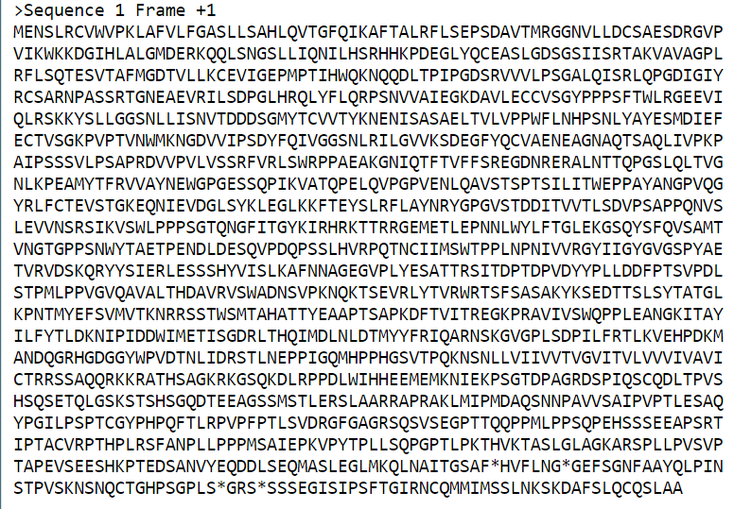
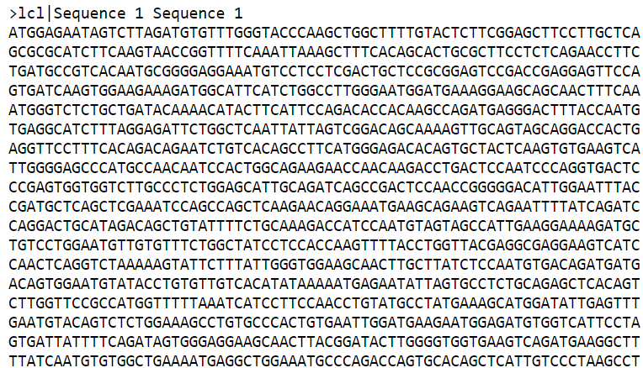
Fasta protein
Fasta nucleotide

Slide 9
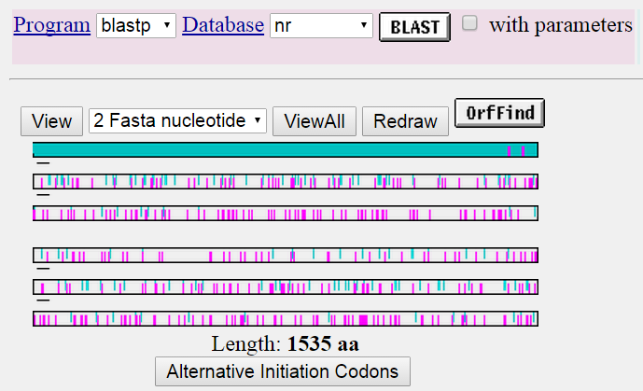

Slide 10
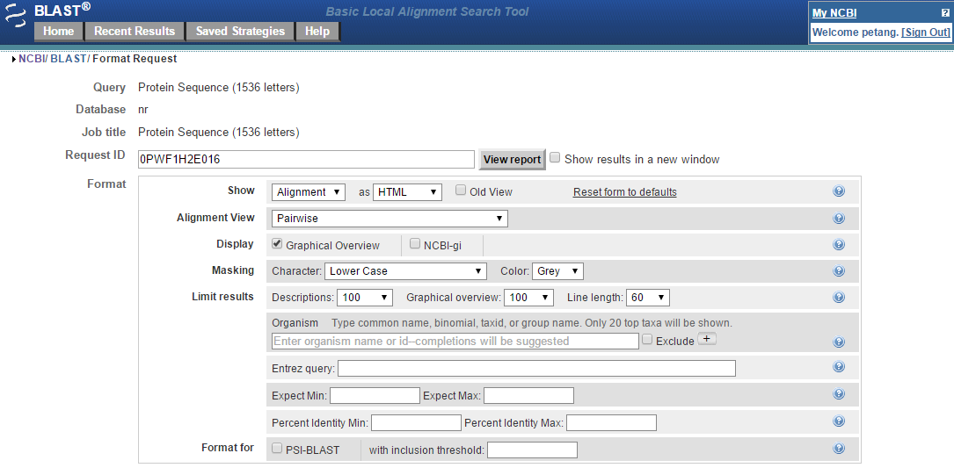
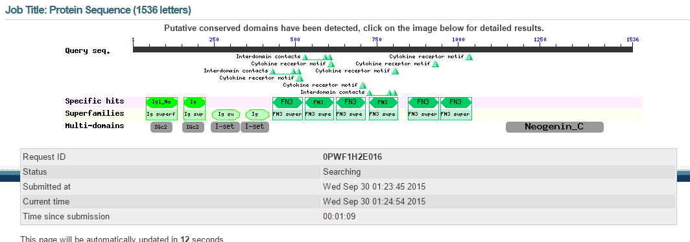

Slide 11
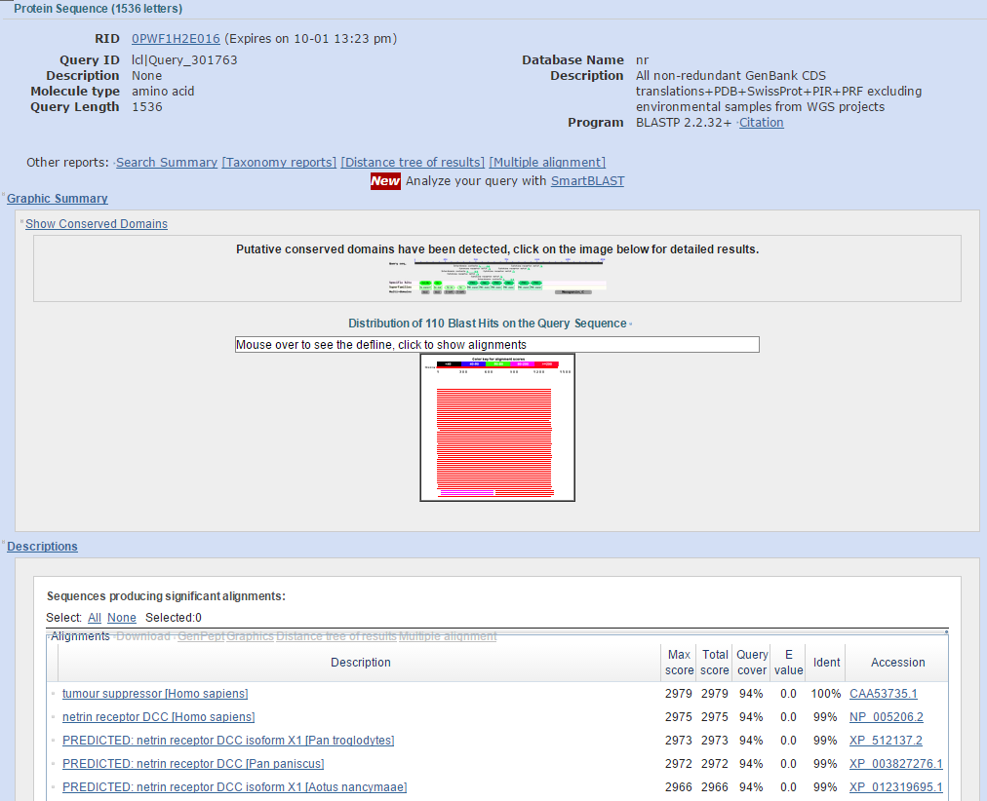
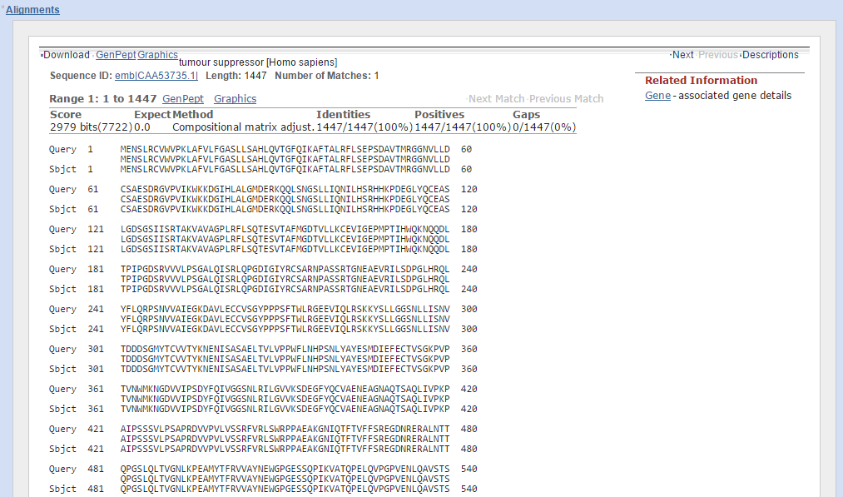
Graphic Summary
Description
Alignment

Slide 12
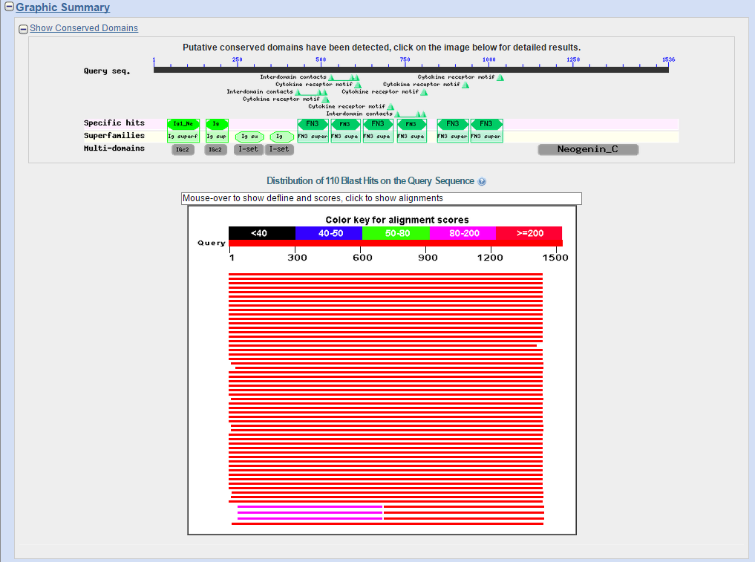

Slide 13
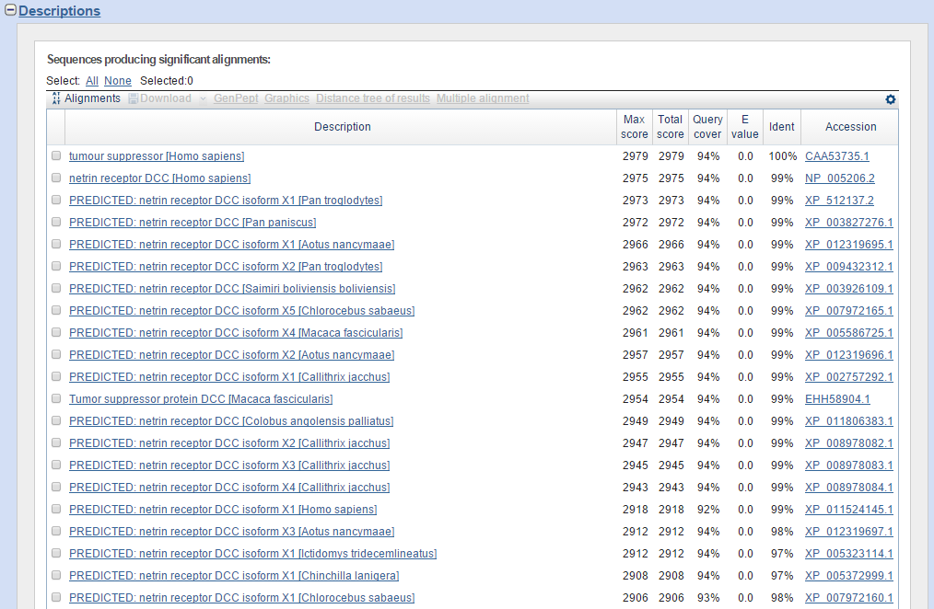

Slide 14
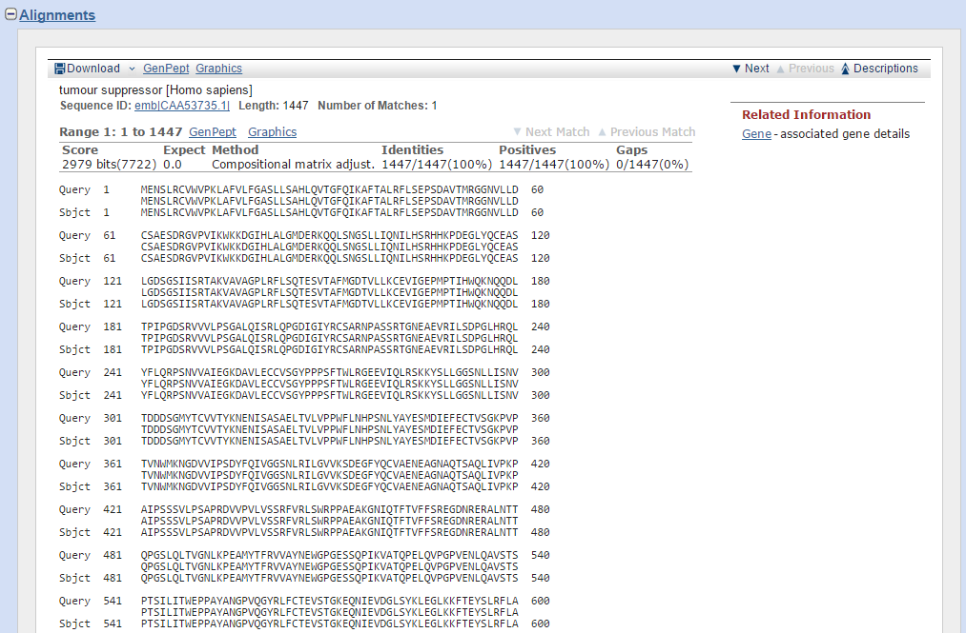

Slide 15
The E-value describes the number of hits one can expect to see by chance when searching a database of a particular size. The lower the E-value, the more "significant" a match to a database sequence

Slide 16
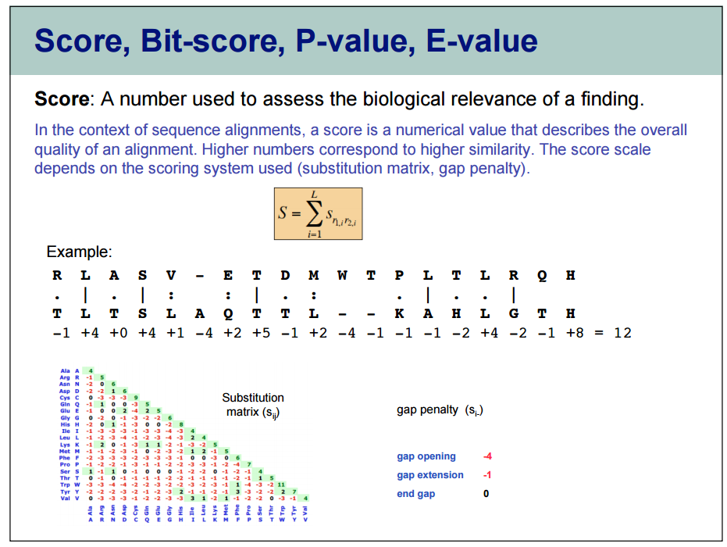

Slide 17
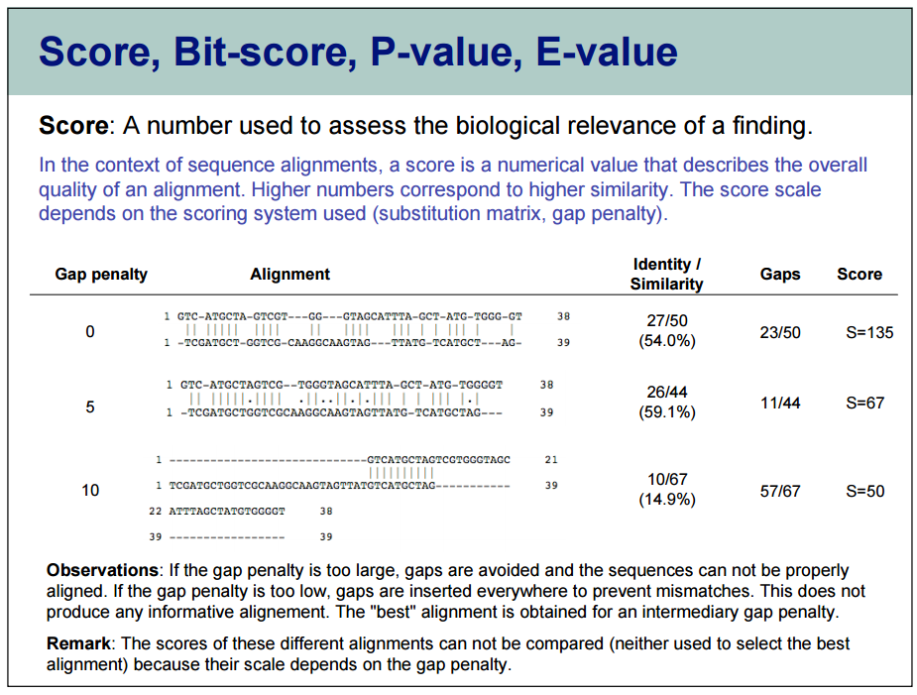

Slide 18
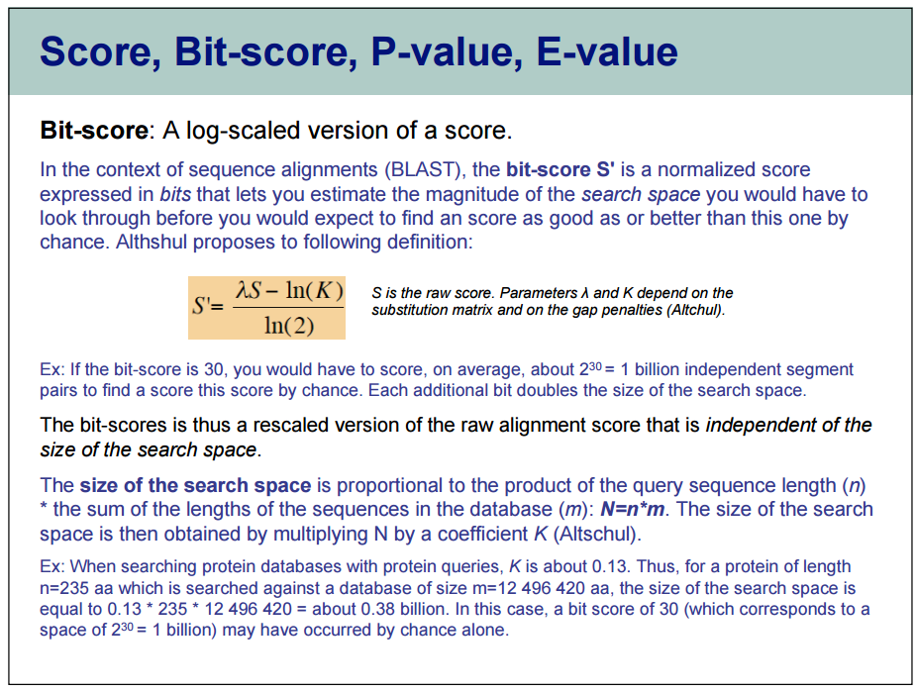

Slide 19
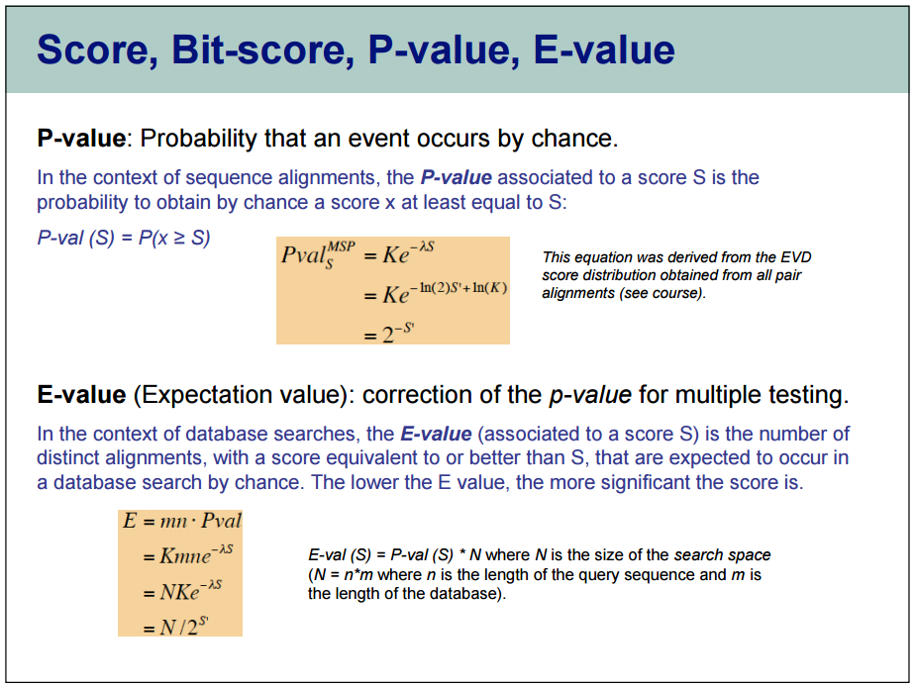

Slide 20
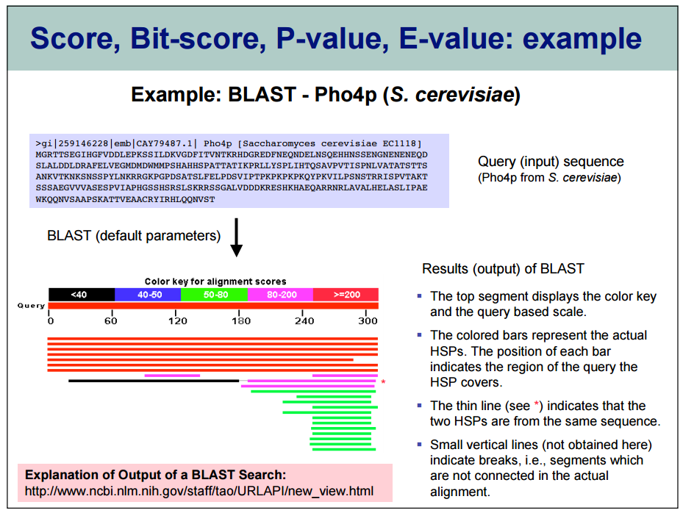

Slide 21
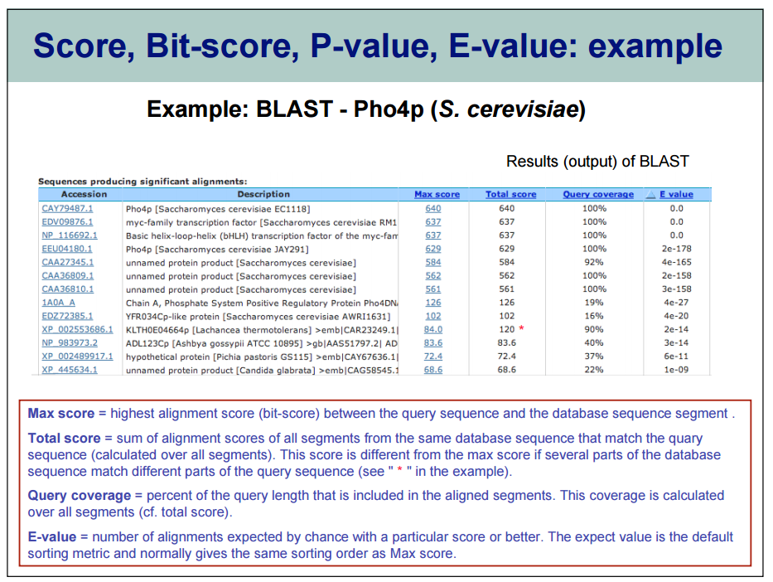

Slide 22
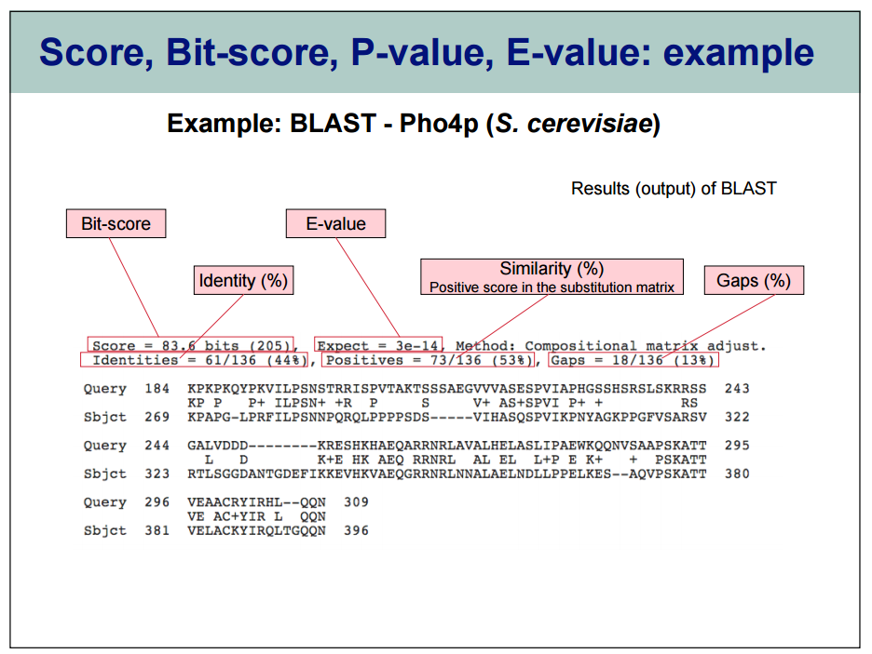

Slide 23


