Slide 1
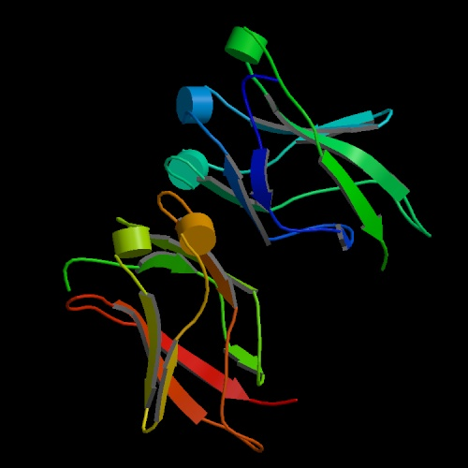
PROTEIN
SEQUENCE
ANALYSIS

Slide 2
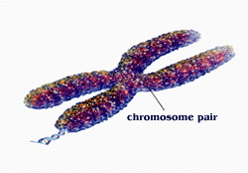
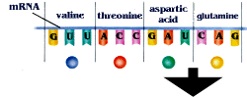
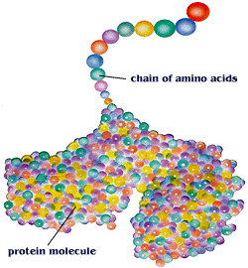
PROTEIN
DATABASES
PROTEIN
SEQUENCE
PROPERTIES
TOOLS
MOTIF/DOMAIN
FOLDING

Slide 3




Protein Sequence/Motif/Domain Databases
http://www.uniprot.org/
http://www.ncbi.nlm.nih.gov/Structure/cdd/wrpsb.cgi
http://www.ebi.ac.uk/Tools/pfa/iprscan/
Protein Analysis Tools
http://tw.expasy.org/

Slide 4
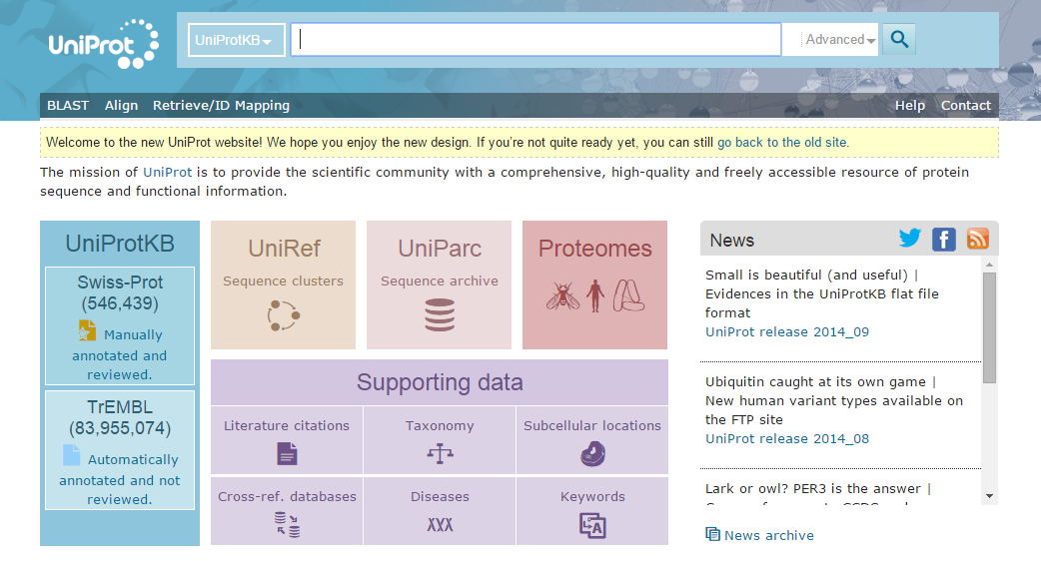
http://www.uniprot.org/
P53 again

Slide 5
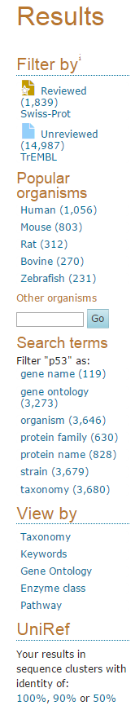
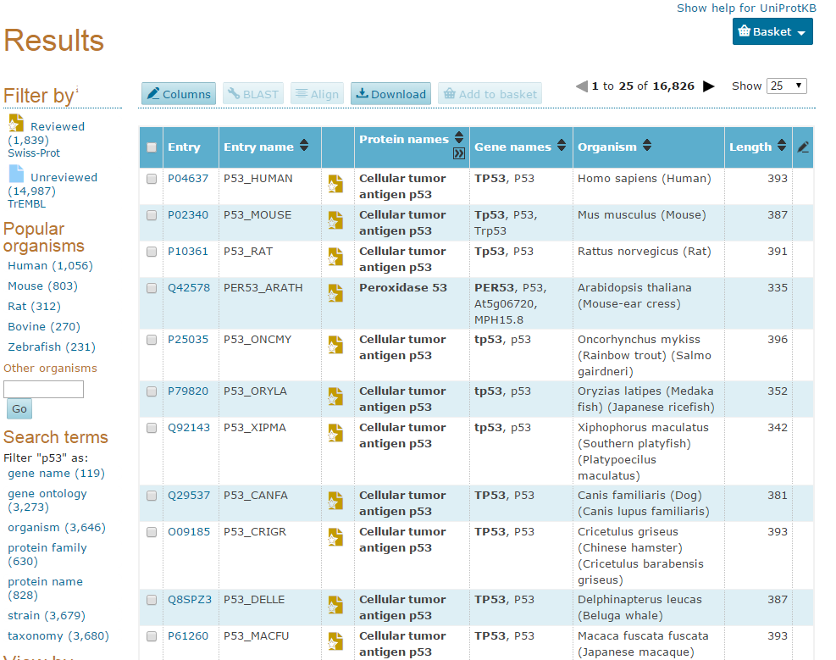
http://www.uniprot.org/uniprot/?query=p53&sort=score

Slide 6
http://www.uniprot.org/uniprot/?query=p53&sort=score

Slide 7
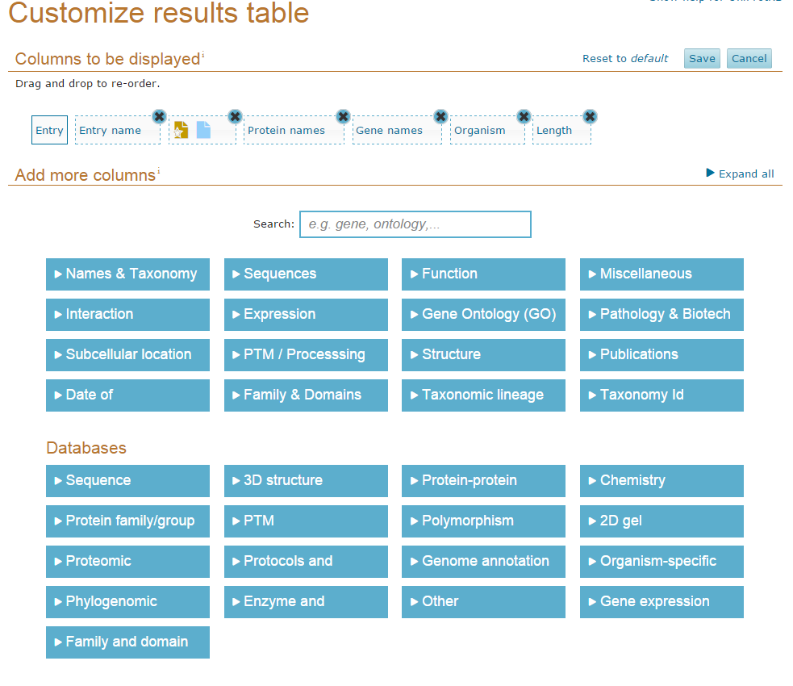

Slide 8
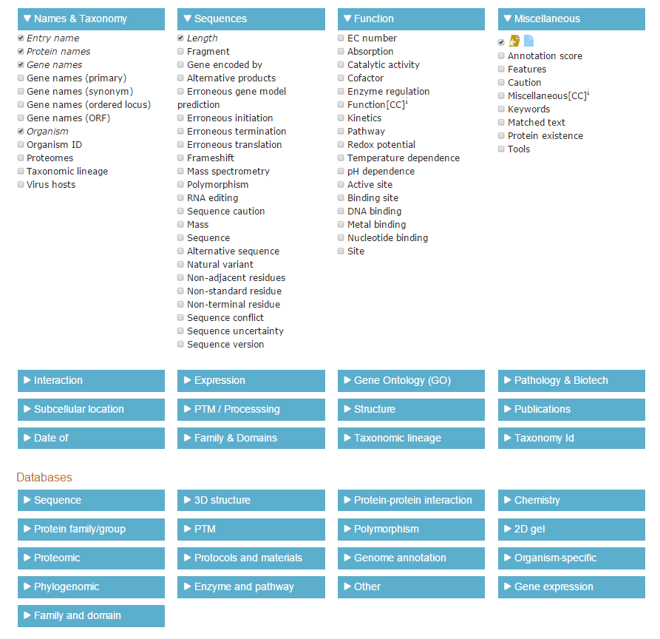

Slide 9
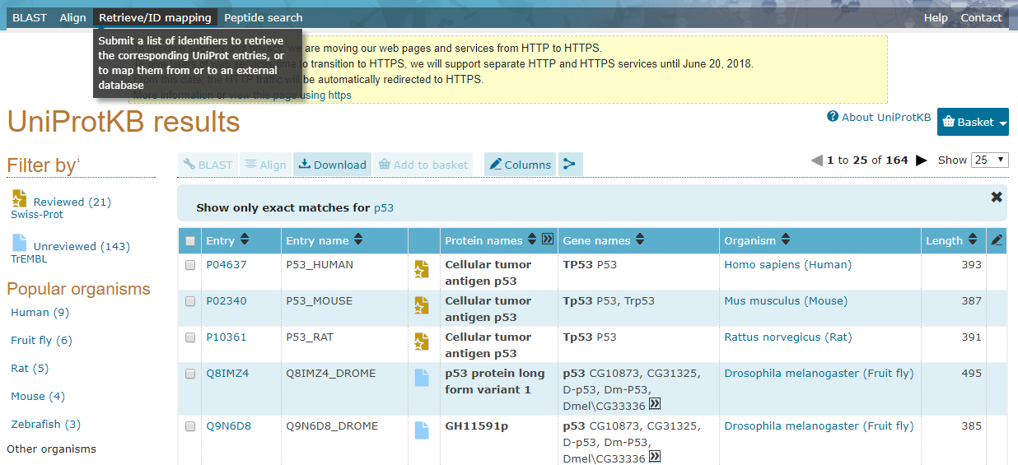
Retrieve information on:
P04637
P02340
P10361
Q8IMZ4
Q9N6D8

Slide 10
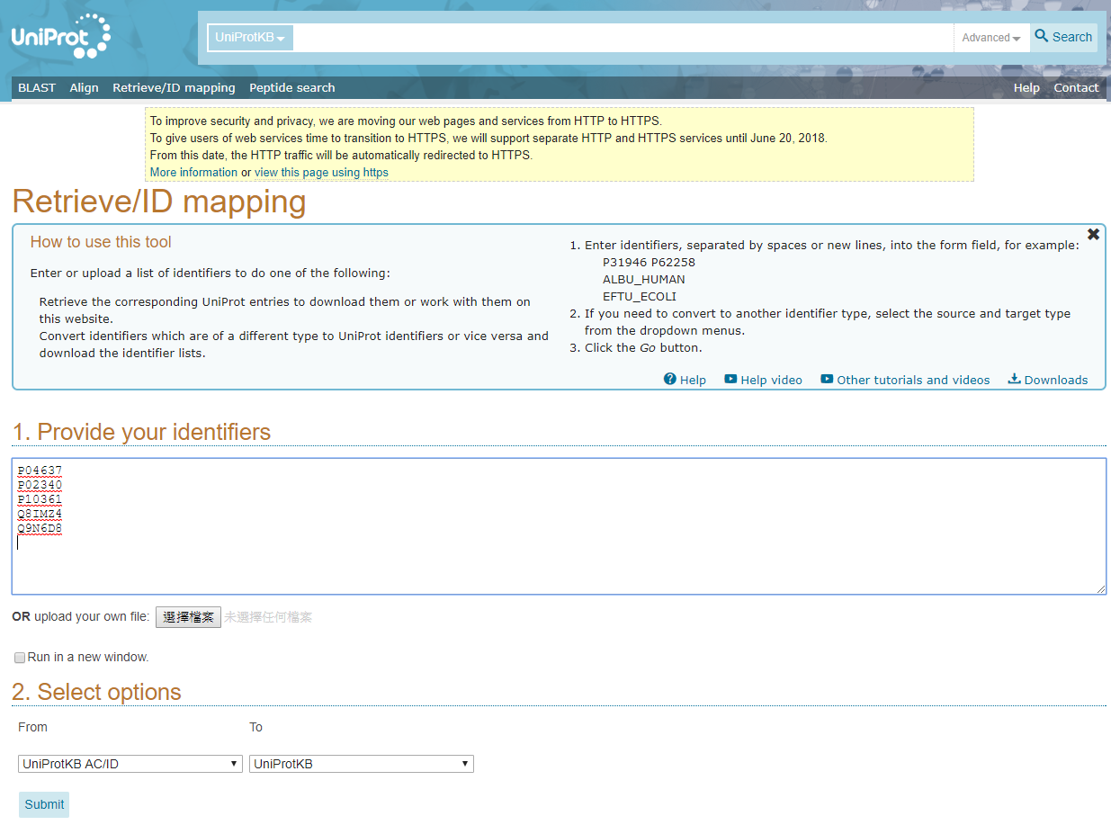
P04637
P02340
P10361
Q8IMZ4
Q9N6D8

Slide 11
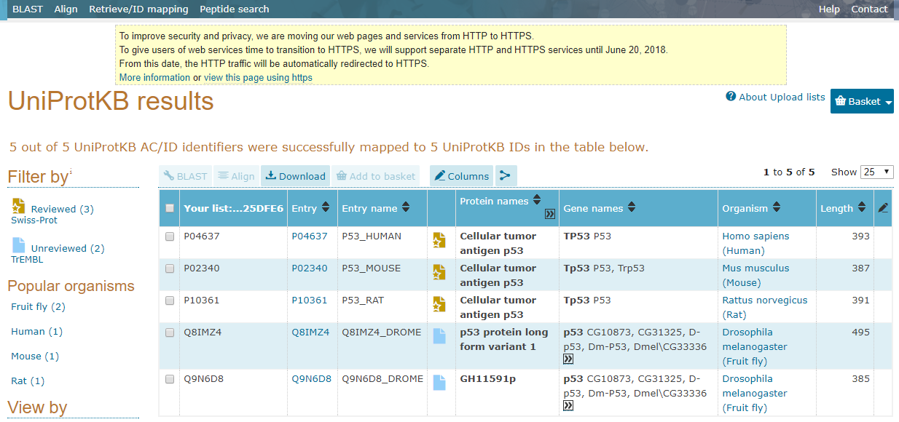

Slide 12
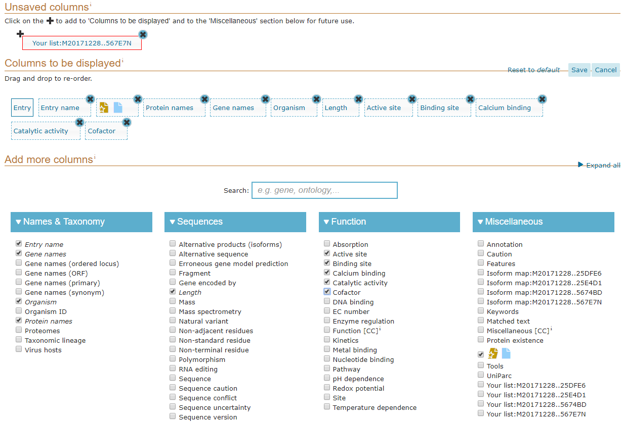
3
2
1

Slide 13
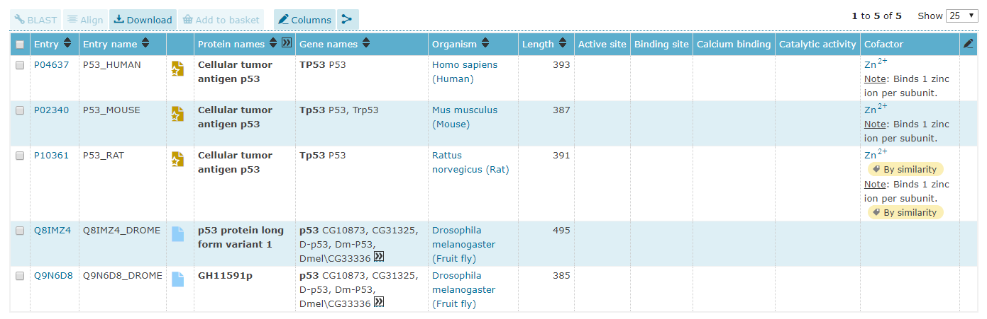
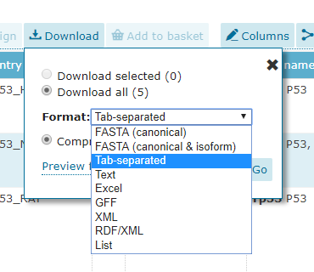
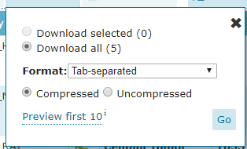

Slide 14
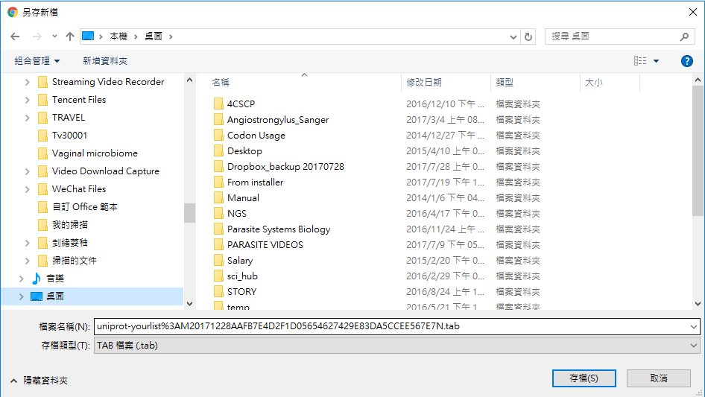

Slide 15
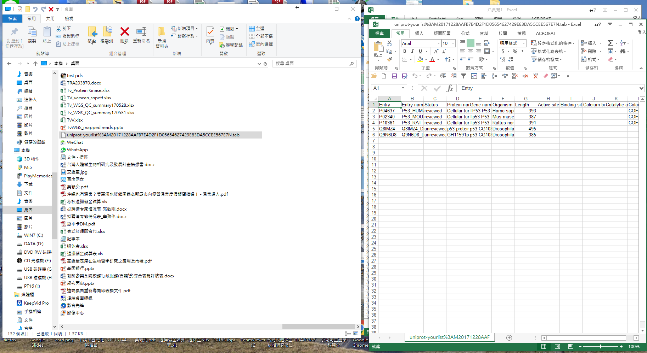
Open excel and drag the file to it

Slide 16
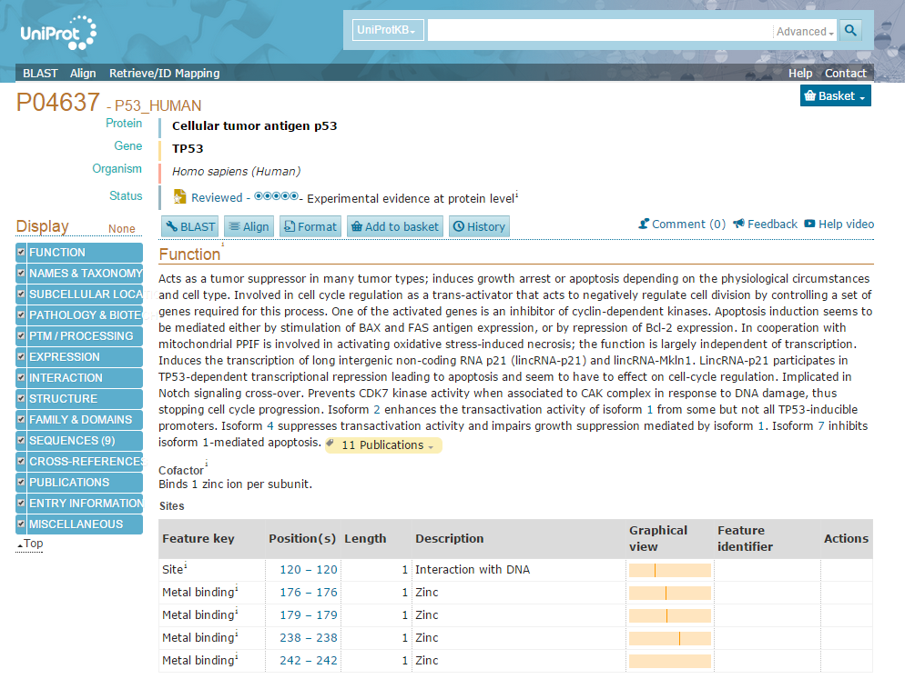
P04637

Slide 17
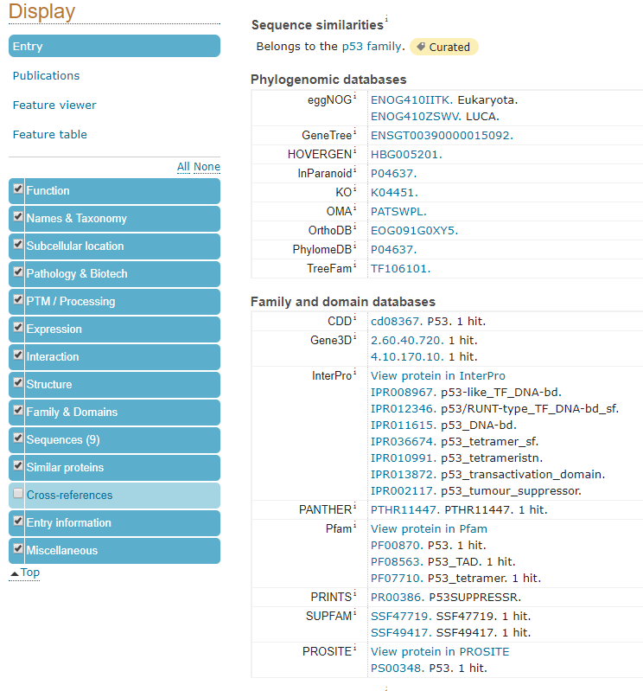

Slide 18
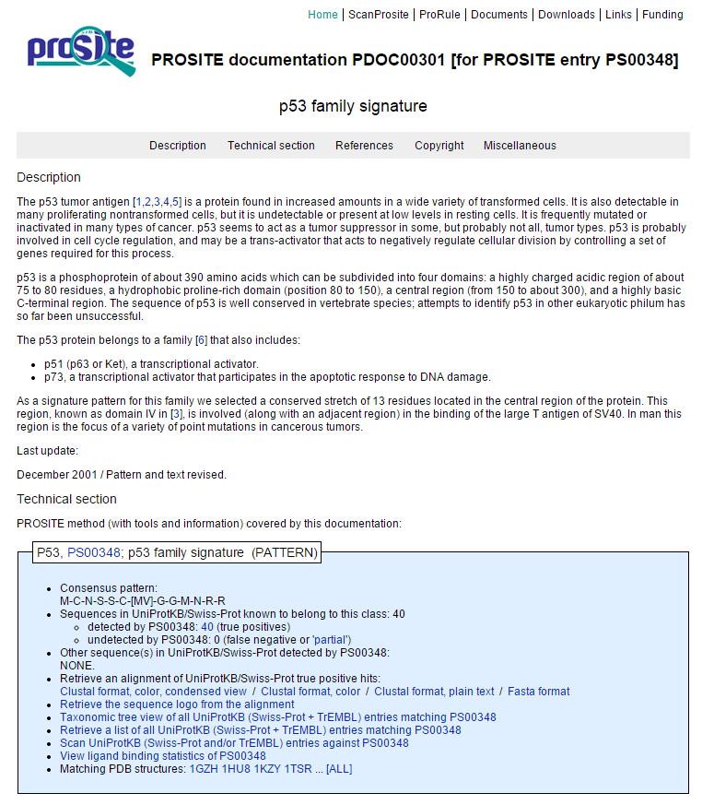

Slide 20
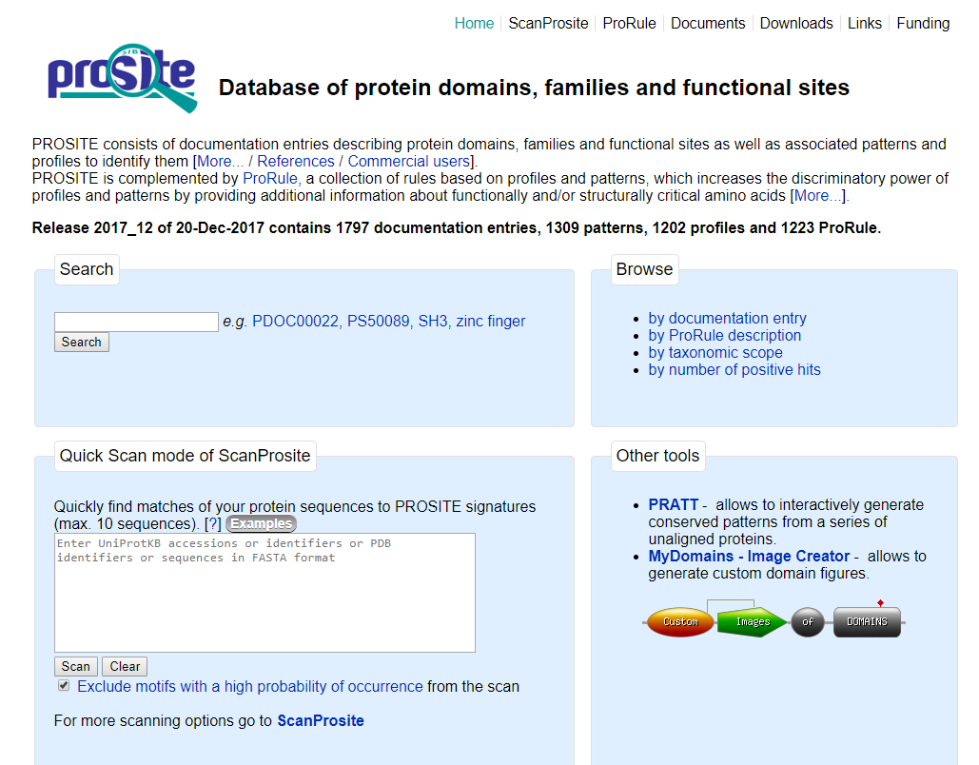
casein kinase

Slide 21
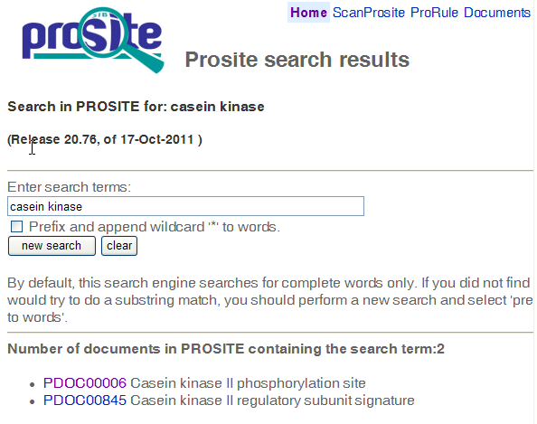

Slide 22
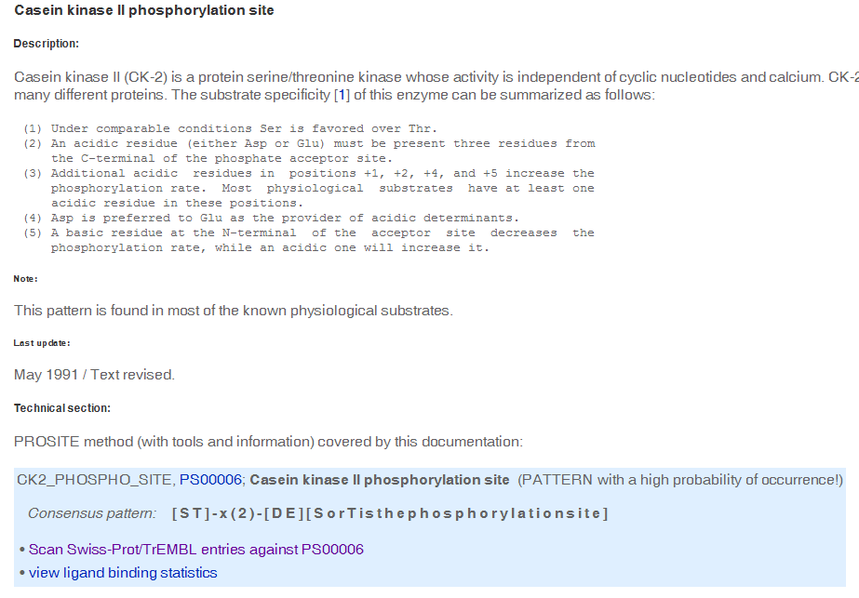

Slide 23
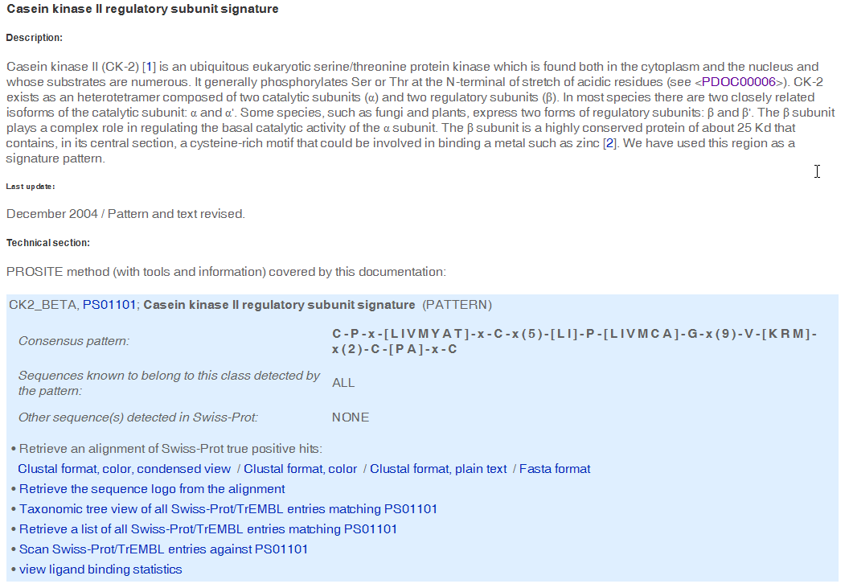

Slide 24

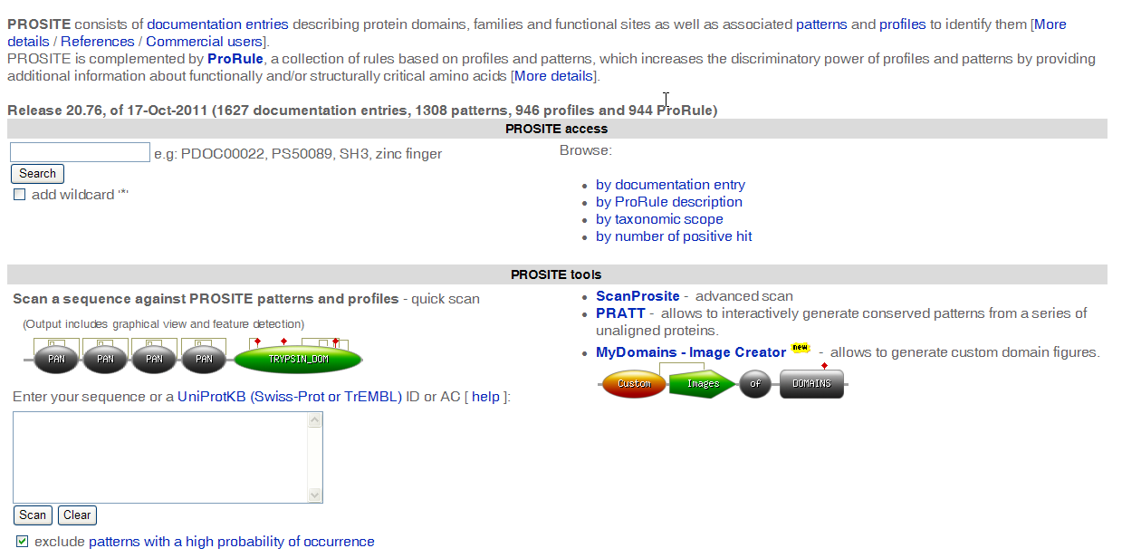
http://prosite.expasy.org/

Slide 25
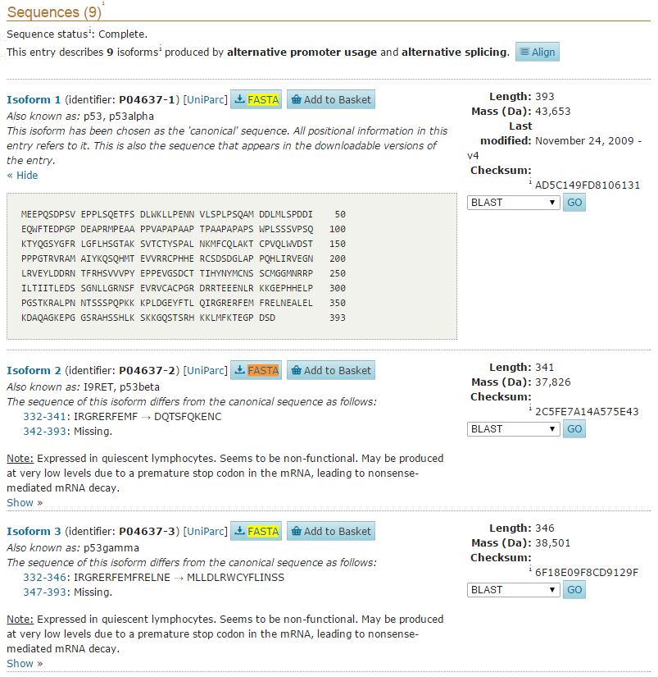
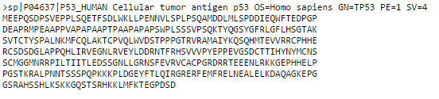
Copy this sequence to your computer

Slide 26
Example
cellular tumor antigen p53 isoform a [Homo sapiens]
>sp|P04637|P53_HUMAN Cellular tumor antigen p53 OS=Homo sapiens GN=TP53 PE=1 SV=4
MEEPQSDPSVEPPLSQETFSDLWKLLPENNVLSPLPSQAMDDLMLSPDDIEQWFTEDPGP
DEAPRMPEAAPPVAPAPAAPTPAAPAPAPSWPLSSSVPSQKTYQGSYGFRLGFLHSGTAK
SVTCTYSPALNKMFCQLAKTCPVQLWVDSTPPPGTRVRAMAIYKQSQHMTEVVRRCPHHE
RCSDSDGLAPPQHLIRVEGNLRVEYLDDRNTFRHSVVVPYEPPEVGSDCTTIHYNYMCNS
SCMGGMNRRPILTIITLEDSSGNLLGRNSFEVRVCACPGRDRRTEEENLRKKGEPHHELP
PGSTKRALPNNTSSSPQPKKKPLDGEYFTLQIRGRERFEMFRELNEALELKDAQAGKEPG
GSRAHSSHLKSKKGQSTSRHKKLMFKTEGPDSD

Slide 27
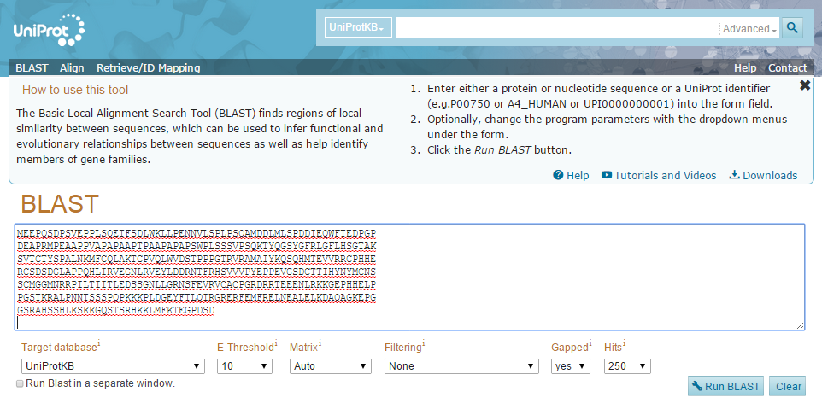
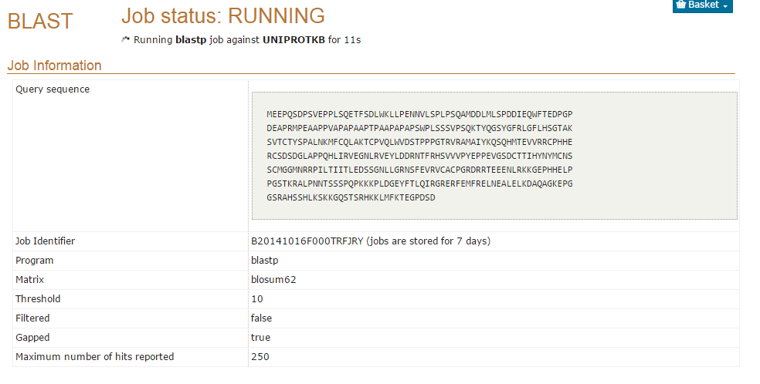

Slide 28
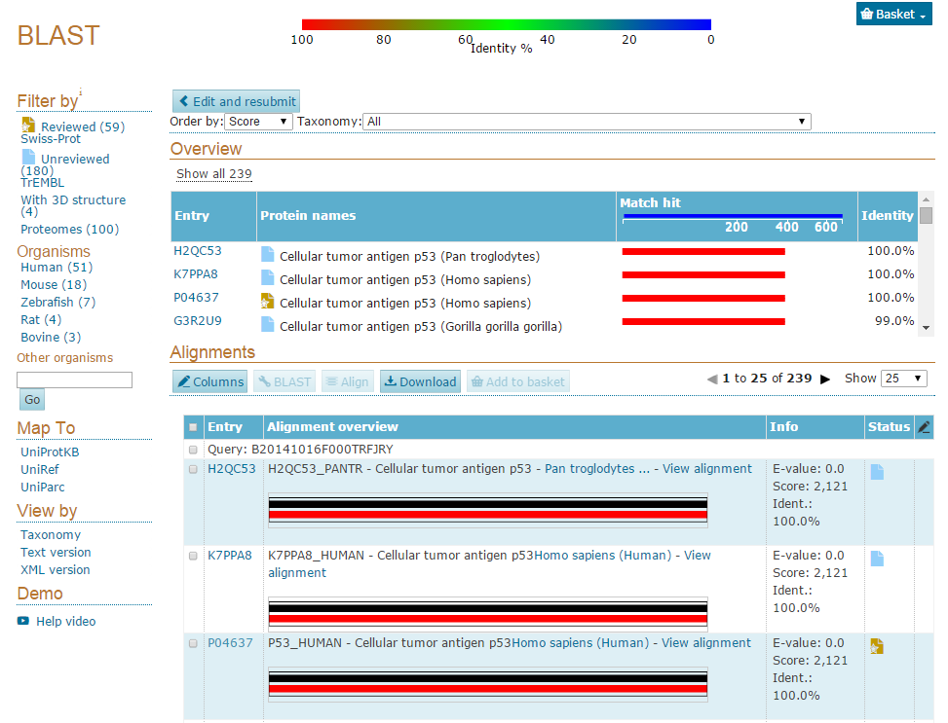

Slide 29

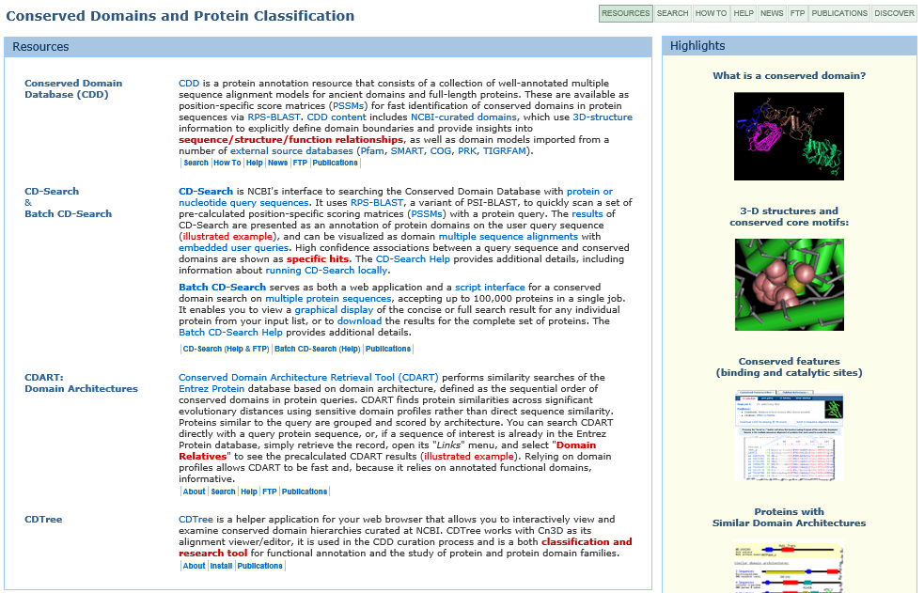
http://www.ncbi.nlm.nih.gov/Structure/cdd/cdd.shtml

Slide 30
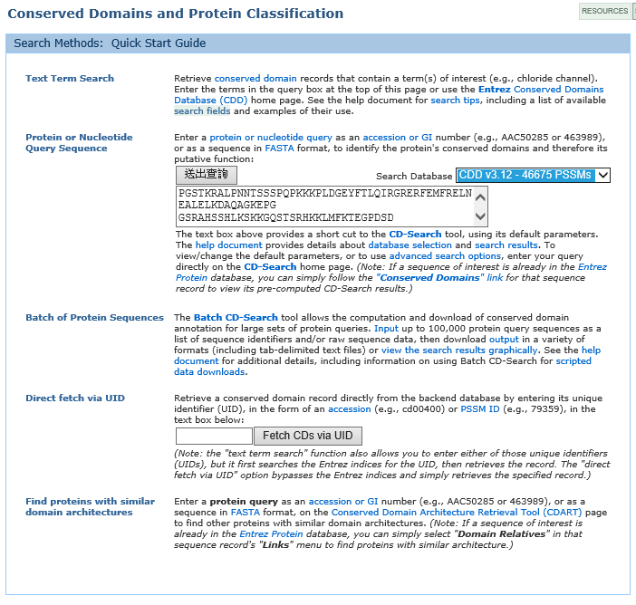

Slide 31
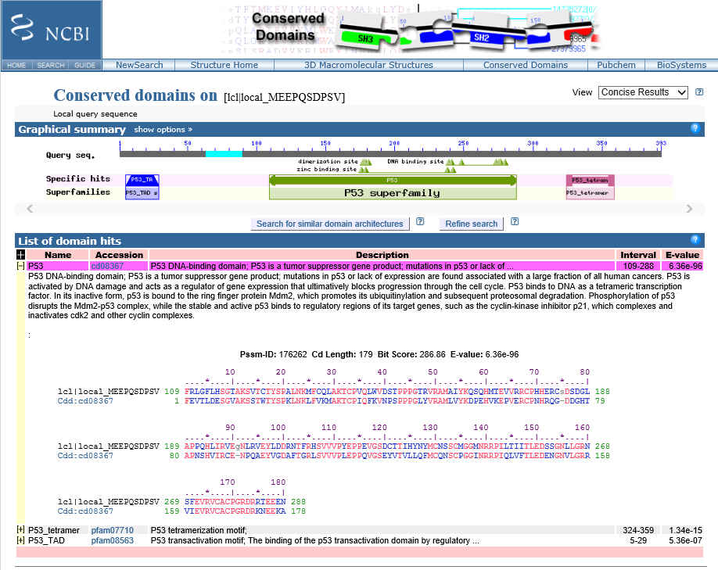

Slide 32
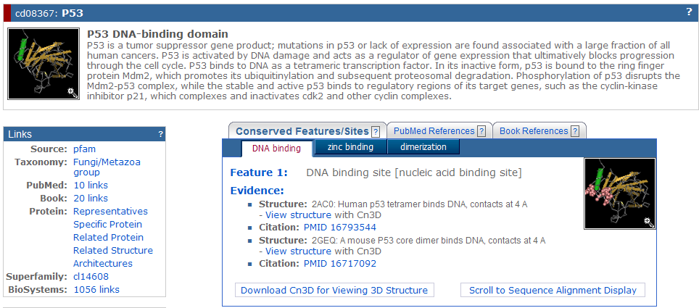

Slide 33
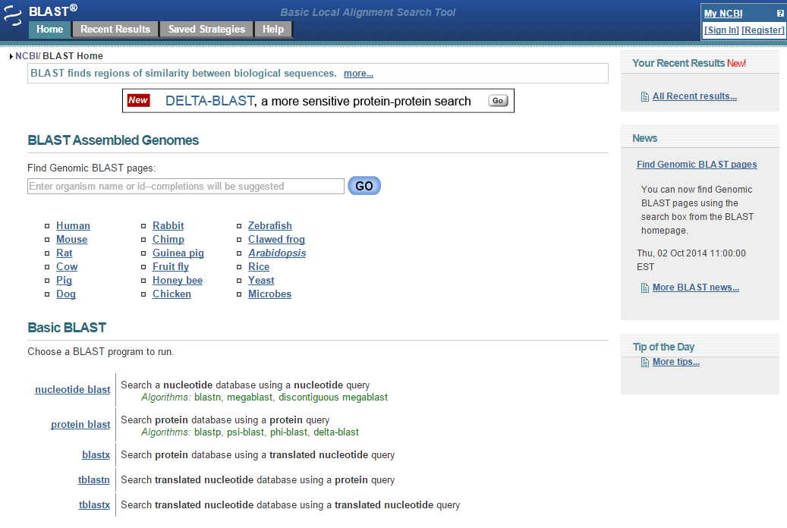

Slide 34
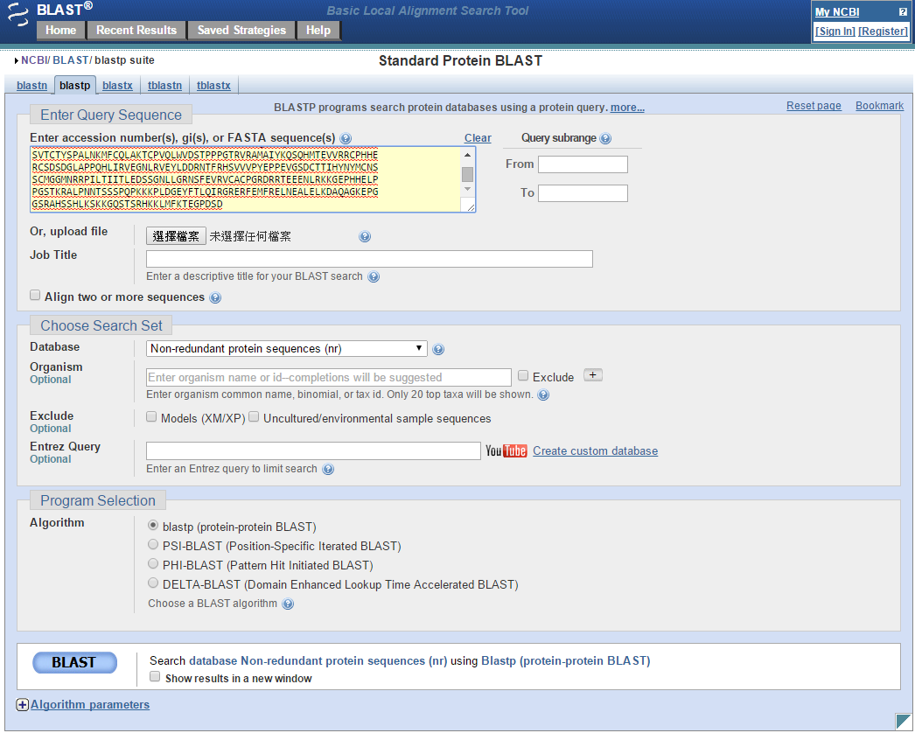
http://blast.ncbi.nlm.nih.gov/Blast.cgi

Slide 35
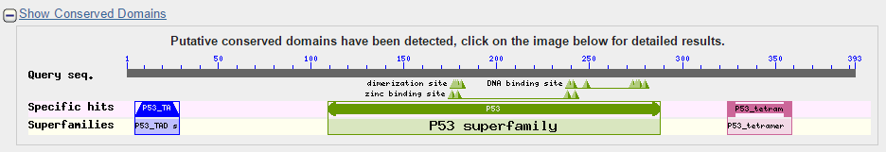
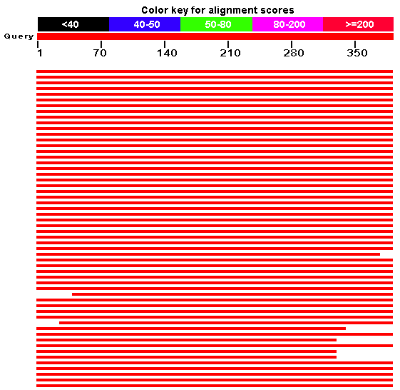
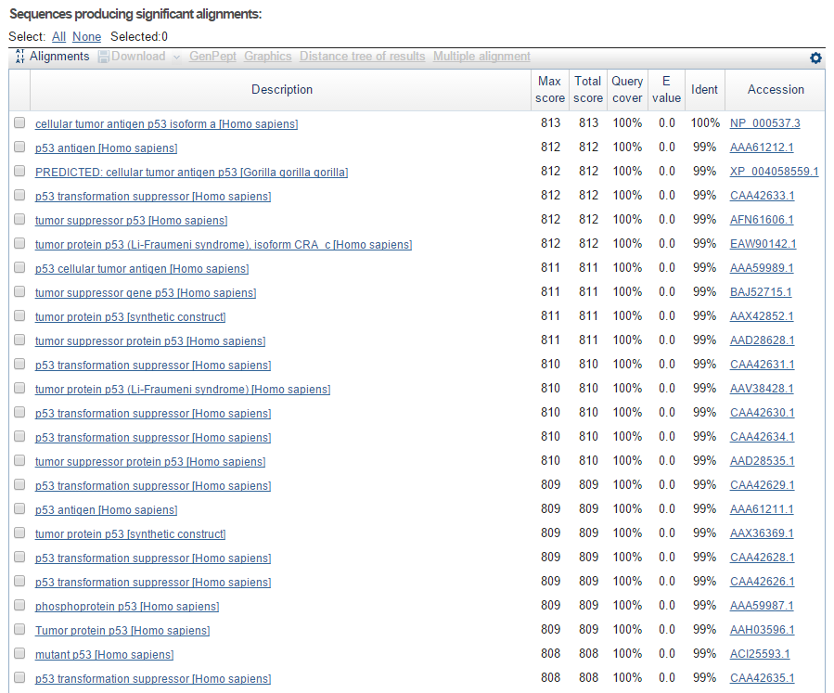
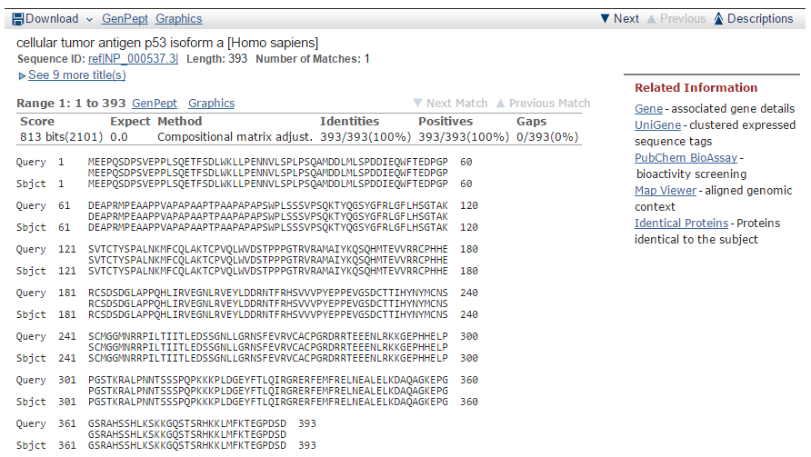

Slide 36
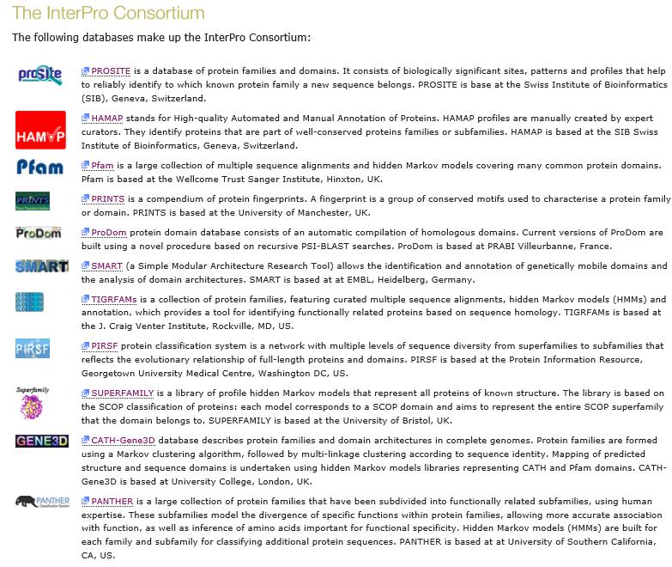
http://www.ebi.ac.uk/interpro/about.html

Slide 37
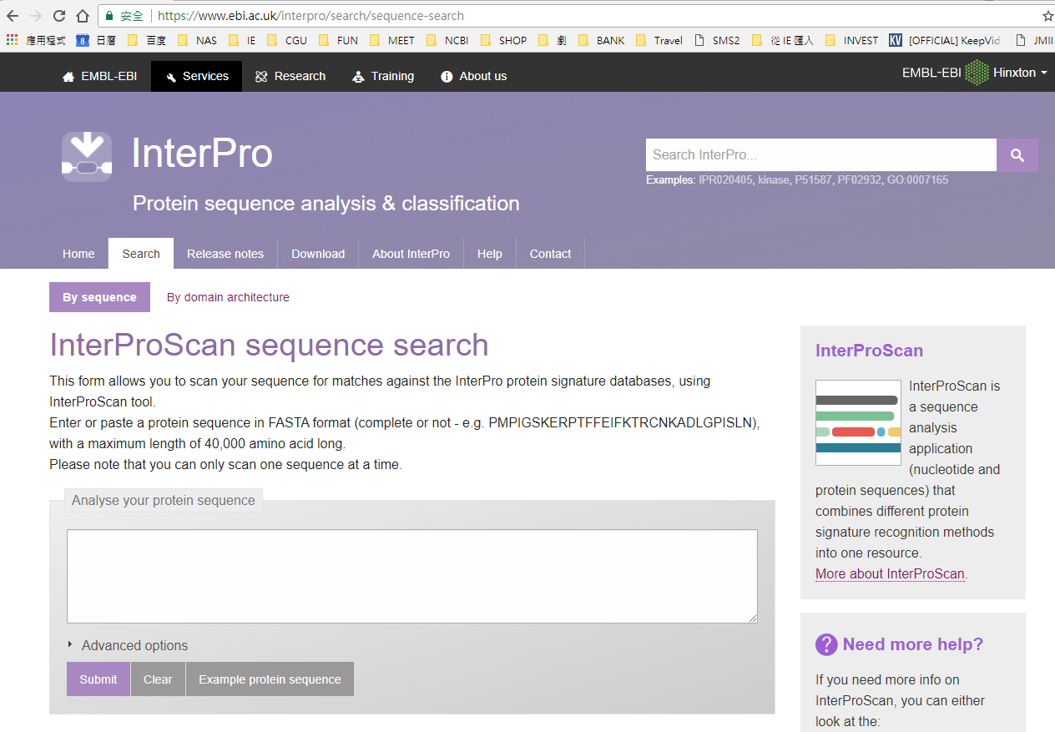
https://www.ebi.ac.uk/interpro/search/sequence-search

Slide 38
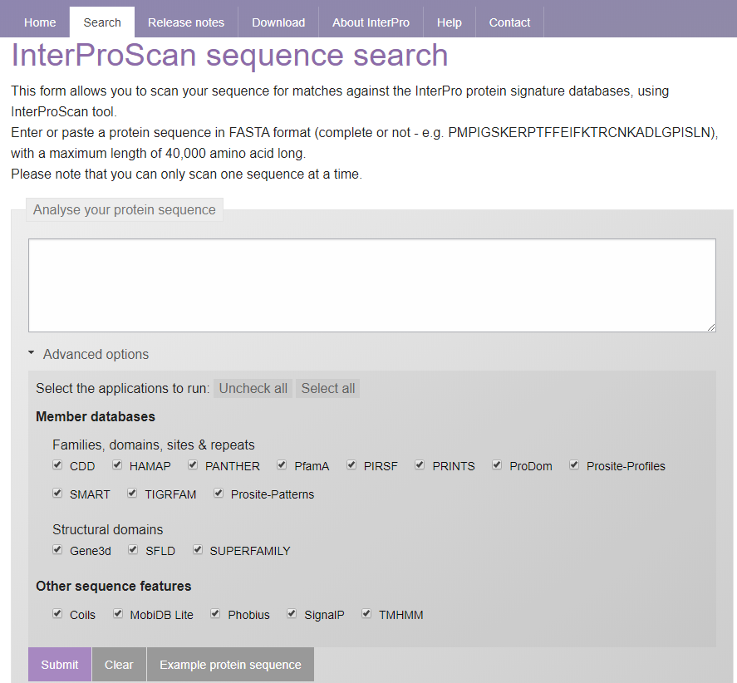

Slide 39
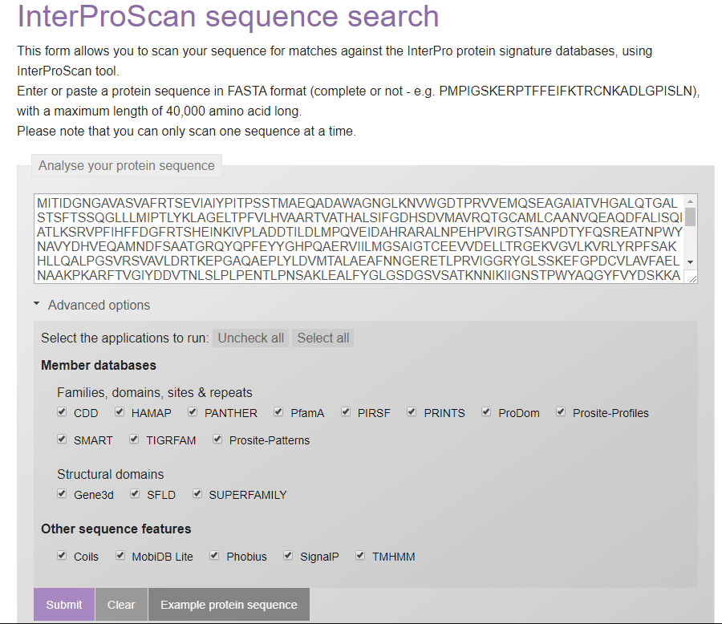
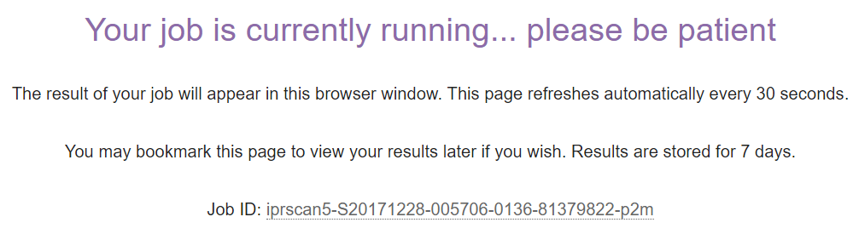

Slide 40
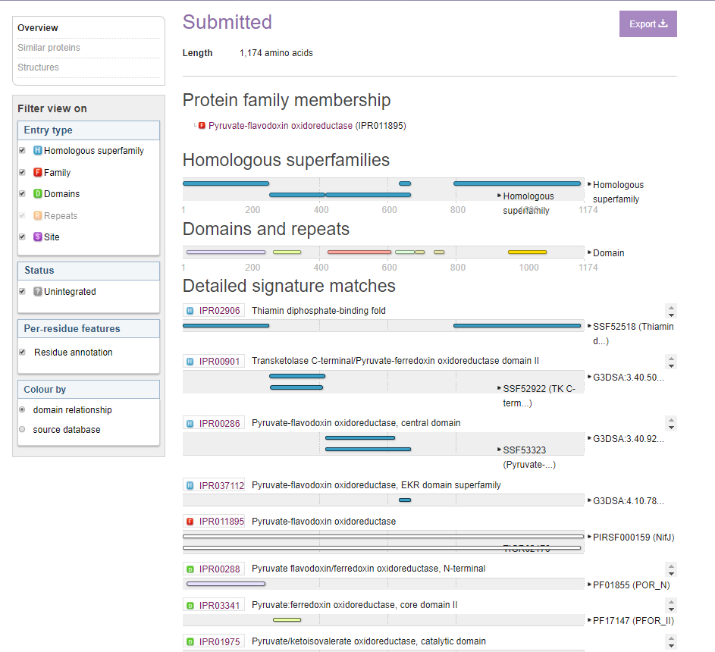
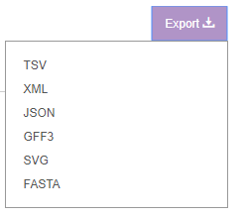

Slide 41
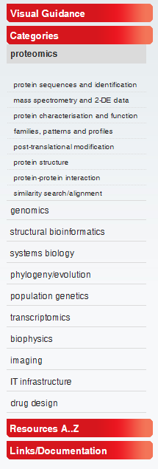
http://www.expasy.org/
Protein Sequence Analysis Tools
ExPASy Molecular Biology Server
Expert Protein Analysis System is the new SIB Bioinformatics Resource Portal which provides access to scientific databases and software tools in different areas of life sciences including proteomics, genomics, phylogeny, systems biology, population genetics, transcriptomics etc

Slide 42
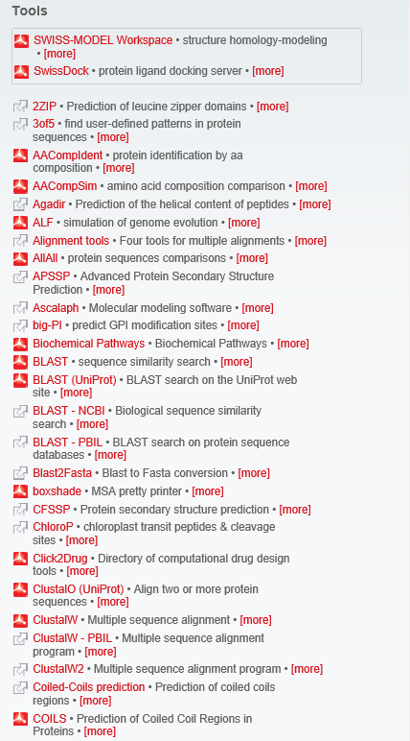



Slide 43
Example
cellular tumor antigen p53 isoform a [Homo sapiens]
>sp|P04637|P53_HUMAN Cellular tumor antigen p53 OS=Homo sapiens GN=TP53 PE=1 SV=4
MEEPQSDPSVEPPLSQETFSDLWKLLPENNVLSPLPSQAMDDLMLSPDDIEQWFTEDPGP
DEAPRMPEAAPPVAPAPAAPTPAAPAPAPSWPLSSSVPSQKTYQGSYGFRLGFLHSGTAK
SVTCTYSPALNKMFCQLAKTCPVQLWVDSTPPPGTRVRAMAIYKQSQHMTEVVRRCPHHE
RCSDSDGLAPPQHLIRVEGNLRVEYLDDRNTFRHSVVVPYEPPEVGSDCTTIHYNYMCNS
SCMGGMNRRPILTIITLEDSSGNLLGRNSFEVRVCACPGRDRRTEEENLRKKGEPHHELP
PGSTKRALPNNTSSSPQPKKKPLDGEYFTLQIRGRERFEMFRELNEALELKDAQAGKEPG
GSRAHSSHLKSKKGQSTSRHKKLMFKTEGPDSD

