Slide 1

http://petang.cgu.edu.tw/bioinformatics/index.htm
Bioinformatics
Lecture 2 – Bioinformatics Databases
Petrus Tang, Ph.D. (鄧致剛)
Graduate Institute of Basic Medical Sciences
and
Bioinformatics Center, Chang Gung University.
petang@mail.cgu.edu.tw
EXT: 5136
助教：
蔡智宇(分機5690)

Slide 2







Databases?

Slide 3
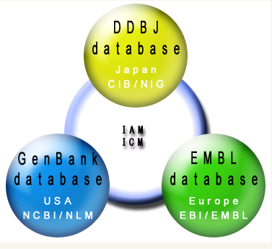
GenBank/EMBL/DDBJ
International
Nucleotide Sequence Database
DDBJ: DNA Data Bank of Japan
CIB: Center for Information Biology and
DNA Data Bank of Japan
NIG: National Institute of Genetics
IAM: International Advisory Meeting
ICM: International Collaborative Meeting
Primary
Databases
EMBL:
European Molecular Biology
Laboratory
EBI:
European Bioinformatics
Institute
NCBI:
National Center for Biotechnology Information
NLM:
National Library of Medicine

Slide 4
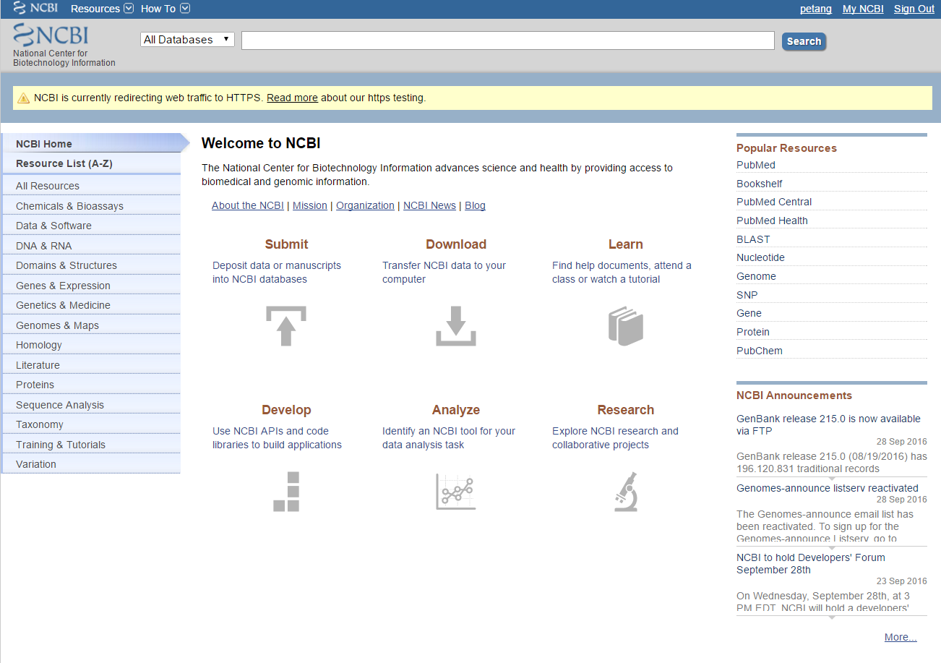
https://www.ncbi.nlm.nih.gov/

Slide 5
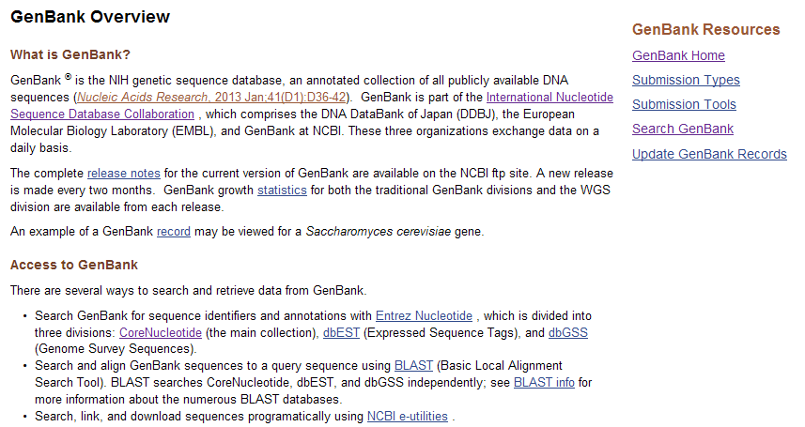
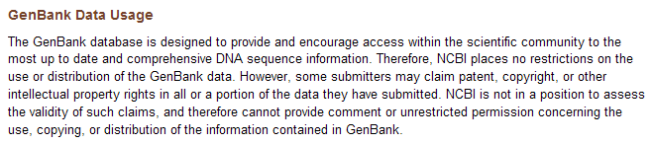
http://www.ncbi.nlm.nih.gov/genbank/

Slide 6
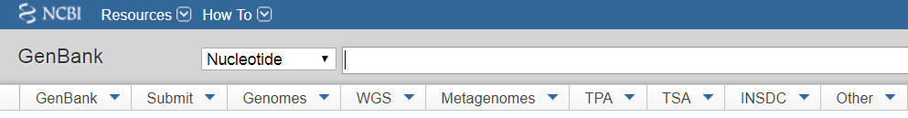
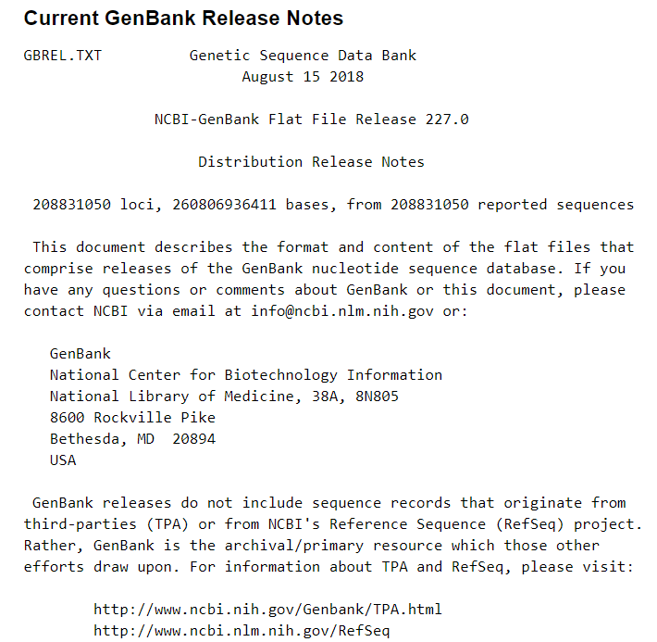
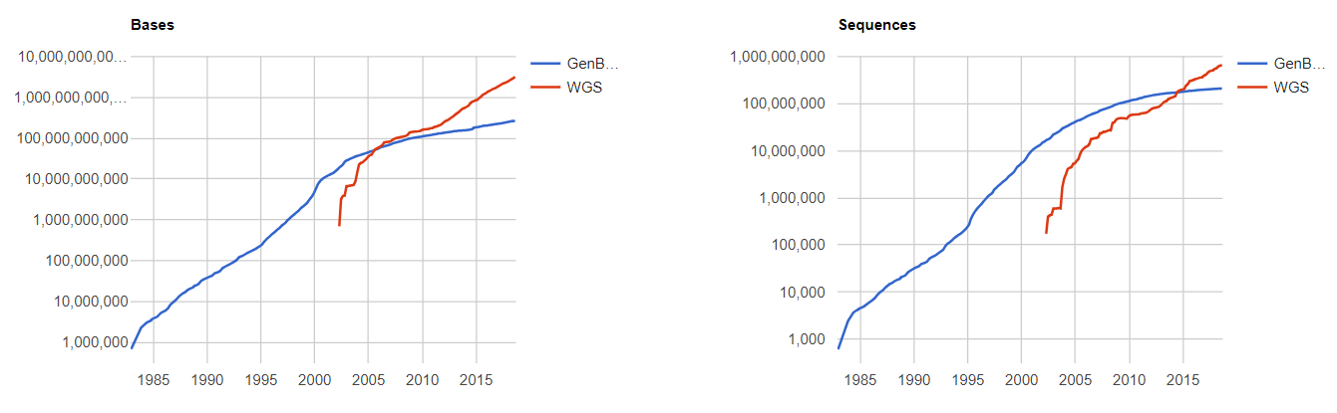

Slide 7
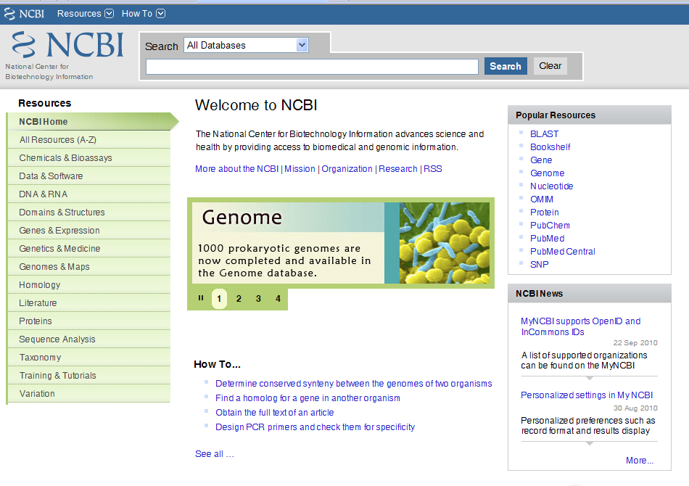
Secondarily Databases

Slide 8
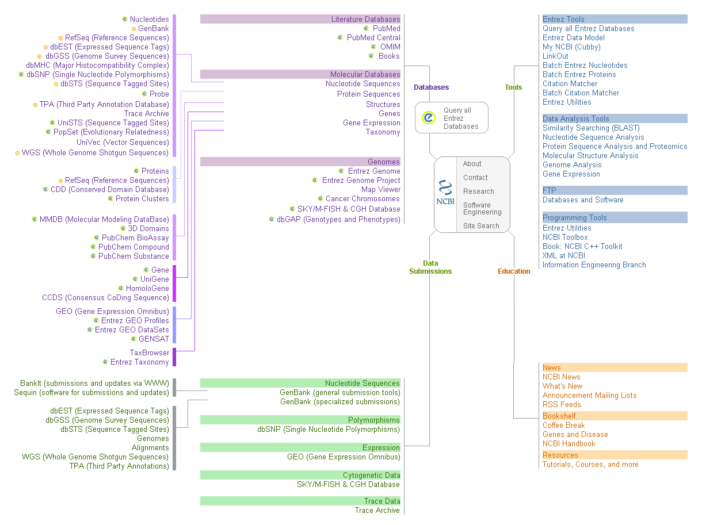
Notes:
shiuan
8

Slide 9
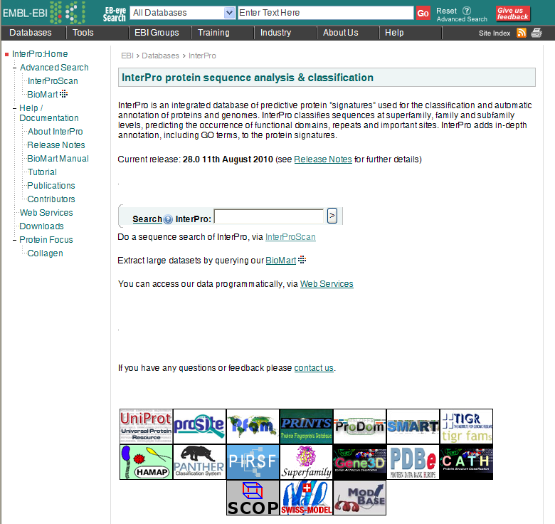
Secondarily Databases

Slide 10
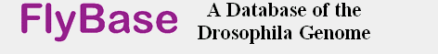




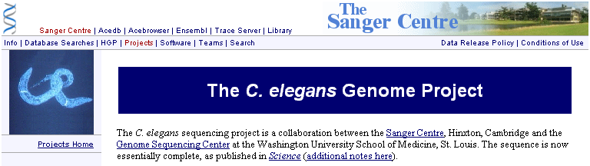

Slide 11
Database Retrieving and
Manipulation Network
Databases
Literature Database
Sequence Databases -
Primary Databases
Secondarily Databases
GCG
Vector NTI
CLC
Open Sources
Endnote
MS Office
Adobe
Query by
1.Text
2.Sequence
Retrival
System
Softwares
Fasta
GenBANK
Embl
GCG
Image
Formats
Information
Sequence
Converter
Sequnece,Structure,Image,Document

Slide 12

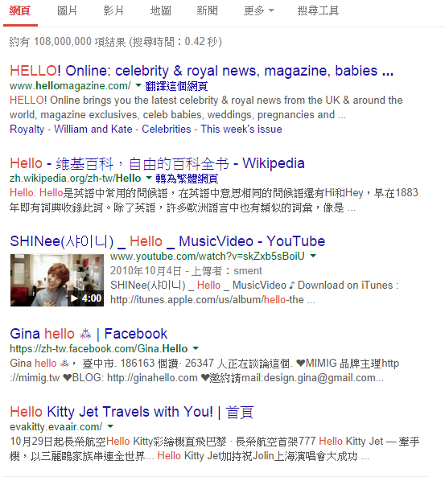
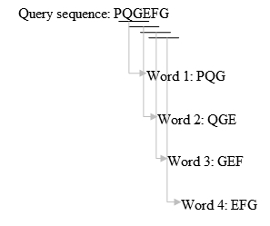
Query by Text
fuzzy search
（approximate string matching）

Slide 13
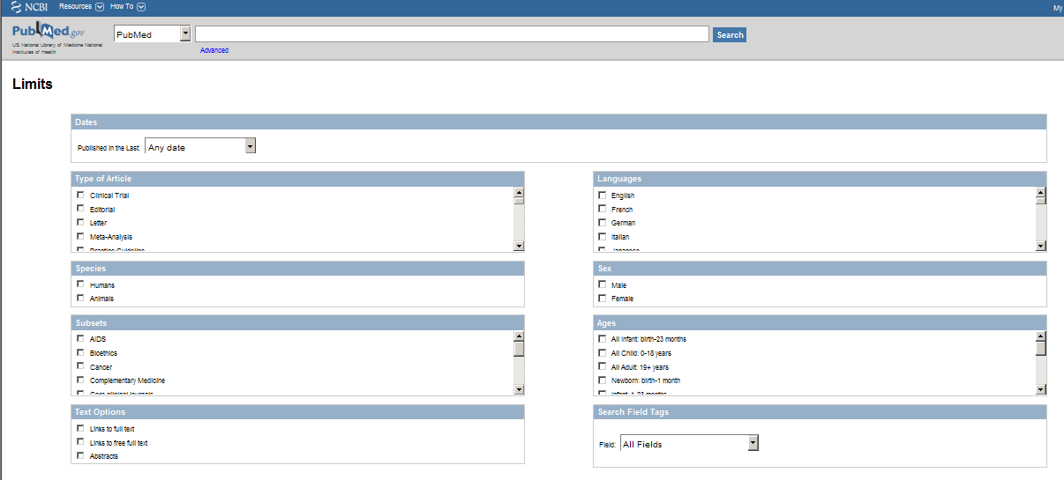
Literature Databases

Slide 14
Query by Sequence
Local Alignment
compares regions within two sequences and
can return several matches
BLAST
vs
Global Alignment
compare entire sequences
FASTA

Slide 15
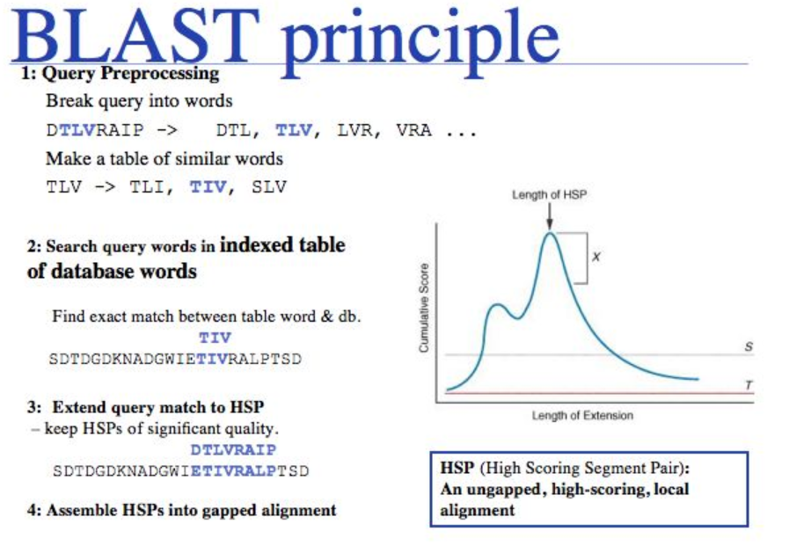

Slide 16

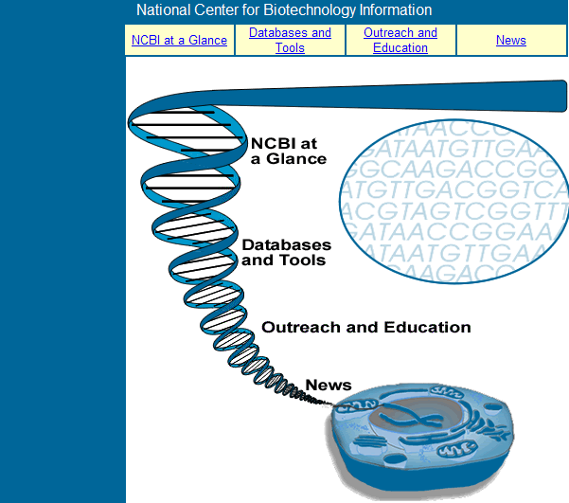
http://www.ncbi.nlm.nih.gov/About/glance/index.html

Slide 17
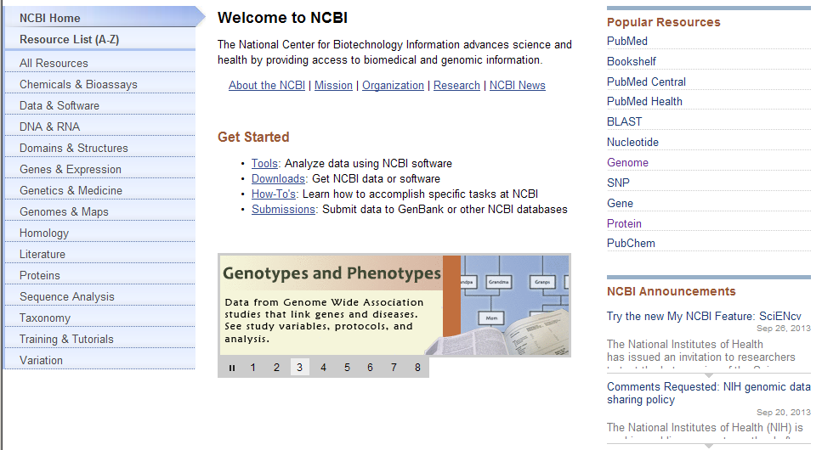

Slide 18
Notes:
shiuan
18

Slide 19
Tp53 as an example
What is tp53?
How many tp53 variants are there?
How to find the reference gene/protein sequence?
Which kind of information are included in gene bank record?
More………………….

Slide 20
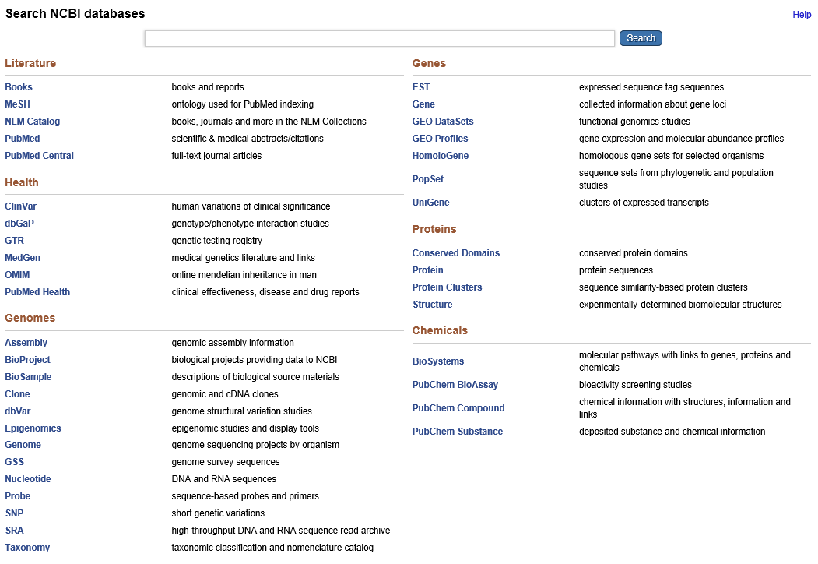
http://www.ncbi.nlm.nih.gov/sites/gquery

Slide 21
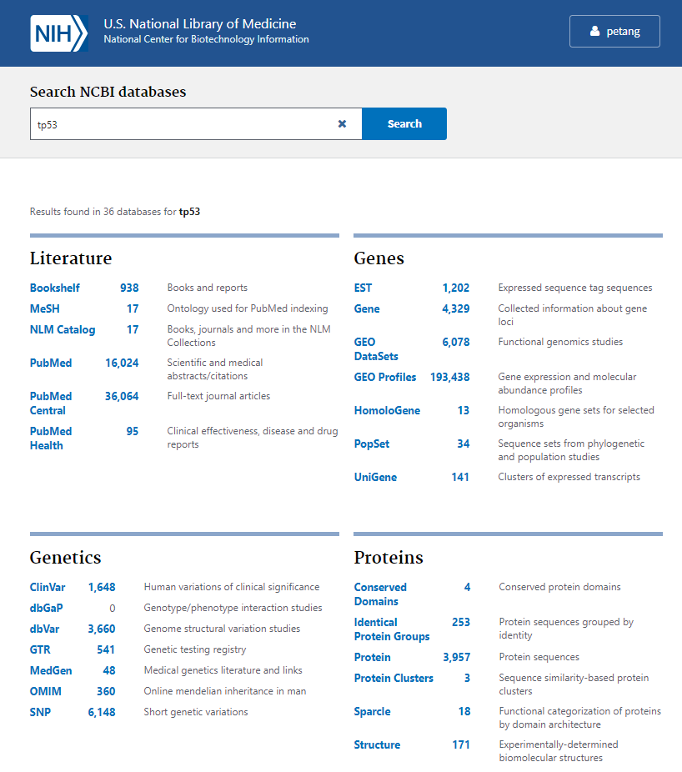

Slide 22
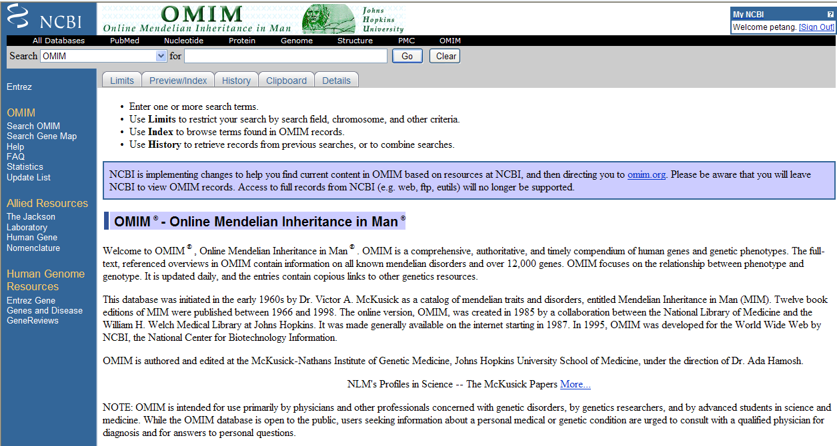
Literature Databases
http://www.ncbi.nlm.nih.gov/omim

Slide 23
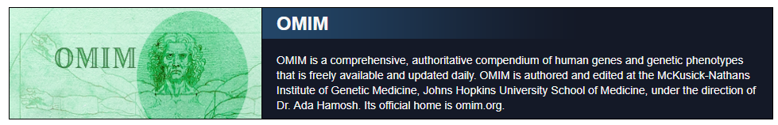
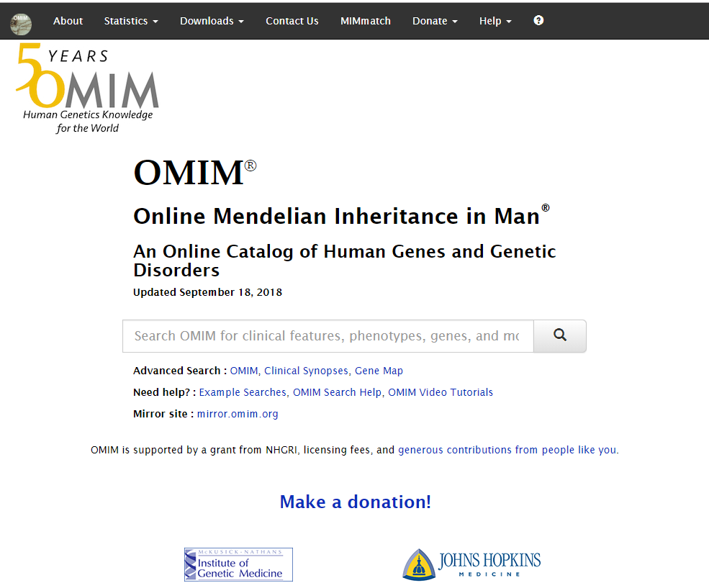
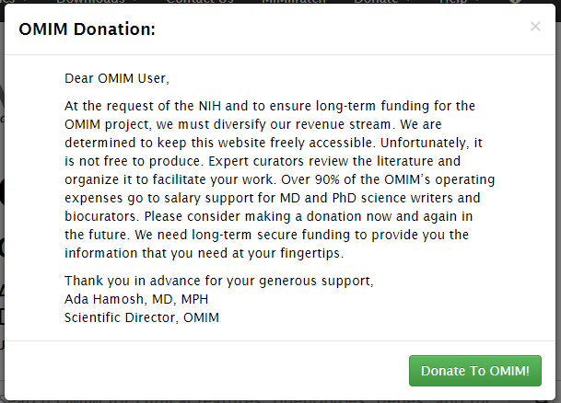

Slide 25
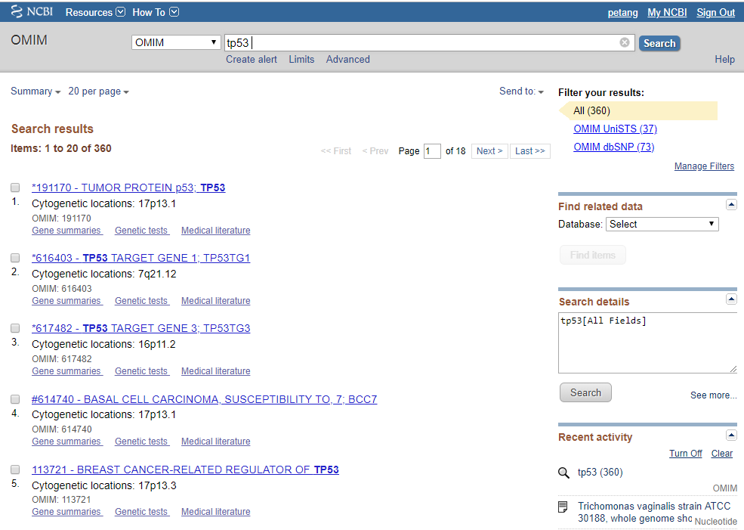

Slide 26
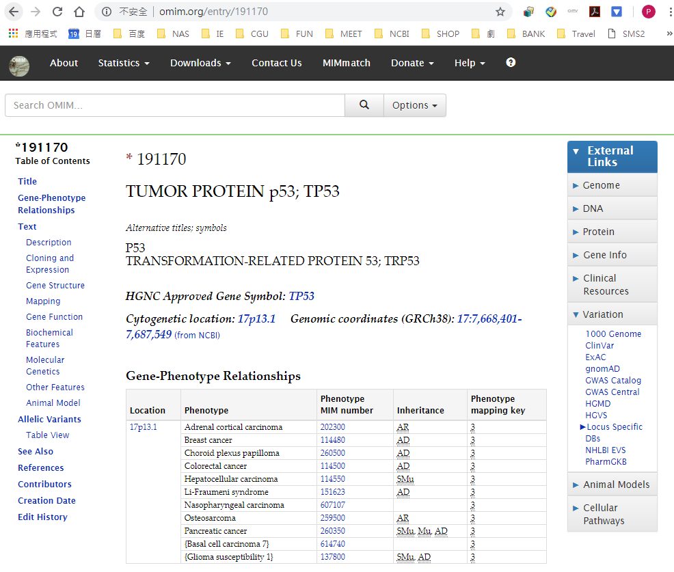

Slide 27
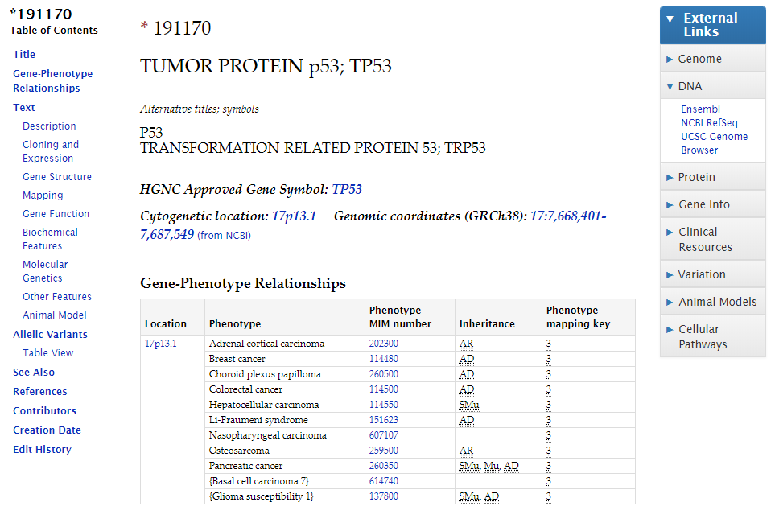

Slide 28
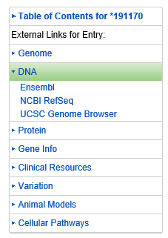
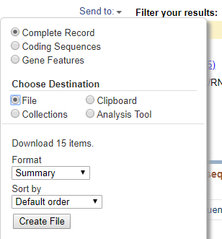
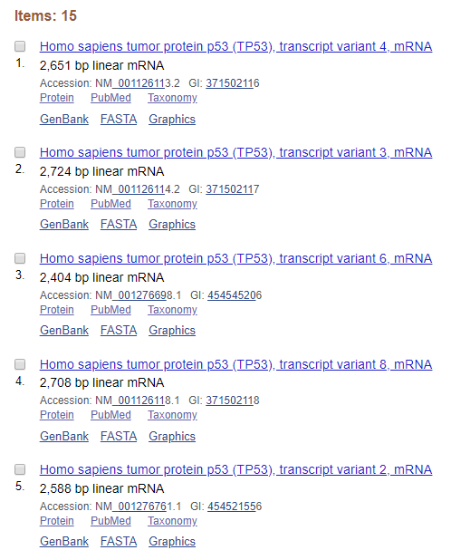
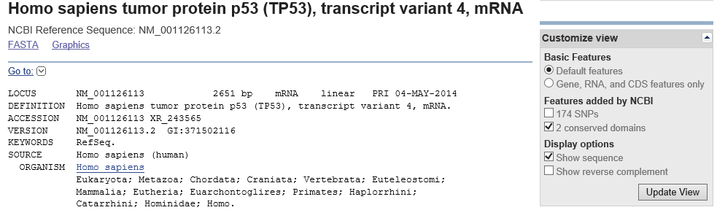

Slide 29
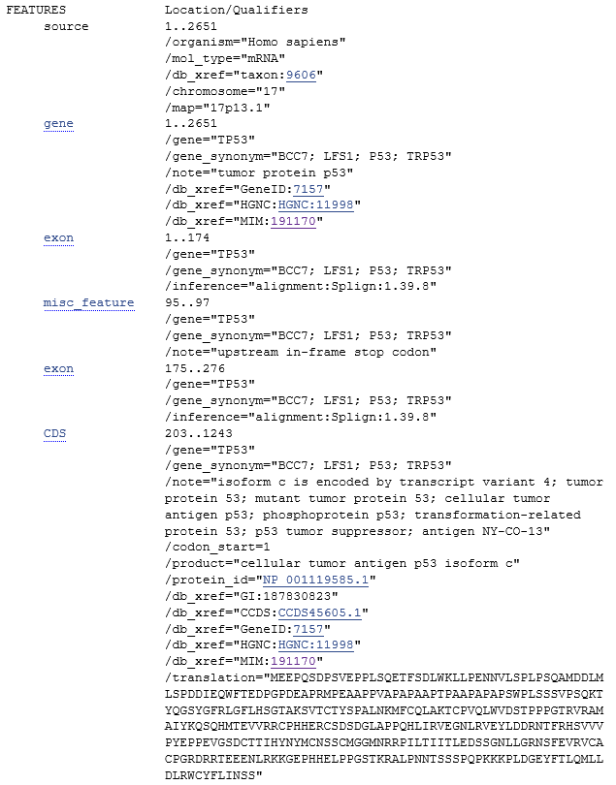
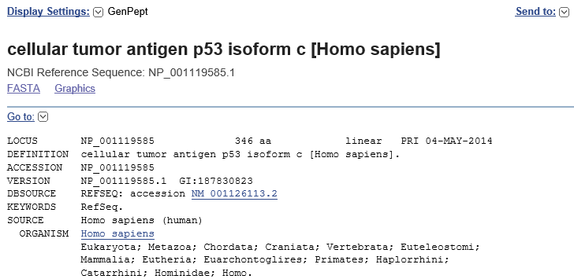

Slide 30
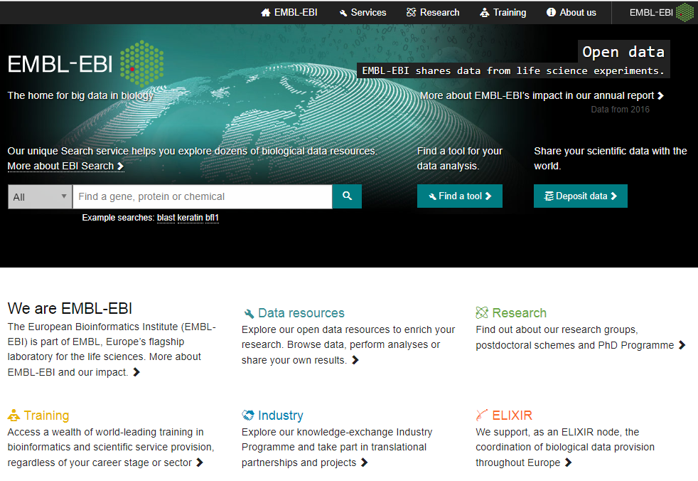
http://www.ebi.ac.uk/

Slide 31
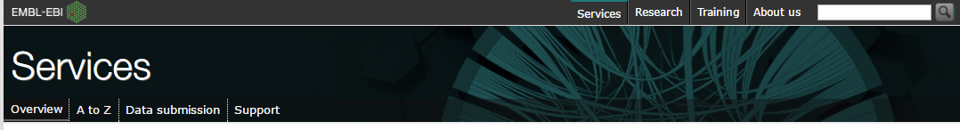
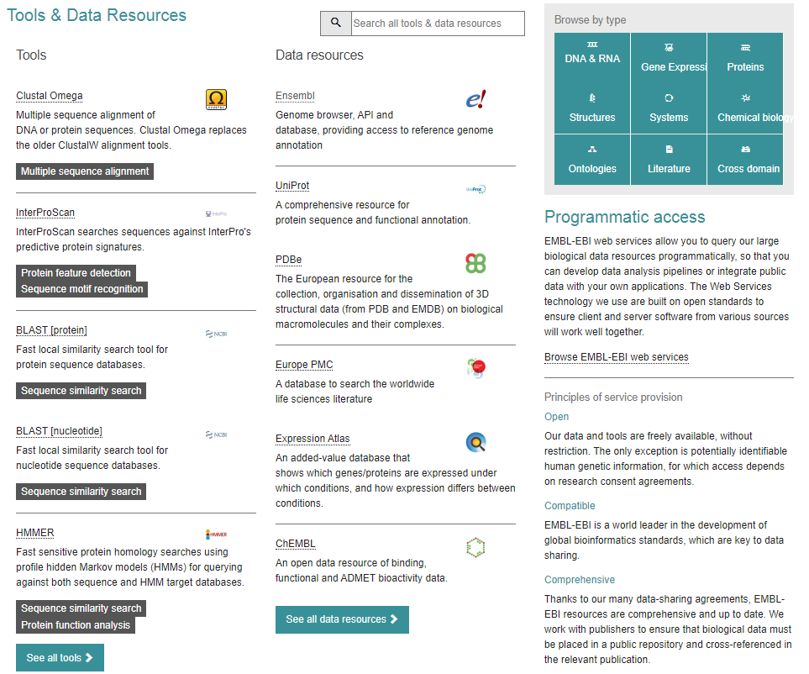

Slide 32
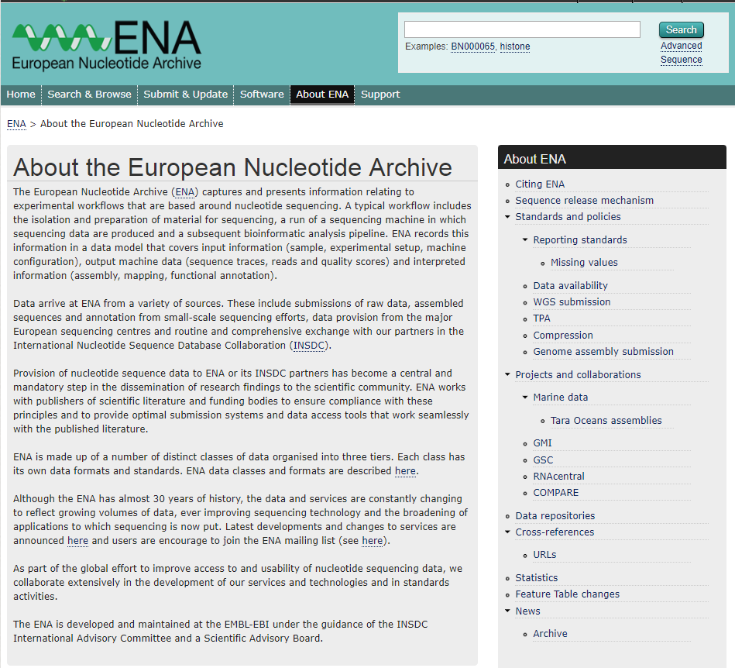
https://www.ebi.ac.uk/ena/about

Slide 33
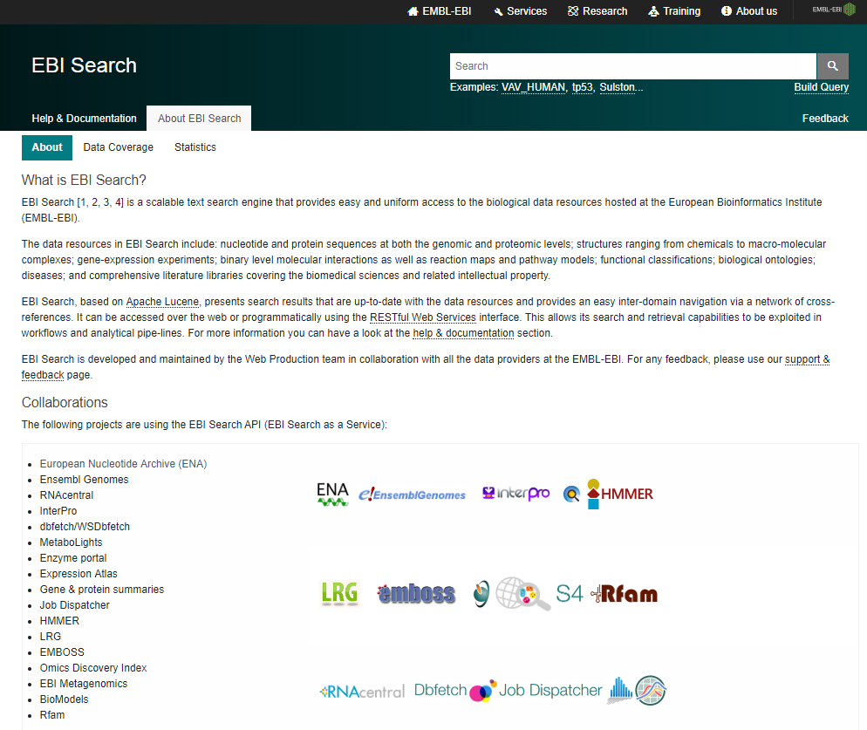
https://www.ebi.ac.uk/ebisearch/overview.ebi/about
tp53

Slide 34
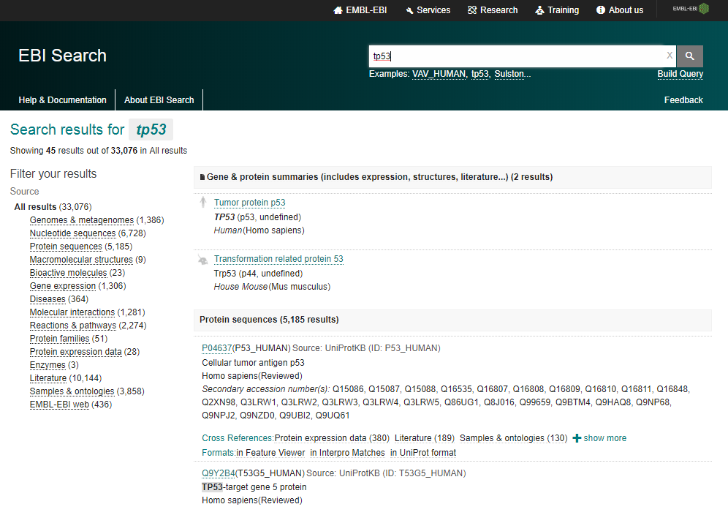

Slide 35
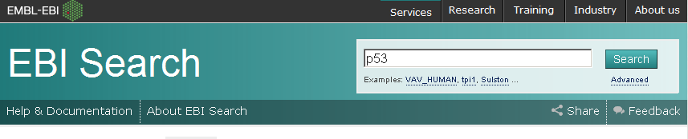
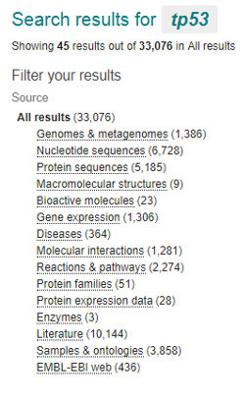
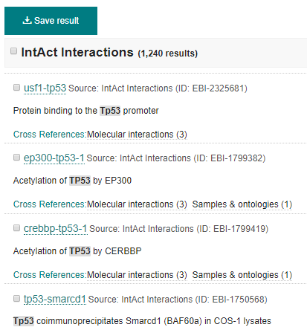
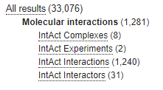
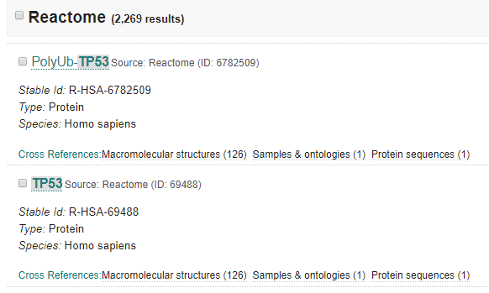
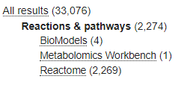

Slide 36
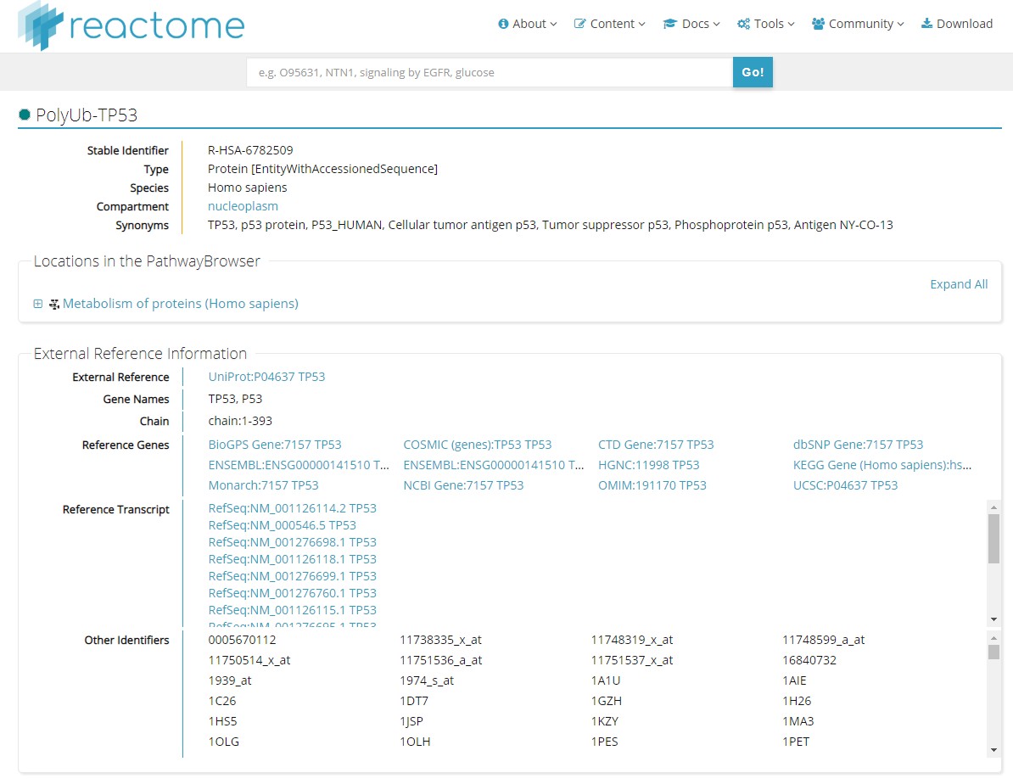

Slide 37
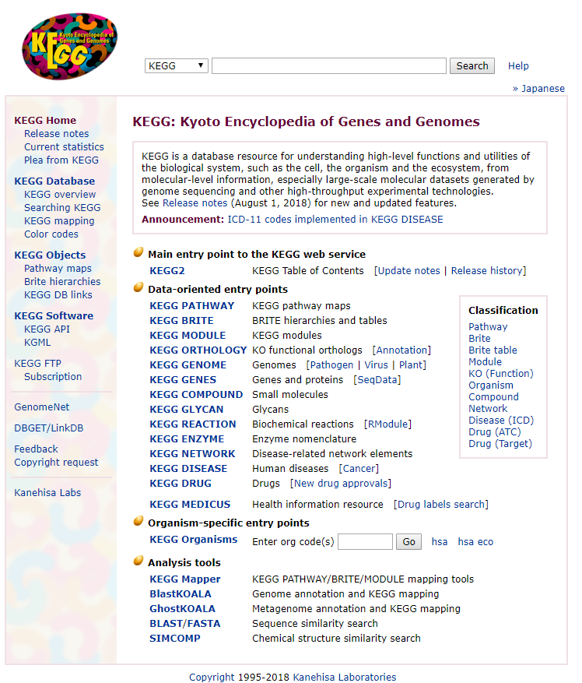
Metabolic & Signalling Pathways
Kyoto Encyclopedia of Genes &Genomes http://www.genome.ad.jp/kegg/
p53

Slide 38
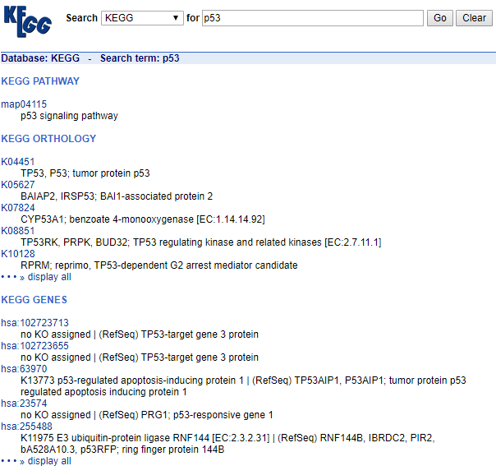
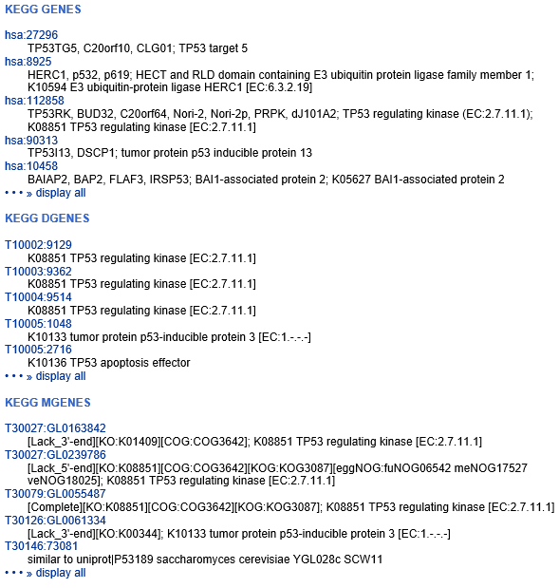

Slide 39
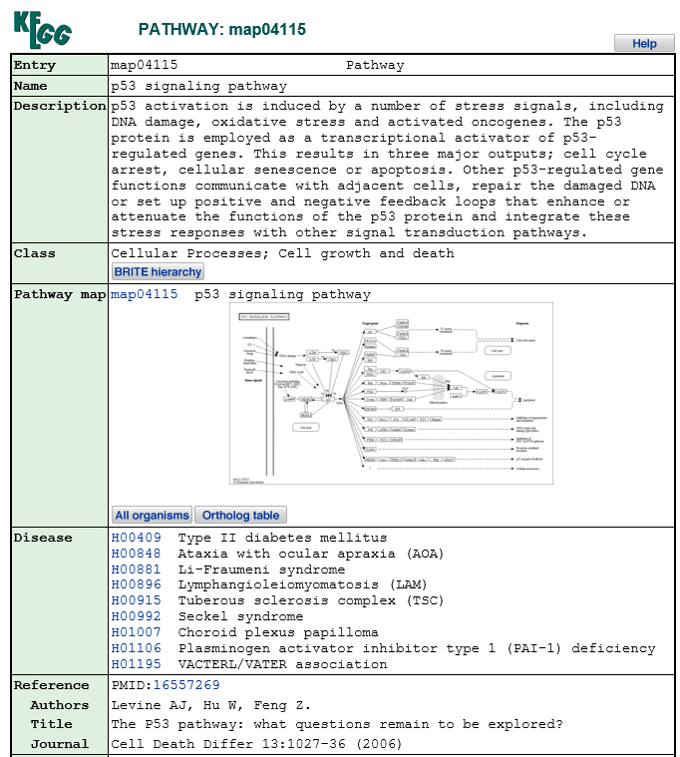

http://www.genome.jp/kegg-bin/show_pathway?map04115

Slide 40

http://www.ihop-net.org/UniPub/iHOP/

Slide 41


Slide 42


Minimal information for this gene
Most recent information for this gene
Interaction information for this gene
Defining information for this gene

Slide 43



Slide 44



January each year

Slide 45
Exercise
Use the database searching techniques you learned today to retrieve the reference sequence
Homo sapiens LEGUMAIN
and the amino acid sequence of
ALL LEGUMAIN
(Store all the fasta sequences in your USB or Notebook)
AND
Everything about LEGUMAIN
There are many different ways to DO it.
You can have your lunch now if you can make it.

