Slide 1
Install PCMAN & FILEZILLA in your notebook
(1) PCMAN
http://pcman.ptt.cc/
Windows-> Download PCMan Combo Novus Ver. 9.4.2
http://pcman.ptt.cc/windows.html
(2) FILEZILLA
https://filezilla-project.org/
Download FileZilla Client ->
https://filezilla-project.org/download.php?show_all=1

Slide 2
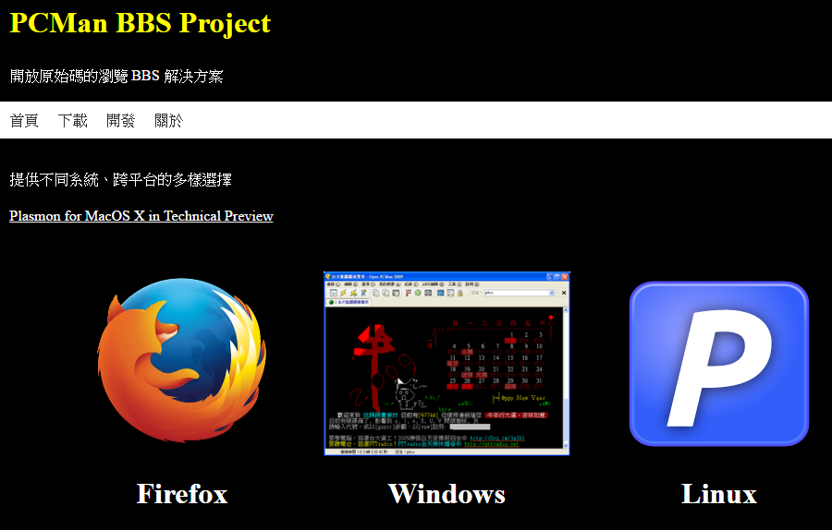
http://pcman.ptt.cc/
http://pcman.ptt.cc/windows.html

Slide 3
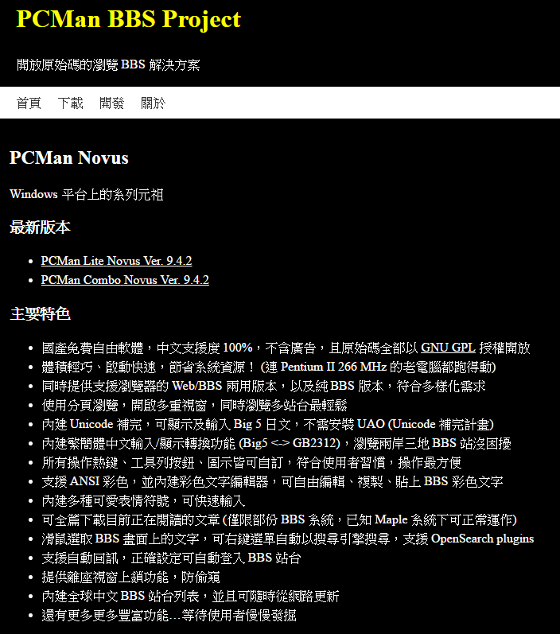
http://pcman.ptt.cc/windows.html

Slide 4
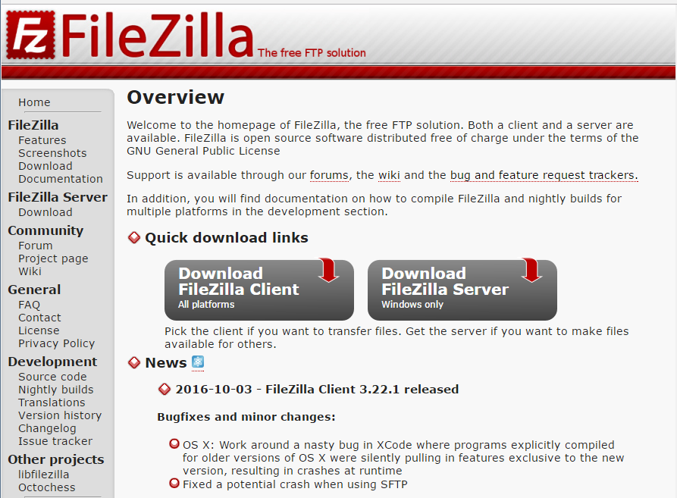
https://filezilla-project.org/

Slide 5
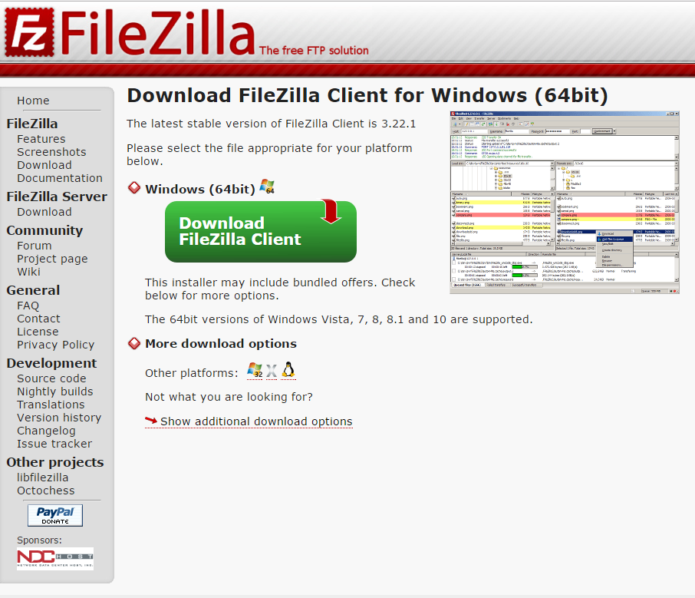
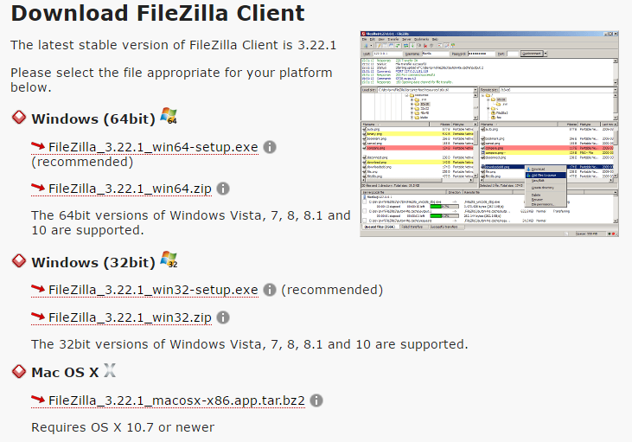
https://filezilla-project.org/download.php?show_all=1

