Slide 1

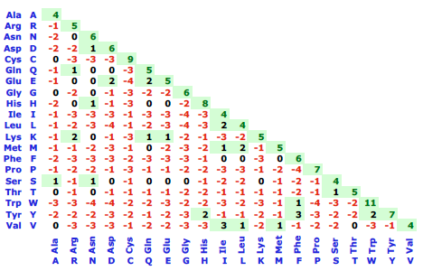
Score, Bit-score, P-value, E-value
Score: A number used to assess the biological relevance of a finding.
In the context of sequence alignments, a score is a numerical value that describes the overall quality of an alignment. Higher numbers correspond to higher similarity. The score scale depends on the scoring system used (substitution matrix, gap penalty).
Example:
R | L | A | S | V | - | E | T | D | M | W | T | P | L | T | L | R | Q | H
. | | | . | | | : |  | : | | | . | : |  |  | . | | | . | . | |
T | L | T | S | L | A | Q | T | T | L | - | - | K | A | H | L | G | T | H
-1 | +4 | +0 | +4 | +1 | -4 | +2 | +5 | -1 | +2 | -4 | -1 | -1 | -1 | -2 | +4 | -2 | -1 | +8 | = 12
Substitution matrix (s_{ij})
gap penalty (s_{i-})
gap opening gap extension end gap
-4
-1
0

Slide 2


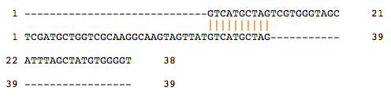
Score, Bit-score, P-value, E-value
Score: A number used to assess the biological relevance of a finding.
In the context of sequence alignments, a score is a numerical value that describes the overall quality of an alignment. Higher numbers correspond to higher similarity. The score scale depends on the scoring system used (substitution matrix, gap penalty).
Gap penalty
Alignment
Identity / Similarity
Gaps
Score
0
27/50 (54.0%)
23/50
S=135
26/44 (59.1%)
11/44
S=67
5
10
10/67 (14.9%)
57/67
S=50
Observations: If the gap penalty is too large, gaps are avoided and the sequences can not be properly aligned. If the gap penalty is too low, gaps are inserted everywhere to prevent mismatches. This does not produce any informative alignement. The "best" alignment is obtained for an intermediary gap penalty.
Remark: The scores of these different alignments can not be compared (neither used to select the best alignment) because their scale depends on the gap penalty.

Slide 3

Score, Bit-score, P-value, E-value
Bit-score: A log-scaled version of a score.
In the context of sequence alignments (BLAST), the bit-score S' is a normalized score expressed in bits that lets you estimate the magnitude of the search space you would have to look through before you would expect to find an score as good as or better than this one by chance. Althshul proposes to following definition:
S is the raw score. Parameters λ and K depend on the substitution matrix and on the gap penalties (Altchul).
Ex: If the bit-score is 30, you would have to score, on average, about 2³⁰ = 1 billion independent segment pairs to find a score this score by chance. Each additional bit doubles the size of the search space.
The bit-scores is thus a rescaled version of the raw alignment score that is independent of the size of the search space.
The size of the search space is proportional to the product of the query sequence length (n)
* the sum of the lengths of the sequences in the database (m): N=n*m. The size of the search space is then obtained by multiplying N by a coefficient K (Altschul).
Ex: When searching protein databases with protein queries, K is about 0.13. Thus, for a protein of length n=235 aa which is searched against a database of size m=12 496 420 aa, the size of the search space is equal to 0.13 * 235 * 12 496 420 = about 0.38 billion. In this case, a bit score of 30 (which corresponds to a space of 2³⁰ = 1 billion) may have occurred by chance alone.

Slide 4
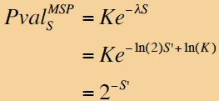
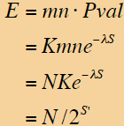
Score, Bit-score, P-value, E-value
P-value: Probability that an event occurs by chance.
In the context of sequence alignments, the P-value associated to a score S is the probability to obtain by chance a score x at least equal to S:
P-val (S) = P(x ≥ S)
This equation was derived from the EVD
score distribution obtained from all pair alignments (see course).
E-value (Expectation value): correction of the p-value for multiple testing.
In the context of database searches, the E-value (associated to a score S) is the number of distinct alignments, with a score equivalent to or better than S, that are expected to occur in a database search by chance. The lower the E value, the more significant the score is.
E-val (S) = P-val (S) * N where N is the size of the search space (N = n*m where n is the length of the query sequence and m is the length of the database).

Slide 5
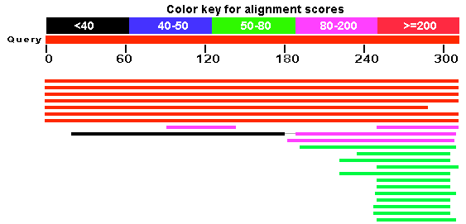
Score, Bit-score, P-value, E-value: example
Example: BLAST - Pho4p (S. cerevisiae)
>gi|259146228|emb|CAY79487.1| Pho4p [Saccharomyces cerevisiae EC1118] MGRTTSEGIHGFVDDLEPKSSILDKVGDFITVNTKRHDGREDFNEQNDELNSQEHHNSSENGNENENEQD SLALDDLDRAFELVEGMDMDWMMPSHAHHSPATTATIKPRLLYSPLIHTQSAVPVTISPNLVATATSTTS ANKVTKNKSNSSPYLNKRRGKPGPDSATSLFELPDSVIPTPKPKPKPKQYPKVILPSNSTRRISPVTAKT SSSAEGVVVASESPVIAPHGSSHSRSLSKRRSSGALVDDDKRESHKHAEQARRNRLAVALHELASLIPAE WKQQNVSAAPSKATTVEAACRYIRHLQQNVST
Query (input) sequence
(Pho4p from S. cerevisiae)
BLAST (default parameters)
Results (output) of BLAST
The top segment displays the color key and the query based scale.
The colored bars represent the actual HSPs. The position of each bar indicates the region of the query the HSP covers.
The thin line (see *) indicates that the two HSPs are from the same sequence.
Small vertical lines (not obtained here) indicate breaks, i.e., segments which are not connected in the actual alignment.
*
Explanation of Output of a BLAST Search:
http://www.ncbi.nlm.nih.gov/staff/tao/URLAPI/new_view.html

Slide 6
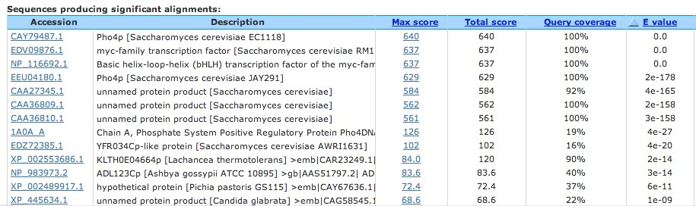
Score, Bit-score, P-value, E-value: example
Example: BLAST - Pho4p (S. cerevisiae)
Results (output) of BLAST
*
Max score = highest alignment score (bit-score) between the query sequence and the database sequence segment .
Total score = sum of alignment scores of all segments from the same database sequence that match the quary sequence (calculated over all segments). This score is different from the max score if several parts of the database sequence match different parts of the query sequence (see " * " in the example).
Query coverage = percent of the query length that is included in the aligned segments. This coverage is calculated over all segments (cf. total score).
E-value = number of alignments expected by chance with a particular score or better. The expect value is the default sorting metric and normally gives the same sorting order as Max score.

Slide 7
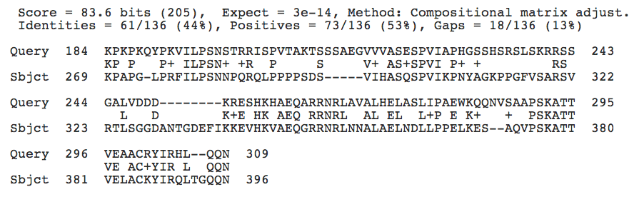
Score, Bit-score, P-value, E-value: example
Example: BLAST - Pho4p (S. cerevisiae)
Results (output) of BLAST
Bit-score
E-value
Identity (%)
Similarity (%)
Positive score in the substitution matrix
Gaps (%)

Slide 8
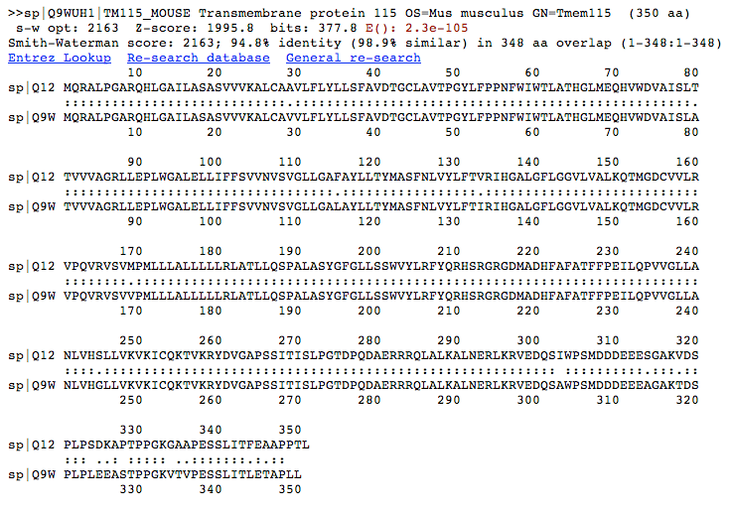
Score, Bit-score, P-value, E-value: example
Example: FASTA - PL6 human vs PL6 mouse
z-score bit-score E-value Identity Similarity Overlap
row score
NB: The alignment statistics are here computed by shuffling the second sequence many times (here 200).
Z-score
_{Z ″ score =} S ″ mean(S)
st. dev.(S)
The program FASTA was run at http://wrpmg5c.bioch.virginia.edu/fasta_www2/fasta_www.cgi?rm=shuffle

