Slide 1

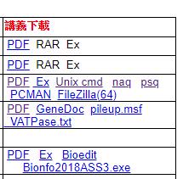
http://www.mbio.ncsu.edu/bioedit/bioedit.html

Slide 2
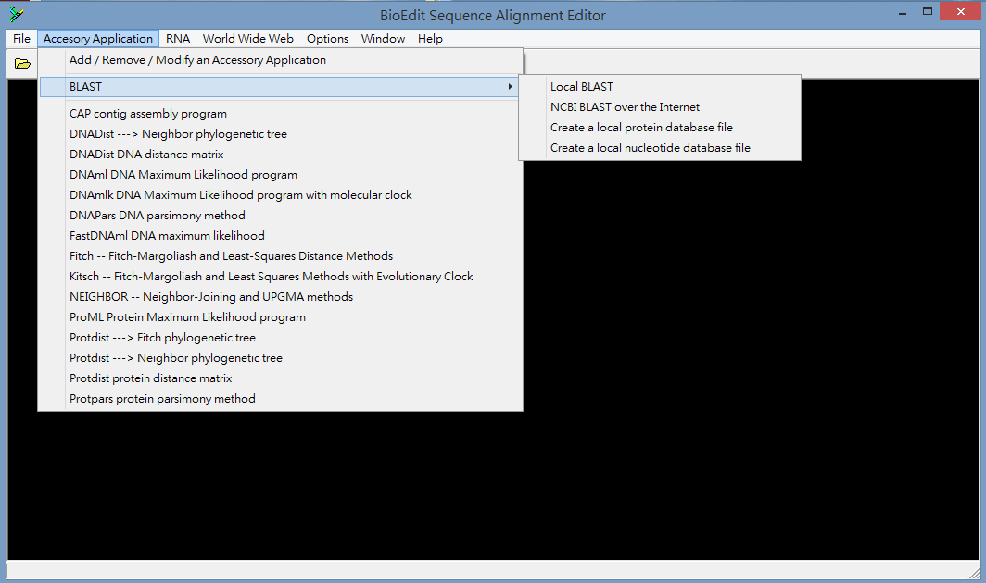
Download and install BioEdit
Create a folder and copy the Vacuolar ATPase sequences that you found to the folder.
Open BioEdit -> Accessory Application -> BLAST -> Create a local protein database file

Slide 3
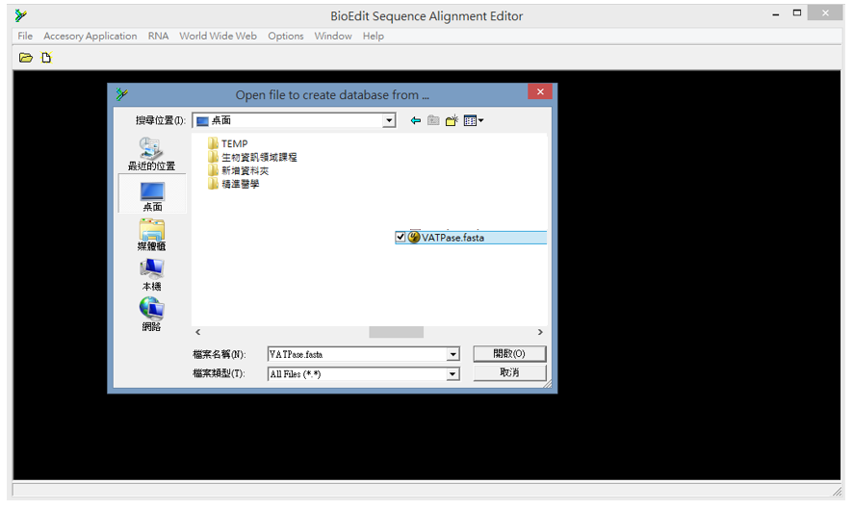
(4) Locate your sequence file (fasta format)

Slide 4
(5) Accessory Application -> BLAST -> Local BLAST

Slide 5
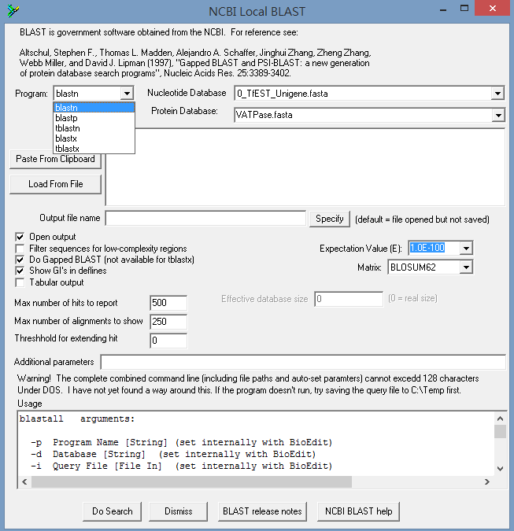
1
2
3
Copy & paste your query sequence to here
1.0E-10
4

Slide 6
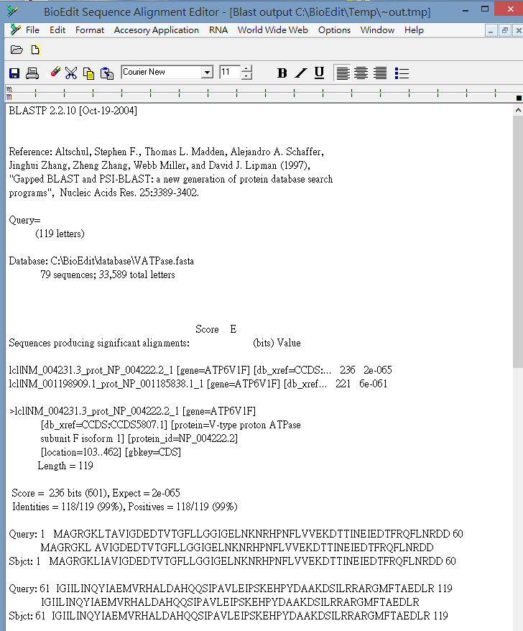
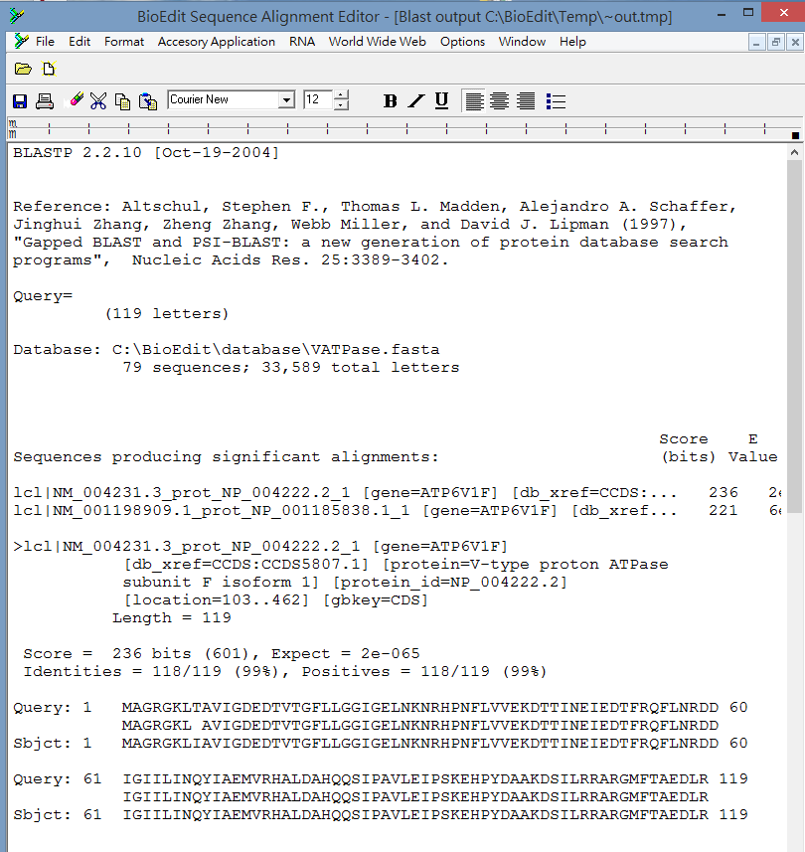
BUG:序列無法對齊
Ctr-A 選擇全部
字型 Courier New
大小 12
Save file

