Slide 1

http://petang.cgu.edu.tw/bioinformatics/index.htm
Bioinformatics
Lecture 6 – Nucleic Acids
Sequence Analysis
Petrus Tang, Ph.D. (鄧致剛)
Graduate Institute of Basic Medical Sciences
and
Bioinformatics Center, Chang Gung University.
petang@mail.cgu.edu.tw
EXT: 5136
助教：
蔡智宇(分機5690)

Slide 2
The Organization of an Eukaryotic Gene
GENE
Promoter
Enhancer
Exon 1
Intron
Exon 2
Intron
Exon 3
Intron
Exon 4
Transcription
Poly(A) signal
mRNA transcript
5’
3’
5’-untranslated
region
Exon 1
Intron
Exon 2
Intron
Exon 3
Intron
Exon 4
3’-untranslated
region
Processing
Mataure mRNA
start
stop
(AAAAAA)n
5’
7-mG cap
3’
Exon 1
Exon 2
Exon 3
Exon 4

Slide 3
Gene identification involves
4 main stages
Find the putative coding region(s)
in the sequence
Open reading frame
Find non-coding features
of interest in the sequence
CpG islands
Tandemly and dispersed repeats
Promoter regions (TATA box, cap signal,
CCAAT-box)
Transcription factors, Poly-A sites
Determine the exon-intron organization
Branch point signal
CT(G,A)A(C,T)
5’ and 3’ splice sites:
AG/GUAAGU--------------PyPyPyPyPyPyPyPy-CAG/G
Identify the gene
motif, signal and pattern
Blast, FASTA
Functional studies

Slide 4







Function
Command
GCG
SeqWEB
Sequence manipulation
ORF Searching
Mapping (restriction sites)
Mapping
(transcription factors)
Reverse
Frames
Map
Translate
Map
(-minc)
(-maxc)
Mapsort
(-exclude)
(-digest)
Mapplot
Map tfsites
+
+
+
+
+
+
+
+
+
+
+
+
+
+
+
+
+
+
+
+
-
-
+
-

Slide 5
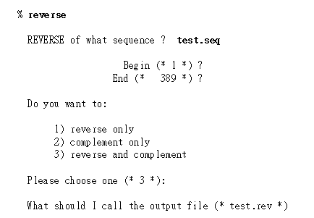
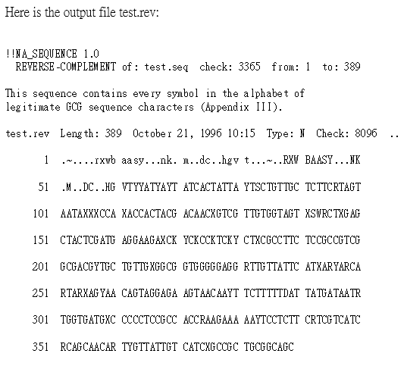
REVERSE
Reverse reverses and/or complements a sequence
5’-3’ -> 3’-5’
A <->T/G<->C
5’-3’ -> 3’-5’
A <->T/G<->C

Slide 6
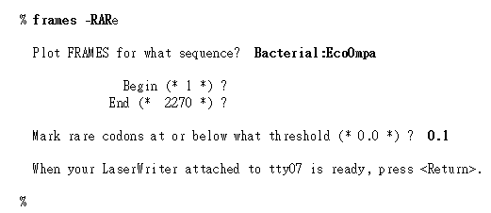
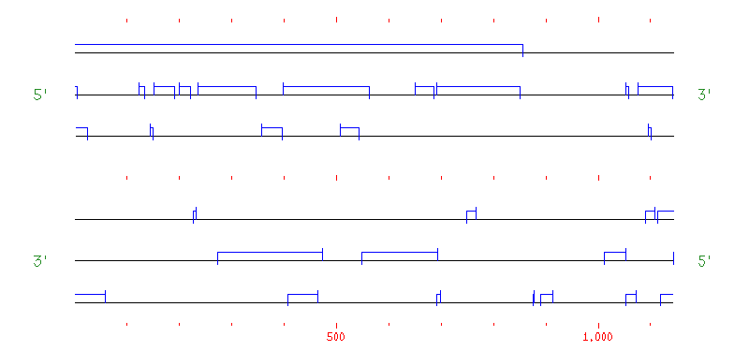
FRAMES
Frames shows open reading frames for the six translation frames of a DNA sequence. Frames can superimpose the pattern of rare codon choices if you provide it with a codon frequency table.

Slide 7
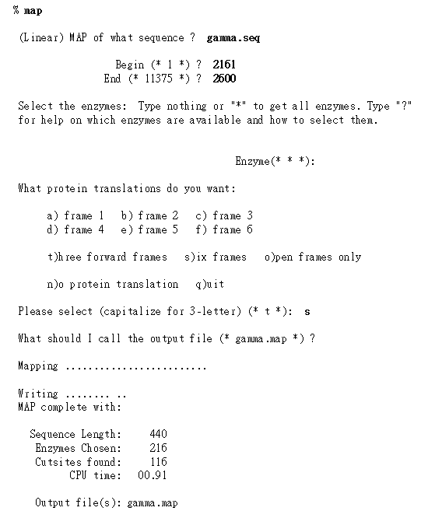
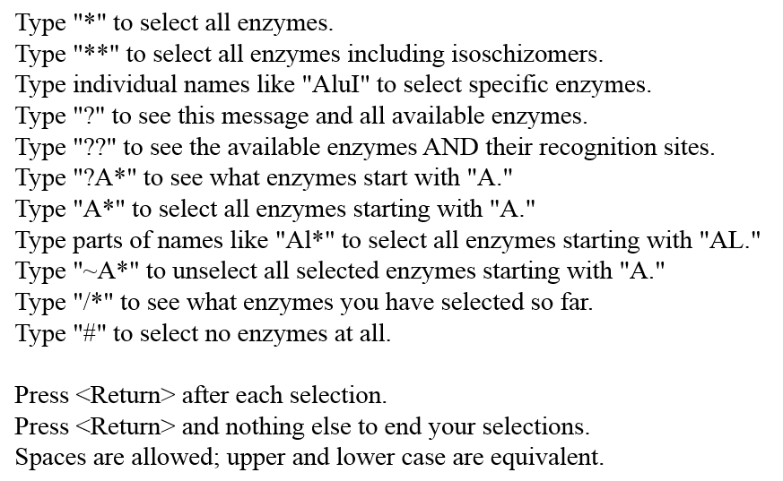
MAP - Restriction Enzymes
Map maps a DNA sequence and displays both strands of the mapped sequence with restriction enzyme cut points above the sequence and protein translations below.
Map can also create a peptide map of an amino acid sequence.

Slide 8
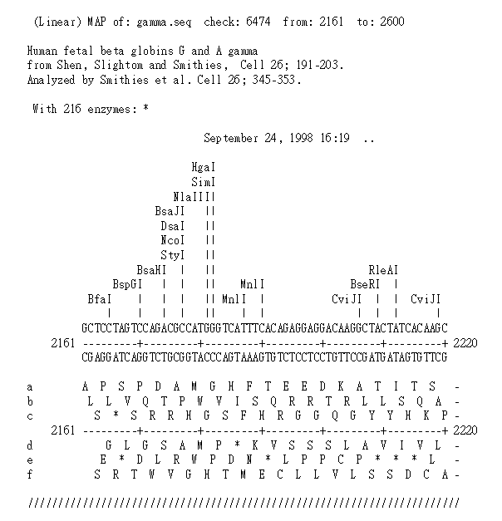
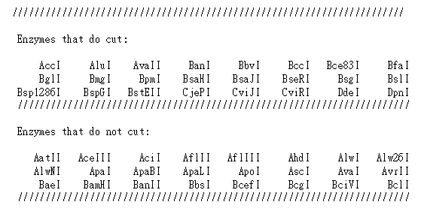
MAP

Slide 9
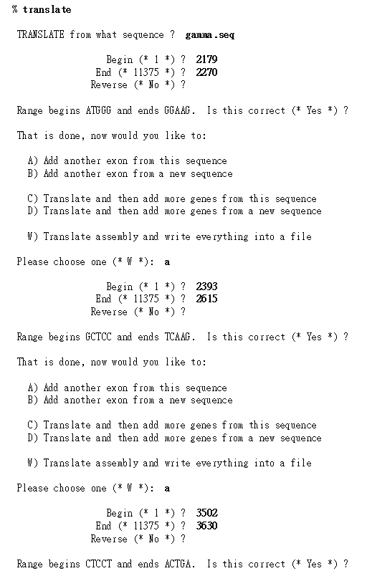
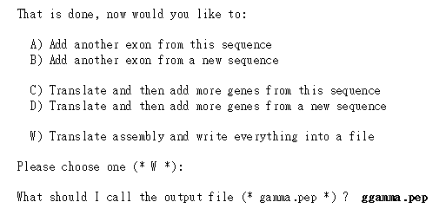
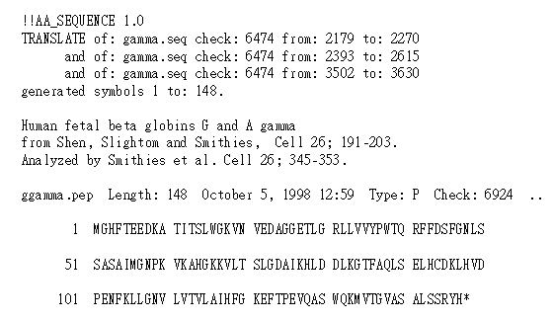
TRANSLATE
Translate translates nucleotide sequences into peptide sequences.

Slide 10
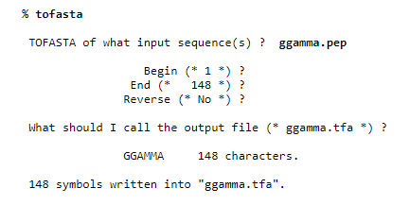

TOFASTA
tofasta converts GCG sequence(s) into FastA format.

Slide 11
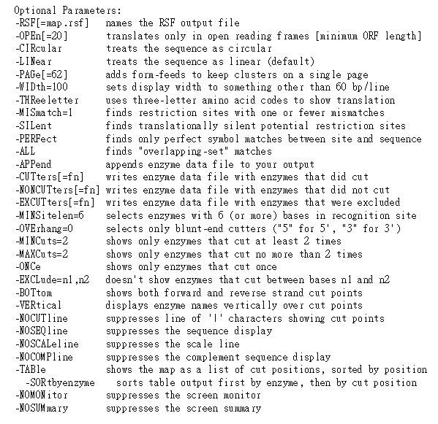
MAP

Slide 12
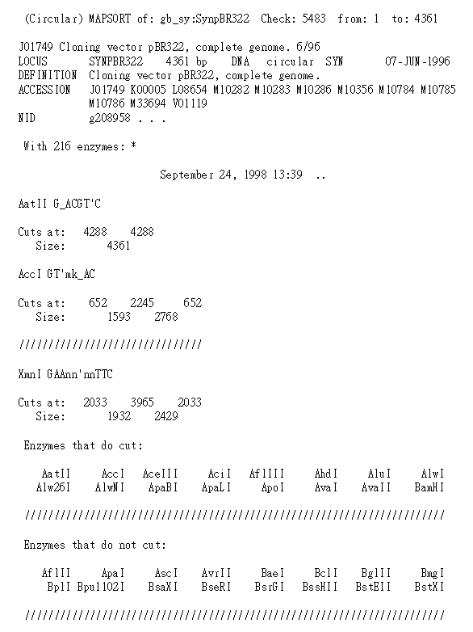
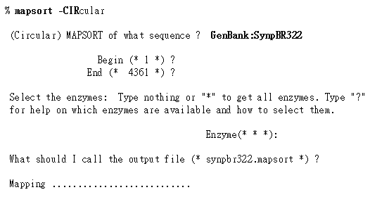
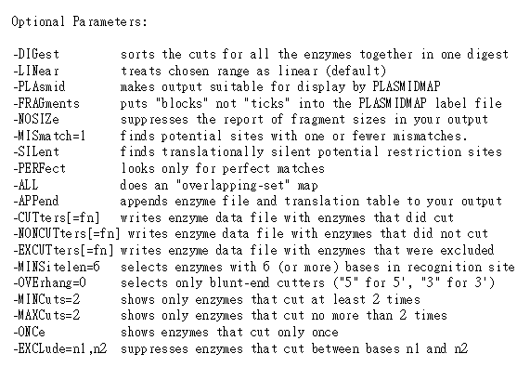
MAPSORT
MapSort finds the coordinates of the restriction enzyme cuts in a DNA sequence and sorts the fragments of the resulting digest by size.
MapSort can sort the fragments from single or multiple enzyme digests.

Slide 13
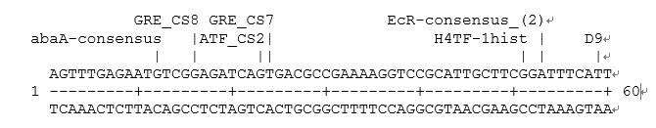
MAP – Transcription Factor Binding Sites (tfsites)
-DATa=enzyme.dat
names file of restriction enzyme names and recognition sites
% fetch tfsites.dat
Fetch copies GCG sequences or data files from the GCG database
into your directory or displays them on your terminal screen.
tfsites.dat
% mv tfsites.dat enzyme.dat
% map

Slide 14
Exercise 107-06-1
Programs used in this exercise:
(1) Sequence manipulation – reverse
(3) ORF Searching – frames , map , translate
(4) Mapping (restriction sites)
– map (-minc, -maxc), mapsort(-exclude, -digest),
mapplot, plasmidmap
(5) Mapping (transcription factor)
– map(tfsites).
Sequences used in this exercise:
fetch z18853 (C.elegans mRNA for capping protein alpha subunit.)
cds:10-858
fetch x03795 (Human mRNA for platelet derived growth factor A-chain, PDGF-A) cds:388-1020.

Slide 15

(1) Store fragment sequences;
(2) Recognize overlapping sequences and create aligned assemblies, called contigs;
(3) Display, edit and output the contigs for further analysis.
5
Contig 1
3
1
4
Contig 2
2
Consensus
Assemble overlapping fragment sequences from a sequencing project.

Slide 16
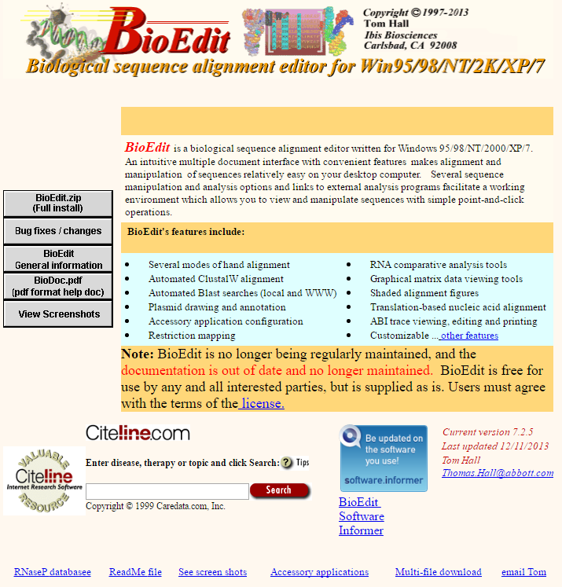
http://www.mbio.ncsu.edu/bioedit/bioedit.html

Slide 17
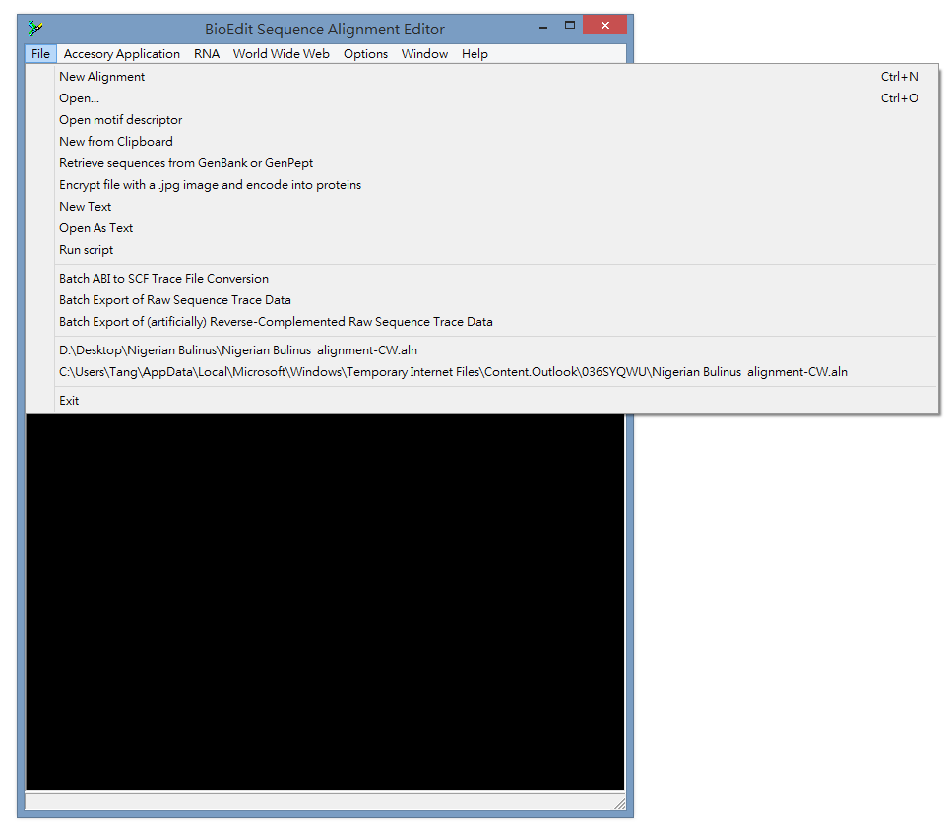

Slide 18
ASS3
Download Bioinfo2018_ASS3.exe
Decompress the file
-> Seq01.txt - seq10.txt
Use BioEdit to assembly the sequences (Seq01.txt - seq10.txt).
Q1: What is the correct order of the assembled sequence?
Transfer the assembled sequence to GCG
Q2: Identity putative protein coding region
Q3: Export the coding sequences (nucleotide and amino acid)
Q4: Is there any potential regulatory elements upstream of the gene?
Q5: What is the identity and similarity with the human homologues protein?
E-mail the ANSWER as attached pdf file (Bioinfo2018ASS3_學號.pdf) to
--petang@mail.cgu.edu.tw. before 12:00 25Oct 2018
****郵件主旨： Bioinfo2018ASS3_學號

