Slide 1

http://petang.cgu.edu.tw/bioinformatics/index.htm
Bioinformatics
Lecture 7 –
Protein Sequence Analysis
Petrus Tang, Ph.D. (鄧致剛)
Graduate Institute of Basic Medical Sciences
and
Bioinformatics Center, Chang Gung University.
petang@mail.cgu.edu.tw
EXT: 5136
助教：
蔡智宇(分機5690)

Slide 2
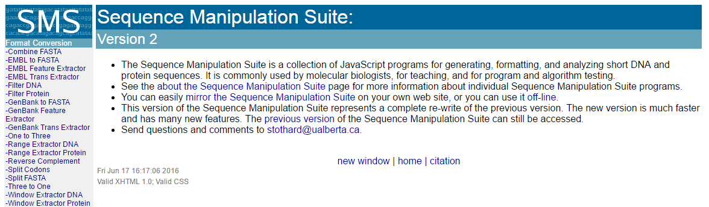
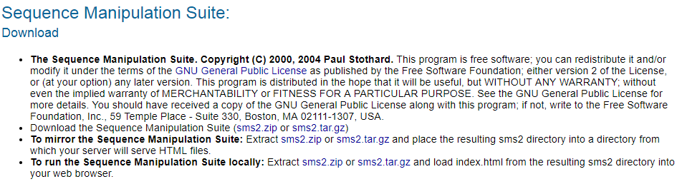
http://www.bioinformatics.org/sms2/

Slide 3
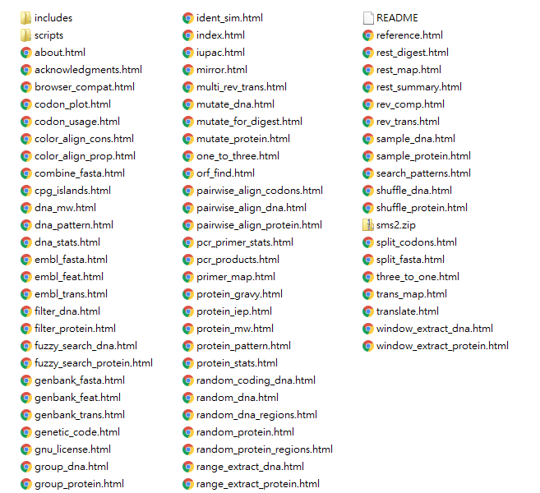

Slide 4
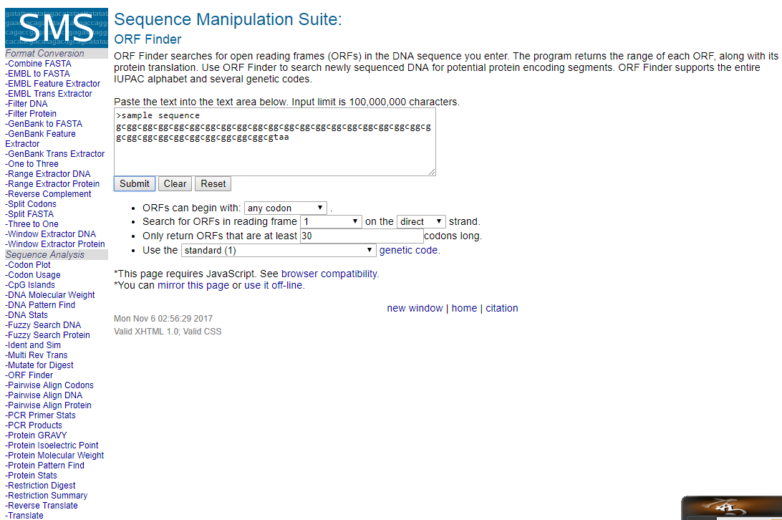

Slide 5
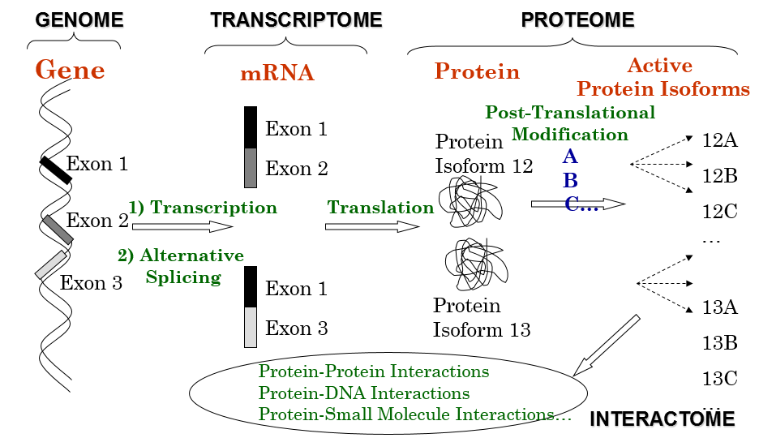
Why Proteomics: One-Gene-one-Protein?
25,000
100,000
1,000,000

Slide 6
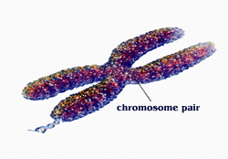
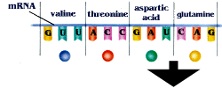
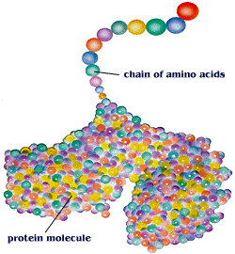
PROTEIN
DATABASES
PROTEIN
SEQUENCE
PROPERTIES
TOOLS
MOTIF/DOMAIN
FOLDING

Slide 7




Protein Sequence/Motif/Domain Databases
http://www.uniprot.org/
http://www.ncbi.nlm.nih.gov/Structure/cdd/wrpsb.cgi
http://www.ebi.ac.uk/Tools/pfa/iprscan/
Protein Analysis Tools
http://tw.expasy.org/

Slide 8
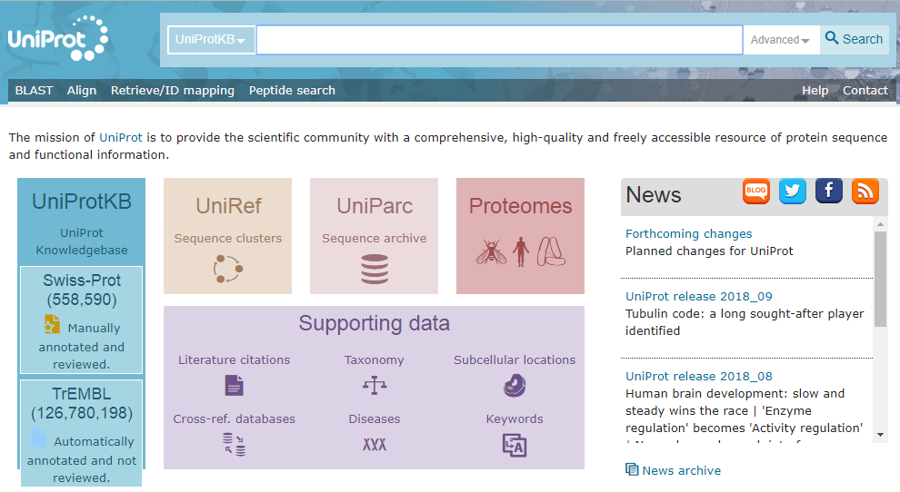
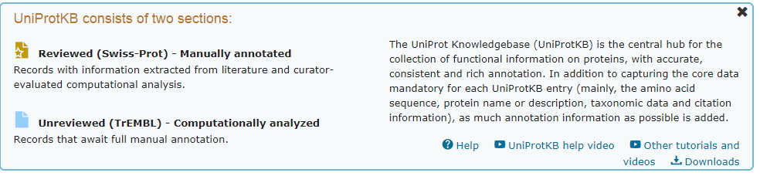
http://www.uniprot.org/
p53

Slide 9
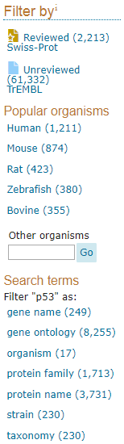

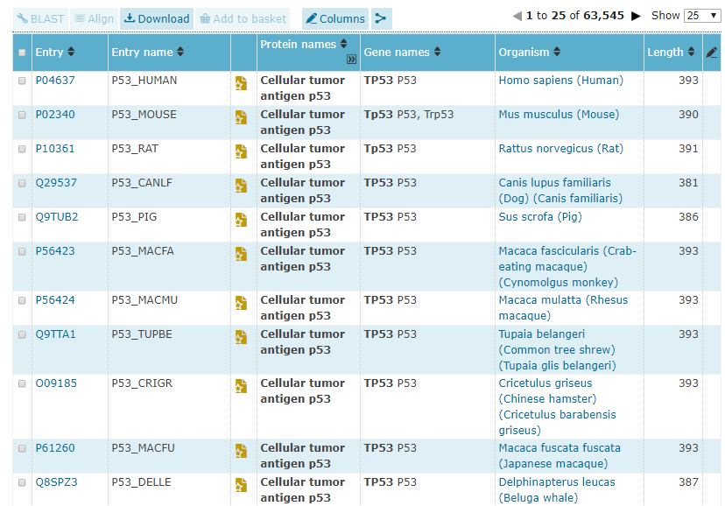
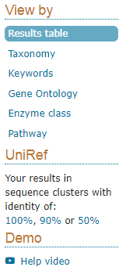
http://www.uniprot.org/uniprot/?query=p53&sort=score

Slide 10
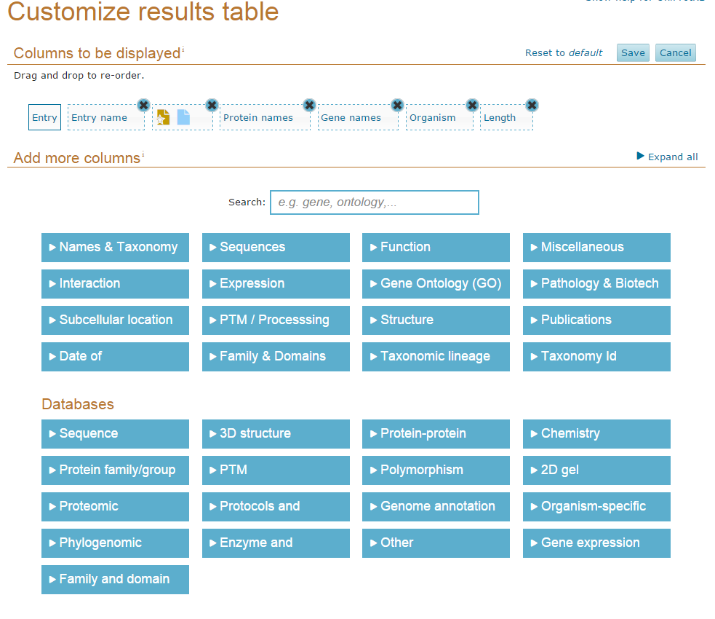

Slide 11
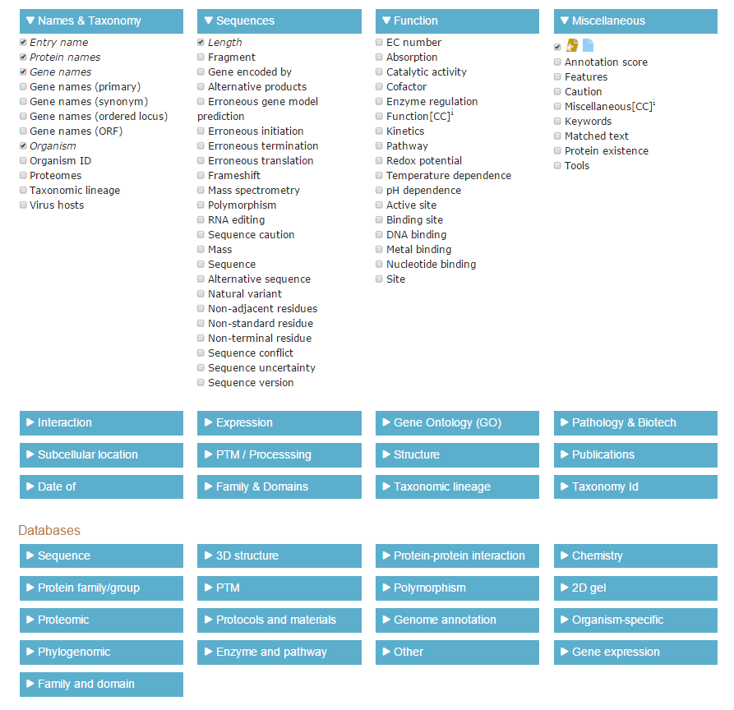

Slide 12
http://www.uniprot.org/uniprot/?query=p53&sort=score

Slide 13
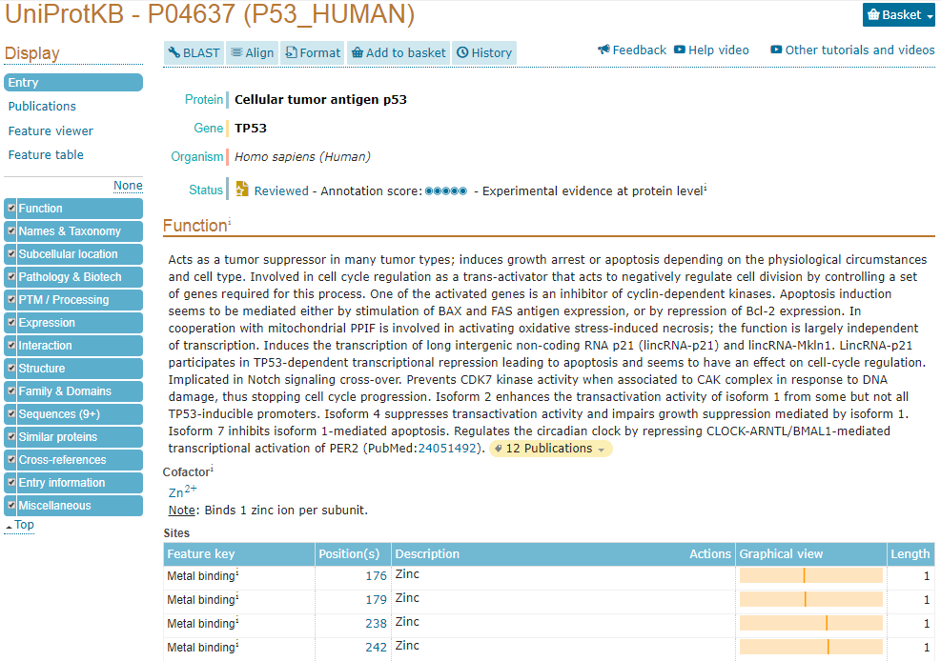
https://www.uniprot.org/uniprot/P04637

Slide 14
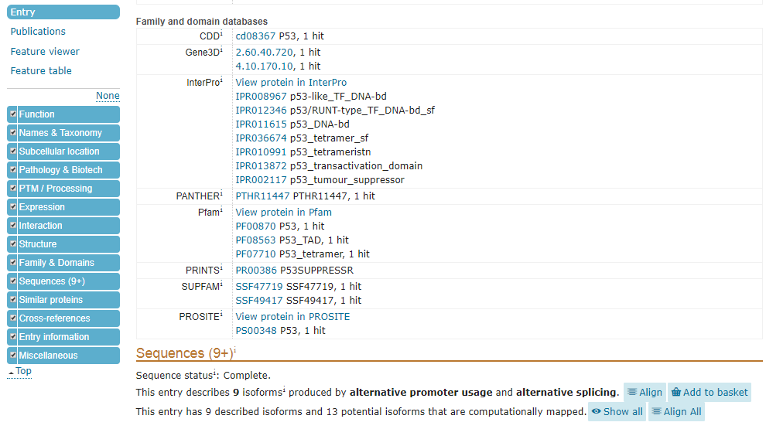
Ctr-f -> prosite

Slide 15
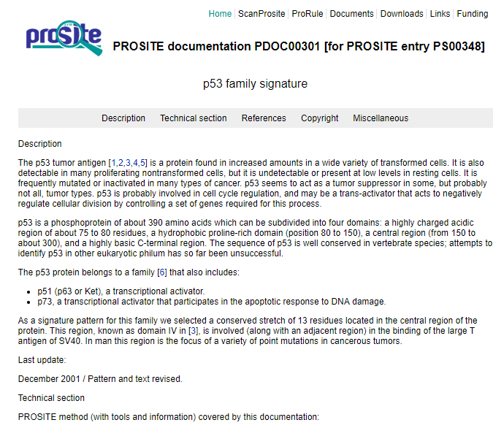
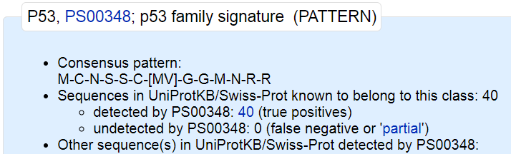
https://prosite.expasy.org/doc/PS00348

Slide 16
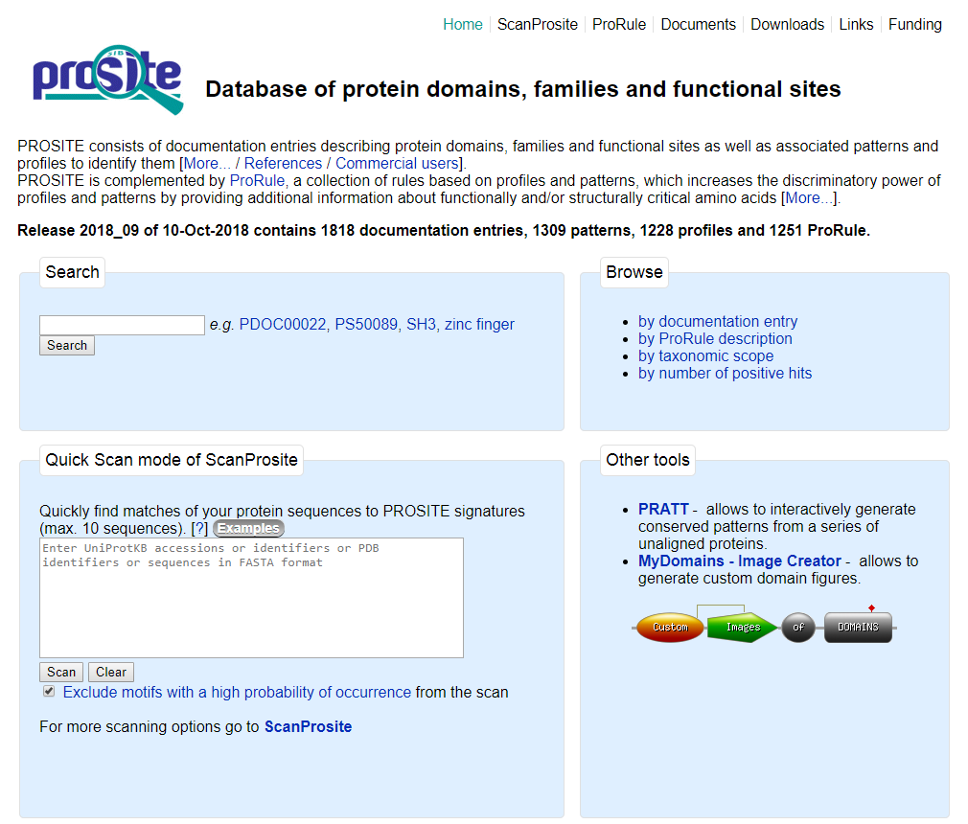
http://prosite.expasy.org/

Slide 17
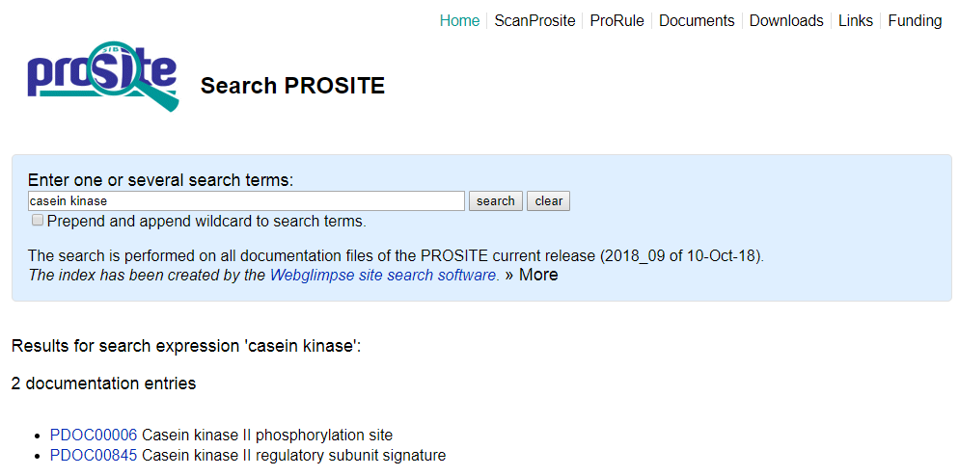
Casein kinase

Slide 18
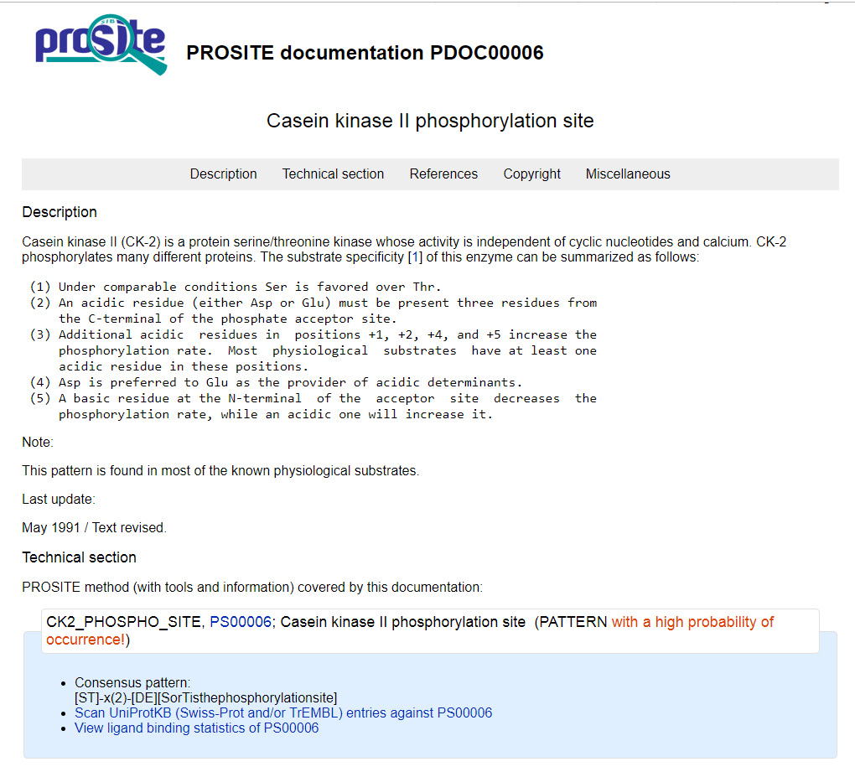
https://prosite.expasy.org/PDOC00006

Slide 19
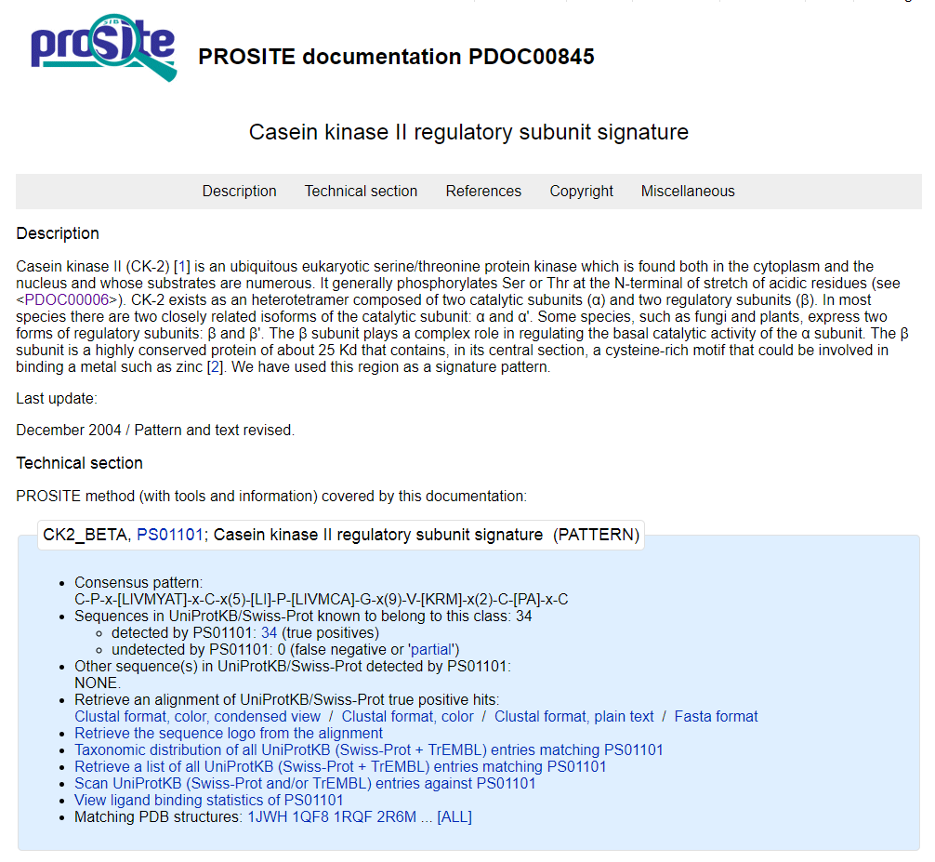
https://prosite.expasy.org/PDOC00845

Slide 20
http://prosite.expasy.org/

Slide 21
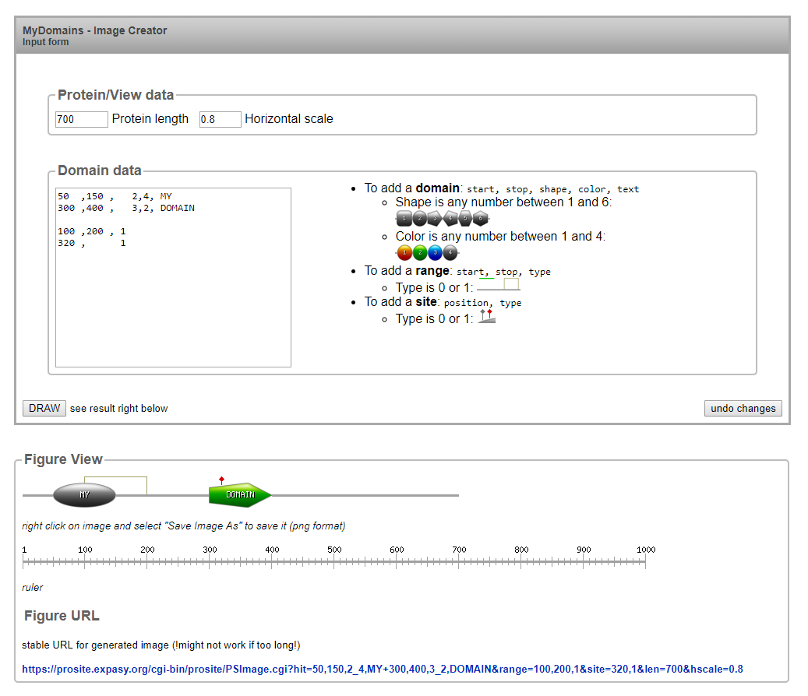
终點
顏色
50 ,150 , 2,4, MY
起點
圖形
文字
100 ,200 , 1
320 , 1
50 ,150 , 2,4, MY
300 ,400 , 3,2, DOMAIN

Slide 22
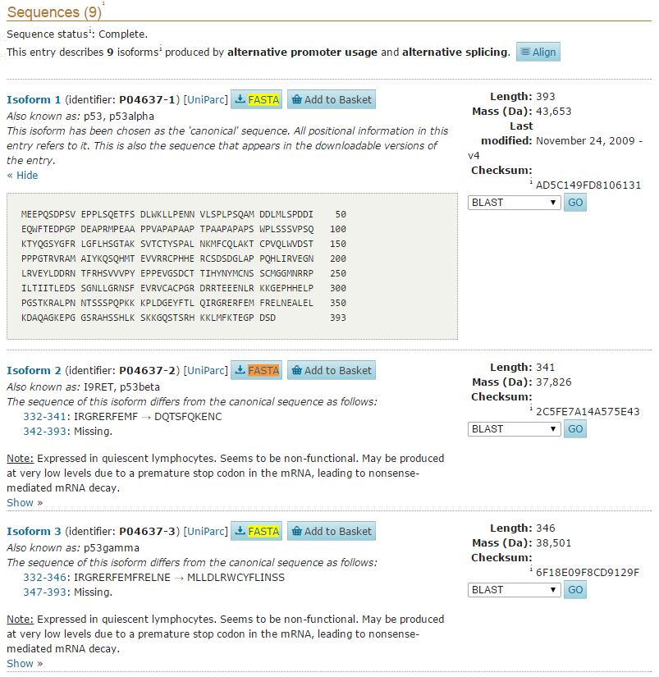
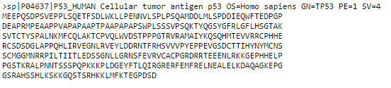
1. https://www.uniprot.org/uniprot/P04637
2. Ctr-f -> fasta
3
4. Copy this sequence to your computer

Slide 23
Example
cellular tumor antigen p53 isoform a [Homo sapiens]
>sp|P04637|P53_HUMAN Cellular tumor antigen p53 OS=Homo sapiens GN=TP53 PE=1 SV=4
MEEPQSDPSVEPPLSQETFSDLWKLLPENNVLSPLPSQAMDDLMLSPDDIEQWFTEDPGP
DEAPRMPEAAPPVAPAPAAPTPAAPAPAPSWPLSSSVPSQKTYQGSYGFRLGFLHSGTAK
SVTCTYSPALNKMFCQLAKTCPVQLWVDSTPPPGTRVRAMAIYKQSQHMTEVVRRCPHHE
RCSDSDGLAPPQHLIRVEGNLRVEYLDDRNTFRHSVVVPYEPPEVGSDCTTIHYNYMCNS
SCMGGMNRRPILTIITLEDSSGNLLGRNSFEVRVCACPGRDRRTEEENLRKKGEPHHELP
PGSTKRALPNNTSSSPQPKKKPLDGEYFTLQIRGRERFEMFRELNEALELKDAQAGKEPG
GSRAHSSHLKSKKGQSTSRHKKLMFKTEGPDSD
How to identify domains/motifs in protein?
Uniprot Protein Blast
NCBI Blastp (Conserved Domain Database-CCD)
Interpro domain/motif search

Slide 24
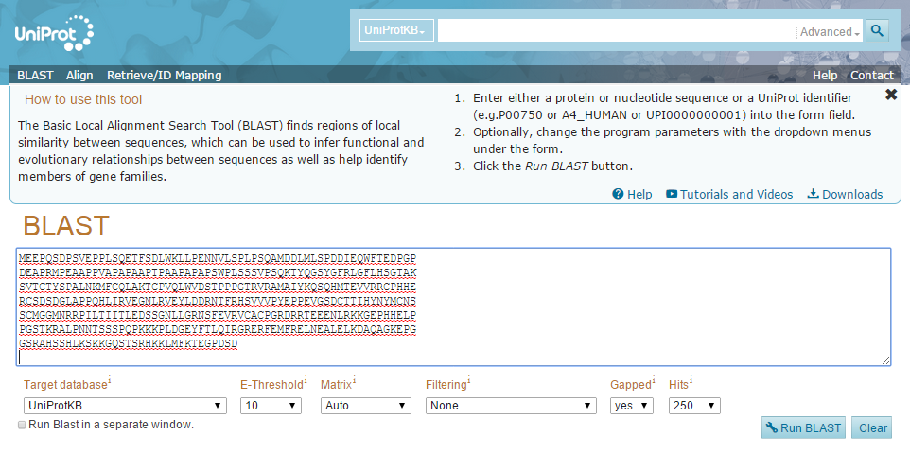
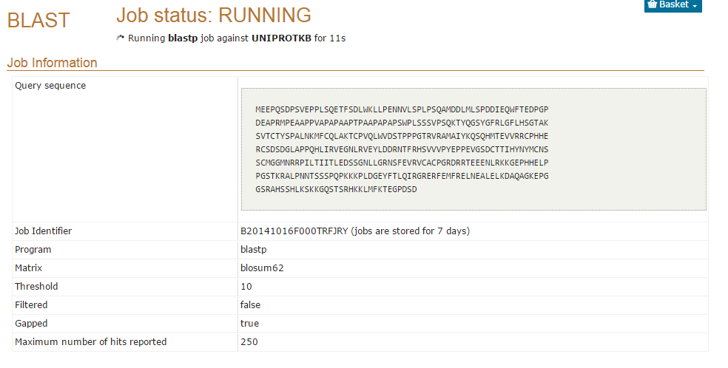
Uniprot Protein Blast

Slide 25
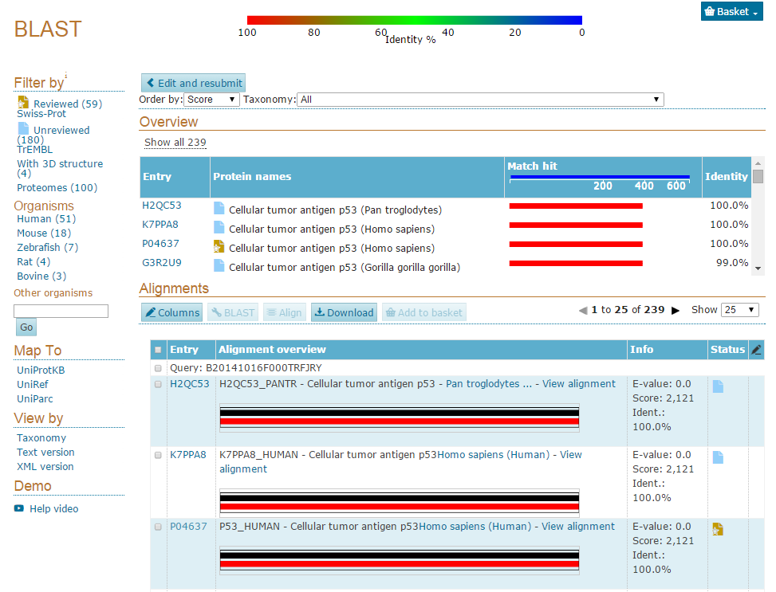

Slide 26
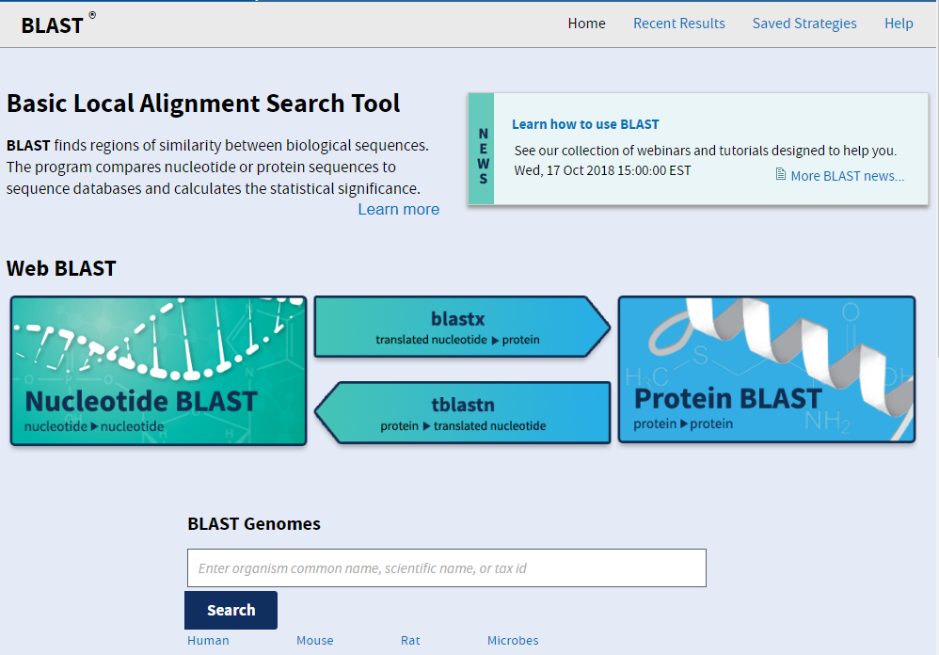
2. NCBI Blastp (Conserved Domain Database-CCD)

Slide 27
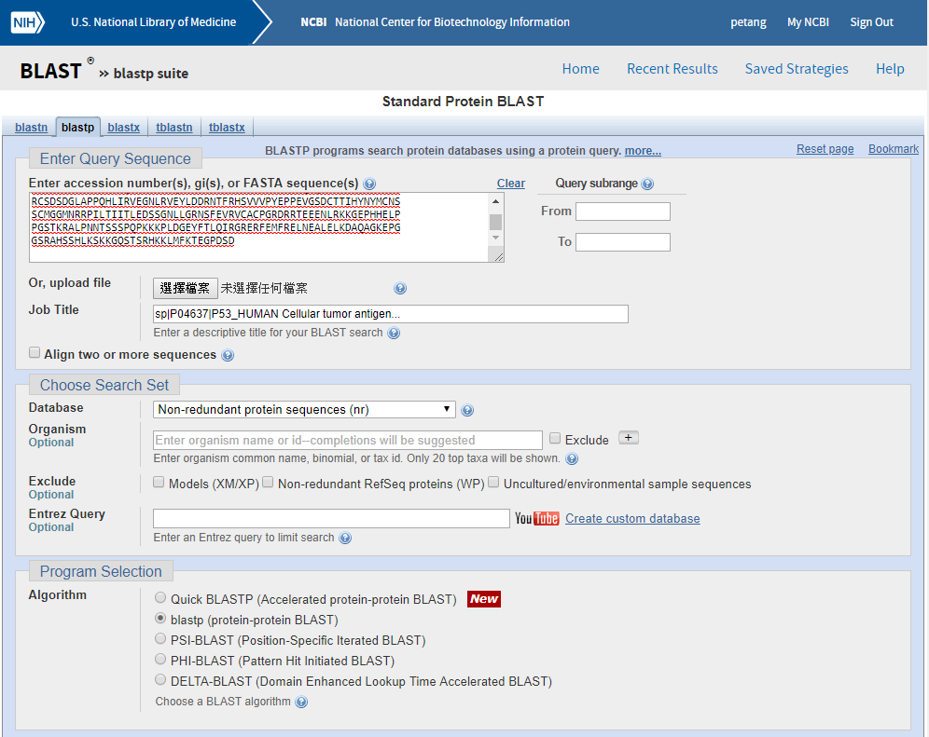
2. NCBI Blastp (Conserved Domain Database-CCD)
https://blast.ncbi.nlm.nih.gov/Blast.cgi?PAGE=Proteins

Slide 28
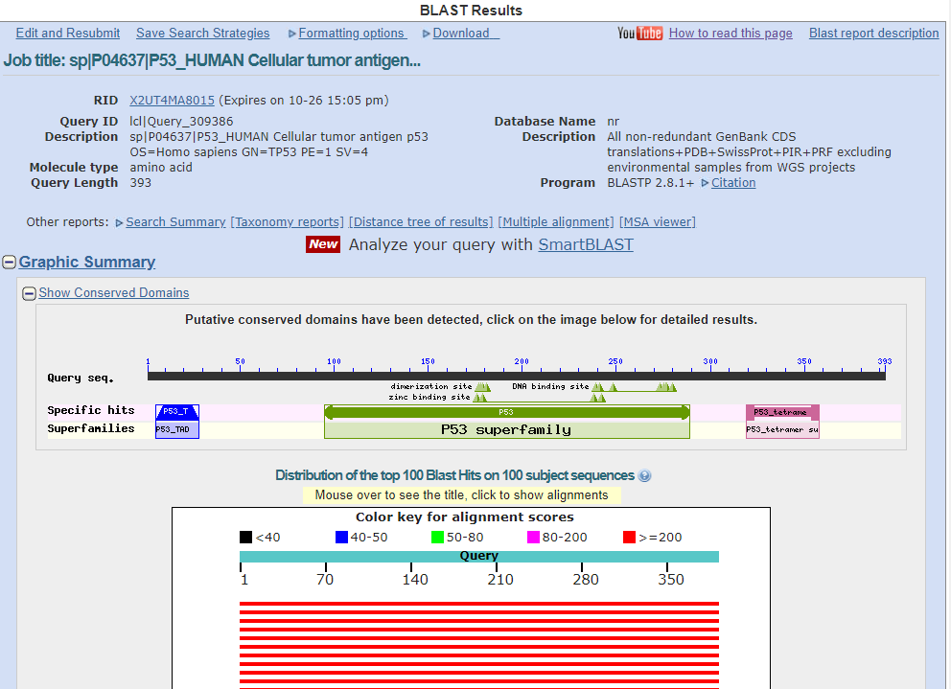

Slide 29

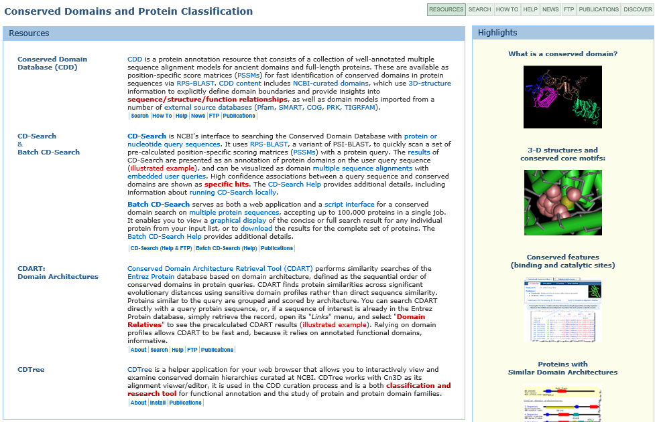
http://www.ncbi.nlm.nih.gov/Structure/cdd/cdd.shtml

Slide 30
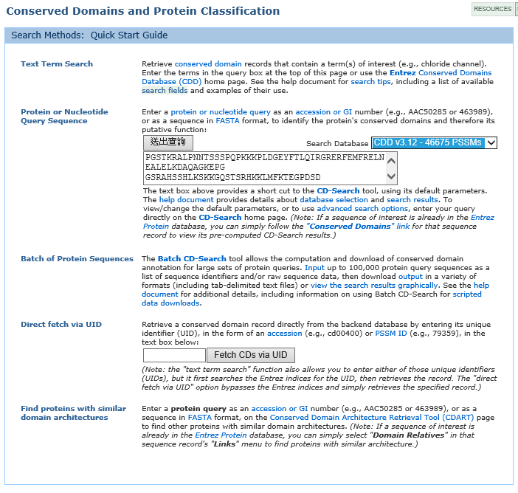

Slide 31
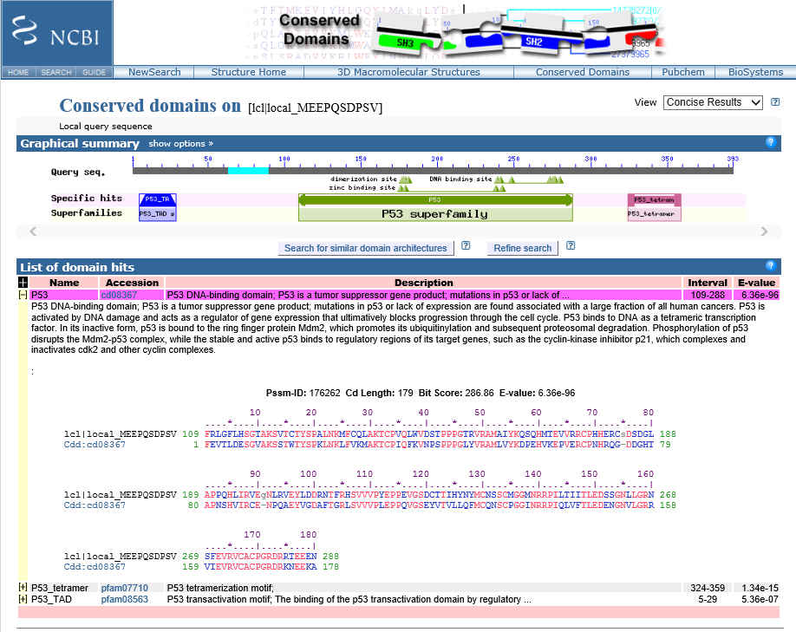

Slide 32
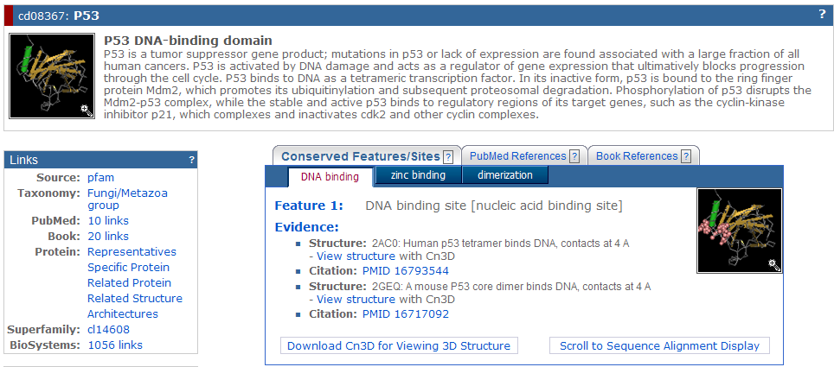

Slide 33
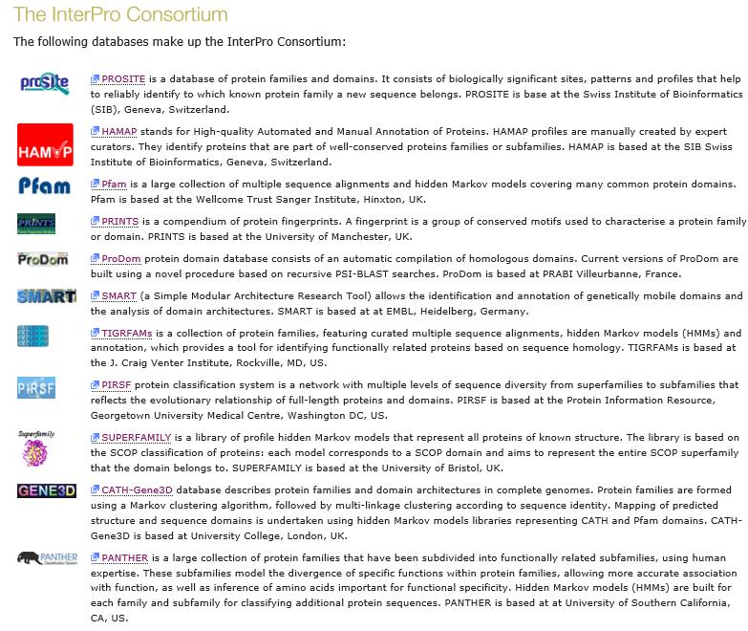
http://www.ebi.ac.uk/interpro/about.html

Slide 34
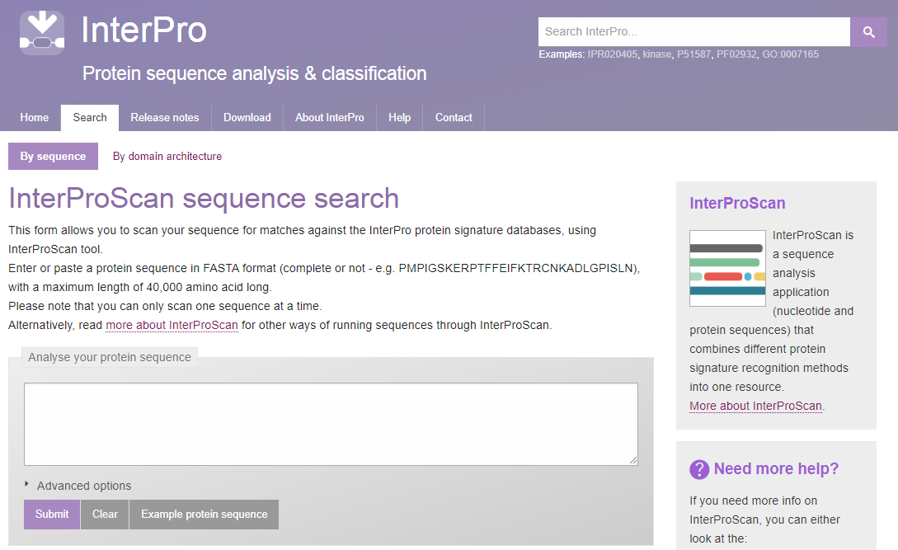
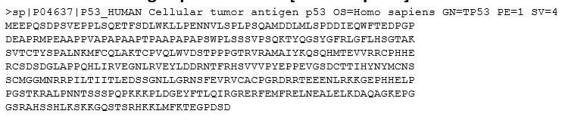
http://www.ebi.ac.uk/interpro/search/sequence-search

Slide 35
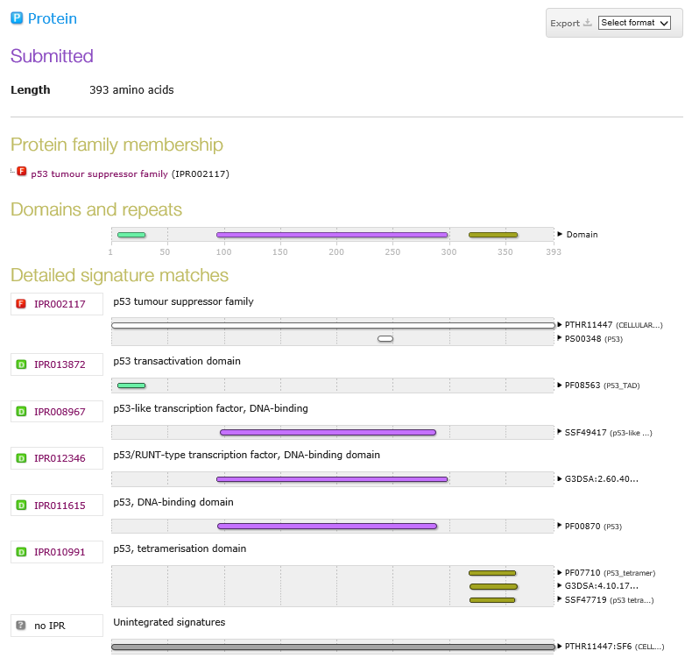

Slide 36
Example
cellular tumor antigen p53 isoform a [Homo sapiens]
>sp|P04637|P53_HUMAN Cellular tumor antigen p53 OS=Homo sapiens GN=TP53 PE=1 SV=4
MEEPQSDPSVEPPLSQETFSDLWKLLPENNVLSPLPSQAMDDLMLSPDDIEQWFTEDPGP
DEAPRMPEAAPPVAPAPAAPTPAAPAPAPSWPLSSSVPSQKTYQGSYGFRLGFLHSGTAK
SVTCTYSPALNKMFCQLAKTCPVQLWVDSTPPPGTRVRAMAIYKQSQHMTEVVRRCPHHE
RCSDSDGLAPPQHLIRVEGNLRVEYLDDRNTFRHSVVVPYEPPEVGSDCTTIHYNYMCNS
SCMGGMNRRPILTIITLEDSSGNLLGRNSFEVRVCACPGRDRRTEEENLRKKGEPHHELP
PGSTKRALPNNTSSSPQPKKKPLDGEYFTLQIRGRERFEMFRELNEALELKDAQAGKEPG
GSRAHSSHLKSKKGQSTSRHKKLMFKTEGPDSD
How to identify
post-translational modifications (PTM)?

Slide 37
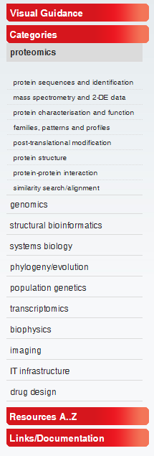
http://www.expasy.org/
Protein Sequence Analysis Tools
ExPASy Molecular Biology Server
Expert Protein Analysis System is the new SIB Bioinformatics Resource Portal which provides access to scientific databases and software tools in different areas of life sciences including proteomics, genomics, phylogeny, systems biology, population genetics, transcriptomics etc

Slide 38
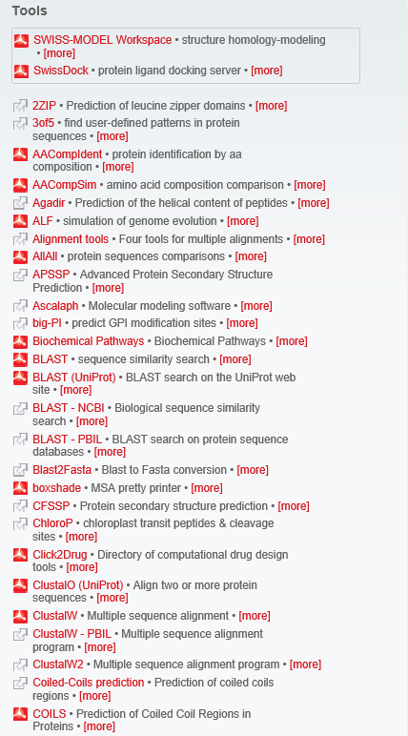
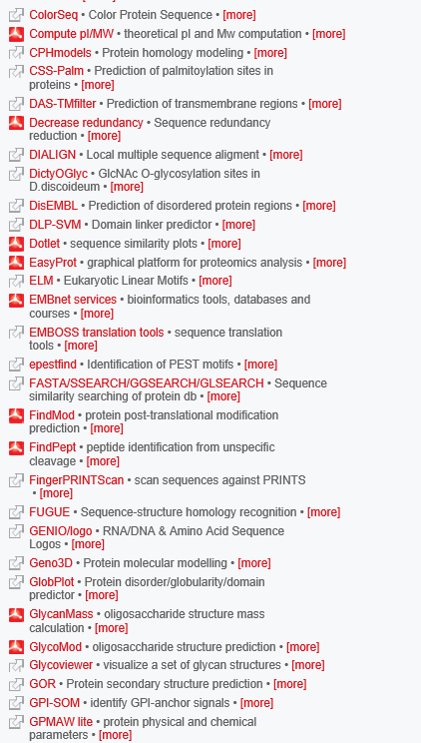
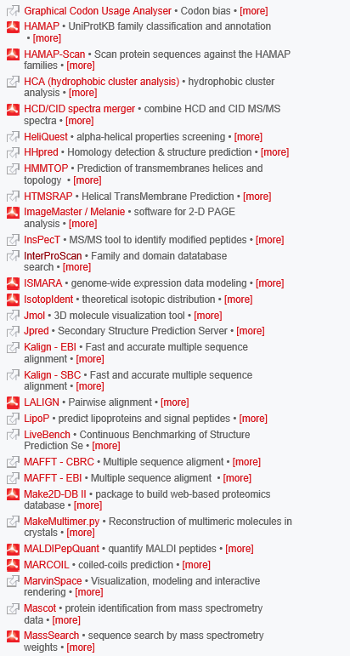

Slide 39
ASSIGNMENT 03
Download the file ex.fasta from website
Assemble the fragments
2. How many potential reading frames are there?
3. Give the potential names of these genes?
4. The identity and similarity of these proteins with H. sapiens homlogues?
5. MW, pI and potential post-translational modification sites of the proteins.
6. Any motifs/domains present in the proteins?
7. Pick one protein and use ProSite My Domains Image Creator to draw the motif structure.
E-mail the ANSWER as attached pdf file to
petang@mail.cgu.edu.tw. Before 8 Nov 2018
****郵件主旨： Bioinfo2018ASS4 _學號

