Slide 1









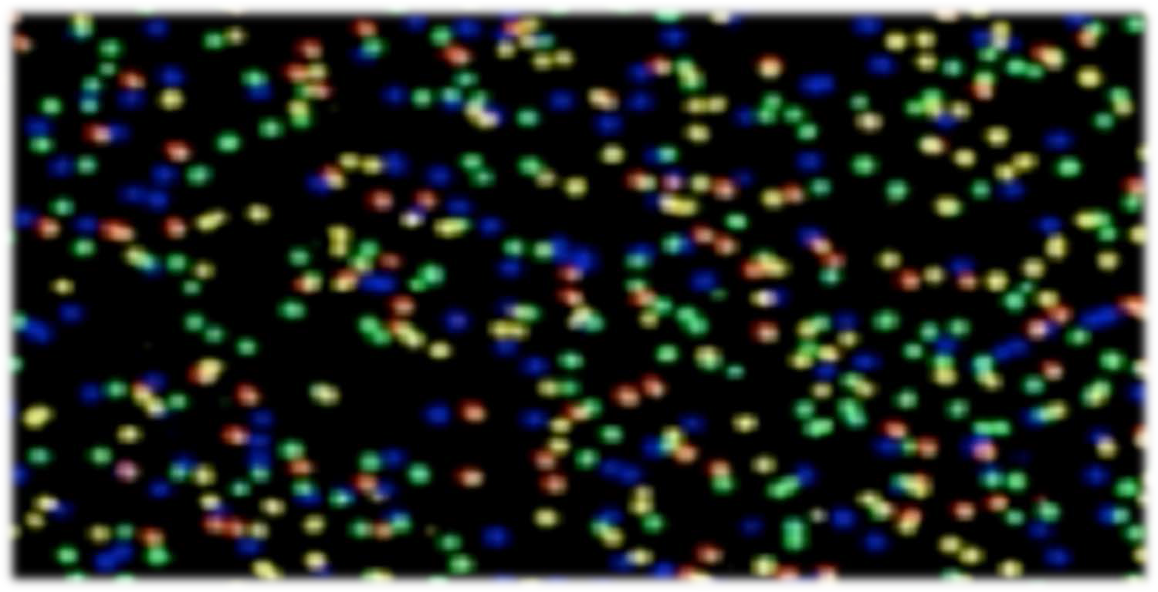

High Throughput Sequencing
(NEXT GENERATION SEQUENCING)
Technologies and Applications
Petrus Tang, Ph.D. (鄧致剛)
Graduate Institute of Basic Medical Sciences and
Bioinformatics Center, Chang Gung University.
petang@mail.cgu.edu.tw http://petang.cgu.edu.tw

Slide 2


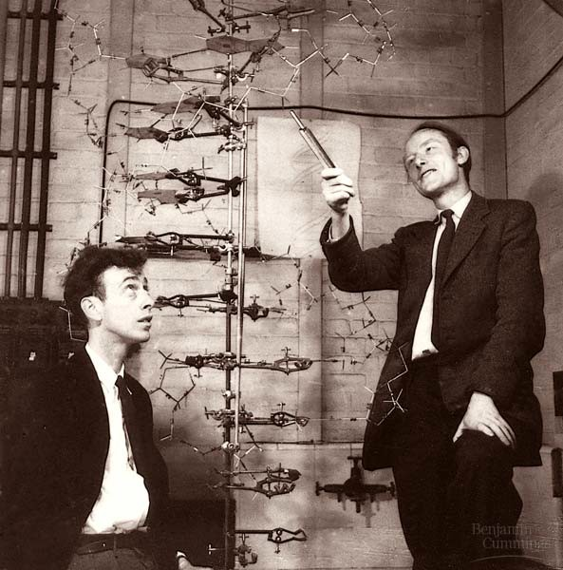

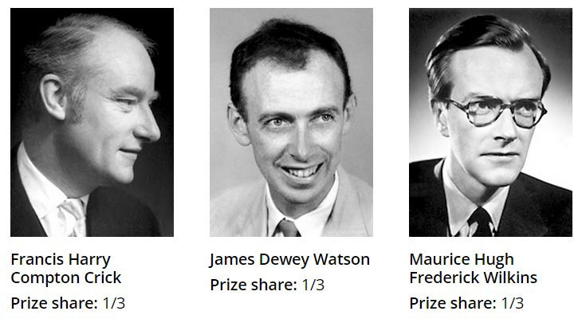
James Watson and Francis Crick with their DNA model at the Cavendish Laboratories in 1953

Slide 3





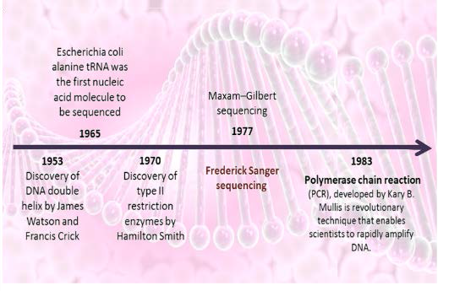
Do You Read Me?

Slide 4



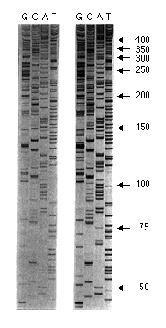
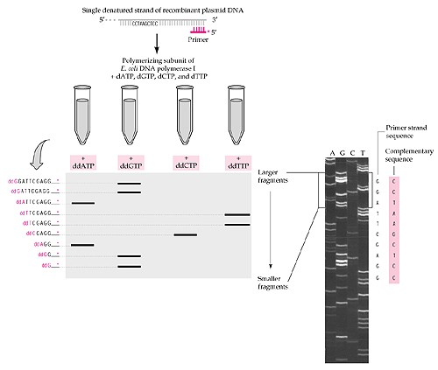
Sanger Dideoxy Sequencing
Sanger, F. et al. Nature 24, 687–695 (1977).
Sanger, F., Nicklen, S. & Coulson, A.R. Proc. Natl. Acad. Sci. USA 74, 5463–5467 (1977).

Slide 5
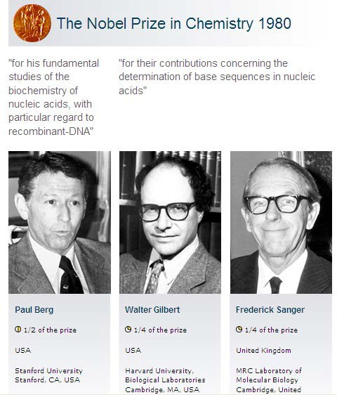
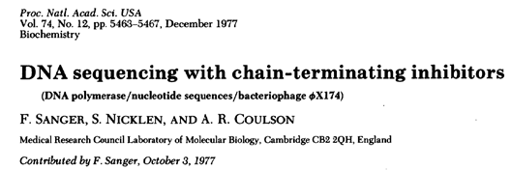
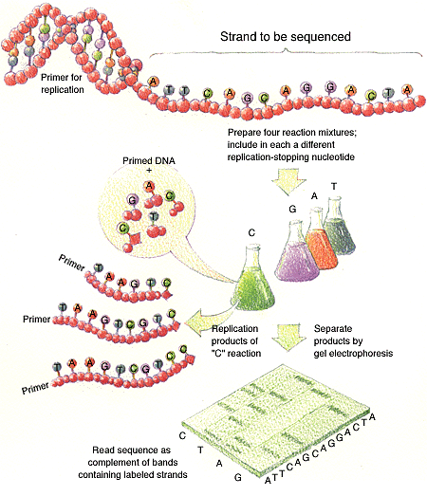
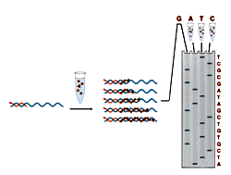
Recombinant DNA
Chemical sequencing
Chain-termination sequencing

Slide 6
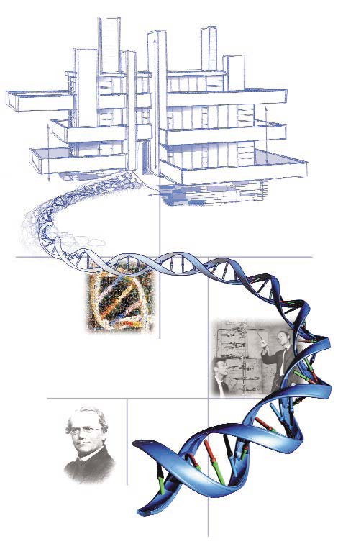







February 2001: Completion of the Draft Human Genome
>10 years to finish USD 3 billion
Science, 16 February 2001
Vol. 291, Pages 1145-1434
Nature, 15 February 2001
Vol. 409, Pages 813-960
April 2003: High-Resolution Human Genome
Nature, 23 April 2003
Vol. 422, Pages 1-13

Slide 7
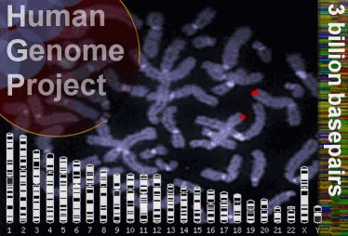



3,000,000,000 bp

Slide 8

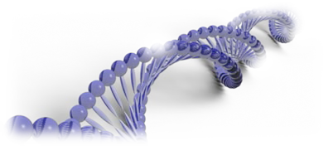


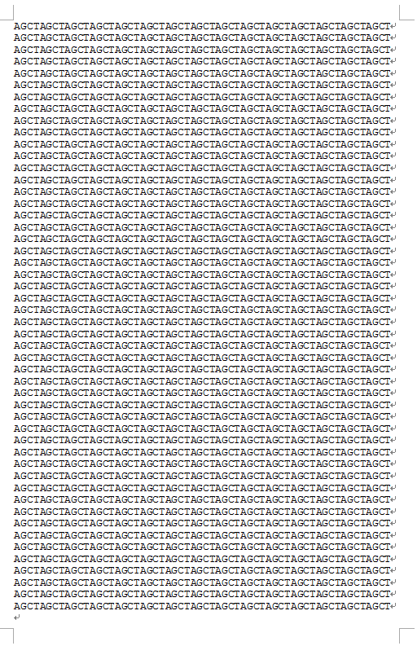
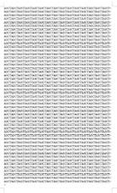



3,000,000,000 bp
60 words
100 pages/book
509.2m
3G
50 columns
3000 words/page
Height=1cm
Human Genome
=1,000,000 pages
Human Genome
=10,000 books
Human Genome
=100 m High

Slide 9

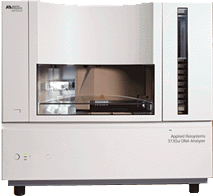
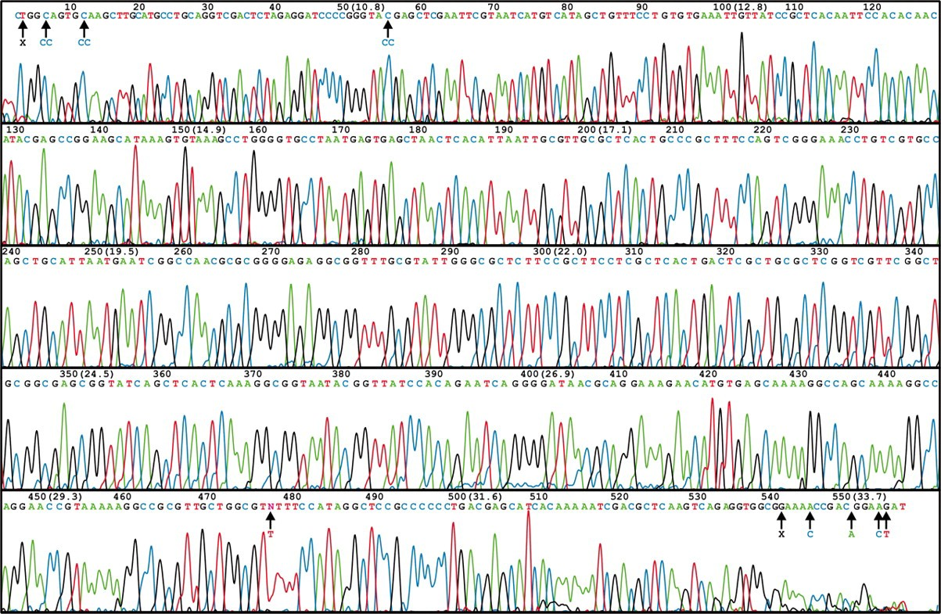




ABI 3730 XL DNA Sequencer
96/384 DNA sequencing in 2 hrs, approximately 600-1000 readable bps per run.
1-4 MB bps/day
A human genome of 3GB need 750 days to finish at 1X coverage

Slide 10
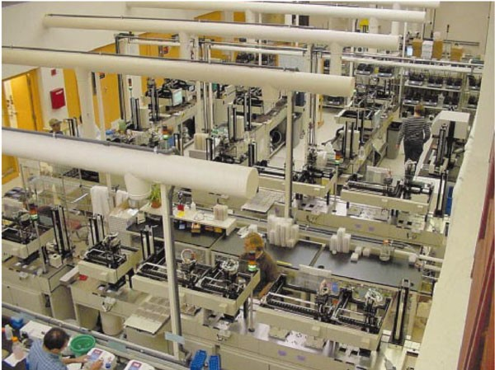
Whitehead Institute

Slide 11


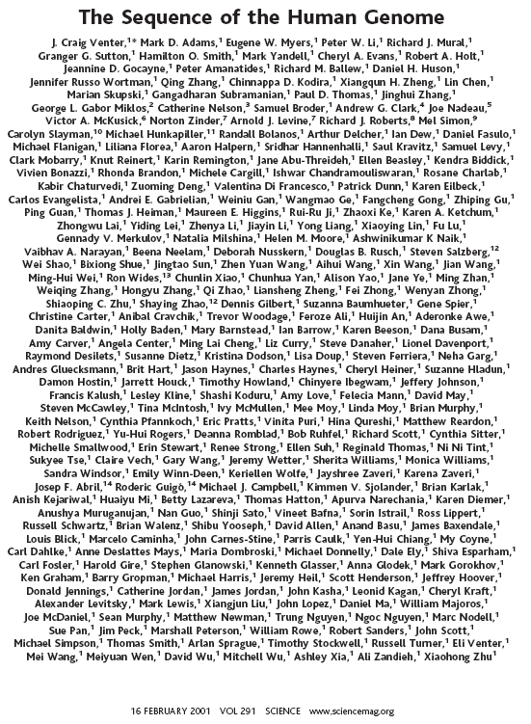

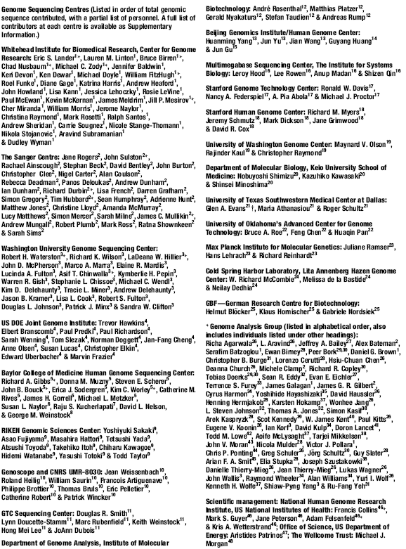
273 authors
254 authors

Slide 12
國Genorr
Tong et al. Genome Biology 2010, 1l:R91 http://genomebiology.com/2010/11月／R91
lR ES EA RC H Open Accessj
Sequencing and analysis of an Irish human genome
Pin Tong汁 James GD Prende旬的戶 Amanda J Lohan 1,Susan M Farrington口 Simon C『on咐 Nial Friel5, Dan G Bradle，戶 0『la Ha『diman7,A lex Evans8,James F Wilson9, erendan LoftusI警
Abstract
Background: Recent studies generating complete human sequences from Asian, African and European subgroups have 『evealed population-specific variation and disease susceptibility loci. Here, choosing a DNA sample f『om a population of inte『est due to its 『elative geographical isolation and genetic impact on fu『ther populations,we extend the above studies th『ough the gene『ation of 11-fold coverage of the 面的t Irish human genome sequence
Results:Using sequence data from a branch of the Eu『opean ancest的lt『ee as yet unsequenced, we identify variants that may be specific to this population Th『ough comparisons with HapMap and previous genetic
association studies, we identified novel disease-associated va 『iants, including a novel nonsense va 『iant putatively associated with inflammatory bowel disease. We desc『ibe a novel method for improving SNP calling accu『acy at
low genome coverage using haplotype information. This analysis has implications for futu陀 『e-sequencing studies and va lidates the imputation of Irish haplotypes using data f『om the cu何ent Human Genome Dive的ity Cell Line Panel (HGDP-CEPH) Final紗 we identify gene duplication events as constituting significant targets of 『ecent positive selection in the human lineage
Conclusions: Our findings show that there 『emains utility in gen芒『ating whole genome sequences to illustrate both general principles and 『eveal specific instances of human biology. 以/ith inc『easing access to low cost sequencing we would predict that even armed with the 陀的凹的 of a small m凹的 group a number of similar initiatives geared towa 『ds answering specific biological questions will emerge

Slide 13
nature
、
genetics 、
Whole-genome sequencing and comprehensive variant analysis of a Japanese individual using massively parallel sequencing
Ak ihiro Fujimoto,Hidewak i Nakagawa’”aoya Hos ”，Kaon』Nakano,Tetsuo Abe,Keith A Boroevicl司 Masao Nagasaki,Rui Yamaguch i,Tetsuo Shibuya,Michiaki Kubo,Saton』Miyano,Yusuke
Nakamura & Tatsuh iko Tsunoda
Affiliations I Contr ibutions I Corresponding authors
Nature Genetics 42, 931-936 (2010) I doi:10.1038/ng.691
Received 18 February 2010 I Accepted 10 September 2010 I Published online 24 October 2010
Abstract
Abstract ﹒Auth r infom可ati n﹒Supplemen祖吋 infom祖甜 n
We repo仕 the analysis of a Japanese male using high-throughput sequencing to x40 coverage. More than 99% of the sequence reads were mapped to the reference human genome. Using a Bayesian decision method,we identified
3,132,608 single nucleotide variations (SNVs). Comparison with six previously repo前ed genomes revealed an excess of singleton nonsense and nonsynonymous SNVs,as well as singleton SNVs in conseived non-coding regions.We also identified 5,319 deletions smaller than 10 kb with high accuracy,in addition to copy number variations and rearrangements.De novo assembly of the unmapped sequence reads generated around 3 Mb of novel sequence,which showed high similarity to non-reference human genomes and the human herpesvirus 4 genome. Our analysis suggests that considerable variation remains undiscovered in the human genome and that whole到genome
sequencing is an invaluable tool for obtaining a complete understanding of human genetic variation

Slide 14








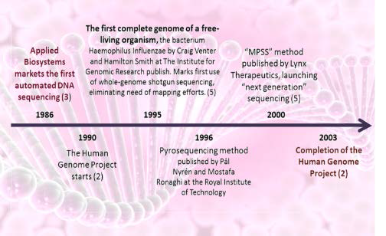
Next Generation Sequencing Technology
Massively Parallel Signature Sequencing (MPSS)

Slide 15







NEXT GENERATION SEQUENCING

Slide 16
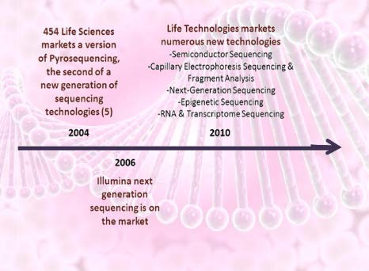
Next Generation Sequencing Technology
Massively Parallel Signature Sequencing (MPSS)
(Genome Sequencer, GS)
(Sequencing by Oligonucleotide Ligation and Detection, SOLiD)
(Genome Analyzer, GA)

Slide 17




Next Generation Sequencing Technology
Massively Parallel Signature Sequencing (MPSS)
NATURE METHODS | VOL.5 NO.1 | JANUARY 2008
Nature Methods' Method of the Year 2007 goes to next- generation sequencing. This series of articles showcase how these novel sequencing methods came into their own in 2007 and the incredible impact they promise to have in a variety of research applications. The Methods to Watch feature provide a glimpse and a wish list for future Methods of the Year.
454 GS FLX
http://www.454.com/
SOLEXA
http://www.illumina.com/pages.ilmn?ID=250
SOLID
http://marketing.appliedbiosystems.com/

Slide 18



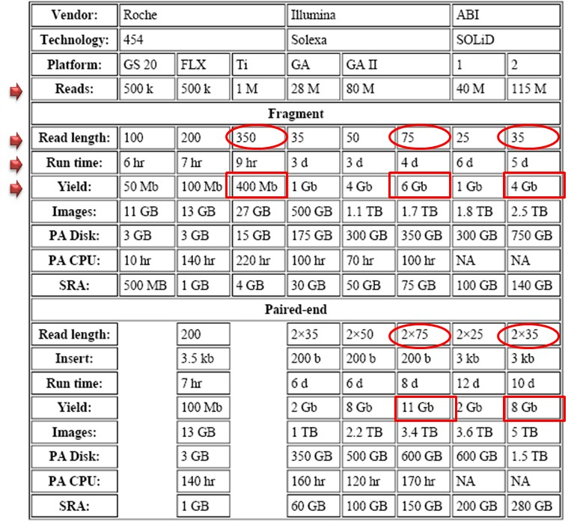




Throughput of NGS machines (2007-2009)
Throughput = total number of reads x read length
High throughput Short read/run Illumina
SOLiD
Low throughput- Long read/run Roche
(~4Gb/4 days)

Slide 19


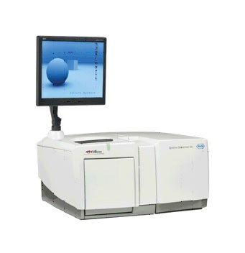
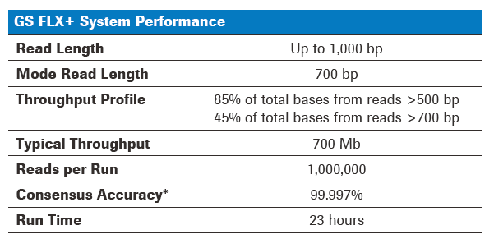
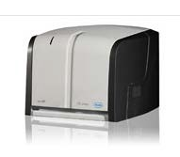
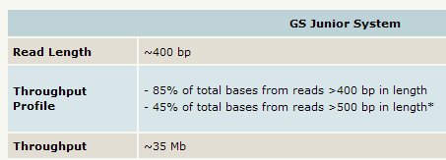
Throughput of NGS machines: Roche (2012)

Slide 20

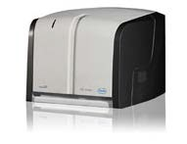
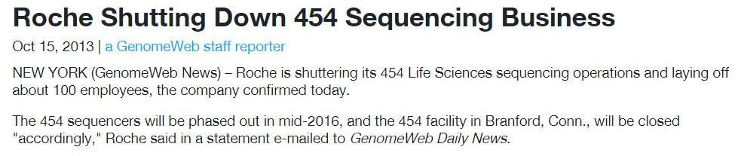
Throughput of NGS machines: Roche

Slide 21




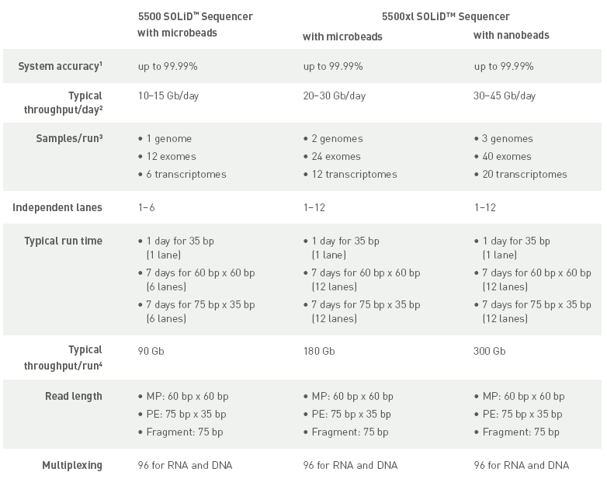
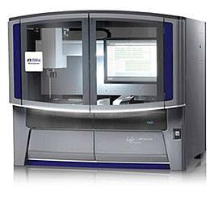
Throughput of NGS machines: SOLiD 4 (2013)
In 2014 ABI SOLiD was replaced by the Ion Torrent sequencing platforms (Proton and Personal Genome Machine)

Slide 22
Next Generation Sequencing Technology
Massively Parallel Signature Sequencing (MPSS)
NATURE METHODS | VOL.5 NO.1 | JANUARY 2008
Nature Methods' Method of the Year 2007 goes to next- generation sequencing. This series of articles showcase how these novel sequencing methods came into their own in 2007 and the incredible impact they promise to have in a variety of research applications. The Methods to Watch feature provide a glimpse and a wish list for future Methods of the Year.
X
SOLEXA
http://www.illumina.com/pages.ilmn?ID=250
454 GS FLX
http://www.454.com/
X
SOLID
http://marketing.appliedbiosystems.com/

Slide 23

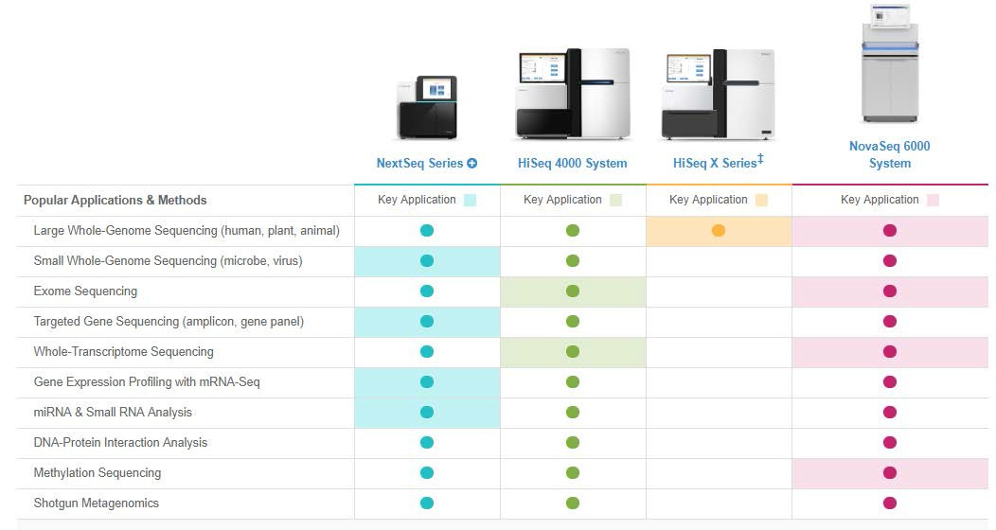
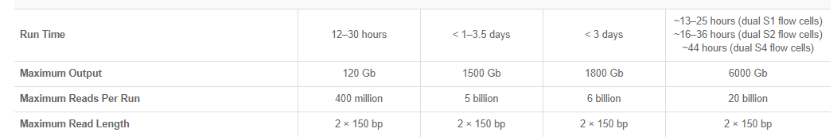
Production scale Sequencers

Slide 24


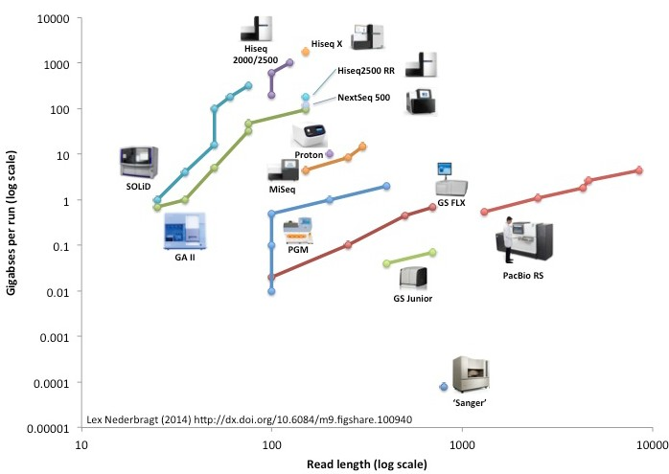


Throughput of NGS machines
High throughput short read Illumina
X
X
X
Low throughput, Very long read PacBio
X

Slide 25











NEXT GENERATION SEQUENCING
Basis Principles
Temple fragmentation (library) Amplification
Sequencing
Detection

Slide 26


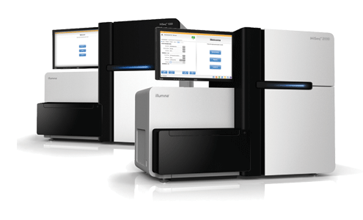
Illumina Sequencing by Synthesis (SBS)

Slide 27


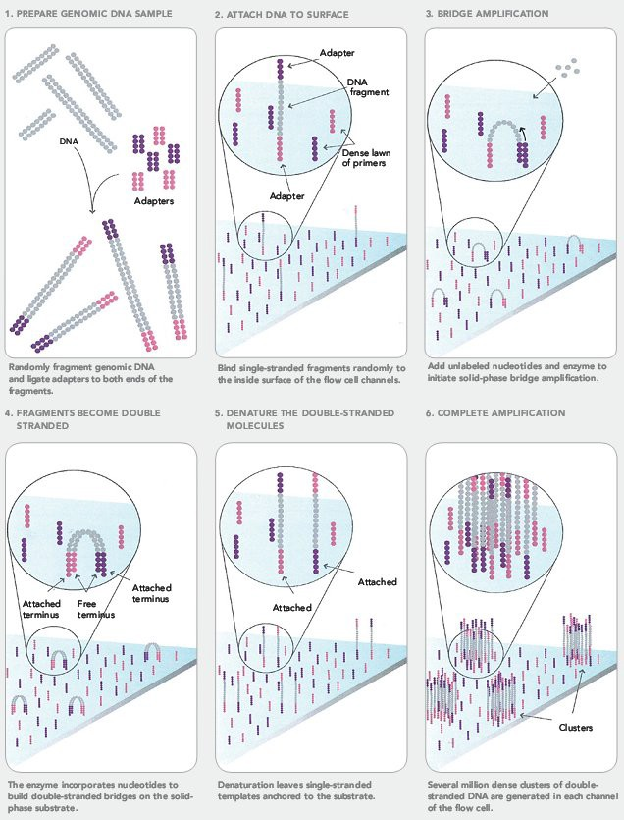
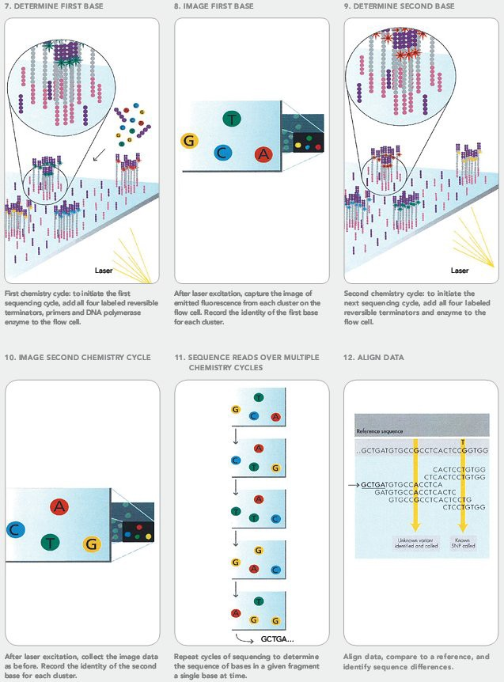
Solexa Genome Analyzer

Slide 28

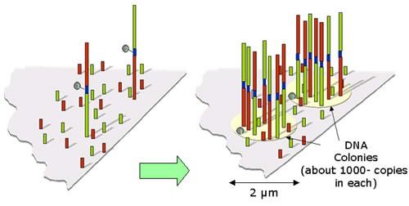
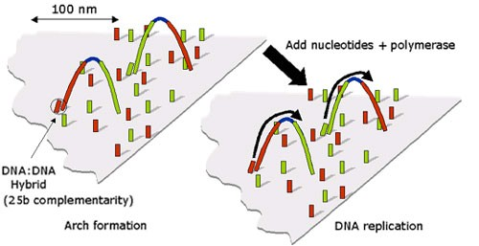
Cluster Generation
Clusters Array
Template Bridging

Slide 29
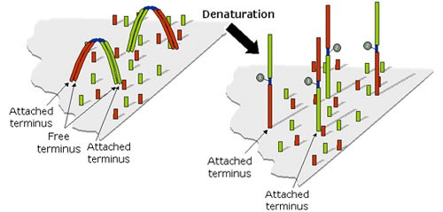
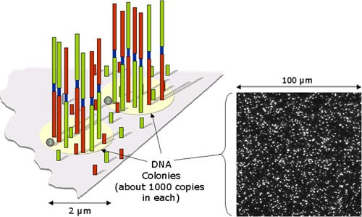
Denaturation
Ready For Sequencing

Slide 30
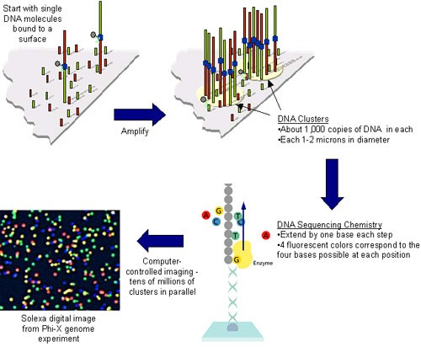
Sequencing-By-Synthesis

Slide 31
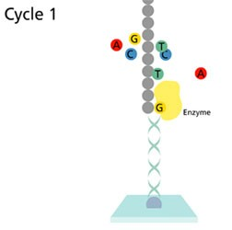
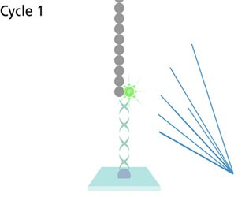
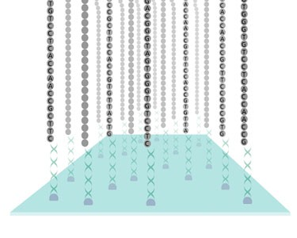
Incorporation
Fluorescent Detection
Sequence Generated At Every Site On The Array

Slide 32
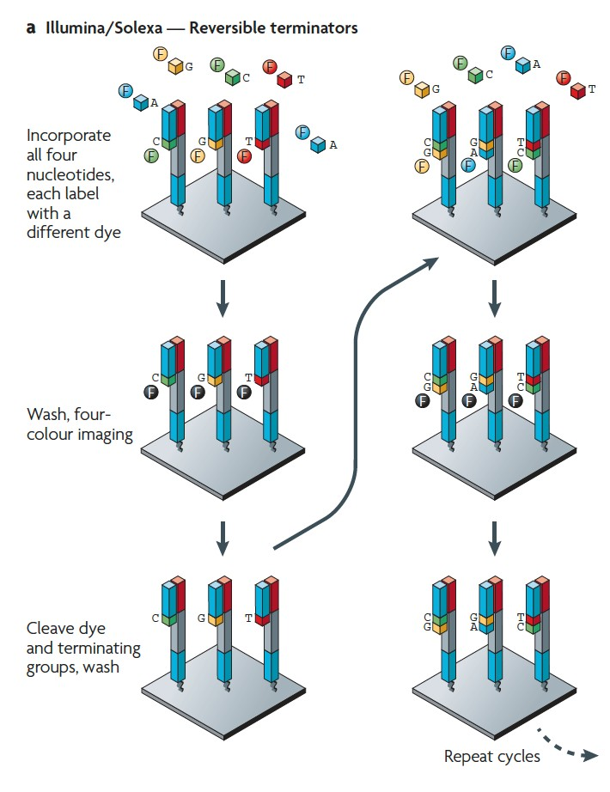
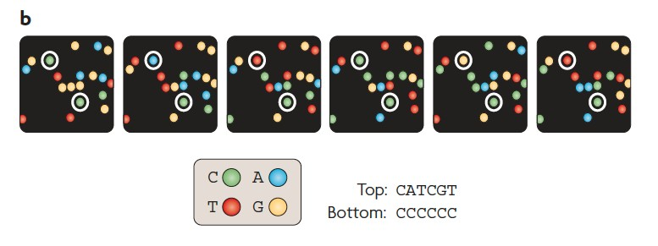
From Debbie Nickerson, Department of Genome Sciences, University of Washington, http://tinyurl.com/6zbzh4

Slide 33
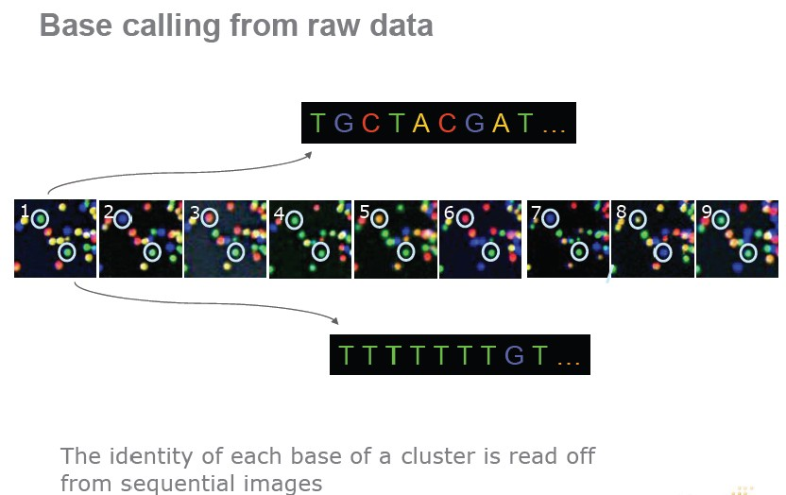
From Debbie Nickerson, Department of Genome Sciences, University of Washington, http://tinyurl.com/6zbzh4

Slide 34
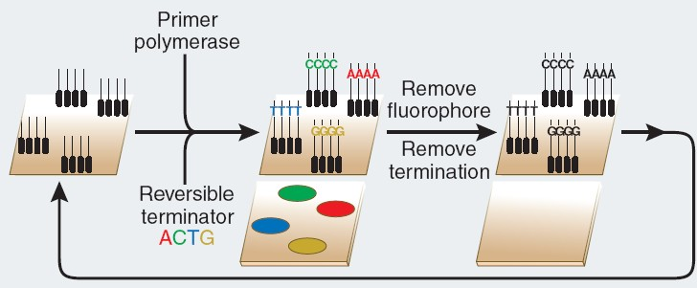
Solexa technology (sequencing-by-synthesis)
Sample preparation.
Fragments of DNA are ligated to end adapters, denatured and bound at one end to a solid surface already coated with a dense layer of the adapters. Each single stranded fragment is immobilized at one end, while its free end ‘bends over’ and hybridizes to a complementary adapter on the surface, which initiates the synthesis of the complementary strand in the presence of amplification reagents. Multiple cycles of this solid-phase amplification followed by denaturation create clusters of ~1,000 copies of single-stranded DNA molecules distributed randomly on the surface.
Sequencing with reversible terminators.
Synthesis reagents, added to the flow cell, consist of primers, DNA polymerase and four differently labeled, reversible terminator nucleotides. After incorporation of a nucleotide, which is identified by its color, the 3′ terminator on the base and the fluorophore are removed, and the cycle is repeated for a read length of 30–35 nucleotides.

Slide 35

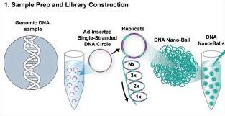



Combinatorial Probe-Anchor Ligation (cPAL) sequencing
Technology description: Drmanac, R et al. (2010) Human Genome Sequencing Using Unchained Base Reads on Self-Assembling DNA Nanoarrays. Science 327, 78-81

Slide 36

Chinese Company to Ac,qui1re DNA Sequencing Firm. ... Complete Genomics, a struggling DNA sequencing company in Silicon ValleyJ said on Monday that it had agreed to be acquired fot$117.6 millionlby BGI﹒ Shenzhen, a Chinese company that operates the world's
largest sequenci呵 operation. 2012年9月173
草大基因
產量豆豆iii
BGISEQ-500
BGISEQ-50
BGISEQ-500 is an industry leading high-throughput
sequencing solution,powered by combinatorial Probe-Anchor Synthesis (cPAS) and improved
DNA Nanoballs (DNB)
－
The BGISE0-50 has a built-in independent sample reagent loadi「昀 「eservoir and full- automatic 「eagent needle
penetration system.This simplified structu「e can ca「ry out multiple automatic functions. including sampleloadi門g,
sequencing and data analysis.The
compact size makes it practical for most labo「atories.The BGISEQ-50 has been designed with specific applicabi ity for basic sequencing projects in clinical and scientific 「esearch
J一
technology.The cPAS chemistry
w。rks by incorporating a
fluorescent probe to a DNA
ancho「 on the DNB, followed by high resolution digitalimaging.This combination oflinear amplification and DNB technology reduces the error rate
whie enhancing the signal. In addition,the size of the DNB is cont「olled in
such a way that 。nly 。ne DNB is b。und per active site.This patterned array
technology not only provides sequenc ing accu「acy, but it alsoinc『eases the chip utilization and sample density

Slide 37













Evolution of Sequencing Technology
Sanger dideoxy-sequencing
ABI 3730XL
Single molecule sequencing and nanopore technology?
Oxford Nanopore Technologies,, Electron Optica, Electronic BioSciences, GenapSys, Genia, GnuBIO, IBM, LaserGen, Lightspeed Genomics, NABsys, NobleGen Biosciences, QuantuMDx, Reveo, Stratos Genomics, Two Pore Guys, ZS Genetics………………….
Massive parallel sequencing
Roche 454 FLX, Life Technologies SOLiD,
Illumina Hiseq, Life Tech Ion Torrent
Bead-based em-PCR and sequencing by ligation
Dover Systems' Polonator
Massive parallel sequencing and single molecule sequencing
Pacific Biosciences (single-molecule real-time DNA sequencing (SMRT) technology)
Helicos (true single-molecule-sequencing (tSMS) technology)
VisiGen Biotechnologies (real-time, single-molecule sequencing fluorescence resonance energy transfer (FRET) technology)

Slide 38













NEXT-NEXT-NEXT-
NEW GENERATION SEQUENCING
Basis Principles
Temple fragmentation (library) Amplification
Sequencing
Detection

Slide 39
















Single Molecule Real-Time Sequencing
Real-time monitoring of PCR activity
Read-out by fluorescence resonance energy transfer between polymerase and nucleotides or
Waveguides allow direct observation of polymerase and fluorescently labeled nucleotides
VisGen Biotechnologies Helicos Biosciences
Pacific Biosciences
Helicos BioSciences said in a regulatory filing that it has sold certain patent applications covering molecular diagnostic applications of its technology to Sequenom for $1.3 million. The patent applications cover methods for detecting fetal nucleic acids and diagnosing fetal abnormalities. Helicos also warned that if it is "unable to successfully raise additional capital, we may have to cease operations and/or seek bankruptcy protection."

Slide 40





Single Molecule Real-Time (SMRT) Sequencing

Slide 41





Figure 10. Processive Synthesis with Phospholinked Nucleotides.
Step 1: Fluorescent phospholinked labeled nucleotides are introduced into the Zlv1W
Step 2: The base being incorporated is held in the detection volume for tens of milliseconds, pr
。ducing a bright flash 。f light
Step 3: The phosphate chain is cleavedτ releasing the a前ached dye molecule Step 4-5: The process repeats.
A
Expected:
600
TC
﹛．2．S^{h}扭^{曲}CS－c
nHV
nu
申
EG
UCDO呻由 OD
nU 《υ
A且可
《MV 《MV
』
俏 。
－
《川uw 《川日，
《U υ《
u
內4．，
k
。45 46 47 48
49
Time (s)
50
51
52
53
B
Bases:
25
50
75
100
125
150
gz8g的
（ 2 S
RU
AU nu
AU nU
-
A揖5-<IATP
．
－
A崎－
-
ASGl!o<ITTP
-
A647-dGTP
KE
nU AU
nJ
一一A600-d CTP
gE
的 －
SHE
200
100
0
0
10
20
30
T1m<> le:\
40
50
60
70

Slide 42


1 November 2018
Illumina, Inc. (NASDAQ: ILMN) and Pacific Biosciences (NASDAQ:PACB) today announced they have signed an agreement for Illumina to acquire Pacific Biosciences at a price of $8.00 per Pacific Biosciences share in an all-cash transaction.
This price represents a premium of 71% to Pacific Biosciences30 trading day volume weighted average share price as of the market close on October 31st, 2018, and a total enterprise value of approximately $1.2 billion on a fully diluted basis.
•Brings Together Highly Accurate Short- and Long- Read Sequencing Technologies, Paving the Path to a More Perfect View of a Genome
•Pacific Biosciences’ Recent Advances with its
Sequel SMRT® Technology, Combined with Illumina’s Infrastructure, will Expand Biological Discovery and Clinical Insight
•Long-Read Sequencing Market Opportunity Expected to Grow to $2.5B by 2022

Slide 43





Bio何World
r<- (UI叫圳帥 叫t .llr•• r. 品 阱 ，，叫 tr ,40<-•,;1巾，＂
Oxford Strikes First in DNA Sequencing Nanopore Wars
By KevinDavies
Februa內仰 2012 IBreaking a neartotal vo咐 f silence afterthree y官ars instealth mode,Oxford Nanopore has o仟＇ered stunningdetailsof its nanopore next-generation sequencing(NGS) technologyto a packed house atthe premier genome sequencing conference inMarco Island,Florida
﹛Ii)
Qv)
州）
(vi
{viii﹜
In a talk attheAdvances inGenome Biology
and Technologyconference this morning 旦旦旦l
technoloavofficer Clive Brnwnpresented details ofwhatthe British company calls its “new generation'of single一strand sequencing technology,featuringaccurate longreads of
single-stranded DNA molecules,includingthe completion oftwoviralgenomes.
Inthe second half ofthis yea人the companywill
commercially release its previouslyannounced GridlON instrument rnode,as w官II as thewo叫d's
smallest DNA sequencinginstrument -a po叫able ca此ridge calledthe MinlONthat doubles (and works as)a USS drive.
Oxford Nanopore'sdisruptive Min/ON USBdevice

Slide 44








Nanopore Sequencing
Oxford Nanopore
Nucleic acids driven through a nanopore.
Differences in conductance of pore provide readout.
This diagram shows a protein nanopore set in an electrically resistant membrane bilayer. An ionic current is passed through the nanopore by setting a voltage across this membrane.
If an analyte passes through the pore or near its aperture, this event creates a characteristic disruption in current. By measuring that current it is possible to identify the molecule in question. For example, this system can be used to distinguish the four standard DNA bases and G, A, T and C, and also modified bases. It can be used to identify target proteins, small molecules, or to gain rich molecular information for example to distinguish the enantiomers of ibuprofen or molecular binding dynamics.

Slide 45




Biomolecular Detection and Quantification 3 (2015) 1–8
The data presented in this study was generated using R6 sequencing chemistry; to explore if our results for error rate and the effect of G + C content held true for the R7 chemistry we evaluated data from [24]. Re-analysing this data with our methods resulted in 57.8% of template reads aligned(55.4% of bases aligned), with 37.5% error.
High Quality Two Direction reads resulted in 82.5% of reads aligned (82.3% of bases aligned), with 26.6% error.

Slide 46


0
ill
Weight
87g (103g with a flow cell)
Size
W 105, H 23, D 33mm
Flongle
Adapting MinlON for smaller, frequent, rapid tests and analyses
Flongle is an adapter (flow cell dongle) for MinlON or GridlON that enables direct,real-time DNA or RNA sequencing on smaller, single-use flow cells.
Providing access to sequence data as soon your expe「iment sta「ts, Flongle is designed to be the quickest, most accessible and cost-efficient sequencing system to「 smaller tests and experiments.
、、

Slide 47
PromethlON (1 flow cell)
Promethl。N
Flongle
MinlON Mk 18
GridlON X5
﹛彷 flow cell司
Read length
fragment length = read length. L。ngest read n。W>2 Mb
min - 48 hrs 1 min - 64 hrs
Run time
1 min - " 6 hrs
1 min - 48 hrs
1 min - 64 hrs
Yield ONA sequencing
The。reticalmaximum 10 Yield Current y巴Id range 10 | Upt。3.3 Gb Early access t。Staπ ASAP - c。mmercialtarget 1 Gb | Up t。40 Gb Up t。30Gb (Rev 0 Chip) | Up t。200 Gb Up t。150Gb (RevD Chip) | Upt。315 Gb Upt。150 Gb | Up t。15 Tb
c。St 間r Gb: (cited as c。st per | @1Gb $go | @10Gb SSO
Gb of data at a ce門ain yield per flow cell, best package price) |  | @20Gb S25 @30Gb S16.50
。”Ex:
@50Gb $14
@100Gb $7
@150Gb $3.5
@50Gb $" 2.5
@100Gb $6.25
@150Gb $4.1
@10Gb: S47 .50
@20Gb: S23.75
@30Gb: S15 .70
CapEx:
@10Gb: S30
@20Gb S15
@30Gb: S10.00
Starter pack fee
Pr. ＞
Vided as 阻π 。f early access
No instrument c。st . Starter kit
$50k
N。1nstrun可 ent c。st
No 1nstrt』ment c。st
（。ther purchasing schemes als。 pack available)
(includes MinlON, 2 fl。w cells
& sequencing kit) $1000
Multiplexing enabled N。t in 自rst release | Kits for g5 samples | Kits for 96 samples | c。ming s。。n | c。m1ng s。n
Number 。f channels available Upt。126 f。r sequencing | Up t。512 | up t。2,560 | Upt。3,000 | Up t。144,000

Slide 48



R9.4 flow cell
Throughput: 5-10 Gb
2014 E. coli genome Avg. read length: 5.4 kb Longest read: 10 kb
2015
Mean read length: 2 kb Median read length : 1 kb Longest read: 98 kb

Slide 49


https://www.youtube.com/watch?v=62ATIxGYLKY

Slide 50
Wellcome Trust Centre for Human Genetics and Genomics pie First to Sequence Multiple Human Genomes Using Hand-Held Nanopore Technology
Demonstrates potential for wide-scale whole-genome sequencing in humans using nanopore appr， aches
Decembe『01,2016 07:01PM Eastern Standard Time
OXFORD, England-(BUSINESS WIRE）一Oxfo「d Unive「S旬，s Wellcome Trust Cent「e fa「 Human Genetics (WTCHG) and the leading genome ana圳臼 company Genomics pie today announced the 甜st sequencing and analysis of multiple human genomes using nanopore technology_ The announcement, made on Thursday at the Oxford Nanopo「e Community Meeting in New York City, ma『ks a majo「 b「eakth「ough in sequencing technology in opening up the potential of wide-scale whole叫genome sequencing in humans using nanopore approaches_
“It is a significant breakthrough to sequence multiple human genomes with nanopore technology. Moving fo『ward,the idea that the『e will be alternative technologies with new prope吋ies in this space will be very
appealing to 『esea『che『s and to clinical geneticists.n
Today ’s announcement 「aises the possibility of a majo『change to both the economics and the science of DNA sequencing_ Researche『s at the WTCHG and Genomi臼 plc used the MinlON sequencer developed by Oxford Nanopore
Technologies_ The portable MinlON is a hand- held device about the s坦e of a Mars bar,and is powe「ed by a laptop computer to which it connects via a USB p 此＿ It is available tor $ 1,000 plus the cost of consumables_ While nanopore sequencing has been available for two yea悶，此 has p「eviously only been p『acticab le
to apply it to relatively small genomes o「 regions of DNA, such as the much smaller genomes of viruses and bacteria_ Recent upgrades to the technology have now made 他 possible for
「esearche『s to conduct larqer-s臼le studies such as sequencing complete human genomes by using multiple Mi內IONs_
，Tweet this

Slide 51



^{山配} E oz 邊。
書
•
•
‘．’
E I
《zo sz bc ^{E} E UE Eε部^{詣}。冒”。直盟
s f
，E、^{單，}，E
l l ^{k}尸叫It －－
苟8 E a ＠盲 EE OF．a g e d、d
^{的}¢ 貧COFV
、
。主Eez Z E ^{甘}S Z苟且 6．s－E S－－ r－。E E E Z S E E E E Eew 苟且b EU E E EE E 3^{g} z s s z z o S E E S－PE－－a^{奇}百^{g} s』＠旬，宴”Eh E 2 a ^{p}－－OS ^{毒} 品
E E Ea E E 主義C Z ^{P}ZHugo z a cE E GC雪σ$ 』Ea B E BOMB E－。”里至每2 83 2 2晶且 連 8hE E。s p g E E E串sao苟且，E Z g Ewes g a dz口百 E EωM
岡州州山山山川凶
•
E Z OG S E Z E R E 空 E E Sa Z E9h E E－－ Hwz e E－B E E－S E句話膏，且串 E E R E E 串 E E 宮 室 里ava哥哥52g meg a－J E伺口”。喜g a這苟且^{會}哩
HOO－dg－u 白的
‘ ‘
c 2、曲。ov
•
書
自目，．， ，
•
•
•
•
‘
！→！
一今！
→ ！
‘ ‘
e ‘
‘
’
、
，因
...
I l-t1h1l lll
囂
，、
{J L
。”，．．’，aa－－缸”Z Z．B．、－u
iilF i
CE H曲。的
〈zdG 6 8色Eaw dz 口自
!iII 11
苟－a 個缸 』O O N Z X ^{O} Z－uzo 3^{σ}也ω E O Z咽。－J ª C F Z X ^{O} C－uc ^{自}3^{σ}也ω Z O Z咽。－^{e}－
．．
…
E E Ch
s－oz OE－－ZDυE E ^{E} －b E S＠ E aga E…皇
____.,.
5!
書
t →，t → _{鈕}i→ i
甸GMWZBC臭”揖＠』』品嘗著。古泣c。OZ宇$ 4 2 0 0』必有吉姆
I•
I ·一
_{z}－jz．．．4 『’
E Ea Z T hnd_{f}
UCE S－－ E E E ª g c E呵，CEc－S E S且全且B SSE －E
器。品－B E E－ME昌』豆－uOG
‘
JE de－‘F
U ．．‘．
EE
百eg ^{倚重} 盲apa苟地wmcao E ^{甸}
『C匠、曲。OF
《zou d。且全誨，歪ZO^{研}
•
Ii1i
”。，鍾的」－ua O的
•
”一一
ωZ一E口的
r此g x a－z uc ^{由}2。^{σ}ω
humwhaQQ、d ω－苟。主ghmw 由g c。”v苟草
anM戶垣甸甸 盲az
KFeiazEO〉O Zo。”。』a ag a－mw且3

Slide 52





1αlOng
﹛20-1αlO ngfor gen白a protocols)
﹛5000 ng tαult的－loog ＇ ds﹜
Efficiency of library pr， parahon
食貪食
﹛All tho自adapted fragments ate av割恰b蛤 f()( sequenclng﹜
會會
（包ime f『agments lost due to double halrp帥 me攝e­ cu胎s whlch will not be s自quenced﹜
＊＊會
（釗Ithe adapt自dfragme叫s ar自avatlab蛤 for
鉛qu自nclng﹜
Pro ocol / Kit adaptions
Nat1veba闊別Ing PCR barcodlng
州 附 山 圳 岫 伽
們叫 u qa nH UH
沈紅叫
9
Wash Kit
而川 崎 ψ 的 旭 K
M ”X t Au hud
M間 ． 缸
ι
““
Low Input DNA Long reads (>SOkb﹜
Readl自ng伽 S叫自ctlα1
Wasll Kit
I M 』
．，
M 叫
b
4
岫
”
AddIt＇°＇叫coost.rnables required forllbraty prep
Agencoon AMPure XP beads (A6組曲﹜
N回Next End 的pair / dA－凶ling Module (E7546). NEB Blunt/TA Llgase Master Max (M0367)
Agencoort AMPure XP beads (A6:'.泌80)
NEBNexlEnd 『epalr I dA-talllng Modul自﹛E7546). NEB Bit』nt/TA Ugase Master Mix ﹛M0367), MyO『祖 Cl Streptall1d1n beads ﹛6個﹜哨5001).
Optional Covarls g-lUBE ﹛＃520079). NEB FFPE Repair MIX ﹛M鉛30)
NEB Blunt/TA Ugase Master Mix ﹛M0367)
Opt心nalCovans g-TUBE (#52C沁79), N回FFPE Repair Mix ﹛M6630)
Readlengths v fragment length
Read length as the sa何也 as fragmentlength
Readlength Is double the fragmentlength
Re甜 lengthIs too 鉛me as fragment length
2 st ：：心帥
岫咀Il 圖
呵圈
呵圈
DNA tagmentatlon by transposase
研姐回國﹒
DNA shear＇ using Covans g-TUBE DNA shear1
using Covaris g-TUBE
區
L司
I
u著姐”可YC ＂＇

Slide 53




The GridlON system
Oxford Nanopore's proprietary nanopore-based sensing chemistries are operated on an electronics-based platform, the GridlON system. This enables the scaled-up measurements of multiple nanopores and the sensing, processing and analysis of data in real time.
A single instrument, a Q且型企址且且且車 operates with a single-use 且也包g_that contains the necessary reagents to pe吋orm an experiment.
Scalability
A node can be employed as a single desktop instrument, or scaled up in a similar way to computing installations.
As a desktop instrument for the individual researcher, it canwrite data to the network or a locally attached disc (directly through a
USS orthrough a network﹜ and work in a small lab.
唱團 ．
Each node is a network device and multiple nodes can be
aggregated together into larger co-operating units or clusters,
communicating with each other in a peer-to-peer fashion over the use「s network. The system is designed to interface, or even co­
locate, with standard or hi叭 pe吋ormance IT infrastructure. Wor附ow overheads, and total costs, including IT, scale linearly with the
GridlON system.
g用1phi c: a single node (le仿 may be used as a desktop device r的stalled 的 co句unction 晰的 other nodes that communica悟 with each other through a network (cen『·e, right).
A single node as a desktop installation Nodes may be clustered through a EachGridlON node ope用tes with a single
network for larger throughput installations dispoable cartridge.

Slide 54


SmidgION: nanopore sensing for use with mobile devices

Slide 55








NGS machines (2012-2016)
Novaseq 5000/6000
X
X
X
X

Slide 56








Cost of NGS machines
High throughput, short read/run COST USD800,000
X
X
Low throughput- long read/run
COST USD1,000,000
X
X

Slide 57











Cost of NGS machines
Medium throughput, short read/run COST USD200,000-400,000
X
X
X
X

Slide 58









Personal/Benchtop Sequencer
Miseq/MiniSeq
Personal Sequencing System
Ion Torrent/Ion Proton
Personal Genome Machine

Slide 59

1仙m 1na·MiS cht S
_..
Prep
Sequence
Analyze
風馳＂＂啊＇ 岫
抄 盟，R '"
可別
咽，
1.5
MOORS
4.5
<2
”心RS
”OURS
MISEQ REAGE NT KIT V2
MISEQ REAGE NT KIT V3
READ LE NGTH TOTAL TIME* 。 υTPUT
READ LE NGTH TOTAL TIME* OUTPυτ
1× | 36 bp | N4 hrs | 540-6 10 Mb | 2 × 75 bp | ～24 hrs | 3.3-3.8 Gb
2 × | 25 bp | ～5.5 hrs | 750-850 Mb | 2 × 300 bp | ～65 hrs | 13.2-15 Gb
2 × 2 x | 150 bp 250 bp | N24 hrs ～39 hrs | 4.5 -5. 1 Gb 7.5-8.5 Gb

Slide 60


io。n＊ tQrrent
A O × 口 ＋古已
by ／，帶technologies
：盛行T
10 Mb to 1 Gb
j叫b 盛行？
－－
100 fold scaling means you can ch 但e
the amount of sequencing thr。ughpυt
required f。r your •pec1fic application
法 1叫 3
ION PGM"' SEQUENCER
SMALL GENOMES SETS OF GENES GENE EXPRESSION
ChIP-SEO
Read Length：。bp ”。bp
400bp -
2012
4 2 。
。2 2011 。4 20刊
90-minute run times
Rapid 100-base sequencing on the Ion 314• Chip.
35-400* bp reads
If your application requires short-read or long-read 目q四nc1ng ，r single-end, paired-
end，r mate-paired sequencing, the Ion PGM"
Sequencer delivers the greatest fl凹巾ility,

Slide 61

。＊A O × 口 ＋三已
by 徉techno
iont
rrent

Slide 62






Ion Torrent
314 chip
316 chip

Slide 63


iontQrrent
。＊A O × 口 ＋弓已
by 徉technol咖f
區
f •o -- f盛行竺
!咖 3 三？
10 Mb to 1 Gb
100-fold scaling means you can ch 但e
the am。uni of sequencing thr。ughput
required f。r your specific application
ION PGM ”SEQUENCER
SMALLGENOMES SETS OF GENES GENEEXPRESS 日N ChIP-SEO
Read Length 呵 ^{bp} 2。Obp
4。Obp - 2012
04:2010
。2.2 。”
042011
90-minute run times
Rapid 100-base sequencing on the l。n 314• Chip.
35-400* bp 「eads
If your application requires short-read 。r
long-read目quencl呵，r single-end, paired­ end, or mate-paired sequencing, the Ion PGM"
Sequencer delivers the greatest fL凹ibility.

Slide 64



(2012)

Slide 65


Benchtop Sequencers

Slide 66








Droplet-based Sequencing

Slide 67







Droplet-based Sequencing
Microfluidics, the science that deals with the behavior, precise control and manipulation of fluids that are geometrically constrained to a small, typically sub-millimeter scale, emerged in the beginning of the 1980s and is used widely in technologies such as inkjet print heads, DNA chips, lab-on-a-chip technology, micro-propulsion and micro-thermal technologies. GnuBIO has adapted technology developed in Dr. David Weitz laboratory at Harvard. This technology is combined with proprietary molecular biology assays to create a unique next- generation DNA sequencing technology.
The science behind this GnuBIO sequencing technology utilizes droplet microfluidics to perform the biochemical reactions for sequencing inside of tiny picoliter -sized aqueous drops. Each droplet acts as a discrete reaction vessel, like a miniature test tube, where the sequencing assay is performed.

Slide 68




Storage & Computing Power
Next gen sequencers generated Giga bp to Tera bp of data
fastq

Slide 69




fastq

Slide 70




Storage & Computing Power
Next gen sequencers generated Giga bp to Tera bp of data

Slide 71

http://allseq.com/knowledgebank

Slide 72

http://seqanswers.com/

Slide 73








NEXT GENERATION SEQUENCING
Applications & Analysis

Slide 74

旦旦!:!J SOFTWARES I 。 ”· LINE ANALYS S l 封面D EN TSI
MS bioinformatic s www site
同欄棚可叫叫s) 1hu甜珊珊隔開IB闊的Biootat l
高通量定序分析
上讓時間 每適五上午的 10-12:00 ﹛08:10-09:00一授課，09:10-12:00一實習 ﹜ 上課地點 醫學院 9F 生物資訊中心 電腦教室
助教：蔡智字（分機5690)
違反 | 議程違反 | 授課老師 | 講義下裁 L:lectu『e T:tutorial E:exercise
 | New Gene『ation Sequencing (NGS} Technologies & Biological Big Data | 畫 責同d
2 | Databases and Tools for High Throughput Sequencing Analysis | 葉元鴨
3 | Small RNA Analysis and Target Identification | 黃干自榕
4 | Gene Exp『ession Analysis for Non-model 0『ganisms | 畫；！（剛
5 | Gene Exp『ession Analysis | 葉元鴨
6 | τ『anscriptome Functional P『ofiling - DAVID | 朱俐j緊
7 | Small Genome de novo Assembly & Annotation I | 陳亭紋
8 | Small Genome de novo Assembly & Annotation II | 陳亭紋
9 | MID-TERM EXAMINATION | 畫；！（剛
10 | Genome Annotation & Genome Browser | 黃干自榕
11 | Chip Sequencing Analysis | 陳亭紋
12 | Metagenome Analysis | 葉元鴨
13 | Cance『PanelSequencing Analysis | 黃干自榕
14 | Exome Sequencing Analysis | 黃干自榕
15 | Biological Big Data Visualization & lnteg『ation | 李季青
16 | Galaxy | 黃干自榕
17 | Student P『esentation | 畫；！（剛
18 | Final-Examination | 畫 責同d

