Slide 1
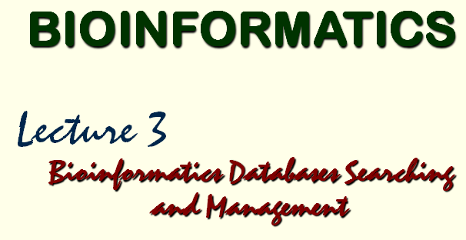

Slide 2







Databases?

Slide 3
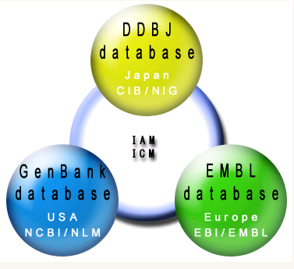
GenBank/EMBL/DDBJ
International
Nucleotide Sequence Database
DDBJ: DNA Data Bank of Japan
CIB: Center for Information Biology and
DNA Data Bank of Japan
NIG: National Institute of Genetics
IAM: International Advisory Meeting
ICM: International Collaborative Meeting
EMBL:
European Molecular Biology
Laboratory
EBI:
European Bioinformatics
Institute
NCBI:
National Center for Biotechnology Information
NLM:
National Library of Medicine

Slide 4
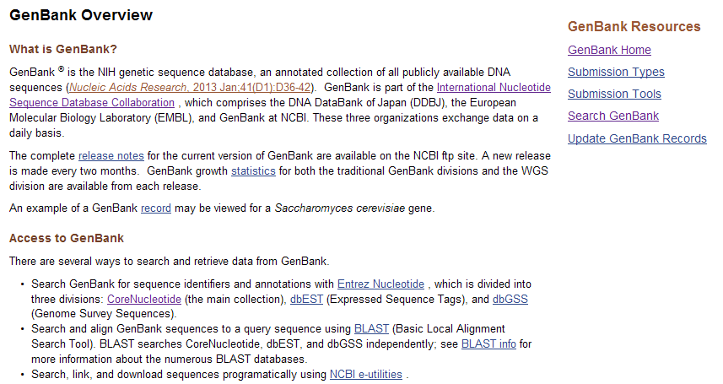
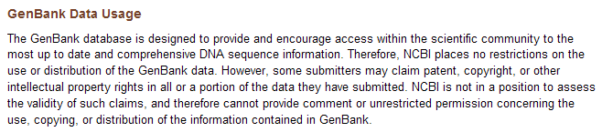
http://www.ncbi.nlm.nih.gov/genbank/

Slide 5
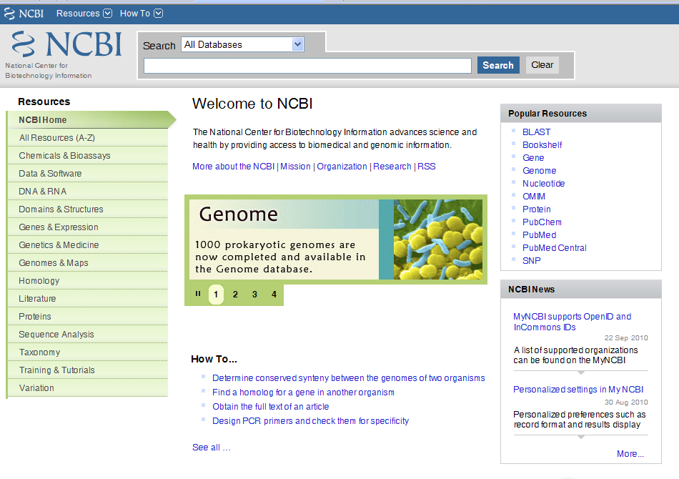
Secondarily Databases

Slide 6
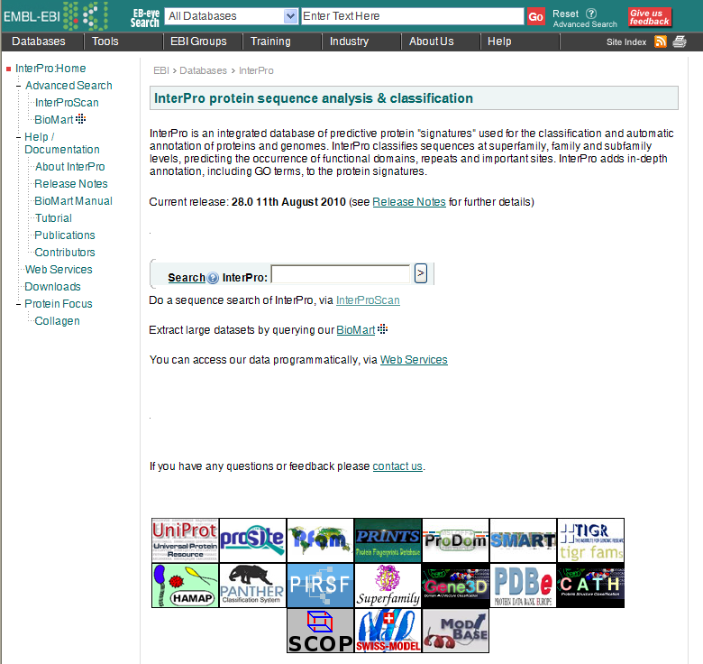
Secondarily Databases

Slide 7
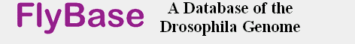




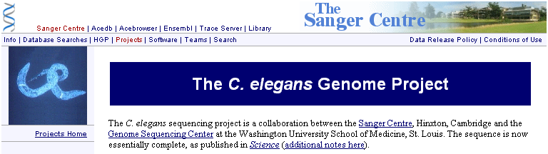

Slide 8
Database Retrieving and
Manipulation Network
Databases
Literature Database
Sequence Databases -
Primary Databases
Secondarily Databases
GCG
Vector NTI
CLC
Open Sources
Endnote
MS Office
Adobe
Query by
1.Text
2.Sequence
Retrival
System
Softwares
GenBANK
GCG
FASTA
Staden
Image
Formats
Information
Sequence
Converter
Sequnece,Structure,Image,Document

Slide 9

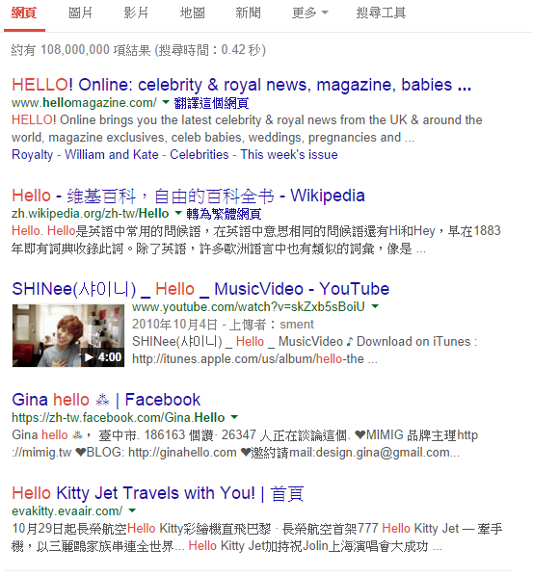
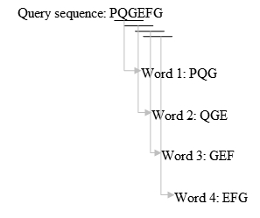
fuzzy search
（approximate string matching）

Slide 10
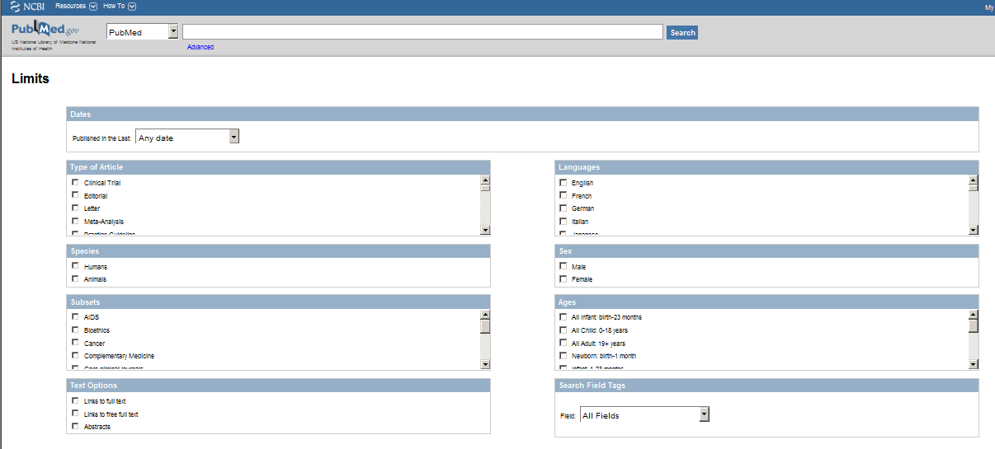
Literature Databases

Slide 11
Sequence Comparison
Nucleotide sequence alignments
mismatch
gap
match
137 AGACCAACCTGGCCAACATGGTGAAATCCCATCTCTAC.AAAAATACAAA 185
|||||| ||||||||||||||||||| |||||||||| ||||||||||
1 AGACCAGCCTGGCCAACATGGTGAAACTCCATCTCTACTGAAAATACAAA 50
Protein sequence alignments
Conserved substitution
10 20 30 40 50 60
ggamma.pep MGHFTEEDKATITSLWGKVNVEDAGGETLGRLLVVYPWTQRFFDSFGNLSSASAIMGNPK
|||||||||||||||||:|||::|||||:|||||:|||||||||||||||||||||||||
HGCZG MGHFTEEDKATITSLWGHVNVDEAGGETIGRLLVLYPWTQRFFDSFGNLSSASAIMGNPK
10 20 30 40 50 60
Residues with shared chemical properties can substitute for each other
Size, charge, hydrophobicity, polarity
scored less than a match, but better than a mismatch
Conservative changes scored as better than non-conservative

Slide 12
Pairwise Comparsion
Local Alignment
compares regions within two sequences and
can return several matches
BLAST
vs
Global Alignment
compare entire sequences
FASTA

Slide 13
Query by sequence
Program | QUERY | Database
blastp | amino acid sequence | protein sequence database.
blastn | nucleotide sequence | nucleotide sequence database.
blastx | nucleotide sequence translated in all reading frames | protein sequence database (use this option to find potential translation products of an unknown nucleotide sequence)
tblastn | amino acid sequence | nucleotide sequence database translated in all reading frames
tblastx | six-frame translations of a nucleotide sequence | six-frame translations of a nucleotide sequence database. (tblastx program cannot be used with the nr database on the BLAST Web page because it is computationally intensive)

Slide 14
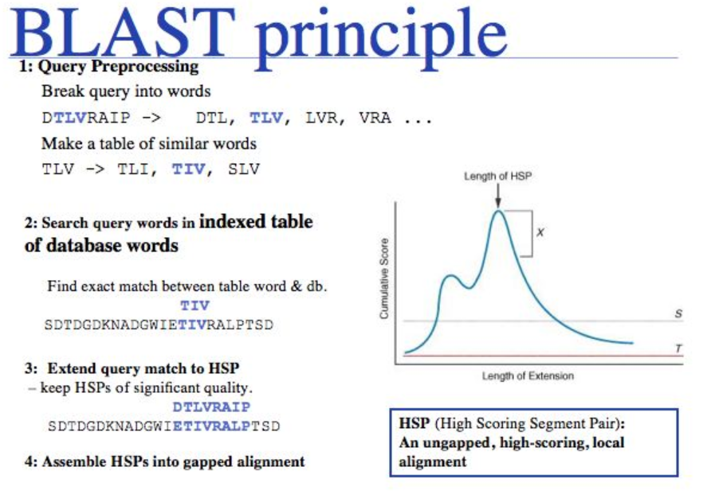

Slide 15

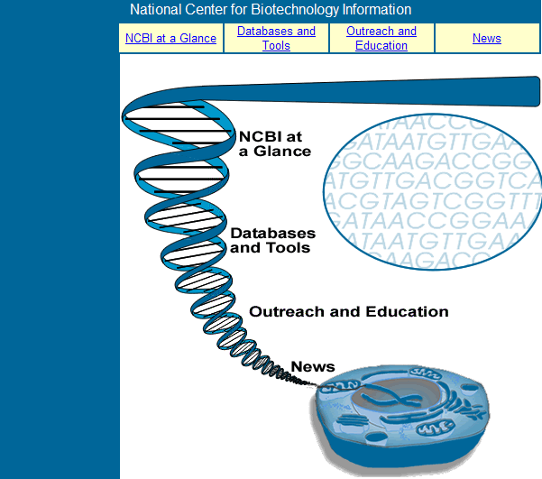
http://www.ncbi.nlm.nih.gov/About/glance/index.html

Slide 16
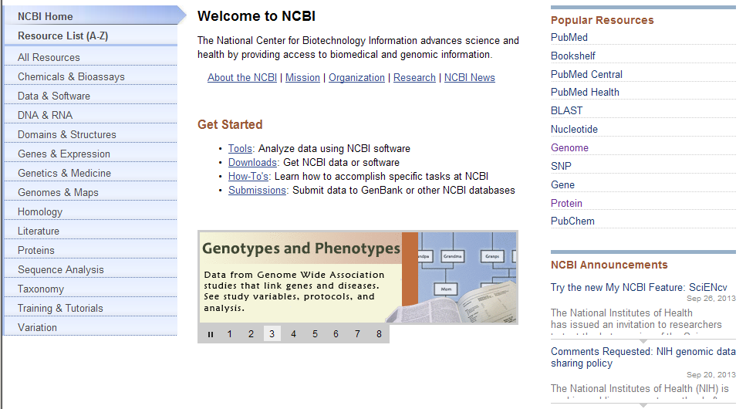

Slide 17
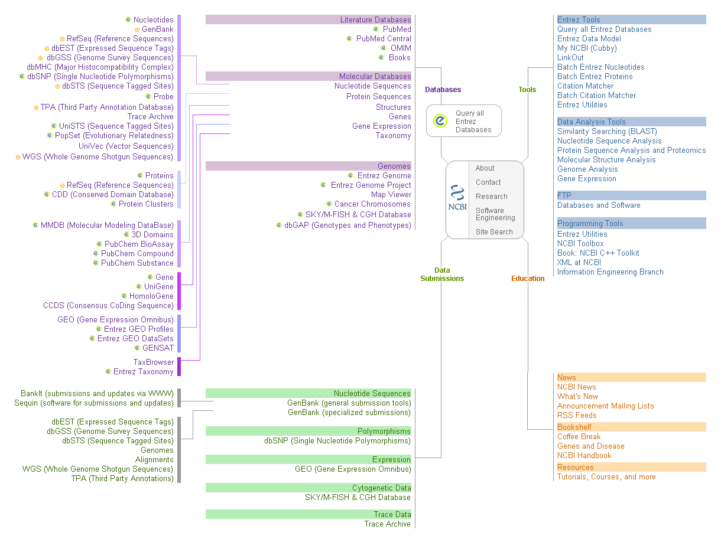
Notes:
shiuan
17

Slide 18
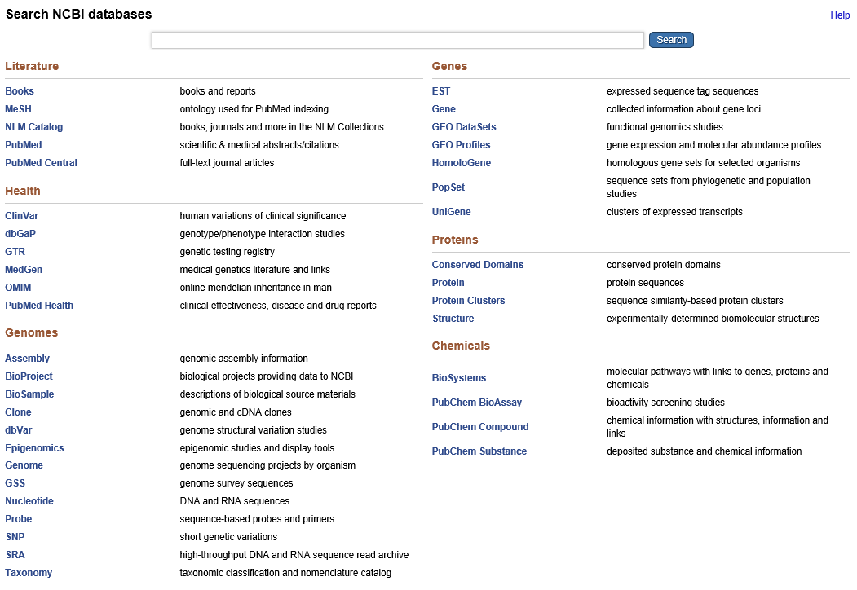
http://www.ncbi.nlm.nih.gov/sites/gquery

Slide 19
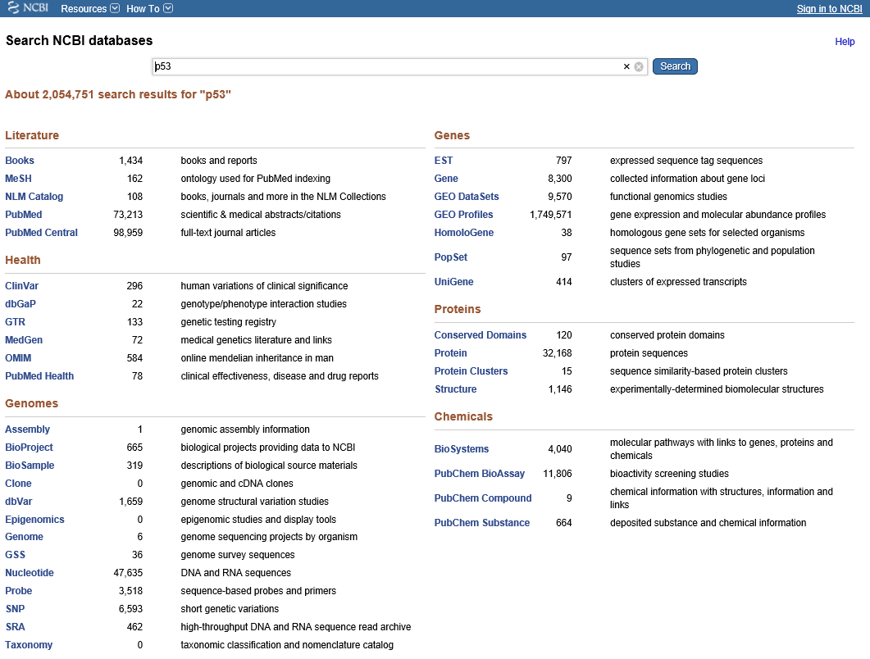

Slide 20
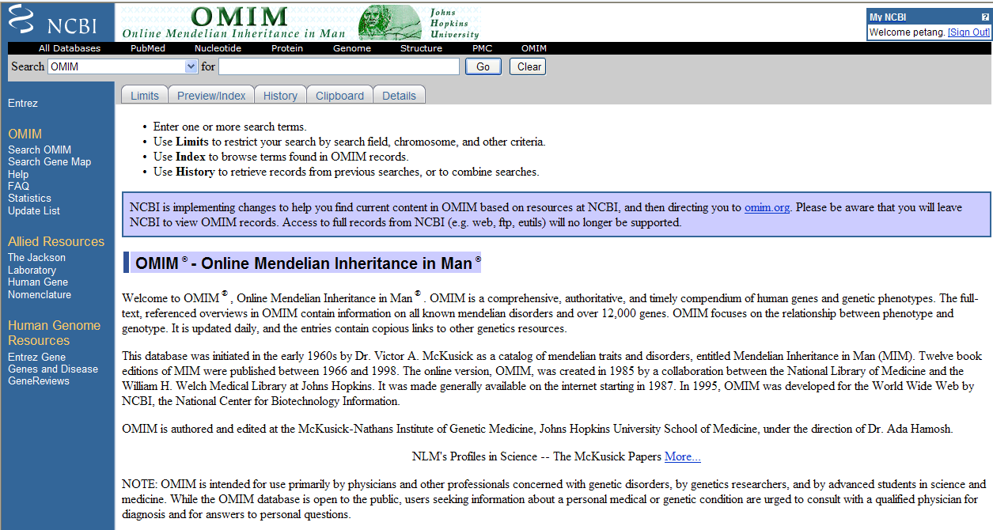
Literature Databases
http://www.ncbi.nlm.nih.gov/omim

Slide 21
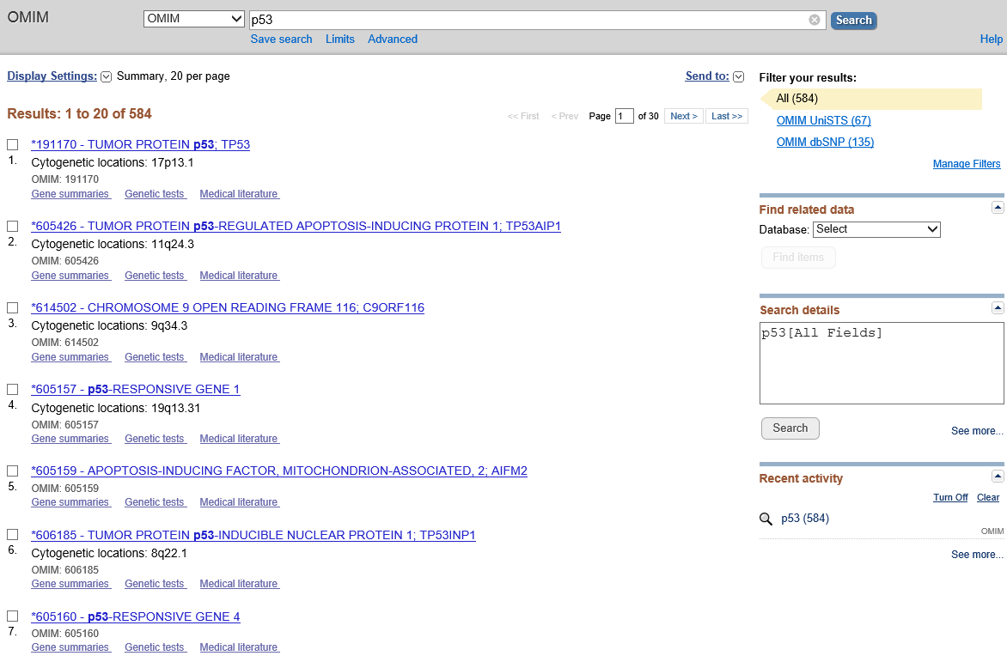

Slide 22
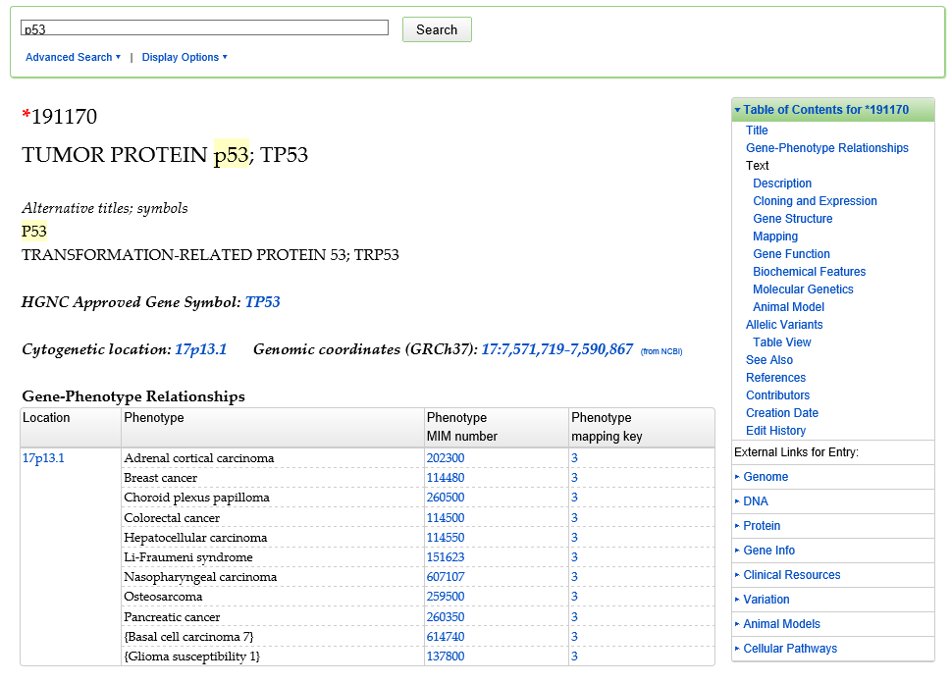

Slide 23
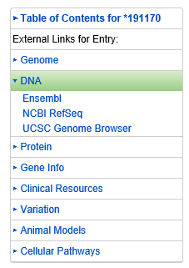
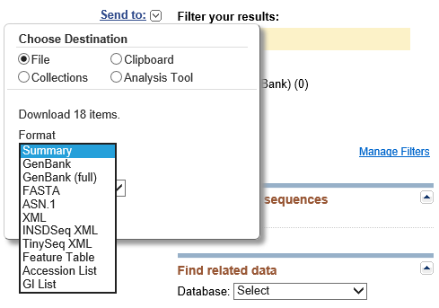
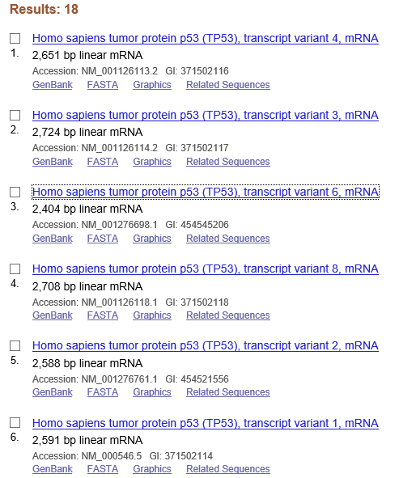
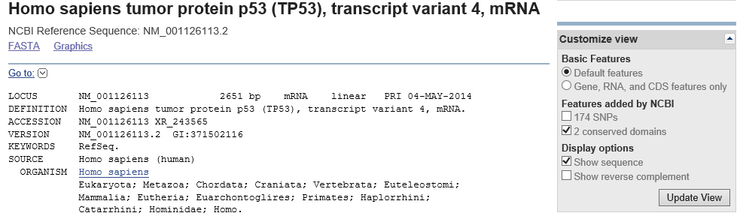

Slide 24
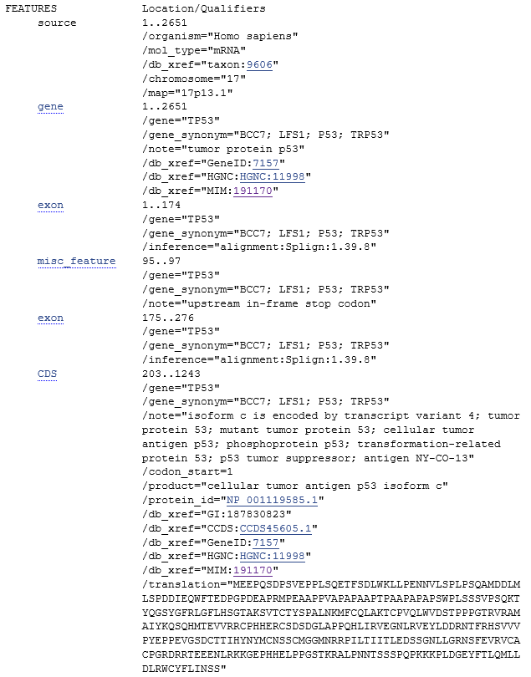
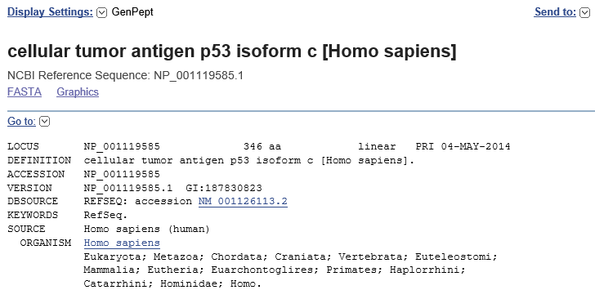

Slide 25
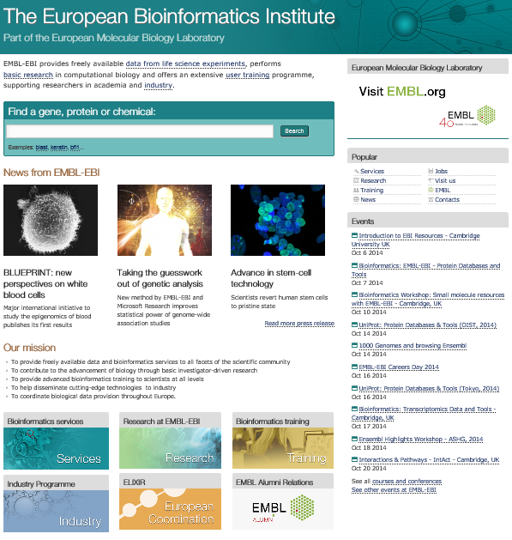
http://www.ebi.ac.uk/

Slide 26
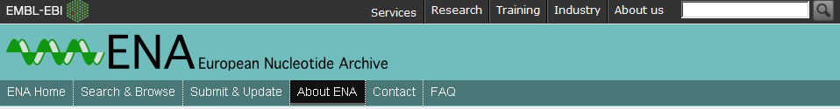
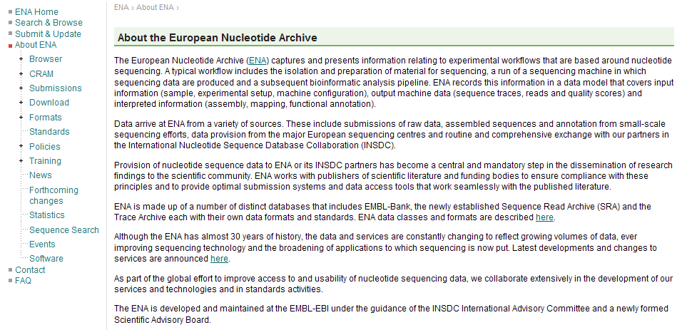

Slide 27


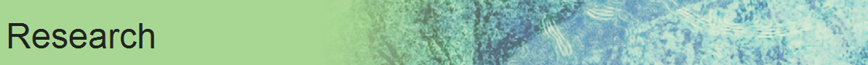


http://www.ebi.ac.uk/
EMBL-EBI provides freely available data from life science experiments, performs basic research in computational biology and offers an extensive user training programme, supporting researchers in academia and industry.

Slide 28
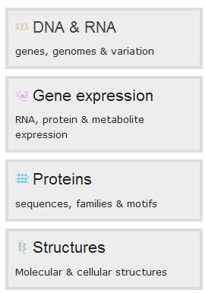
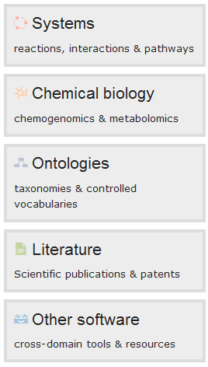

Slide 29
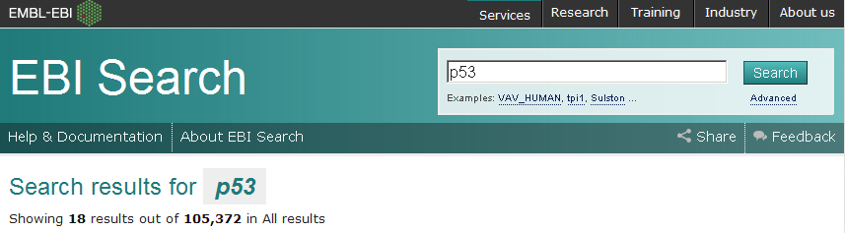
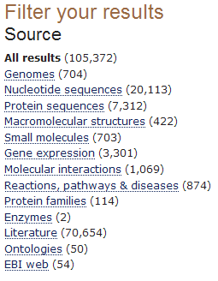
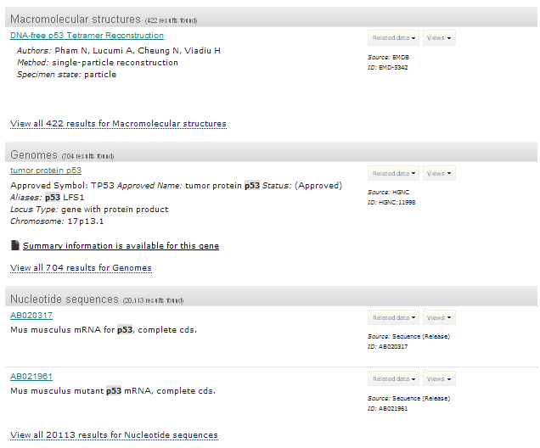

Slide 30
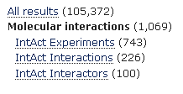
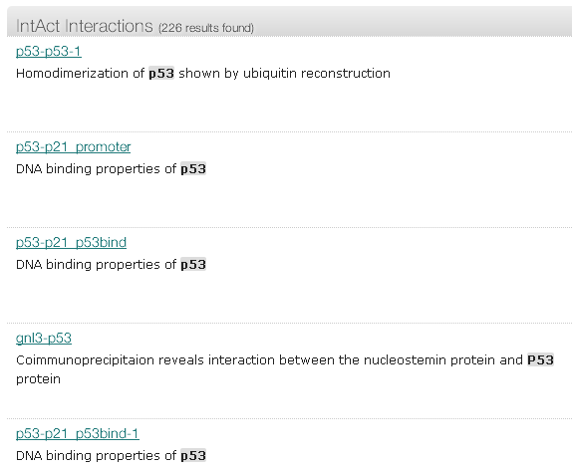

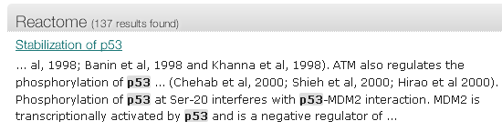

Slide 31
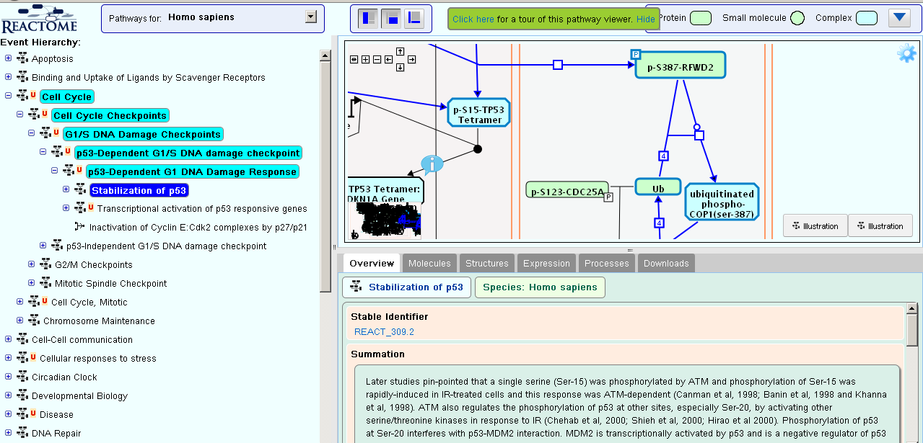
http://www.ebi.ac.uk/intact/pages/interactions/interactions.xhtml?query=EBI-1799550&filter=ac

Slide 32

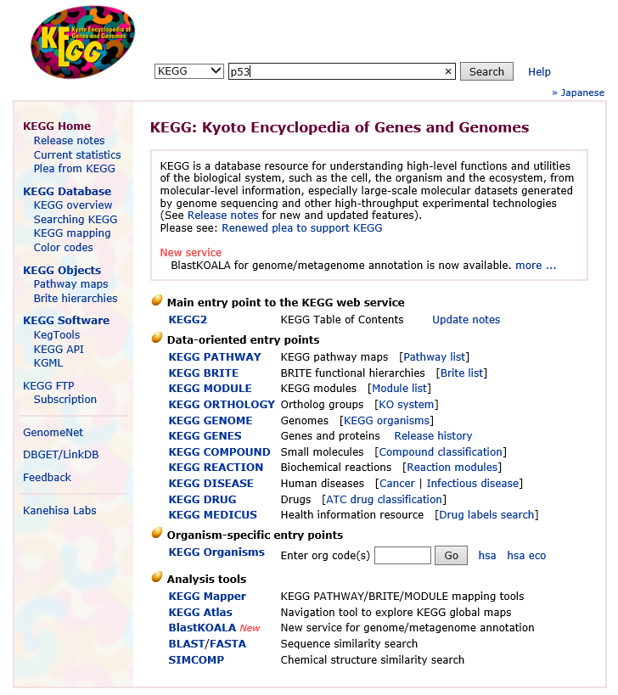
Metabolic & Signalling Pathways
Kyoto Encyclopedia of Genes &Genomes
http://www.genome.ad.jp/kegg/

Slide 33
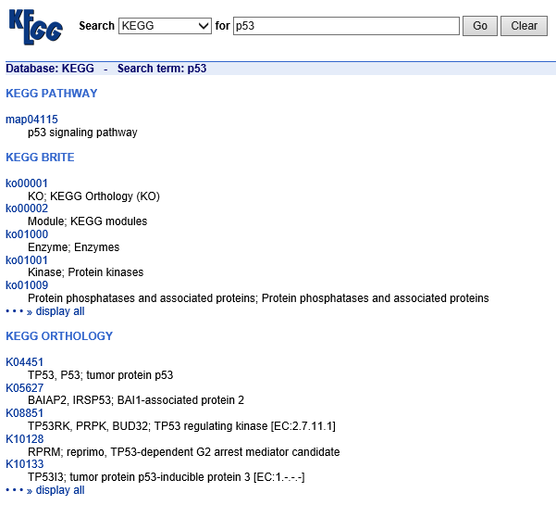
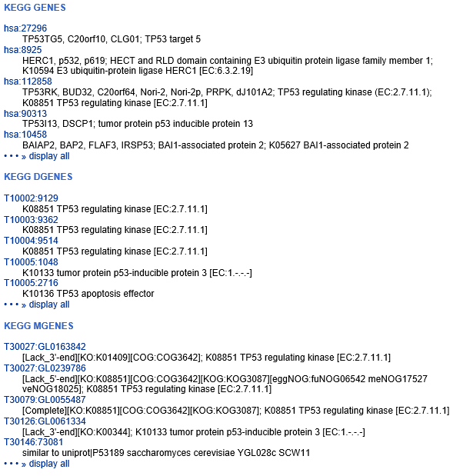

Slide 34
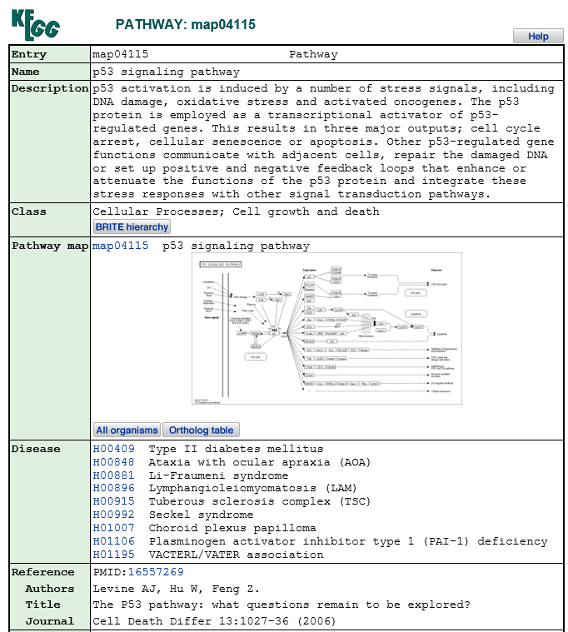
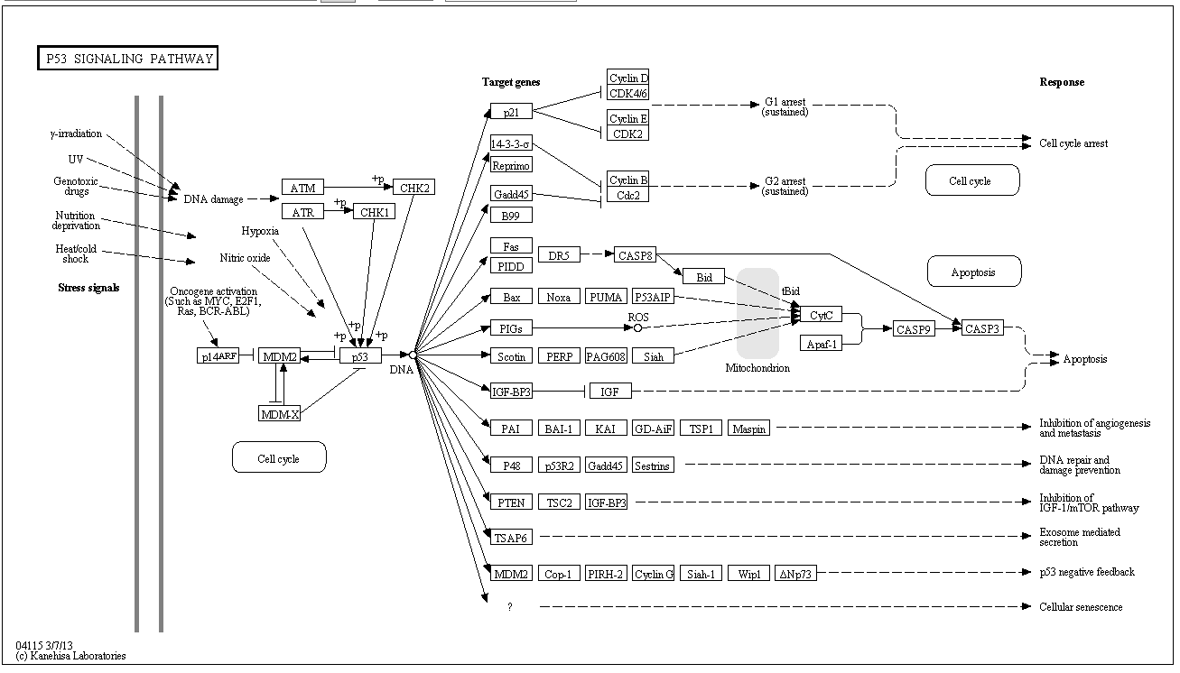
http://www.genome.jp/kegg-bin/show_pathway?map04115

Slide 35
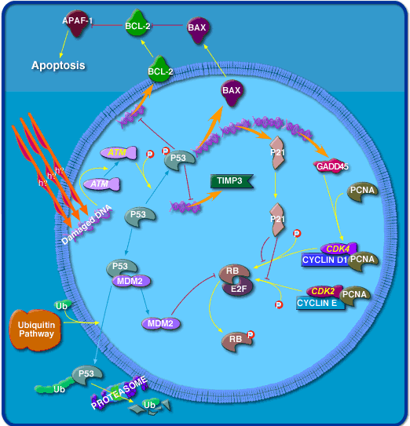

Metabolic & Signalling Pathways
Biocarta
( http://biocarta.com)

Slide 36
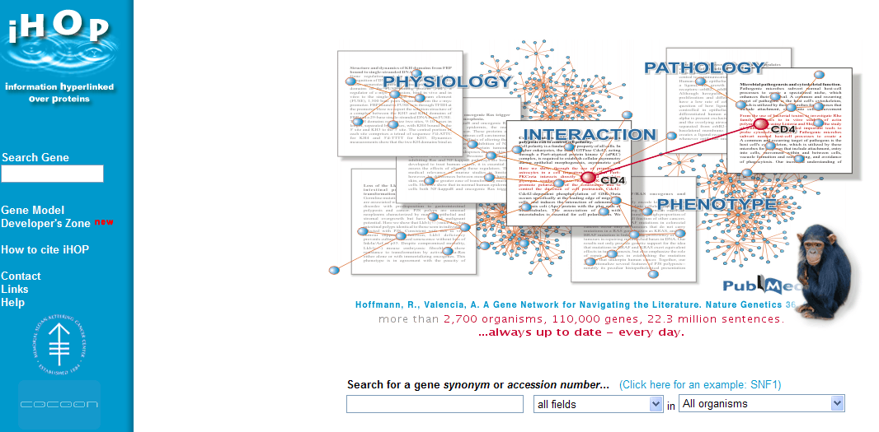
http://www.ihop-net.org/UniPub/iHOP/

Slide 37
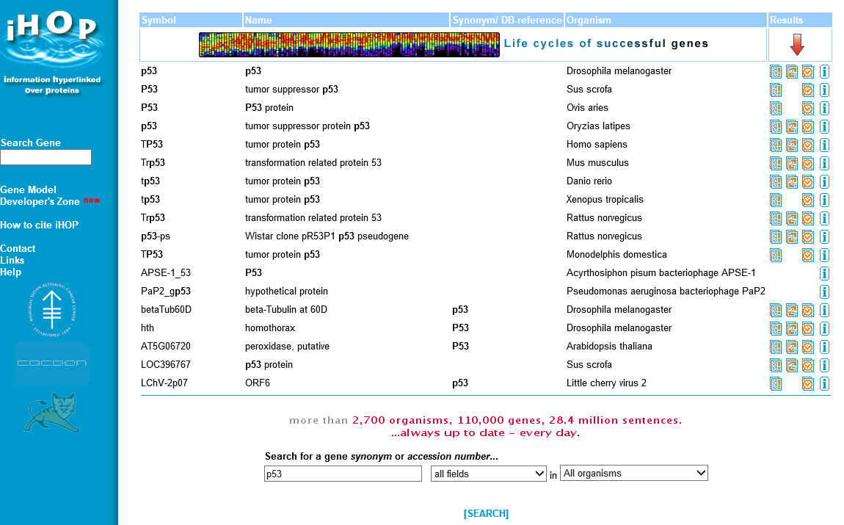

Slide 38
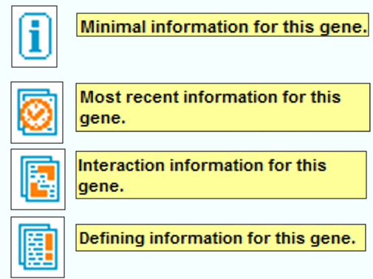
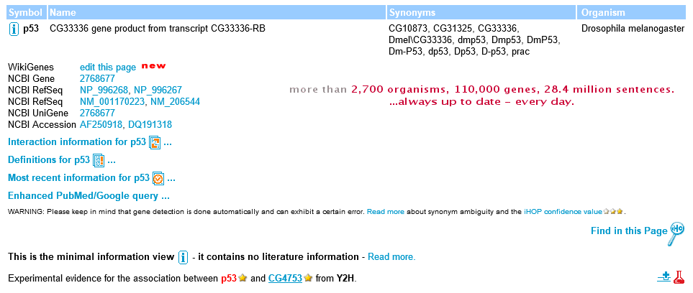
Minimal information for this gene
Most recent information for this gene
Interaction information for this gene
Defining information for this gene

Slide 39

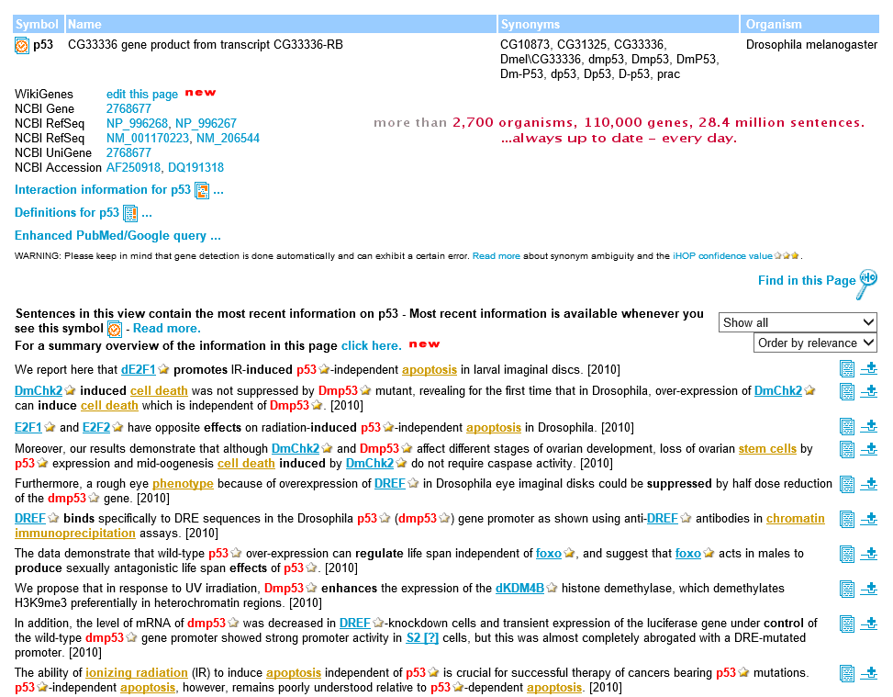

Slide 40



January each year

Slide 41

Softwares & Sequence Formats
Formats
Default Accept
Program
Multiple sequence
WWW
SeqWEB
GCG
VectorNTI
CLC Genomics
text file paste & Copy
text file paste & copy
GCG file FASTA Multiple sequence file (msf) GenBANK Rich sequence file (rsf)
EMBL List files (lst)
Staden
SwissProt

Slide 42
Retrieve Sequences in GCG
Fetch
Copies GCG sequences or data files from the GCG database
Into your directory or displays them on your terminal screen.
Syntax: % fetch [-Infile=]database:acession number
Example: fetch gb:l10131
SeqEd
An interactive editor for entering and modifying sequences and for assembling parts of existing sequences into new genetic constructs

Slide 43
Importing and Exporting
You need a FTP program to transfer files between your PC and GCG.
The sequence file must be in “plain text” format.
chopup: converts a non-GCG format sequence file containing lines longer than 511 characters and as long as 32,000 characterters into a new file containing no longer than 50 characters.
breakup: reads a non-GCG format sequence file containing more than 350,000 sequence characterters and writes it as a set of separate, shorter, overlapping sequence files than can be analyzed by GCG.
reformat: rewrites sequence files, scoring matrix files, or enzyme data files so than they can be read by GCG programs.
fromfasta: reformats one or more sequences from FastA format into single sequence files in GCG format.

Slide 44
Exercise 03-1
Transfer sequence files from your PC to GCG
Chopup the sequence
Reformat the sequence
Edit the sequence
Create a folder “BIO” in your hard disk
Start WsFTP (ftp://bioinfo.nhri.org.tw)
Upload “naq.txt” & “psq.txt” to GCG
Start Netterm
Start GCG
Chopup “naq.txt” & “psq.txt”
Reformat “naq.dat” or “psq.dat”
Cat “naq.txt” or “psq.txt”

Slide 45
Exercise 03-3
Sequence Manipulation in GCG UNIX
Use the database searching techniques you learned today to retrieve the reference sequence
Homo sapiens LEGUMAIN
and the amino acid sequence of
ALL LEGUMAIN
From NCBI and EMBL
And then transfer the sequence(s) to
1. SeqWEB and
2. GCG Unix (in GCG format)
There are many different ways to DO it.
You can have your lunch now if you can make it.

Slide 46
ASSIGNMENT 1.
Use the Entrez searching techniques you learned today to retrieve the
Reference sequence and
the corresponding amino acid sequences of
All the subclasses of Homo sapiens cyclophilin
Transfer the sequences to GCG Unix,
Transform the sequences to GCG format
E-mail
1. The steps (including URL of WWW sites) you used and
2. The sequences in GCG format as attached file to
petang@mail.cgu.edu.tw before next Thursday 1200
****郵件主旨： ASS1 bioinfo – (學號)

