Slide 1
BIOINFORMATICS
Lecture 3
Sequence Retrieving, Manipulation
and Management

Slide 2
A Sequence Retrieving and
Manipulation Network
Databases
DNA Protein
NCBI-GenBANK PIR
DDBJ SWISSPROT
EBI-EMBL EXPASY, PDB
Retrival
System
Softwares
GCG
SeqWEB
Vector NTI
GenoMAX
Entrez
SRS
GenBANK
GCG
FASTA
Staden
Image
Formats
Information
Sequence
Converter
Sequnece, Pdb, Image

Slide 3
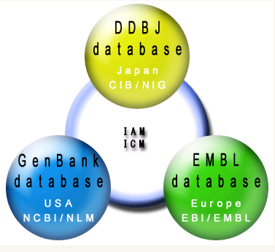
GenBank/EMBL/DDBJ
International
Nucleotide Sequence Database
DDBJ: DNA Data Bank of Japan
CIB: Center for Information Biology and
DNA Data Bank of Japan
NIG: National Institute of Genetics
IAM: International Advisory Meeting
ICM: International Collaborative Meeting
EMBL:
European Molecular Biology
Laboratory
EBI:
European Bioinformatics
Institute
NCBI:
National Center for Biotechnology Information
NLM:
National Library of Medicine

Slide 4
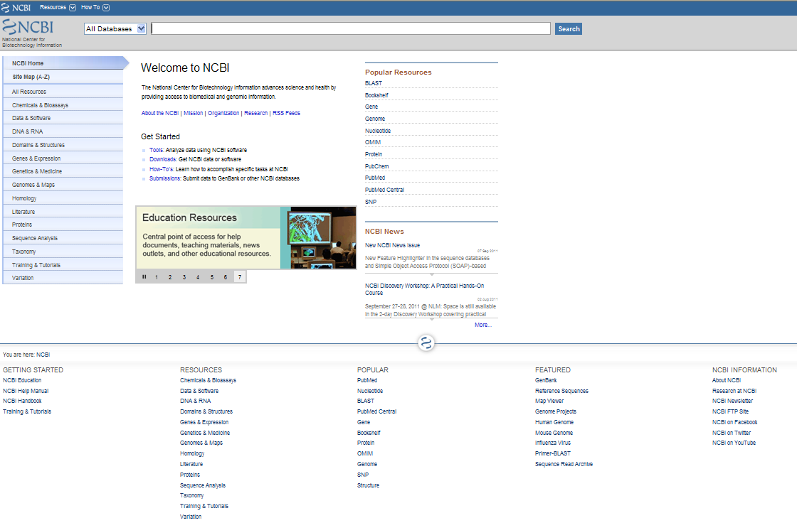
http://www.ncbi.nlm.nih.gov/

Slide 5


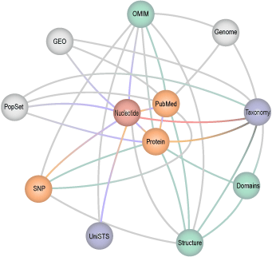
http://www.ncbi.nlm.nih.gov/Entrez/
Entrez is the text-based search and retrieval system used at NCBI for the major databases, including PubMed, Nucleotide and Protein Sequences, Protein Structures, Complete Genomes, Taxonomy, and others.
PubMed: The biomedical literature (PubMed)
Nucleotide sequence database (Genbank)
Protein sequence database
Structure: three-dimensional macromolecular structures
Genome: complete genome assemblies
PopSet: population study data sets
OMIM: Online Mendelian Inheritance in Man
Taxonomy: organisms in GenBank
Books: online books
ProbeSet: gene expression and microarray datasets
3D Domains: domains from Entrez Structure
UniSTS: markers and mapping data
SNP: single nucleotide polymorphisms
CDD: conserved domains
Database Interlinking

Slide 6
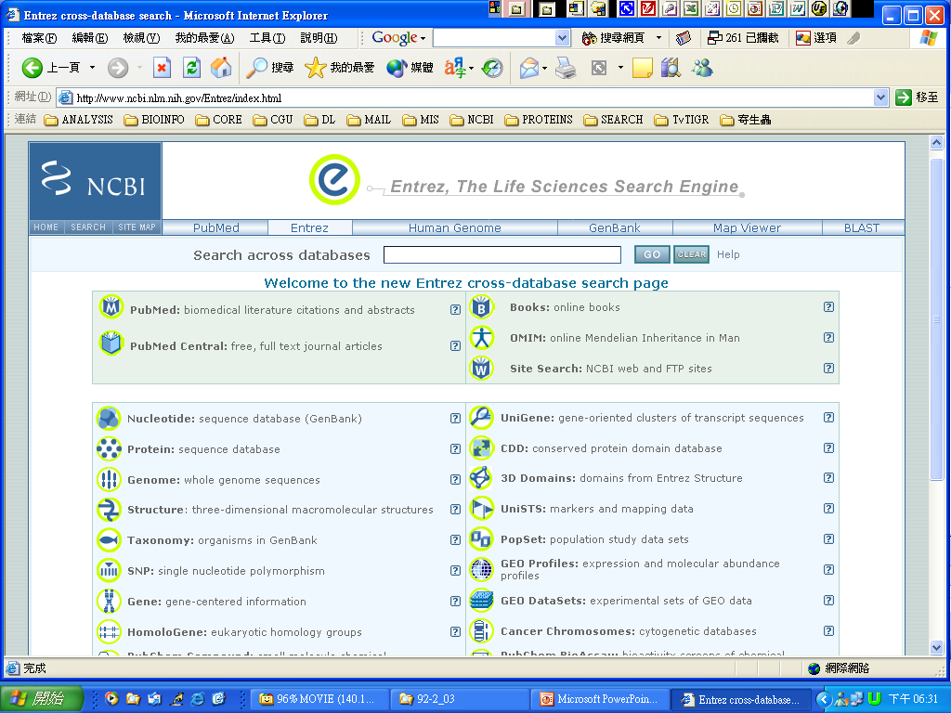
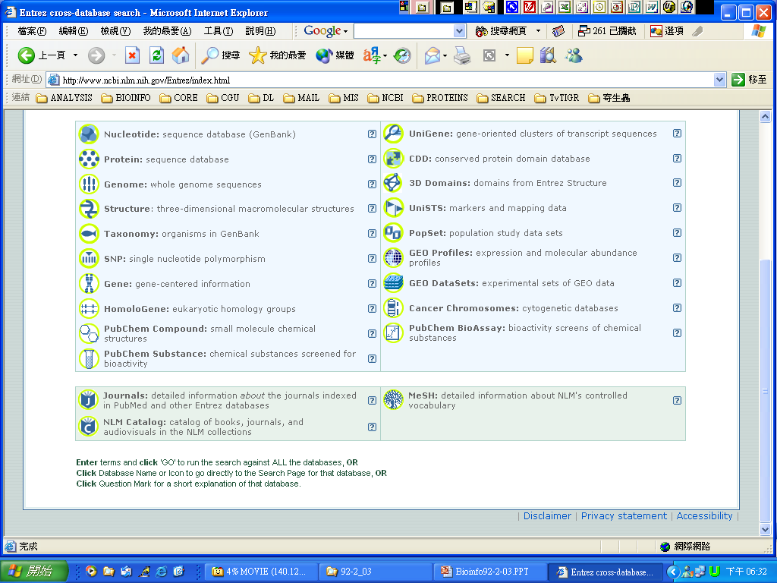
http://www.ncbi.nlm.nih.gov/Entrez/index.html

Slide 7
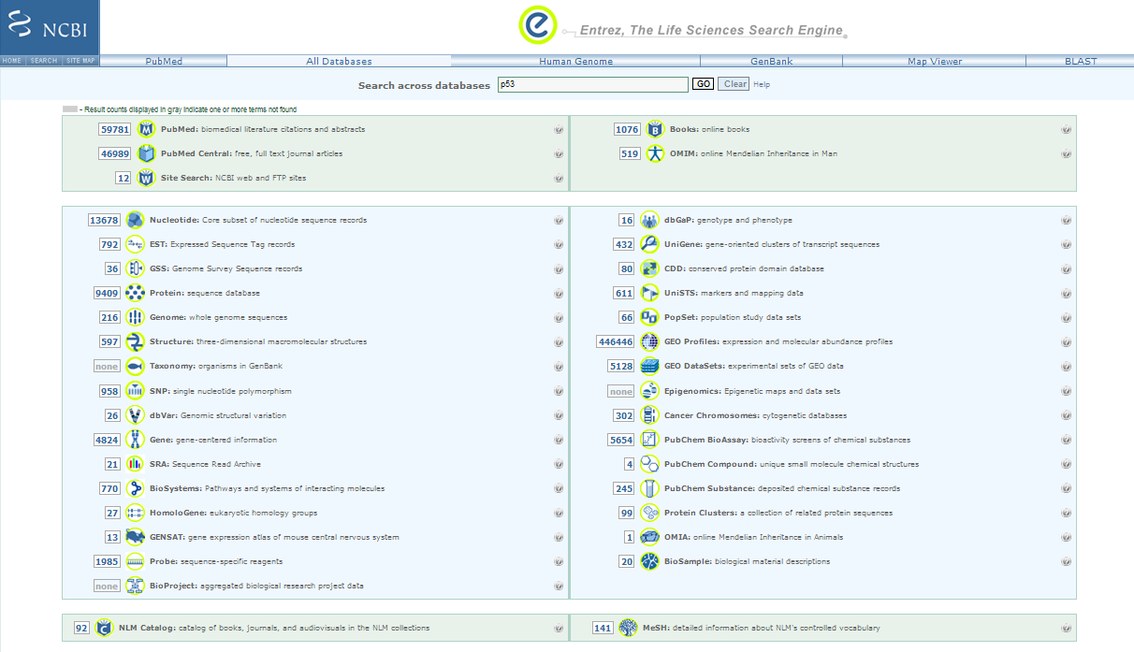
http://www.ncbi.nlm.nih.gov/sites/gquery

Slide 8
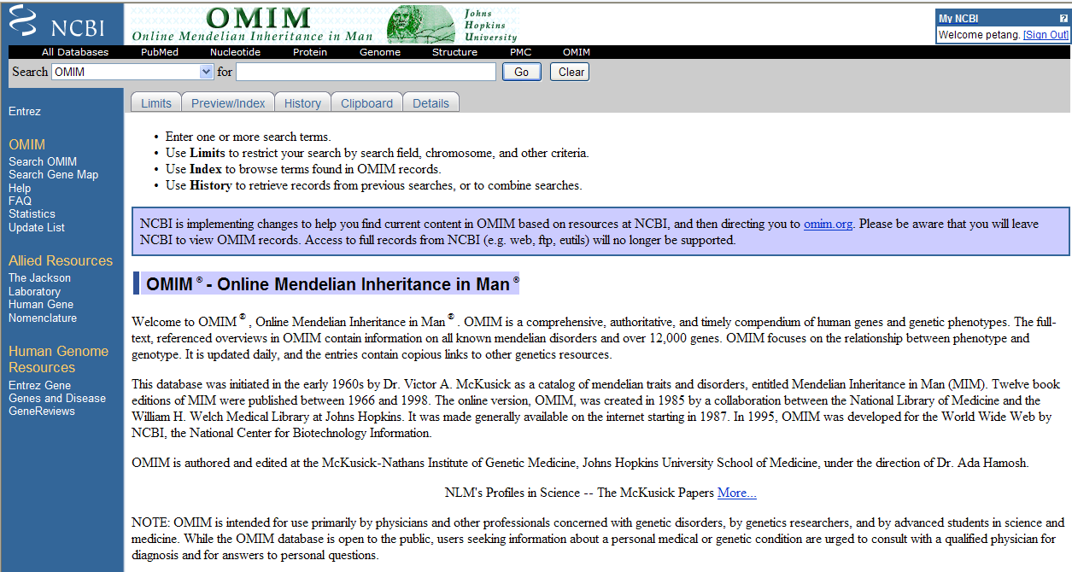

Slide 9
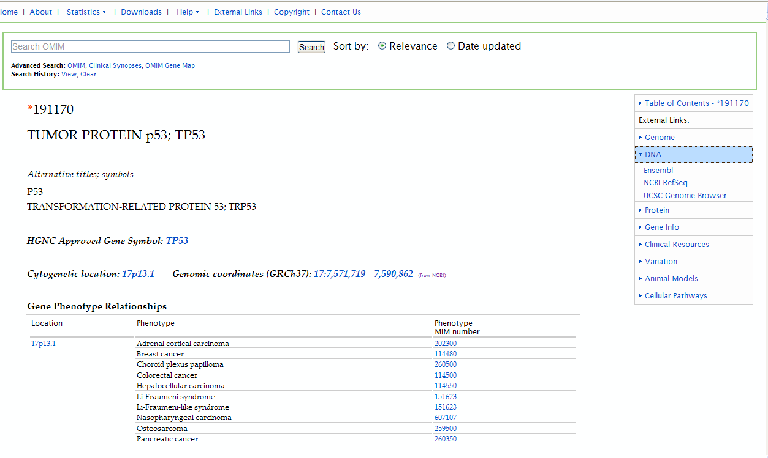

Slide 10
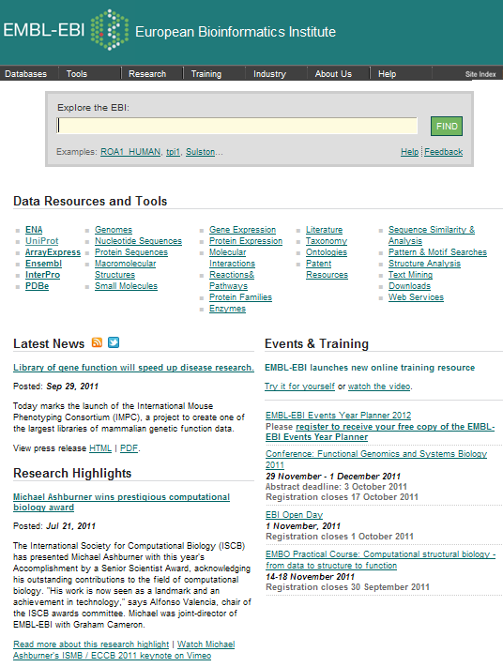
http://www.ebi.ac.uk/

Slide 11
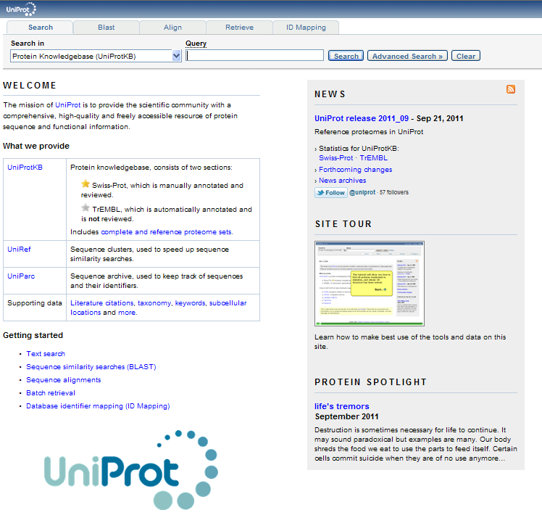
http://www.uniprot.org/

Slide 12
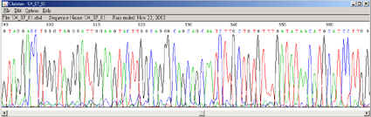
Softwares & Sequence Formats
Formats
Default Accept
Program
Multiple sequence
WWW
SeqWEB
GCG
VectorNTI
CLC Genomics
text file paste & Copy
text file paste & copy
GCG file FASTA Multiple sequence file (msf) GenBANK Rich sequence file (rsf)
EMBL List files (lst)
Staden
SwissProt

Slide 13
Retrieve Sequences in GCG
Fetch
Copies GCG sequences or data files from the GCG database
Into your directory or displays them on your terminal screen.
Syntax: % fetch [-Infile=]database:acession number
Example: fetch gb:l10131
SeqEd
An interactive editor for entering and modifying sequences and for assembling parts of existing sequences into new genetic constructs

Slide 14
Importing and Exporting
You need a FTP program to transfer files between your PC and GCG.
The sequence file must be in “plain text” format.
chopup: converts a non-GCG format sequence file containing lines longer than 511 characters and as long as 32,000 characterters into a new file containing no longer than 50 characters.
breakup: reads a non-GCG format sequence file containing more than 350,000 sequence characterters and writes it as a set of separate, shorter, overlapping sequence files than can be analyzed by GCG.
reformat: rewrites sequence files, scoring matrix files, or enzyme data files so than they can be read by GCG programs.
fromfasta: reformats one or more sequences from FastA format into single sequence files in GCG format.

Slide 15
Exercise 03-1
Transfer sequence files from your PC to GCG
Chopup the sequence
Reformat the sequence
Edit the sequence
Create a folder “BIO” in your hard disk
Start WsFTP (ftp://bioinfo.nhri.org.tw)
Upload “naq.txt” & “psq.txt” to GCG
Start Netterm
Start GCG
Chopup “naq.txt” & “psq.txt”
Reformat “naq.dat” or “psq.dat”
Cat “naq.txt” or “psq.txt”

Slide 16
Exercise 03-3
Sequence Manipulation in GCG UNIX
Use the database searching techniques you learned today to retrieve the reference sequence
Homo sapiens LEGUMAIN
and the amino acid sequence of
ALL LEGUMAIN
From NCBI and EMBL
And then transfer the sequence(s) to
1. SeqWEB and
2. GCG Unix (in GCG format)
There are many different ways to DO it.
You can have your lunch now if you can make it.

Slide 17
ASSIGNMENT 1.
Use the Entrez searching techniques you learned today to retrieve the
Reference sequence and
the corresponding amino acid sequences of
All the subclasses of Homo sapiens cyclophilin
Transfer the sequences to GCG Unix,
Transform the sequences to GCG format
E-mail
1. The steps (including URL of WWW sites) you used and
2. The sequences in GCG format as attached file to
petang@mail.cgu.edu.tw before next Thursday 1200
****郵件主旨： ASS1 bioinfo – (學號)

