Slide 1

http://petang.cgu.edu.tw/bioinformatics/index.htm
Bioinformatics
Lecture 6 – Nucleic Acids
Sequence Analysis
Petrus Tang, Ph.D. (鄧致剛)
Graduate Institute of Basic Medical Sciences
and
Bioinformatics Center, Chang Gung University.
petang@mail.cgu.edu.tw
EXT: 5136
助教：
蔡智宇(分機5690)

Slide 2
The Organization of an Eukaryotic Gene
GENE
Promoter
Enhancer
Exon 1
Intron
Exon 2
Intron
Exon 3
Intron
Exon 4
Transcription
Poly(A) signal
mRNA transcript
5’
3’
5’-untranslated
region
Exon 1
Intron
Exon 2
Intron
Exon 3
Intron
Exon 4
3’-untranslated
region
Processing
Mataure mRNA
start
stop
(AAAAAA)n
5’
7-mG cap
3’
Exon 1
Exon 2
Exon 3
Exon 4

Slide 3
Gene identification involves
4 main stages
Find the putative coding region(s)
in the sequence
Open reading frame
Find non-coding features
of interest in the sequence
CpG islands
Tandemly and dispersed repeats
Promoter regions (TATA box, cap signal,
CCAAT-box)
Transcription factors, Poly-A sites
Determine the exon-intron organization
Branch point signal
CT(G,A)A(C,T)
5’ and 3’ splice sites:
AG/GUAAGU--------------PyPyPyPyPyPyPyPy-CAG/G
Identify the gene
motif, signal and pattern
Blast, FASTA
Functional studies

Slide 4







Function
Command
GCG
SeqWEB
Sequence manipulation
ORF Searching
Mapping (restriction sites)
Mapping
(transcription factors)
Reverse
Frames
Map
Translate
Map
(-minc)
(-maxc)
Mapsort
(-exclude)
(-digest)
Mapplot
Map tfsites
+
+
+
+
+
+
+
+
+
+
+
+
+
+
+
+
+
+
+
+
-
-
+
-

Slide 5
Select enzymes for MAP:
Type "*" to select all enzymes.
Type "**" to select all enzymes including isoschizomers.
Type individual names like "AluI" to select specific enzymes.
Type "?" to see this message and all available enzymes.
Type "??" to see the available enzymes AND their recognition sites.
Type "?A*" to see what enzymes start with "A."
Type "A*" to select all enzymes starting with "A."
Type parts of names like "Al*" to select all enzymes starting with "AL."
Type "~A*" to unselect all selected enzymes starting with "A."
Type "/*" to see what enzymes you have selected so far.
Type "#" to select no enzymes at all.
Press <Return> after each selection.
Press <Return> and nothing else to end your selections.
Spaces are allowed; upper and lower case are equivalent.

Slide 6
What to do next?
The predictions by these programs is just that: a prediction.
NEVER TRUST A COMPUTER!

Slide 7
Exercise 105-06-1
Programs used in this exercise:
(1) Sequence manipulation – reverse
(3) ORF Searching – frames , map , translate
(4) Mapping (restriction sites)
– map (-minc, -maxc), mapsort(-exclude, -digest),
mapplot, plasmidmap
(5) Mapping (transcription factor)
– map(tfsites).
Sequences used in this exercise:
fetch z18853 (C.elegans mRNA for capping protein alpha subunit.)
cds:10-858
fetch x03795 (Human mRNA for platelet derived growth factor A-chain, PDGF-A) cds:388-1020.

Slide 8

(1) Store fragment sequences;
(2) Recognize overlapping sequences and create aligned assemblies, called contigs;
(3) Display, edit and output the contigs for further analysis.
5
Contig 1
3
1
4
Contig 2
2
Consensus
Assemble overlapping fragment sequences from a sequencing project.

Slide 9
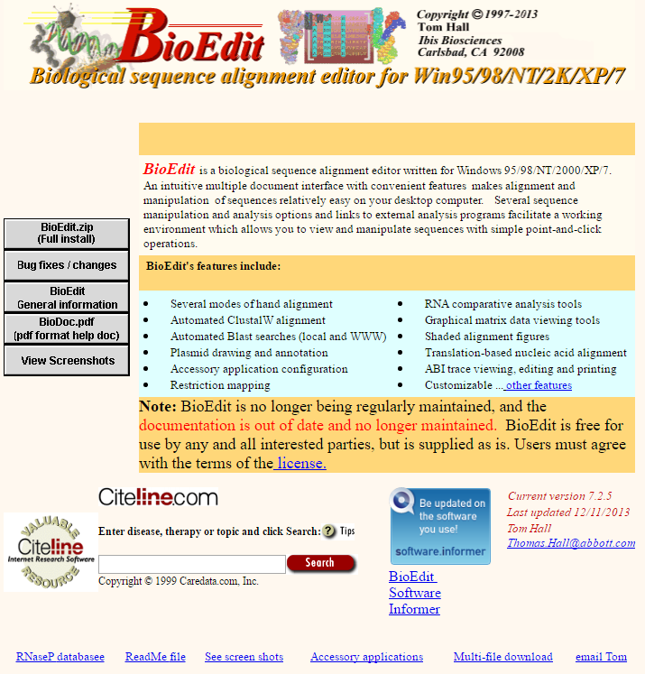
http://www.mbio.ncsu.edu/bioedit/bioedit.html

Slide 10
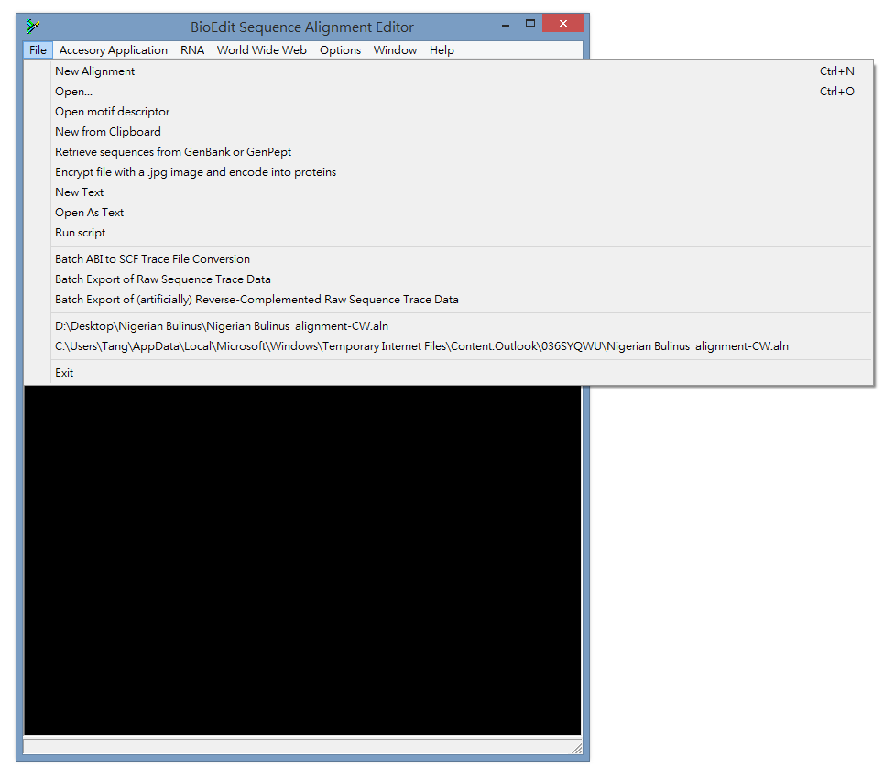

Slide 11
Exercise 105-06-2
Download EX105_6Seq.exe
Decompress the file
-> Seq01.txt - seq10.txt
Use BioEdit to assembly the sequences.
Q1: What is the correct order of the assembled sequence?
Transfer the assembled sequence to GCG
Q2: Identity putative protein coding region
Q3: Is there any potential regulatory elements upstream of the gene?
Q4: Export the amino acid sequence
Q5: What is the identity with the human homologues protein?

