Slide 1

http://petang.cgu.edu.tw/bioinformatics/index.htm
Bioinformatics
Lecture 8 –
Protein Sequence Analysis
Petrus Tang, Ph.D. (鄧致剛)
Graduate Institute of Basic Medical Sciences
and
Bioinformatics Center, Chang Gung University.
petang@mail.cgu.edu.tw
EXT: 5136
助教：
蔡智宇(分機5690)

Slide 2
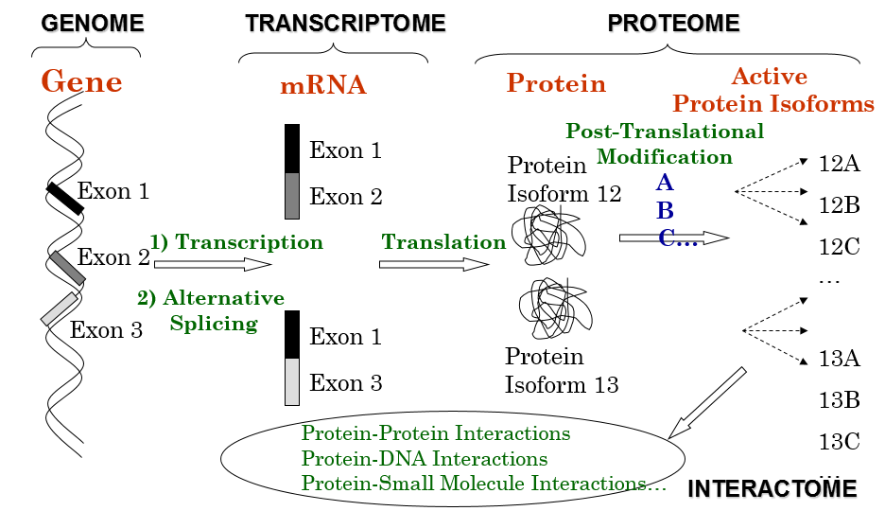
Why Proteomics: One-Gene-one-Protein?
25,000
100,000
1,000,000

Slide 3
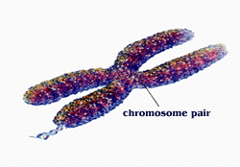
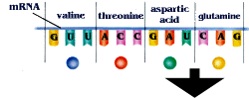
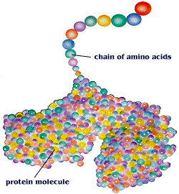
PROTEIN
DATABASES
PROTEIN
SEQUENCE
PROPERTIES
TOOLS
MOTIF/DOMAIN
FOLDING

Slide 4




Protein Sequence/Motif/Domain Databases
http://www.uniprot.org/
http://www.ncbi.nlm.nih.gov/Structure/cdd/wrpsb.cgi
http://www.ebi.ac.uk/Tools/pfa/iprscan/
Protein Analysis Tools
http://tw.expasy.org/

Slide 5
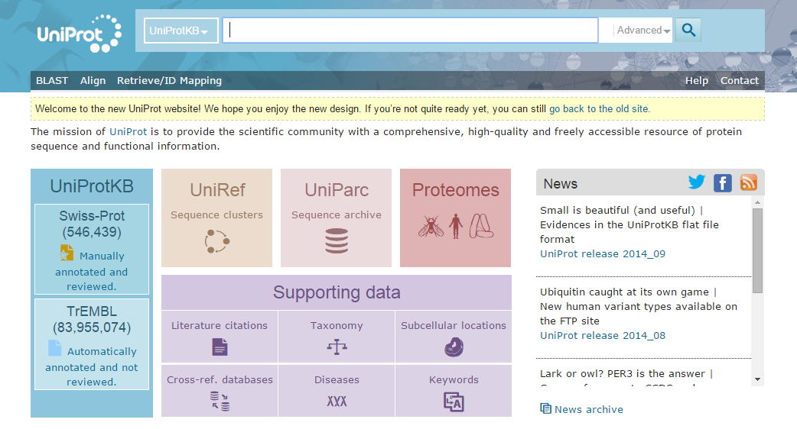
http://www.uniprot.org/

Slide 6
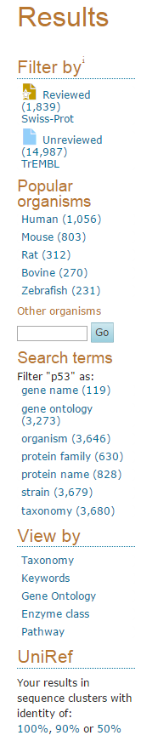
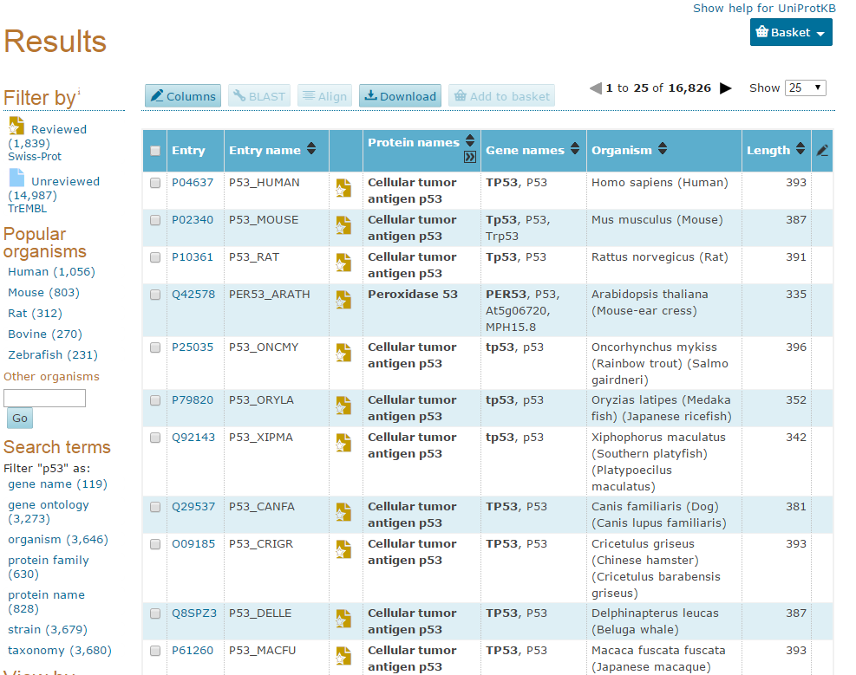
http://www.uniprot.org/uniprot/?query=p53&sort=score

Slide 7
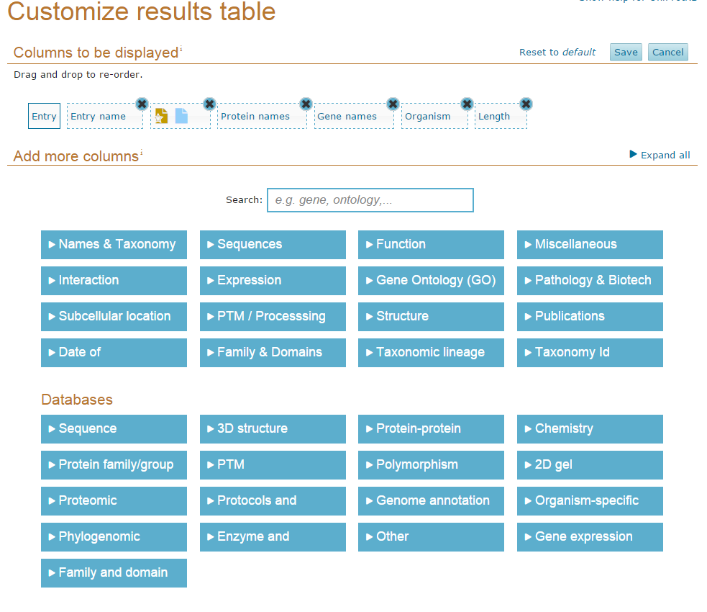

Slide 8
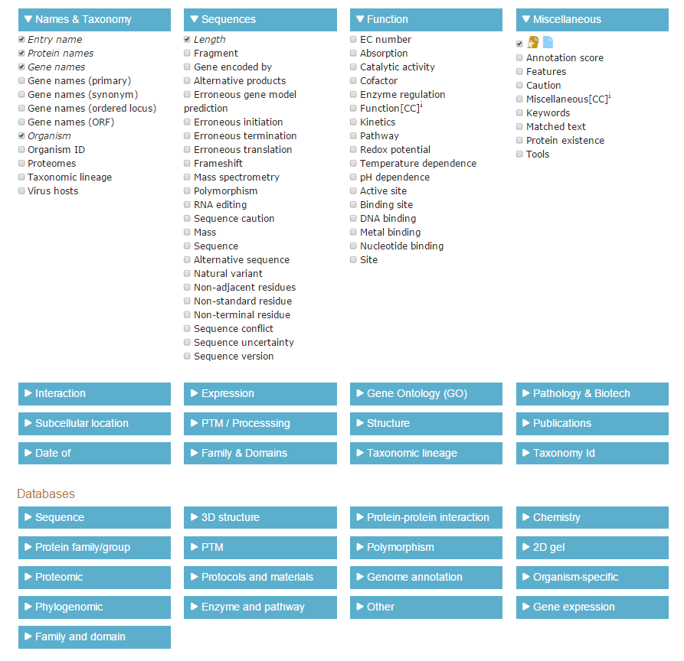

Slide 9
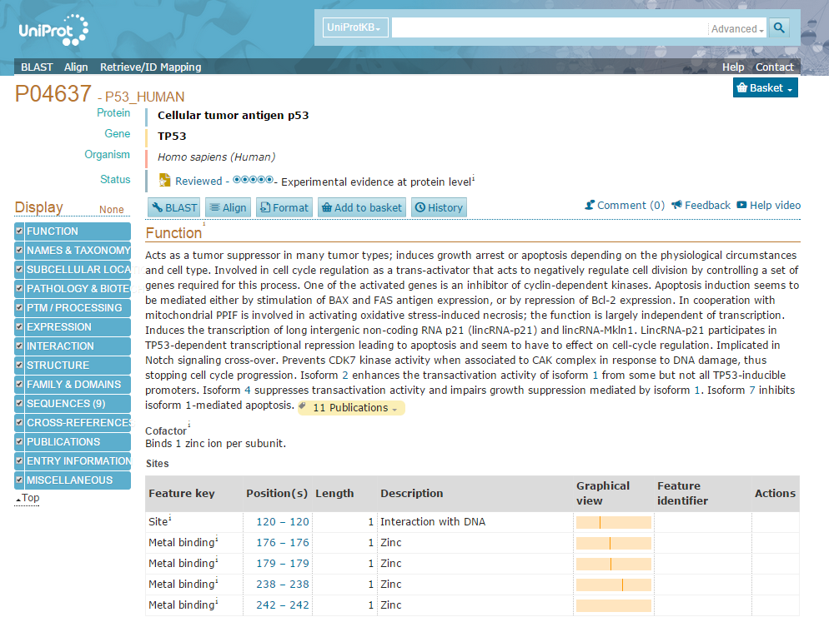

Slide 10
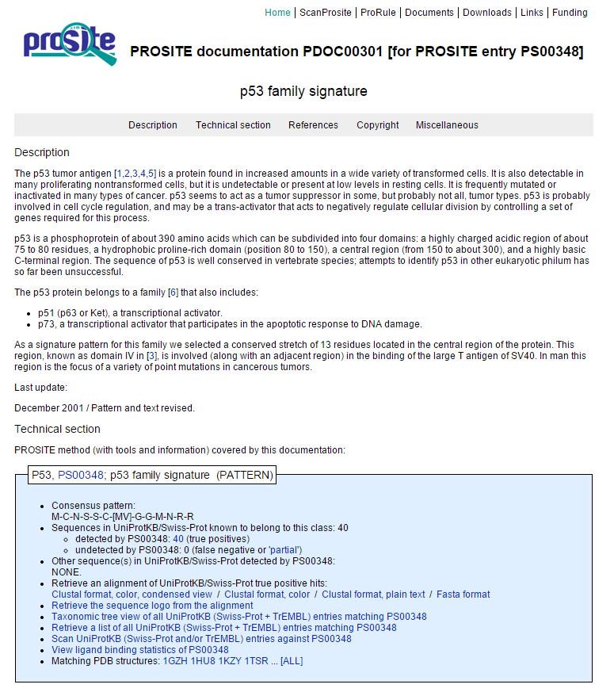

Slide 11
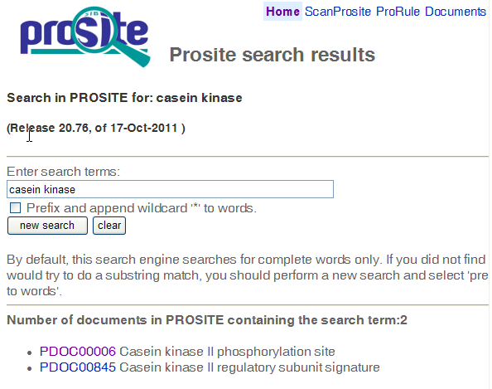

Slide 12
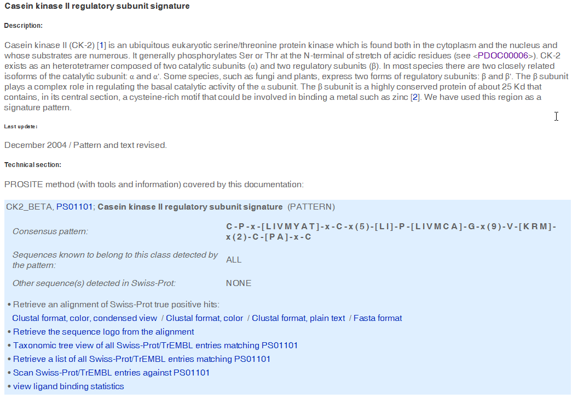

Slide 13
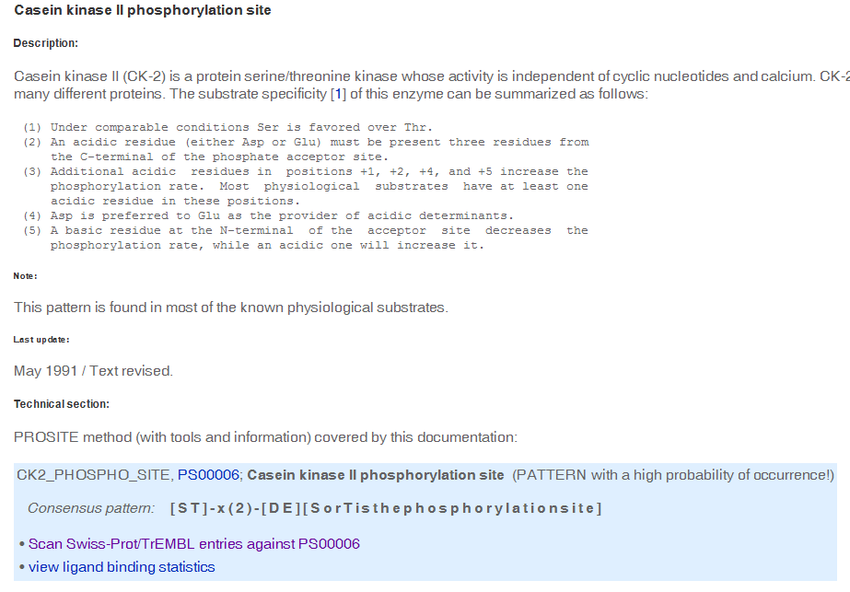

Slide 14

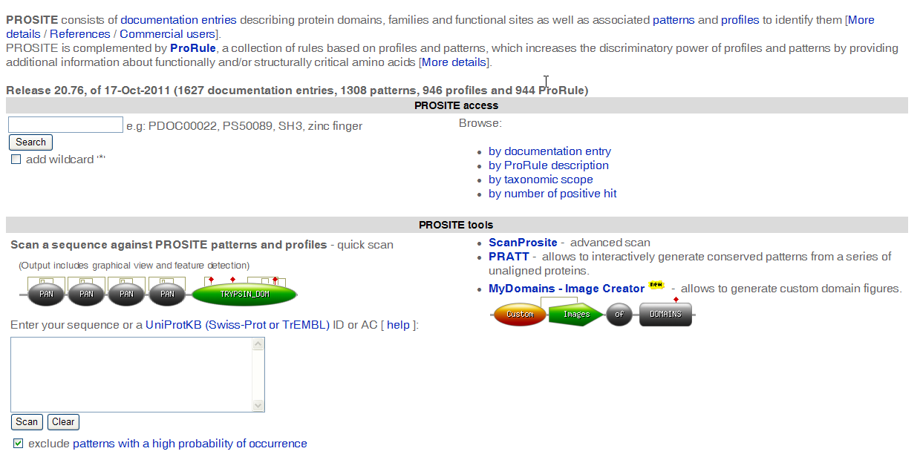
http://prosite.expasy.org/

Slide 15
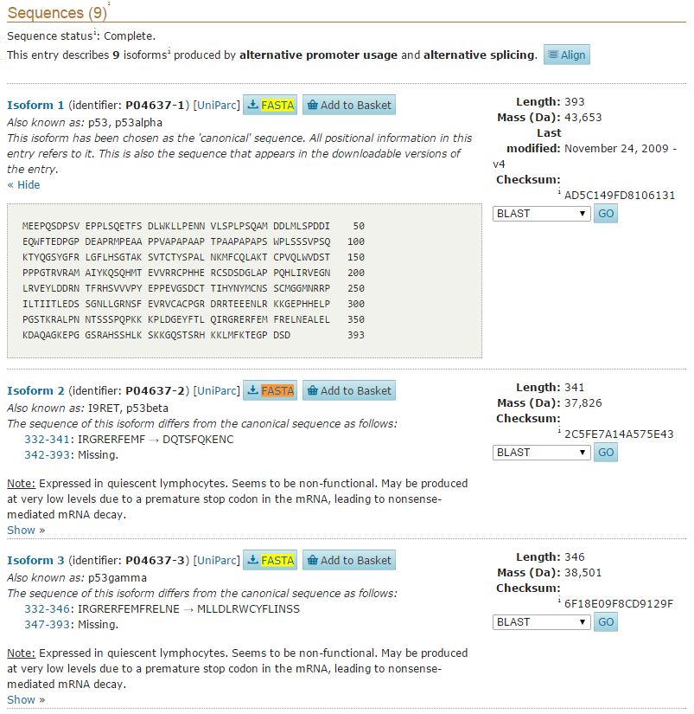
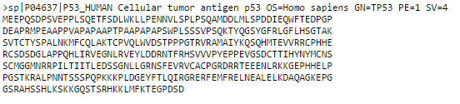
Copy this sequence to your computer

Slide 16
Example
cellular tumor antigen p53 isoform a [Homo sapiens]
>sp|P04637|P53_HUMAN Cellular tumor antigen p53 OS=Homo sapiens GN=TP53 PE=1 SV=4
MEEPQSDPSVEPPLSQETFSDLWKLLPENNVLSPLPSQAMDDLMLSPDDIEQWFTEDPGP
DEAPRMPEAAPPVAPAPAAPTPAAPAPAPSWPLSSSVPSQKTYQGSYGFRLGFLHSGTAK
SVTCTYSPALNKMFCQLAKTCPVQLWVDSTPPPGTRVRAMAIYKQSQHMTEVVRRCPHHE
RCSDSDGLAPPQHLIRVEGNLRVEYLDDRNTFRHSVVVPYEPPEVGSDCTTIHYNYMCNS
SCMGGMNRRPILTIITLEDSSGNLLGRNSFEVRVCACPGRDRRTEEENLRKKGEPHHELP
PGSTKRALPNNTSSSPQPKKKPLDGEYFTLQIRGRERFEMFRELNEALELKDAQAGKEPG
GSRAHSSHLKSKKGQSTSRHKKLMFKTEGPDSD

Slide 17
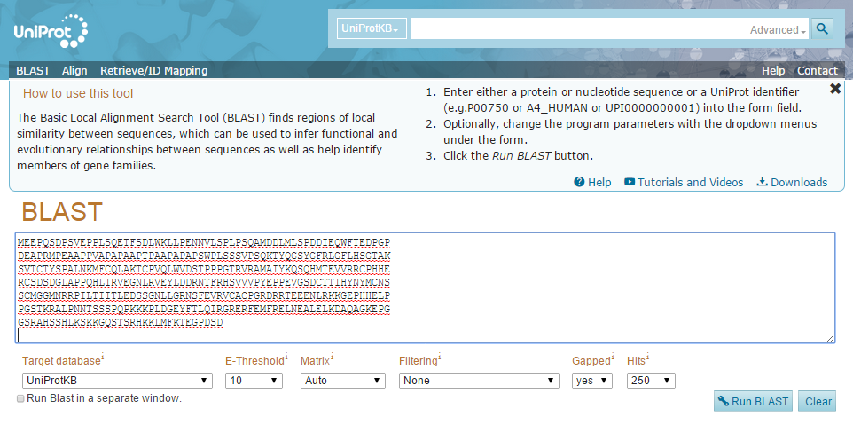
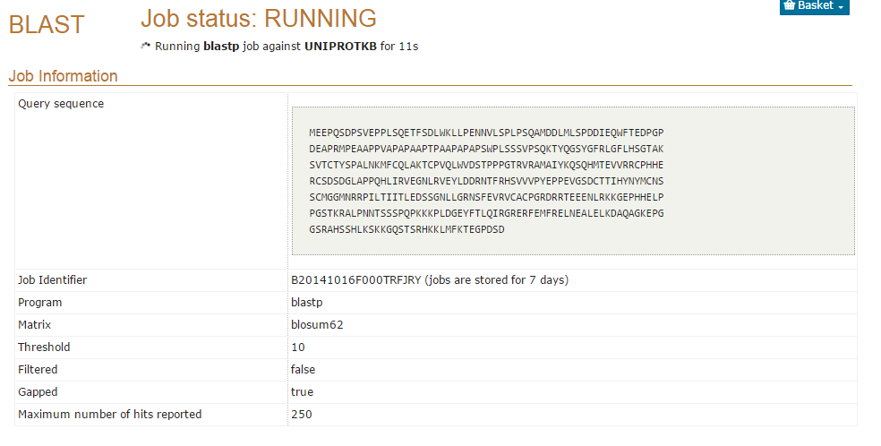

Slide 18
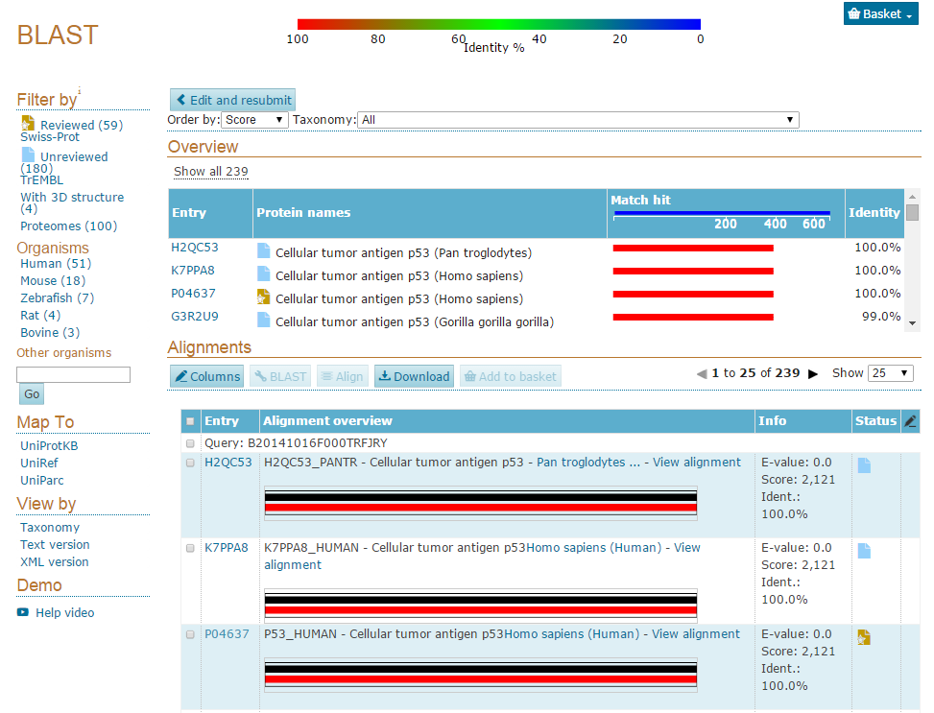

Slide 19

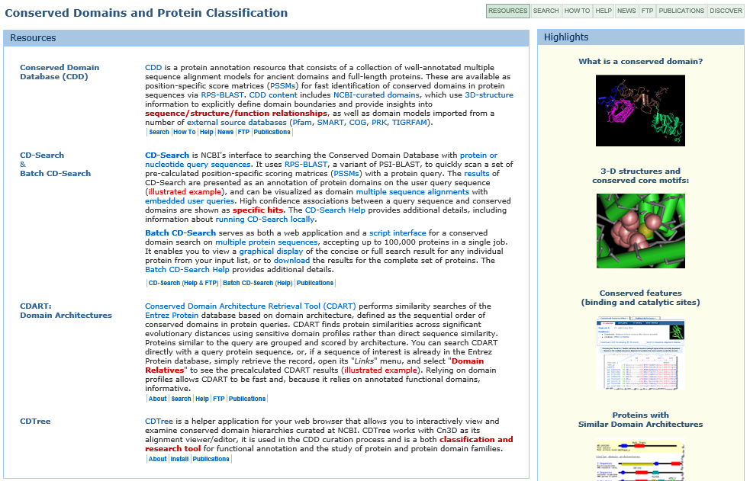
http://www.ncbi.nlm.nih.gov/Structure/cdd/cdd.shtml

Slide 20
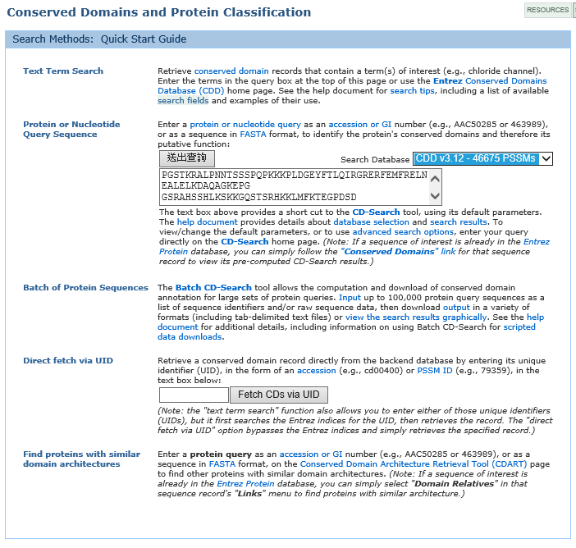

Slide 21
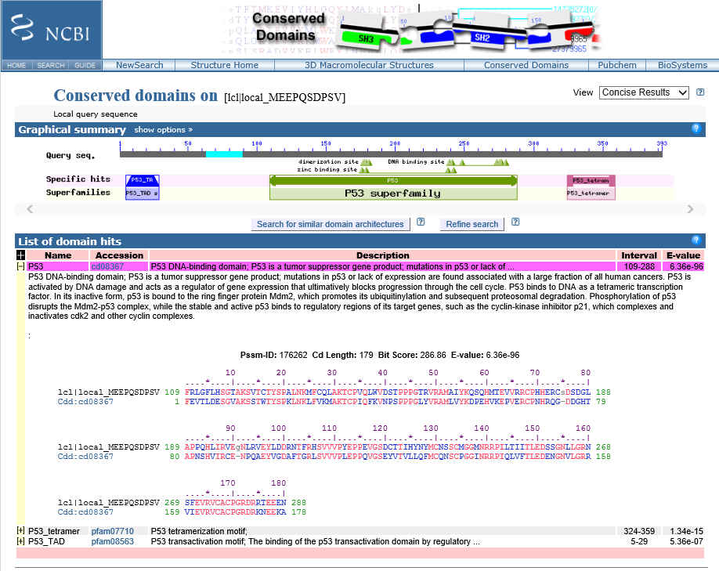

Slide 22
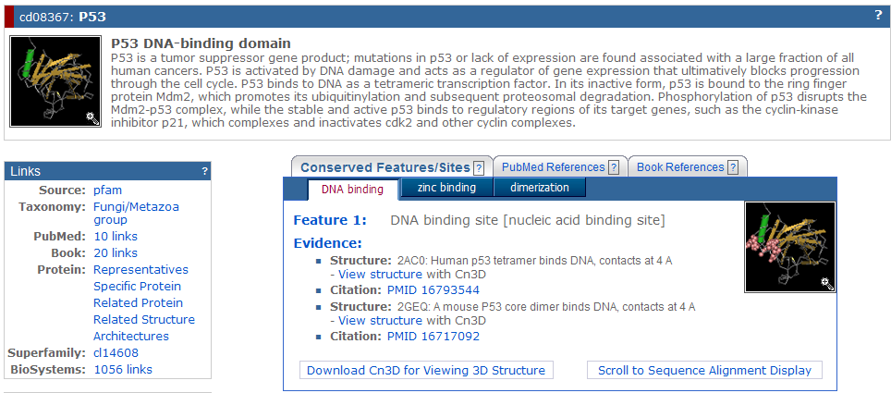

Slide 23
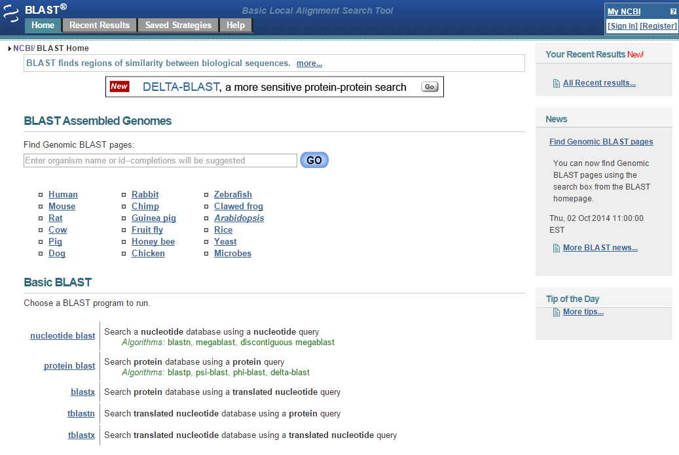

Slide 24
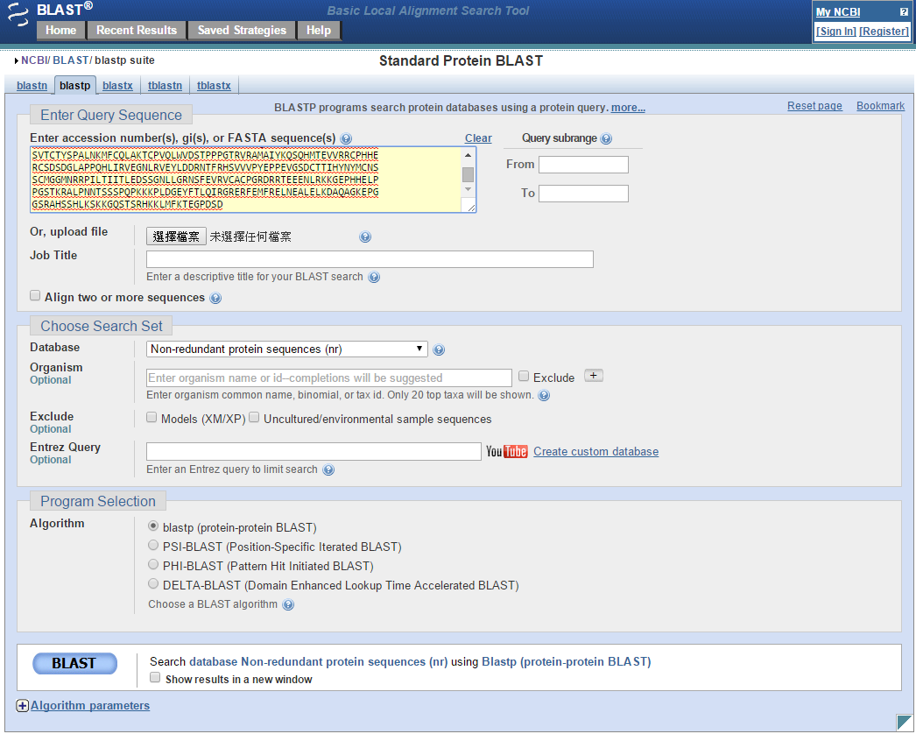
http://blast.ncbi.nlm.nih.gov/Blast.cgi

Slide 25
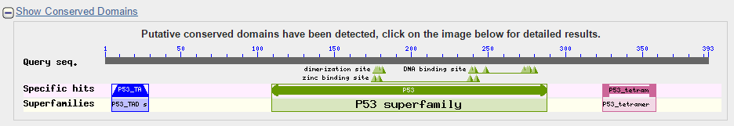
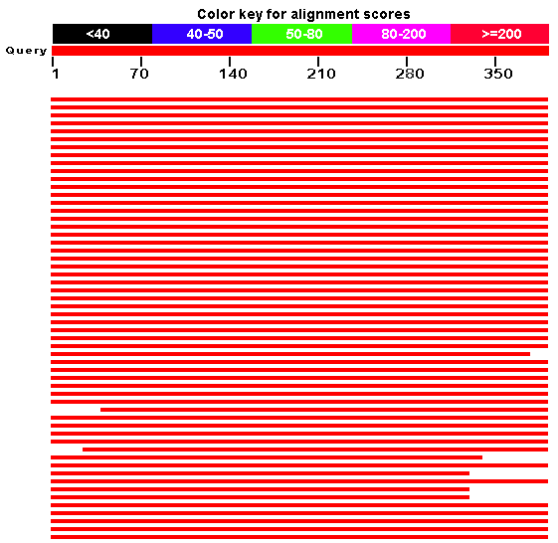
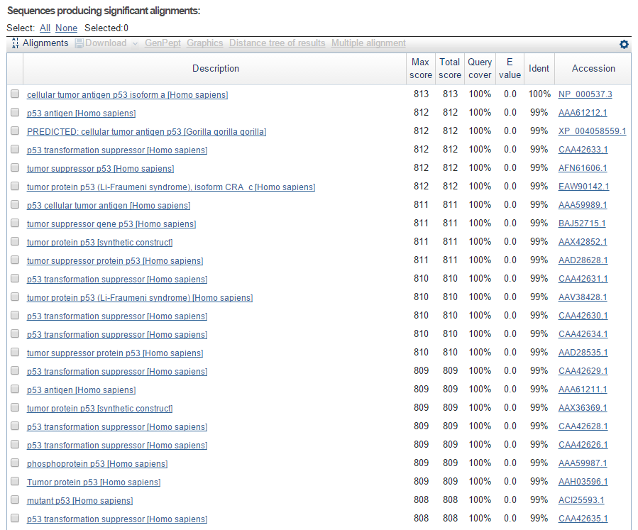
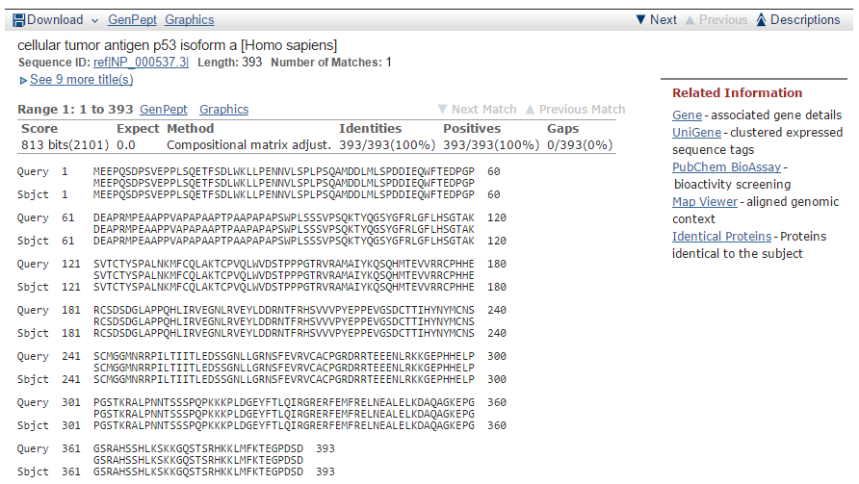

Slide 26
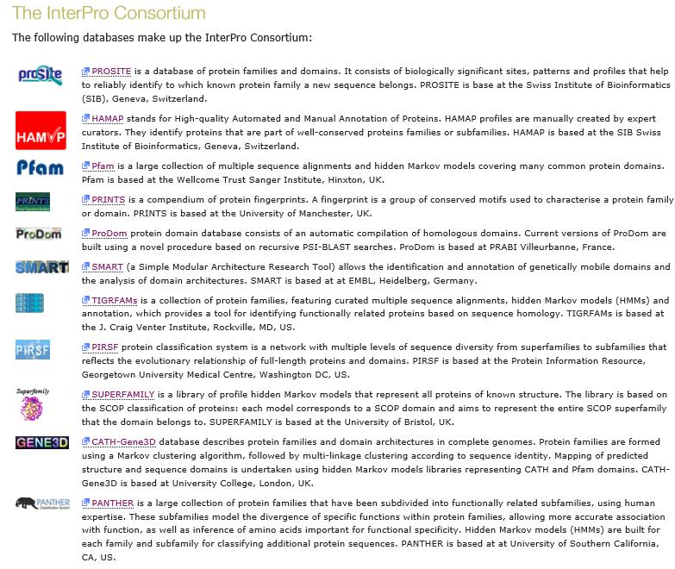
http://www.ebi.ac.uk/interpro/about.html

Slide 27
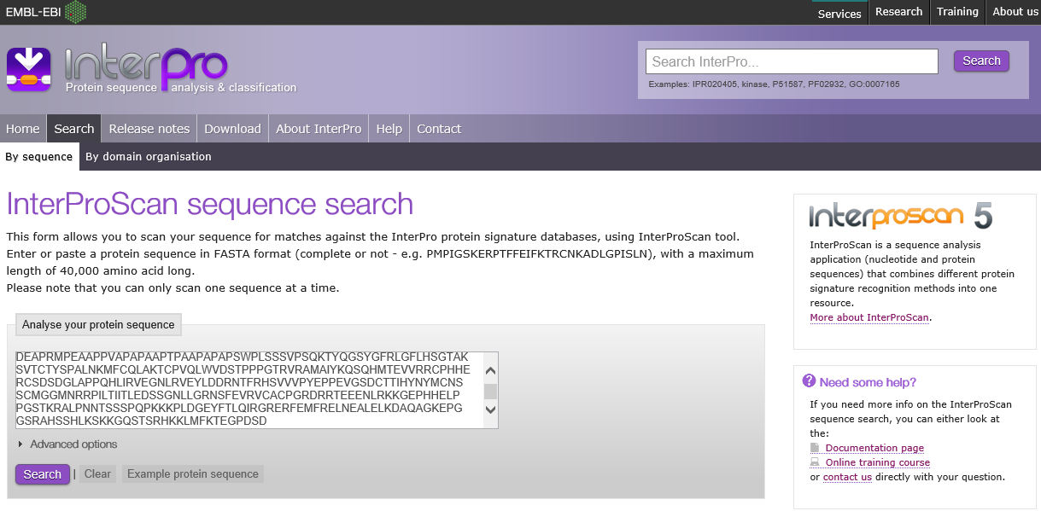
http://www.ebi.ac.uk/Tools/pfa/iprscan5/

Slide 28
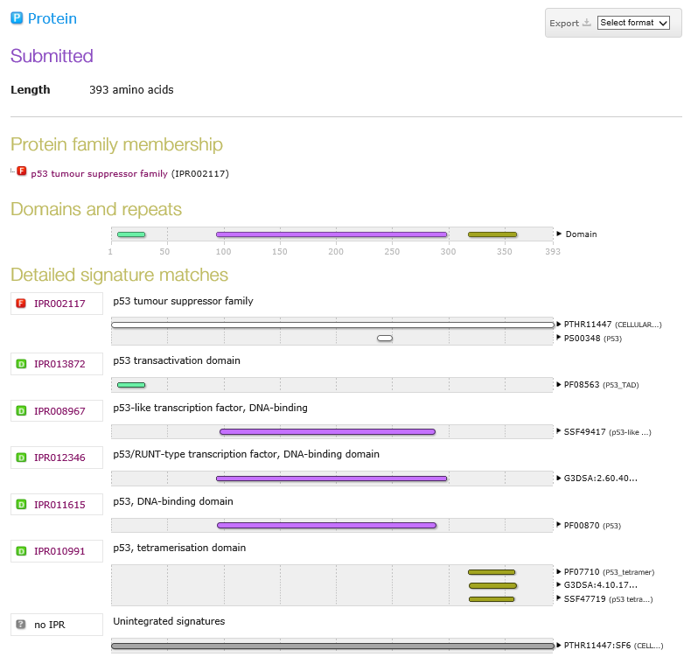

Slide 29
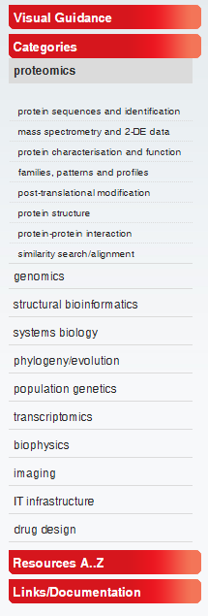
http://www.expasy.org/
Protein Sequence Analysis Tools
ExPASy Molecular Biology Server
Expert Protein Analysis System is the new SIB Bioinformatics Resource Portal which provides access to scientific databases and software tools in different areas of life sciences including proteomics, genomics, phylogeny, systems biology, population genetics, transcriptomics etc

Slide 30
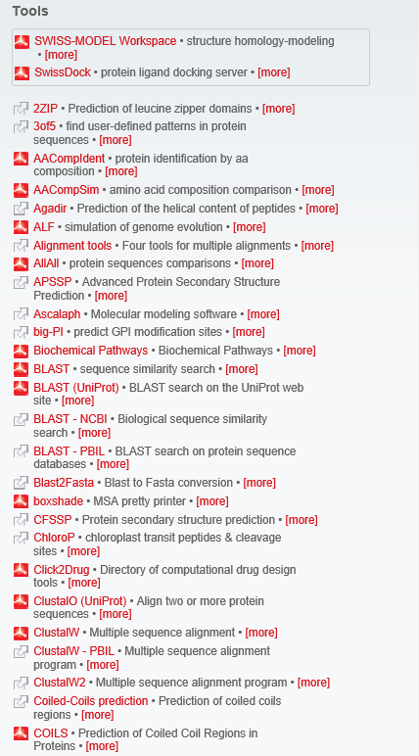
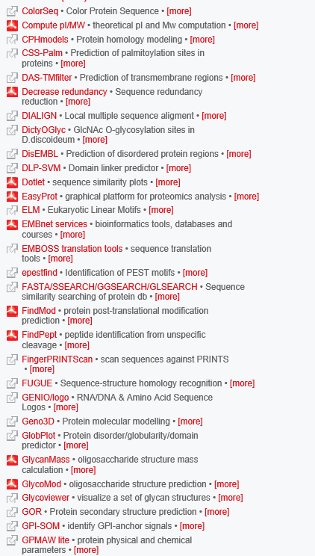
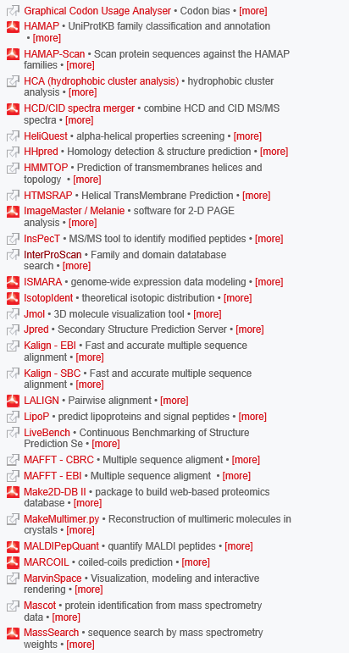

Slide 31
Practical: Gene; RNA; Protein
U62639 (Gene)
aaaaatgtat gtctgatttt gaaatgctca tttcctttga ggtttccatt tttgagttgc 61 ccgtaatttg tatttttctg aagatgagca attcaatttt taaattgccc gcacctctac 121 cgtttccatc gtgtattttg ttaaaatatt cacagattaa cccatttacc gtttcatcca 181 cctgtttttc ctcgaaaaga ttccaatgtt ctataattct acaaaacttc ccacgcgaga 241 aacaactgta ataaactgaa tatattatct atcgcatcgt tttcaaccag aattaagcaa 301 gaggttccac aactttaaac accaacaacg caatcctaaa tcatttgcaa gattttattt 361 cagatgctac actttctgcc tgaaaaaaat tctgaaaagc cgaacaataa ttcatggtaa 421 caatgaatgg cagatacatc aaagttttag atgaacaatt tttatgtatt aaatgtacat 481 ttaaaaacaa attgcacaac gattctacta ctgtcgcact aattttacgt atgtctgtac 541 ttgaagattt cgaattaatt tgttcaatat tgtgttaaaa tgtttgattt atacactcaa 601 atctttaaaa gatttattgg aaaagataaa tggttaattt aaaccaaaaa tttccatcaa 661 gccttttctg aaaacactaa aattattttc gtggtgggac caggcgcgcg cgtcccatga 721 tgttccttta atcaaaatgc atttctgtcc cggcgggaga aattgaattt tgattttaag 781 gcgcgaattt ttgcctaaaa acgatgccat tctttcattc ttttcataat ctcactcacc 841 atgagaacca tgcgccttgc ttggttgctc ccacttttta ttcacatact aatcaaggta 901 atttccccgt ttttctagtt ttttcaatgt attttcatgt ttcagaacac agctcaagct 961 ccggctgtca acaactcgac atgcgatcaa gcaaaggaat ttgattgcgg gaacgggaga 1021 ctccgatgca ttcccgcgga gtggcaatgc gacaacgtag cggactgcga caaaggaaga 1081 gacgaatcgg gctgctcata tgcgcatcat tgttcgacaa gcttcatgtt atgcaagaat 1141 ggactgtgtg tcgcaaatga gttcaaatgc gacggcgaag acgactgccg cgatggaagc 1201 gatgagcagc attgcgagta caatatcctg aagtctcgct tcgatggttc caatccttcg 1261 gctcctacca ctttcgttgg tcacaatggc ccagaatgcc atcctcctcg tttacgatgc 1321 cgatcaggac aatgtattca accagatctc gtttgtgatg gacatcagga ttgttctgga 1381 ggagatgatg aggtcaactg caccagaagg ggacatgaaa atatgcagtc ctcgactgat 1441 tttcacgatg atgttcatct tgtcgatcca acctttttcg ctaatgaaga caataaggta 1501 attgtttaat gtttattaat ccgttttaac ttttattttt cagtgtcgga gtggatacac 1561 aatgtgccat agcggagacg tctgcatacc tgacagtttt ctttgtgacg gcgatctaga 1621 ttgtgatgat gcttcggacg agaaaaactg ccaaactaat gctccaagcg aagaagaata 1681 tctttctggg caagccgatc acatgcattc gtgctcagca gcaggaatgt attcttgtgg 1741 aacaaaagga tccgaaattg gcgtttgtat tccgatgaat gccacgtgta atgggatcaa 1801 ggagtgtcca ctaggagatg acgagtcaaa acattgctcc gaatgtgcca gaaagcgatg 1861 tgaccacaca tgtatgaaca ctccacacgg ggctcgctgc atttgtcaag aaggatataa 1921 gcttgccgat gacggactca cttgcgagga tgaagatgag tgtgcaactc atgggcactt 1981 gtgccagcat ttctgtgaag atcgtttggg ttcctttgca tgcaaatgtg ccaacggtta 2041 tgagcttgaa acggatgggc attcttgtaa atacgaggca accactacgc cagaaggata 2101 tttgttcatc agtcttggtg gagaagttcg acagatgcca ttggcagatt tcaccgatgg 2161 ttcaaattac tcggcgattc aaaagtttgc tggccacgga accatcagat cgatcgactt 2221 catgcatcgc aacaacaaaa tgttcatgtc aatttctgat gagcacggtg atccaactgg 2281 cgaattgtca gtgtccgaca atggattgat gagagttctt cgagaaaatg tcattggagt 2341 gagcaacgtg gcagtcgact ggattggtgg aaacgttttc ttcacacaaa aatgtatgtt 2401 tatctaatgt ttaaattttt catttgtgat tcttacagct ccatctccaa gcgctgggat 2461 ttccatctgc acaatgagcg gaatgttctg tcgccgagtt atcgaaggca aagaacaagg 2521 acaatcctat cgtggtcttg ttgttcaccc gatgcgcggt ctcatcatct ggatcgattc 2581 ttatcagaaa tatcatcgca tcatgatggc taatatggat gggtctcagg tgagtcgatc 2641 gagtcgatct gatttagttc atttctaaat aaatttcagg tcagaatcct tctcgacaac 2701 aagttggaag ttccatcagc tcttgccatc gactacatcc gccacgatgt ctattttgga 2761 gatgttgaac gtcagttgat cgaaagagtc aatatcgaca cgaaagagcg ccgcgtagtg 2821 atttcgaacg gagttcatca tccgtatgac atggcttact tcaatggttt cctatactgg 2881 gcagattggt aagacatctt atctaattta tattttcaaa tttatttttc aggggaagcg 2941 agtcattaaa ggttcaagag atgacccatc atcattcgag tcctcaagtc atccatactt 3001 tcaatcgtta tccatatggt attgctgtca atcactcact ctaccagact ggtcctccat 3061 caaacccatg ccttgaactc gagtgcccat ggctctgcgt tattgtgcca aagagcgatt 3121 tcattatgac tgccaagtgt gtctgcccag acggatacac tcattccgtc actgaaaact 3181 cttgcatccc gcctgtgacg attgaggacg aggagaacct tgagaagctt tcccacattg 3241 gatctgcttt gatggccgaa tactgcgaag ctggtgtcgc gtgtatgaat ggaggagcct 3301 gccgtgaact acaaaatgag cacggaagag ctcatcgcat cgtttgtgat tgtgagggtc 3361 catatgacgg gcaatactgc gaacggctca atccagagaa gttctccgca atggaagagg 3421 aagattcgtc cttatggctt atcgttctgc ttctcatttt tctcatcatc gttgcggtag 3481 tcggaattat tgccttcctt tggttttctc aacaagagca tatgaaagat gtgatttcca 3541 ctgcccgtgt ccgtgttgat aacatggcta gaaaagcgga agatgctgca gctccaattg 3601 tcgagaagtt ccgcaaggtc actgataagc agaggagcac gcctcctaga gaaggttgtc 3661 aaacggcaac aaacgttgac ttcgtttcct acgagacaaa tgctgagaaa agaattcgga 3721 tggactcttc gccgacgtca tacggaaacc ccatgtacga tgaagttcct gaatcgtcaa 3781 ctggtttcgt cagatcggct tccgcaccat tcgctggagt cattcgattt gagaacgaca 3841 gcttgttgtg aattctacta caaaattact aaatcagatg tctgtaaagt atatctattt 3901 ttgcctattt attgcatgaa agttgataat gtcta

Slide 32
Practical: Gene; RNA; Protein
U62639 (mRNA)
atgagaacca tgcgccttgc ttggttgctc ccacttttta ttcacatact aatcaagaac 61 acagctcaag ctccggctgt caacaactcg acatgcgatc aagcaaagga atttgattgc 121 gggaacggga gactccgatg cattcccgcg gagtggcaat gcgacaacgt agcggactgc 181 gacaaaggaa gagacgaatc gggctgctca tatgcgcatc attgttcgac aagcttcatg 241 ttatgcaaga atggactgtg tgtcgcaaat gagttcaaat gcgacggcga agacgactgc 301 cgcgatggaa gcgatgagca gcattgcgag tacaatatcc tgaagtctcg cttcgatggt 361 tccaatcctt cggctcctac cactttcgtt ggtcacaatg gcccagaatg ccatcctcct 421 cgtttacgat gccgatcagg acaatgtatt caaccagatc tcgtttgtga tggacatcag 481 gattgttctg gaggagatga tgaggtcaac tgcaccagaa ggggacatga aaatatgcag 541 tcctcgactg attttcacga tgatgttcat cttgtcgatc caaccttttt cgctaatgaa 601 gacaataagt gtcggagtgg atacacaatg tgccatagcg gagacgtctg catacctgac 661 agttttcttt gtgacggcga tctagattgt gatgatgctt cggacgagaa aaactgccaa 721 actaatgctc caagcgaaga agaatatctt tctgggcaag ccgatcacat gcattcgtgc 781 tcagcagcag gaatgtattc ttgtggaaca aaaggatccg aaattggcgt ttgtattccg 841 atgaatgcca cgtgtaatgg gatcaaggag tgtccactag gagatgacga gtcaaaacat 901 tgctccgaat gtgccagaaa gcgatgtgac cacacatgta tgaacactcc acacggggct 961 cgctgcattt gtcaagaagg atataagctt gccgatgacg gactcacttg cgaggatgaa 1021 gatgagtgtg caactcatgg gcacttgtgc cagcatttct gtgaagatcg tttgggttcc 1081 tttgcatgca aatgtgccaa cggttatgag cttgaaacgg atgggcattc ttgtaaatac 1141 gaggcaacca ctacgccaga aggatatttg ttcatcagtc ttggtggaga agttcgacag 1201 atgccattgg cagatttcac cgatggttca aattactcgg cgattcaaaa gtttgctggc 1261 cacggaacca tcagatcgat cgacttcatg catcgcaaca acaaaatgtt catgtcaatt 1321 tctgatgagc acggtgatcc aactggcgaa ttgtcagtgt ccgacaatgg attgatgaga 1381 gttcttcgag aaaatgtcat tggagtgagc aacgtggcag tcgactggat tggtggaaac 1441 gttttcttca cacaaaaatc tccatctcca agcgctggga tttccatctg cacaatgagc 1501 ggaatgttct gtcgccgagt tatcgaaggc aaagaacaag gacaatccta tcgtggtctt 1561 gttgttcacc cgatgcgcgg tctcatcatc tggatcgatt cttatcagaa atatcatcgc 1621 atcatgatgg ctaatatgga tgggtctcag gtcagaatcc ttctcgacaa caagttggaa 1681 gttccatcag ctcttgccat cgactacatc cgccacgatg tctattttgg agatgttgaa 1741 cgtcagttga tcgaaagagt caatatcgac acgaaagagc gccgcgtagt gatttcgaac 1801 ggagttcatc atccgtatga catggcttac ttcaatggtt tcctatactg ggcagattgg 1861 ggaagcgagt cattaaaggt tcaagagatg acccatcatc attcgagtcc tcaagtcatc 1921 catactttca atcgttatcc atatggtatt gctgtcaatc actcactcta ccagactggt 1981 cctccatcaa acccatgcct tgaactcgag tgcccatggc tctgcgttat tgtgccaaag 2041 agcgatttca ttatgactgc caagtgtgtc tgcccagacg gatacactca ttccgtcact 2101 gaaaactctt gcatcccgcc tgtgacgatt gaggacgagg agaaccttga gaagctttcc 2161 cacattggat ctgctttgat ggccgaatac tgcgaagctg gtgtcgcgtg tatgaatgga 2221 ggagcctgcc gtgaactaca aaatgagcac ggaagagctc atcgcatcgt ttgtgattgt 2281 gagggtccat atgacgggca atactgcgaa cggctcaatc cagagaagtt ctccgcaatg 2341 gaagaggaag attcgtcctt atggcttatc gttctgcttc tcatttttct catcatcgtt 2401 gcggtagtcg gaattattgc cttcctttgg ttttctcaac aagagcatat gaaagatgtg 2461 atttccactg cccgtgtccg tgttgataac atggctagaa aagcggaaga tgctgcagct 2521 ccaattgtcg agaagttccg caaggtcact gataagcaga ggagcacgcc tcctagagaa 2581 ggttgtcaaa cggcaacaaa cgttgacttc gtttcctacg agacaaatgc tgagaaaaga 2641 attcggatgg actcttcgcc gacgtcatac ggaaacccca tgtacgatga agttcctgaa 2701 tcgtcaactg gtttcgtcag atcggcttcc gcaccattcg ctggagtcat tcgatttgag 2761 aacgacagct tgttgtga

Slide 33
Practical: Gene; RNA; Protein
AAD09364 (Protein)
1 MRTMRLAWLL PLFIHILIKN TAQAPAVNNS TCDQAKEFDC GNGRLRCIPA EWQCDNVADC
61 DKGRDESGCS YAHHCSTSFM LCKNGLCVAN EFKCDGEDDC RDGSDEQHCE YNILKSRFDG
121 SNPSAPTTFV GHNGPECHPP RLRCRSGQCI QPDLVCDGHQ DCSGGDDEVN CTRRGHENMQ
181 SSTDFHDDVH LVDPTFFANE DNKCRSGYTM CHSGDVCIPD SFLCDGDLDC DDASDEKNCQ
241 TNAPSEEEYL SGQADHMHSC SAAGMYSCGT KGSEIGVCIP MNATCNGIKE CPLGDDESKH
301 CSECARKRCD HTCMNTPHGA RCICQEGYKL ADDGLTCEDE DECATHGHLC QHFCEDRLGS
361 FACKCANGYE LETDGHSCKY EATTTPEGYL FISLGGEVRQ MPLADFTDGS NYSAIQKFAG
421 HGTIRSIDFM HRNNKMFMSI SDEHGDPTGE LSVSDNGLMR VLRENVIGVS NVAVDWIGGN
481 VFFTQKSPSP SAGISICTMS GMFCRRVIEG KEQGQSYRGL VVHPMRGLII WIDSYQKYHR
541 IMMANMDGSQ VRILLDNKLE VPSALAIDYI RHDVYFGDVE RQLIERVNID TKERRVVISN
601 GVHHPYDMAY FNGFLYWADW GSESLKVQEM THHHSSPQVI HTFNRYPYGI AVNHSLYQTG
661 PPSNPCLELE CPWLCVIVPK SDFIMTAKCV CPDGYTHSVT ENSCIPPVTI EDEENLEKLS
721 HIGSALMAEY CEAGVACMNG GACRELQNEH GRAHRIVCDC EGPYDGQYCE RLNPEKFSAM
781 EEEDSSLWLI VLLLIFLIIV AVVGIIAFLW FSQQEHMKDV ISTARVRVDN MARKAEDAAA
841 PIVEKFRKVT DKQRSTPPRE GCQTATNVDF VSYETNAEKR IRMDSSPTSY GNPMYDEVPE
901 SSTGFVRSAS APFAGVIRFE NDSLL

Slide 34
Practical: Gene; RNA; Protein
Download the sequences Gene, RNA and Protein
ANALYSIS:
Exon/intron organization.
Use (1) BESTFIT & GAP (“gene” vs “rna”)
(2) SEARCH U62639 in NCBI
CDS join(841..897,946..1497,1544..2393,2439..2629,2680..2888, 2933..3851)
Opening Reading Frame
Use MAP to find the ORF
Use TRANSLATE to write the ORF
Compare your ORF with “protein”
3. Protein Domain Search (NCBI CD Search, Interpro)
4. Protein Sequence Analysis
-use ExPASY as a portal

Slide 35
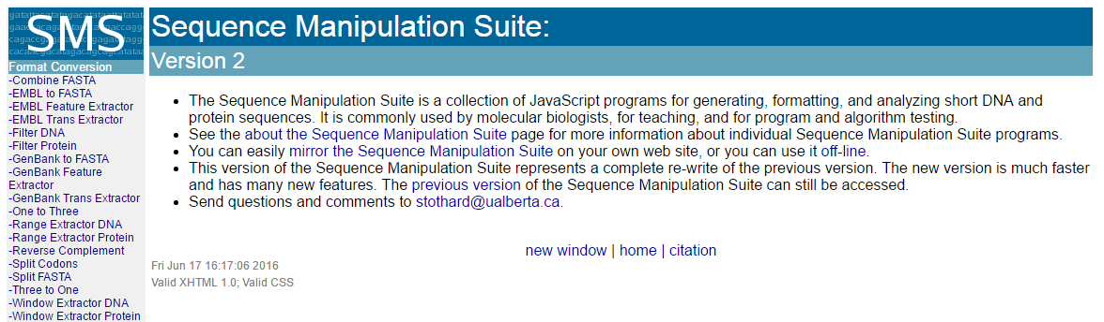
http://www.bioinformatics.org/sms2/

Slide 36
ASSIGNMENT 03
Download the file ex.fasta from website
Assemble the fragments
2. How many potential reading frames are there?
3. Give the names of these genes?
4. The identity and similarity of the last gene with H. sapiens?
- nucleotide and amino acid sequence
5. MW, pI and potential post-translational modification sites of any ONE protein.
E-mail the ANSWER as attached files to
--petang@mail.cgu.edu.tw. Before nest Thursday 1200
****郵件主旨： ASS04 bioinfo – (學號)

