Slide 1
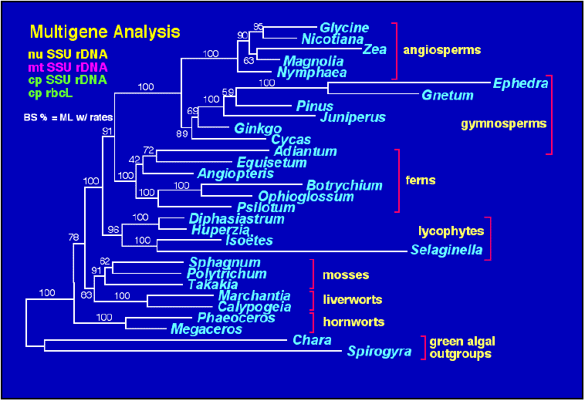
Phylogenetic Analysis
Shin, Jyh-wei
hippo@mail.ncku.edu.tw
Systems Parasitology Laboratory
Microarray Center and Departement of Parasitology
College of Medicine, National Chung Kung UNiversity

Slide 2
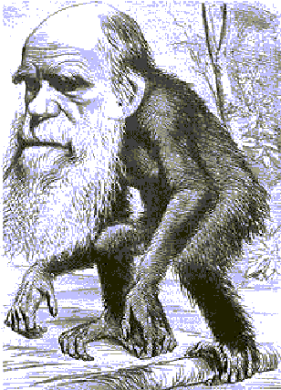
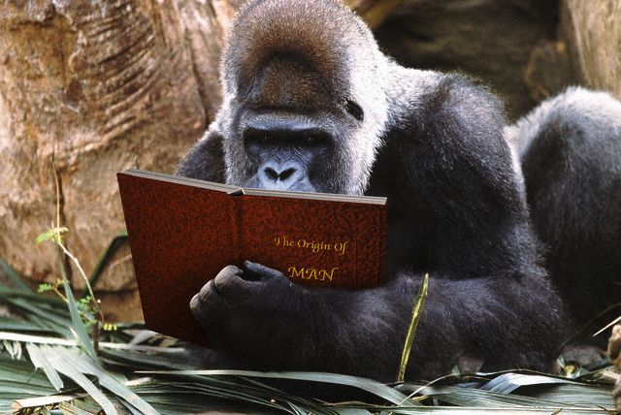
Can we doubt … that individuals having any advantage, however slight, over others, would have the best chance of surviving and proceeding their kind? On the other hand, we may feel sure that any variation in the least degree injurious would be rigidly destroyed variations, I call Nature Selection.
Nature Selection

Slide 3
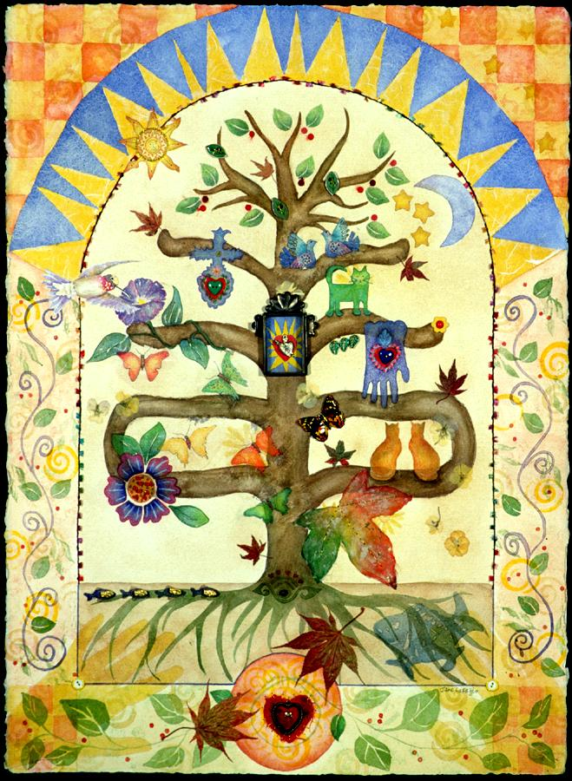
Phylogenetic systematics
The identification and analysis of homologies is central to phylogenetic systematics
  Sees homology as evidence of common ancestry
  Uses tree diagrams to portray relationships based upon recency of common ancestry
  Monophyletic groups (clades) - contain species which are more closely related to each other than to any outside of the group

Slide 4
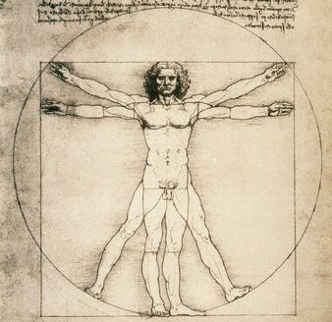
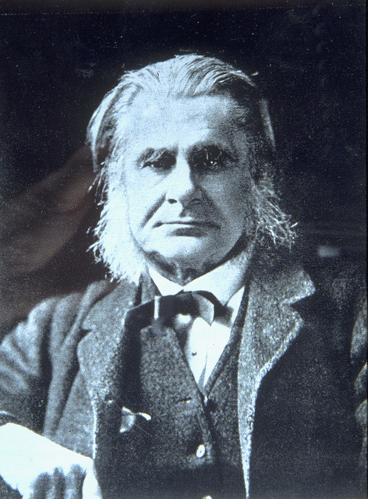
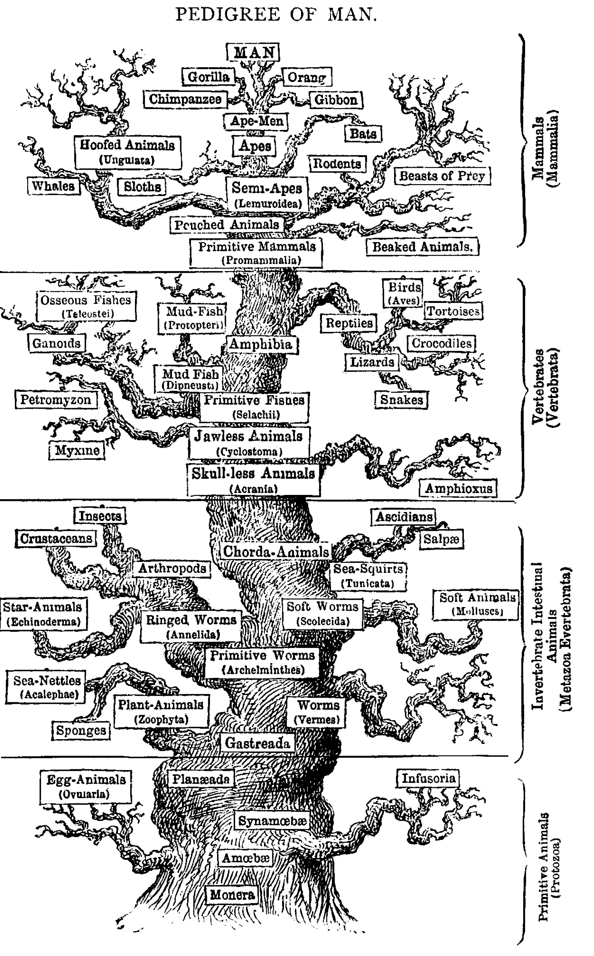
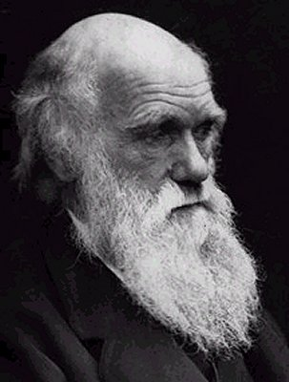
Darwin’s letter to Thomas Huxley 1857
Dear Thomas,
The time will come I believe,
though I shall not live to
see it, when we shall have
fairly true genealogical
(phylogenetic) trees of each
great kingdom of nature.
Charles Darwin
Haeckel’s pedigree of man

Slide 5
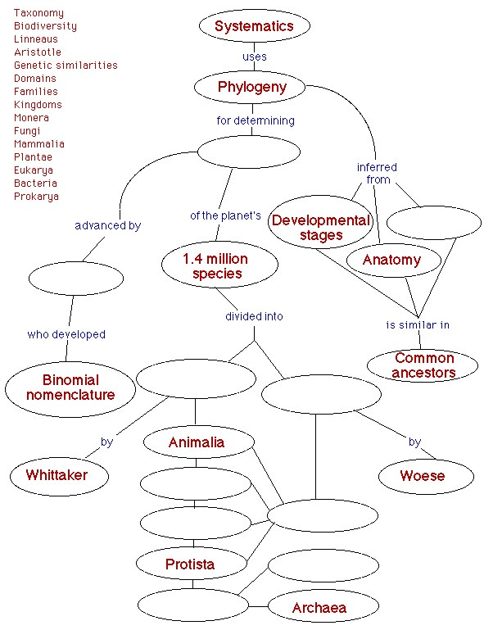
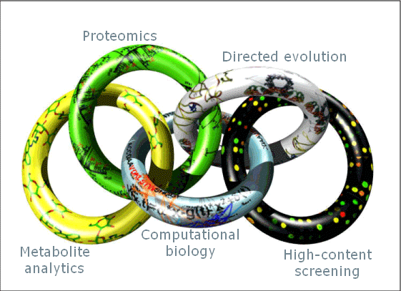
Systematics: Field of biology that deals with the diversity of life. Systematics is usually divided into the two areas of phylogenetics and taxonomy
Phylogenetics: Field of biology that studies the evolutionary relationships between organisms. It includes the discovery of these relationships, and the study of the causes behind this pattern
Taxonomy: The science of naming and classifying organisms
SYSTEMS BIOLOGY
http://www.biology.lsu.edu/introbio/tutorial/Concept-maps/1002/systematics-map.html
http://www.cmdr.ubc.ca/pathogenomics/terminology.html

Slide 6
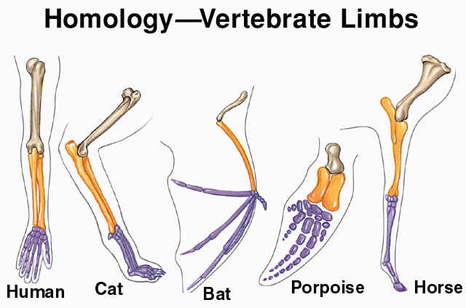
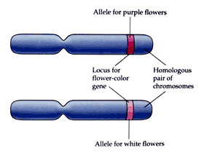
Homology is...
The relationship of any two characters that have descended from a common ancestor. This term can apply to a morphological structure, a chromosome or an individual gene or DNA segment.
Homologous structure
Characters in different species
which were inherited from a
common ancestor and thus
share a similar ontogenetic
pattern.
Homologous chromosome
One part of two genetically
different chromosomes.
Each homologous chromo-
some is inherited from a
different parent, and contains
information about the same
gene sequence.
Homologous gene
Molecular investigations by
developmental biologists have
revealed striking similarities
between the structure of genes
(The hereditary determinant of
a specified characteristic of an
individual; specific sequences
of nucleotides in DNA.)
regulating ontogenetic
phenomena in diverse
organisms.

Slide 7
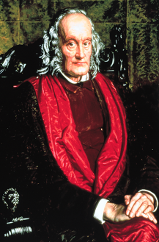
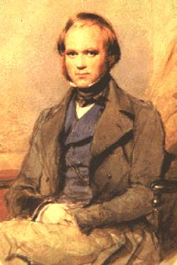
Homology is... They said that ………
Homologue:
the same organ under every variety of
form and function (true or essential
correspondence)
Analogy:
superficial or misleading similarity
Richard Owen 1843
“The natural system is based upon
descent with modification ..
the characters that naturalists
consider as showing true affinity
(i.e. homologies) are those which
have been inherited from a common
parent, and, in so far as all true
classification is genealogical; that
community of descent is the
common bond that naturalists have
been seeking”
  Charles Darwin, Origin of species
  1859 p. 413

Slide 8
Cladistic vs. Phenetic
Within the field of taxonomy there are two different methods and philosophies of building phylogenetic trees: cladistic and phenetic.
  Cladistic methods rely on assumptions about ancestral relationships as well as on current data.
  Phenetic methods construct trees (phenograms) by considering the current states of characters without regard to the evolutionary history that brought the species to their current phenotypes.
For character data about the physical traits of organisms (such as morphology of organs etc.) and for deeper levels of taxonomy, the cladistic approach is almost certainly superior.
Cladistic methods are often difficult to implement with molecular data because all of the assumptions are generally not satisfied.
Computer algorithms based on the phenetic model rely on Distance Methods to build of trees from sequence data.
Phenetic methods count each base of sequence difference equally, so a single event that creates a large change in sequence (insertion/deletion or recombination) will move two sequences far apart on the final tree.
Phenetic approaches generally lead to faster algorithms and they often have nicer statistical properties for molecular data.
The phenetic approach is popular with molecular evolutionists because it relies heavily on objective character data (such as sequences) and it requires relatively few assumptions.

Slide 9
Cladograms
show branching order
and branch lengths are meaningless
分支圖 (cladograms)
表示現存與化石物種彼此的關係，
並非祖先或子嗣的關係。
Cladograms and Phylograms
Phylograms
show branch order
and branch lengths
系統發生圖 (phylograms)
描述一群有機體發生或進化順
序的拓撲結構。
Bacterium 1
Bacterium 2
Bacterium 3
Eukaryote 1
Eukaryote 2
Eukaryote 3
Eukaryote 4
Bacterium 1
Bacterium 2
Bacterium 3
Eukaryote 1
Eukaryote 2
Eukaryote 3
Eukaryote 4

Slide 10
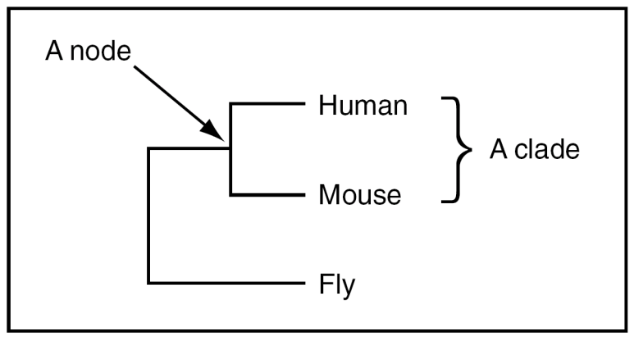
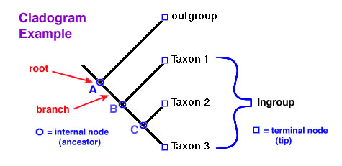
3 three basic assumptions in cladistics（遺傳分類學）
Any group of organisms is related by descent from a common ancestor.
There is a bifurcating pattern of cladogenesis. This assumption is controversial.
Change in characteristics occurs in lineages over time.
Clades are groups of organisms or genes that include the most recent common ancestor of all of its members and all of the descendants of that most recent common ancestor.
Clade is derived from the Greek word ‘‘klados,’’ meaning branch or twig.
branch
• clade 【群】 is a monophyletic taxon
• taxon 【分類群】 is any named group of organisms
but not necessarily a clade
• branch lengths correspond to divergence
• node is a bifurcating branch point.

Slide 11
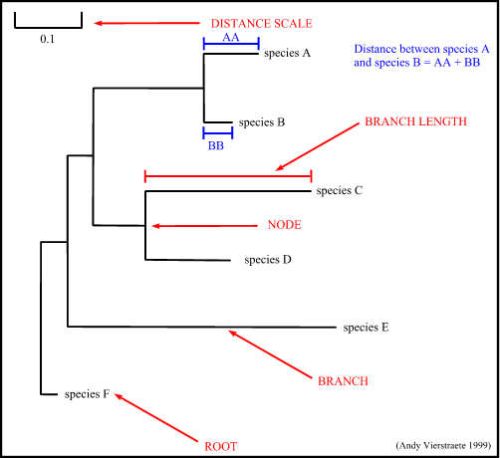
Tree Terminology
3
branch : defines the relationship between the taxa in terms of descent and ancestry
branch length : often represents the number of changes that have occurred in that branch
distance scale : scale which represents the number of differences between sequences (e.g. 0.1 means 10 % differences between two sequences)
node : a node represents a taxonomic unit. This can be a taxon (an existing species) or an ancestor (unknown species : represents the ancestor of 2 or more species).
root : is the common ancestor of all taxa
2
4
1
5

Slide 12
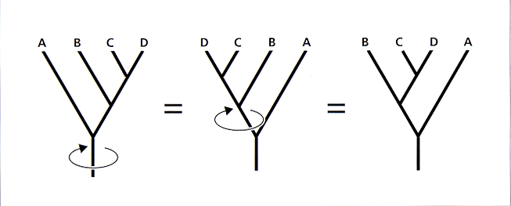
Unrooted versus rooted phylogenies
unrooted
rooted
R
time
only specifies relationships not the
evolutionary path
root (R) is common ancestor of all OTUs (operational taxonomic unit)
path from root to OTUs specifies time knowledge of outgroup required to define root
Branches can be rotated at a node, without changing relationships among the taxa.

Slide 13
unrooted tree
Rooting using an outgroup
rooted by outgroup
archaea
eukaryote
archaea
archaea
eukaryote
eukaryote
eukaryote
bacteria outgroup
archaea
archaea
Monophyletic
group
archaea
eukaryote
eukaryote
Monophyletic
group
root
eukaryote
eukaryote

Slide 14
Different visual representations of phylogram trees
slanted cladogram
rooted
scaled branches
rooted
unscaled cladogram
unrooted
Time
1 unit
rectangular cladogram
rooted
scaled branches
rooted
scaled branches
unrooted
Time
1 unit
1 unit

Slide 15
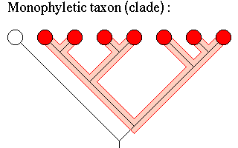
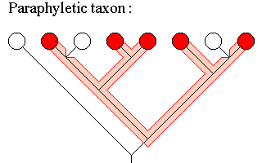
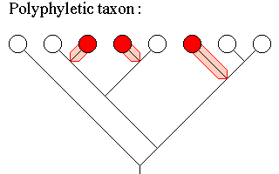
Monophyletic taxon : A group composed of a collection of organisms, including the most recent common ancestor of all those organisms and all the descendants of that most recent common ancestor. A monophyletic taxon is also called a clade. Examples : Mammalia, Aves (birds), angiosperms, insects, fungi, etc.
Paraphyletic taxon : A group composed of a collection of organisms, including the most recent common ancestor of all those organisms. Unlike a monophyletic group, a paraphyletic taxon does not include all the descendants of the most recent common ancestor. Examples : Traditionally defined Dinosauria, fish, gymnosperms, invertebrates, protists, etc.
Polyphyletic taxon : A group composed of a collection of organisms in which the most recent common ancestor of all the included organisms is not included, usually because the common ancestor lacks the characteristics of the group. Polyphyletic taxa are considered "unnatural", and usually are reclassified once they are discovered to be polyphyletic. Examples : marine mammals, bipedal mammals, flying vertebrates, trees, algae, etc.

Slide 16
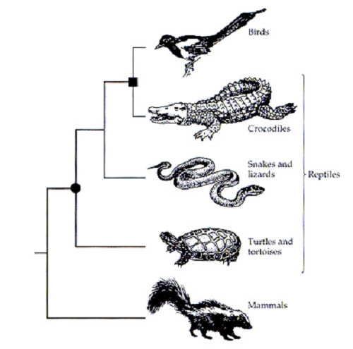
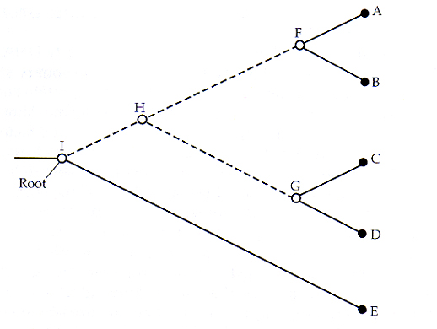
Clade vs. Grade
Sister Taxa
Clade: monophyletic group
Grade: non-monophyletic group, put together out of tradition or convenience, or to reflect morphologically distinct traits
Sister Taxa: two taxa (= named group of organisms) that are more closely related to each other than either is to a 3rd taxon, and derived from a common ancestral node.
Birds: clade
A + B
C + D
Reptiles: grade (paraphyletic group)
Mammals: clade

Slide 17
Default assumptions in phylogenetics
The sequence is correct and originates from the specified source.
The sequences are homologous (i.e., are all descended in some way from a shared ancestral sequence).
Each position in a sequence alignment is homologous with every other in that alignment.
Each of the multiple sequences included in a common analysis has a common phylogenetic history with the others (e.g., there are no mixtures of nuclear and organellar sequences).
The sampling of taxa is adequate to resolve the problem of interest.
Sequence variation among the samples is representative of the broader group of interest.
The sequence variability in the sample contains phylogenetic signal adequate to resolve the problem of interest.

Slide 18
Additional assumptions in phylogenetics
The sequences in the sample evolved according to a single stochastic process.
All positions in the sequence evolved according to the same stochastic process.
Each position in the sequence evolved independently.

Slide 19
Homologs
orthologs/orthologous (直向同源)：
共同祖先的直接後代(沒有發生基因複製事件)之間的同源基因稱為直向同源。
Orthologs are homologs produced by speciation.
paralogs/paralogous (共生同源)：
兩個物種 A 和 B 的同源基因，分別是共同祖先基因組中由複製事件而產生的不同拷貝的後代，這被稱為共生同源基因。
Paralogs are homologs produced by gene duplication.
paralogous
b*
C*
A*
orthologous
orthologous
a
b*
c
C*
B
A*
Xenologs are homologs resulting from horizontal gene transfer between two
organisms.
Synologs are homologs resulting from genes ended up in one organism through fusion of lineages
A mixture of orthologues and paralogues sampled
Duplication to give 2 copies = paralogues on the same genome
Ancestral gene

Slide 20



PHYLOGENETIC DATA ANALYSIS: THE FOUR STEPS
A straightforward phylogenetic analysis consists of four steps:
Alignment
Building the data model
Extraction of a phylogenetic data set
Determining the substitution model
Substitution rates between bases
Among-site substitution rate heterogeneity
Substitution rates between amino acids
1
Tree building
Distance-Based Methods
Unweighted Pair Group Method with Arithmetic
Mean (UPGMA).
Neighbor Joining (NJ).
Fitch-Margoliash (FM).
Minimum Evolution (ME).
Character-Based Methods
Maximum Parsimony (MP).
Maximum Likelihood (ML).
2
3
Tree evaluation
Randomized Trees (Skewness Test)
Randomized Character Data (Permutation Tests)
Bootstrap
Likelihood Ratio Tests
4

Slide 21
Alignment
1
Aligned sequence positions subjected to phylogenetic analysis represent a priori phylogenetic conclusions because the sites themselves (not the actual bases) are effectively assumed to be genealogically related, or homologous. Steps in building the alignment include selection of the alignment procedure(s) and extraction of a phylogenetic data set from the alignment.
ALIGNMENT
ALINEMENT
ALCHEMIST
ALIMENT
ALMOST
ALIGHT
ALIGNMENT
ALINEMENT
ALCHEMIST
ALI--MENT
AL---MOST
AL---IGHT
ALIG--N--M-E--N--T
ALI---NE-M-E--N--T
AL--CH-E-M--I--S-T
ALI------M-E--N--T
AL-------M---O-S-T
ALIG----H--------T
OR
ORIGINAL
SEQUENCE
PHYLOGENY

Slide 22
Notices of multiple sequence alignment
The alignment step in phylogenetic analysis is one of the most important because it produces the data set on which models of evolution are used.
It is not uncommon to edit the alignment, deleting unambiguously aligned regions and inserting or deleting gaps to more accurately reflect probable evolutionary processes that led to the divergence between sequences.
It is useful to perform phylogenetic analyses based on a series of slightly modified alignments to determine how ambiguous regions in the alignment affect the results and what aspects of the results one may have more or less confidence in.

Slide 23
Modeling
2
In general, substitutions are more frequent between bases that are biochemically more similar.
In the case of DNA, the four types of transition (A → G, G → A, C → T, T → C) are usually more frequent than the eight types of transversion (A → C, A → T, C → G, G → T, and the reverse). Such biases will affect the estimated divergence between two sequences.
A
C
A
C
T
A
C
A
C
A
C
T
A
C
C
G
A
C
T
T
A
C
A
C
T
A
C
A
A
A
T
T
C
conservation
single substitution
multiple substitution
coincidental substitution
parallel substitution
convergent substitution
convergent substitution
ATGCTGTTAGGG
ATGCTCGTAGGG
MetLeuLeuGly
* *
ATGCT-GTTAGGGXX
ATGCTCGT-AGGGXX
MetLeuValArgXxx

Slide 24
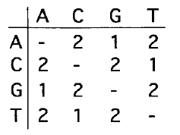
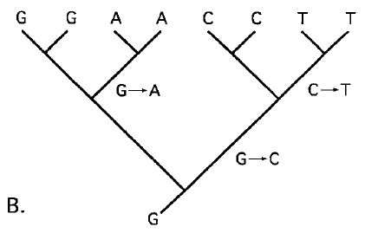
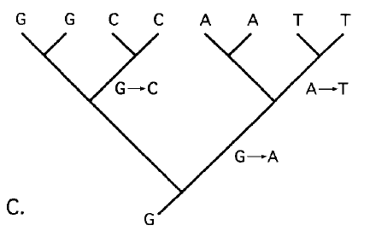
Character-state weight matrices have usually been estimated more or less by eye, but they can also be derived from a rate matrix. For example, if it is presumed that each of the two transitions occurs at double the frequency of each transversion, a weight matrix can simply specify, for example, that the cost of A-G is 1 and the cost of A-T is 2.

Slide 25
Specification of the relative rates of substitution among particular residues usually takes the form of a square matrix; the number of rows/columns is four in the case of bases, 20 in the case of amino acids (e.g., in PAM and BLOSUM matrices), and 61 in the case of codons (excluding stop codons).
The PAM 250 scoring matrix
A R N D C Q E G H I L K M F P S T W Y V
A 2
R -2 6
N 0 0 2
D 0 -1 2 4
C -2 -4 4 -5 4
Q 0 1 1 2 -5 4
E 0 -1 1 3 -5 2 4
G 1 -3 0 1 -3 -1 0 5
H -1 2 2 1 -3 3 1 -2 6
I -1 -2 -2 -2 -2 -2 -2 -3 -2 5
L -2 -3 -3 -4 -6 -2 -3 -4 -2 2 6
K -1 3 1 0 -5 1 0 -2 0 -2 -3 5
M -1 0 -2 -3 -5 -1 -2 -3 -2 2 4 0 6
F -4 -4 -4 -6 -4 -5 -5 -5 -2 1 2 -5 0 9
P 1 0 -1 -1 -3 0 -1 -1 0 -2 -3 -1 -2 -5 6
S 1 0 1 0 0 -1 0 1 -1 -1 -3 0 -2 -3 1 3
T 1 -1 0 0 -2 -1 0 0 -1 0 -2 0 -1 -2 0 1 3
W -6 2 -4 -7 -8 -5 -7 -7 -3 -5 -2 -3 -4 0 -6 -2 -5 17
Y -3 -4 -2 -4 0 -4 -4 -5 0 -1 -1 -4 -2 7 -5 -3 -3 0 10
V 0 -2 -2 -2 -2 -2 -2 -1 -2 4 2 -2 2 -1 -1 -1 0 -6 -2 4

Slide 26
Distance Matrix Methods
Convert sequence data into a set of discrete pairwise distance values, arranged
into a matrix.
Distance methods fit a tree to this matrix.
The phylogenetic topology tree is constructed by using a cluster analysis method (like UPGMA or NJ methods).
The phylogeny makes an estimation of the distance for each pair as the sum of branch lengths in the path from one sequence to another through the tree.

Slide 27
Tree building
3
Distance - Based Methods
Character - Based Methods
距離建樹方法根據一些尺度計算出雙重序列的距離，然後拋開真實資料，只是根據固定的距離建立進化樹。
這個簡單的運算法，在不同分支的演化速度相近時，可以用來建立親緣樹。因為在上述假設之下，核甘酸或胺基酸的置換速率與親緣遠近大約成正比，所以使用算術平均數來表示距離還算合理。此法採用一系列漸進的雙序列並列分析來做。在程式啟動後，會先將各序列兩兩比對，以找出未來做進一步並列的順序。原則上是先將最相似的序列排列在一起，變為一群 (cluster)，然後再將剩餘序列中與這兩個序列最相似的一個，與這兩個排好的序列群做並列分析。最常用的基於特徵符的建樹方法包括 UPGMA 和 NJ。
基於特徵符的建樹方法在建立進化樹時，優化了每一個特徵符的真實資料模式的分佈，於是雙重序列的距離不再固定，而是取決於進化樹的拓撲結構。最常用的基於特徵符的建樹方法包括 MP 和 ML。

Slide 28
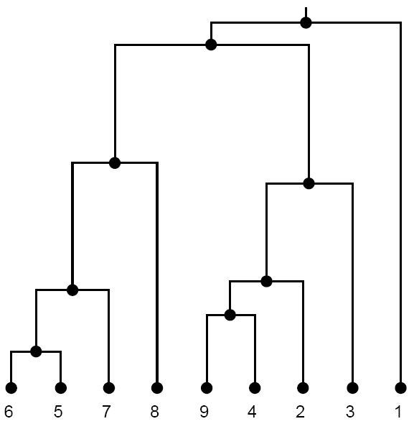
Unweighted Pair Group Method with Arithmetic Mean (UPGMA)
UPGMA 是一種聚類或者說是分類方法；它按照配對序列的最大相似性和連接配對的平均值的標準將進化樹的樹枝連接起來。它還不是一種嚴格的進化距離建樹方法。只有當序列分歧是基於一個分子鐘或者近似等於原始的序列差異性的時候，我們才會期望 UPGMA 會產生一個擁有真實的樹枝長度的準確的拓撲結構。
UPGMA is a clustering or phenetic algorithm - it joins tree branches based on the criterion of greatest similarity among pairs and averages of joined pairs. It is not strictly an evolutionary distance method. UPGMA is expected to generate an accurate topology with true branch lengths only when the divergence is according to a molecular clock or approximately equal to raw sequence dissimilarity. As mentioned
earlier, these conditions are
rarely met in practice.
UPGMA

Slide 29
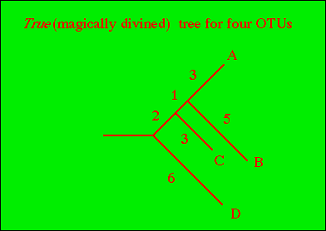
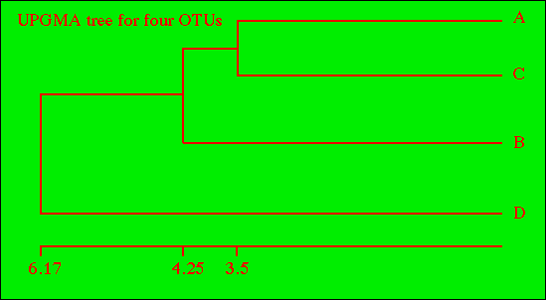
UPMGA Tree
2
OTU
A
B
C
D
3
OTU
A-C
B
D
A
—
8
7
12
A-C
—
8.5
11.5
B
—
9
14
B
—
14
C
—
11
D
—
1
D
—
Dist. fr A-C-B to D = 12 + 14 + 11 = 12.33333
3
= (A to D) + (B to D) + (C to D)
3
Dist. fr A-C to B = 8 + 9 = 8.5 = (A to B) + (C to B)
2 2
Dist. fr A-C to D = 12 + 11 = 11.5 = (A to D) + (C to D)
2 2
First node unites A & C with branch lengths of 7/2 = 3.5
Second node unites the A-C clade with B with branch length of 8.5/2 = 4.25
Third node unites A-C-B with D with branch length of 12.33/2 = 6.17
Internode distances can be calculated by subtraction
Node 1 to Node 2 = (Node 2 to B) - ("Height" of Node 1)
= 4.25 - 3.5 = 0.75
"Height" of Node 1 can be taken from EITHER branch length 1-A or 1-C because branch lengths from any node to tip are equal by definition
Node 2 to Node 3 = (Node 2 to D) - ("Height of Node 2)
= 6.17 - 4.25 = 1.91667
4
5
http://www.dina.dk/~sestoft/bsa/Match7Applet.html

Slide 30
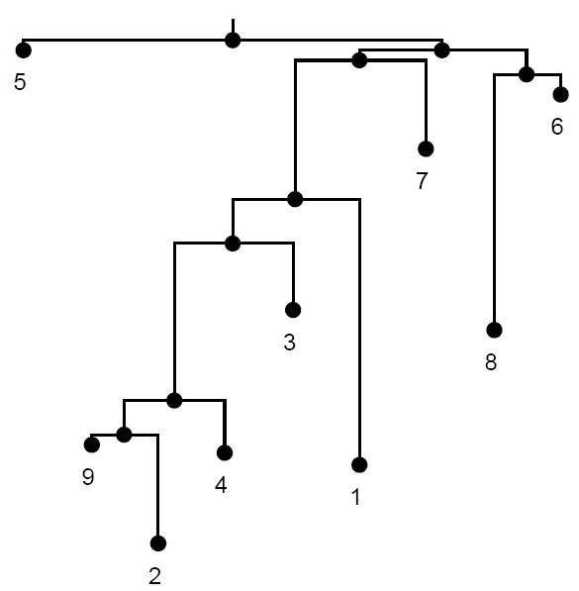
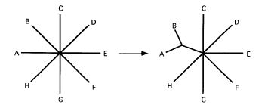
Neighbor Joining (NJ)
NJ 在距離建樹中經常會用到，不會理會使用什麼樣的優化標準。解析出的進化樹是通過對完全沒有解析出的 “星型” 進化樹進行 “分解” 得到，分解的步驟是連續不斷地在最接近（實際上，是最孤立的）的序列對中插入樹枝，而保留進化樹的終端。最接近的序列對被鞏固了，而 “星型” 進化樹被改善了，這個過程將不斷重複。
The neighbor-joining algorithm is commonly applied with distance tree building, regardless of the optimization criterion. The fully resolved tree is ‘‘decomposed’’ from a fully unresolved ‘‘star’’ tree by successively inserting branches between a pair of closest (actually, most isolated) neighbors and the remaining terminals in the tree. The closest neighbor pair is then consolidated, effectively reforming a star tree, and the process is
repeated. The method is
comparatively rapid.
NJ

Slide 31
NJ Tree
8+7+12
2
OTU | A | B | C | D | r | r/2
A | - | 8 | 7 | 12 | 27 | 13.5
B |  | - | 9 | 14 | 31 | 15.5
C |  |  | - | 11 | 27 | 13.5
D |  |  |  | - | 37 | 18.5
8+9+14
1
Note that we have two new columns to the right.
The first column (r) is the sum of the distances from the row OTU to all other OTUs. Thus 8+7+12 = 27 (A to everything else); 8+9+14 = 31 (B to everything else); etc. The r/2 is something we will use later. The denominator (the 2) is the matrix size (number of OTUs) minus two. I will explain that later.
3
4
OTU | A | B | C | D
A | - | 8 | 7 | 12
B | -21.00 | - | 9 | 14
C | -20.00 | -20.00 |  | 11
D | -20.00 | -20.00 | -21.00 | -
B to Node 1: Original B-A distance divided by two (original distance between the components/2) plus (B's r/2 minus A's r/2) divided by two.
8/2 + (15.5 - 13.5)/2 = 5
B to Node 1 = 5
A to B = 8; B to Node 1 = 5. Therefore A to Node 1 = 8 - 5 = 3.
A to Node 1 = 3
Alternative method starting with A to Node 1:
(Original A to B) + (A's r/2 minus B's r/2) divided by two
8/2 + (13.5 - 15.5)/2 = 4 + -1 = 3
Finally B to Node 1 = A to B - A to Node 1 = 8 - 3 = 5
Original A-B value (8) minus the average of the A and B r-values [(27+31)/2 = 29].
8 - 29 = -21.
A-C = -20. Original A-C value (7) minus average of A and C r-values
[(27+27)/2 = 27]. 7 - 27 = -20.

Slide 32
NJ Tree (cont’ 1)
 | C | D | Node 1 | r | r/1
C | - | 11 | 4 | 15 | 15
D | -6.5 | - | 9 | 20 | 20
Node 1 | -10 | -7.5 | - | 13 | 13
5
6
C to Node 1. Original C to A (=7) minus A to Node 1 (=3) plus Original C to B (=9) minus B to Node 1 (=5) all divided by two.
So… C to Node 1 = [(7-3) + (9-5)]/2 = 4.
D to Node 1. Original D to A (=12) minus A to Node 1 (=3) plus Original D to B (=14) minus B to Node 1 (=5) all divided by two.
So… D to Node 1 = [(12-3) + (14-5)]/2 = 9.
D to C = Original D to C minus the sum of the (reduced matrix) r-values divided by two.
11-(15+20)/2 = -6.5
Node 1 to C = Original Node 1 to C [N.B., this value comes from the upper-diagonal]
minus the sum of their (reduced matrix) r-values divided by two.
4 -(15+13)/2 = -10
Node 1 to D = Original Node 1 to D minus the sum of their (reduced matrix) r-values divided by two.
9 -(20+13)/2 = -7.5
C to Node 2 = (Original C to Node 1)/2 plus (C's r/1 minus Node 1's r/1)/2.
4/2 + (15-13)/2 = 3
C to Node 2 = 3
Node 1 to Node 2 = (Original C to Node 1) minus distance just computed for C to Node 2.
4 - 3 = 1
Node 1 to Node 2 = 1
Alternative starting with Node 1 to Node 2. What do we know about Node 1 to Node 2? We know something that INCLUDES it, which is C to Node 1 (= C to Node 2, which we don't want, plus Node 2 to Node 1, which we do want).
Node 1 to Node 2 = (C to Node 1)/2 plus (Node 1's r/1 - C's r/1)

Slide 33
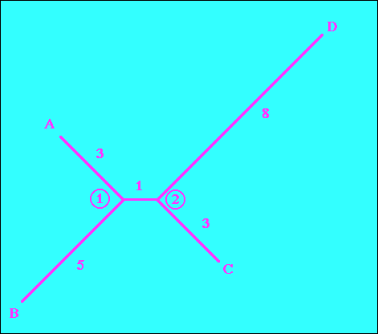
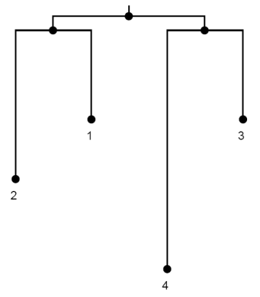
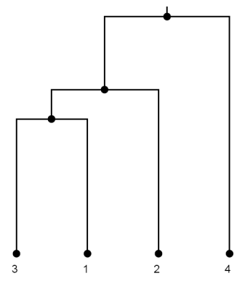
NJ Tree (cont’ 2)
 | D | Node 2 | r
D | - | 8
Node 2 |  | -
7
D to Node 2 =
[(D to Node 1 minus Node 1 to Node 2) + (D to C minus C to Node 2)]/2
[(9 - 1) + (11-3)]/2 = 8
D to Node 2 = 8
8
9
http://www.dina.dk/~sestoft/bsa/Match7Applet.html
UPGMA
A
C
B
NJ
D
C
A
B
D

Slide 34
Character Matrix Methods
Parsimony is the most popular method for reconstructing ancestral
relationships.
Parsimony allows the use of all known evolutionary information in tree.
The phylogenetic topology tree is constructed by using a cluster analysis method (like MP or ML methods).
Approaches involve two components:
  A search through space of trees.
  A procedure to find the minimum number of changes needed to explain the data – used for scoring each tree.

Slide 35
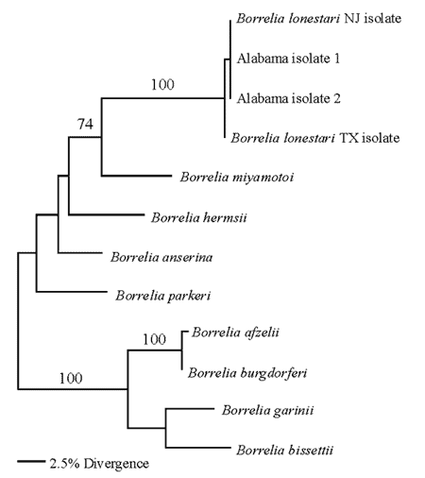
Maximum Parsimony (MP)
最大節約方法是一種優化標準，對資料最好的解釋也是最簡單的，而最簡單的所需要的特別假定也最少。在實際應用中，MP 進化樹是最短的；也是變化最少的進化樹，根據定義，這個進化樹的平行變化最少，或者說是同形性最低。MP 中有一些變數與特徵符狀態改變的可行方向不盡相符。
Maximum Parsimony (MP). Maximum parsimony is an optimization criterion that adheres to the principle that the best explanation of the data is the simplest, which in turn is the one requiring the fewest ad hoc assumptions. In practical terms, the MP tree is the shortest - the one with the fewest changes - which,
by definition, is also the
one with the fewest parallel
changes. There are
several variants of MP
that differ with regard
to the permitted
directionality of
character state
change.

Slide 36
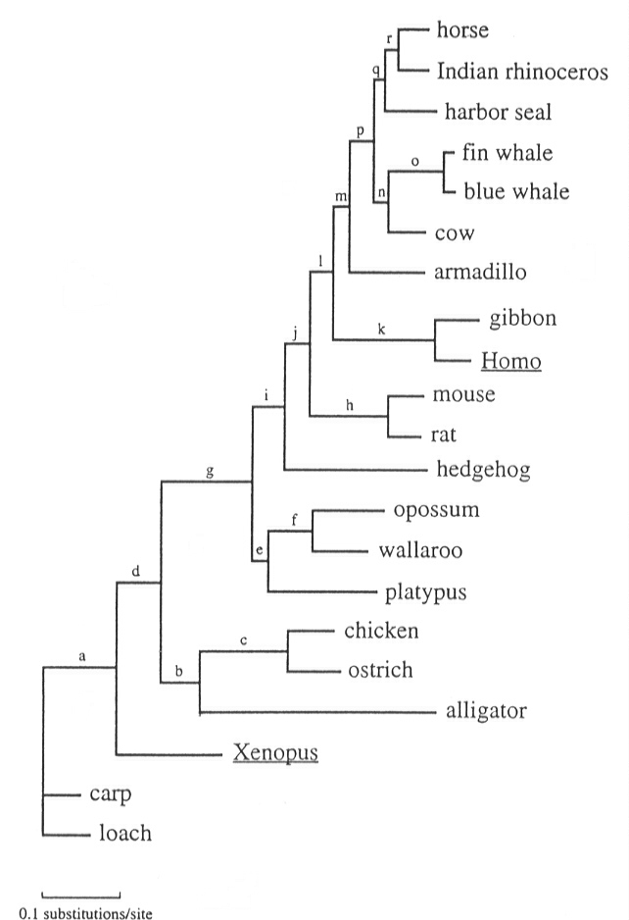
Maximum Likelihood (ML)
ML 對系統發育問題進行了徹底搜查。ML 期望能夠搜尋出一種進化模型（包括對進化樹本身進行搜索），使得這個模型所能產生的資料與觀察到的資料最相似。
Maximum Likelihood (ML). ML turns the phylogenetic problem inside out. ML searches for the evolutionary model, including the tree itself, that has the highest likelihood of producing the observed data.

Slide 37
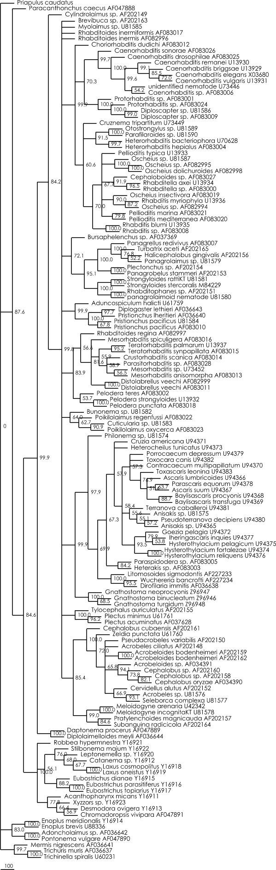
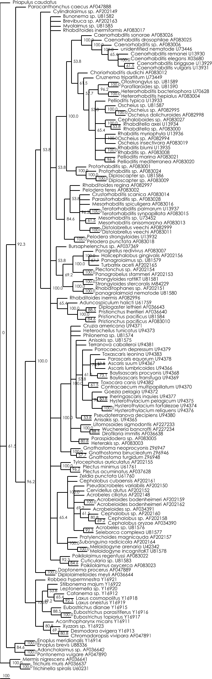
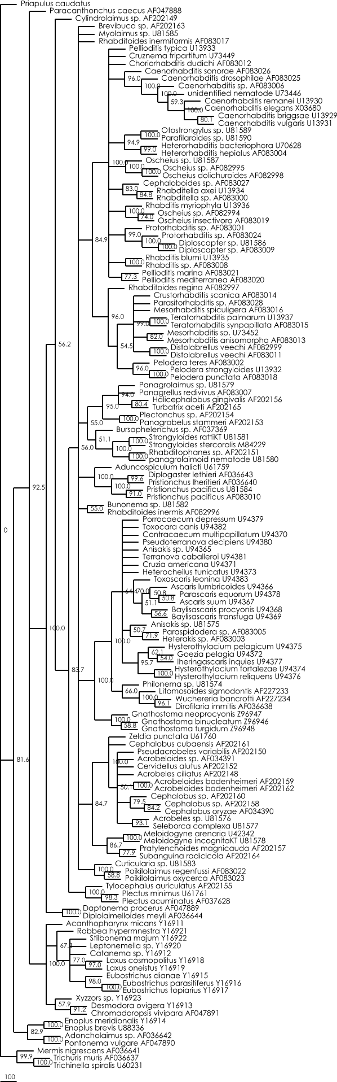
142 nematode
SSU sequences
Bootstrap distance tree
Bootstrap maximum likelihood tree
Bootstrap maximum parsimony tree

Slide 38


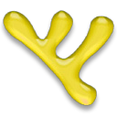



TOOLS
BioEdit
http://www.mbio.ncsu.edu/BioEdit/BioEdit.html
PHYLIP
http://evolution.genetics.washington.edu/phylip/getme.html
TreeView X
http://darwin.zoology.gla.ac.uk/~rpage/treeviewx/
HyperTree
http://kinase.com/tools/HyperTree.html
Java
http://www.java.com/zh_TW/
CLC Sequence
Viewer
http://www.clcbio.com/index.php?id=1113
Geneious
http://www.geneious.com/default,83,home.sm

Slide 39
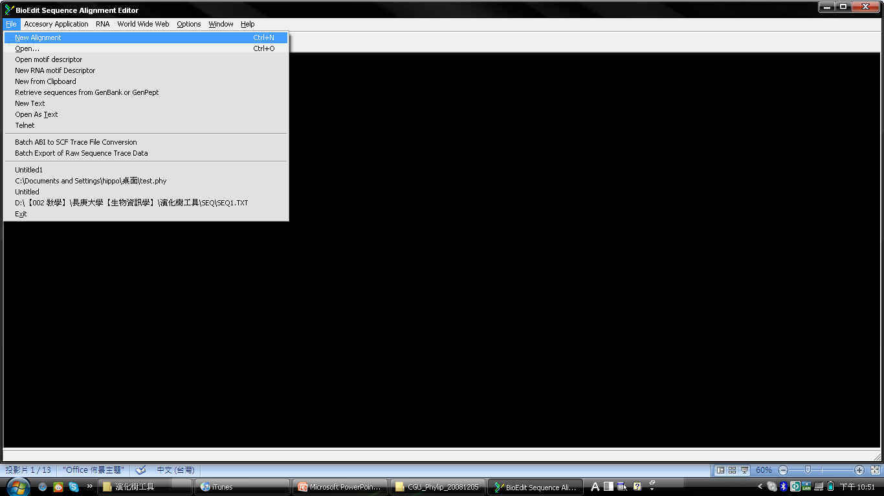
BIOEDIT → ClustalW Multiple Alignment → PHYLIP

Slide 40
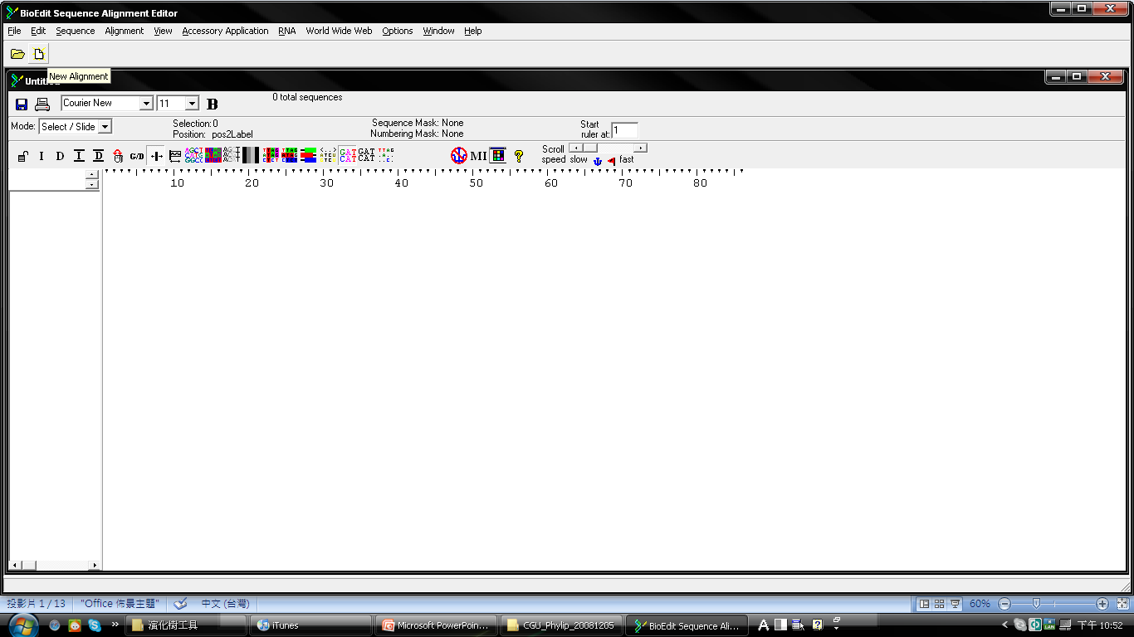

Slide 41
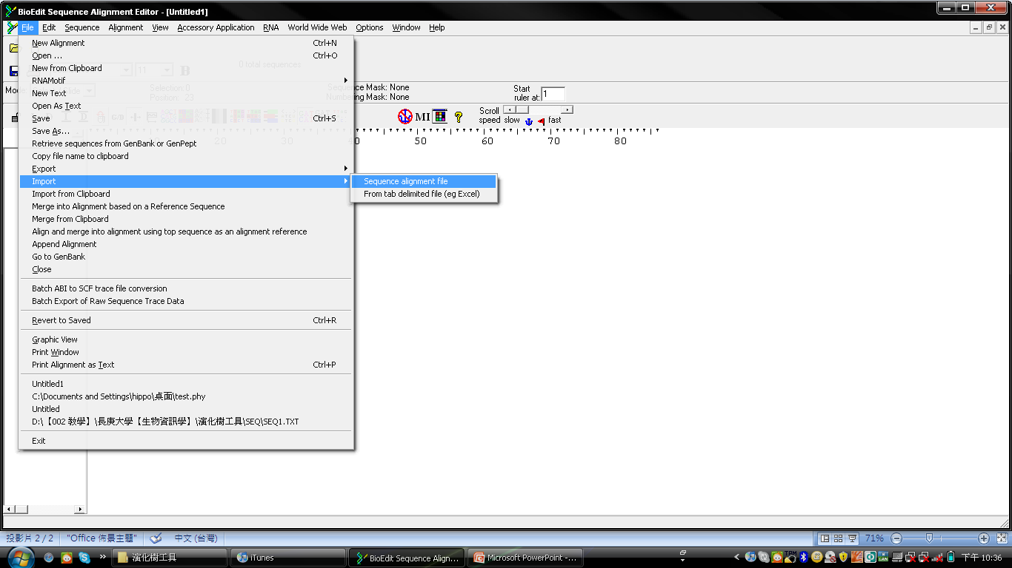

Slide 42
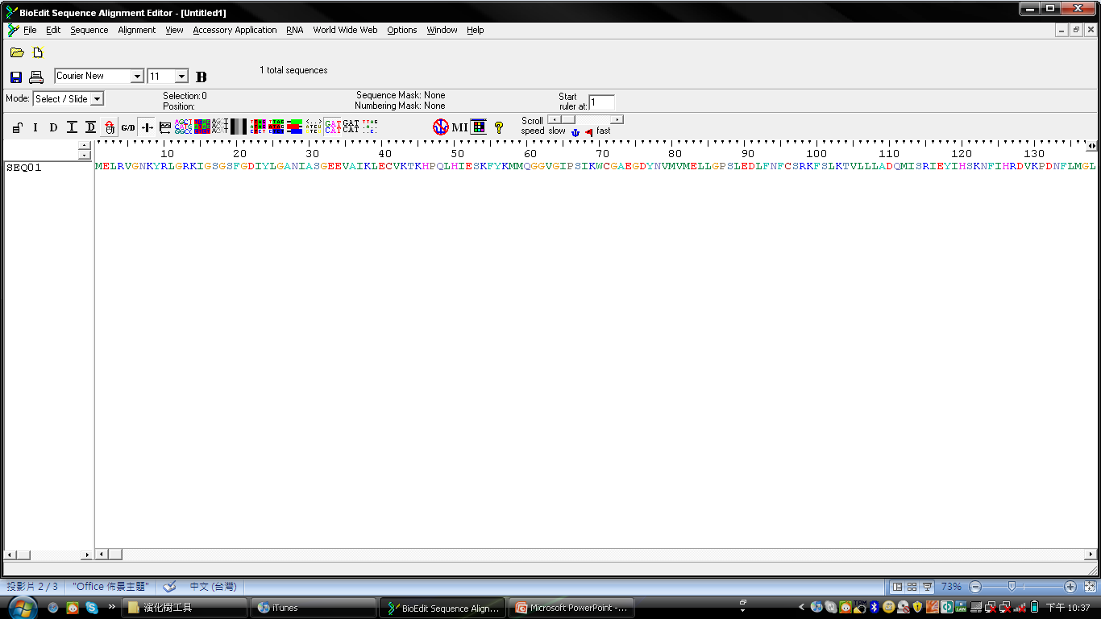

Slide 43
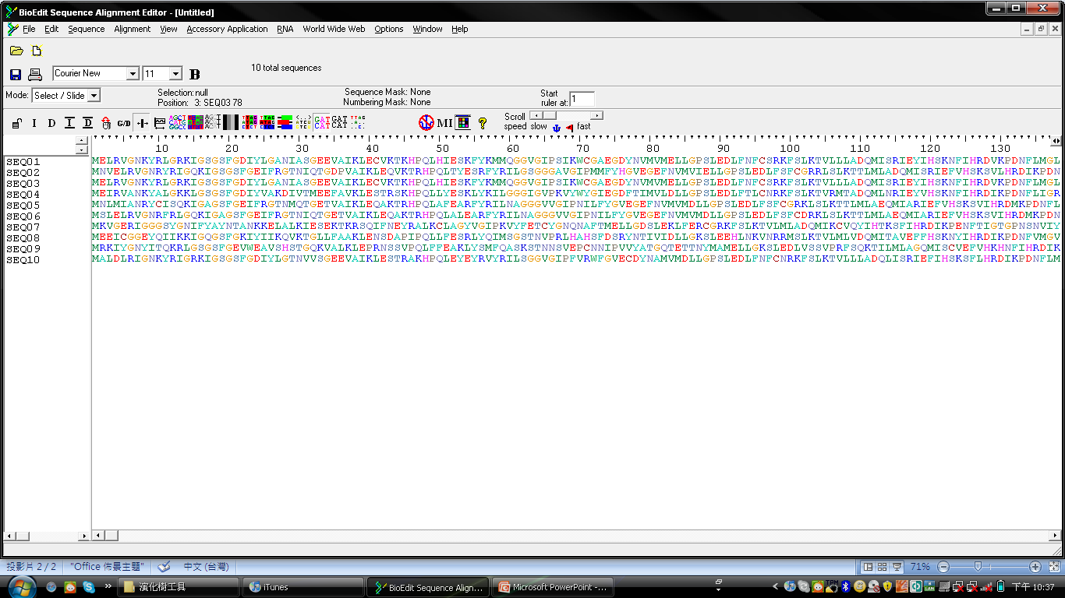

Slide 44
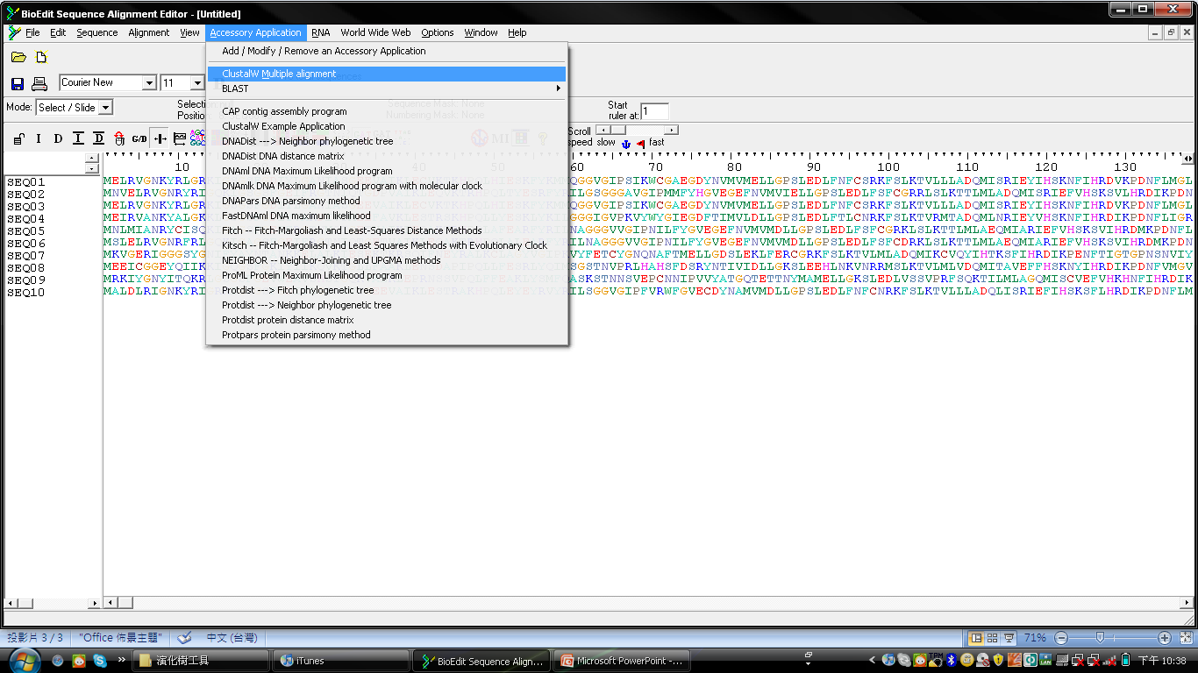

Slide 45
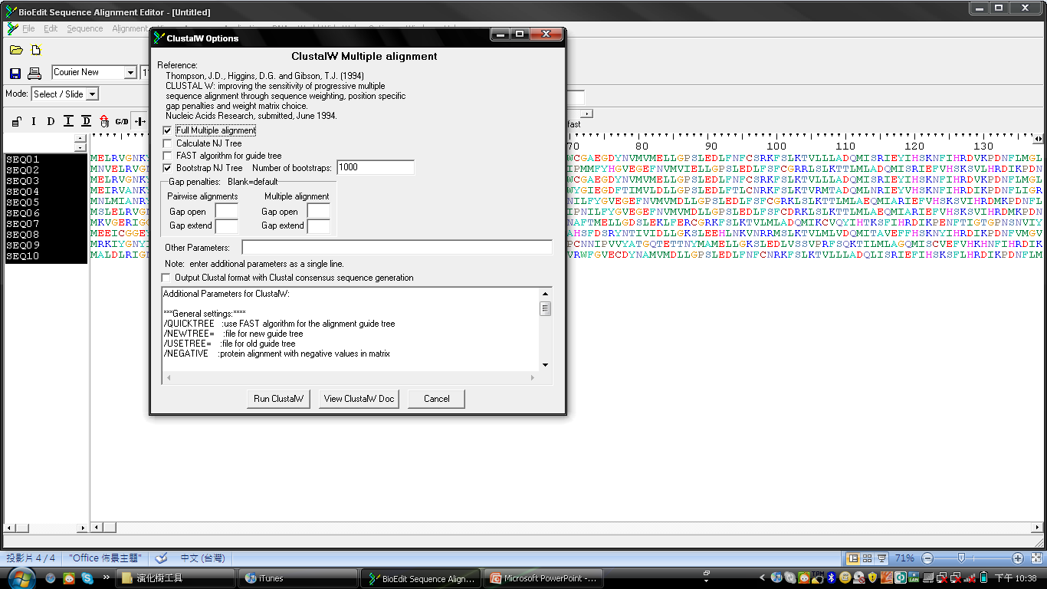

Slide 46
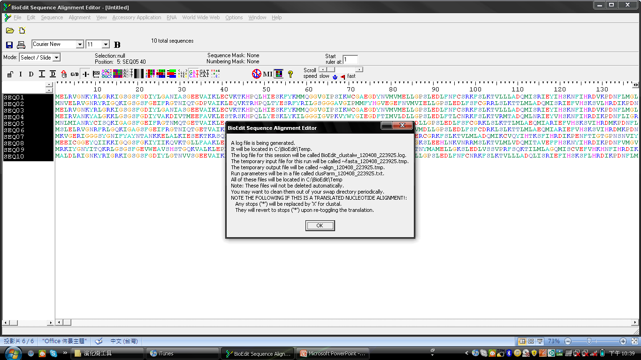

Slide 47
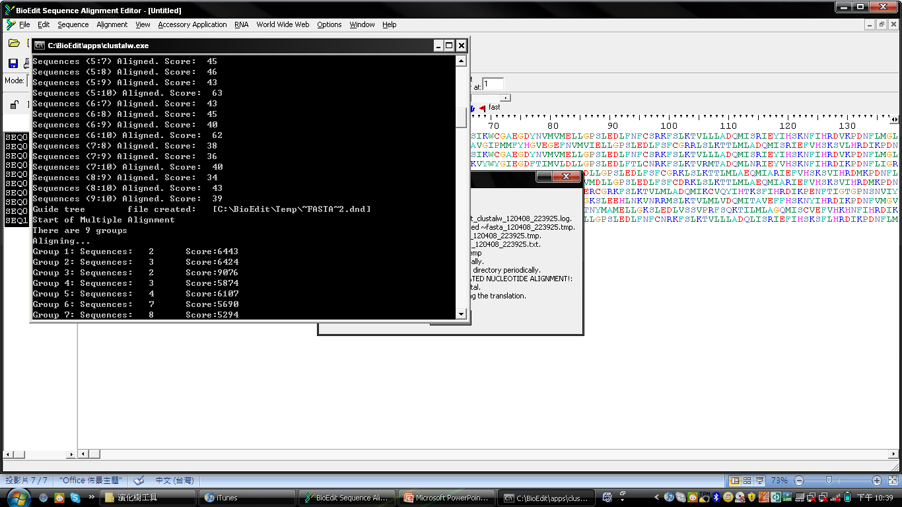

Slide 48
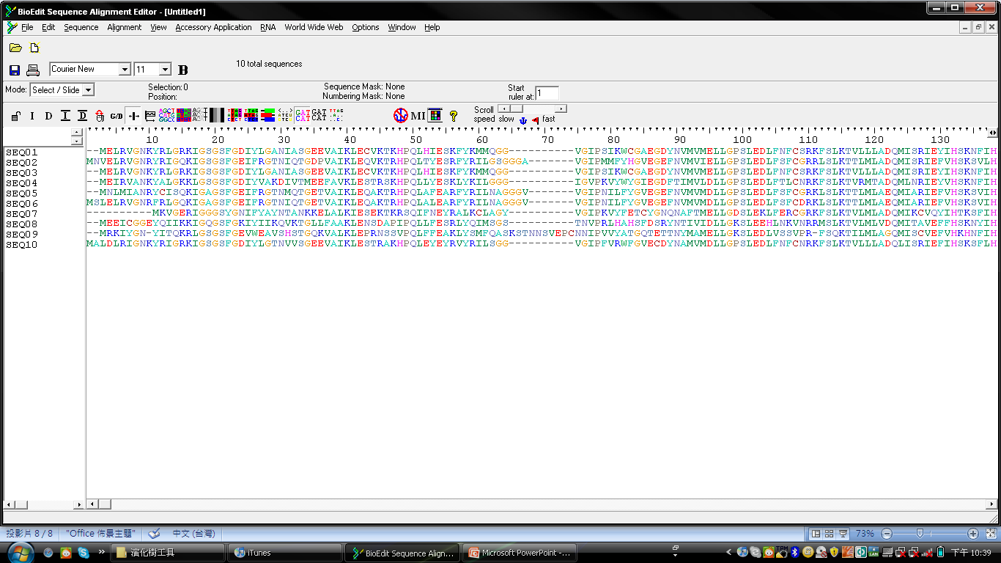

Slide 49

Phylip 4.0

Slide 50


Slide 51

Phylip 3.2

Slide 52


Slide 53


Slide 54






Tree build pipeline
PROTDIST.EXE
treefile
infile
SEQBOOT.EXE
DNADIST.EXE
NEIGHBOR.EXE
infile
CONSENSE.EXE
outfile
infile
outfile
infile
outfile
outfile

Slide 55
Distance-Based Methods
Unweighted Pair Group Method with ArithmeticMean (UPGMA).
Neighbor Joining (NJ).
Fitch-Margoliash (FM).
Minimum Evolution (ME).
Tree Generation Flowchart
outtree
treefile
PROTDIST.EXE
infile
SEQBOOT.EXE
DNADIST.EXE
NEIGHBOR.EXE
intree
CONSENSE.EXE
outfile
infile
outfile
infile
outfile
outfile
PROTPARS.EXE
outfile
intree
Character-Based Methods
Maximum Parsimony (MP).
Maximum Likelihood (ML).
DNAPARS.EXE

Slide 56

Sequence alignment and trimming
Clustalw
Get Programs
... by type of data
DNA sequences
Protein sequences
Restriction sites
Distance matrices
Gene frequencies
Quantitative characters
Discrete characters
tree plotting, consensus trees, tree distances and tree manipulation
... by type of algorithm
Heuristic tree search
Branch-and-bound tree search
Interactive tree manipulation
Plotting trees, consenus trees, tree distances
Converting data, making distances or bootstrap replicates
http://evolution.genetics.washington.edu/phylip/programs.html

Slide 57



Step 1.1
Bootstraping 就是從整個序列的堿基（氨基酸）中任意選取一半，剩下的一半序列隨機補齊組成一個新的序列。這樣，一個序列就可以變成了許多序列。一個多序列組也就可以變成許多個多序列組。根據某種演算法（最大簡約性法、最大可能性法、除權配對法或鄰位相連法）每個多序列組都可以生成一個進化樹。將生成的許多進化樹進行比較，按照多數規則（majority-rule）我們就會得到一個最“逼真”的進化樹。
Jackknife 則是另外一種隨機選取序列的方法。它與 Bootstrap 法的區別是不將剩下的一半序列補齊，只生成一個縮短了一半的新序列。
Permute 是將一個數組中的元素的順序隨機化。
treefile
outtree
PROTDIST.EXE
infile
SEQBOOT.EXE
DNADIST.EXE
NEIGHBOR.EXE
infile
CONSENSE.EXE
outfile
infile
outfile
intree
outfile
outfile
Republicate 就是用 Bootstrap 法生成的一個多序列組。
PROTDIST.EXE
outtree
intree
DNADIST.EXE

Slide 58


Step 1.2
O 是讓使用者設定一個序列作為 outgroup。
M 是輸入剛才設置的 republicate 的數目。
treefile
outtree
PROTDIST.EXE
infile
SEQBOOT.EXE
DNADIST.EXE
NEIGHBOR.EXE
infile
CONSENSE.EXE
outfile
infile
outfile
intree
outfile
outfile
PROTPARS.EXE
outtree
intree
DNAPARS.EXE

Slide 59



Step 1.3
THIS TREE
treefile
outtree
PROTDIST.EXE
infile
SEQBOOT.EXE
DNADIST.EXE
NEIGHBOR.EXE
infile
CONSENSE.EXE
Outfile
infile
outfile
intree
outfile
outfile
PROTPARS.EXE
outtree
intree
DNAPARS.EXE
THESE
DISTANCE

Slide 60
CONSENSUS TREE:
the numbers forks indicate the number
of times the group consisting of the species
which are to the right of that fork occurred
among the trees, out of 98.00 trees
+------SEQ05
+-96.0-|
+-82.0-| +------SEQ06
| |
+-97.5-| +-------------SEQ02
| |
+-98.0-| +--------------------SEQ04
| |
+-98.0-| +---------------------------SEQ10
| |
+-98.0-| +----------------------------------SEQ07
| |
| | +------SEQ09
+-98.0-| +-----------------------------98.0-|
| | +------SEQ08
| |
| +------------------------------------------------SEQ03
|
+-------------------------------------------------------SEQ01
SEQ01
SEQ03
SEQ07
SEQ10
SEQ04
SEQ02
SEQ05
SEQ06
SEQ09
10
SEQ08
rooted

Slide 61
Step 2.1
Bootstraping 就是從整個序列的堿基（氨基酸）中任意選取一半，剩下的一半序列隨機補齊組成一個新的序列。這樣，一個序列就可以變成了許多序列。一個多序列組也就可以變成許多個多序列組。根據某種演算法（最大簡約性法、最大可能性法、除權配對法或鄰位相連法）每個多序列組都可以生成一個進化樹。將生成的許多進化樹進行比較，按照多數規則（majority-rule）我們就會得到一個最“逼真”的進化樹。
Jackknife 則是另外一種隨機選取序列的方法。它與 Bootstrap 法的區別是不將剩下的一半序列補齊，只生成一個縮短了一半的新序列。
Permute 是將一個數組中的元素的順序隨機化。
treefile
outtree
PROTDIST.EXE
infile
SEQBOOT.EXE
DNADIST.EXE
NEIGHBOR.EXE
infile
CONSENSE.EXE
outfile
infile
outfile
intree
outfile
outfile
Republicate 就是用 Bootstrap 法生成的一個多序列組。
PROTDIST.EXE
outtree
intree
DNADIST.EXE

Slide 62


D 有四種距離模式可以選擇，分別是Kimura 2-parameter、Jin/Nei、Maximum-likelihood 和 Jukes-Cantor。
Step 2.2
treefile
outtree
PROTDIST.EXE
infile
SEQBOOT.EXE
DNADIST.EXE
NEIGHBOR.EXE
infile
CONSENSE.EXE
T 一般鍵入一個 15-30 之間的數字。
outfile
infile
outfile
infile
outfile
outfile
M 鍵入 100。
PROTPARS.EXE
outtree
intree
DNAPARS.EXE

Slide 63

Step 2.3
outtree
outtree
PROTDIST.EXE
infile
SEQBOOT.EXE
DNADIST.EXE
NEIGHBOR.EXE
intree
CONSENSE.EXE
outfile
infile
outfile
infile
outfile
outfile
NJ or UPGMA
PROTPAR.EXE
outtree
intree
M 鍵入 100。
DNAPARS.EXE

Slide 64
Step 2.4
THIS TREE
outtree
treefile
PROTDIST.EXE
infile
SEQBOOT.EXE
DNADIST.EXE
NEIGHBOR.EXE
intree
CONSENSE.EXE
outfile
infile
outfile
infile
outfile
outfile
PROTPARS.EXE
outtree
intree
DNAPARS.EXE
THESE
DISTANCE

Slide 65
CONSENSUS TREE:
the numbers on the branches indicate the number
of times the partition of the species into the two sets
which are separated by that branch occurred
among the trees, out of 100.00 trees
+-------------SEQ02
+100.0-|
| | +------SEQ05
| +-60.0-|
+-60.0-| +------SEQ06
| |
| | +------SEQ09
| | +-41.0-|
+-54.0-| +-81.0-| +------SEQ07
| | |
| | +-------------SEQ08
+100.0-| |
| | +---------------------------SEQ04
+------| |
| | +----------------------------------SEQ10
| |
| +-----------------------------------------SEQ01
|
+------------------------------------------------SEQ03
SEQ03
SEQ01
SEQ10
SEQ04
SEQ02
SEQ05
SEQ06
SEQ08
SEQ09
10
SEQ07
unrooted

Slide 66
SEQ10
SEQ03
SEQ01
SEQ01
SEQ01
SEQ03
SEQ03
SEQ10
SEQ07
SEQ02
SEQ04
SEQ10
SEQ05
SEQ02
SEQ04
SEQ06
SEQ05
SEQ02
SEQ04
SEQ06
SEQ05
SEQ08
SEQ08
SEQ06
SEQ07
SEQ09
SEQ09
SEQ09
10
SEQ07
10
SEQ08
0.1
VECTNTI Prediction
Distance Matrix Methods (NJ)
Character Matrix Methods (ML)

Slide 67
努力試 用力試 你就會了

