Slide 1
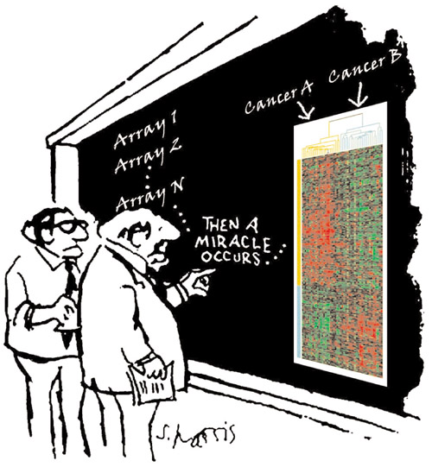
MICROARRAYS:
Chipping Away at the Mysteries of Science and Medicine
“I think you should be more explicit here in step two.“ Modified with permission from a cartoon by Sidney Harris and from an image provided by Patrick Brown. Leung et al. Genome Biology 2001 2:reports4021.1 doi:10.1186/gb-2001-2-9-reports4021

Slide 2
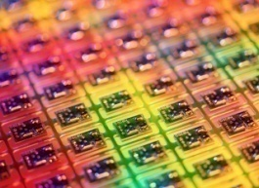
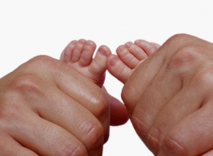
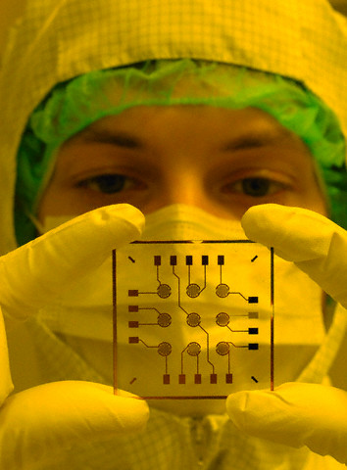
陣列
In computer science an array is a data structure consisting of a group of elements that are accessed by indexing. In most programming languages each element has the same data type and the array occupies a contiguous area of storage. Most programming languages have a built-in array data type.
Some programming languages support array programming (e.g., APL, newer versions of Fortran) which generalises operations and functions to work transparently over arrays as they do with scalars, instead of requiring looping over array members.
Multi-dimensional arrays are accessed using more than one index: one for each dimension.
Arrays can be classified as fixed-sized arrays (sometimes known as static arrays) whose size cannot change once their storage has been allocated, or dynamic arrays, which can be resized.
微
Micro is an English prefix of Greek origin that refers to an object as being smaller than an object or scale of focus, in contrast with macro.

Slide 3
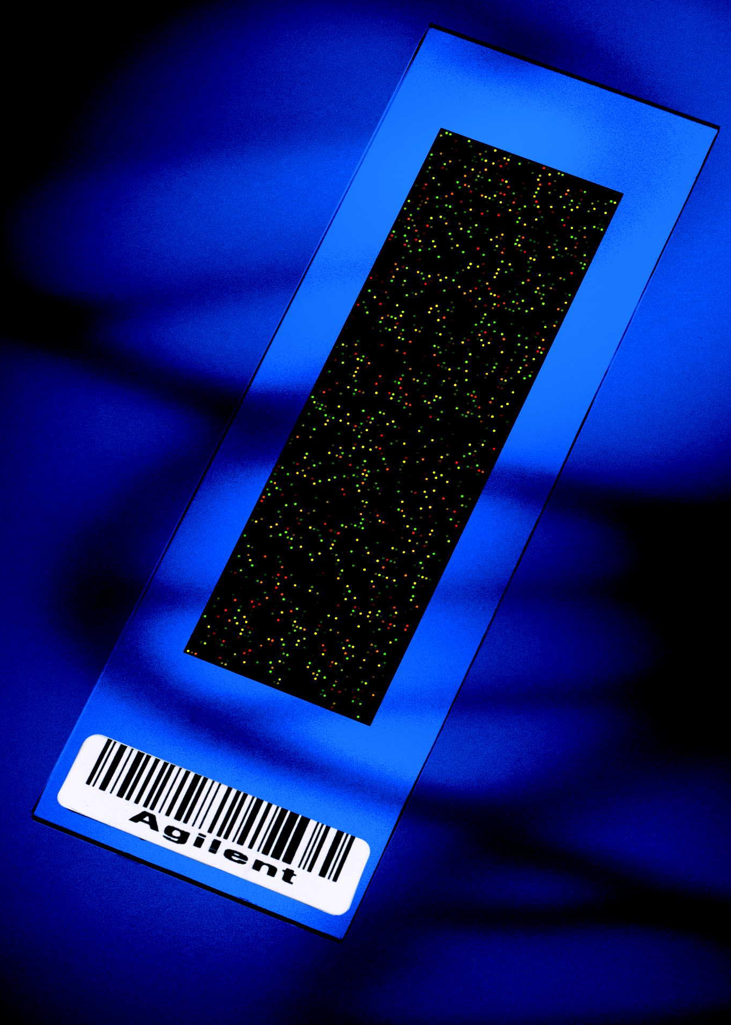
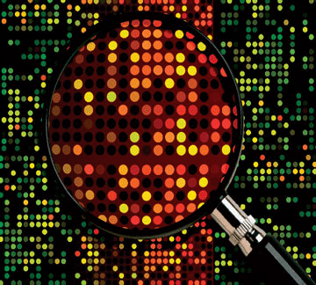
Microarrays are miniaturized biological devices consisting in molecules, for example DNA or protein, named the "probes", that are orderly arranged at a microscopic scale onto a solid support such as a membrane or a glass microscope slide.

Slide 4

What problems can it solve?
Differing expression of genes over time, between tissues, and disease states
Identification of complex genetic diseases
Drug discovery and toxicology studies
Mutation/polymorphism detection (SNP’s)
Pathogen analysis

Slide 5
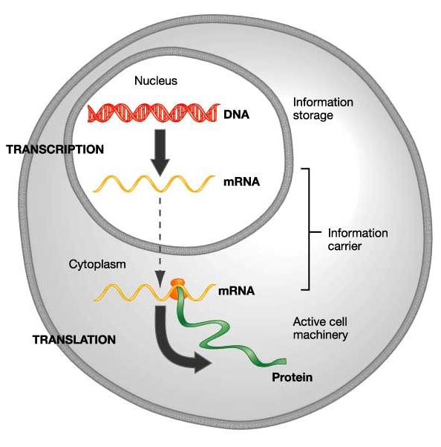
1. Type of target DNA (immobilized nucleic acid molecule) used in the array fabrication.
cDNA, oligonucleotide, RNA, protein, antibody, tissue
DNA
Transcription
RNA
Translation
Protein
CHIP-on-chip
array CGH
expression array
protein chip
tissue array

Slide 6
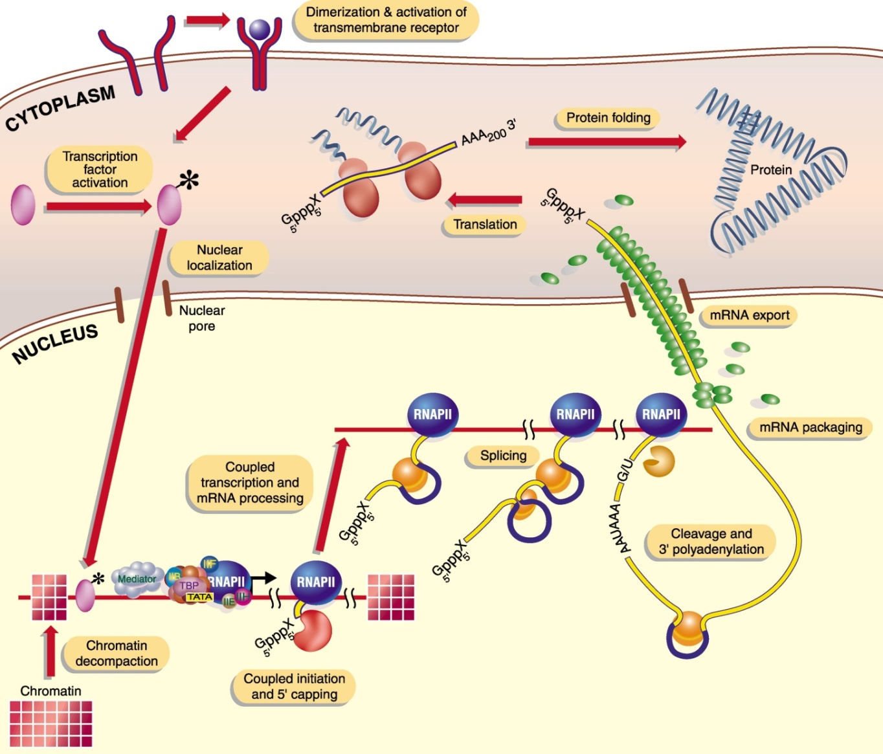
Central Dogma and Existing Microarrays Types
aCGH
SNP array
Tilling array
ROMA
Barcode array
cDNA array
qPCR array
RNA array
Protein array
CHIP on chip
Antibody array
Organic compound
Small molecule
ELISA array
Cell array
Tissue array
Lab-on-a-chip
Cell array, Tissue array, ELISA array
Protein array, Antibody array,
Small molecular array, Organic compound
Protein array
Expression array, qPCR array
Expression array
CHIP on chip
aCGH, SNP array, Tilling array, ROMA, Barcode,

Slide 7
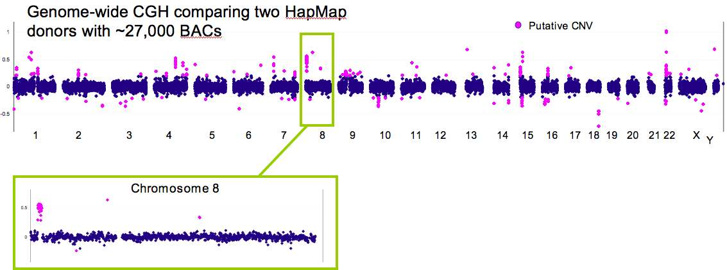
aCGH
SNP array
Tilling array
cDNA array
qPCR array
RNA array
Protein array
CHIP on chip
Antibody array
Organic compound
ELISA array
Cell array
Tissue array
Lab-on-a-chip
Array comparative genomic hybridization (also CMA, Chromosomal Microarray Analysis, Microarray-based comparative genomic hybridization, array CGH, a-CGH, aCGH, or virtual karyotype) genomic copy number variations at a higher resolution level than chromosome-based comparative genomic hybridization (CGH). This is a molecular-cytogenetic method for the analysis of copy number changes (gains/losses) in the DNA content of a given subject's DNA and often in tumor cells.

Slide 8
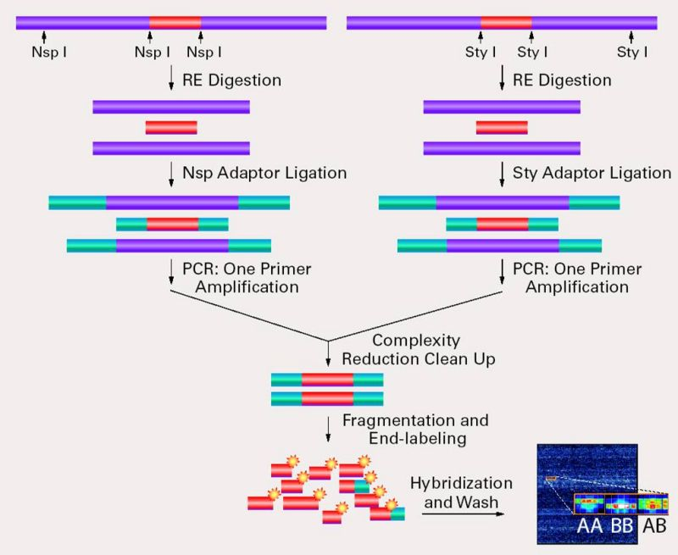
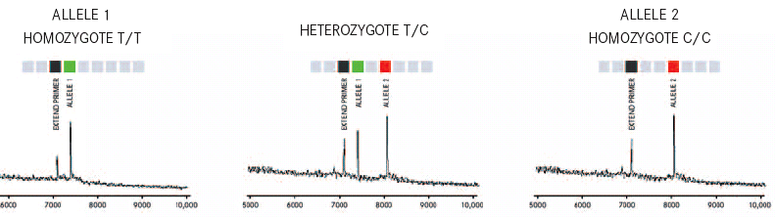
aCGH
SNP array
Tilling array
cDNA array
qPCR array
RNA array
Protein array
CHIP on chip
Antibody array
Organic compound
ELISA array
Cell array
Tissue array
Lab-on-a-chip
A single nucleotide polymorphism (SNP, pronounced snip) is a DNA sequence variation occurring when a single nucleotide — A, T, C, or G — in the genome (or other shared sequence) differs between members of a species (or between paired chromosomes in an individual). For example, two sequenced DNA fragments from different individuals, AAGCCTA to AAGCTTA, contain a difference in a single nucleotide. In molecular biology and bioinformatics, a SNP array is a type of DNA microarray which is used to detect polymorphisms within a population.

Slide 9
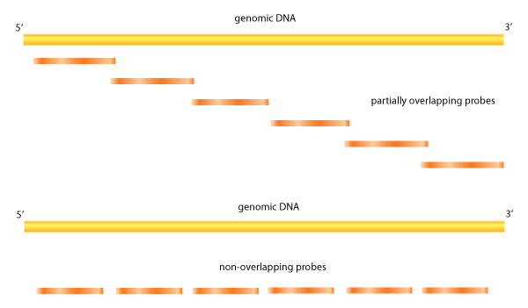
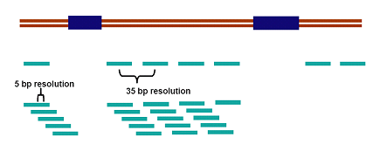
aCGH
SNP array
Tilling array
cDNA array
qPCR array
RNA array
Protein array
CHIP on chip
Antibody array
Organic compound
ELISA array
Cell array
Tissue array
Lab-on-a-chip
Tiling arrays differ in the nature of the probes. Short fragments are designed to cover the entire genome or contigs of the genome. Depending on the probe lengths and spacing different degrees of resolution can be achieved. Number of features on a single array can range from 10,000 to greater than 6,000,000, with each feature containing millions of copies of one probe. Tiling arrays can produce an unbiased look at gene expression because previously unidentified genes can still be incorporated. On top of individual gene expression analysis, other tiling arrays can be used in transcriptome mapping, ChIP-chip, MeDIP-chip and DNase Chip studies, Array CGH among others.

Slide 10
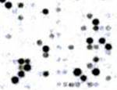
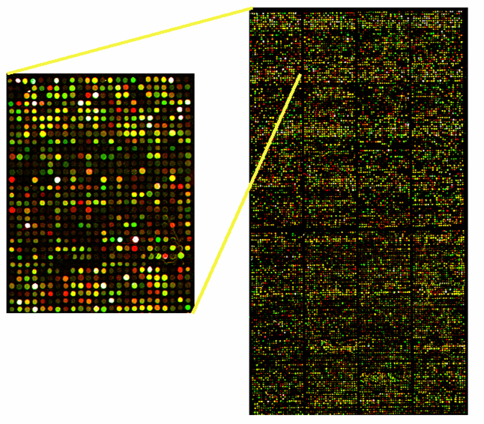

aCGH
SNP array
Tilling array
cDNA array
qPCR array
RNA array
Protein array
CHIP on chip
Antibody array
Organic compound
ELISA array
Cell array
Tissue array
Lab-on-a-chip
A DNA microarray (also commonly known as gene or genome chip, DNA chip, or gene array) is a collection of microscopic DNA spots, commonly representing single genes, arrayed on a solid surface by covalent attachment to a chemical matrix. DNA arrays are different from other types of microarray only in that they either measure DNA or use DNA as part of its detection system. Qualitative or quantitative measurements with DNA microarrays utilize the selective nature of DNA-DNA or DNA-RNA hybridization under high-stringency conditions and fluorophore-based detection. DNA arrays are commonly used for expression profiling, i.e., monitoring expression levels of thousands of genes simultaneously, or for comparative genomic hybridization.
Isotope
Nylon – cDNA (300-900 nt)
Two-colour
cDNA or Oligo (80 nt)
500 – 11,000 elements
Affymetrix
Silicone – oligo (20 nt)
22 ,000 elements

Slide 11
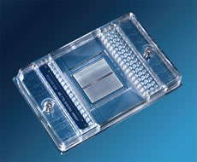
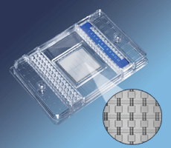
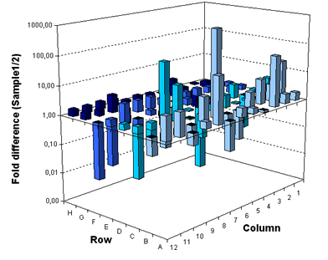
aCGH
SNP array
Tilling array
cDNA array
qPCR array
RNA array
Protein array
CHIP on chip
Antibody array
Organic compound
ELISA array
Cell array
Tissue array
Lab-on-a-chip
Tiling arrays
Quantitative polymerase chain reaction (qPCR) is a modification of the polymerase chain reaction used to rapidly measure the quantity of DNA, complementary DNA or ribonucleic acid present in a sample. Like other forms of polymerase chain reaction, the process is used to amplify DNA samples, via the temperature-mediated enzyme DNA polymerase. qPCR Arrays are designed to profile the expression of a panel of genes relevant to a specific pathway or disease state.

Slide 12
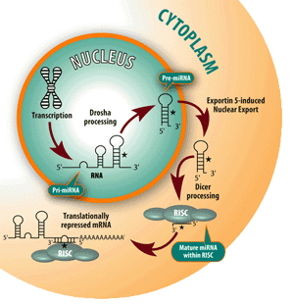
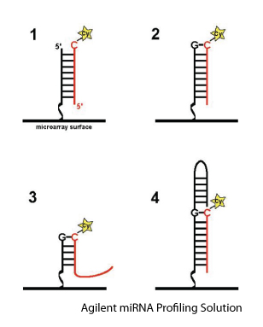
aCGH
SNP array
Tilling array
cDNA array
qPCR array
RNA array
Protein array
CHIP on chip
Antibody array
Organic compound
ELISA array
Cell array
Tissue array
Lab-on-a-chip
In genetics, microRNAs (miRNA) are single-stranded RNA molecules of 21-23 nucleotides in length, which regulate gene expression. miRNAs are encoded by genes from whose DNA they are transcribed but miRNAs are not translated into protein (non-coding RNA); instead each primary transcript (a pri-miRNA) is processed into a short stem-loop structure called a pre-miRNA and finally into a functional miRNA. Mature miRNA molecules are partially complementary to one or more messenger RNA (mRNA) molecules, and their main function is to down-regulate gene expression. MicroRNA array is a kind of arrays which is designed for the detection of miRNA expression profile.

Slide 13
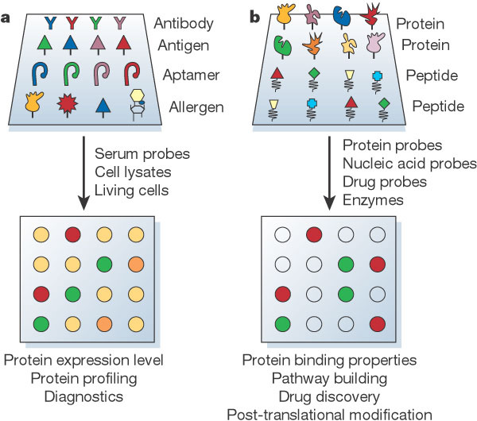
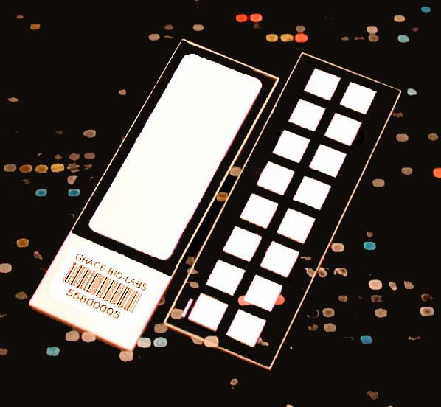
aCGH
SNP array
Tilling array
cDNA array
qPCR array
RNA array
Protein array
CHIP on chip
Antibody array
Organic compound
ELISA array
Cell array
Tissue array
Lab-on-a-chip
A protein microarray is a piece of glass on which different molecules of protein have been affixed at separate locations in an ordered manner thus forming a microscopic array. These are used to identify protein-protein interactions, to identify the substrates of protein kinases, or to identify the targets of biologically active small molecules. The most common protein microarray is the antibody microarray, where antibodies are spotted onto the protein chip and are used as capture molecules to detect proteins from cell lysate solutions. Related microarray technologies also include DNA microarrays, Antibody microarrays, Tissue microarrays and Chemical Compound Microarrays.

Slide 14
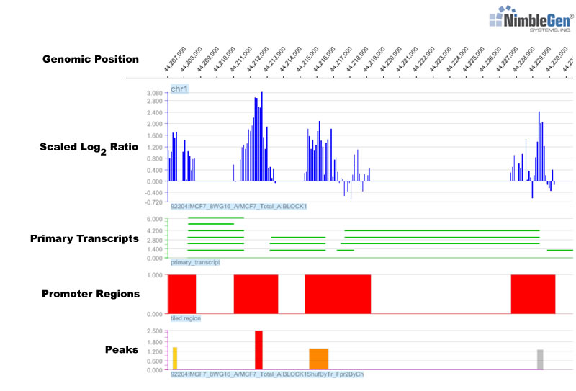
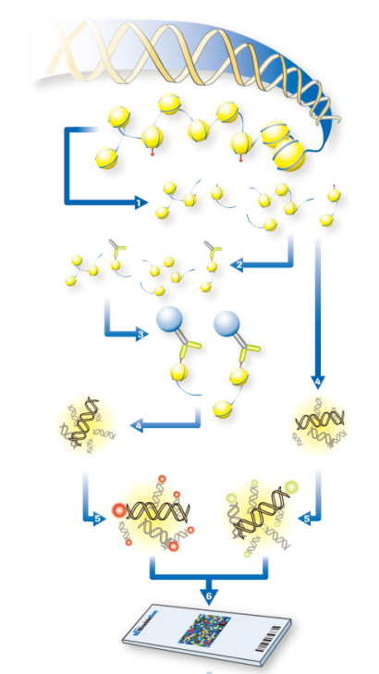
aCGH
SNP array
Tilling array
cDNA array
qPCR array
RNA array
Protein array
CHIP on chip
Antibody array
Organic compound
ELISA array
Cell array
Tissue array
Lab-on-a-chip
ChIP-on-chip (also known as ChIP-chip) is a technique that combines chromatin immunoprecipitation ("ChIP") with microarray technology ("chip"). Like regular ChIP, ChIP-on-chip is used to investigate interactions between proteins and DNA in vivo. Specifically, it allows the identification of binding sites of DNA-binding proteins on a genome-wide basis. One of the long-term goals ChIP-on-chip was designed for is to establish a catalogue of (selected) organisms that lists all protein-DNA interactions under various physiological conditions.

Slide 15
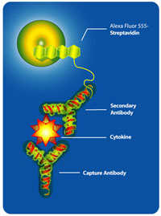
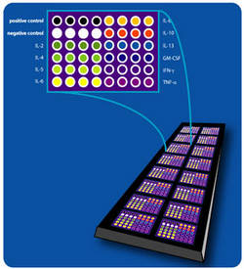
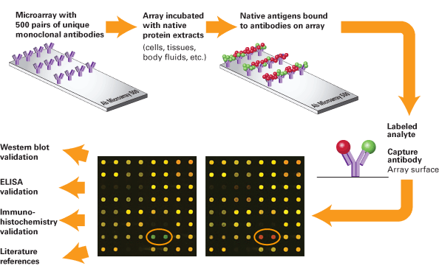
aCGH
SNP array
Tilling array
cDNA array
qPCR array
RNA array
Protein array
CHIP on chip
aAntibody
Organic compound
ELISA array
Cell array
Tissue array
Lab-on-a-chip
An antibody microarray is a specific form of protein microarrays, a collection of capture antibodies are spotted and fixed on a solid surface, such as glass, plastic and silicon chip for the purpose of detecting antigens. Antibody microarray is often used for detecting protein expressions from cell lysates in general research and special biomarkers from serum or urine for diagnostic applications.

Slide 16
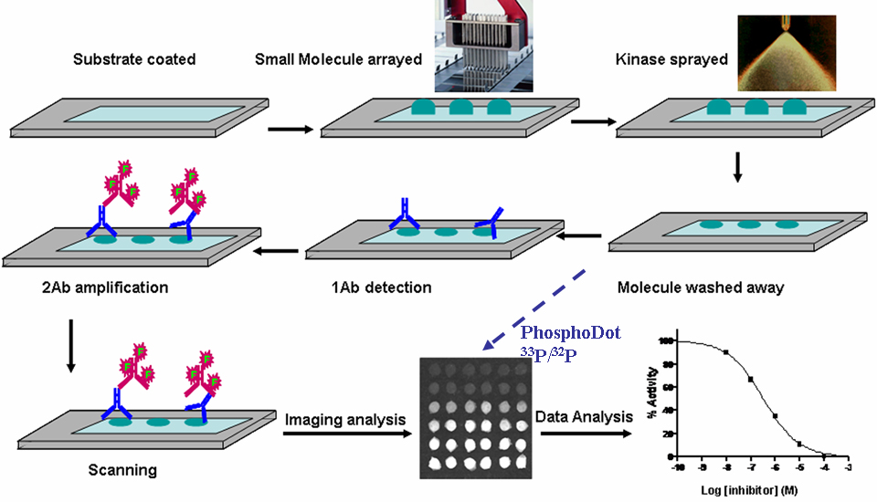
aCGH
SNP array
Tilling array
cDNA array
qPCR array
RNA array
Protein array
CHIP on chip
Antibody array
aOrganic cpd
ELISA array
Cell array
Tissue array
Lab-on-a-chip
A chemical compound microarray is a collection of organic chemical compounds spotted on a solid surface, such as glass and plastic. In chemical genetics research, they are routinely used for searching proteins that bind with specific chemical compounds, and in general drug discovery research, they provide a multiplex way to search potential drugs for therapeutic targets. There are three different forms of chemical compound microarrays based on the fabrication method, to covalently immobilize (usually called Small Molecule Microarray), to spot and dry organic compounds on the solid surface without immobilization (commercial name as Micro Arrayed Compound Screening (µARCS)), and to spot organic compounds in a homogenous solution without immobilization and drying effect.

Slide 17
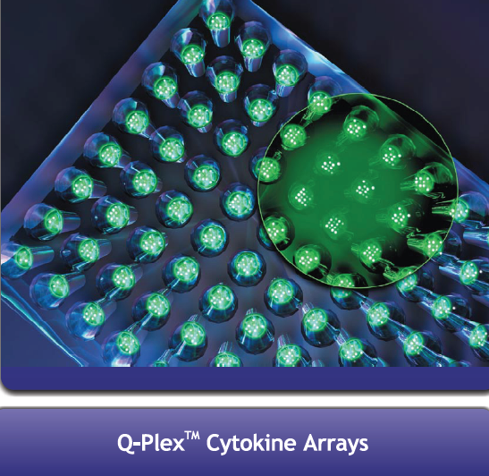

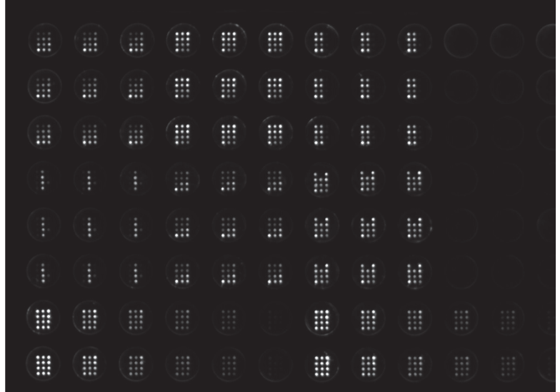
aCGH
SNP array
Tilling array
cDNA array
qPCR array
RNA array
Protein array
CHIP on chip
Antibody array
Organic compound
ELISA array
Cell array
Tissue array
Lab-on-a-chip
Enzyme-Linked ImmunoSorbent Assay, or ELISA, is a biochemical technique used mainly in immunology to detect the presence of an antibody or an antigen in a sample. The ELISA has been used as a diagnostic tool in medicine and plant pathology, as well as a quality control check in various industries. ELISA array (or array ELISA) is a new technology capable of simultaneously identifying multiple biomarkers to generate a biochemical profile. Once the ELISA protocol is completed the array is imaged using either a CCD imaging system or X-ray film to capture the chemiluminescent signal. The pixel intensity of each spot is directly correlated to the concentration.

Slide 18
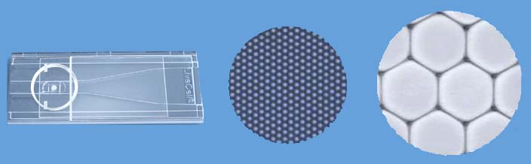
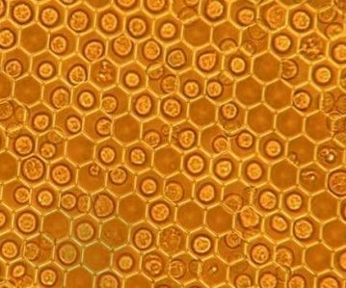
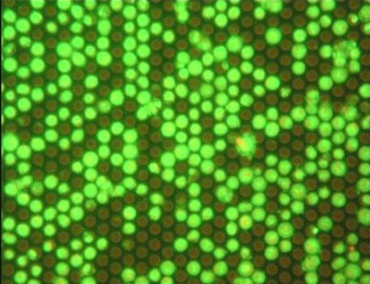
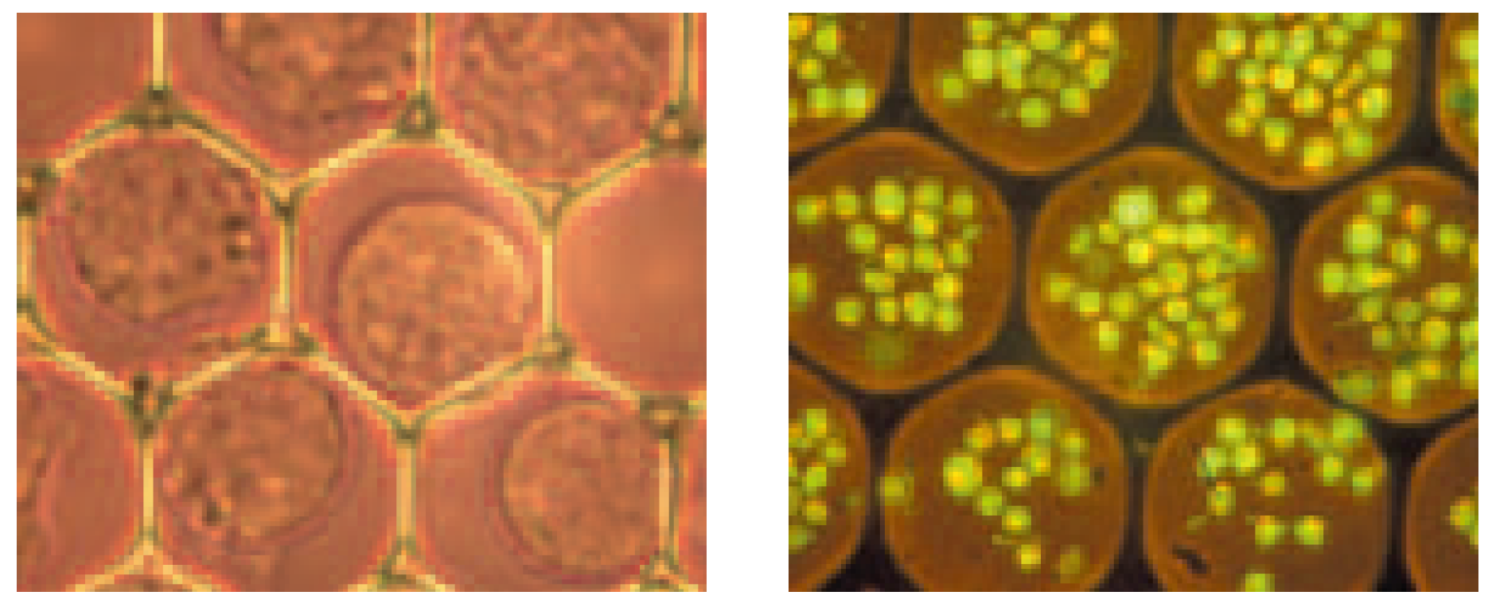
aCGH
SNP array
Tilling array
cDNA array
qPCR array
RNA array
Protein array
CHIP on chip
Antibody array
Organic compound
ELISA array
Cell array
Tissue array
Lab-on-a-chip
Cell array is a common term for different techniques, which are used in genomic-level cell biological testing. The live cell array, a microscope slide-based high content analysis tool, enables multi-parametric imaging-based assays on thousands of intact individual cells, including non-adhering blood and bone marrow cells. Cells can be observed in their own identified location, tracking individual, real-time responses to intervention. Multiple functional assays can be performed on a living cell, followed by post-fixation studies on the same cell to maximize usage of cell samples
LIVECELL ARRAY microscope slide
The Individual Cell Array with 15 (left) and 100-micron.

Slide 19
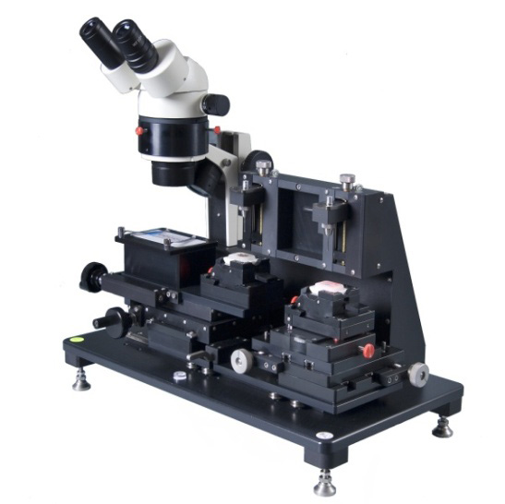
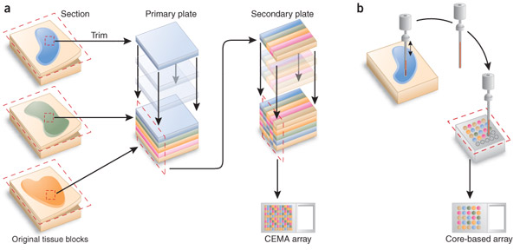
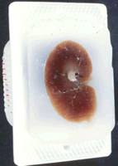
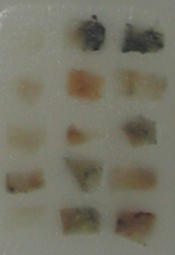
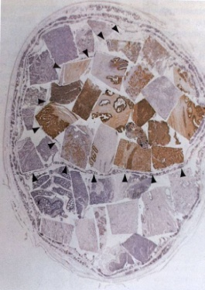
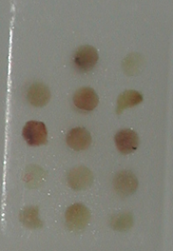
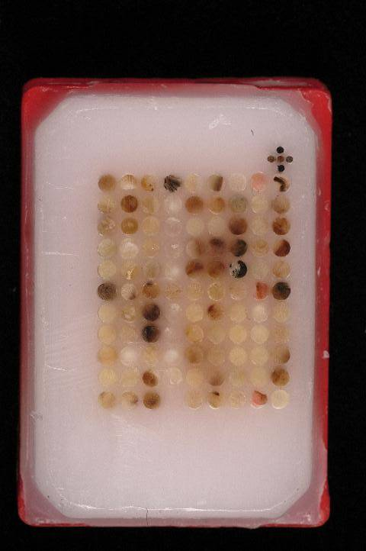
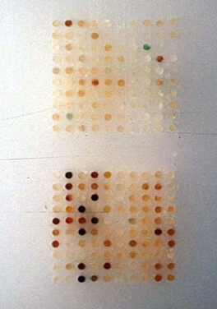
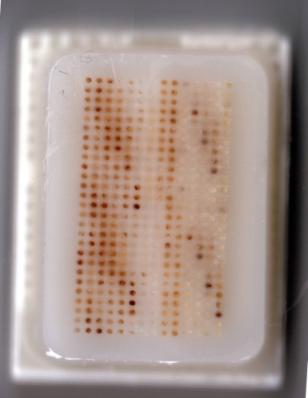
aCGH
SNP array
Tilling array
cDNA array
qPCR array
RNA array
Protein array
CHIP on chip
Antibody array
Organic compound
ELISA array
Cell array
Tissue array
Lab-on-a-chip
Tissue microarrays are produced by a method of re-locating tissue from conventional histologic paraffin blocks so that tissue from multiple patients or blocks can be seen on the same slide. This is done by using a needle to biopsy a standard histologic sections and placing the core into an array on a recipient paraffin block.
1
2
3
4
5
6
7
whole
tissue
tissue
cocktail
tissue
sausage
tissue array

Slide 20
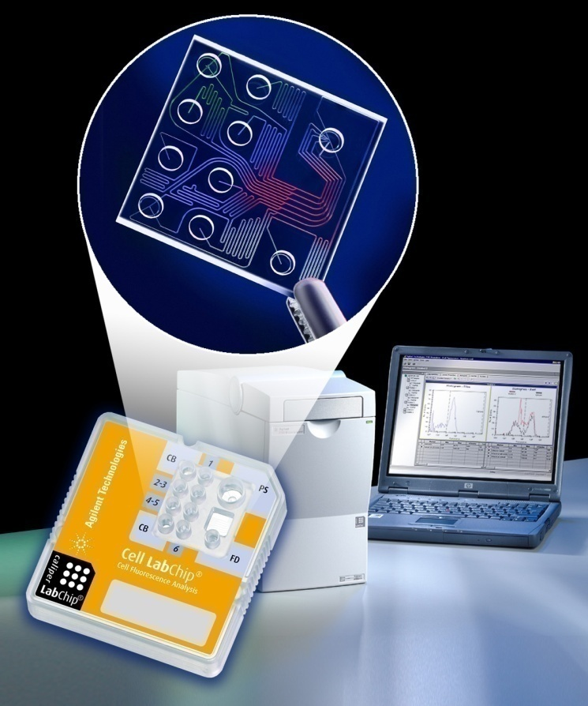
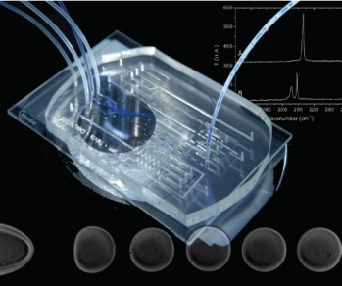
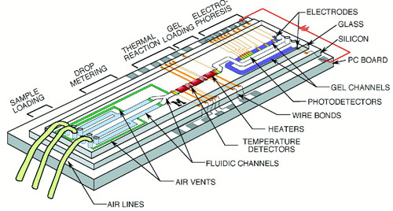
aCGH
SNP array
Tilling array
cDNA array
qPCR array
RNA array
Protein array
CHIP on chip
Antibody array
Organic compound
ELISA array
Cell array
Tissue array
Lab-on-a-chip
Lab-on-a-chip (LOC) is a term for devices that integrate (multiple) laboratory functions on a single chip of only millimeters to a few square centimeters in size and that are capable of handling extremely small fluid volumes down to less than pico liters.

Slide 21







Digital Image Analogy
Northern blot
Customized
Commercial
Expression
CGH (LOH)
ChIP,
CGR,
Exp Tiling,
Methylation,
…
Low density
low content
High density
high content
Short probes
limited contrast
limited channels
High density
high content
Long, isothermal probes
high contrast
multiple channels

Slide 22

make a choice,
which one you like it and start on it

Slide 23

The 6 steps of a microarray experiment
Manufacturing of the microarray
Experimental design and choice of reference: what to compare to what?
Target preparation (labeling) and hybridization
Image acquisition (scanning) and quantification (signal intensity to numbers)
Database building, filtering and normalization
Statistical analysis and data mining
Microarrayer
Experimental design
Hybridization
Washing and Drying
Scanning
Application

Slide 24
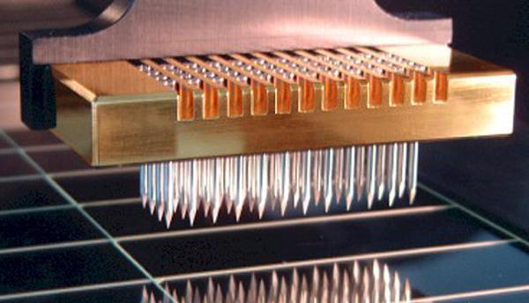
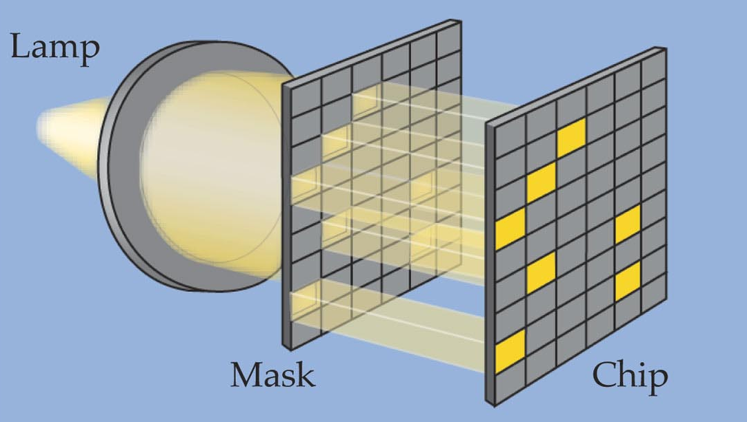
  Ink-jet printer microarrays
Photolithography
  Ink-jet printhead draws up DNA Ink-jet printer microarrays
  Printhead moves to specific location on solid support
  DNA ejected through small hole
  Used to spot DNA or synthesize oligonucleotides directly on glass slide
  Use pioneered by Agilent Technologies, Inc.
Light-activated chemical reaction
  For addition of bases to growing oligonucleotide
Custom masks
  Prevent light from reaching spots where bases not wanted
Mirrors also used
  AffymetrixTM, NimbleGen™ uses this approach
Notes:
Another method for depositing DNA on glass slides is the use of ink-jet printer technology. Ink-jet printers are designed to deposit very small quantities of ink in precise locations. As adapted for microarray spotting, the printhead draws up a small amount of DNA, moves to a particular point on the slide, and ejects the DNA through a very small hole. This technology has also been adapted to provide for the synthesis of oligonucleotides on slides. After each base is added through the printhead to the growing oligonucleotide, the slide is washed free of excess nucleotides, and the exposed bases are primed for the addition of the next nucleotide. Agilent Technologies has pioneered the use of ink-jet printing for making microarrays. The primary drawback of this approach as compared with photolithography is that the maximum number of spots on a slide is far fewer with the ink-jet printing of DNA.

Slide 25

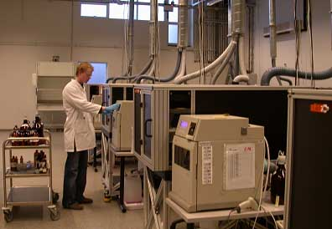


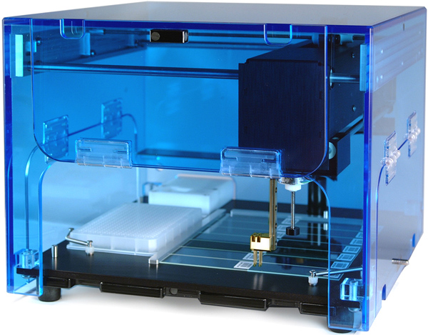





DNA spotting
DNA spotting usually uses multiple pins
DNA in microtiter plate
DNA usually PCR amplified
Oligonucleotides can also be spotted
Notes:
Most robotic spotters use pins that act by capillary action similar to that of fountain pens. Multiple pins are mounted together and dipped simultaneously into DNA aliquoted into the different wells of a microtiter plate. The DNA in the wells has usually been amplified from cDNA or genomic DNA, using PCR. Oligonucleotides can also be spotted in this way.

Slide 26

Oligonucleotide microarrays – pioneered by Affymetrix
Oligonucleotides
  usually at least 20–25 bases in length, optimal with 45~60 bps long
  10–20 different oligonucleotides for each gene
Oligonucleotides for each gene selected by computer program to be the following:
  unique in genome (4 ^{(20 to 25)} =2⁽⁴⁰ ^{to 50)} >> 3*10⁹ = 2³⁰), not likely to appear twice
  non-overlapping (if the sequence length is too short then specificity is low, whereas if the length is too long, self-hybridization could happen)
Composition based on design rules
  empirically derived rules
  (ratio of G-C pairs vs. A-T pairs which
  could affect the melting temperature
  of the seq., ie. T_{m} = 64.9+0.41*(GC%)
  -675/L)
Notes:
On Affymetrix GeneChips, there are between 10 and 20 oligonucleotides for each gene. The choice of oligonucleotides is determined using a computer program that searches for nonoverlapping stretches of 20-25 bases that are unique in the genome (in order to prevent cross-hybridization). Furthermore, the computer searches for oligonucleotides that will fit empirically derived design rules that dictate the ratio of G–C pairs vs. A–T pairs and that attempt to reduce the likelihood that the oligonucleotide will hybridize to itself, creating hairpin structures.

Slide 28





Experimental methodology
1
2
3
4
5
Experimental
Design
Microarray
Experiments
Image
Processing
Data
Normalization
Data
Analysis

Slide 30


Microarray Experiment Design
Type I: (n = 2) Differential Expression
  How is this gene expressed in target 1 as compared to target 2?
  Which genes show up/down regulation between the two targets?
Type II: (n > 2) Data Partitioning
  How does the expression of gene A vary over time, tissues, or treatments?
  Do any of the expression profiles exhibit similar patterns of expression?

Slide 31

Manufacturing of the microarray
Experimental design and choice of reference: what to compare to what?
Target preparation (labeling) and hybridization
Image acquisition (scanning) and quantification (signal intensity to numbers)
Database building, filtering and normalization
Statistical analysis and data mining
Samples
Platform
Raw Data (image, 16bit .tif file)
image acquisition
spot location
Preprocessed Data (.gal file)
computation of spot intensities
Data Analysis (different levels)
data reporting

Slide 32


5. Type of labeling for hybridization.
single channel using one color and double channel using two color
cy3
cy5
Scan and detect with
confocal laser system
Green channel
Red channel
Overlay images
and normalize
Image process
and analyze

Slide 33



Image Processing
Addressing or gridding
  locate centers, assigning coordinates to each of the spots
Segmentation or spot picking
  classifying pixels either as foreground or as background
Intensity extraction (for each spot)
  Foreground fluorescence intensity pairs (R, G)
  Background intensities
  Quality measures
Information extraction
  for each spot of the array, calculates signal intensity pairs, background and quality measures
background
signal
Raw (combined) image
Gridded
Spots picked & flagged
Intensity

Slide 34

Manufacturing of the microarray
Experimental design and choice of reference: what to compare to what?
Target preparation (labeling) and hybridization
Image acquisition (scanning) and quantification (signal intensity to numbers)
Database building, filtering and normalization
Statistical analysis and data mining
Reduces systematic (multiplicative) differences between two channels of a single hybridization or differences between hybridizations
Sources of Systematic Bias
  Different dye labeling efficiencies
  Scanning (laser and detector, chemistry of the fluorescent label)
  Differences in concentration of DNA on arrays (plate effects)
  Differences in total mRNA in one sample versus another or mRNA degradation
  Printing or tip problems
  Uneven hybridization
Several Methods:
  Global mean method
  Linear regression method
  Curvilinear methods
  (e.g. LOWESS; LOcally WEighted Scatterplot Smoothing)
  Variance model methods

Slide 35

Manufacturing of the microarray
Experimental design and choice of reference: what to compare to what?
Target preparation (labeling) and hybridization
Image acquisition (scanning) and quantification (signal intensity to numbers)
Database building, filtering and normalization
Statistical analysis and data mining
Guidelines for the statistical analysis of microarray experiments.
Allison DB et al. (2005) Microarray data analysis: from disarray to consolidation and consensus
Nat Rev gene. 7: 55–65 doi:10.1038/nri1749

Slide 36

Find the genes that change expression between experimental and control samples
Classify samples based on a gene expression profile
Find patterns: Groups of biologically related genes that change expression together across samples and treatments
Allison DB et al. (2005) Microarray data analysis: from disarray to consolidation and consensus
Nat Rev gene. 7: 55–65 doi:10.1038/nri1749

Slide 37


Basic Data Analysis
  Fold change (relative increase or decrease in intensity for each gene)
  Set cutoff filter for low values (background +noise)
  Cluster genes by similar changes - only really meaningful across multiple treatments or time points
  Cluster samples by similar gene expression profiles

Slide 38


Higher Level Microarray data analysis
  Clustering and pattern detection
  Data mining and visualization
  Controls and normalization of results
  Statistical validatation
  Linkage between gene expression data and gene sequence/function/metabolic pathways databases
  Discovery of common sequences in co-regulated genes
  Meta-studies using data from multiple experiments
Diagnostic ALL BM samples (n=327)
Genes for class distinction (n=271)
E2A-PBX1
MLL
T-ALL
Hyperdiploid >50
BCR-ABL
Novel
TEL-AML1
-3σ
-2σ
-1σ
0
1σ
2σ
3σ
σ = std deviation from mean

Slide 39
MIAME (Minimum Information About a Microarray Experiment)
MIAME is a standard for reporting microarray experiments. It is intended to specify all the information necessary to interpret the results of the experiment unambiguously and to potentially to reproduce the experiment. While the standard defines the content required for compliant reports, it does not specify the format in which this data should be presented. There are a number of file formats for representing this data, and both public and subscription-based repositories for such experiments. (http://www.mged.org/Workgroups/MIAME/miame_1.1.html)
A need to establish a public repository or repositories for microarray gene expression data became apparent in 1998, which requires data standards
MGED-1 (Microarray Gene Expression Database) Group: November 14-15, 1999, Cambridge, UK
  Established five working groups, including the microarray data annotation group (MIAME)
MGED-2: May 25 - 27, 2000, Heidelberg, Germany
  Endorsed a MIAME draft
MGED-3: March 29-31, 2001, Stanford University
  Adopted MIAME 1.0
MGED-4: Feb. 13-16, 2002, Boston
  Adopted MIAME 1.1
Images
Samples
Spots
Spot/Image quantization
Genes
Gene expression levels
Gene Expression Matrix
The final gene expression matrix (on the right) is needed for higher level analysis and mining.

Slide 40
MIAME: six parts
Experimental Design: the set of the hybridization experiments as a whole
Array Design: each array used and each element (spot) on the array
Samples: samples used, the extract preparation and labeling
Hybridizations: procedures and parameters
Measurements: images, quantitation, specifications
Normalization: types, values, specifications
The solution (e.g. concentration of solutes)
Blocking agent
Wash procedure
Quantity of labelled target used
Time, concentration, volume, temperature
Description of the hybridization instruments
Sample source and treatment
Hybridization extract preparation
Laboratory protocol, including extraction method, whether RNA, mRNA, or genomic DNA is extracted, amplification method
Labeling
Laboratory protocol, including amount of nucleic acids labeled, label used (e.g. Cy3, Cy5, 33P, etc)
Author, contact information, citations
Type of experiment (e.g., time course, normal vs diseased comparison)
Experimental factors – i.e. tested parameters in the experiment (e.g. time, dose, genetic variation, response to a compound)
List of organisms used in the experiment
List of platforms used
Publication
Experiment
Source
(e.g. Taxonomy)
Sample
Hybridization
Array
Gene
(e.g. EMBL)
Normalization strategy (spiking, housekeeping genes, total array, other)
Normalization algorithm
Control array elements
Normalization
Data
Array design related information (e.g. platform type – in situ synthesized or spotted, array provider, surface type – glass, membrane, other, etc)
Properties of each type of elements on the array, that are generated by similar protocols (e.g. synthesized oligos, PCR products, plasmids, colonies, others) – may be simple or composite (Affymetrix)
Each element (spot) on the array
Scanning information
  Scan parameters, including laser power, spatial resolution, pixel space, PMT voltage
  Laboratory protocol for scanning, including scanning hardware and software used
Image analysis information
Image analysis software specification
All parameters
Summarized information from possible replicates

Slide 41

Can networks describe organisms?
Nature Methods - 5, 217 (2008)

