Slide 1

http://petang.cgu.edu.tw/bioinformatics/index.htm
Bioinformatics
Lecture 1 – Introduction to Bioinformtics
Petrus Tang, Ph.D. (鄧致剛)
Graduate Institute of Basic Medical Sciences
and
Bioinformatics Center, Chang Gung University.
petang@mail.cgu.edu.tw
EXT: 5136
助教：
蔡智宇(分機5690)

Slide 2
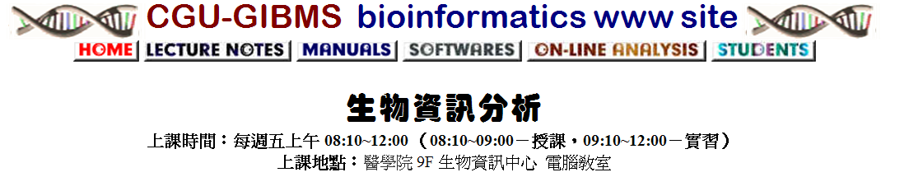
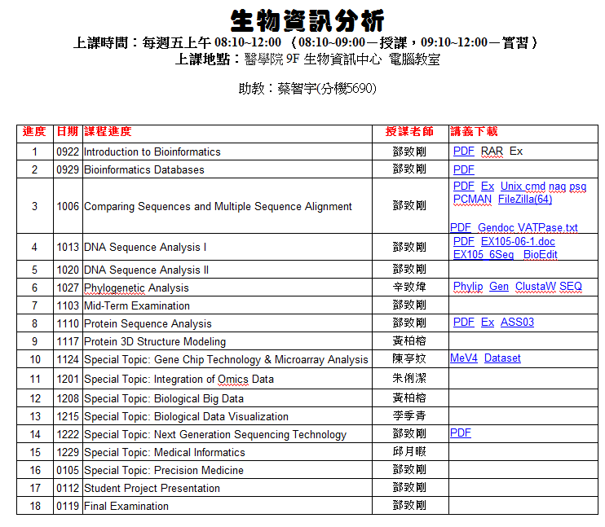
http://petang.cgu.edu.tw/bioinformatics/index.htm

Slide 3
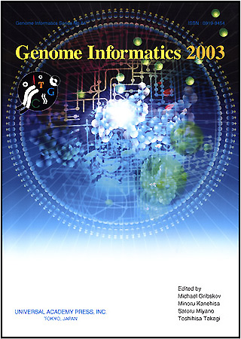
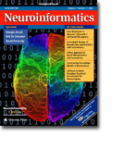

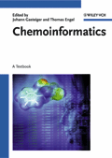
Bio informatics
-Omics Mania biome, cellomics, chronomics, clinomics, complexome, crystallomics, cytomics, degradomics, diagnomics, enzymome, epigenome, expressome, fluxome, foldome, secretome, functome, functomics, genomics, glycomics, immunome, transcriptomics, integromics, interactome, kinome, ligandomics, lipoproteomics, localizome, phenomics, metabolome, pharmacometabonomics, methylome, microbiome, morphome, neurogenomics, nucleome, secretome, oncogenomics, operome, transcriptomics, ORFeome, parasitome, pathome, peptidome, pharmacogenome, pharmacomethylomics, phenomics, phylome, physiogenomics, postgenomics, predictome, promoterome, proteomics, pseudogenome, secretome, regulome, resistome, ribonome, ribonomics, riboproteomics, saccharomics, secretome, somatonome, systeome, toxicomics, transcriptome, translatome, secretome, unknome, vaccinome, variomics...

Slide 4
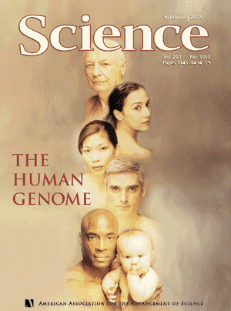
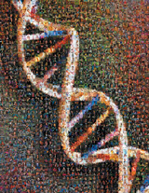
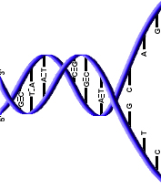
WHAT IS
BIOINFORMATICS?
?
AGCTAGCTAGCTAGCTAGCTAGCTAGCTAGCTAGCTAGCT
AGCTAGCTAGCTAGCTAGCTAGCTATCGATGCATGCATGCATGCA
TGCATGCATGCATGCACTAGCTAGCTAGTGCATGCATGCATG
Bioinformatics

Slide 5

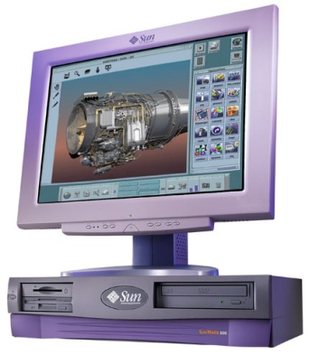
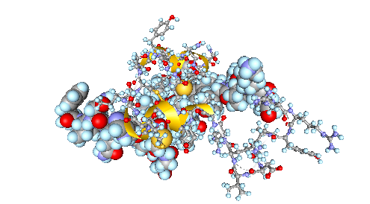
AGGTTGACCAATGTGAAATGGCCAATTGATGACCAGAGATTTAGGCCAATTAA
AGGTTGACCAATGTGAAATGGCCAATTGATGACCAGAGA

Slide 6
What is Bioinformatics?
Development of methods & algorithms to organize, integrate, analyze and interpret biological and biomedical data
Study of the inherent structure & flow of biological information
Goals of bioinformatics:
  Identify patterns
  Classify
  Make predictions
  Create models
  Better utilize existing knowledge
Notes:
6

Slide 7
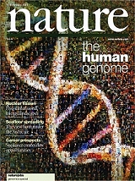
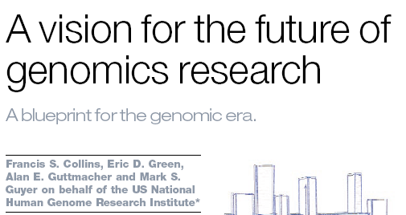

>10 years to finish
USD 3 billion
February 2001: Completion of the Draft Human Genome
Science, 16 February 2001
Vol. 291, Pages 1145-1434
Nature, 15 February 2001
Vol. 409, Pages 813-960
April 2003: High-Resolution Human Genome
Nature, 23 April 2003
Vol. 422, Pages 1-13

Slide 8
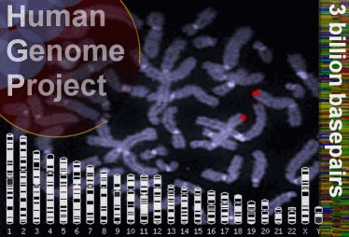
Protein coding sequence
3‘UTR
5‘UTR
promotor
exon 1
exon 2
exon n-1
exon n

Slide 9
Gene Number in the Human Genome

Slide 10
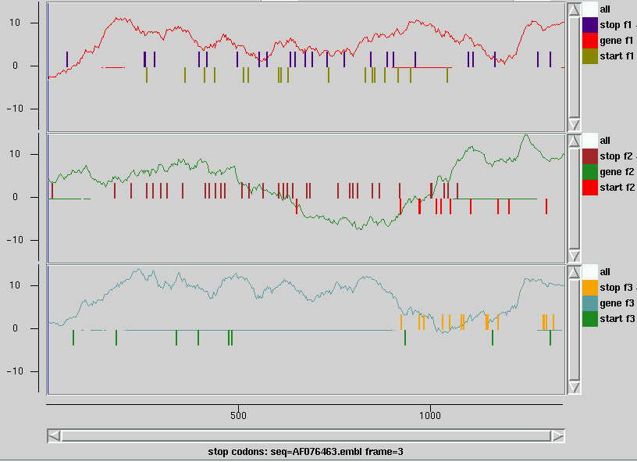
Gene prediction
Codon usage (single exon)
coding
Frame 1
non-coding
Frame 2
coding sequence
Frame 3
correct start

Slide 11
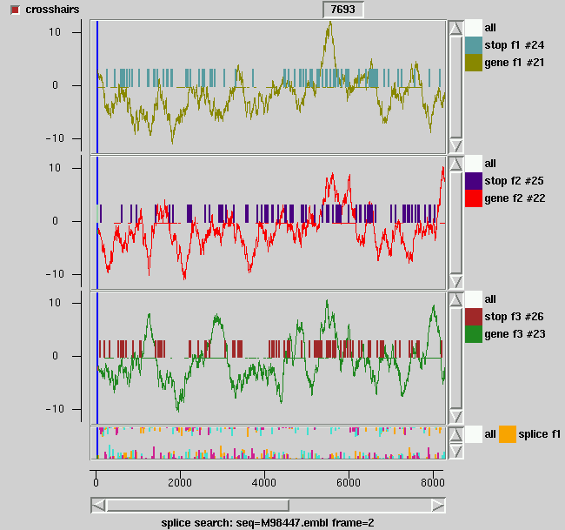
Gene prediction
Codon usage (multiple exons)
Exons:
208. .295
1029. .1349
1500. .1688
2686. .2934
3326. .3444
3573. .3680
4135. .4309
4708. .4846
4993. .5096
7301. .7389
7860. .8013
8124. .8405
8553. .8713
9089. .9225
13841. .14244
coding
Frame 1
non-coding
Frame 2
Frame 3
Splice sites

Slide 12
Drosophila
Functional Assignment using Gene Ontology
13,601 Genes

Slide 13
THE COMPONENTS OF
BIOINFORMATICS
TECHNOLOGY
ALGORITHM
ANALYSIS
TOOLS
DATABASE
COMPUTING
POWER

Slide 14
THE COMPONENTS OF
BIOINFORMATICS
TECHNOLOGY
ALGORITHM
ANALYSIS
TOOLS
DATABASE
COMPUTING
POWER

Slide 15
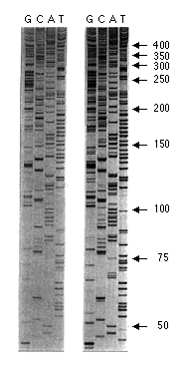
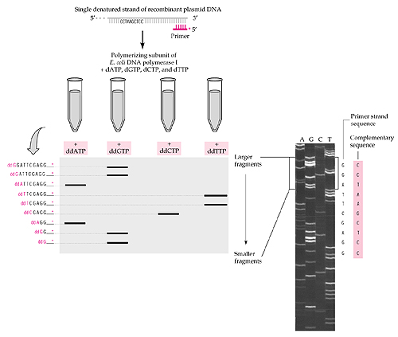
Sanger Dideoxy Sequencing

Slide 17
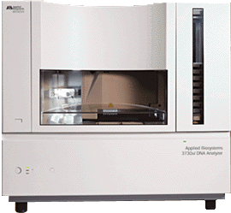
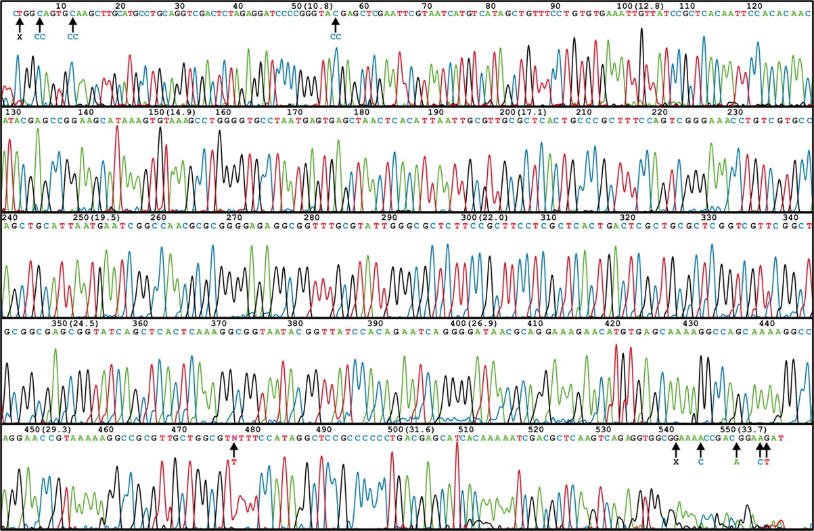
ABI 3730 XL DNA Sequencer
96/384 DNA sequencing in 2 hrs, approximately 600-1000 readable bps per run.
1-4 MB bps/day
A human genome of 3GB need 750 days to finish

Slide 18
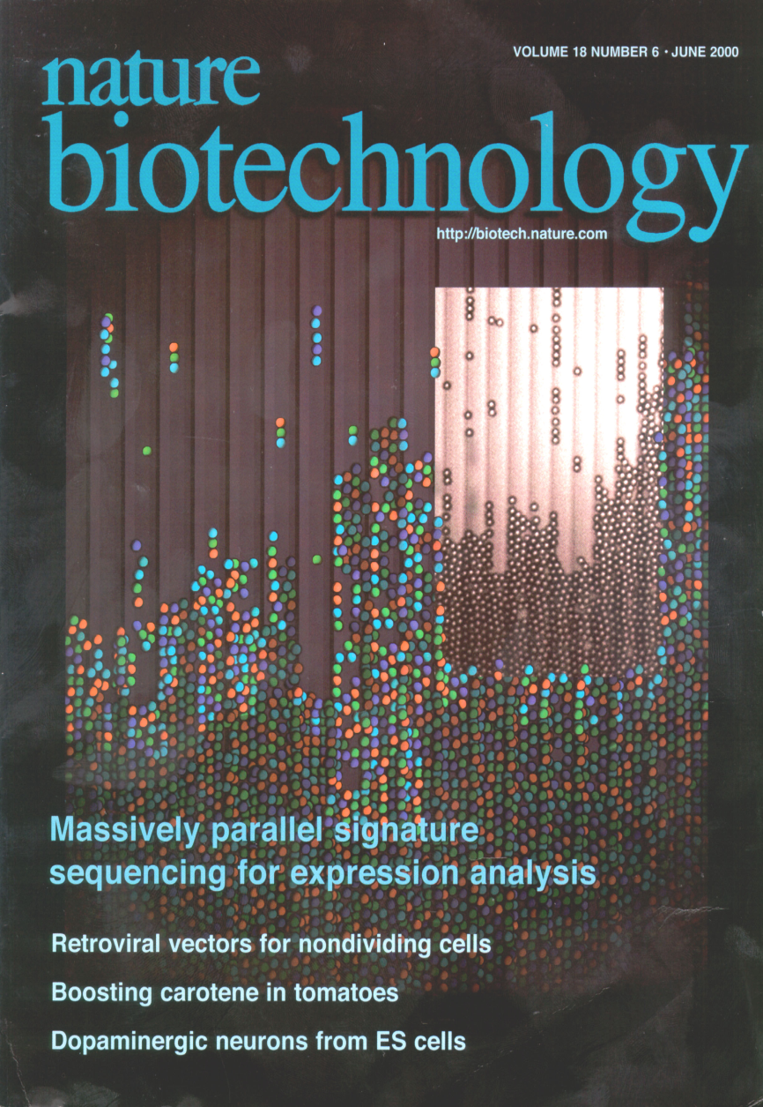
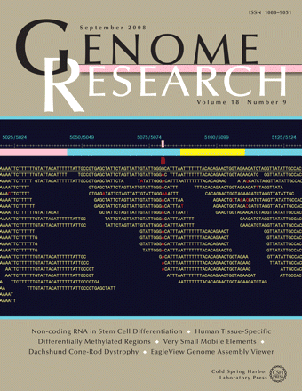
Next Generation Sequencing (NGS) Technology

Slide 19
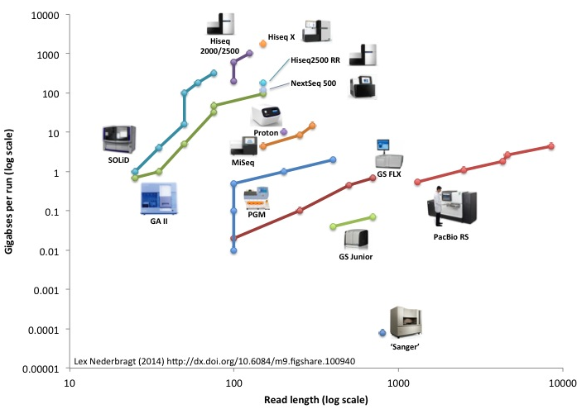
Throughput of NGS machines (2014)

Slide 20
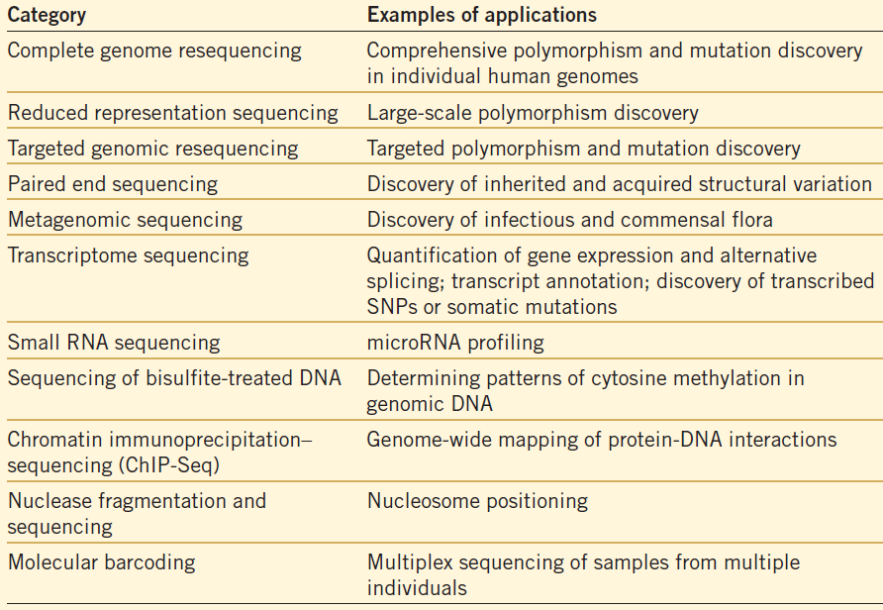
Applications on Biomedical Sciences

Slide 21
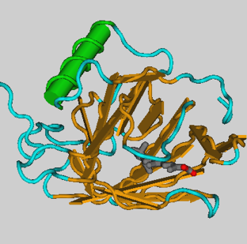
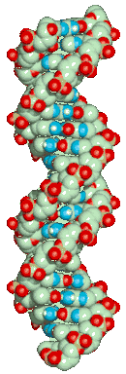
DNA
RNA
protein
phenotype
Genome
Transcriptome
Proteome

Slide 22
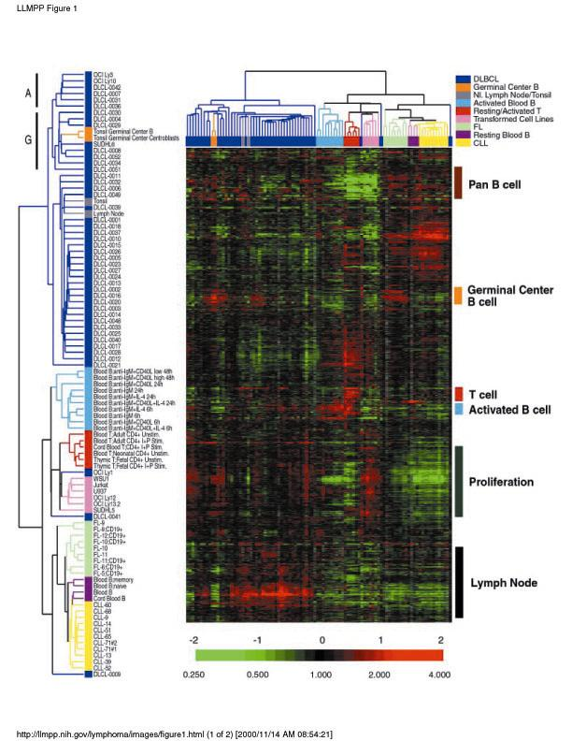
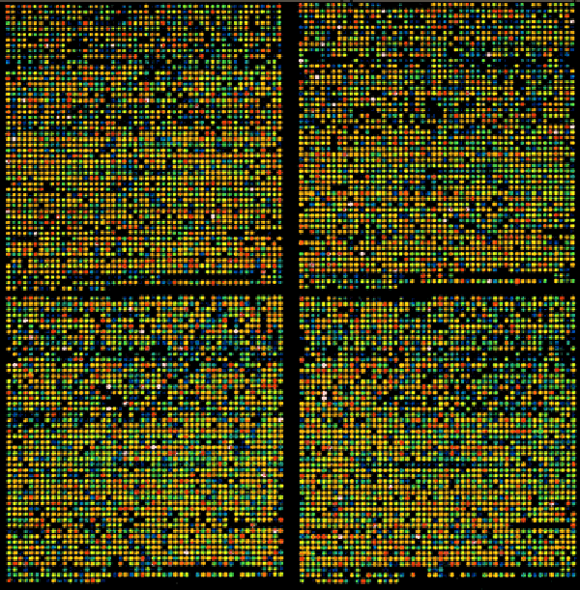
Microarray
20,000-40,000
Clones
per
slide

Slide 23
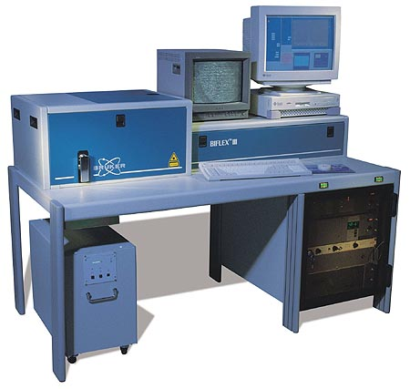
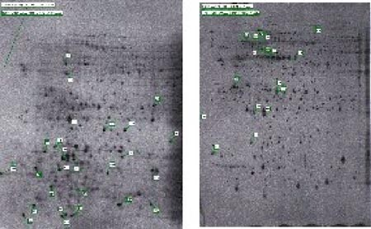
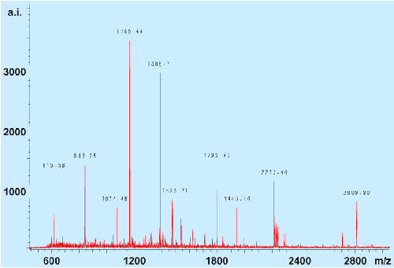
Proteomics
MALDI-MS peptide mass fingerprint, for identification of proteins separated by 2D electrophoresis
2 Dimensional Electrophoresis gels, differences that are characteristics of the individual starting states recognized by comparison of two protein pattern
6,000
protein spots
per gel

Slide 24
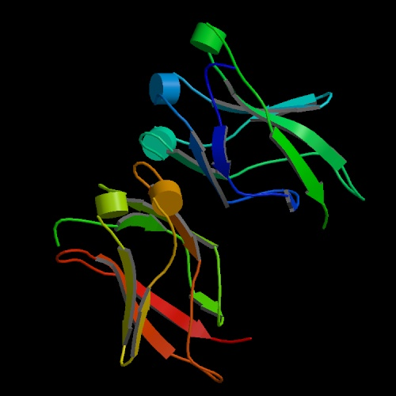
3D Modeling

Slide 25
THE COMPONENTS OF
BIOINFORMATICS
TECHNOLOGY
ALGORITHM
ANALYSIS
TOOLS
DATABASE
COMPUTING
POWER

Slide 26
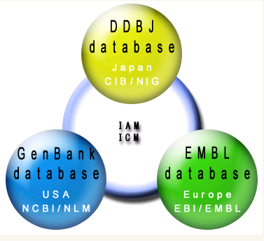
GenBank/EMBL/DDBJ
International
Nucleotide Sequence Database
DDBJ: DNA Data Bank of Japan
CIB: Center for Information Biology and
DNA Data Bank of Japan
NIG: National Institute of Genetics
IAM: International Advisory Meeting
ICM: International Collaborative Meeting
EMBL:
European Molecular Biology
Laboratory
EBI:
European Bioinformatics
Institute
NCBI:
National Center for Biotechnology Information
NLM:
National Library of Medicine

Slide 27
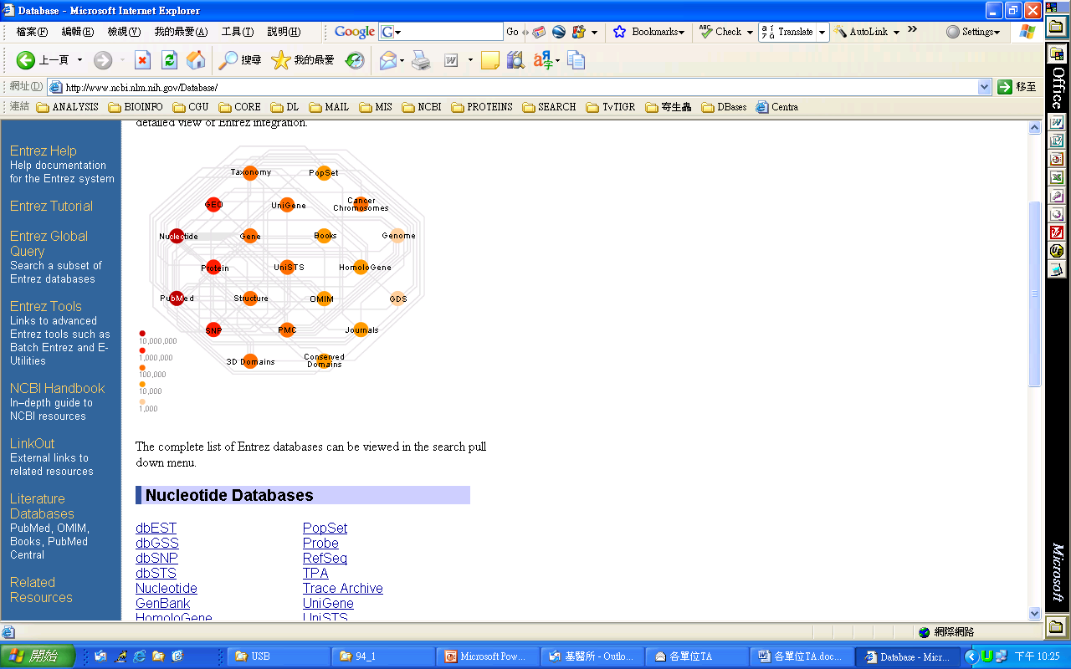
GenBank
Recent years have seen an explosive growth in biological data. Large sequencing projects are producing increasing quantities of nucleotide sequences. The contents of nucleotide databases are doubling in size approximately every 14 months. The latest release of GenBank exceeded 165 billion base pairs. Not only the size of sequence data is rapidly increasing, but also the number of characterized genes from many organisms and protein structures doubles about every two years. To cope with this great quantity of data, a new scientific discipline has emerged: bioinformatics, biocomputing or computational biology
Genetic Sequence Data Bank
Aug 15 2014,
Release 203.0
165,722,980,375 bases, from
174,108,750 reported sequence
ENTRIES
20614460
9724856
2193460
2203159
3967977
3296476
1727319
1796154
744380
1332169
257614
456726
1376132
1588338
1778369
2398266
1267298
809463
2104483
217105
BASES
17575474103
9993232725
6525559108
5391699711
5079812801
4894315374
3128000237
1925428081
1764995265
1617554059
1435261003
1297237624
1265215013
1249788384
1200025462
1165816533
1155228906
1071458039
1020646789
1010316029
SPECIES
Homo sapiens
Mus musculus
Rattus norvegicus
Bos taurus
Zea mays
Sus scrofa
Danio rerio
Triticum aestivum
Solanum lycopersicum
Hordeum vulgare subsp. vulgare
Strongylocentrotus purpuratus
Macaca mulatta
Oryza sativa Japonica Group
Xenopus (Silurana) tropicalis
Nicotiana tabacum
Arabidopsis thaliana
Drosophila melanogaster
Vitis vinifera
Glycine max
Pan troglodytes

Slide 28
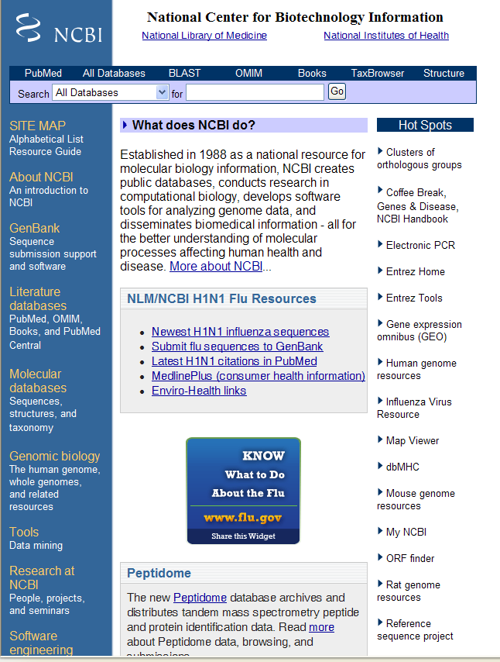
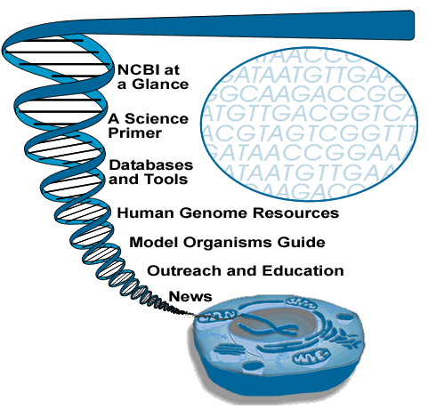

Slide 29
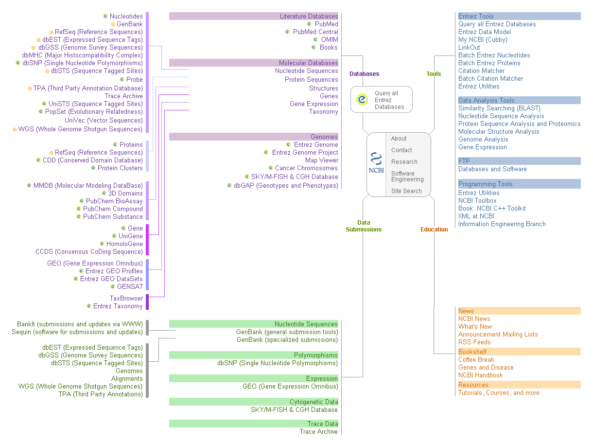
Notes:
shiuan
29

Slide 30
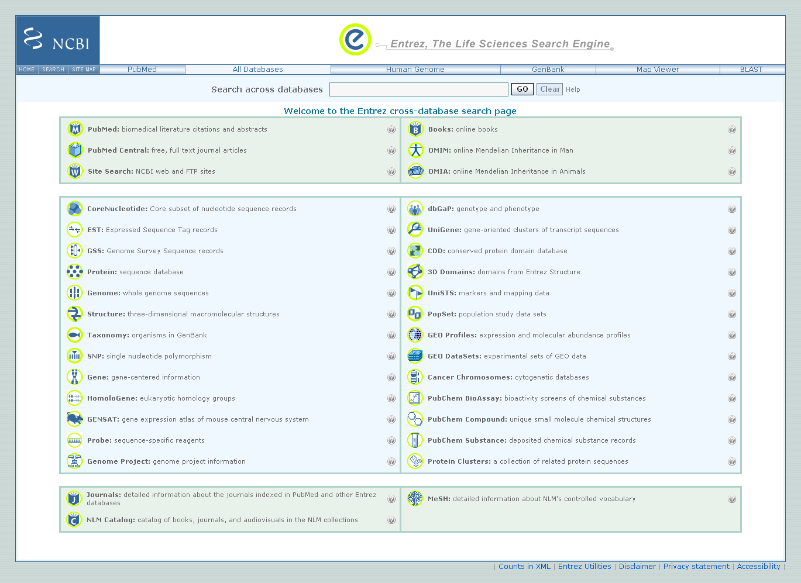

Slide 31
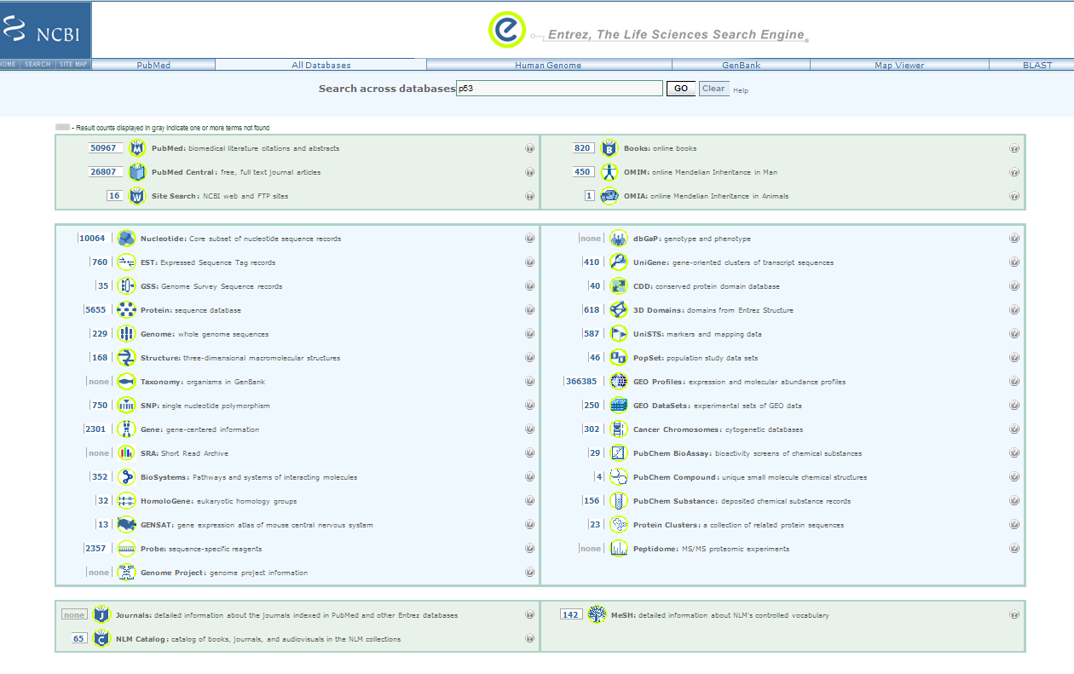

Slide 32
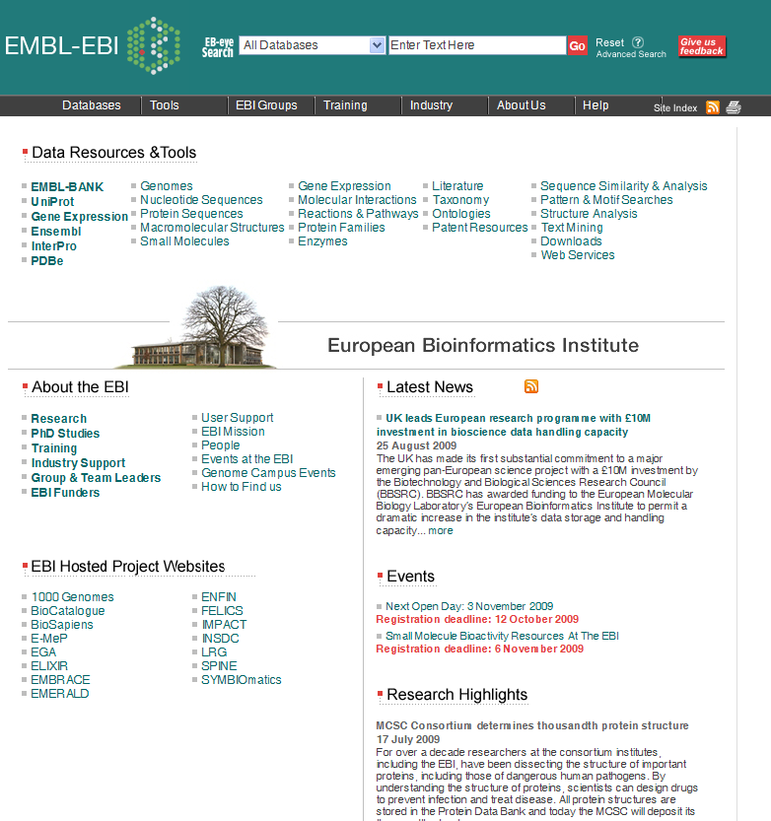

Slide 33
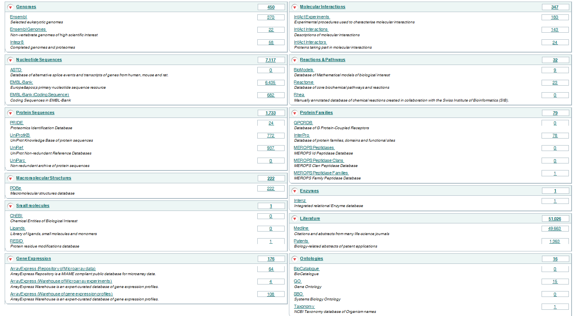

Slide 34

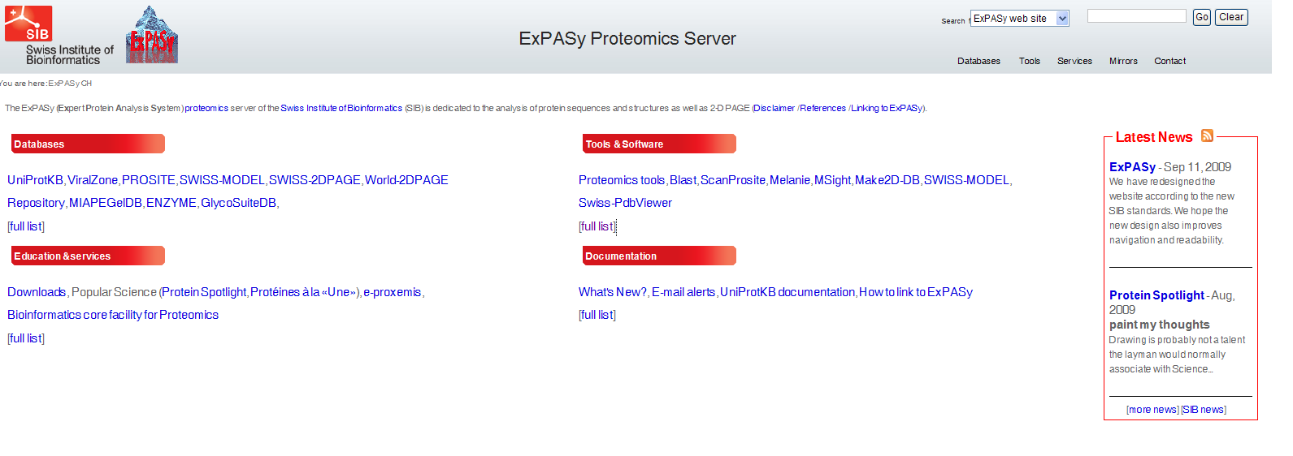
Protein Databases
ExPASY Molecular Biology Server
http://tw.expasy.org
The ExPASy (Expert Protein Analysis System) proteomics server of the Swiss Institute of Bioinformatics (SIB) is dedicated to the analysis of protein sequences and structures as well as 2-D PAGE

Slide 35

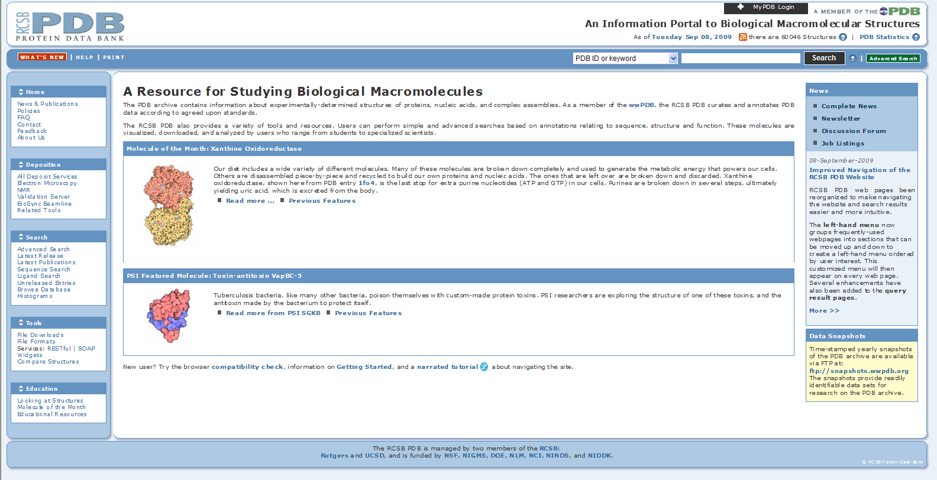
Protein Databases
Protein Data Bank
http://www.rcsb.org
The Protein Data Bank (PDB) is operated by Rutgers, The State University of New Jersey; the San Diego Supercomputer Center at the University of California, San Diego; and the National Institute of Standards and Technology -- three members of the Research Collaboratory for Structural Bioinformatics (RCSB). The PDB is supported by funds from the National Science Foundation, the Department of Energy, and two units of the National Institutes of Health: the National Institute of General Medical Sciences and the National Library of Medicine.

Slide 36
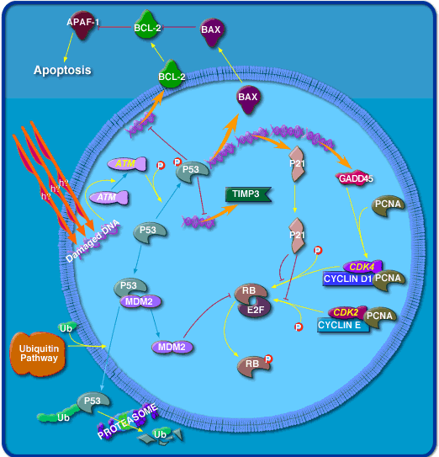

Metabolic & Signalling Pathways
Biocarta
( http://biocarta.com)

Slide 37

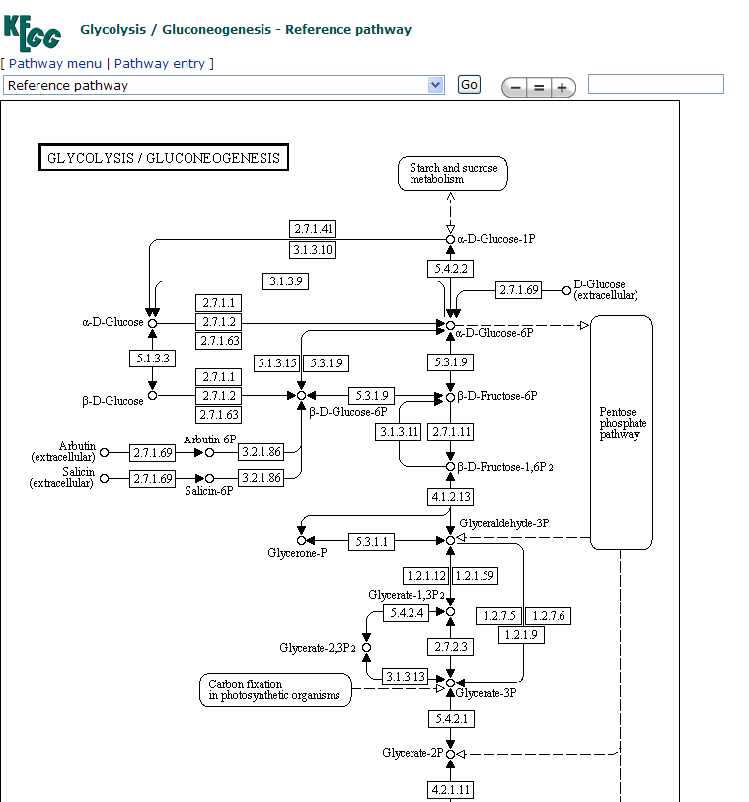
Metabolic & Signalling Pathways
Kyoto Encyclopedia of Genes &Genomes
http://www.genome.ad.jp/kegg/

Slide 38
THE COMPONENTS OF
BIOINFORMATICS
TECHNOLOGY
ALGORITHM
ANALYSIS
TOOLS
DATABASE
COMPUTING
POWER

Slide 39
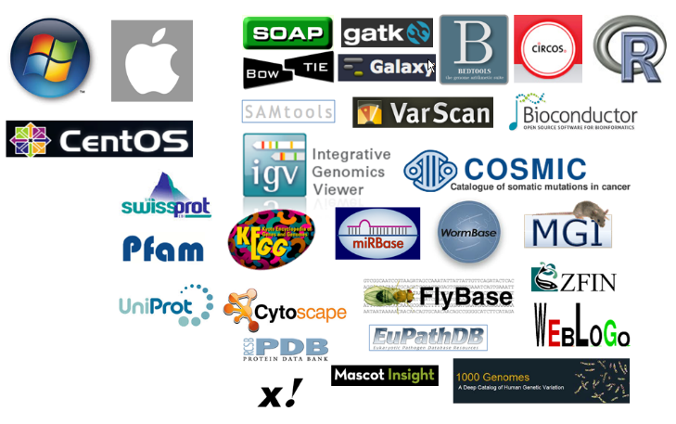
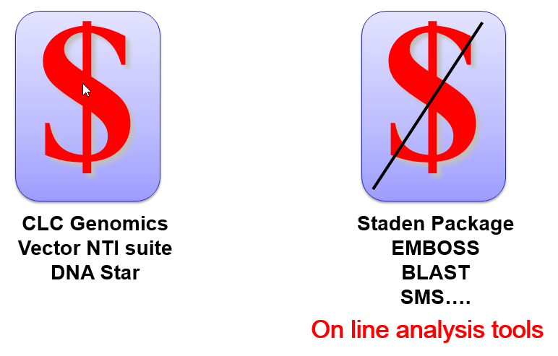
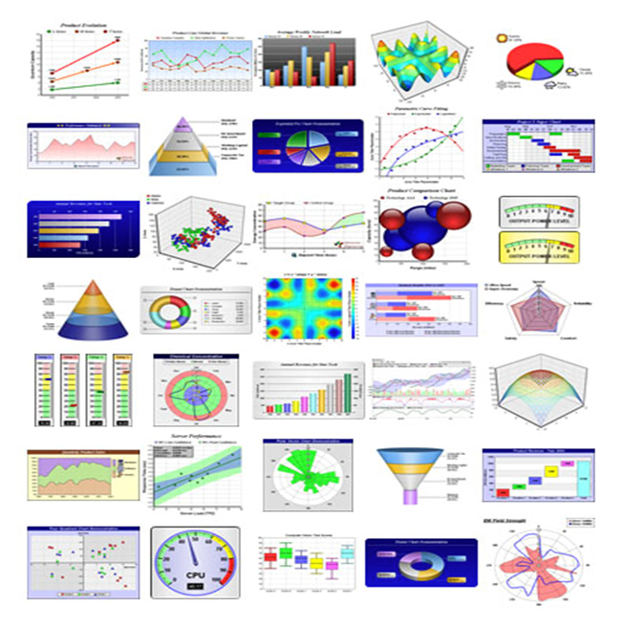
BIOINFORMATICS ANALYSIS TOOLS

Slide 40
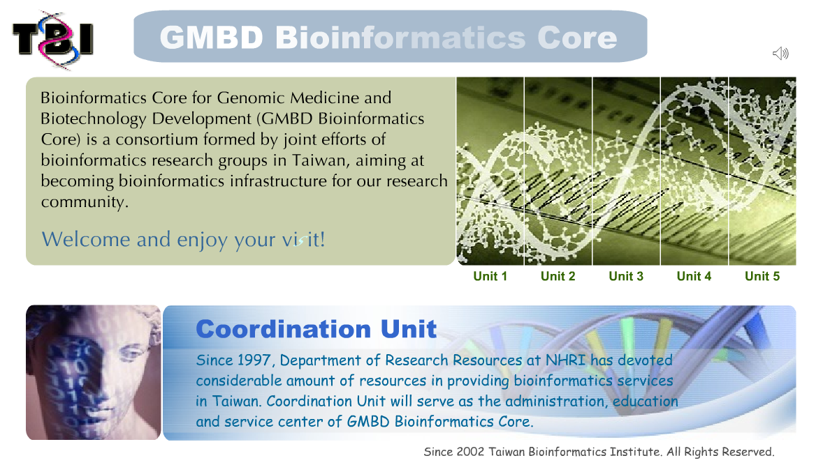

Slide 41

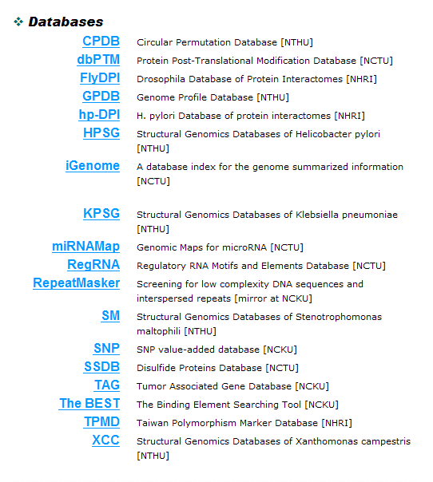
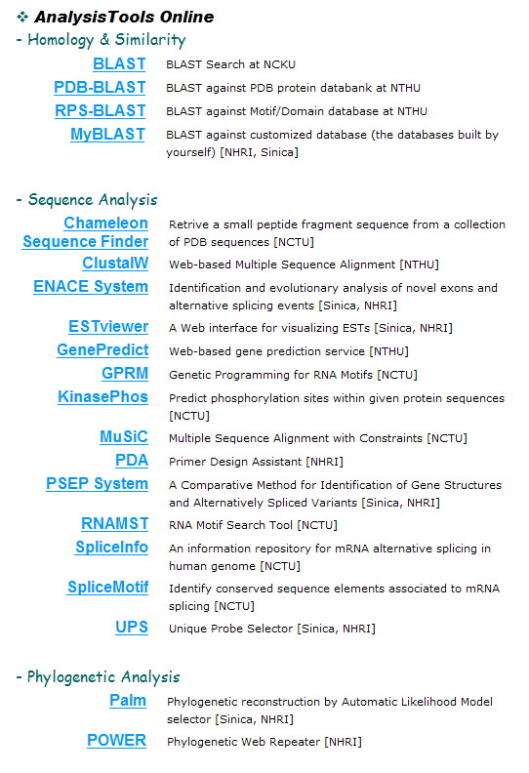


Slide 42

http://www.tbi.org.tw/tools/application01.htm

Slide 43


Slide 44


Slide 45


Slide 46
THE COMPONENTS OF
BIOINFORMATICS
TECHNOLOGY
ALGORITHM
ANALYSIS
TOOLS
DATABASE
COMPUTING
POWER

Slide 47

Server CPU/MEM: 436 Cores/3.04 TB
Workstation GPU/MEM: 12 Cores/192 GB
Workstation CPU/MEM: 66 Cores/ 512 GB
Storage: 736 TB

Slide 48


Small Genomes & Transcriptomes
64GB
4TB

Slide 49
An Example
Steps to Identify a Gene
Gene-Search
Protein-Search
Annotation

Slide 50
Full length ORF of TvEST-14G2
  -2 …AGATGCGAAAAA TCTACGGCAA TTACATTACG CAGAAGCGTC TCGGTTCAGG
  AAGTTTCGGA GAGGTTTGGG AAGCTGTCAG TCATTCGACC GGACAAAAGG
  101 TTGCTCTCAA ATTAGAGCCC CGAAACTCTA GTGTTCCACA ATTATTTTTC
  GAAGCCAAGC TATACTCAAT GTTTCAGGCT TCAAAATCCA CAAATAATAG
  201 TGTAGAACCA TGCAACAACA TTCCAGTTGT TTATGCGACT GGTCAAACAG
  AGACAACTAA CTACATGGCC ATGGAATTAC TTGGCAAGTC TCTGGAAGAT
  301 TTAGTTTCAT CGGTCCCTAG ATTTTCCCAA AAGACAATAT TAATGCTTGC
  CGGACAAATG ATTTCCTGTG TTGAATTCGT TCACAAACAT AATTTTATTC
  401 ACCGCGACAT CAAGCCAGAT AATTTTGCGA TGGGAGTCAG TGAGAACTCA
  AACAAAATTT ATATTATCGA TTTTGGACTT TCCAAGAAGT ACATTGACCA
  501 AAATAATCGT CATATTAGAA ATTGCACAGG AAAATCACTT ACCGGAACCG
  CAAGATATTC ATCAATTAAT GCGCTCGAAG GAAAGGAACA GTCTATAAGA
  601 GATGACATGG AATCTTTGGT ATATGTCTGG GTTTATTTAC TTCATGGACG
  TCTTCCTTGG ATGAGCTTAC CTACAACAGG CCGCAAGAAG TATGAGGCCA
  701 TTTTAATGAA GAAGAGATCA ACGAAACCCG AAGAATTATG TTTAGGACTT
  AATAGTTTCT TTGTAAACTA CTTAATAGCA GTTCGCTCAT TGAAATTTGA
  801 AGAAGAACCA AATTACGCGA TGTACAGGAA AATGATATAC GACGCAATGA
  TTGCTGATCA AATTCCTTTT GATTATCGCT ATGATTGGGT CAAAACGAGA
  901 ATTGTTCGCC CACAACGTGA AAACCAATCA CAGTTGTCCG AACGTCAAGA
  AGGAAAATGT CCAAACTCAG CTGAGTTTGA TGGTTTCTCC TCCATCAAAG
  1001 GATATTCTTC GCACAGACAA GTACAAAGCC CCGTTTCATC TAGAGATGTC
  ATTAAGAACA GTAGTTCAAG TCCATCAAAG GATATTTTGC AATCATCAAC
  1101 CCTTGATGAA TCATCTCAAG ATAAAAAGCC AATCAAAGCT GTCGAATCGA
  ATCAGAAACC ATATACACCG CCACGTACAA TTAATACTAC CGAAACAAGA
  1201 ATGAGATCAA AGACTACAAT CAATACTGCA AGAACAACAG CAAAGAACTC
  TTCGGCAGTT AAGAAAGAAT CGTCAGCAAC AAGGACTGTT AAGAAAGAAA
  1301 CACATCCTGC AACTACAAAA ACAACAAAAA CTGTAAATAG ACAATTGAAC
  TCTTCTACAA CGAAACCGGC AACTACGAGC TCTCACAAAG ACTCAGAACC
  1401 GGCTTCATCA AGACGTACAT CAACTCTACG TTCAAGTCGC CGCCAAAATG
  ACGGAATTCG CCCTGCAAAG GAAAGAACTG CGCTTTTCAC AGCTACAGCC
  1501 AGTAAGCCTC CGGTATCTTA CCGTACTGGA ATGCTTCCGA AATGGATGAT
  GGCTCCTCTC ACATCTCGTC GCTGAAATAT ATTTTTTATA TTATTTATTT
  1601 TTTTCTTTTT CTATCTGTAT ATTAAATGTA TTTCTATATT ATTAAAAAAA

Slide 51
Amino Acid Sequence Comparison
01B1
04E12
14G2
PFCK
Yeast
Human
Mouse
TcCK1.1
TcCK1.2
01B1
04E12
14G2
PFCK
Yeast
Human
Mouse
TcCK1.1
TcCK1.2
01B1
04E12
14G2
PFCK
Yeast
Human
Mouse
TcCK1.1
TcCK1.2
01B1
04E12
14G2
PFCK
Yeast
Human
Mouse
TcCK1.1
TcCK1.2
: kinesin homology domain
: casein kinase 1 specific motifs
PFCK : Plasmodium casein kinase 1
TcCK1.1: Trypansoma cruzi casein kinase 1.1
TcCK1.2: Trypansoma cruzi casein kinase 1.2

Slide 52
Similarity of Various CK1s from Different Species
 | TvEST-04E12 | TvEST-14G2 | TvEST-01B1 | T. cruzi CK1.1 | T. cruzi CK1.2 | PFCK | Yeast CK1 | Mouse CK1 | Human CK1
TvEST-04E12 | 100 | 32 | 32 | 34 | 34 | 34 | 37 | 37 | 37
TvEST-14G2 |  | 100 | 24 | 24 | 23 | 24 | 24 | 26 | 25
TvEST-01B1 |  |  | 100 | 47 | 47 | 48 | 48 | 38 | 38
T. cruzi CK1.1 |  |  |  | 100 | 23 | 73 | 24 | 61 | 61
T. cruzi CK1.2 |  |  |  |  | 100 | 74 | 70 | 63 | 63
PFCK |  |  |  |  |  | 100 | 69 | 62 | 62
Yeast CK1 |  |  |  |  |  |  | 100 | 69 | 67
Mouse CK1 |  |  |  |  |  |  |  | 100 | 99
Human CK1 |  |  |  |  |  |  |  |  | 100

Slide 53







3-D Structure of TvEST-14G2
and other CK1s
1
51
101
151
201
251
301
351
401
451
501
MRKIYGNYIT QKRLGSGSFG EVWEAVSHST GQKVALKLEP RNSSVPQLFF
EAKLYSMFQA SKSTNNSVEP CNNIPVVYAT GQTETTNYMA MELLGKSLED
LVSSVPRFSQ KTILMLAGQM ISCVEFVHKH NFIHRDIKPD NFAMGVSENS
NKIYIIDFGL SKKYIDQNNR HIRNCTGKSL TGTARYSSIN ALEGKEQSIR
DDMESLVYVW VYLLHGRLPW MSLPTTGRKK YEAILMKKRS TKPEELCLGL
NSFFVNYLIA VRSLKFEEEP NYAMYRKMIY DAMIADQIPF DYRYDWVKTR
IVRPQRENQS QLSERQEGKC PNSAEFDGFS SIKGYSSHRQ VQSPVSSRDV
IKNSSSSPSK DILQSSTLDE SSQDKKPIKA VESNQKPYTP PRTINTTETR
MRSKTTINTA RTTAKNSSAV KKESSATRTV KKETHPATTK TTKTVNRQLN
SSTTKPATTS SHKDSEPASS RRTSTLRSSR RQNDGIRPAK ERTALFTATA
SKPPVSYRTG MLPKWMMAPL TSRR
TVEST-14G2
TcCK1.1
TcCK1.2
PfCK1
Yeast CK1
Mouse CK1
Human CK1-δ

Slide 54


Slide 55



The “old” biology
The most challenging task for a scientist is to get good data
Notes:
55
Bioinformatics was born somewhere between the “old” and “new” biology

Slide 56

The “new” biology
The most challenging task for a scientist is to make sense of lots of data
Notes:
56

Slide 57
Old vs New –
What’s the difference?
(1) Economics
Miniaturize – less cost
Multiplex – more data
Parallelize – save time
Automate – minimize human intervention
Thus, you must be able to deal with large amounts of data and trust the process that generated it
Notes:
57

Slide 58
What’s the difference?
(2) Scale
From gene sequencing (~ 1 KB) to genome sequencing (many MB, even GB)
From picking several genes for expression studies to analyzing the expression patterns of all genes
From a catalog of key genes in a few key species to a catalog of all genes in many species
Analyzing your data in isolation makes less sense when you can make much more powerful statements by including data from others
Notes:
58

Slide 59
What’s the difference?
(3) Logic
Hypothesis-driven research to data-driven research
Expertise-driven approach versus information-driven approach
Reductionist versus integrationist
How to answer the question becomes how to question an answer
Algorithmic approaches for filtering, normalizing, analyzing and interpreting become increasingly important
Notes:
59
It’s hard to be an expert on 25,000+ genes
In molecular biology cleverness is finding a way to answer a question definitively by ignoring 99.99% of genes. You can’t see them, so the experiment must exclude them.

Slide 60
Data-driven Science Done Wrong
Must have some hypothesis – data is not the end goal of science
Finding patterns in the data is where analysis starts, not ends
Must understand the limits of high-throughput technology (e.g. microarrays measure transcription only, one genome does not tell you about species variation, etc.)
Must understand or explore the limits of your algorithm
Notes:
60
Controls & stats – if you want to see what genes are changing on a microarray, you should have some controls – those you expect should change and those that shouldn’t

Slide 61
Omics
Genomics
Proteomics
Metabolomics
Transcriptomics
Functional Proteomics/Genomics

Slide 62

SYSTEMS BIOLOGY
Notes:
62

Slide 63

In 20 Jan 2015, President Obama called for a new initiative to fund precision medicine
I want the country that eliminated polio and mapped the human genome to lead a new era of medicine — one that delivers the right treatment at the right time. In some patients with cystic fibrosis, this approach has reversed a disease once thought unstoppable. Tonight, I'm launching a new Precision Medicine Initiative to bring us closer to curing diseases like cancer and diabetes — and to give all of us access to the personalized information we need to keep ourselves and our families healthier.

Slide 64


Slide 65
Q. As a biologist, what skills do I need to make the transition to bioinformatics?
The fact is that many of the jobs available CURRENTLY involve the design and implementation of programs and systems for the storage, management and analysis of vast amounts of DNA sequence data. Such positions require in-depth programming and relational database skills which very few biologists possess, and so it is largely the computational specialists who are filling these roles. This is not to say the computer-savvy biologist doesn't play an important role. As the bioinformatics field matures there will be a huge demand for outreach to the biological community, as well as the need for individuals with the in-depth biological background necessary to sift through gigabases of genomic sequence in search of novel targets. It will be in these areas that biologists with the necessary computational skills will find their niche.
A. Molecular biology packages (GCG, BLAST etc),
Web and programming skills including HTML, Perl, JAVA and C++,
Familiar with a variety of operating systems (especially UNIX),
Relational database skills such as SQL, Sybase or Oracle,
Statistics,
Structural biology and modeling,
Mathematical optimization,
Computer graphics theory and linear algebra.
You will need to be able to readily pick up, use and understand the tools and databases designed by computer programmers, and
To communicate biological science requirements to core computer scientists.

